Slide 1
“I was looking forward to seeing how the workflow was applied to variants of unknown significance to help classify/predict their impact, e.g., using a certain value of ΔF as a threshold. This would be extremely valuable and useful for other investigators.”

Slide 2
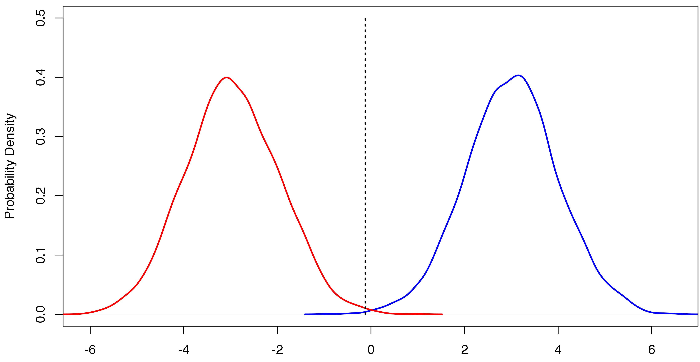
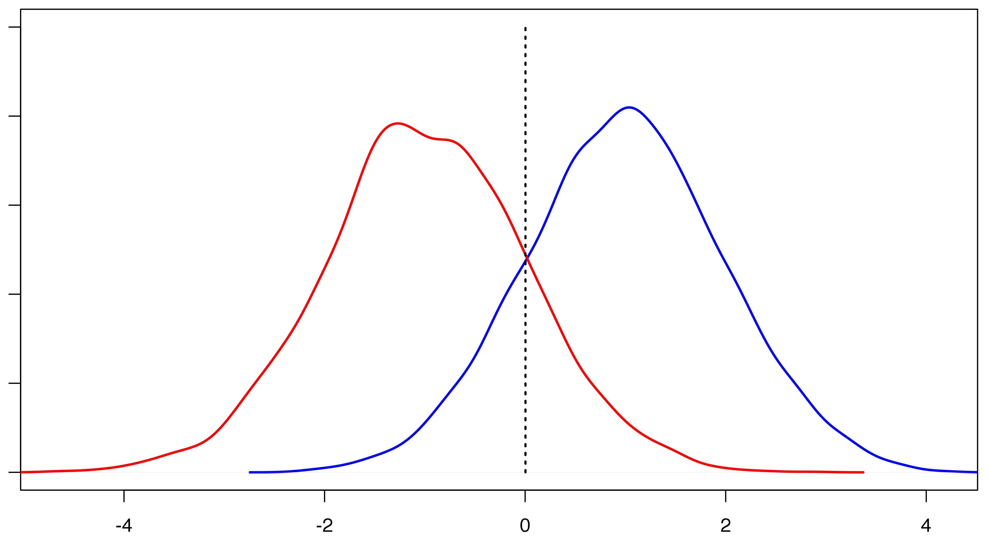
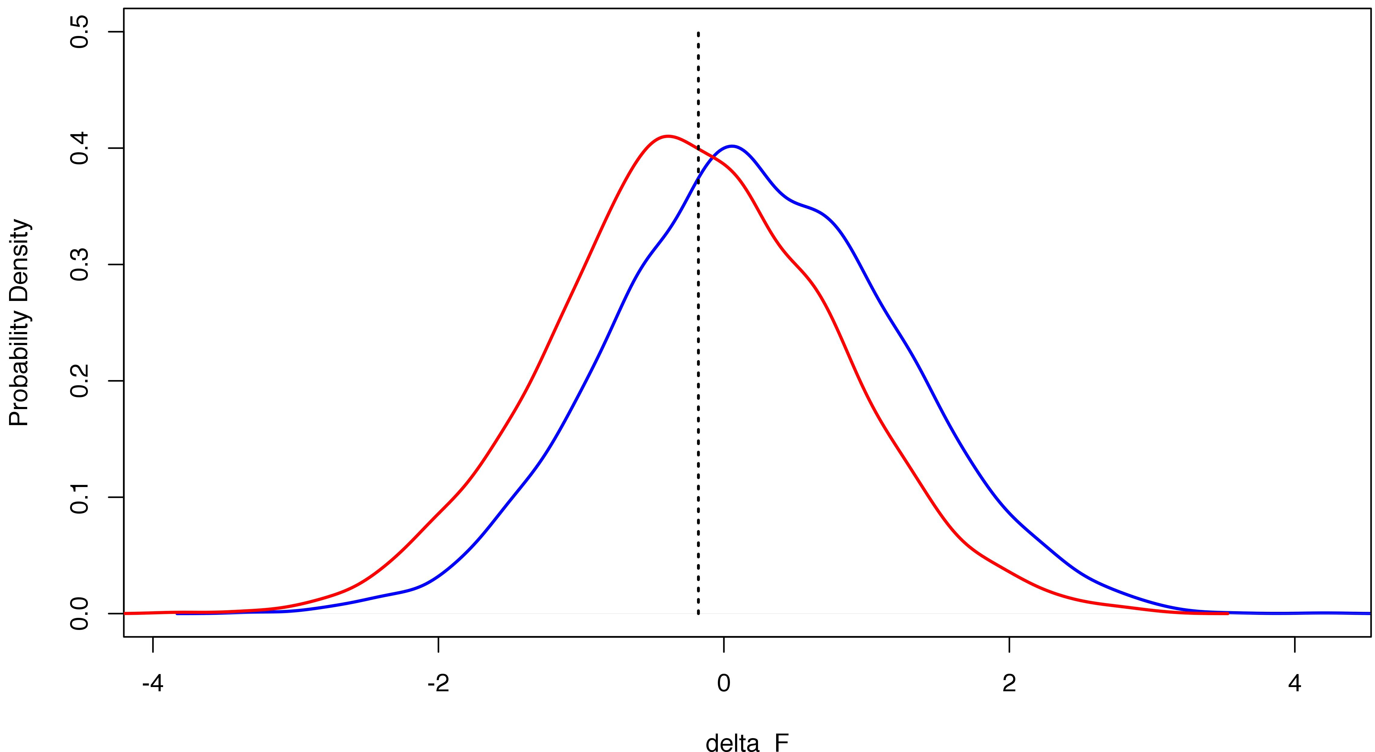
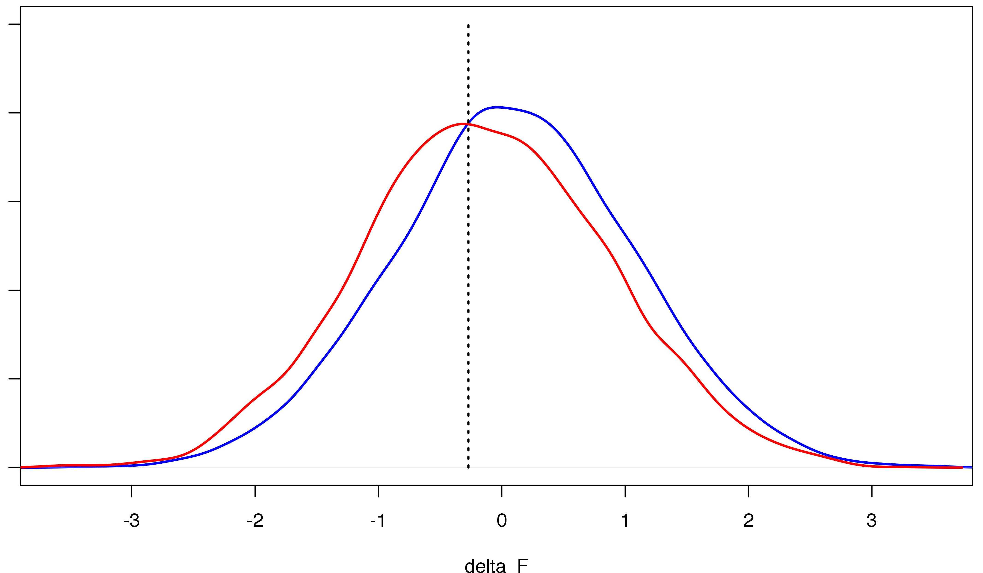

Slide 3
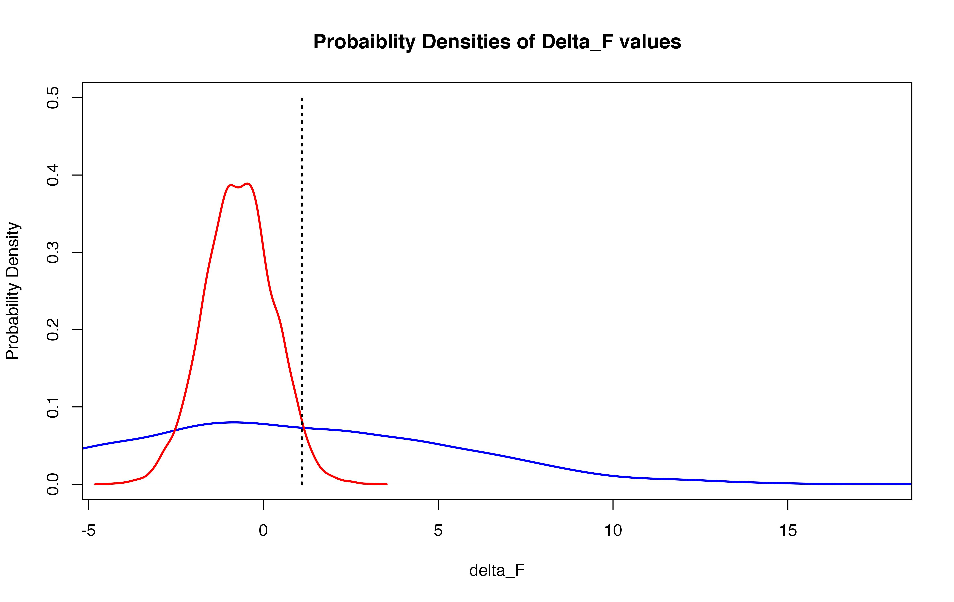

Slide 4
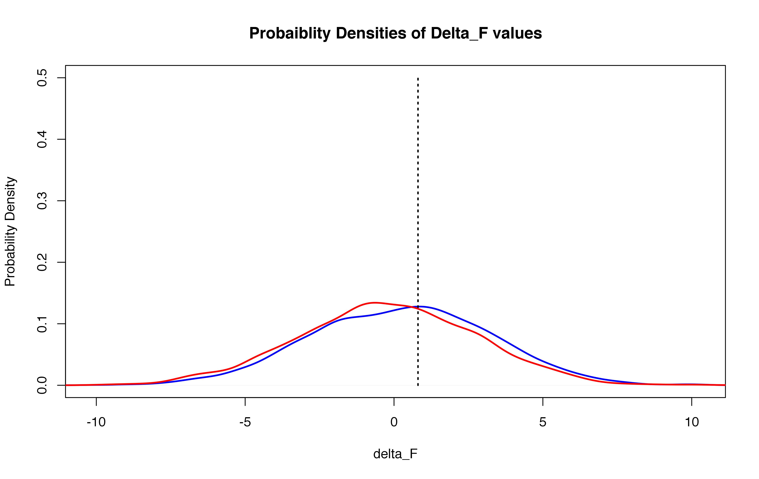

Slide 5
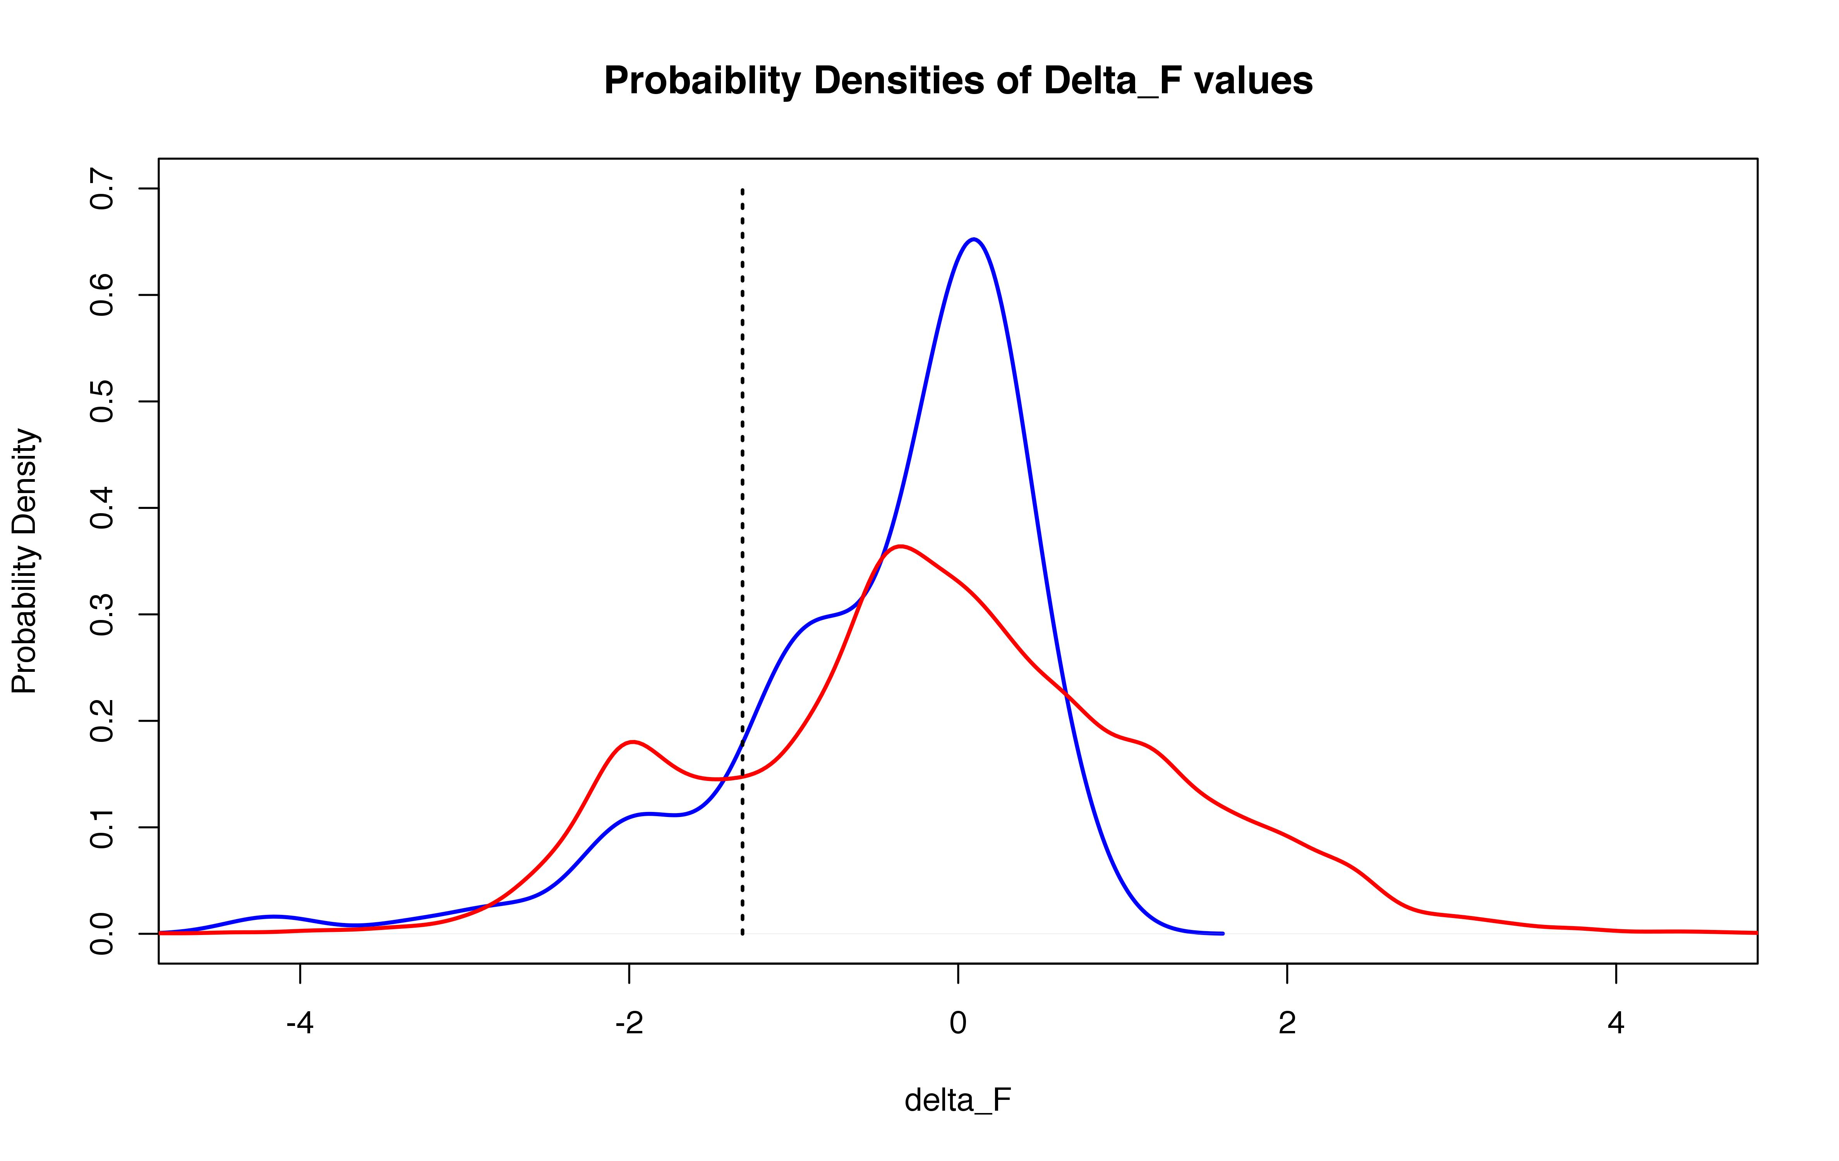
Using ALL common SNVs in ExAC
ΔF Thresh ~ -1.4

Slide 6
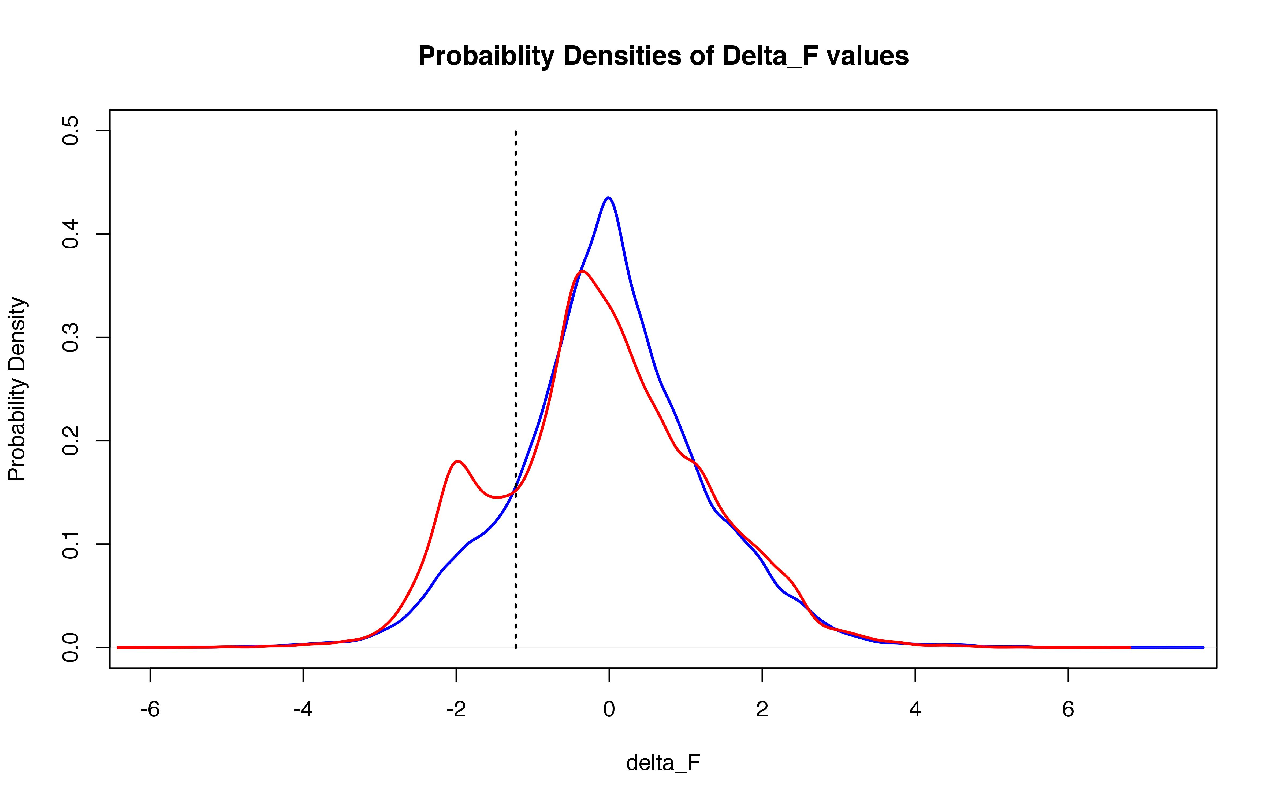
Using randomly-selected sub-sample
ΔF Thresh = -1.221

Slide 7
Please summarize the number of SNVs used in each of your comparison analysis as Table 1 (e.g., benign/disease-associated, common/rare, conserved/variable, driver/passenger).

Slide 9
To underline the usefulness of your method, which is, ... to meet a "growing and urgent need to evaluate the potential effects of low-allele-frequency variants in unbiased ways using high-throughput methodologies", I miss some extra calculations / benchmarking. There are methods existing in order to evaluate potential effects of low-allele-frequency variants in unbiased ways (SIFT, PolyPhen2, MutationTaster, and many others). I would like to see how exactly your method adds up to this. Is the additional information gained from structural analysis really an advantage over existing methods? If you could show this, this would surely be an argument for people to use and cite your method ... One could for ... create a small set of variants and analyse these with one or two of the "common" tools to predict the deleteriousness of SNVs (e.g. PolyPhen2 and MutationTaster2, since these are generally considered the most accurate ones) and then check if there are disease variants predicted as "harmless" by these tools (i.e. false negative) which are then correctly seen as locally maximal frustrated by your method. Or any other way how it can be shown that the method is indeed useful for the analysis of high-throughput data (e.g. compare with other existing "structural prediction" tools, if those exist).

Slide 10
[[see excel file in dropbox]]

Slide 11
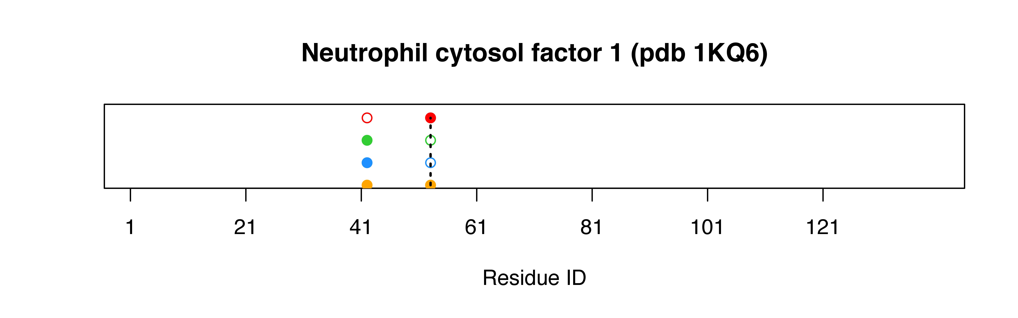
+ (reminder on nets disc)

Slide 12
Older content to be
included in revisions

Slide 13
"Another known issue is strong annotation disparity between known Mendelian disease mutations (e.g. HGMD disease variants) and other variants: most of HGMD mutations are reported in a small subset of proteins, while majority of the proteins only have fewer and mostly benign or unknown significance variants reported for them. This creates bias when performing comparisons between the two functional classes of variants. In case of PDB-mapped variants, such annotation bias might have been alleviated to some extent by the PDB intrinsic bias (mentioned above, skews PDB & HGMD data towards the same proteins) but it requires further investigation. Authors should present statistics for the number of unique proteins and the distribution of variants in the unique proteins for each of their datasets. They should also attempt to perform their analysis on a (semi-)balanced set(s) of variants, using sets of proteins where both disease and neutral mutations are present. See Grimm et al. (2015) Human Mut. 36:513-523 for an example of such balanced sets and trends analysis."

Slide 14
1) Det. the # of unique proteins in each dataset

Slide 15
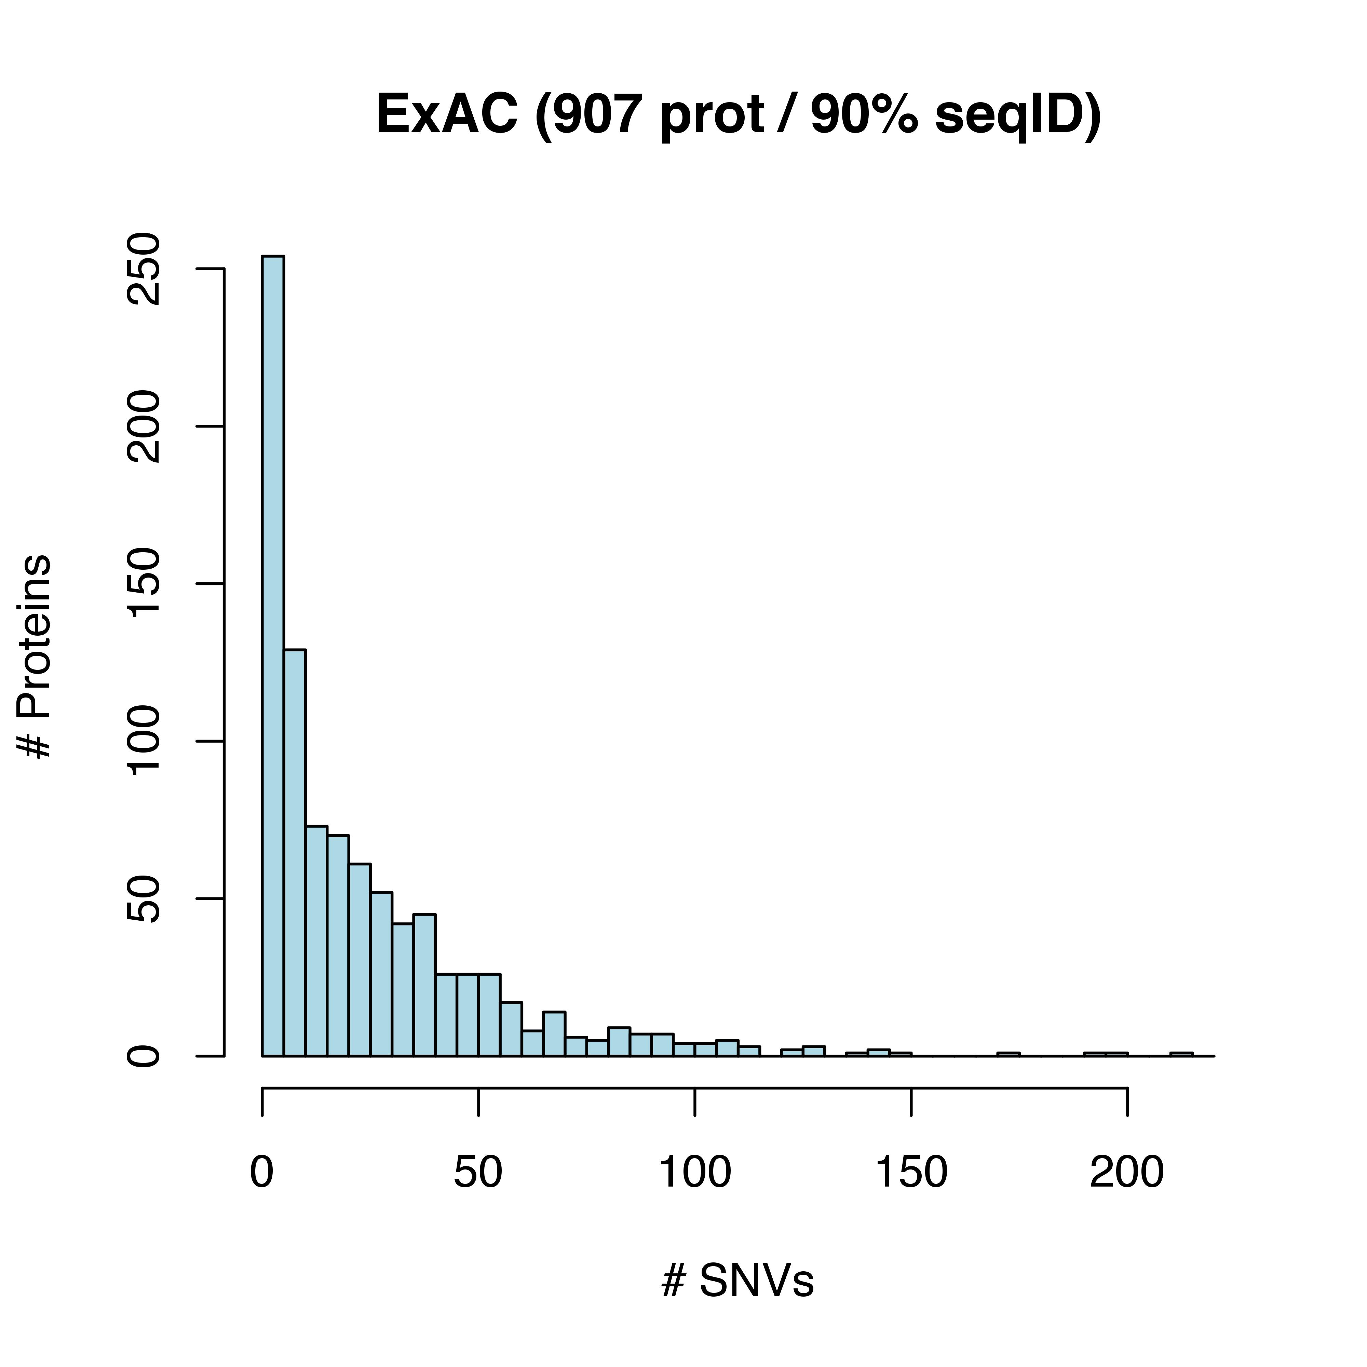
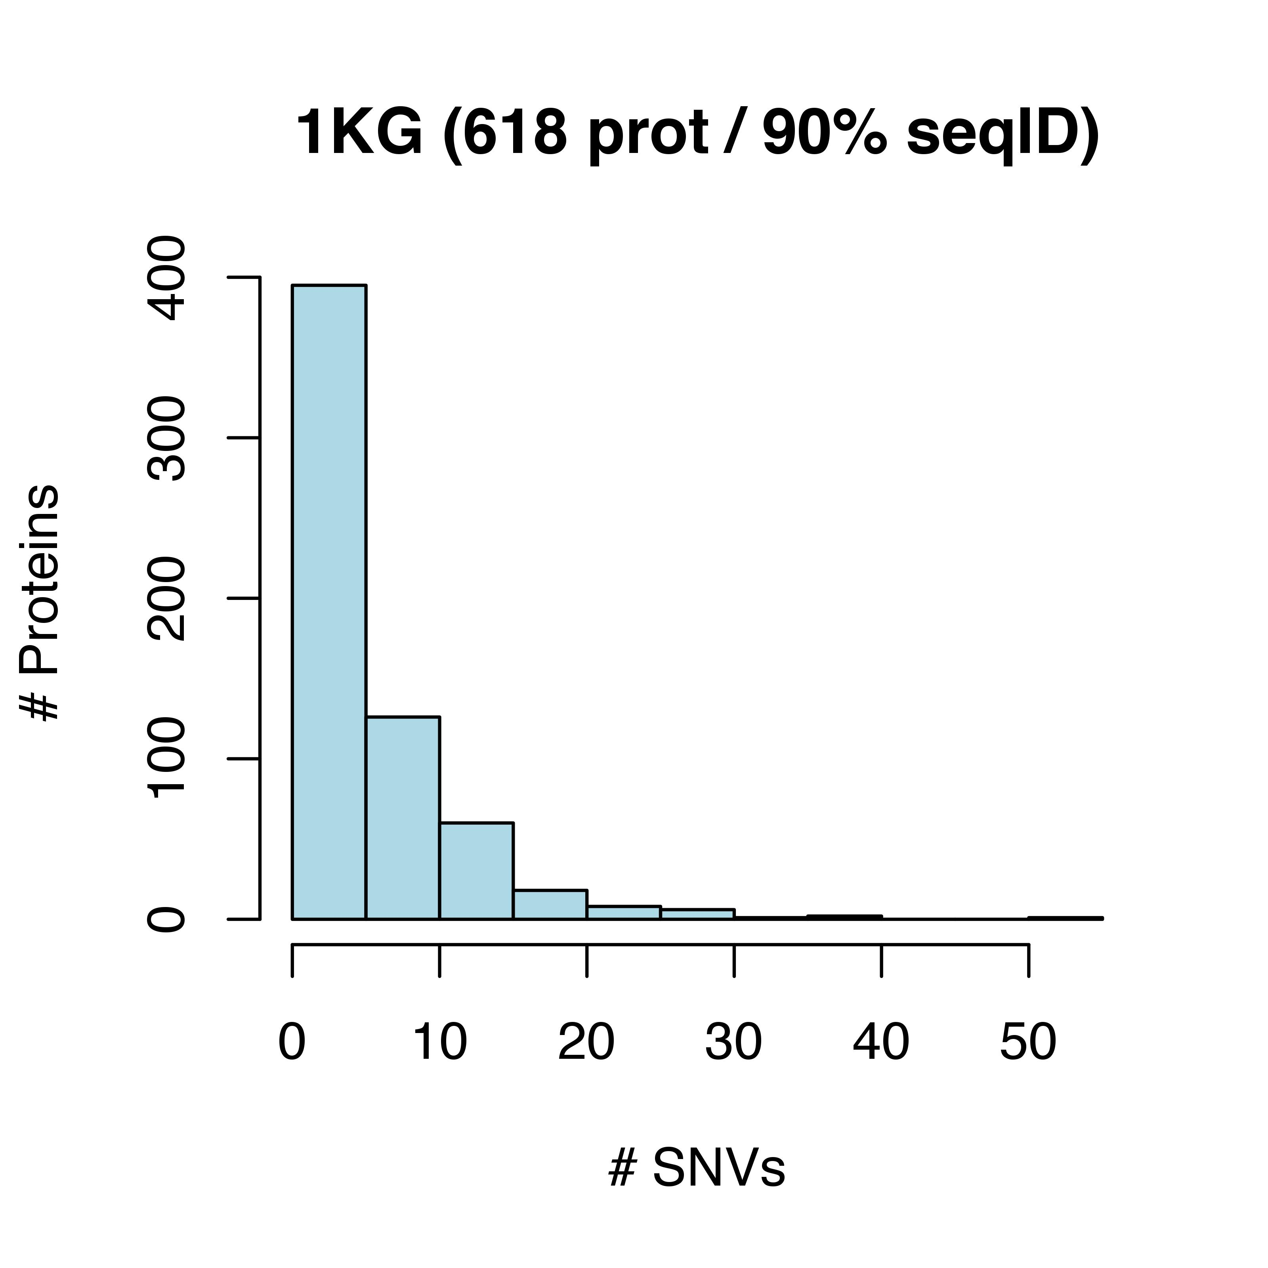
2) Within the set of non-redundant (i.e., unique) set of proteins: “present statistics for the number of unique proteins and the distribution of variants in the unique proteins”

Slide 16
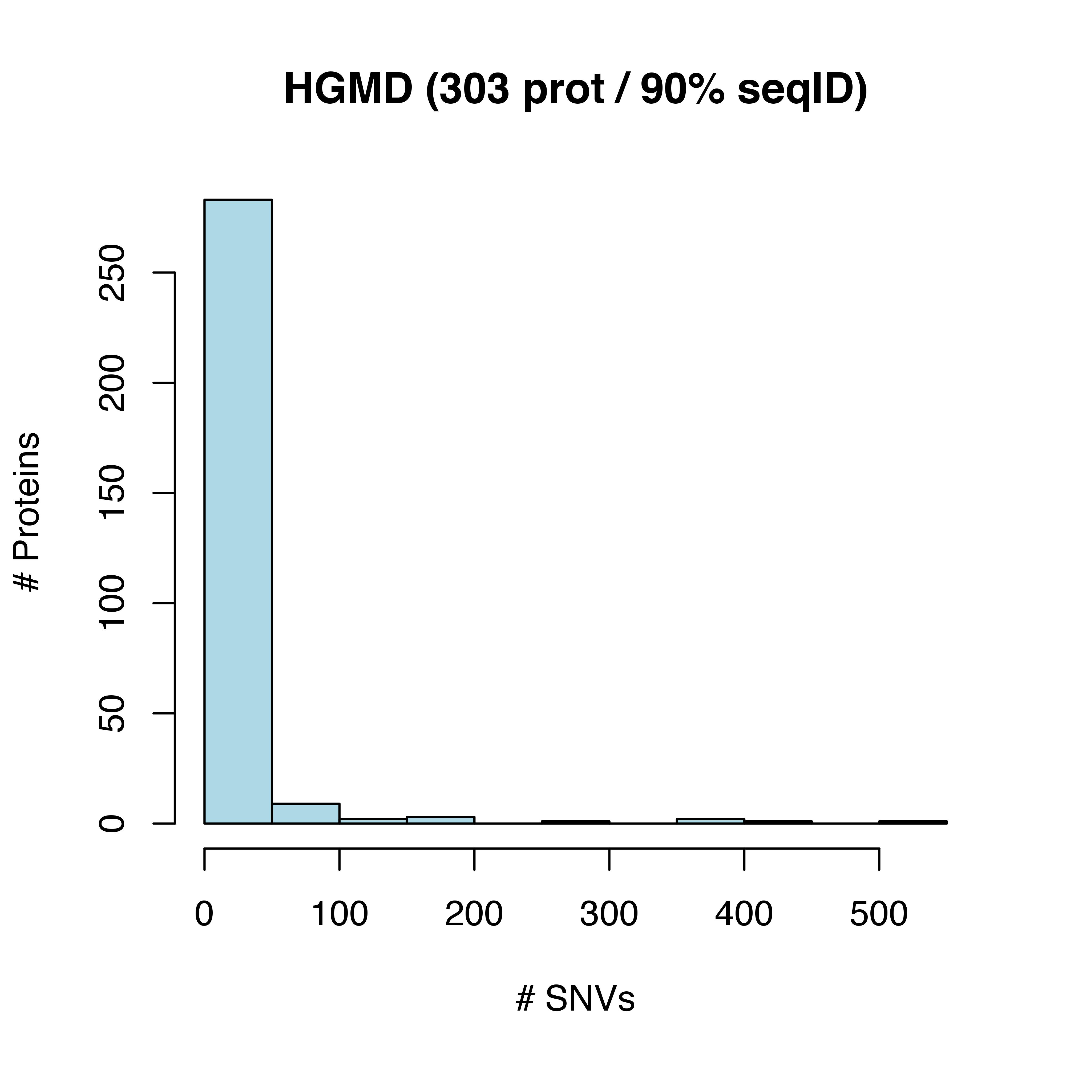
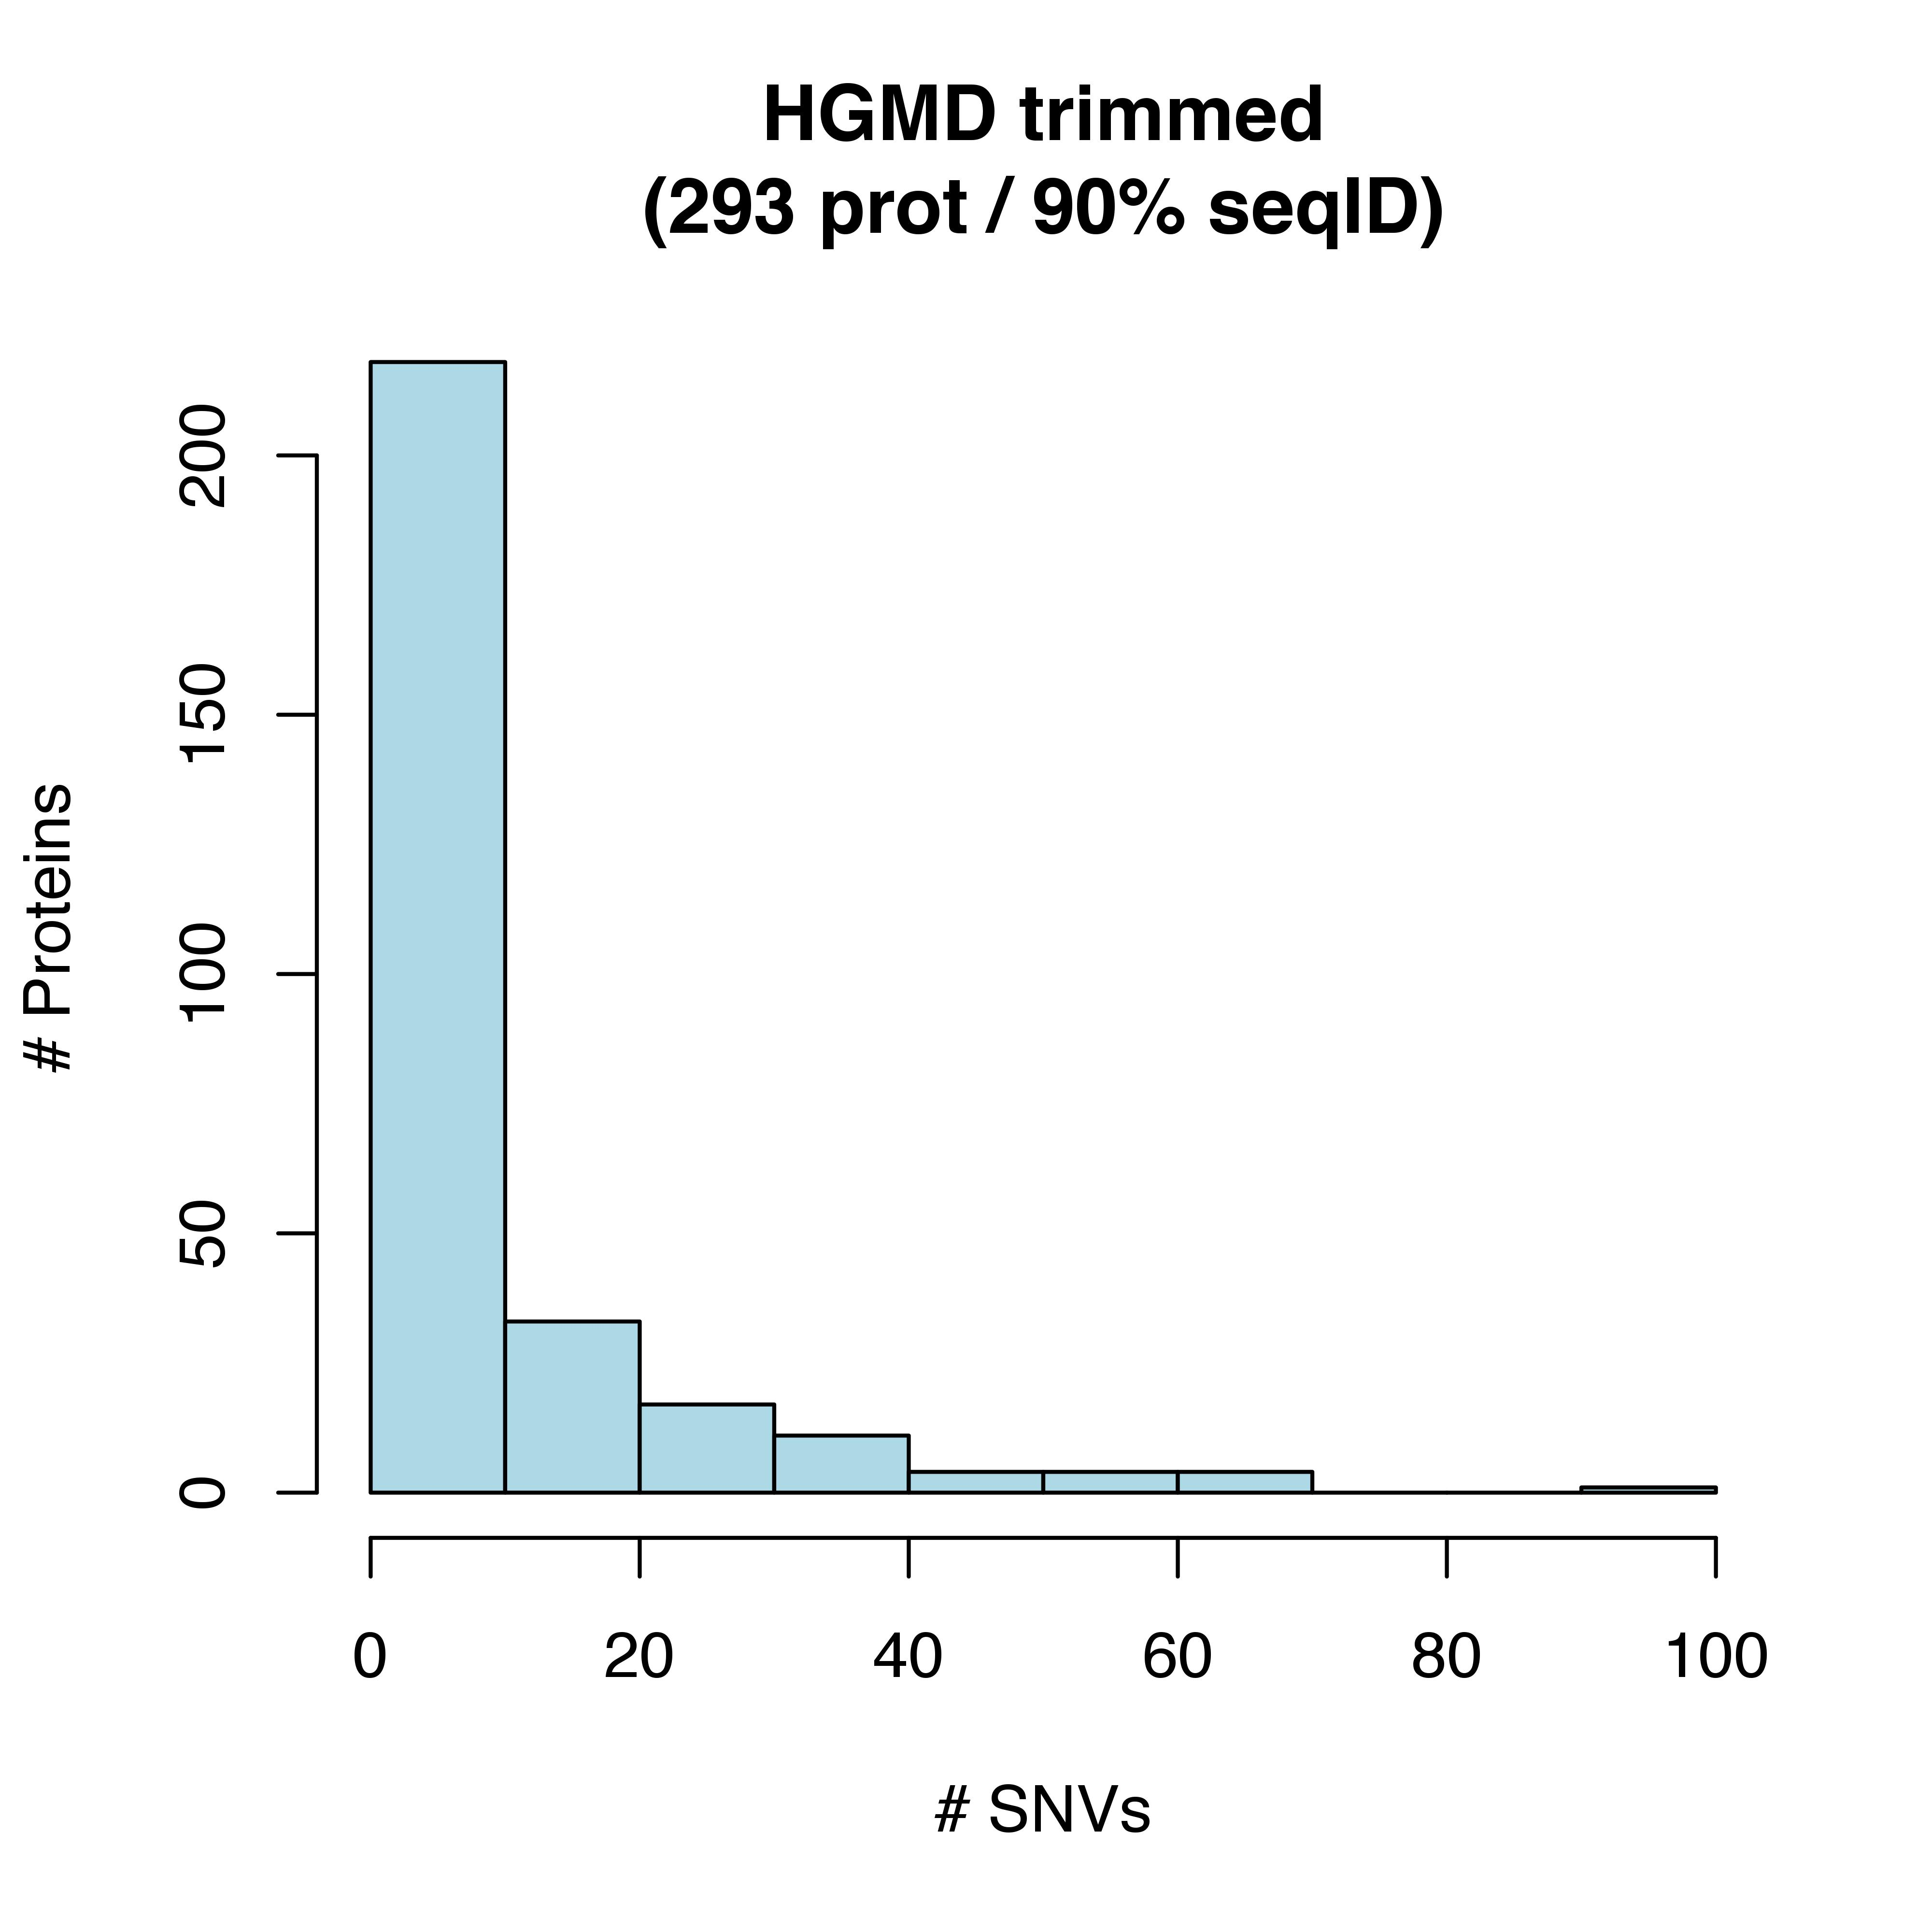
2) Within the set of non-redundant (i.e., unique) set of proteins: “present statistics for the number of unique proteins and the distribution of variants in the unique proteins”

Slide 17
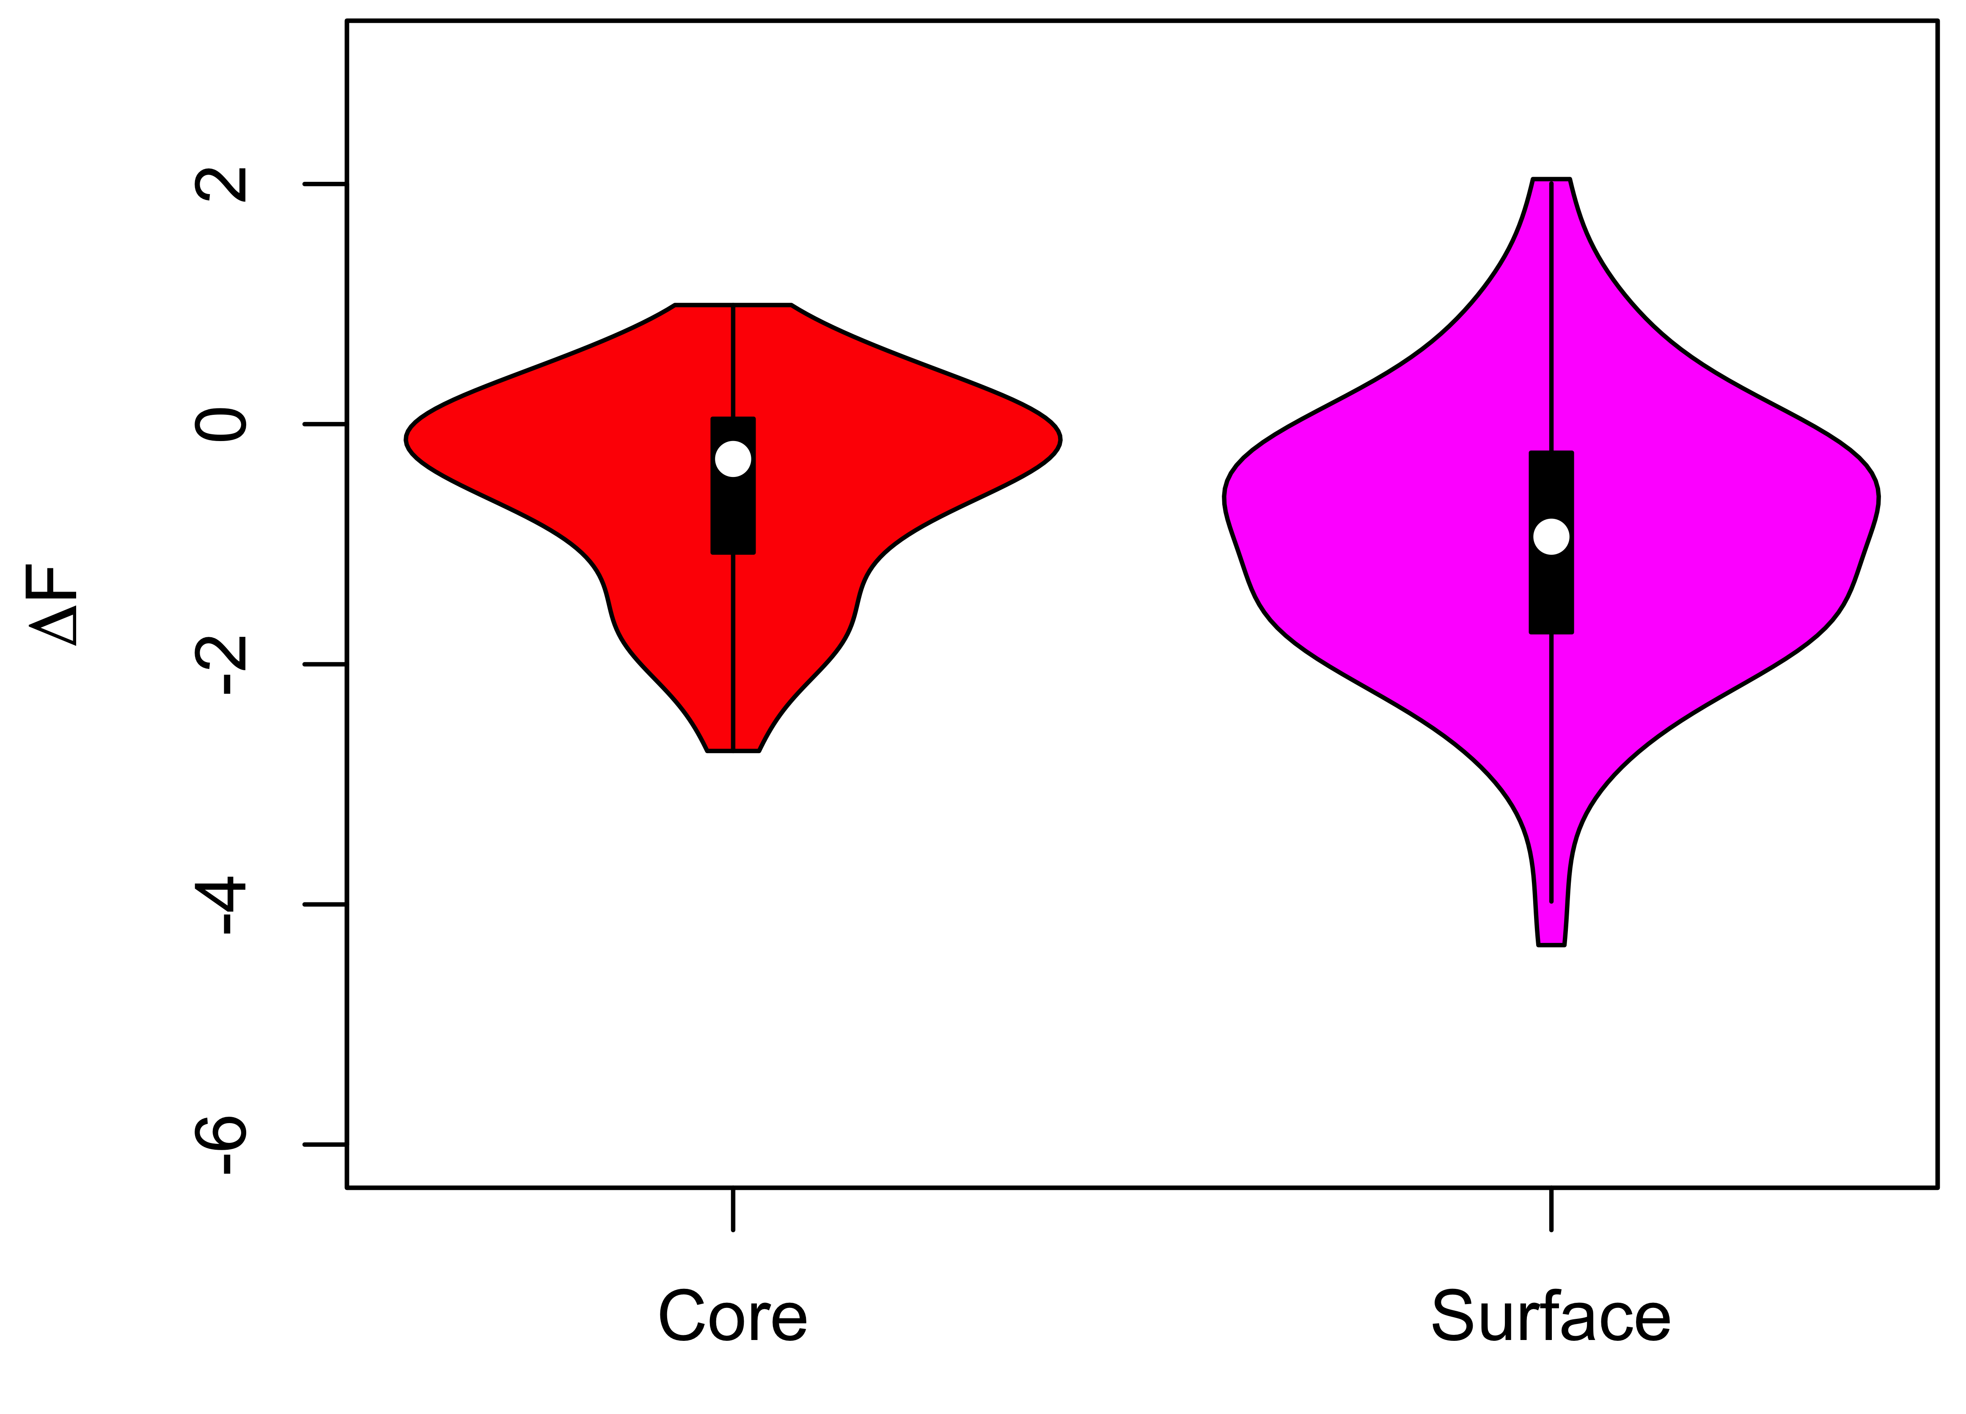
“They should also attempt to perform their analysis on a (semi-)balanced set(s) of variants, using sets of proteins where both disease and neutral mutations are present.”
HGMD (303 PDBs)
1KG (618 PDBs)
204
99
519
Previous
Revision

Slide 18
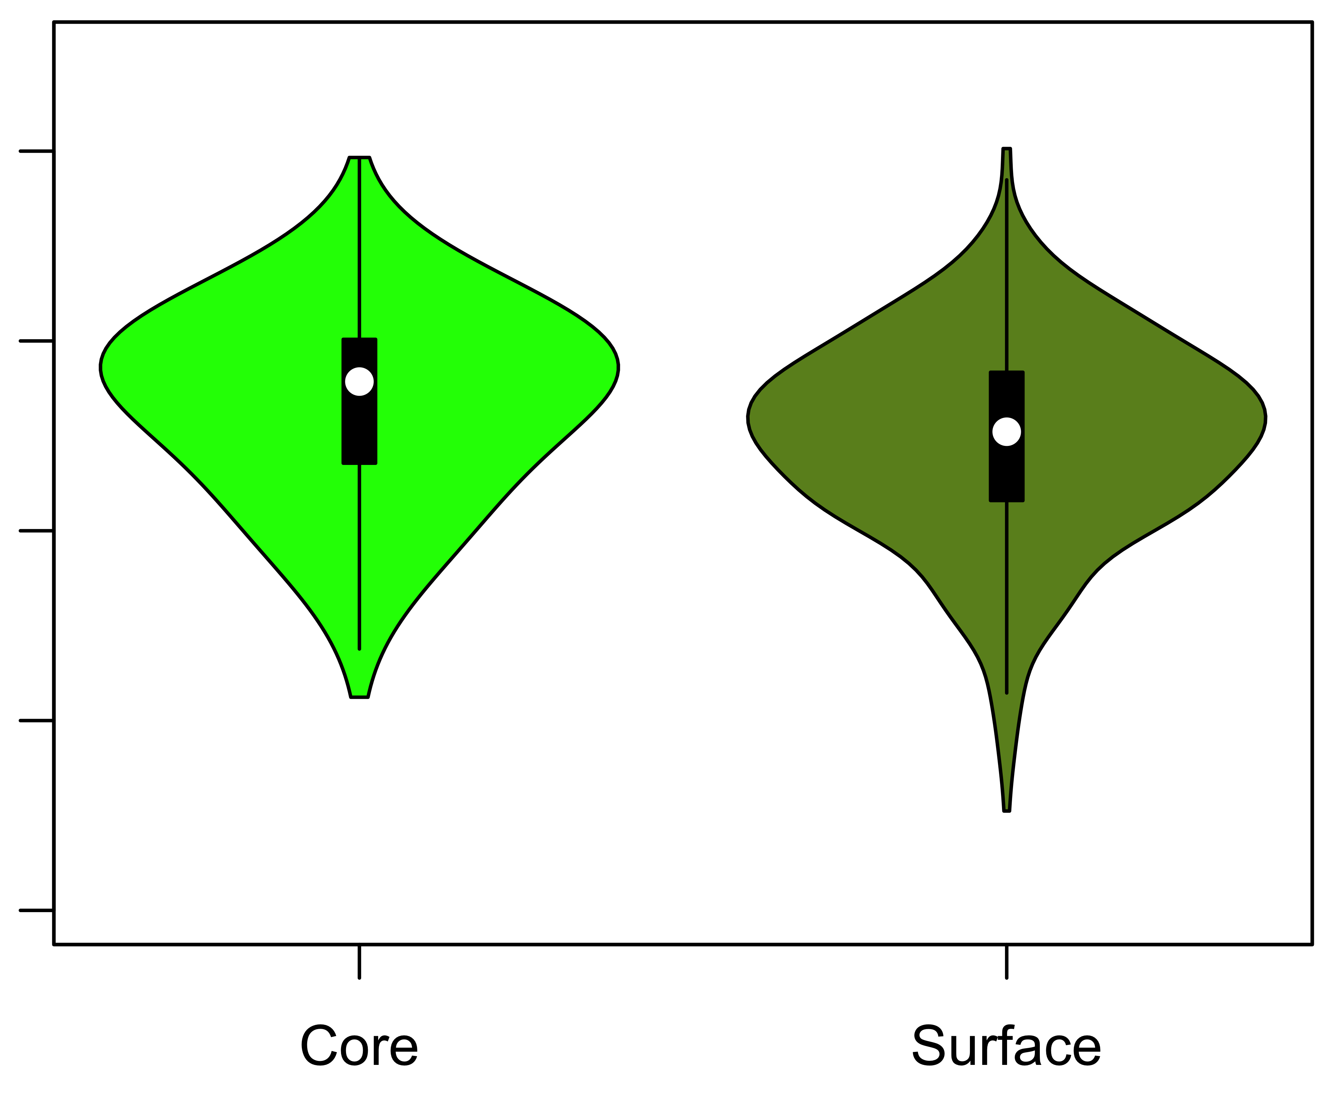
“They should also attempt to perform their analysis on a (semi-)balanced set(s) of variants, using sets of proteins where both disease and neutral mutations are present.”
HGMD (303 PDBs)
ExAC (907 PDBs)
188
115
792
Previous
Revision

