Slide 1
MotifVar slidepack
Jul 14, 2016

Slide 2
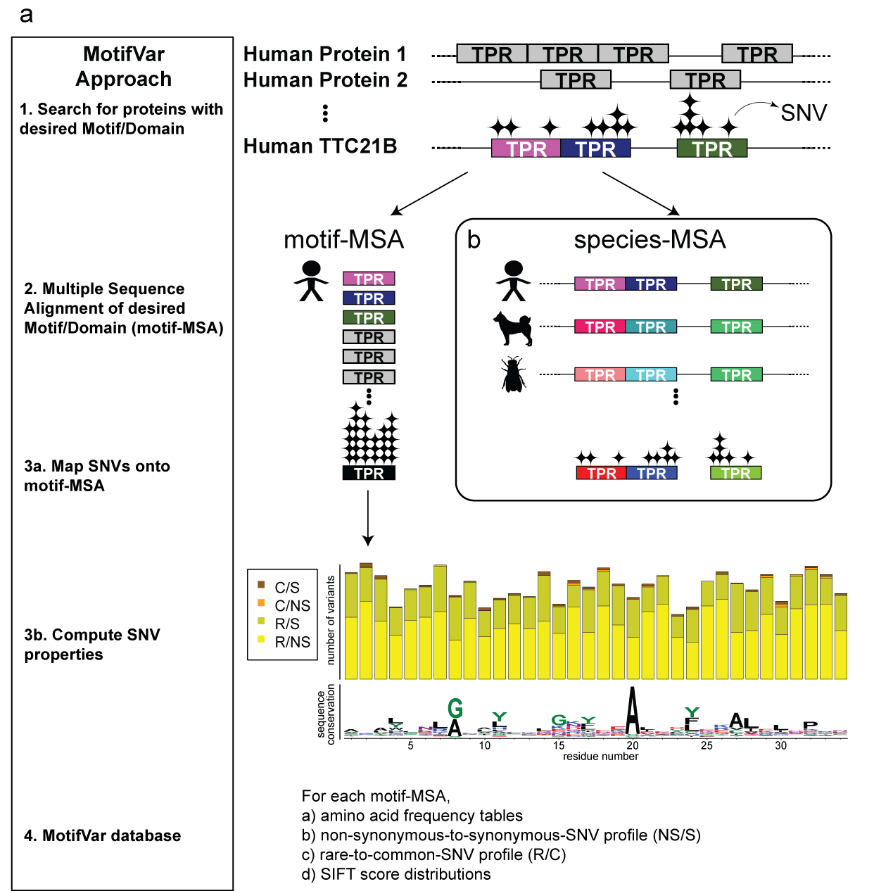
Figure 1. Our MotifVar approach and database and it also serves as a “variant information amplifier” as compared to the species-MSA.

Slide 3
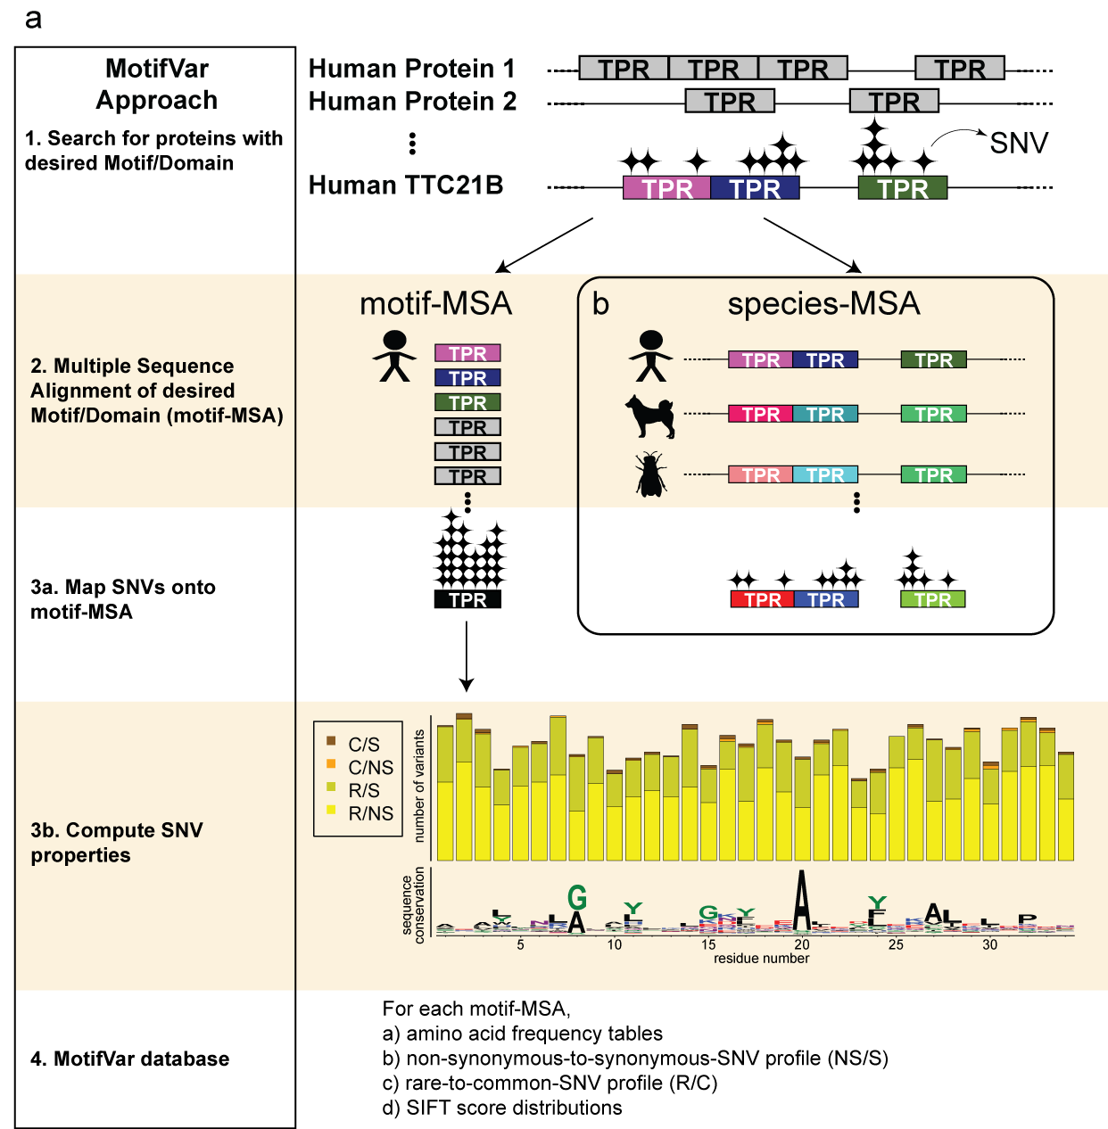
Figure 1. Our MotifVar approach and database and it also serves as a “variant information amplifier” as compared to the species-MSA.

Slide 4
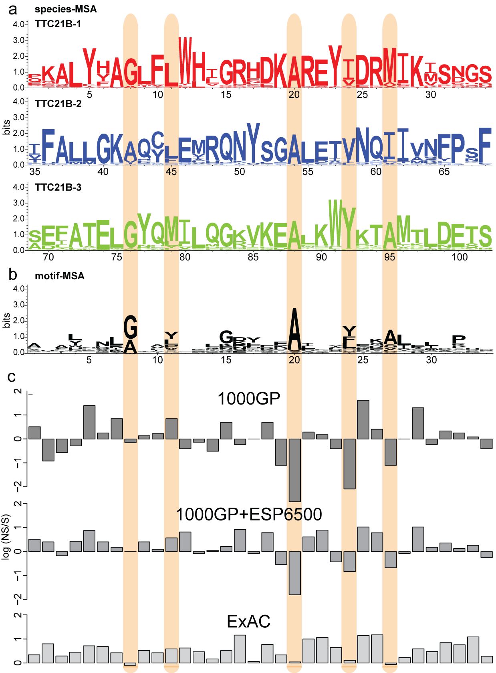
Figure 2. Motif-MSA can uncover important domain positions missed by species-MSA.

Slide 5
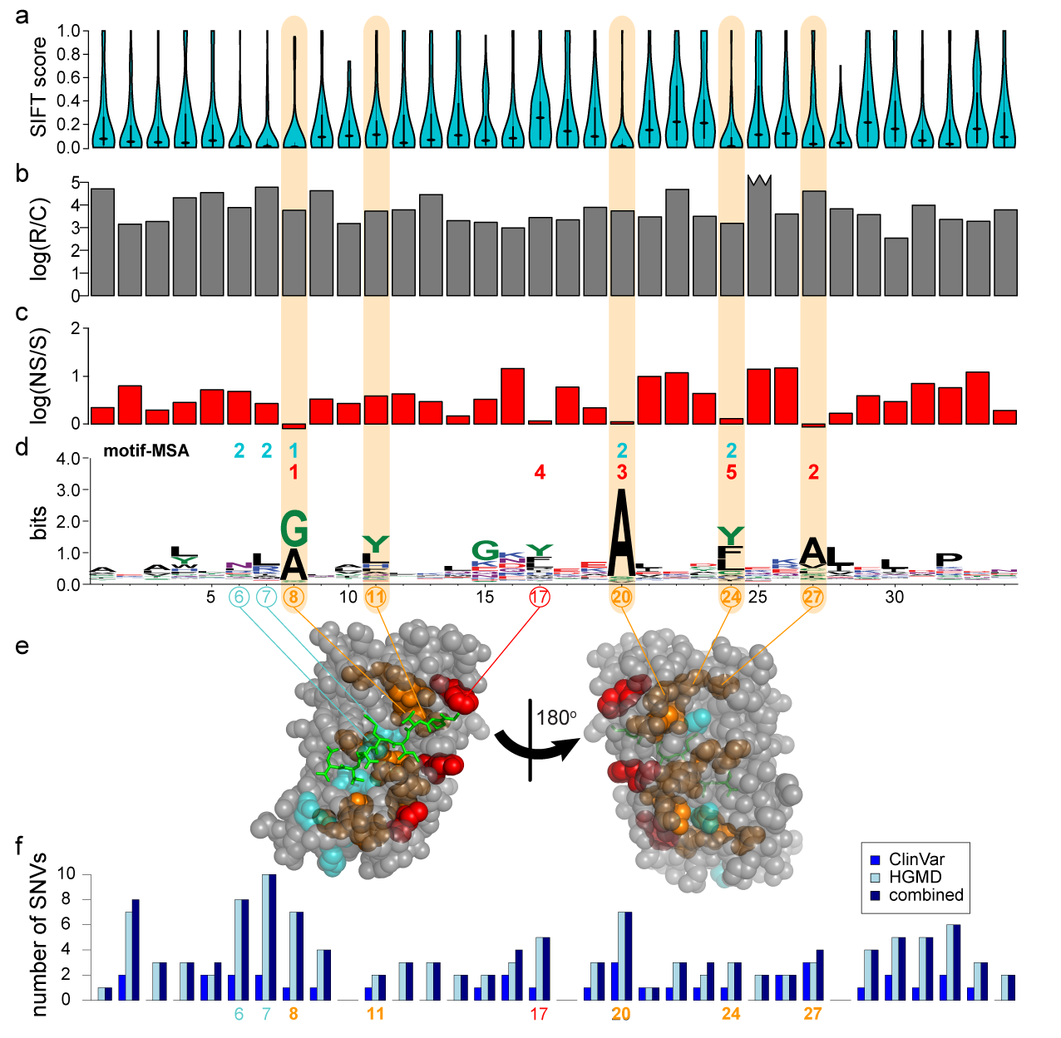

Figure 3. Using genomic variant information in the motif-MSA profile to investigate selective constraints in PPI motifs.

Slide 6
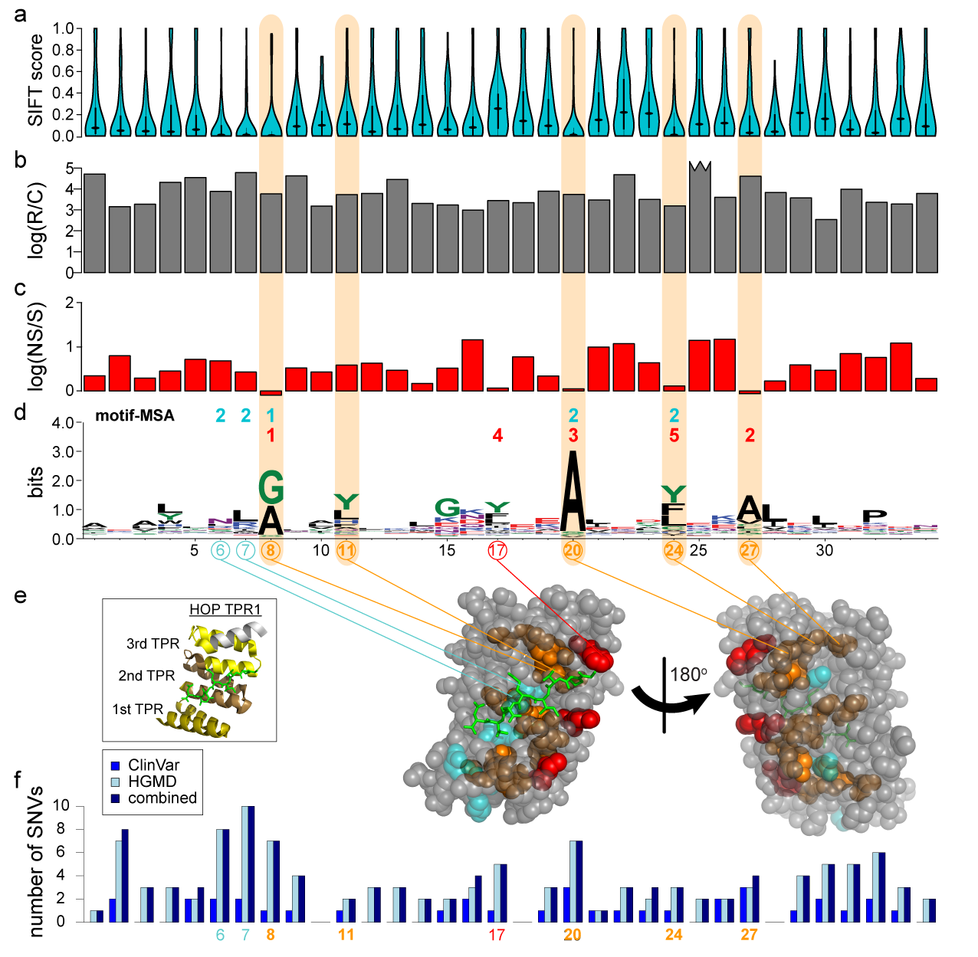
Figure 3. Using genomic variant information in the motif-MSA profile to investigate selective constraints in PPI motifs.

Slide 7
Supplementary Materials

Slide 8
Supplementary Figure 1
- TPR most frequent motif size

Slide 9
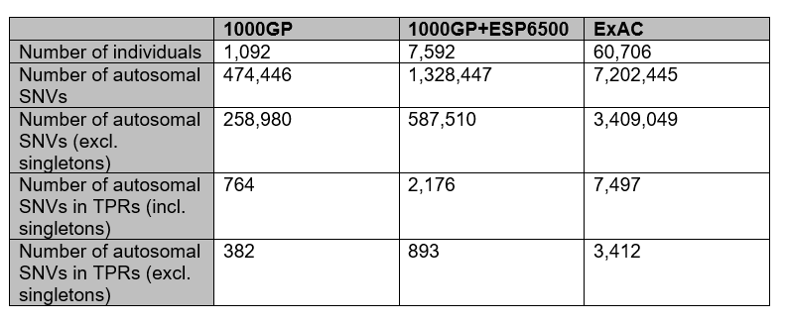
Supplementary Table 1. Number of SNVs in each dataset. The 1000 Genomes Project (1000GP) provides the least number of autosomal SNVs, followed by an approximate 6-fold increase in number of exomes in the combined set of 1000GP and Exome Sequencing Project (ESP6500); this is a corresponding ~3-fold increase in the number of autosomal SNVs. Our study uses the dataset from ExAC, with 60,706 individuals, an almost 8-fold increase from the combined set of 1000GP+ESP6500; this is a corresponding ~5-fold increase in the number of autosomal SNVs.

Slide 10
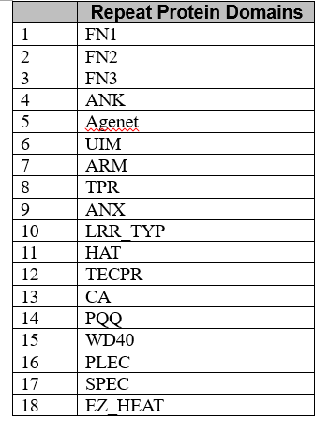
Supplementary Table 2 – list of repeat and non-repeat protein domains in the MotifVar database

