Slide 1
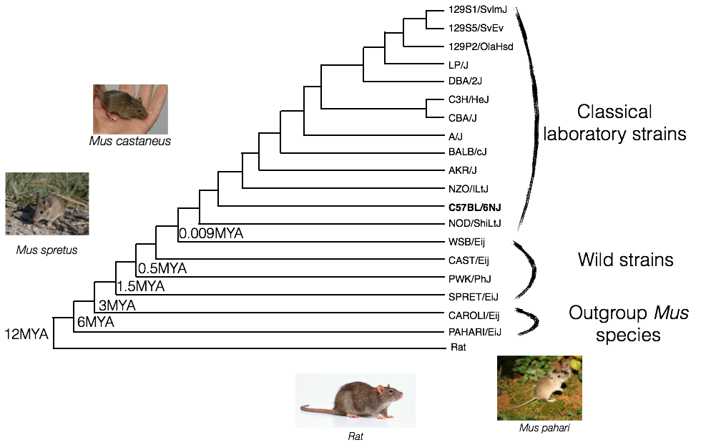
Adapted from Ian Fiddes

Slide 2
Pseudogene Annotation
Using the union of RCPedia & Pseudopipe as well as overlapping with the liftover from manually annotated Mouse reference pseudogene sets.
LEVEL_1_RPM - pseudogenes identified by both pipelines and by manual annotation
LEVEL_2_(PR)M - pseudogenes identified by only 1 pipeline and by manual annotation
LEVEL_3_M- pseudogenes annotated only using the liftover of manually curated reference genome
LEVEL_4_PR - pseudogenes identified by both automatic pipelines
LEVEL_5_(PR) - pseudogenes identified by only an automatic annotation pipeline

Slide 4
Case study: Olfactory Receptors
1294 transcripts & 1106 OR genes in mouse reference genome

Slide 5
ENSMUST00000134687 - NCR3 pseudogene
Pseudogene in reference genome and laboratory strains
Reversed stop codon mutations in CAROLI

Slide 6
Caroli 1 CATGGCCAAGGTGCTTCTGGTCATCTTCATCATGGTTTATCCAGG 45
||||||||||||||| |||||||||||||||||||||||||||||
Refer 1 CATGGCCAAGGTGCTCCTGGTCATCTTCATCATGGTTTATCCAGG 45
Caroli 3751 CCAGGATCCTGTGCTCTCTGGGTGTCTCAGCCCCCTGAGACTCCTGTGCAGAAGGACACT 3805
|||||||||||||||||||| ||||||||||||||||||| || ||||||| ||| |||
Refer 46 CCAGGATCCTGTGCTCTCTGAGTGTCTCAGCCCCCTGAGATTCGTGTGCAGGAGGGGACT 100
Caroli 3806 ACTGCCTCCCTGCCCTGCCCCTTCAATGCCATCCGAGGAAAACCGGCCACTGGCTCTGTC 3865
|||||||||||||||||| |||||||||||||||||||||||||||||||||||||||||
Refer 101 ACTGCCTCCCTGCCCTGCTCCTTCAATGCCATCCGAGGAAAACCGGCCACTGGCTCTGTC 160
Caroli 3866 ACATGGTACCAAGACAAAGTGACCCTGGGGATGGAGTTGAGCAACGTGACTCCGGGGTTC 3925
||||| |||||||||||||||||||||||||||||||||||||| |||||||| ||||||
Refer 161 ACATGATACCAAGACAAAGTGACCCTGGGGATGGAGTTGAGCAAAGTGACTCCAGGGTTC 220
Caroli 3926 GGAGGCCGCTTGGTCTCCTTTTCTGTTTCTCAGTTCATTAGGGACCACAAGGCAGGGCTG 3985
|||||||||||||||||||||||||||||||||||||||||||||||||||||||||||
Refer 221 AGAGGCCGCTTGGTCTCCTTTTCTGTTTCTCAGTTCATTAGGGACCACAAGGCAGGGCTG 280
Caroli 3986 CTCATACAGGACACCCAAAGCTATGATGCTGGAATCTATGTGTGCAGGGTGGAGGTGCTA 4045
||||||||||||||||||||||||||||||||||||||||||||||||||||||||||||
Refer 281 CTCATACAGGACACCCAAAGCTATGATGCTGGAATCTATGTGTGCAGGGTGGAGGTGCTA 340
Caroli 4046 GGCCTGGGCGTCAGAACGGGAGATGGGACTTGGCTGCTGGTGGAGA 4091
|||||||||||||||| |||||| ||||| |||||||||||||||
Refer 341 GGCCTGGGCGTCAGAATGGGAGACAGGACTCGGCTGCTGGTGGAGA 386
Caroli 4209 CTGCTGTAGG-G-CCTCCTCAGCAAGCCTCCAACACAGAGCAAGAGGCTCACACAAGTAT 4255
|||||| || | ||||||||||||||||||||||||||||||||||||||||||||| |
Refer 387 CTGCTGGTGGAGACCTCCTCAGCAAGCCTCCAACACAGAGCAAGAGGCTCACACAAGTCT 433
Caroli 4256 CCTCCTCCGGGCTGGATTCTATGCCCTCAGCTTTCTCTCTGTGGCCACGGGCAGTACCAT 4315
||||||||||||||||||||| ||||||||||||||||||||||||||||||||||||||
Refer 434 CCTCCTCCGGGCTGGATTCTACGCCCTCAGCTTTCTCTCTGTGGCCACGGGCAGTACCAT 493
Caroli 4316 CTATTACCAGGGCAAATGTGAGTTGCTGAGCA 4347
||||||||||||||||||||||||||||||||
Refer 494 CTATTACCAGGGCAAATGTGAGTTGCTGAGCA 525

Slide 7
Reference
MAKVLLVIFIMVYPGSCAL-VSQPPEIRVQEGTTASLPCSFNAIRGKPATGSVT-YQDKV
TLGMELSKVTPGFRGRLVSFSVSQFIRDHKAGLLIQDTQSYDAGIYVCRVEVLGLGVRMG
DRTRLLVETSSASLQHRARGSHKSPPPGWILRPQLSLCGHGQYHLLPGQM-VAE
Caroli
MAKVLLVIFIMVYPGQDPVLSGCLSPLRLLCRRTLLPPCPAPSMPSEENRPLALSHGTKT
K-PWGWS-AT-LRGSEAAWSPFLFLSSLGTTRQGCSYRTPKAMMLESMCAGWRC-AWASE
REMGLGCWWRLL-GLLSKPPTQSKRLTQVSSSGLDSMPSAFSLWPRAVPSITRANVSC-A

