Slide 1
Frequency variations in E miner

Slide 2
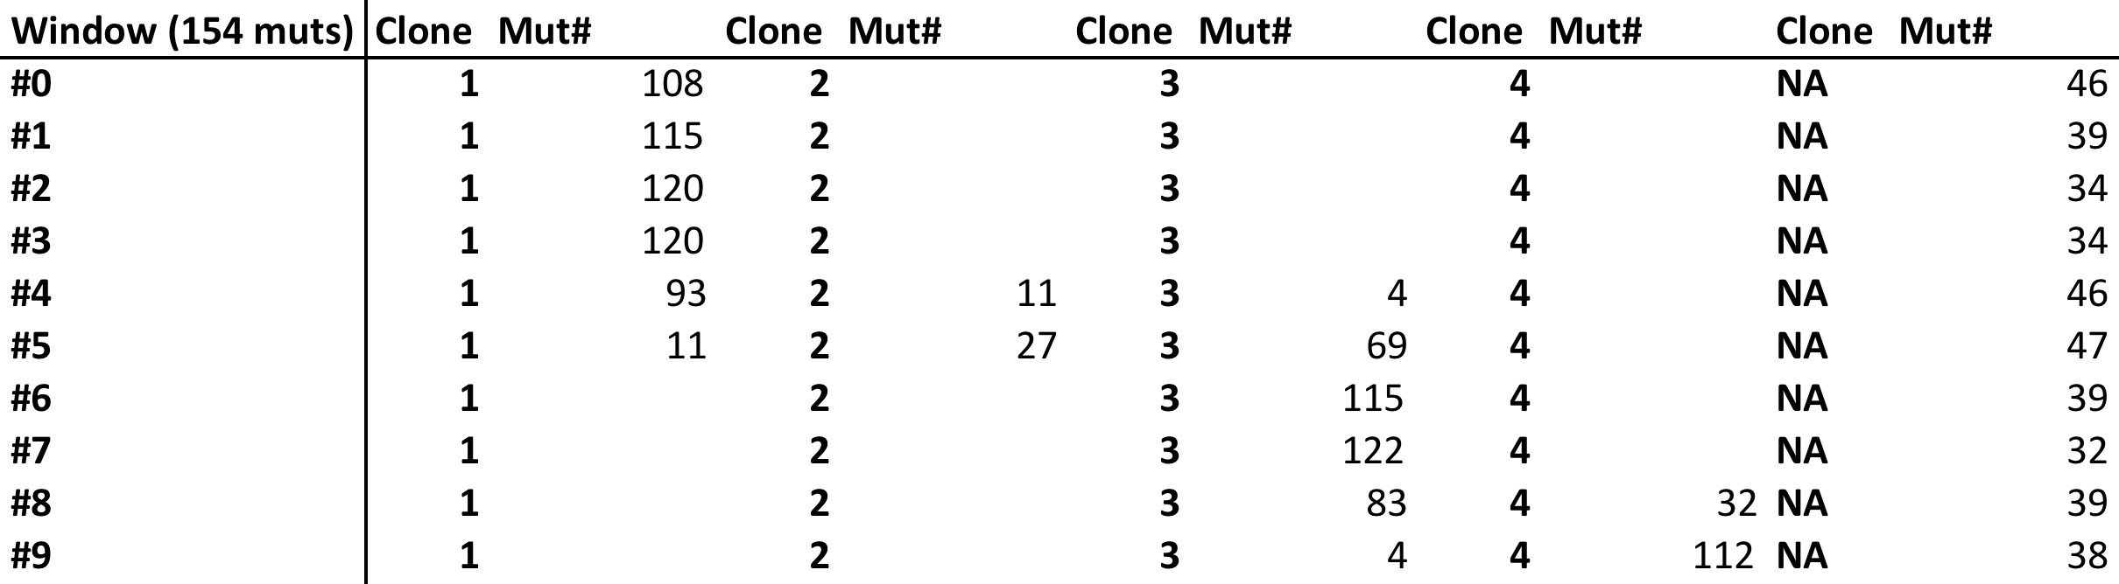
Pat:1f8d8720-30ca-4057-90f7-a34b8383eafe

Slide 3
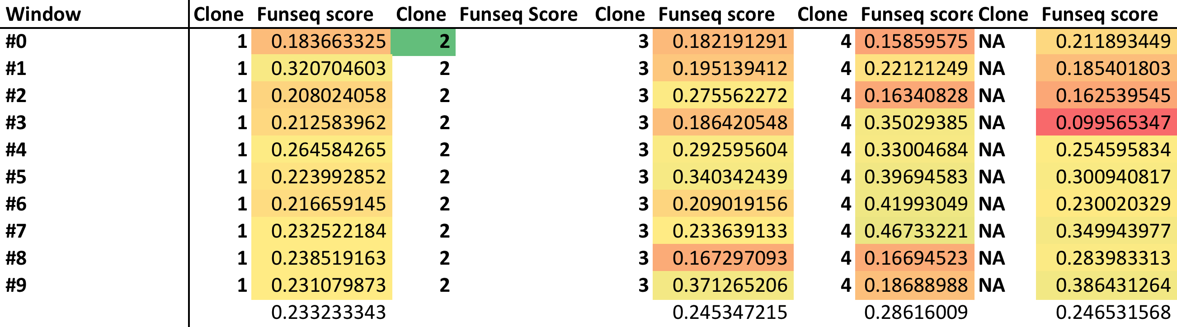
Funseq Score (non coding)

Slide 4
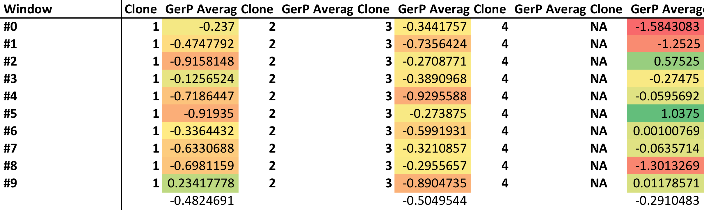
Gerp Scores

Slide 5
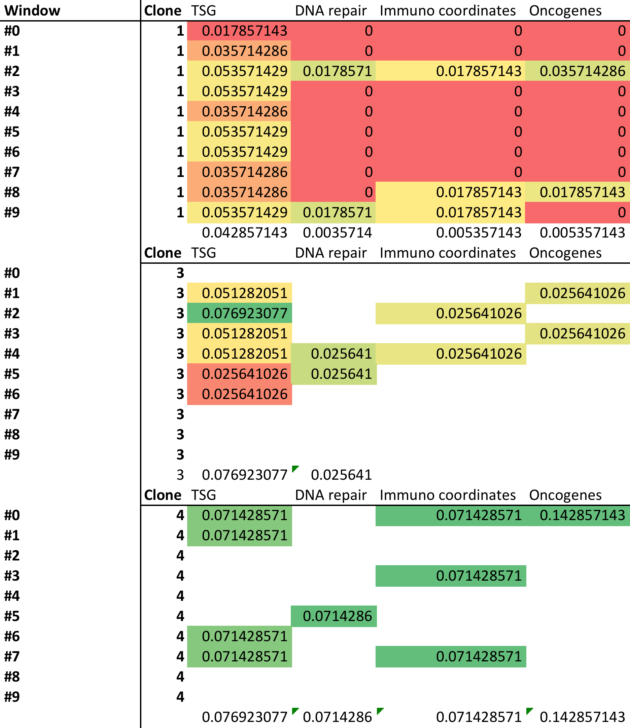
Region Scores

