Slide 1
Somatic Mutations Analysis for IBC WGS data
July 23, 2016
Xiaotong Li

Slide 2
Pipeline to generate catalogue of genomic variants
Raw FASTQ (20 IBC Samples)
Alignment by BWA-MEM
PCR removal
Bam Sorting
SV MODULE
SNV & INDEL CALLING MODULE
CNV CALLING MODULE
Germline
Somatic
Germline
Somatic
CREST
GATK Haplotype Caller
MuTect/Strelka
CNVnator
Somatator
germline SVs
somatic SVs
germline SNPs
germline INDELs
somatic SNPs
somatic INDELs
germline CNVs
somatic CNVs

Slide 3
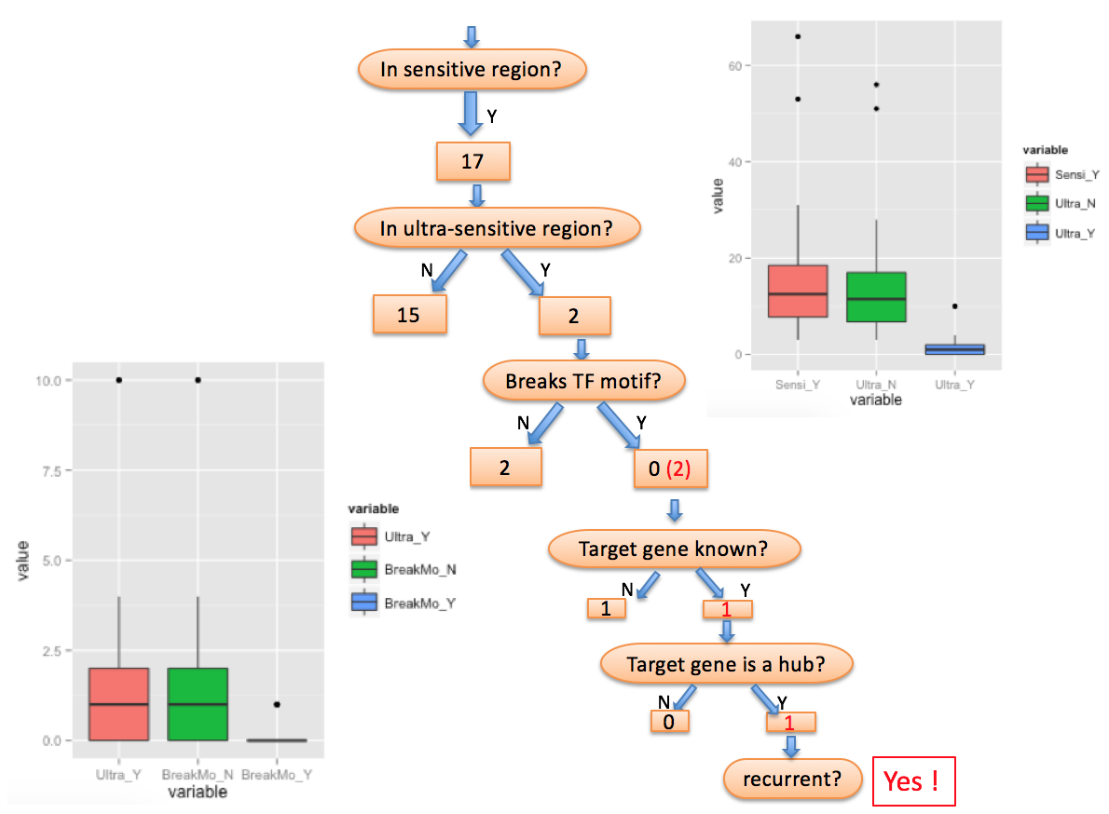
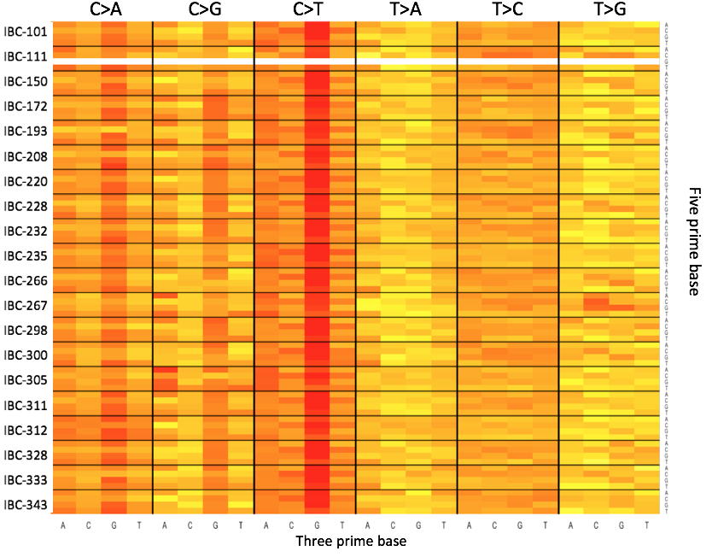
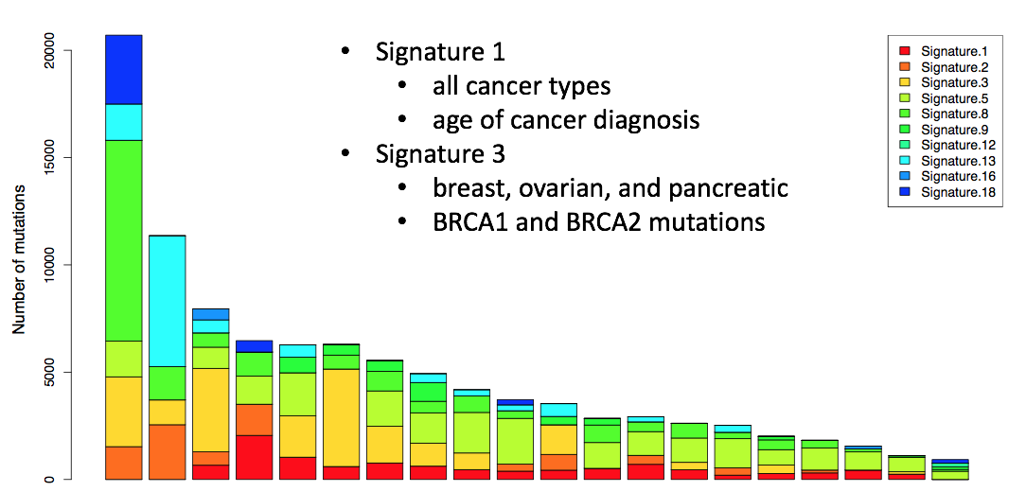
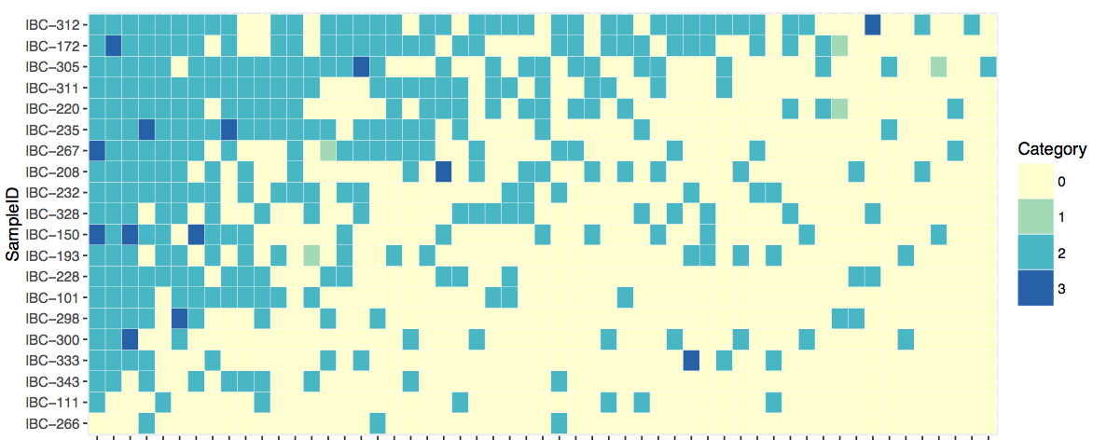
Overview of somatic variants analysis
Functional annotation & prioritization
  coding & non-coding
  identification of candidate drivers
Deciphering somatic mutation profiles
  mutational spectrum
  mutational signatures
Frequency of mutated genes
  most frequently mutated genes
  frequency of known cancer genes
  high-functional impact mutations only
Comparison between IBC vs. Non-IBC samples

Slide 4

Summary of recurrence
mutated in >=2 samples
recurrent “modules”
  genes
  non-coding regulatory modules: promoters, enhancers, DNase I hypersensitive sites (DHS), TF binding sites, etc.
recurrent positions

Slide 5
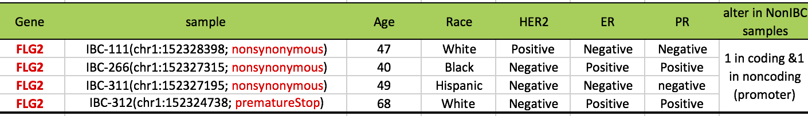
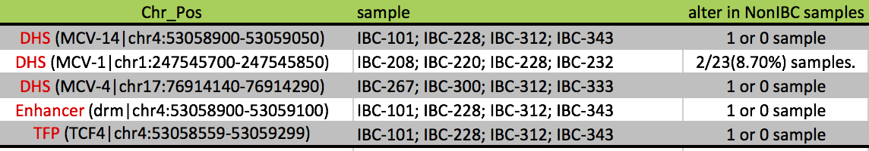
Recurrent Modules across IBC samples
Gene
FLG2: Filaggrin Family Member 2; ion binding & structural molecule activity; paralog to TCHHL1
Altered in 2/119 (1.68%) BRCA; 2/24 (8.33%) Lung_Adeno samples
Non-coding regulatory modules

Slide 6
LARVA: Large-scale Analysis of Variants in noncoding Annotations
Goal: Identify highly mutated regulatory sites that could potentially be noncoding drivers
Derived an accurate model of the background mutation rates of noncoding elements in cancer genomes.
Integrates a comprehensive set of noncoding functional elements, modeling their mutation count with a beta-binomial distribution.
Used regional genomic features such as replication timing to better estimate local mutation rates and mutational enrichments.
Demonstrated its effectiveness on 760 whole-genome tumor sequences
Lochovsky, Lucas, et al. Nucleic acids research (2015): gkv803.

Slide 7
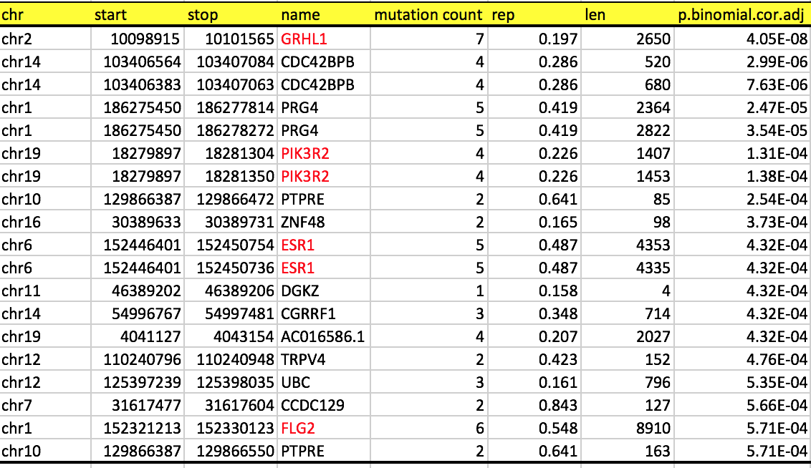
Highly mutated regions identified by LARVA
Genes
p-value: binomial model with repl timing correction and BH adjustment
Notes:
Benjamini & Hochberg

Slide 8
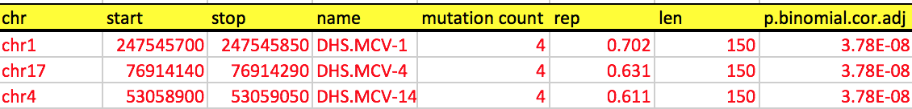
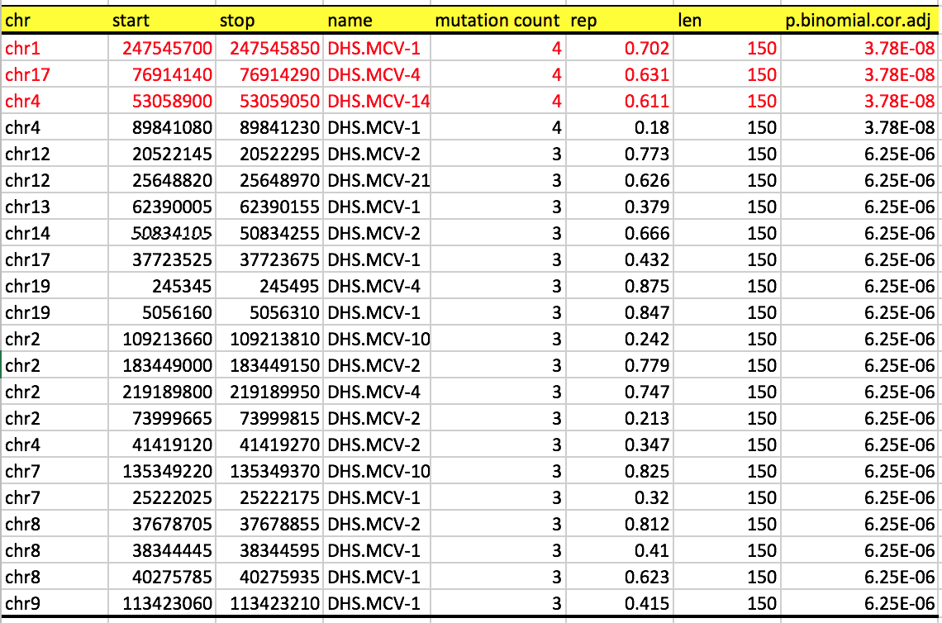
Highly mutated regions identified by LARVA
DNase I Hypersensitive Sites (DHS)
p-value: binomial model with repl timing correction and BH adjustment
Notes:
Benjamini & Hochberg

Slide 9
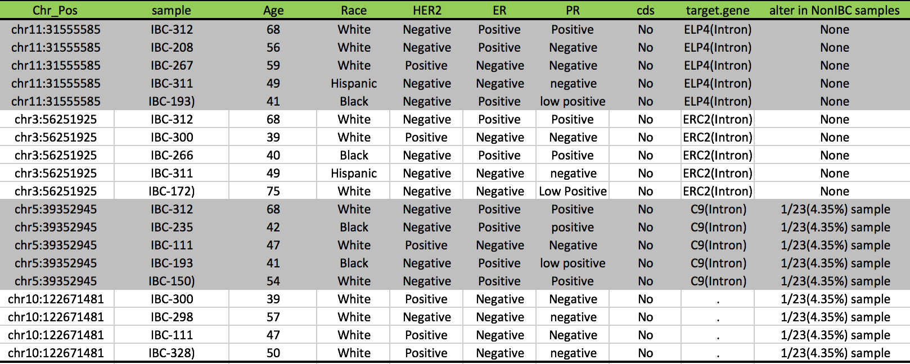
Recurrent positions across IBC samples
doubted it was too good to be true...
manually check in IGV

Slide 10
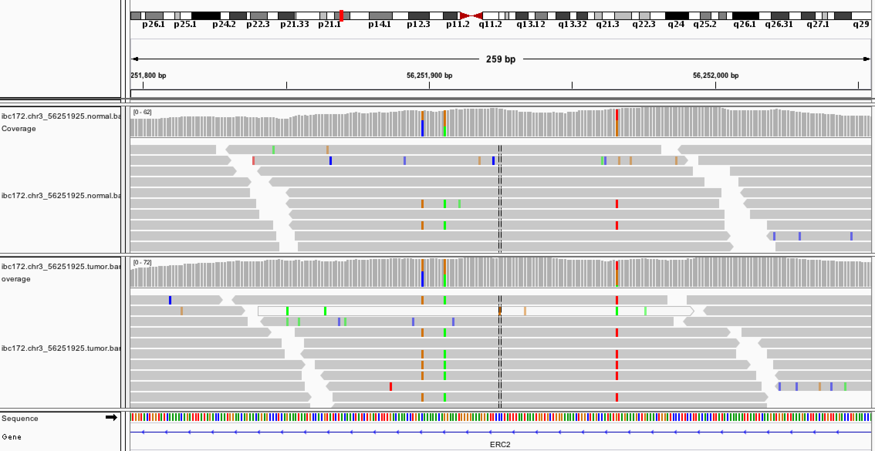
Visualize recurrent variants in IGV
Not at the end of reads

Slide 11
Visualize recurrent variants in IGV
Mapping quality is not good enough for tumor alternate alleles
  Avg~20; lots of 0
Raw reads → filtered reads by MuTect
Mapping quality is acceptable after filtering
  Example: IBC-172 → chr3: 56251925
  Example: IBC-266 → chr3: 56251925
Count of alternate alleles in tumor <=5 in most cases of highly recurrent positions
Samples | Ref_Count | Alt_Count | Qua (Ref) | Qua (Alt)
Normal | 57 (100%) | 0 | 39.39 | NA
Tumor | 47 (94%) | 3 (6%) | 39.21 | 42
Samples | Ref_Count | Alt_Count | Qua (Ref) | Qua (Alt)
Normal | 40 (98%) | 1 (2%) | 39.35 | 42
Tumor | 19 (86%) | 3 (14%) | 37.16 | 40.33

Slide 12
Number of mutations by filters
Current filters:
  “novel” SNP (not dpsnp site)
  apply high mappability mask to remove low mappable region of the genome
New filters:
  “novel” SNP + Alt_Count + Mask?
  “novel” SNP + Alt_Count
  Cutoff for Alt_Count

Slide 13
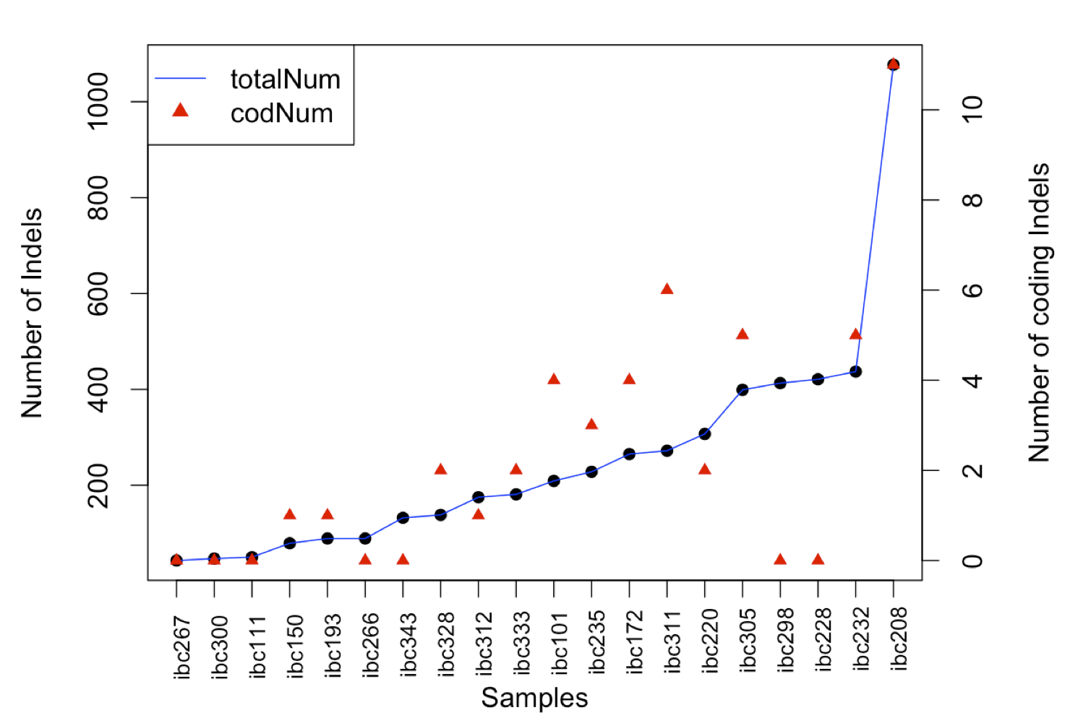
Overview of somatic Indels
# Total | # Cod | # Del | # Ins
5,051 | 47 | 3,057 | 1,994
Notes:
mean(Indel_sample$indel_num)= 252.55
mean(Indel_sample$codNum)=2.35

Slide 14
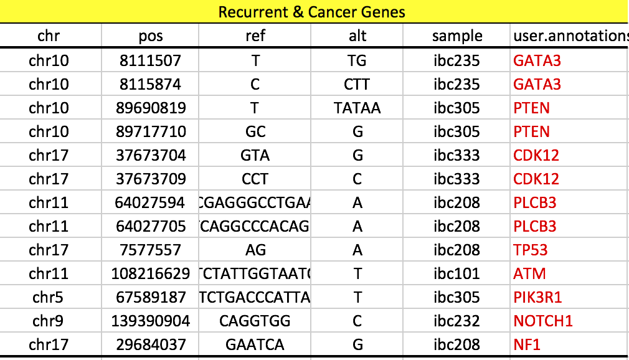
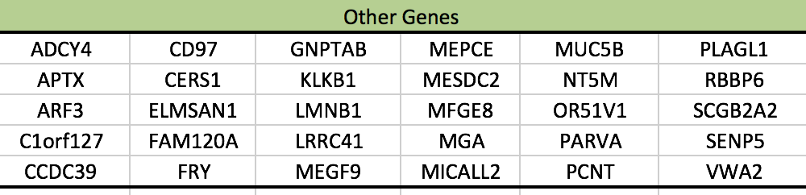
Influenced genes by coding Indels
Notes:
GATA3[TF_regulating_known_cancer_gene:MALAT1]

Slide 15
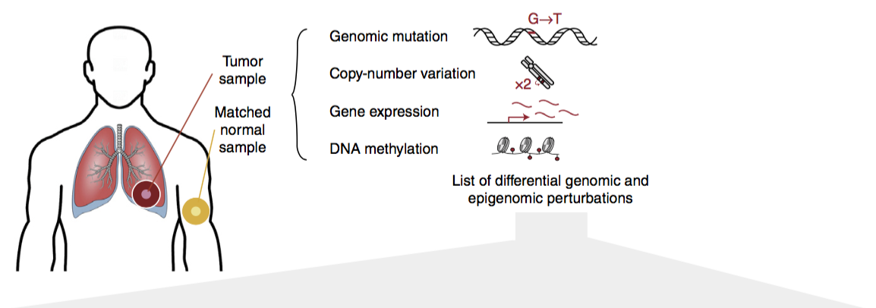
Pathway and network analysis of cancer genomes
Mutation, C. & Pathway Analysis working group of the International Cancer Genome, C. Pathway and network analysis of cancer genomes. Nat Methods 12, 615-621, doi:10.1038/nmeth.3440 (2015).

Slide 16
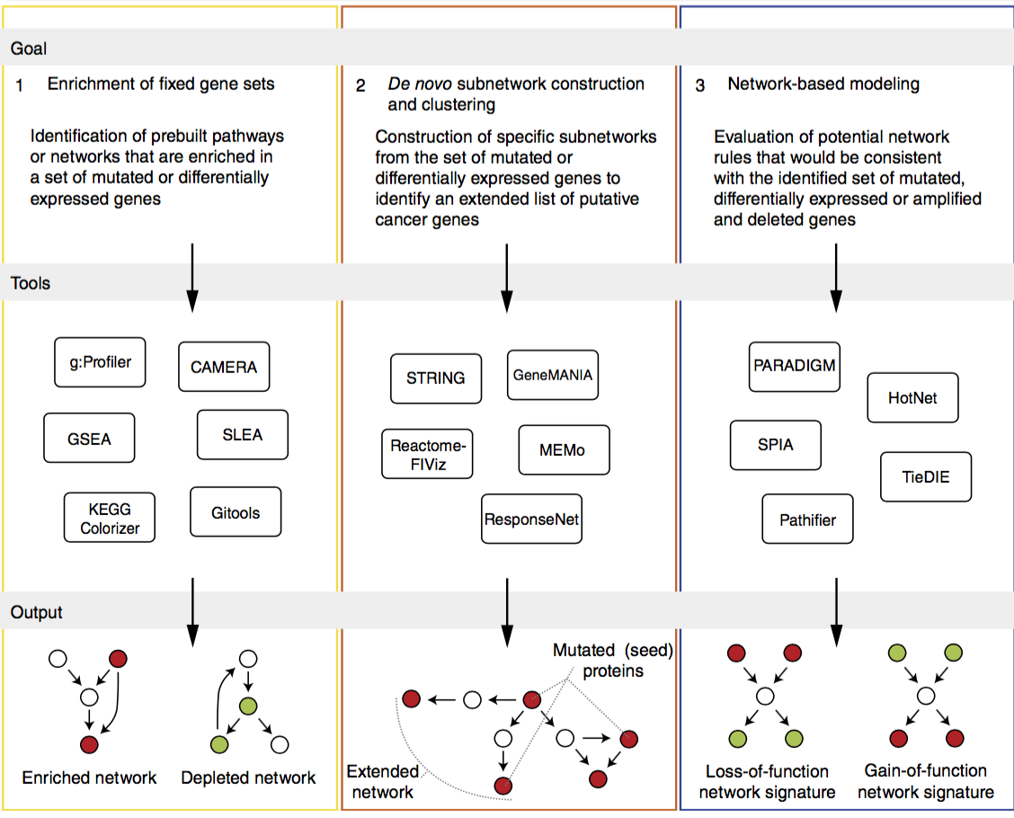

Slide 17
Pathway and network analysis of cancer genomes
Input
  mutated genes
  differentially expressed genes
  amplified and deleted genes
Non-synonymous coding variants
Integrate non-coding information (regulatory modules)
  variants in promoter regions
  variants breaking TF binding motif
  ...
  evaluate functional impact on non-coding variants (FunSeq Score)

Slide 18
Summary of somatic variants analysis
Functional annotation & prioritization
Deciphering somatic mutation profiles
Frequency of mutated genes
Recurrent modules and significance testing
Somatic Indels statistics and functional impact
Filtering on somatic variants from MuTect
Pathway and network analysis
Comparison between IBC vs. Non-IBC samples
  23 TCGA “matched” non-IBC samples
  560 breast cancer WGS

