Slide 1
eCLIP HepG2 Summary
JZ

Slide 2
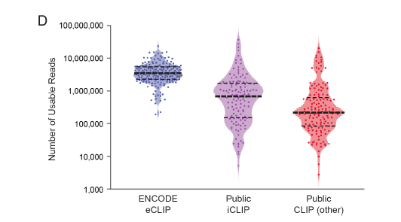

Slide 6
P for correlation test = 0.1206
P for correlation test = 1.604e-06

Slide 7
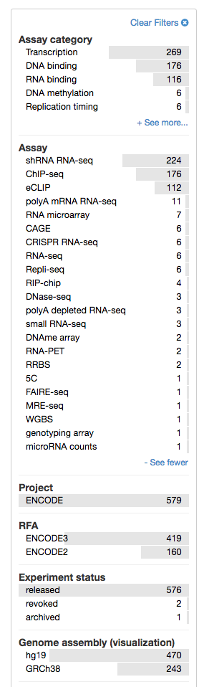
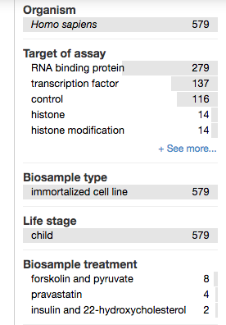
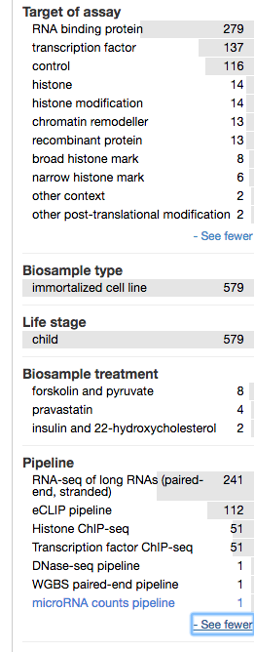

Slide 8
shRNA-Seq
Chip-Seq
200
115
2
CEBPZ
GTF2F1

