Slide 1
Evaluating Ultra-Rare SNVs in the Genome of SubjectZ Using RareVariantVis

Slide 2
Short legend for figures
x axis - position on chromosome
y axis - zygosity (# of alternative variant reads / # of total reads in particular genomic position)
orange lines - position of centromere (UCSC hg19)
red horizontal line - theoretical line separating heterozygous and homozygous
red continuous line - moving average of zygosity, window 2000 variants; when it reaches 1, region could be a loss of heterozygosity (LOH), potential recessive disease hotspot
blue dots - SNVs in their positions
green dots - rare, nonsynonymous coding variants, according to FunSeq2 (prematureStop + nonsynonymous)
orange dots - rare, nonsynonymous coding variants present only in Zimmer sample (not in Synder/NA12878)
Reference :
Stokowy, T, et al. (2016) RareVariantVis: new tool for visualization of causative variants in rare monogenic disorders using whole genome sequencing data. Bioinformatics btw359

Slide 3
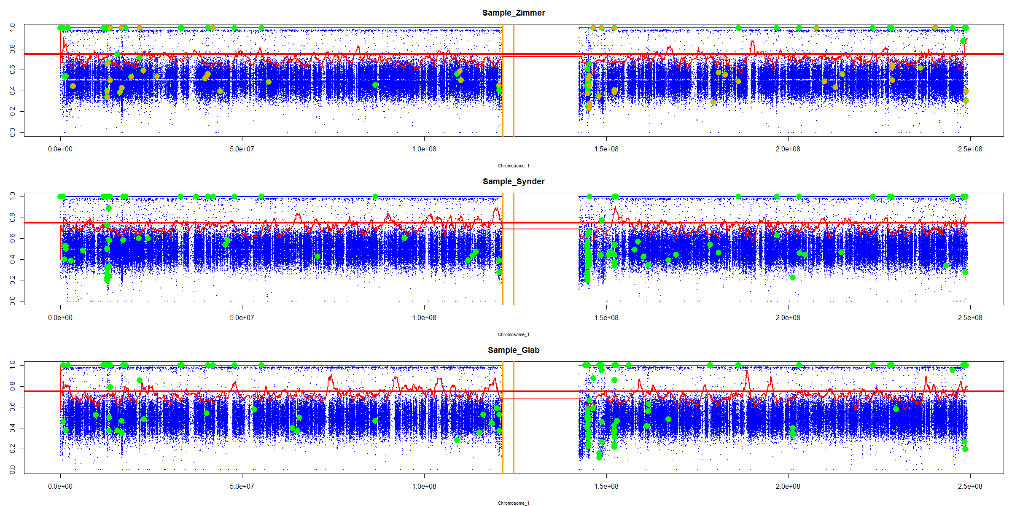
Chromosome 1

Slide 4
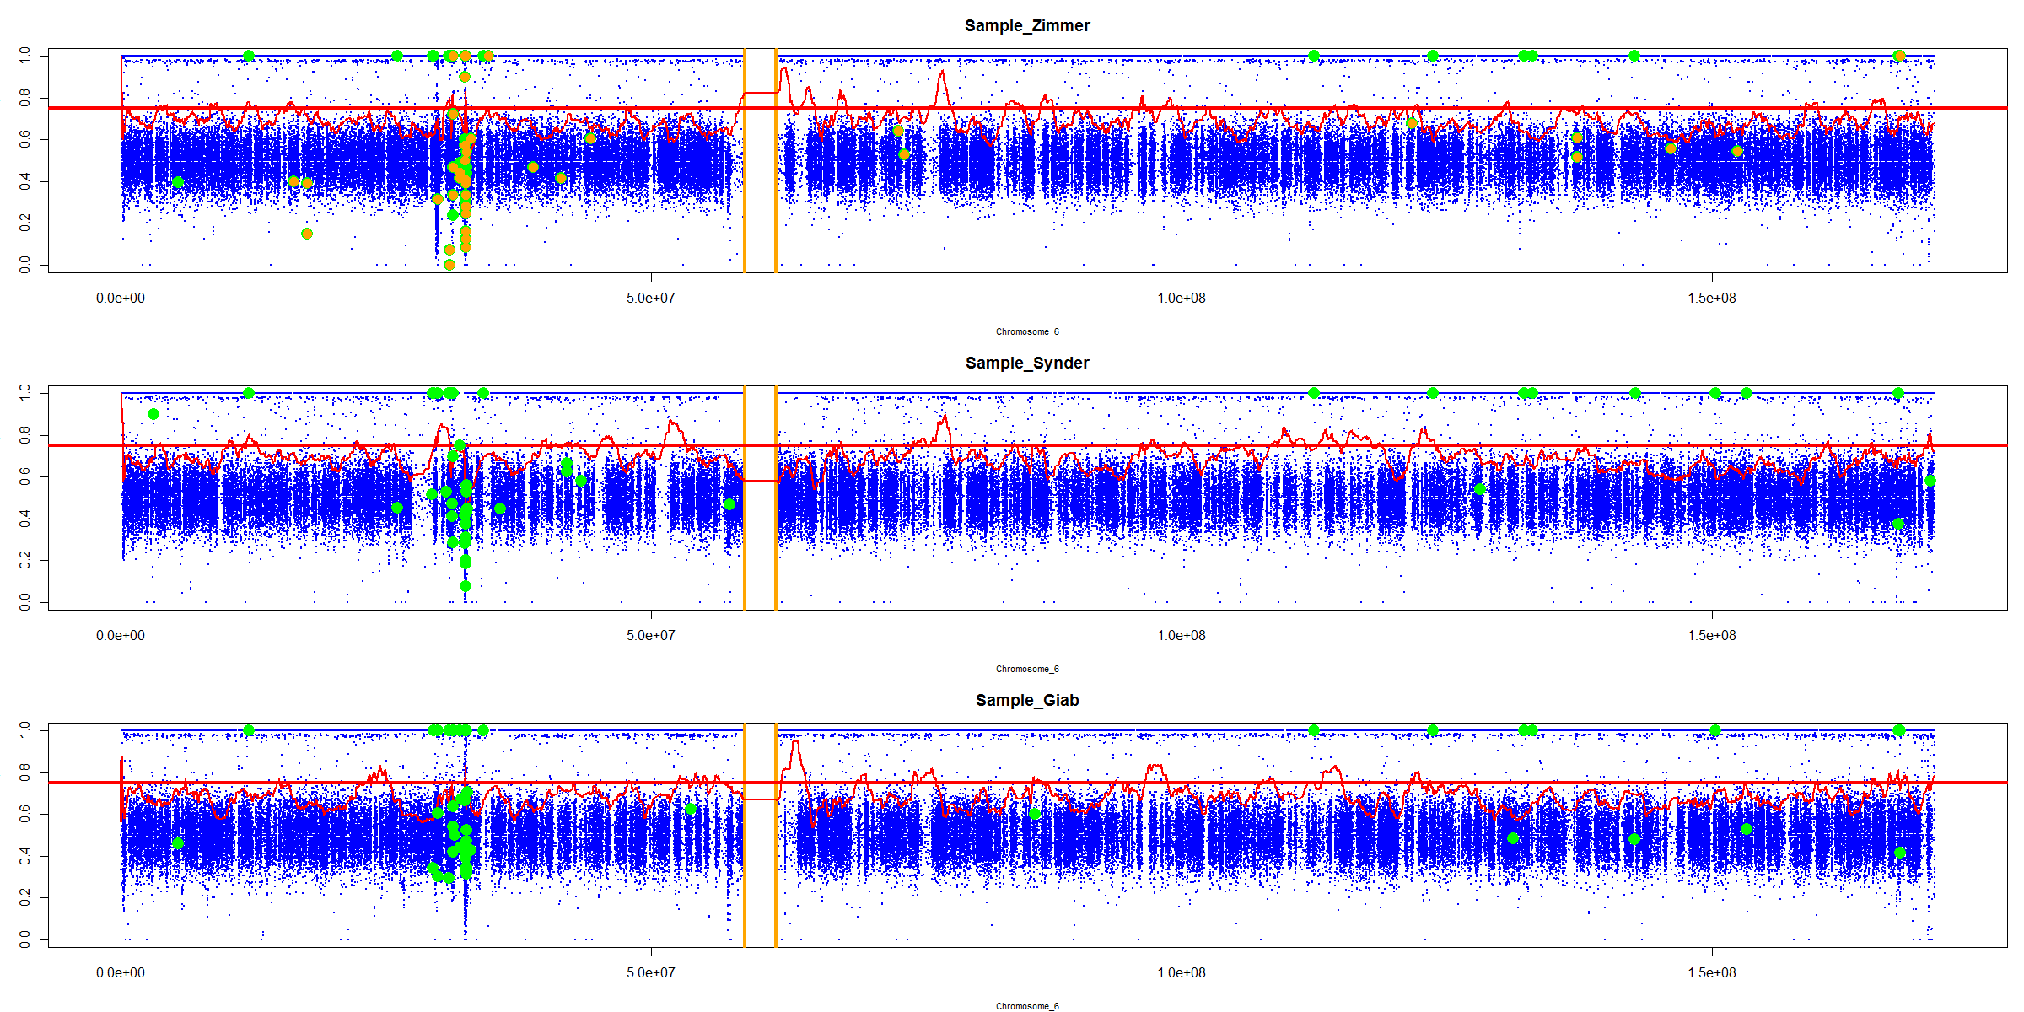
Chromosome 6

Slide 5
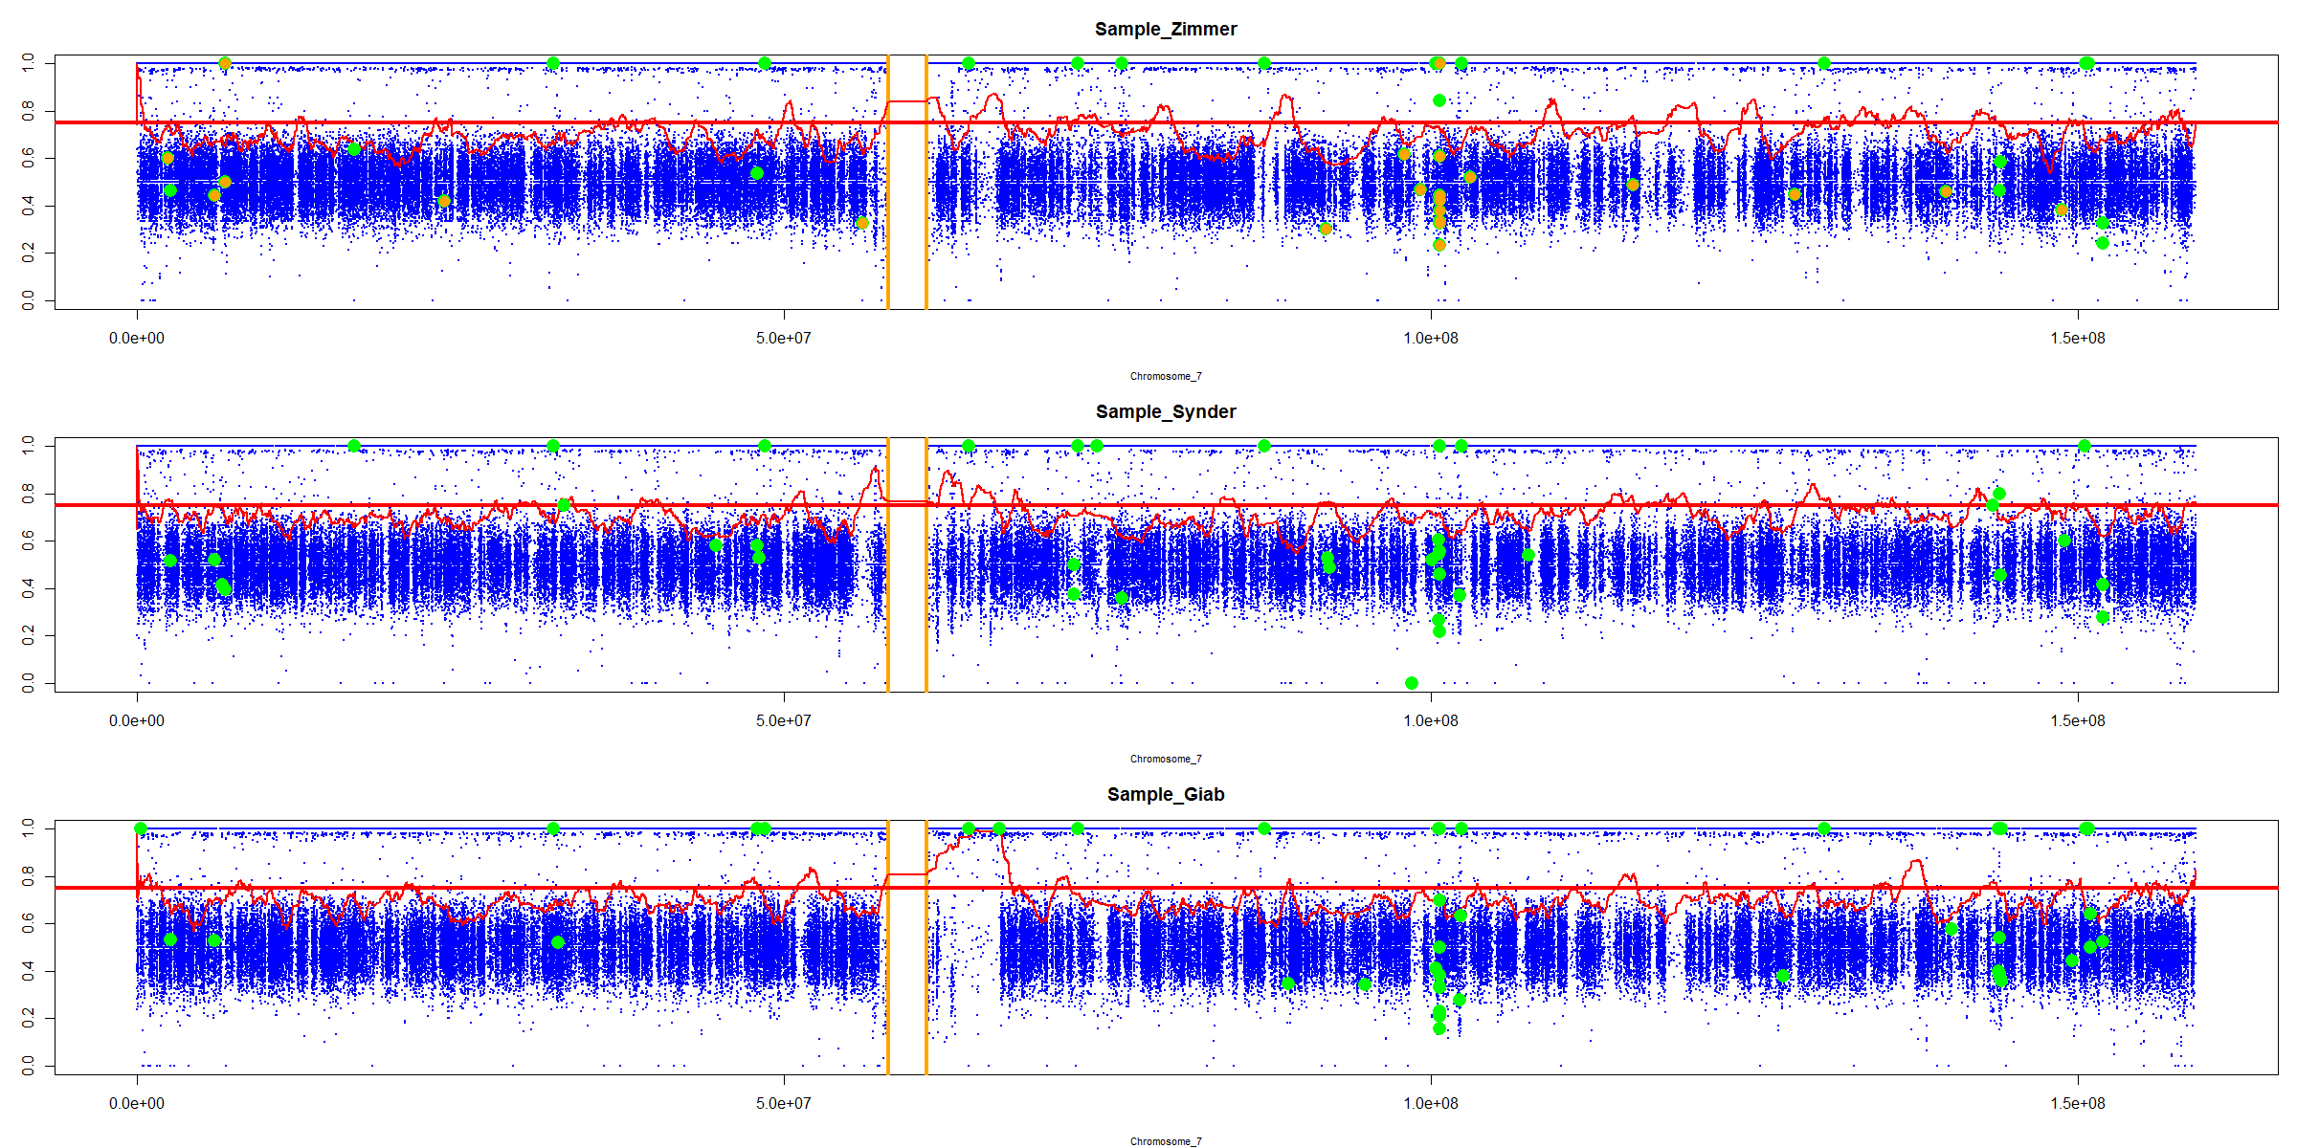
Chromosome 7

Slide 6
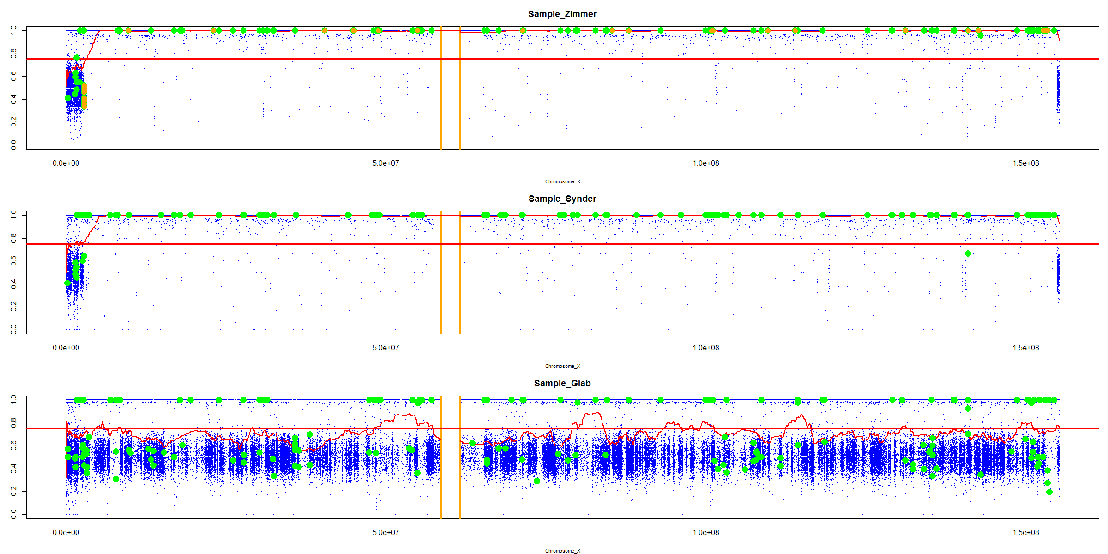
Chromosome X

