Slide 1
CHAS project
Pilot study of the microbiome of sputum from asthmatic patients
08 Jun 2016
Dan Spakowicz

Slide 2
Background
Collaboration between
  Geoff Chupp (Yale SOM, Internal Medicine)
  George Weinstock (Jackson Laboratory for Genomic Medicine)
  Mark Gerstein (Yale MB&B)
General Question
  Does microbial composition in sputum correlate with asthma severity?
Pilot Samples
  10 patients with asthma;
  Sputum processed to cell lystate (CL) and supernatent (S)
Specific Question
  Is there some trend observable in the pilot data that could be used to justify a larger study (e.g. ~100 supernatents from Yan et al 2015)
Data
  16S amplification (bacteria) – presented last time
  ITS amplification (fungi) – focus of this presentation
  Clinical data

Slide 3
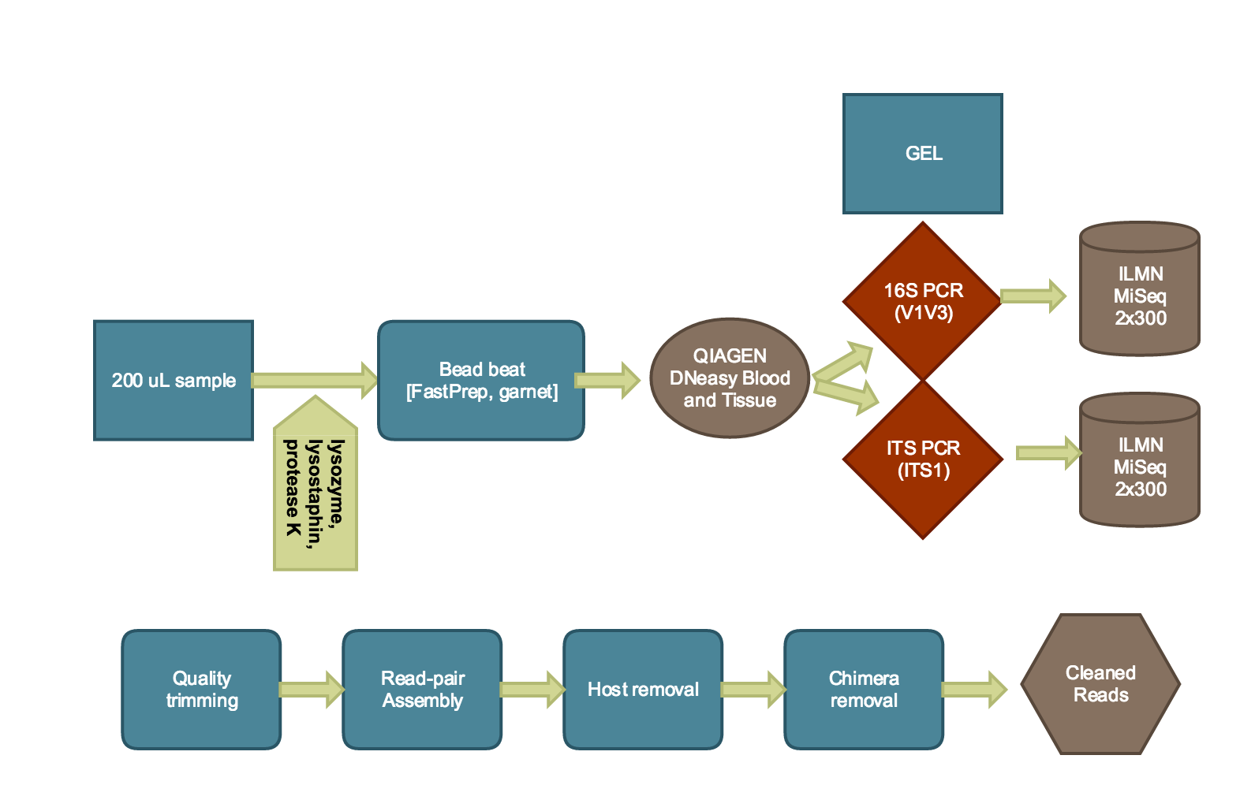
Methods

Slide 4
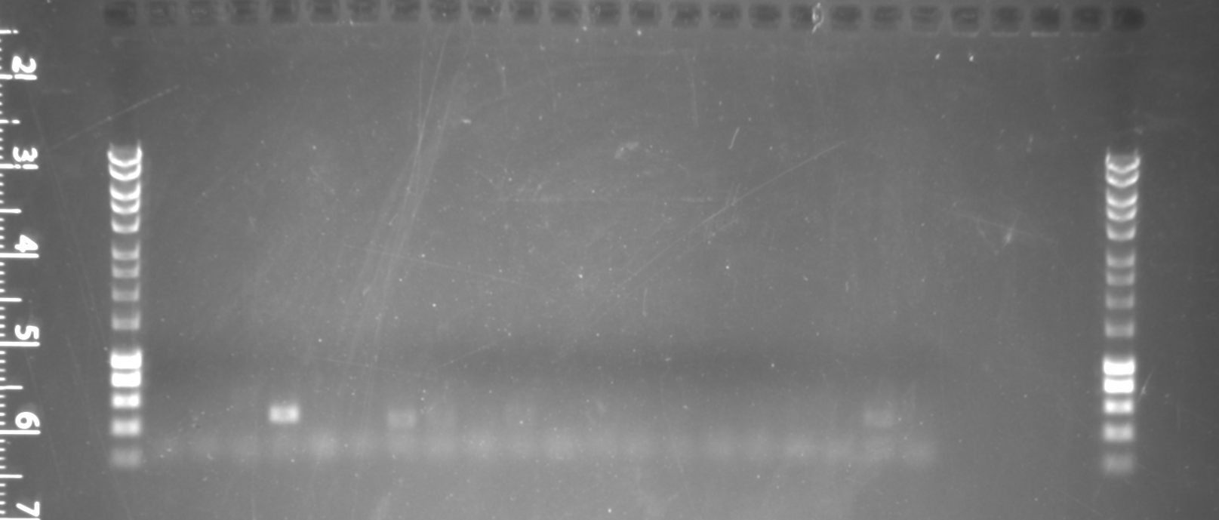
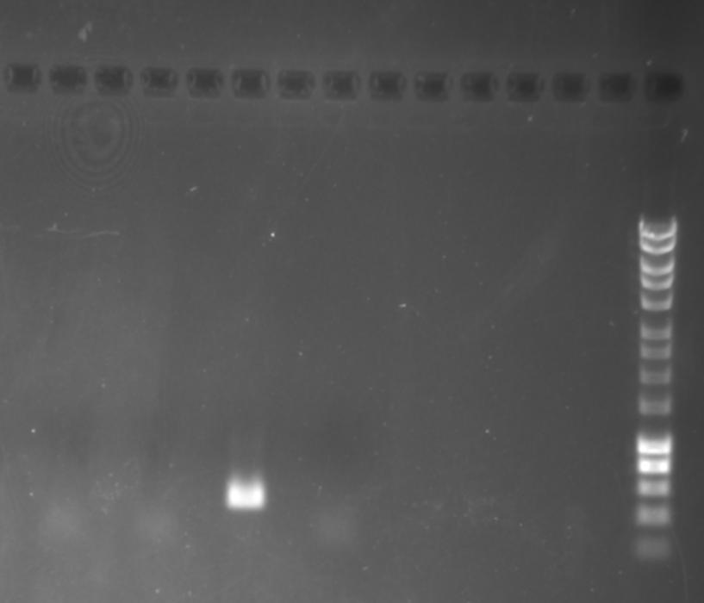
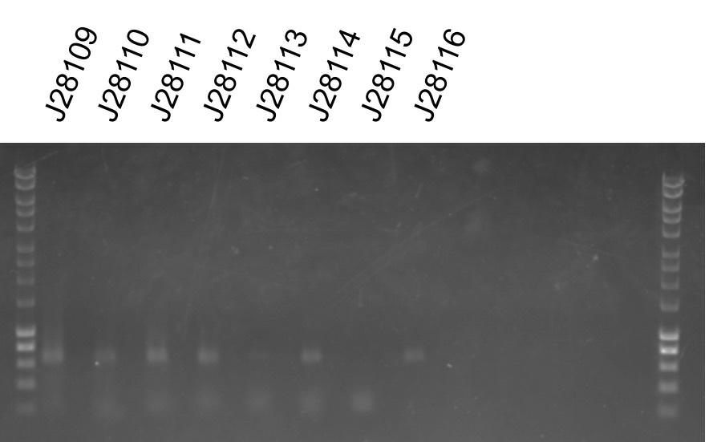
ITS sequencing QC: PCR amplicons by agarose gel
311-CL
314-CL
485-CL
603-CL
698-CL
723-CL
728-CL
745-CL
765-CL
769-CL
311-S
314-S
485-S
603-S
698-S
723-S
728-S
745-S
765-S
769-S
All samples, those with PCR bands in red
Controls look fine
ITS sequencing
Negative PCR Control
Positive PCR Control
16S sequencing was more consistent
(shown previously)
Very few bands observed by PCR, may indicate low fungal load, few usable reads

Slide 5
ITS sequencing QC: Number of reads post processing
Most samples have more reads than the average number of reads per HMP sample

Slide 6
Analyses
Clustering by asthma severity
  PCA
    Bacteria relative abundances (16S)
    Fungi relative abundances (ITS)
    Both
Correlation with clinical parameters
  Pearson correlation

Slide 7
Clustering by fungi relative abundances (Genus level)

Slide 8
Incorporating other definitions of asthma severity: EPR3
Expert Panel Report 3 (EPR 3): guidelines for the diagnosis and management of asthma. National Institutes of Health 40, (2007).

Slide 9
Incorporating other definitions of asthma severity: NICE
NICE guidelines for chronic inflammatory diseases
  FEV₁/FVC ratio < 0.7 &&
  Predicted FEV₁ < 80%
Recoded into a binary indicating top-right vs bottom-left quadrant
Chronic obstructive pulmonary disease: Management of chronic obstructive pulmonary disease in adults in primary and secondary care (partial update). NICE.org.uk. June 2010

Slide 10
Clustering of the relative abundances of fungi (Genus level)
Original classification
EPR3
NICE

Slide 11
Clustering by relative abundances of bacteria (Genus level)
Original classification
EPR3
NICE

Slide 12
Clustering by relative abudances of both fungi and bacteria (Genus level)
Original classification
EPR3
NICE

Slide 13
Analyses
Clustering by asthma severity
  PCA
    Bacteria relative abundances (16S)
    Fungi relative abundances (ITS)
    Both
Correlation with clinical parameters
  Pearson correlation, Bonferroni correction

Slide 14
Other clinical data in the context of asthma phenotyopes
In the clinical data
Feel.bothered.by.or.have.to.avoid.DUST.in.the.environment
Feel.bothered.by.or.have.to.avoid.going.outside.because.of.WEATHER.OR.AIR.POLLUTION
Absolute.Cell.Count...Eosiniphils..Blood
IL-5 column in dataset, but all values missing
IL-9 column in dataset, but all values missing
BMI >30, 4/10 patients
Absolute.Cell.Count...Neutrophils..Blood
Wenzel, S. E. Asthma phenotypes: the evolution from clinical to molecular approaches. Nat Med 18, 716–725 (2012).

Slide 15
Correlation between the relative abundance of Lactobacillus and the number of hospitalizations in one’s lifetime

Slide 16
Literature precedence for Lactobacillus association with asthma
1. Yu, J. et al. The effects of Lactobacillus rhamnosus on the prevention of asthma in a murine model. Allergy, asthma & immunology research 2, 199–205 (2010).
“Oral treatment with Lcr35 prior to sensitization can attenuate airway inflammation and hyperreactivity in a mouse model of allergic airway inflammation. These results suggest that Lcr35 may have potential for preventing asthma.”
2. Thorburn, A. N. et al. Evidence that asthma is a developmental origin disease influenced by maternal diet and bacterial metabolites. Nat Commun 6, 7320 (2015).
“…feeding mice a high-fibre diet yields a distinctive gut microbiota, which increases the levels of the short-chain fatty acid, acetate. High-fibre or acetate-feeding led to marked suppression of allergic airways disease…”

Slide 17
Correlation between the relative abundance of Haemophilus and the number of oral corticosteroids

Slide 18
Literature precedence for Haemophilus association with corticosteroid use
1. Earl, C. S. et al. Haemophilus influenzae responds to glucocorticoids used in asthma therapy by modulation of biofilm formation and antibiotic resistance. EMBO Mol Med 7, 1018–1033 (2015).
“Using a mouse model of infection, we show that corticosteroid treatment promotes H. influenzae persistence. ”

Slide 19
No correlation with fungi, despite literature precedence
Denning, D. W., O’Driscoll, B. R., Hogaboam, C. M., Bowyer, P. & Niven, R. M. The link between fungi and severe asthma: a summary of the evidence. European Respiratory Journal 27, 615–626 (2006).
“Many airborne fungi are involved, including species of Alternaria, Aspergillus, Cladosporium and Penicillium, and exposure may be indoors, outdoors or both”
Denning, D. W., et al. The link between fungi and severe asthma: a summary of the evidence. European Respiratory Journal 27, 615–626 (2006).

Slide 20
Future directions
PCA with other taxonomic levels
Other dimensionality reduction techniques
Correlations with other taxonomic levels

