Slide 1
The role of regulatory variation
in complex traits and disease
Frank W. Albert and Leonid Kruglyak
Nature Reviews Genetics 16.4 (2015)
Notes:
Context and motiv

Slide 3
Common Objectives in eQTL Studies
1) Identifying the precise causal variants themselves; genome-wide association studies (GWAS) generally give genomic window.
2) Determining the mechanisms by which variants may influence gene expression
3) Predicting & understanding the consequences of differential gene expression on phenotypic traits (such as disease risk)
→ Prioritize variants among GWAS studies. Most variants identified through GWAS are in non-coding regions (suggestive of a causative role for regulatory variation).
Notes:
Context and motiv

Slide 4
Identifying the causal variants in differential gene expression

Slide 5
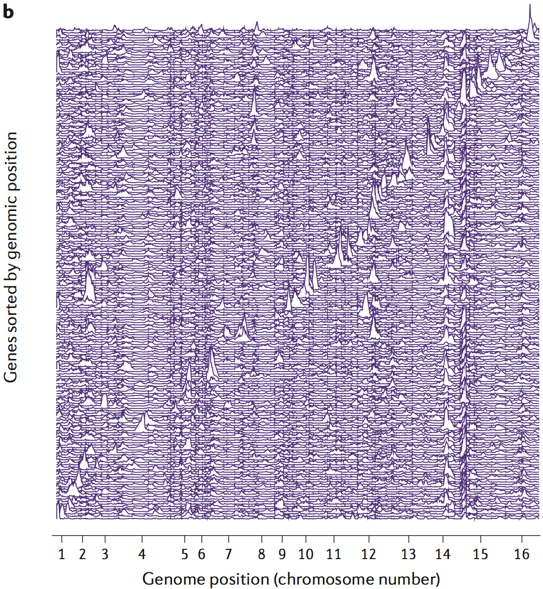
Identifying the causal variants in differential gene expression

Slide 6
Identifying the causal variants in differential gene expression
Notes:
Emph 1) global hotspots and 2) local (many cis)6 eqtls

Slide 7
Identifying the causal variants in differential gene expression

Slide 8
Identifying the causal variants in differential gene expression

Slide 9
Regulatory mechanisms by which an eQTL SNV can affect expression
Pai AA, et al. PLoS Genetics (2015)

Slide 10
Regulatory mechanisms by which an eQTL SNV can affect expression
(local effects)
Chang, J. et al. PLoS Genetics (2013)
2-nt deletion causes differential expression of yeast ERG28 (involved in sterol biosynthesis pathway) as a result of physical clashes between neighboring TFs
Ex: single AA substitution in yeast AMN1 results in differential expression of AMN1 itself

Slide 11
Regulatory mechanisms by which an eQTL SNV can affect expression
(distant effects)

Slide 12
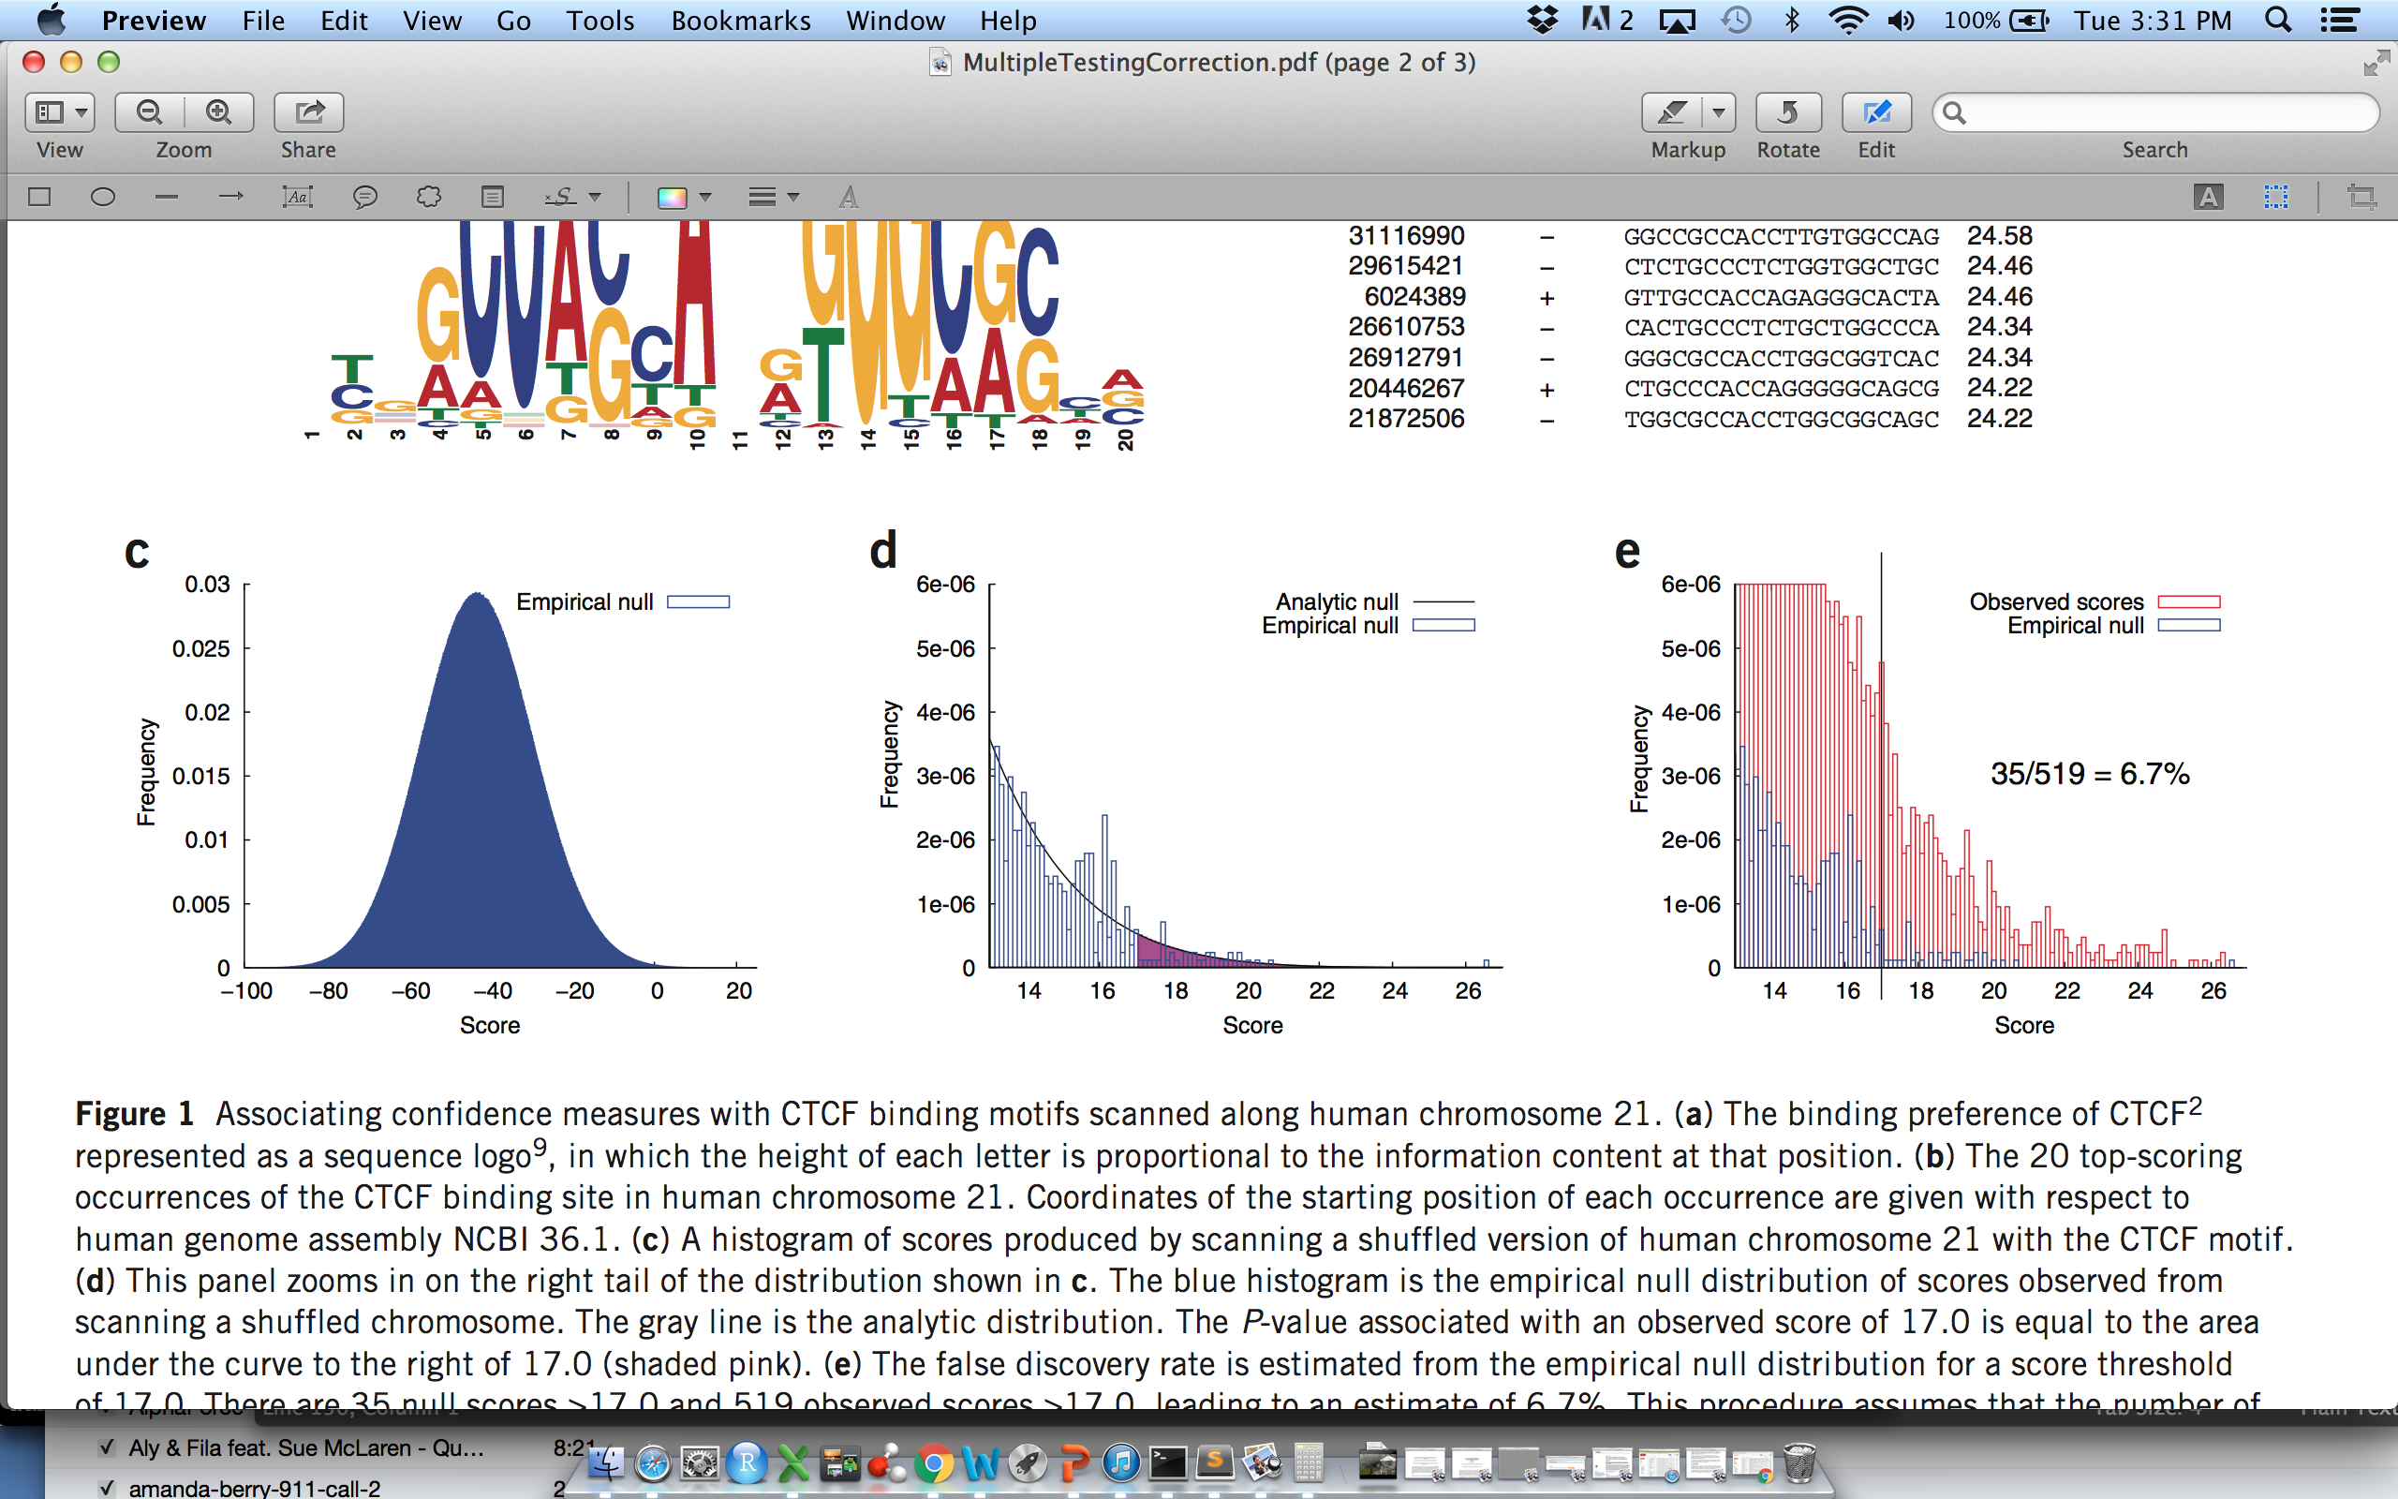
A note on trans eQTLs & multiple testing correction
Adapted from WS Noble. Nat. Biotech. (2009)

Slide 13
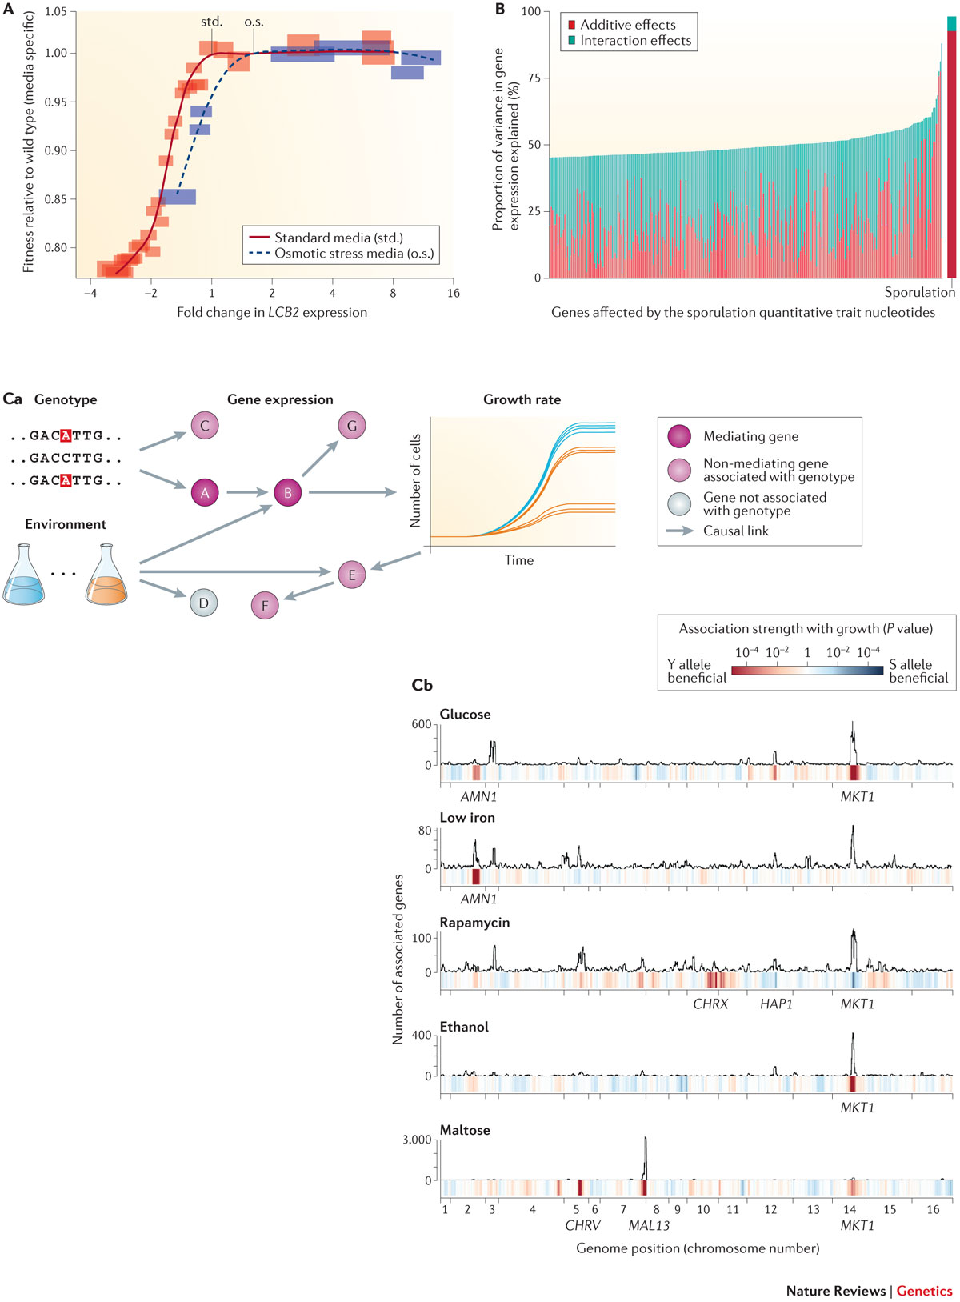
Consequences of differential gene expression on phenotypic traits & complexities of eQTLs
It can be difficult to attribute phenotypic effects to small sets of SNVs when a battery of genes are affected, and different genes exhibit differing degrees of SNV-induced expression variation, as well as additive vs epistatic effects
The effects of expression levels can be highly environmentally-sensitive (even within narrow windows of conditions)

Slide 14
Consequences of differential gene expression on phenotypic traits & complexities of eQTLs
eQTL hotspots (here, hotspots associated with cell division in yeast) may be redistributed across the genome under different conditions

Slide 15
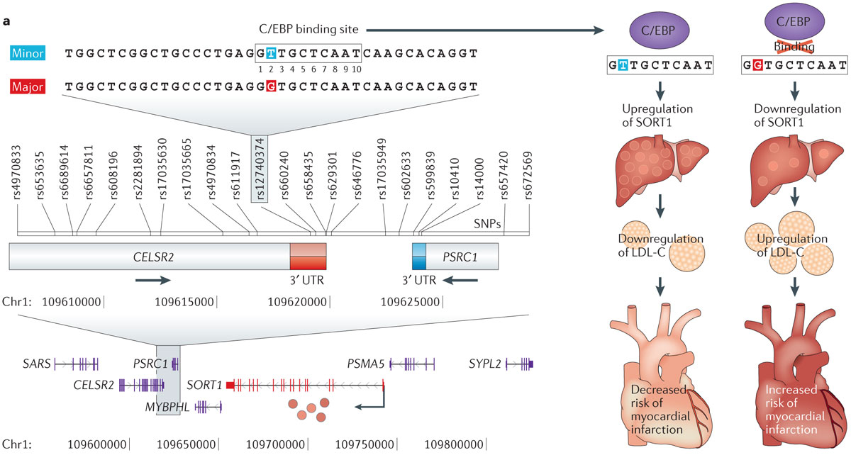
An example of a full chain of causality in a disease-associated eQTL

Slide 16
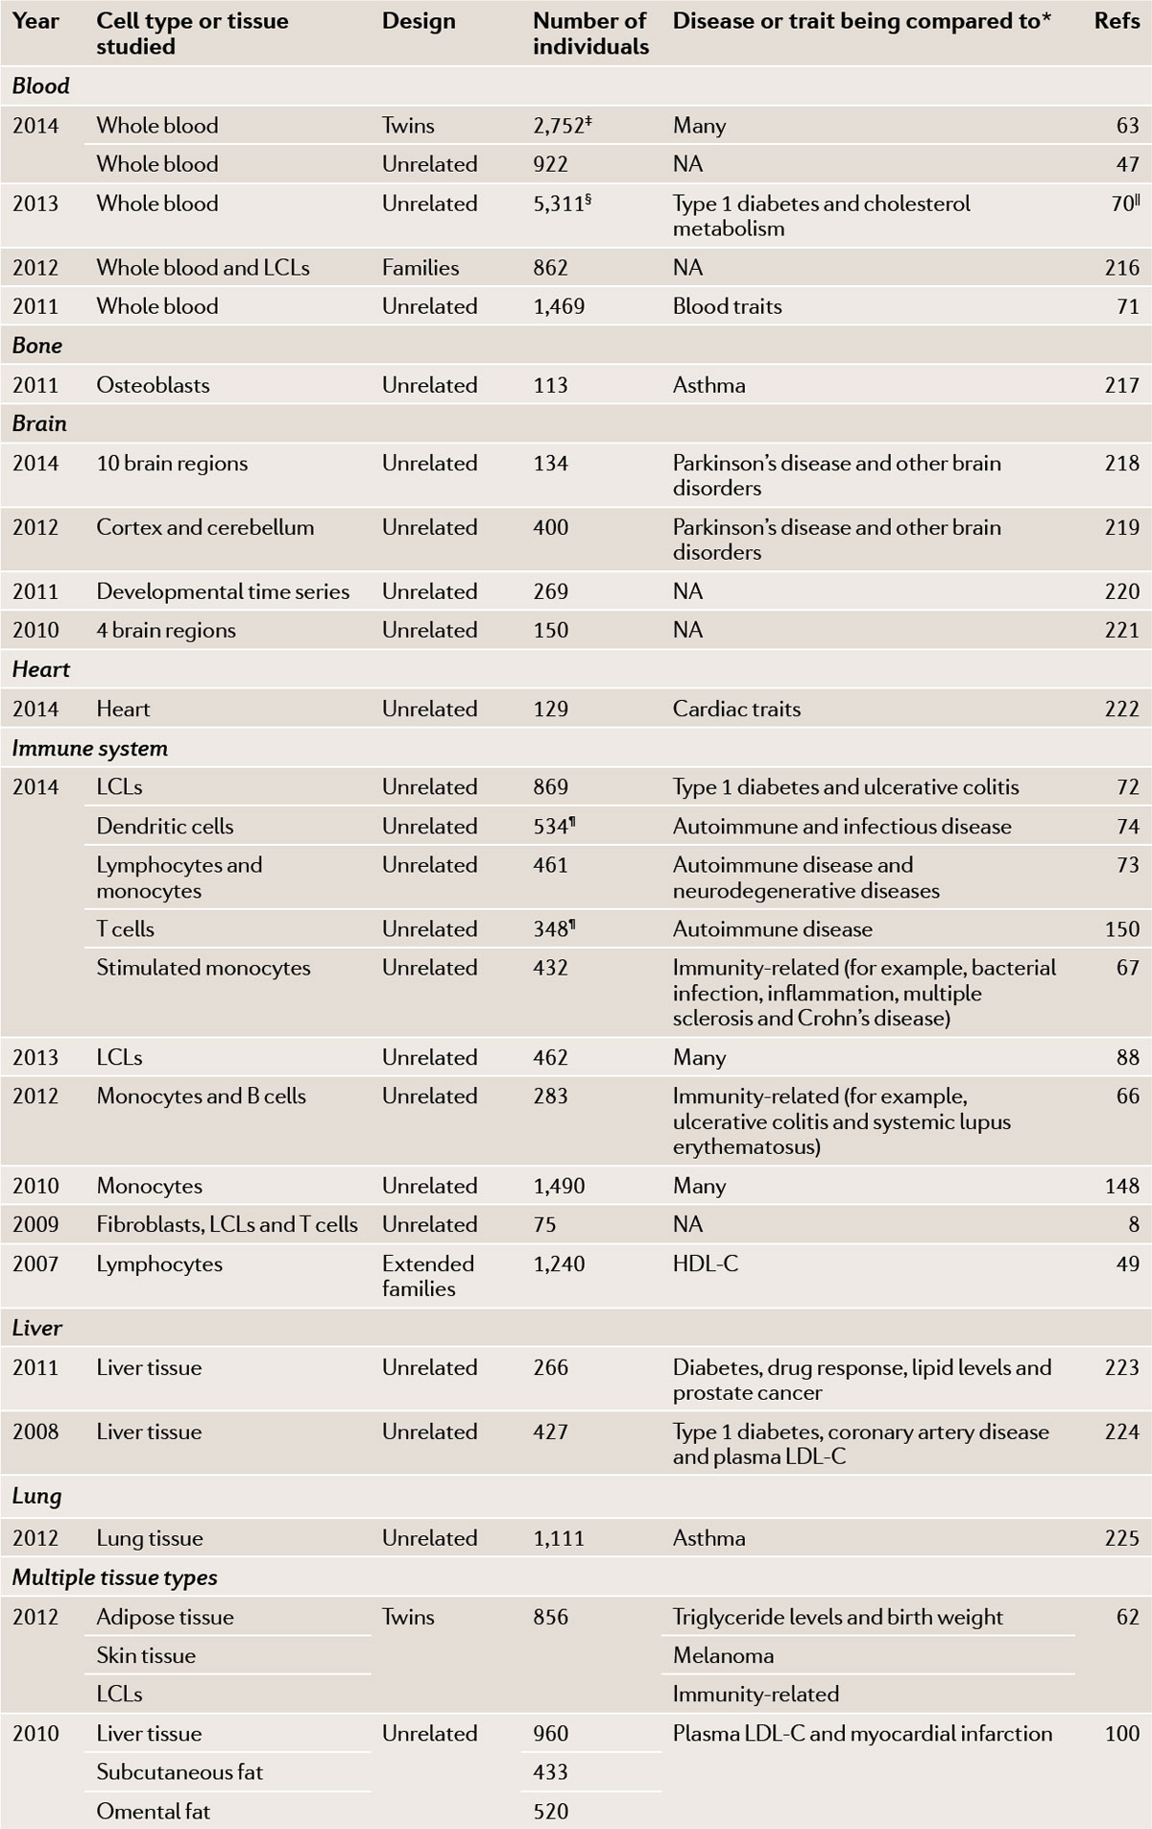
Maps of eQTLs in large-scale studies into human genomes

Slide 17
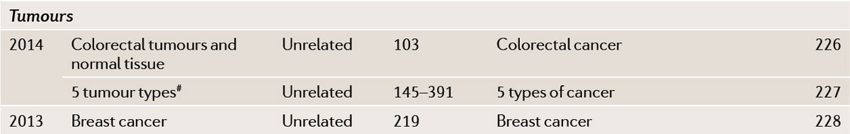
Maps of eQTLs in large-scale studies into human genomes

Slide 18
Previous papers on miRNA eQTLs (miR-eQTLs)
→ built from small sample sizes (~200 or less)
Somel, M. et al. MicroRNA, mRNA, and protein expression link development and aging in human and macaque brain. Genome Res. 20, 1207–1218 (2010).
Borel, C. et al. Identification of cis- and trans-regulatory variation modulating microRNA expression levels in human fibroblasts. Genome Res. 21, 68–73 (2011).
Gamazon, E. R. et al. Genetic architecture of microRNA expression: implications for the transcriptome and complex traits. Am. J. Hum. Genet. 90, 1046–1063 (2012).
Civelek, M. et al. Genetic regulation of human adipose microRNA expression and its consequences for metabolic traits. Hum. Mol. Genet. 22, 3023–3037 (2013).
Siddle, K. J. et al. A genomic portrait of the genetic architecture and regulatory impact of microRNA expression in response to infection. Genome Res. 24, 850–859 (2014).

Slide 19
Available datasets of interests in Freedman et al (2015)
Supp_data_1 The_demographic_and_clinical_characteristics_of_5329_FHS_participants
Supp_data_2 Pedigree_Structure_formed_by_5329_FHS_participants
Supp_data_3 Heritability_estimates_of_miRNA_expression
Supp_data_4 cis_miR-eQTLs_at_FDR_less_than_0p1
Supp_data_5 cis-miR-eQTLs_at_FDR_less_than_0p1_accounting_for_cell_counts_effects
Supp_data_6 Summary_association_results_for_52_peak_cis-miR-eQTLs
Supp_data_7 trans-miR-eQTLs_at_FDR_less_than_0p1
Supp_data_8 trans-miR-eQTLs_at_FDR_less_than_0p1_accounting_for_cell_counts_effects
Supp_data_9 Stat_the_relative_distance_from_cis_miR-eQTLs_to_miRNAs
Supp_data_10 Summary_of_genome_location_of_cis_miR-eQTLs
Supp_data_11 Genomic_features_of_cis_miR-eQTLs_at_FDR_less_than_0p1_annotated_by_Haploreg
Supp_data_12 cis_eQTLs_shared_by_intragenic_miRNAs_and_their_host_mRNA_genes
Supp_data_13 Conditional_analysis_of_cis-miR-eQTLs_on_mRNA_expression_levels

Slide 20
"The distribution of narrow-sense heritability of miRNA expression for the 247 miRNAs expressed in 41,000 participants is shown in Supplementary Fig. 2, with an average heritability estimate (h2miR) of 0.11"
Broad-sense heritability (H2) refers to the inclusion of all potential sources of genetic variation (additive, dominance, epistatic, maternal and paternal effects). Narrow-sense heritability: know additive only
How can t-values & p-values be so strong (ie, high t and low p in Supp data 4) and yet the the heritability be so low?

Slide 21
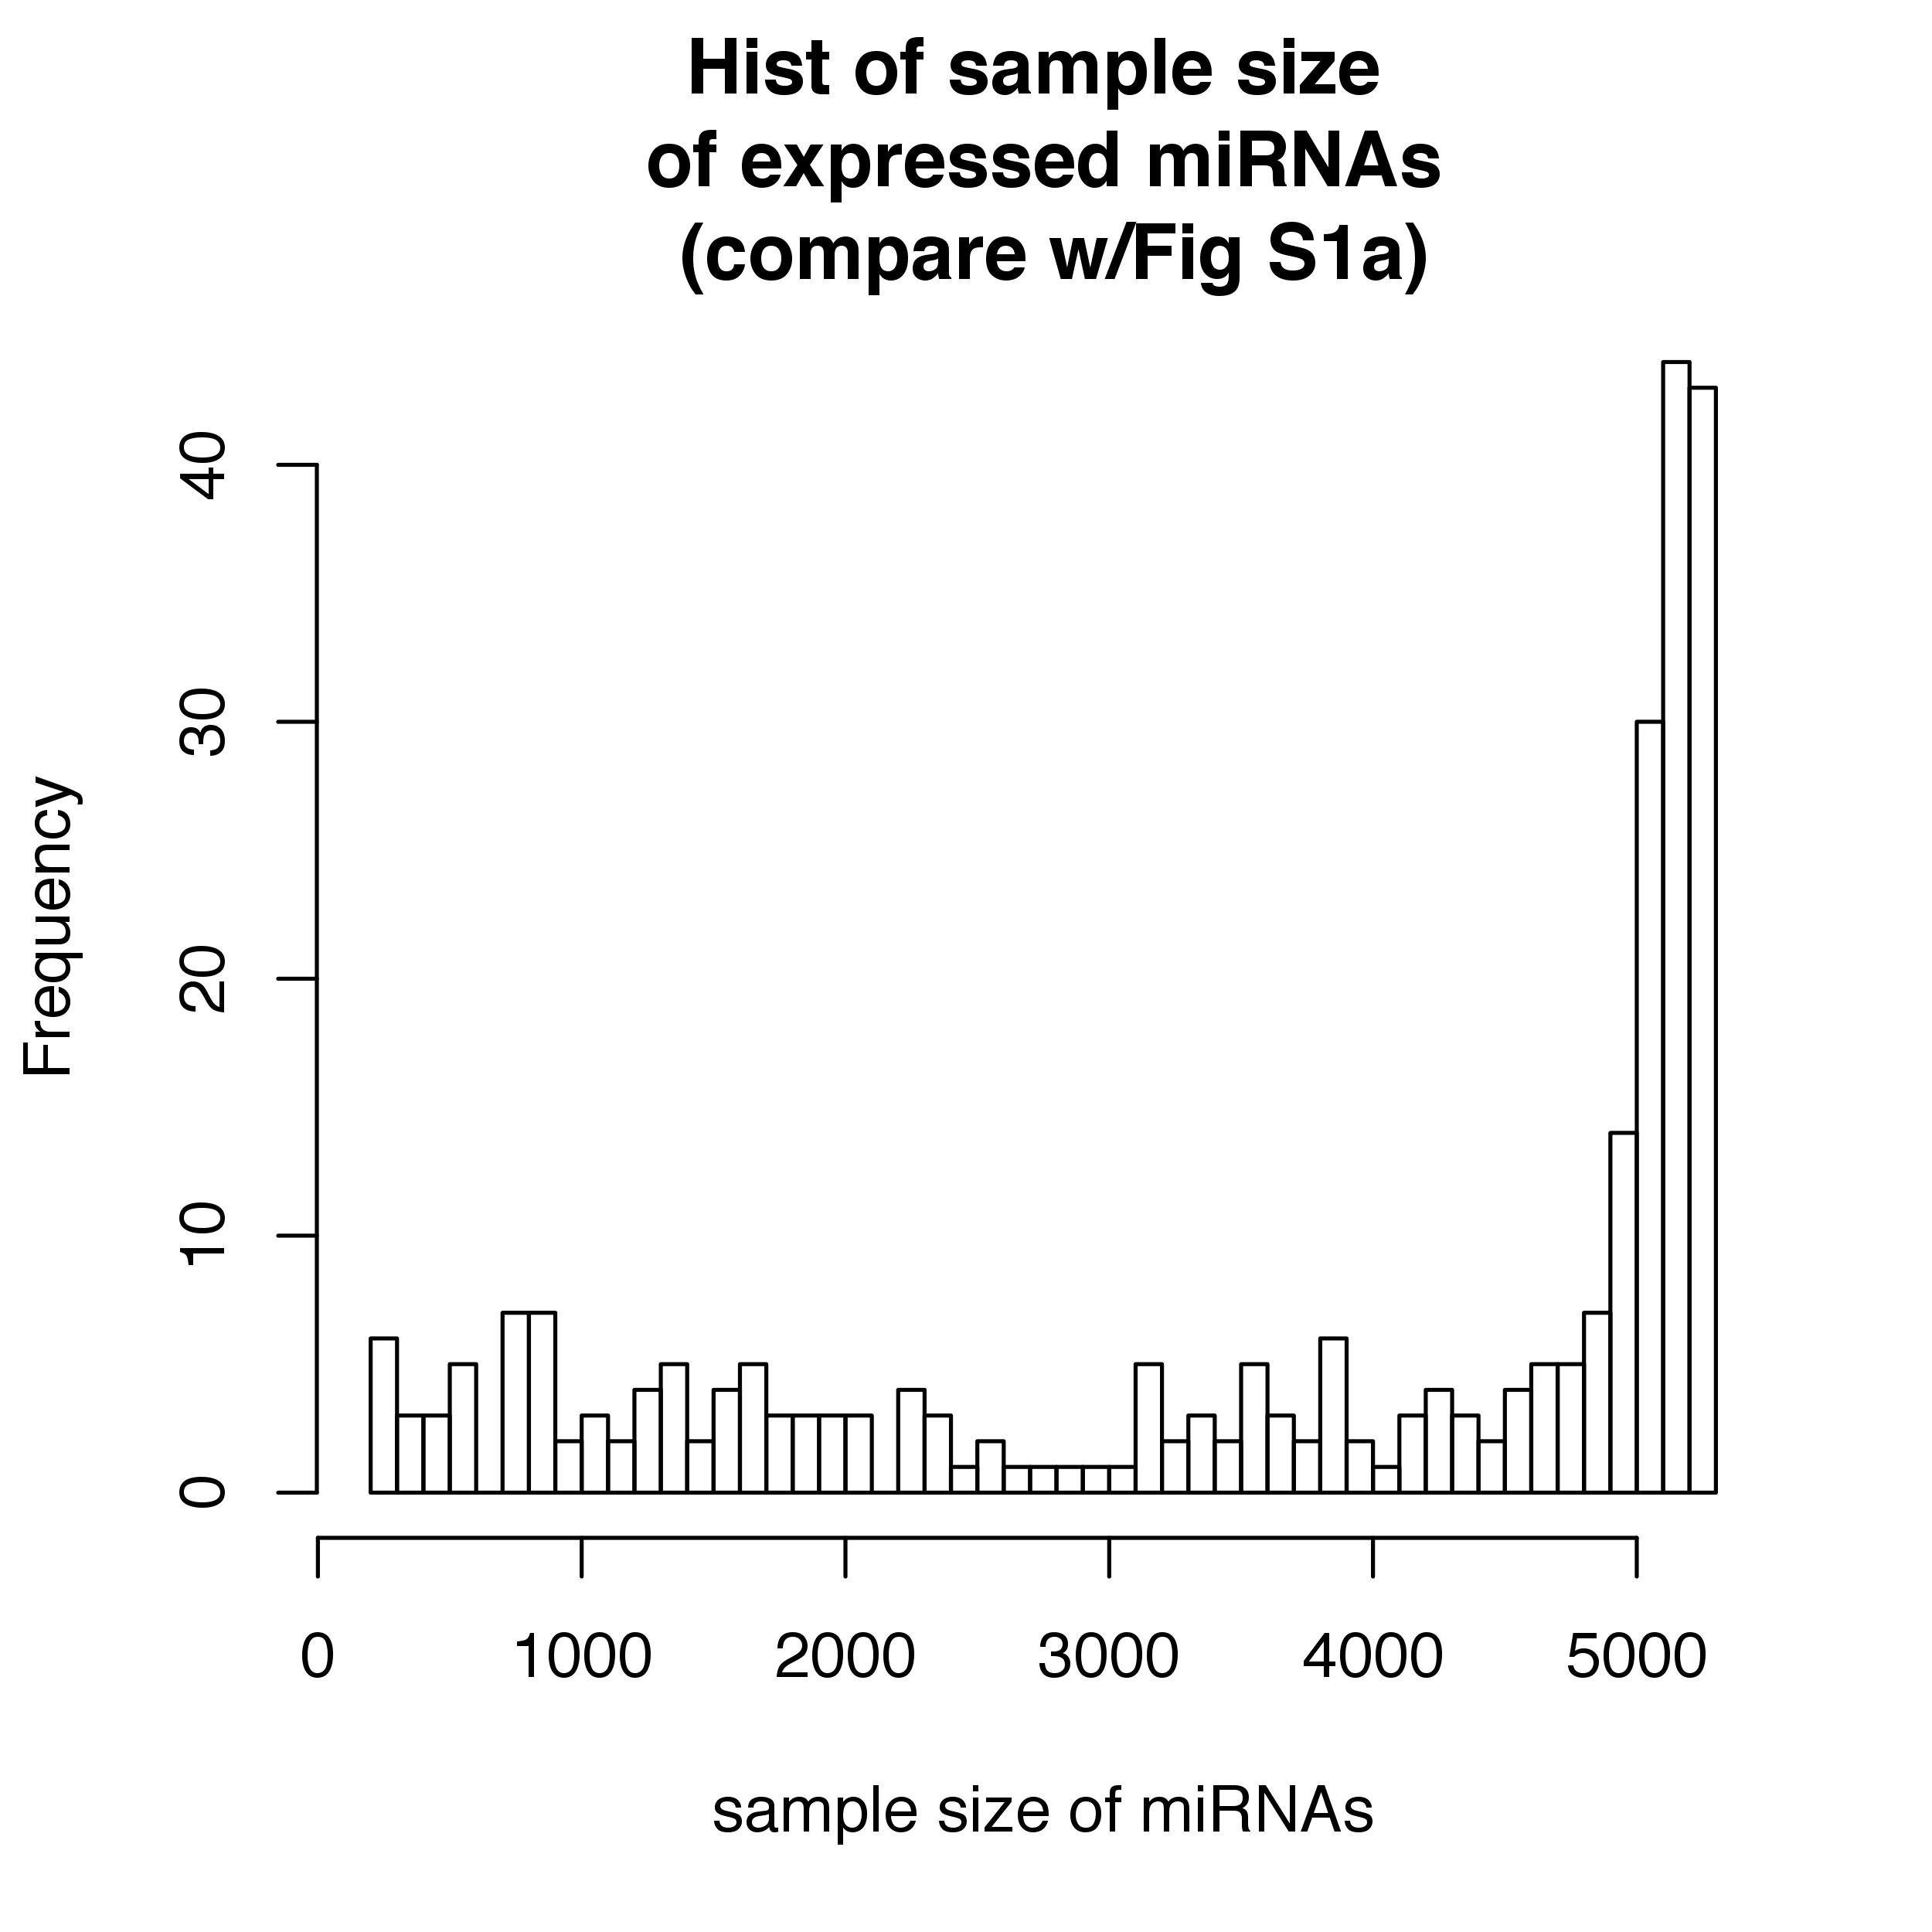
The distribution of sample sizes of expressed miRNAs
Fig S1a from paper
Built from data Supp File 3

Slide 22
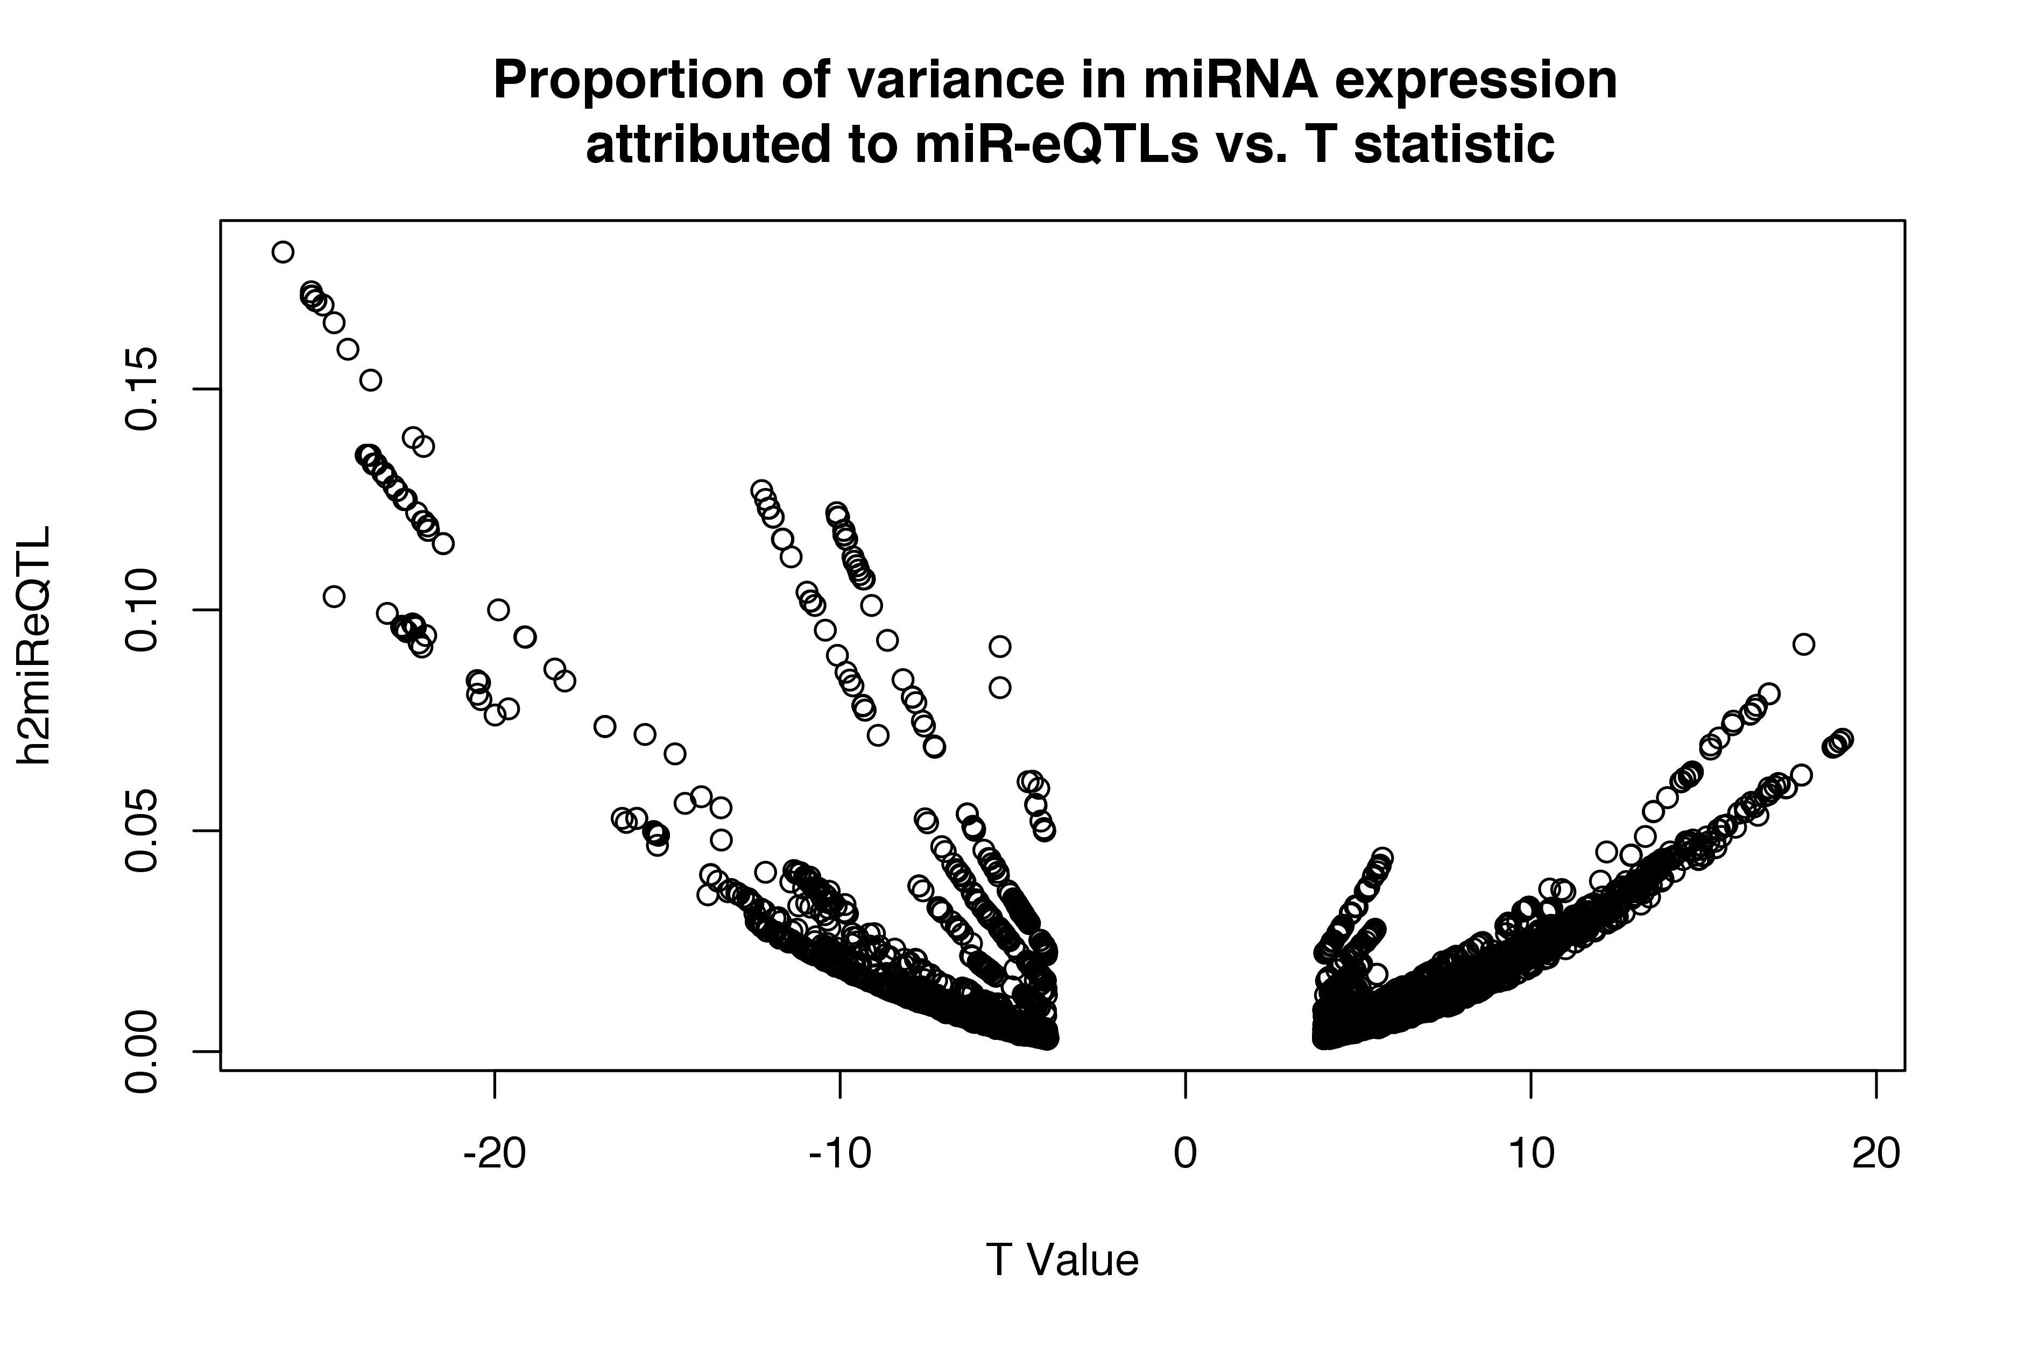

Slide 23
Misc Ambiguities from Paper
Some MAF values in some of the supp files exceed 0.5 (and by a fairly large margin -- ex: 0.63) -- see Sup File 4 (MAF field) -- 2.4656% of the entries have this issue
How to impute cell counts? – few details given
--> "The miR-eQTLs from the model that adjusted for imputed cell counts in the larger set of 5,024 participants are provided in Supplementary Data 5.”
"In the subsequent sections, we focus on miR-eQTLs from analyses that were unadjusted for cell counts of 5,239 individuals (Supplementary Data 4)."
-- but some have a sample size of 5,275 !

Slide 24
Acknowledgements
Joel
Mark

