Slide 1
Summary for CAPSTONE #2 PEC, GTEX, ENCODE, Roadmap, TCGA
Brain meeting
06/08/2016

Slide 2
PEC capstone paper
Comparative transcriptomic analysis
Protein-coding gene and ncRNA/TARs expression from RNA-seq
Disease(ASD, SCZ, BIP) and Region (CBC, NCX, STR, MD,…) –specific expression and gene co-expression modules along with highly associated ncRNAs/TARs
Splicing patterns
Control: GTEX, Brainspan, ENCODE
Gene regulation
TFs/miRNAs regulating disease-region-spec genes from ChIP-seq
Gene regulatory networks/motifs
Statistical/predictive models/regulatory circuits for disease-region-spec expression
Control: Roadmap, ENCODE
Genomic variations and integrated analysis
disease-region-spec eQTLs and Allelic expression
Aging (vs. brainspan)
Connect to Brain cancers (TCGA)
Notes:
Norway study/pamela PGC or Commonmind/use of GTEX

Slide 3
PsychENCODE Human Studies
Study | Assay | Assay Target | Individuals | Samples | Disorder | Tissue | Cell Type | Data types
WGBS-Pilot | WGBS |  | 1 | 3 | Control | Dorsolateral Prefrontal Cortex | tissue homogenate | fastq, metRatio
EpiMap | ChIP-seq | H3K4me3, H3K27ac | 17 | 122 | Control | Dorsolateral Prefrontal Cortex, Anterior Cingulate Cortex | NeuN+, NeuN- | bam, bed, bigwig
HumanFC | ATAC-seq |  | 11 | 12 | Schizophrenia, Bipolar Disorder, Control | Dorsolateral Prefrontal Cortex | tissue homogenate | bam, bed, bigwig
BrainGVEX | RNA-seq |  | 220 | 229 | Schizophrenia, Bipolar Disorder, Control | Frontal Cortex | tissue homogenate | bam, fpkm
EpiGABA | ERRBS |  | 3 | 6 | Control | Orbitofrontal Cortex | GABA Neurons, GLU Neurons | fastq, differential methylation
EpiGABA | RNA-seq |  | 2 | 4 | Control | Orbitofrontal Cortex | GABA Neurons, GLU Neurons | fastq, differential expression
lncRNA-Pilot | IsoSeq |  | 1 | 4 | Control | Dorsolateral Prefrontal Cortex | tissue homogenate | fastq, bed
lncRNA-Pilot | RNA-seq |  | 2 cell lines | 8 |  |  | SH-SY5Y, A549 | bam
UCLA-ASD | RNA-seq |  | 79 | 205 | Autism Spectrum Disorder, Control | Cerebellum, Prefrontal Cortex, Temporal Cortex | tissue homogenate | fastq
UCLA-ASD | ChIP-seq | H3K27ac | 111 | 285 | Autism Spectrum Disorder, Control | Cerebellum, Prefrontal Cortex, Temporal Cortex | tissue homogenate | bam
CNON | ChIP-seq | H3K27ac, H3K4me3, H3K4me1, CTCF | 4 | 15 | Schizophrenia, Control | Olfactory Neuroepithelium | CNON | fastq, bam, bed, bigwig
Yale-ASD | ChIP-seq | H3K27ac | 9 | 18 | Control | Cerebellum, Dorsolateral Prefrontal Cortex | tissue homogenate | ChIP-enriched regions
iPSC | RNA-seq |  | iPSC derived organoids from 2 fetal and 1 adult individual, undifferentiated iPSC from 4 fetal and 2 adult individuals | 31 |  | Organoids | iPSC, NeuN+, NeuN- | bam
Notes:
16K*15gb=240tb

Slide 5
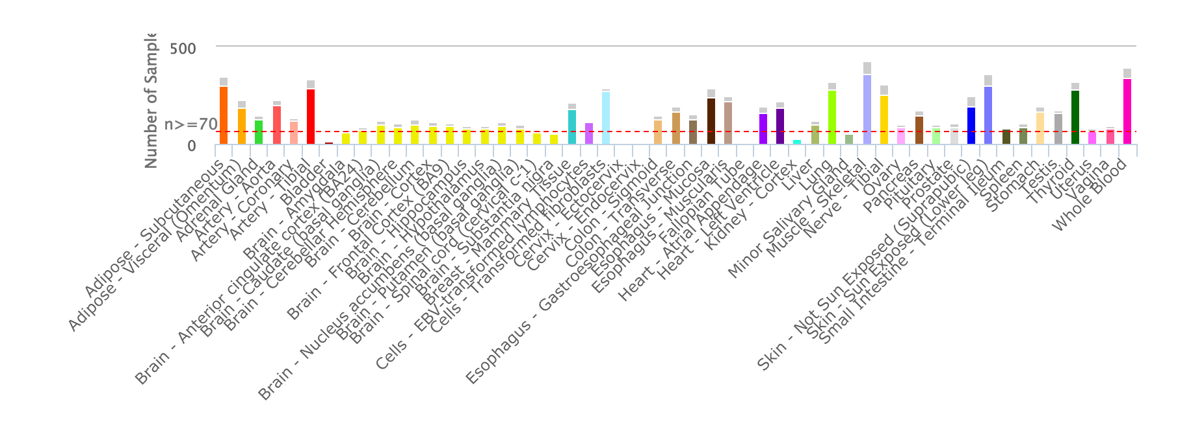
The Genotype - Tissue Expression (GTEx) Project
Notes:
Collect and analyze multiple human tissues from donors who are also densely genotyped, to assess genetic variation within their genomes. 13 brain regions. By analyzing global RNA expression within individual tissues , identified as expression quantitative trait loci, or eQTLs.

Slide 6
The Genotype - Tissue Expression (GTEx) Project
RNA-seq bam files
Tissue | Number of RNASeq and Genotyped samples | Number of RNASeq Samples | Number of eQTL Genes
Brain - Cerebellum | 103 | 125 | 4163
Brain - Caudate (basal ganglia) | 100 | 117 | 2447
Brain - Cortex | 96 | 114 | 2567
Brain - Nucleus accumbens (basal ganglia) | 93 | 113 | 2019
Brain - Frontal Cortex (BA9) | 92 | 108 | 2009
Brain - Cerebellar Hemisphere | 89 | 105 | 3251
Brain - Putamen (basal ganglia) | 82 | 97 | 1588
Brain - Hypothalamus | 81 | 96 | 1157
Brain - Hippocampus | 81 | 94 | 1134
Brain - Anterior cingulate cortex (BA24) | 72 | 84 | 1212
Brain - Amygdala | 62 | 72 | null
Brain - Spinal cord (cervical c-1) | 59 | 71 | null
Brain - Substantia nigra | 56 | 63 | null
V6 Release | # Tissues | # Donors | # Samples
Total | 53 | 544 | 8555
With Genotype | 53 | 449 | 7333
Has eQTL Analysis* | 44 | 449 | 7051
Notes:
Total 572RNA-seq bam files

Slide 7
Brainspan
RNA-seq | ChIP-seq | methylation
592 | 18+8 | 336

Slide 8
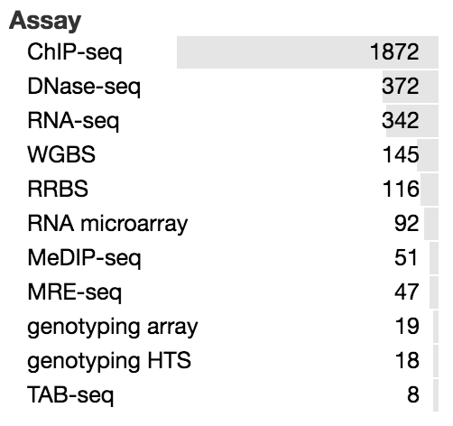
Roadmap Epigenomics Mapping Consortium
The current release 9 contains a total of 2,804 genome-wide datasets ( total of 150.21 billion mapped sequencing reads corresponding to 3,174-fold coverage of the human genome), including
1,821 histone modification datasets
360 DNase datasets
277 DNA methylation datasets
166 RNA-Seq datasets
https://www.encodeproject.org/search/?type=Experiment&replicates.library.biosample.donor.organism.scientific_name=Homo+sapiens
Notes:
Normal epigenomic data including chip seq and Methylation measurement /in brain middle/ 11 adult brain regions and some fetal brain 8 histone markers/129 tissue and cell type/
Release 9 includes a subset of 1,936 datasets grouped into 111 reference epigenomes where each reference epigenome contains a complete set of five core histone marks (H3K4me3, H3K4me1, H3K27me3, H3K9me3, and H3K36me3)(bam, bed, wig)
how many vcfs/array bam wig vcf

Slide 9
Notes:
Roadmap

Slide 10
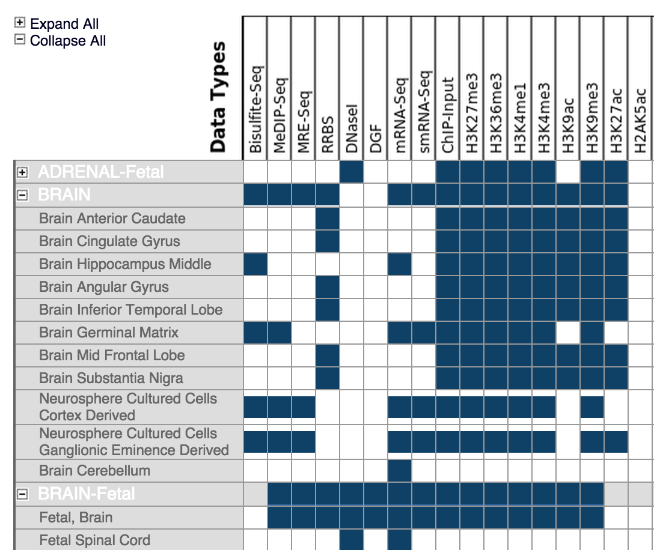
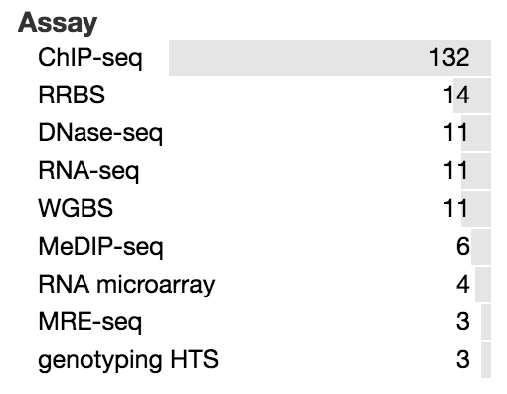
Roadmap human brain data
12 Adult brain regions

Slide 11
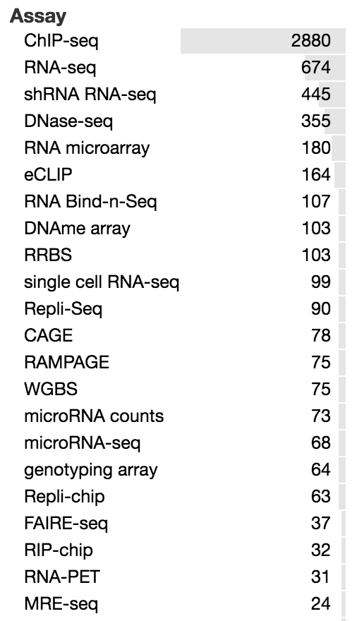
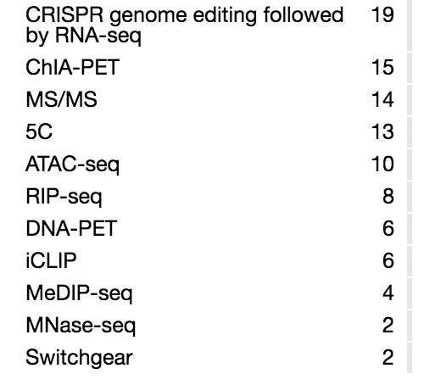
ENCODE total

Slide 12
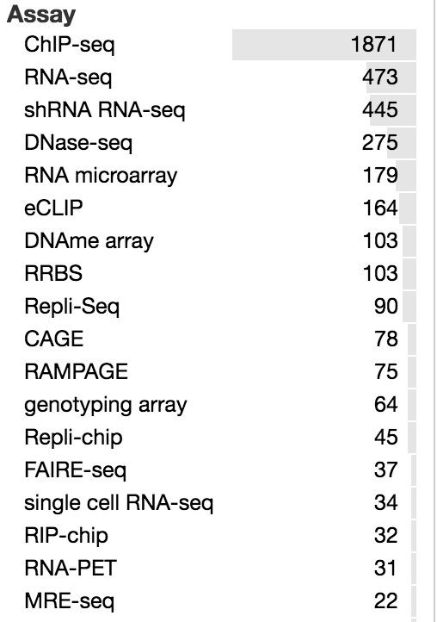
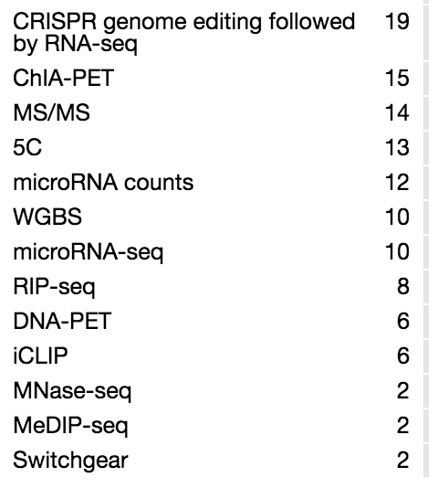
ENCODE Homo sapiens

Slide 13
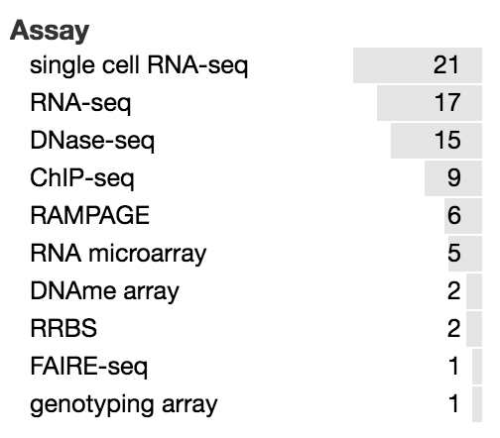
ENCODE Human brain

Slide 14
TCGA data related to brain
Glioblastoma Multiforme
Glioblastoma Multiforme (GBM) is a fast-growing type of malignant brain tumor that is the most common brain tumor in adults.
Brain Lower Grade Glioma
Lower grade glioma is a type of cancer that develops in the glial cells of the brain.
Glioblastoma multiforme [GBM] | Total | Exome¹ | SNP | Methylation | mRNA | miRNA | Clinical
Cases | 528 | 512 | 523 | 524 | 508 | 496 | 523
Organ-Specific Controls² | N/A | N/A | N/A | N/A | N/A | N/A | N/A
Brain Lower Grade Glioma [LGG] | Total | Exome¹ | SNP | Methylation | mRNA | miRNA | Clinical
Cases | 516 | 516 | 515 | 516 | 516 | 512 | 515
Organ-Specific Controls² | N/A | N/A | N/A | N/A | N/A | N/A | N/A

Slide 15
Summary of data size

