Slide 1
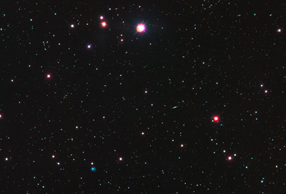
Sequence Universe
SRA ~1 petabyte
TCGA endpoint: ~2.5 Petabytes
~1.5 PB exome
~1 PB whole genome
TCGA 2.3 Petabytes
in CGHub
Clinical
RNASeq
Epigenome
222
TB
miRNA
ARRA
Autism
29
TB
32 TB
34 TB
NHLBI ESP
68 TB
40
TB
GTeX
NHGRI LSSP
Star formation
100K Genomes England
ADSP
Heidi Sofia, 7-16-15
Notes:
TCGA is the largest single project in the visible sequence universe to date.
TCGA is depicted at the center of the solar system because it integrates DNA, RNA-Seq, miRNA, epigenomic, and clinical data.
Currently there is over a Petabyte of TCGA data deposited in the CGHub cancer genomics repository (https://cghub.ucsc.edu/summary_stats.html).
This scale dwarfs its closest competitors which are shown as planets in orbit:
1000G 222 TB http://www.ncbi.nlm.nih.gov/bioproject/28889
ADSP 68 TB http://www.ncbi.nlm.nih.gov/bioproject/202226
NHGRI LSSP 40 TB http://www.ncbi.nlm.nih.gov/bioproject?term=NHGRI%20Large%20Scale%20Sequencing%20Program%5BTitle%5D
GTeX 34 TB http://www.ncbi.nlm.nih.gov/bioproject/75899
NHLBI ESP 32 TB http://www.ncbi.nlm.nih.gov/bioproject/165957
HMP 29 TB http://www.ncbi.nlm.nih.gov/bioproject/43021
ARRA Autism 24 TB http://www.ncbi.nlm.nih.gov/bioproject/74861
ENCODE 9 TB http://www.ncbi.nlm.nih.gov/bioproject/63441
Projects just starting now, like 100K Genomes England, may eventually overtake TCGA.

