Slide 1
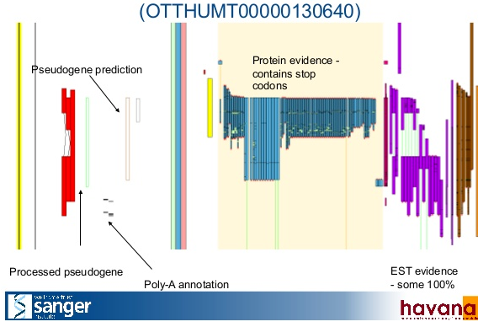
Calling transcribed pseudogenes
Using RNA-seq data
  Looking for a discordant expression:
    misses out of pseudogenes that are coexpressed with the parent
    874 human transcribed pseudogenes
  Counting uniquely mapped reads:
    RPKM > 2
    1441 human transcribed pseudogenes
Using EST evidence:
  map expressed sequence tags to the genome
  1098 human transcribed pseudogenes

Slide 2
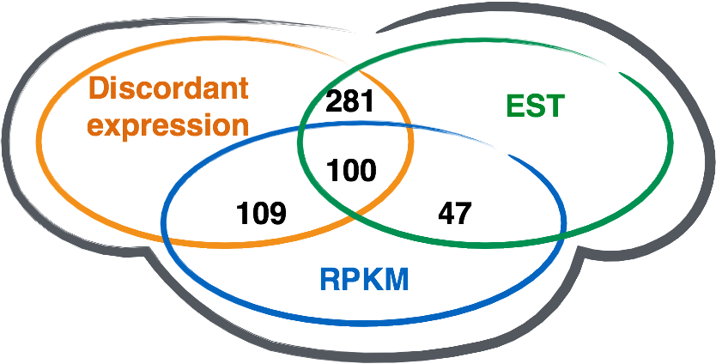
Transcribed pseudogene consensus
100 tri-way transcribed pseudogenes
2241 transcribed pseudognes showing at least one transcription evidence
[Pei et al., GenomeBiology (2012, 13:R51)]
[Sisu et al. PNAS ('14); doi: 10.1073/pnas.1407293111 ]

Slide 3
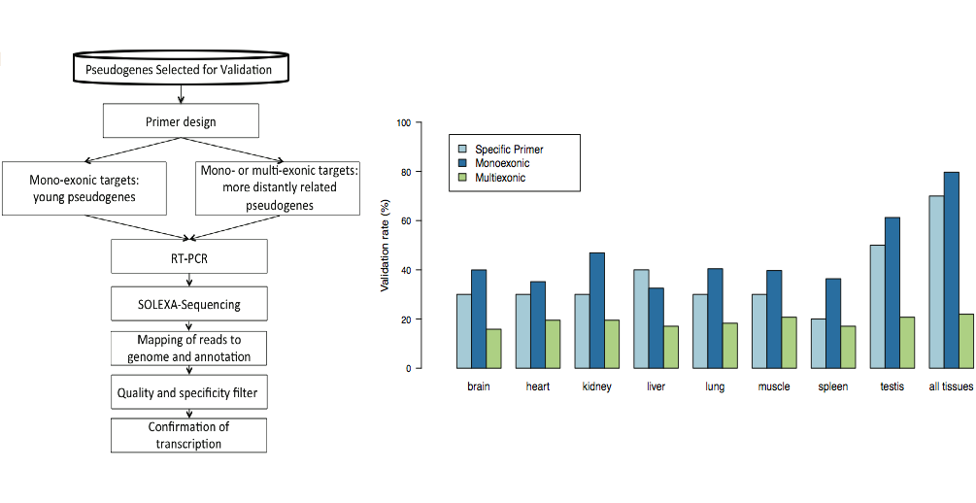
Experimental validation of pseudogene transcription
80% of the monoexonic and 22% of multiexonic human pseudogene models validated using RT-PCR-Seq
[Pei et al., GenomeBiology (2012, 13:R51)]

