Slide 1
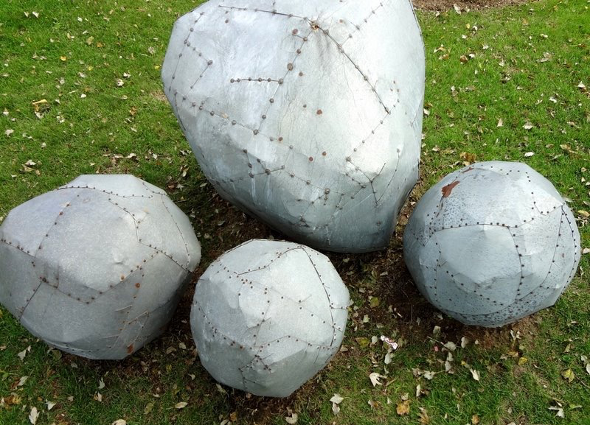
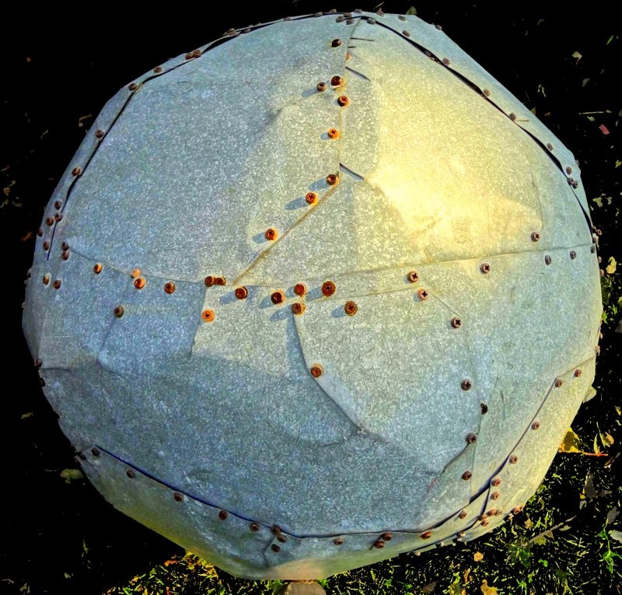
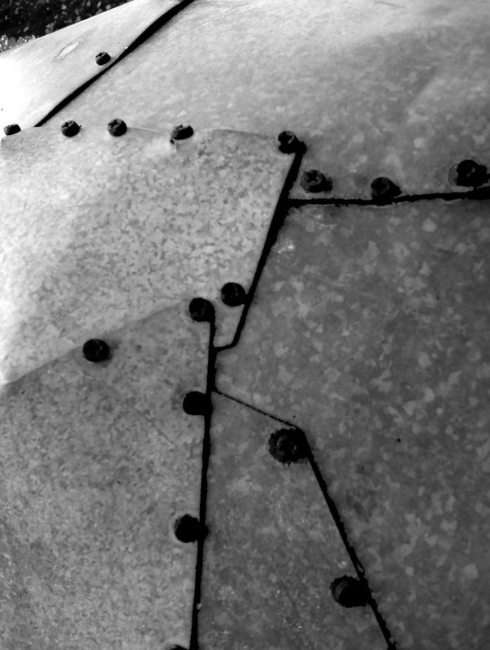
Comparative Genome Analysis:
Comparing Transcriptomes of Distant Organisms
M Gerstein, Yale
See last slide for
references & more info.
Slides freely downloadable from Lectures.GersteinLab.org
& “tweetable” (via @markgerstein)

Slide 2
How might we annotate a human text?
Color is Function
Lines are Similarity
[B Hayes,
Am. Sci.
(Jul.- Aug. '06)]

Slide 3
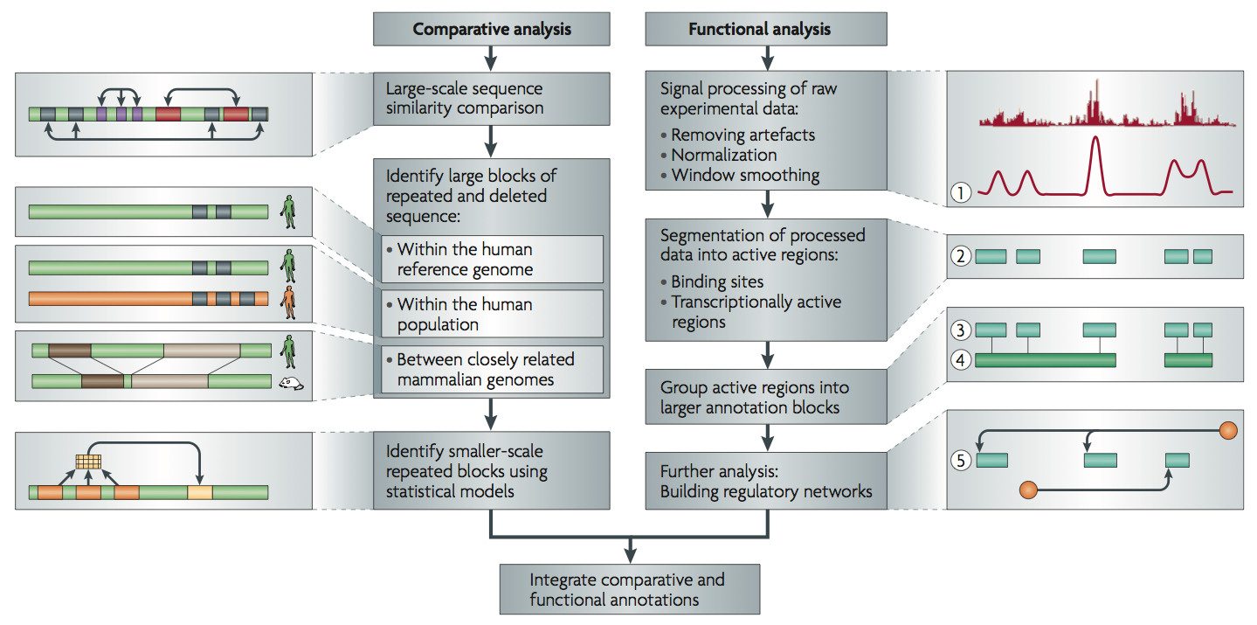
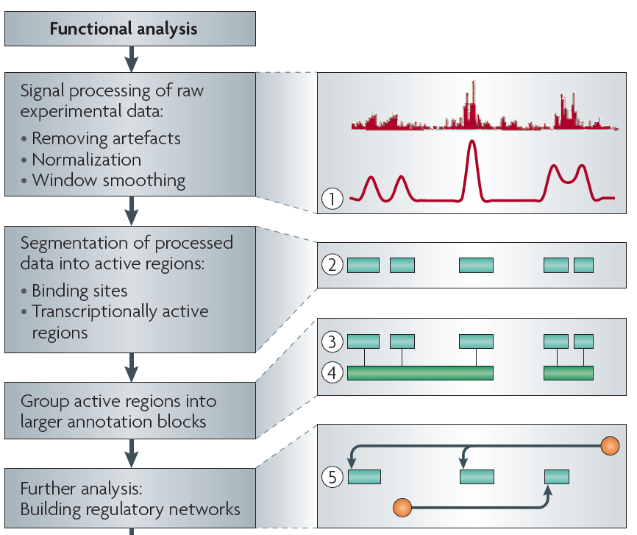
Non-coding Annotations: Overview
There are several collections of information "tracks" related to non-coding features
Sequence features, incl. Conservation
Functional Genomics
ChIP-seq (Epigenome & seq. specific TF) and ncRNA & un-annotated transcription
[Nat. Rev. Genet. (2010) 11: 559]

Slide 4
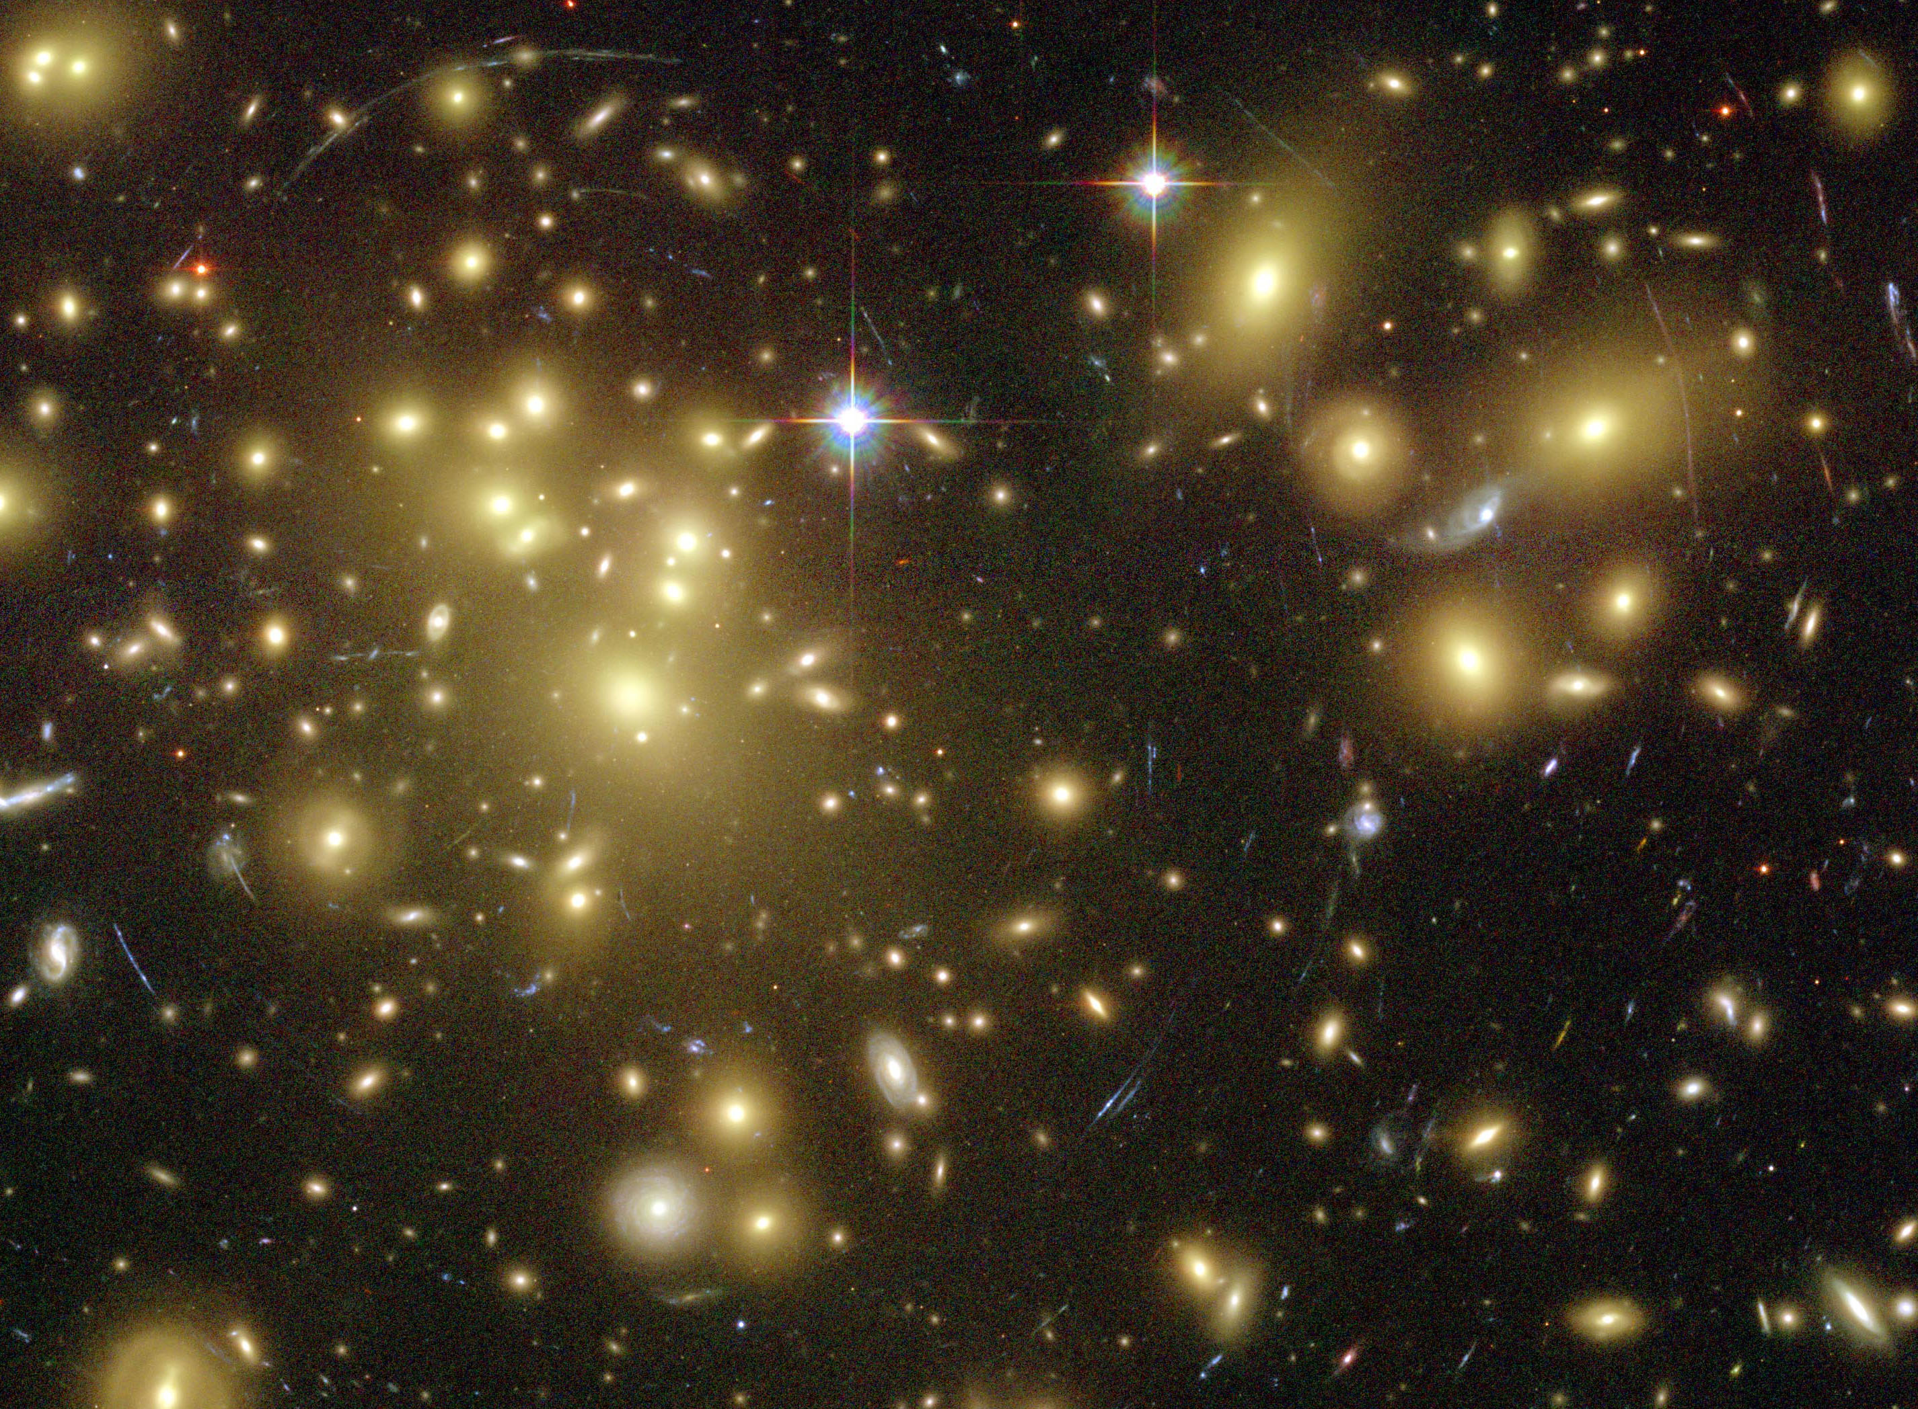
Importance of
Dark Matter of the Genome
  Non-coding regions contain the control elements
  for coding regions.
  Some non-coding regions are functional
  & are pervasively transcribed.
  “Molecular Fossils” in the non-coding genome
  represent a historical record of the genome
  Most disease-associated mutations (e.g. GWAS hits)
  are in non-coding regions.
[Gravitational lensing by dark matter in Abell 1689 – HST (NASA, ESA)]

Slide 5
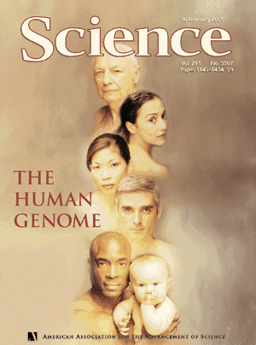
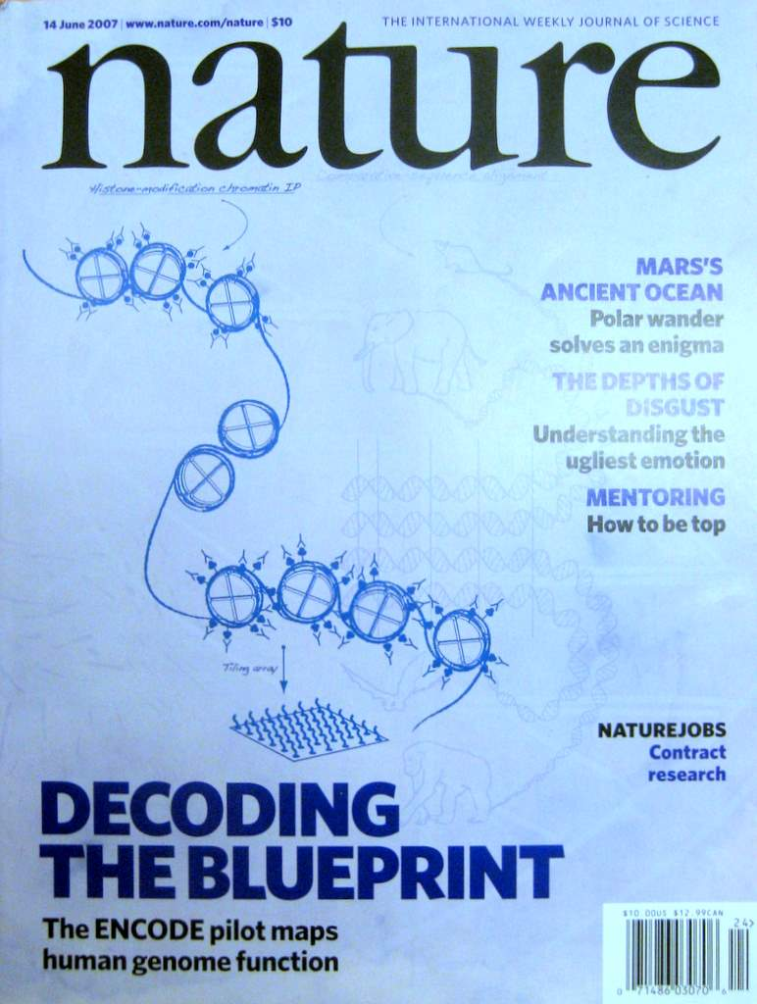

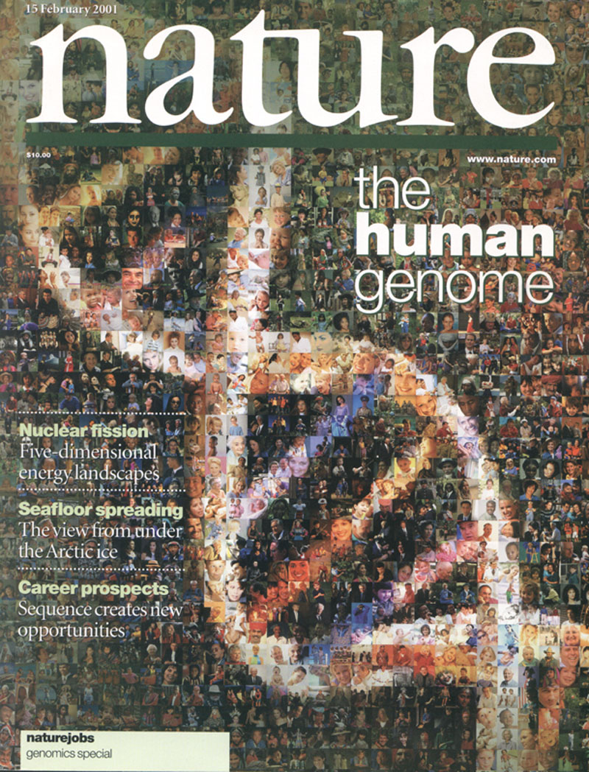

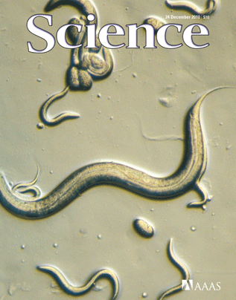
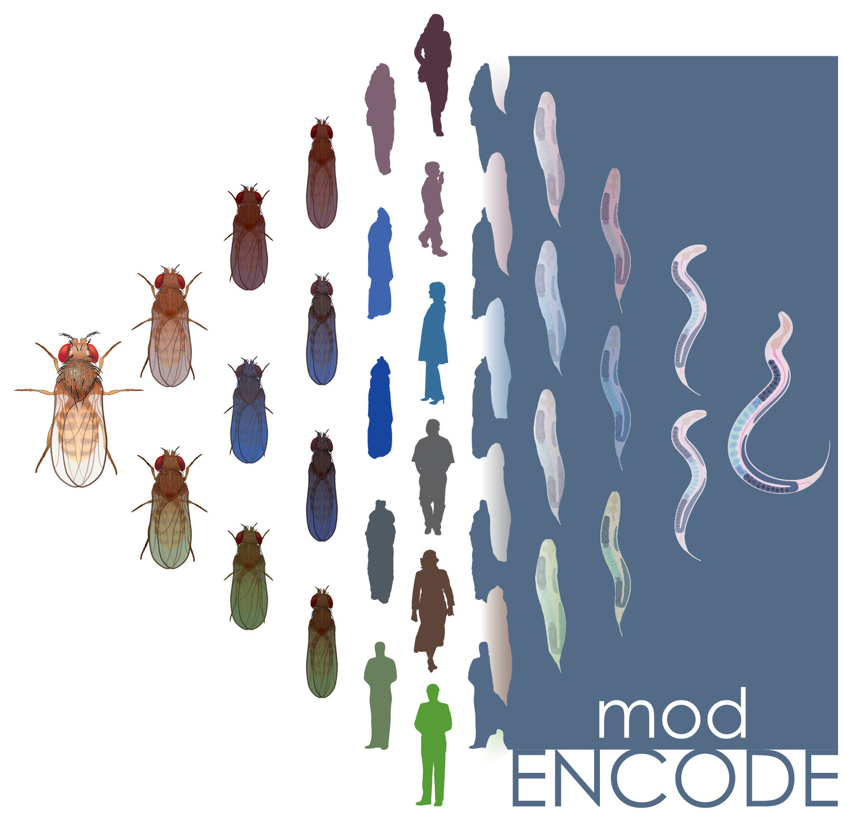
ENCODE
Consortium
& various
annotation
rollouts
1998
1999
2000
2002
2003
2004
2005
2006
2008
2009
2010
2011
2012
2013
2014
2001
2007

Slide 6
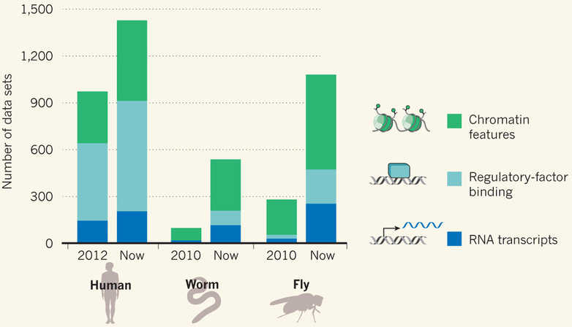
Comparative ENCODE Functional Genomics Resource
(EncodeProject.org/modENCODE.org)
Broad sampling of conditions across transcriptomes & regulomes for human, worm & fly
  embryo & ES cells
  developmental time course (worm-fly)
In total: ~3000 datasets (~130B reads)

Slide 7
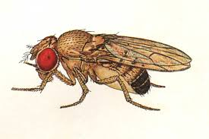
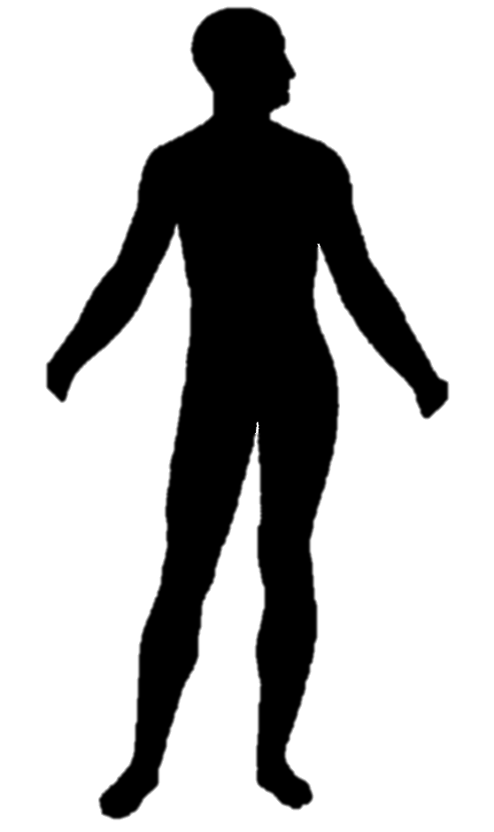
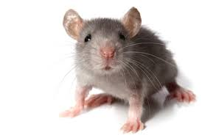
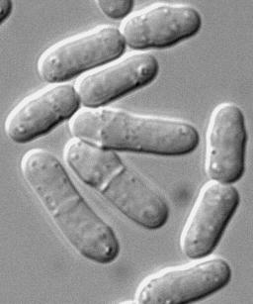
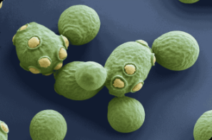

Comparative ENCODE
Previous studies have compared RNA transcription between closely related organisms (e.g. RNA-seq within mammals, Brawand et al. '11) …
EUKARYOTES
ANIMALS
MAMMALS
YEAST
500 MYO
75 MYO
Fly
Worm
Human
Mouse
Fission Yeast
Budding Yeast
RNA

Slide 8
Comparative ENCODE
Previous studies have compared RNA transcription between closely related organisms (e.g. RNA-seq within mammals, Brawand et al. '11) …
… or integrated diverse –omic information within each of several species (eg modencode '10)
EUKARYOTES
ANIMALS
MAMMALS
YEAST
500 MYO
75 MYO
Fly
Worm
Human
Mouse
Fission Yeast
Budding Yeast
RNA
TF
chromatin

Slide 9
Comparative ENCODE
Previous studies have compared RNA transcription between closely related organisms (e.g. RNA-seq within mammals, Brawand et al. '11) …
… or integrated diverse –omic information within each of several species (eg modencode '10)
EUKARYOTES
ANIMALS
A first effort to
comprehensively integrate diverse data across distantly related species
MAMMALS
YEAST
500 MYO
75 MYO
Fly
Worm
Human
Mouse
Fission Yeast
Budding Yeast
RNA
TF
chromatin

Slide 10
Applications of Machine Learning for
Comparing Transcriptomes of Distant Organisms
Intro to Comparative ENCODE
  Lots of Matched Data for Comparative Analysis
App. #1: Characterizing ncRNAs & TARs
  Not much news in canonical gene models
  Simple contig search (TARs) finds uniform density of non-canonical transcription
  ML model shows few TARs similar to existing ones, but some enrichment for eRNAs
App. #2: Expression Clustering, Cross-species
  Potts-model optimization gives 16 conserved co-expression modules (which can potentially annotate ncRNAs/TARs)
  Developmental 'hourglass' genes in 12 of these. They also exhibit intra-organism hourglass behavior.
  Stage alignment of worm & fly development, strongest with hourglass genes
App. #3: HM Models Relating Gene Expression to Promoter Activity
  Works for ncRNAs as well as genes
  Universal cross-species model uses same set of parameters across diverse phyla
App. #4: Similarly constructed TF Models
  Variable importance of regions around genes for HMs & TFs
  TF & HM signals are redundant for ‘prediction'
  Surprisingly, a few TFs are quite predictive

Slide 11
Protein-coding gene counts in worm, fly & human have stabilized & have remained fairly constant
[Nature 512:445 ('14);
doi: 10.1038/nature13424]

Slide 12
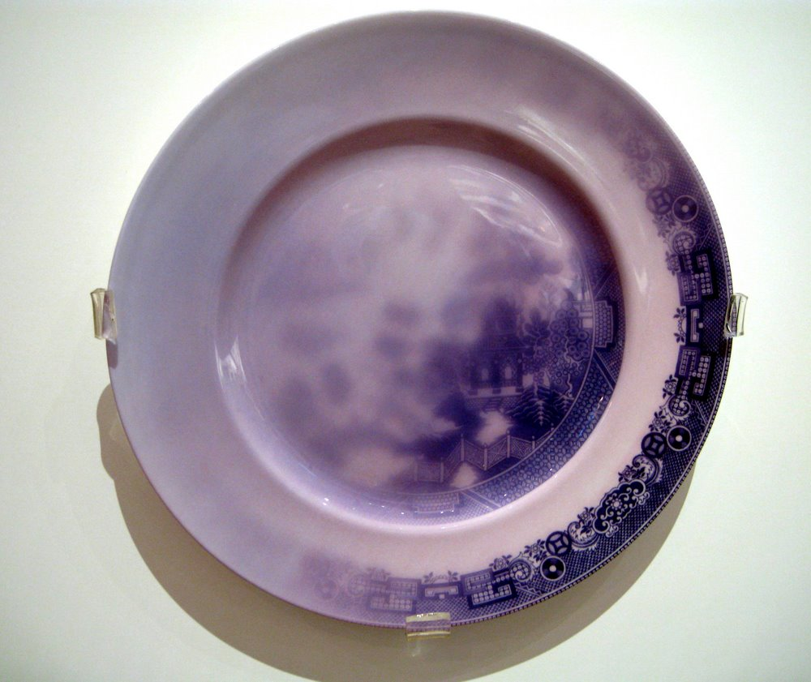
Signal Processing: Normalizing Signal and Finding Initial Annotation Blocks ("Hits")
pers. photo, see streams.gerstein.info

Slide 13
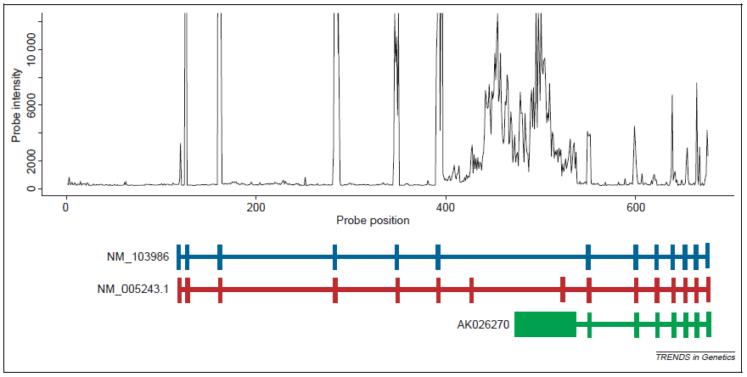
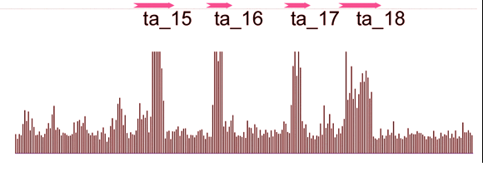
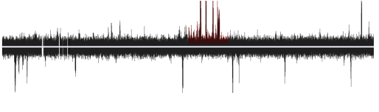
A Starting Point: Noisy Raw Signal from Tiling Arrays (Transcription)
Johnson et al. (2005) TIG, 21, 93-102.
Li et al., PLOS one (2007)
Notes:
13

Slide 14
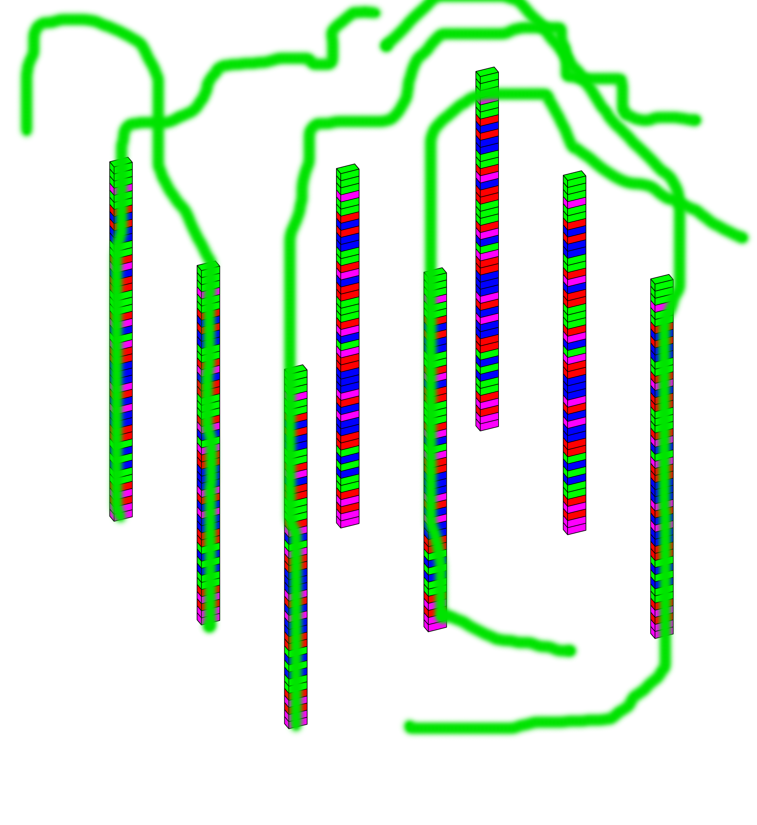
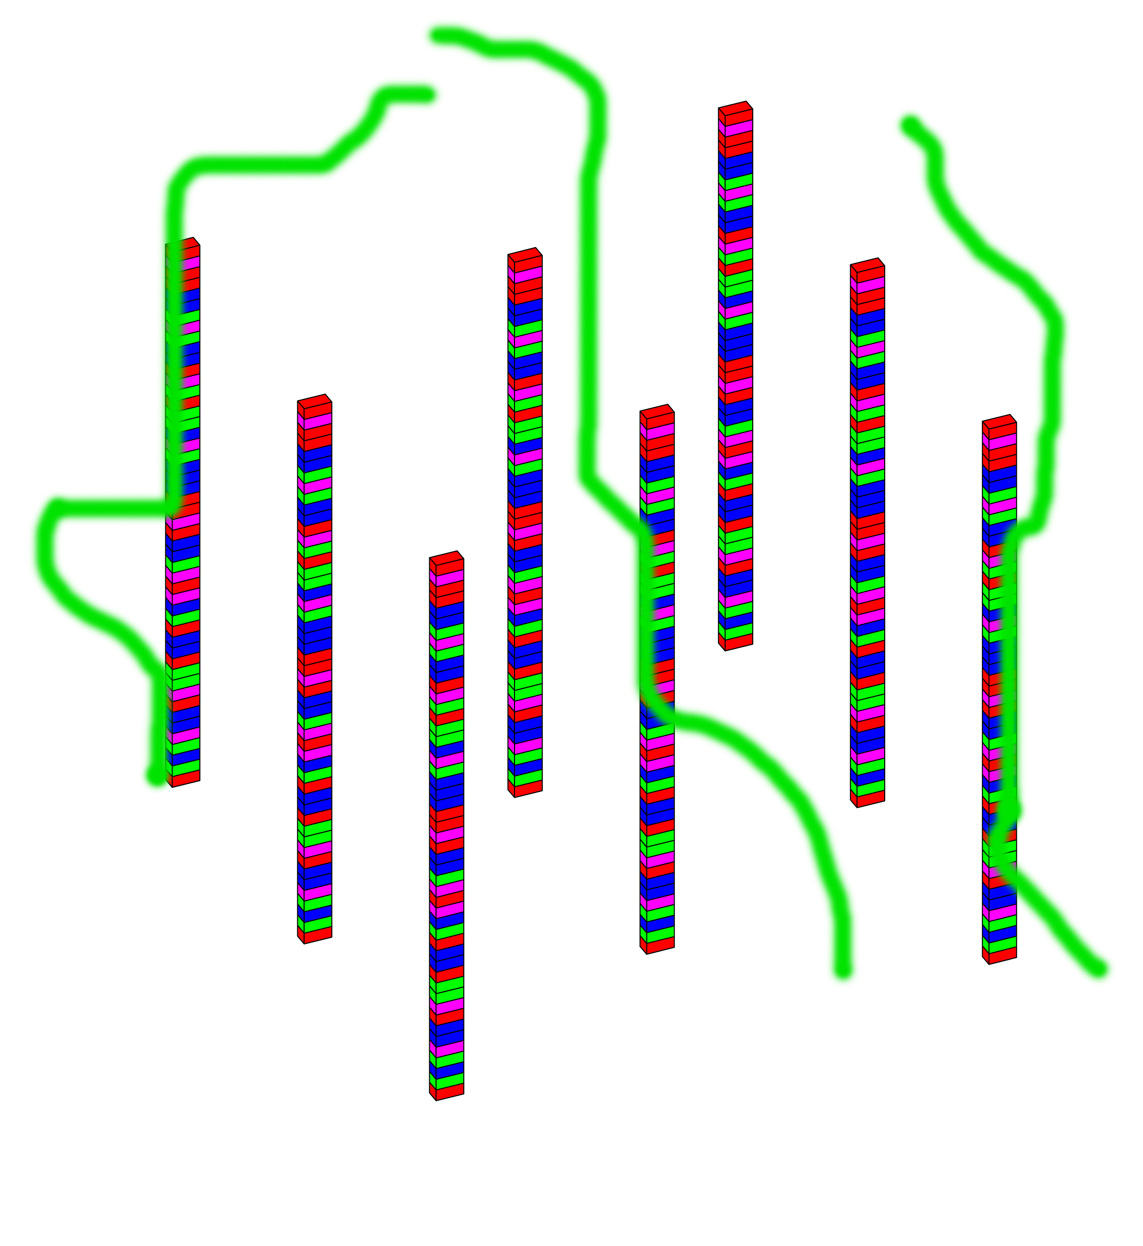
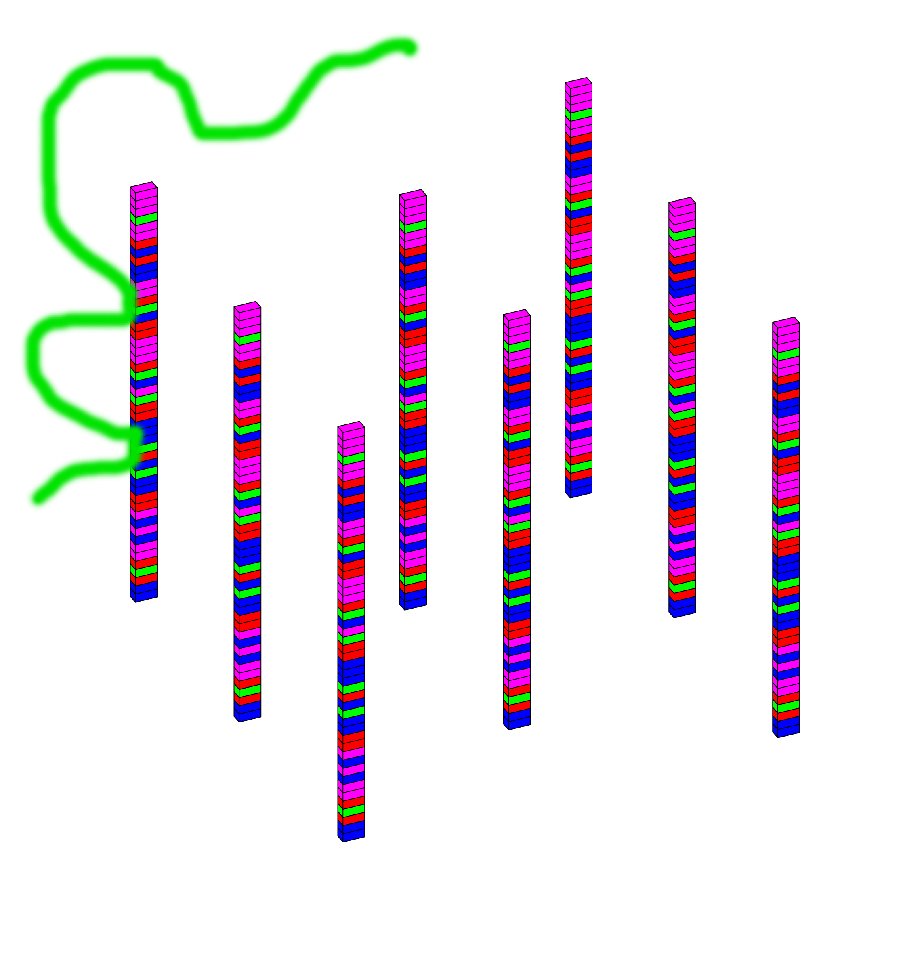
Specific & Non-specific Cross-Hyb.
Perfect match (PM):
probe binding intended target
Specific cross-hyb.: probes binding non-PM targets with a small number of mismatches
Non-specific cross-hyb.: probes binding targets with many mismatches, due to general stickiness of oligos
Perfect Match
Specific Cross-hyb.
Non-specific Cross-hyb.

Slide 15
Non-Specific Cross Hyb. (Sequence Effects)

Slide 16
Creation of Standardized Datasets for Quantifying Effect of Mismatches
[Seringhaus et al., BMC Genomics (in press)]
Yeast ACT1 Gene
Human HBG2 Gene
Normalized Intensity Chg. vs. PM
Number of Mismatches

Slide 17
Creation of Standardized Datasets for Quantifying Effect of Mismatches
[Seringhaus et al., BMC Genomics (in press)]
Yeast
Human
Normalized Intensity MM MM vs. PM
GA v AG
CA v AC
GT v TG
CT v TC
Types of Mispairs
(probe on array is first)

Slide 18
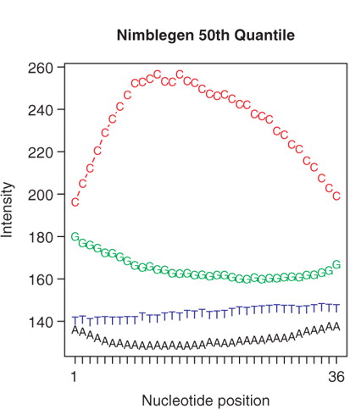
Observing Non-specific Cross-hyb. (Probe sequence effects)
Avg. intensity of all background probes with a C at position 4
Source: Royce, T.E., et al (2007), Bioinformatics, 23, 988-97
Avg. intensity of all background probes with a T at position 33

Slide 19
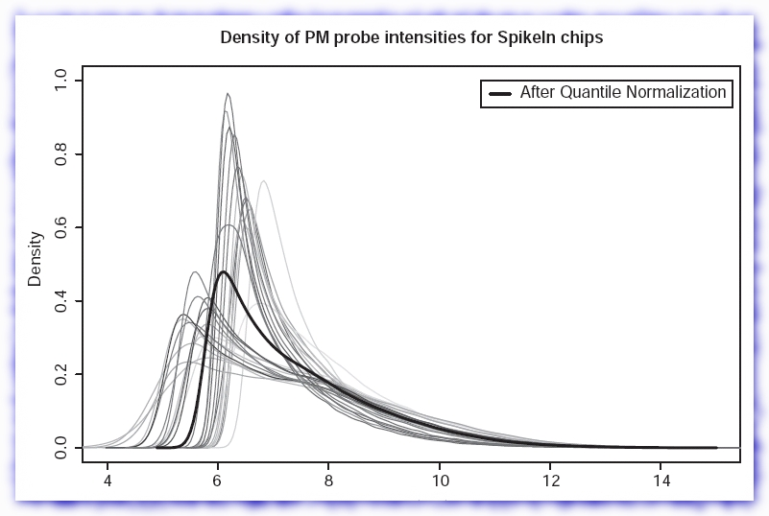
Quantile Normalization
Gene expression quantile normalization
  Quantile normalization has proven to be the most effective way to normalize replicate gene expression arrays.
Example
  Distributions that should be the same are forced to be the same (dark line).
Source: Bolstad, B.M., et al (2003), Bioinformatics, 19, 185-93.

Slide 20
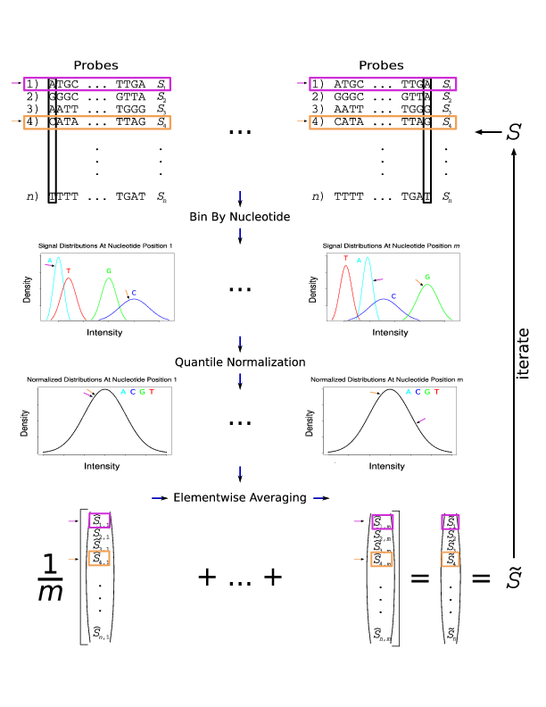
Iterated Quantile Normalization to Correct for
Non-specific Cross-hyb.
Adapt Bolstad et al (2003) approach to tiling arrays
Force distributions with a given nt at each position to be same
Distributions at other positions now different so iterate
Also, robust adaptation of
Naef & Magnasco (2003)
T Royce et al (2007), Bioinformatics, 23, 988-97

Slide 21
Measuring Specific Cross-Hyb
Source: Royce, T.E., et al (2007), Nucleic Acids Res., 23, 98-97

Slide 22
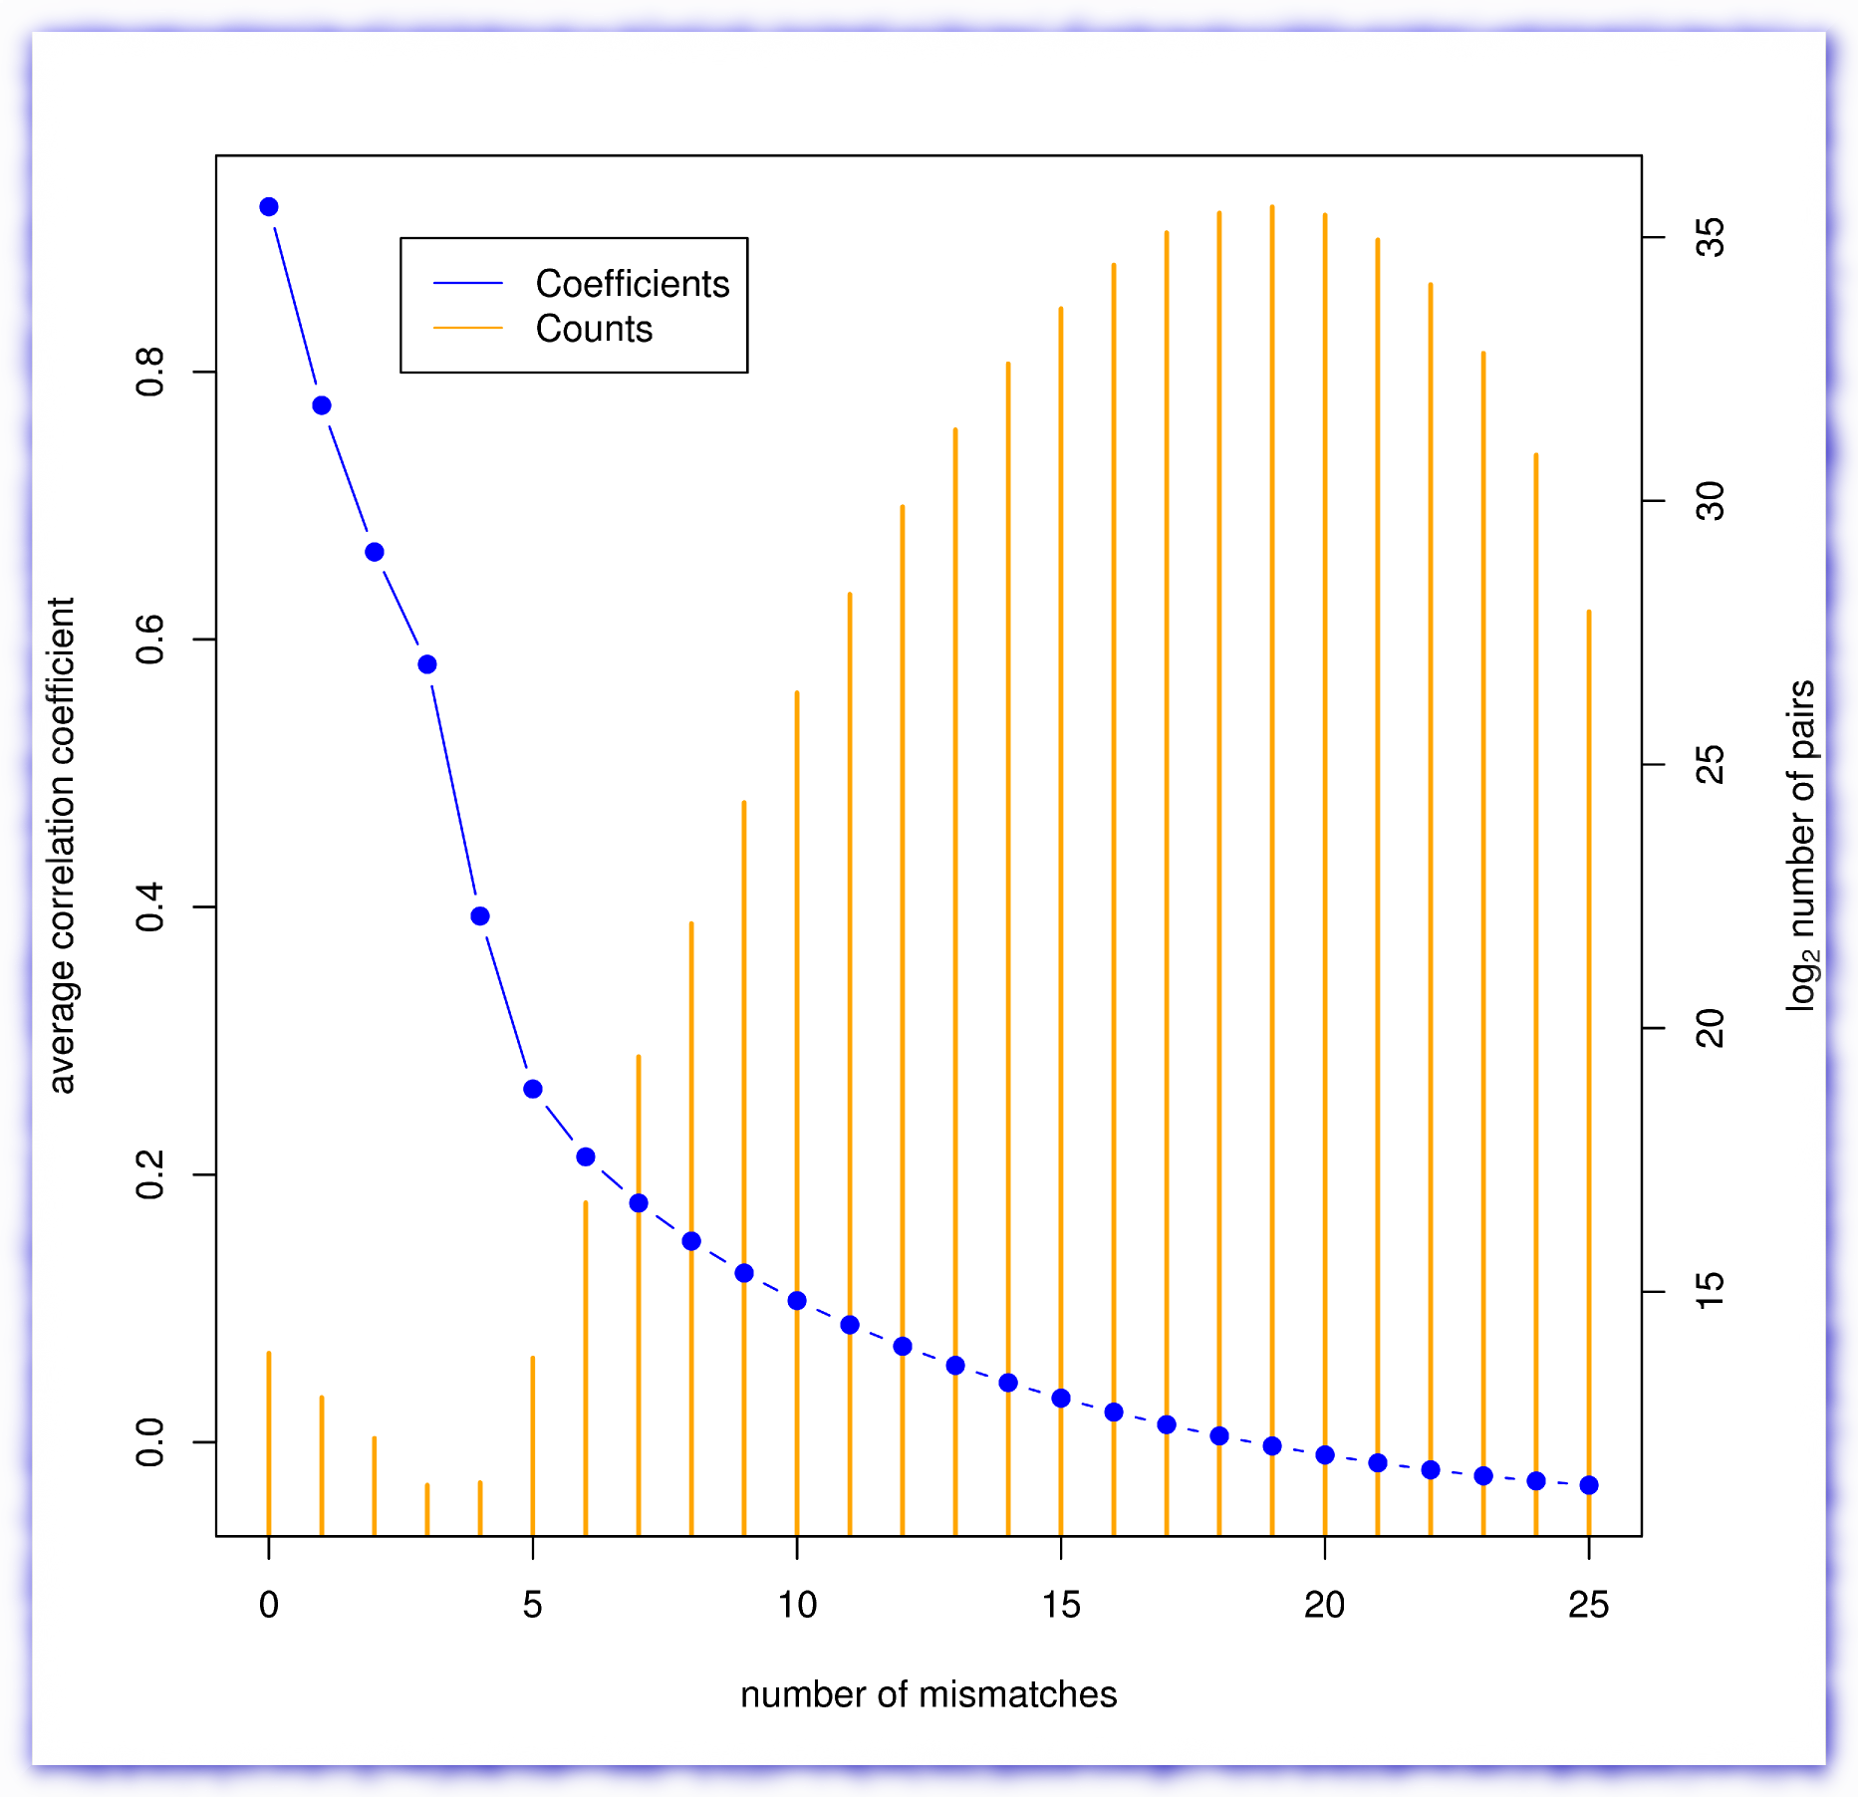
Measuring Specific Cross-Hyb
Start with Cheng et al. (2005) tiling of human genome at 5 nt resolution giving expression profiles across various cell lines
Correlation betw. probe pairs computed across cell lines’ expression profiles and tabulated vs. number of mismatches
The mean correlation coefficient was computed for each mismatch bin (blue series).
The number of pairs is plotted as orange bars.
Source: Royce, T.E., et al (2007), Nucleic Acids Res., 23, 98-97

Slide 23
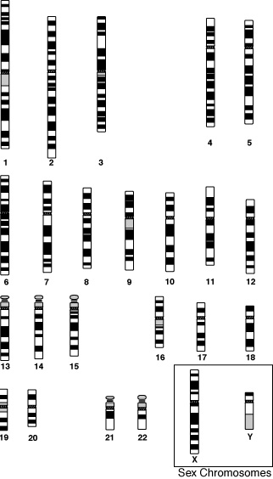
Proof of principle test to “exploit” this
Using Cheng et al. (2005), predict gene expression levels (and profiles across tissues) for genes on part of chr. #6
...Based on closest cross-hyb tiles on part of chr. #7
Then compare to measured levels and profile on #6
Figure from http://www.members.cox.net/amgough/Fanconi-genetics-genetics-primer.htm
Source: Royce, T.E., et al (2007), Nucleic Acids Res., 23, 98-97

Slide 24
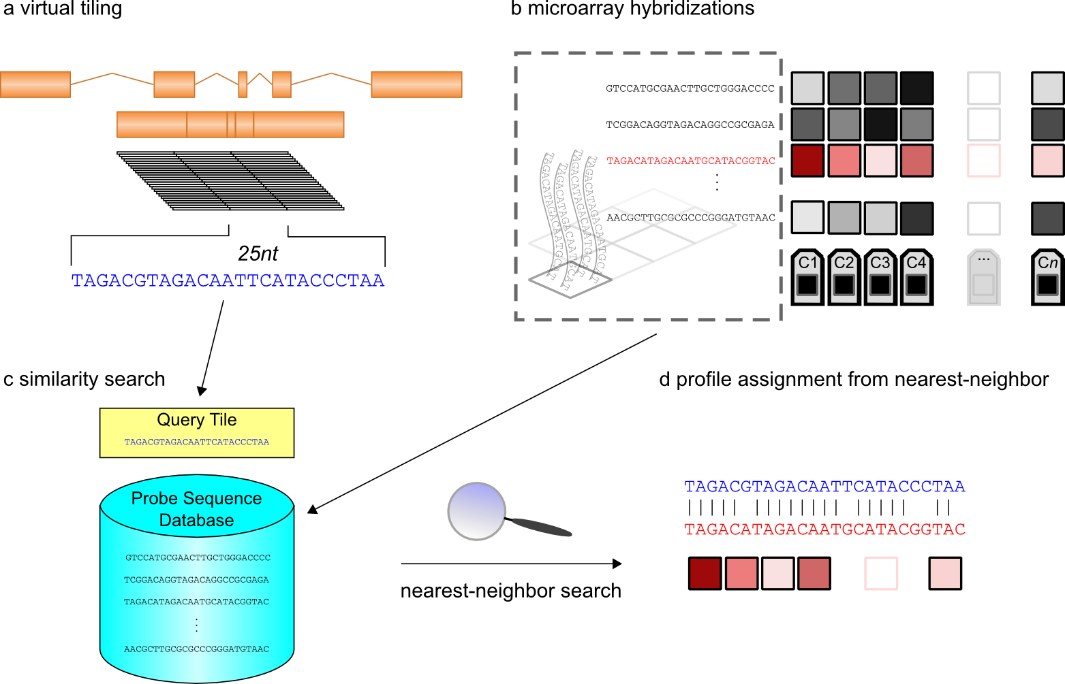
Nearest Nbr Search on Virtual Tiling
Royce, T.E., et al (2007), Nucleic Acids Res., 23, 98-97

Slide 25
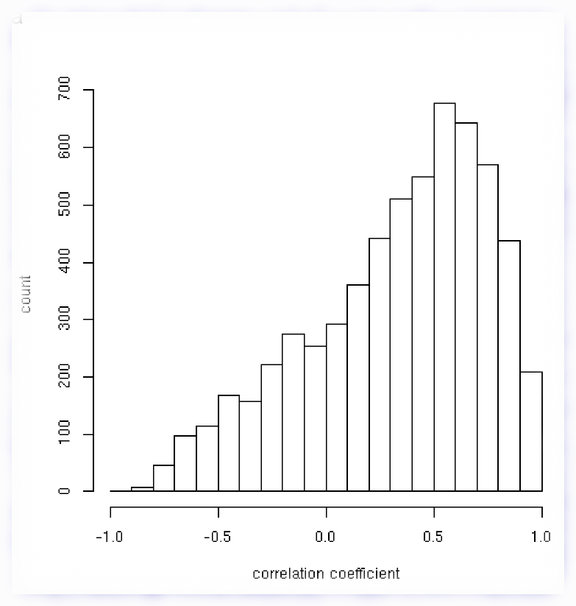
Agreement between predicted tile expression profile and actual one
Correlated predicted profiles with the actual profiles of gene expression across cell lines
Much more correlation than expected by chance (dist. centered on 0)
Source: Royce, T.E., et al (2007), Nucleic Acids Res., 23, 98-97

Slide 26
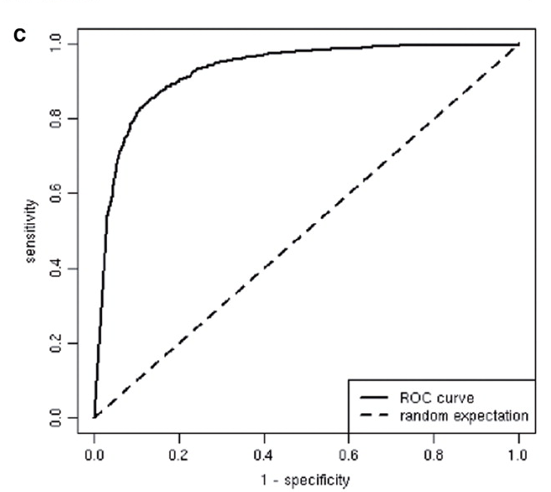
Very Strong ROC Curve: Most genes are accurately detected using nearest-neighbor features' signals
Illustrates great magnitude of cross-hyb. on hi-density arrays
High feature density arrays inadvertently resurrecting generic n-mer concept
(van Dam & Quake, 2003)
Suggests that tiling arrays could be exploited to create universal arrays
Gold std. set of known expressed genes. How well do we find.
A set of known positives was defined as the Refseq genes with at least 75% transfrag coverage. A set of known negatives was constructed by permuting the sequences in the set of known positives. For various thresholds, sensitivity and specificity were computed and then plotted.
Royce, T. E. et al. Nucl. Acids Res. 2007 35:e99

Slide 27
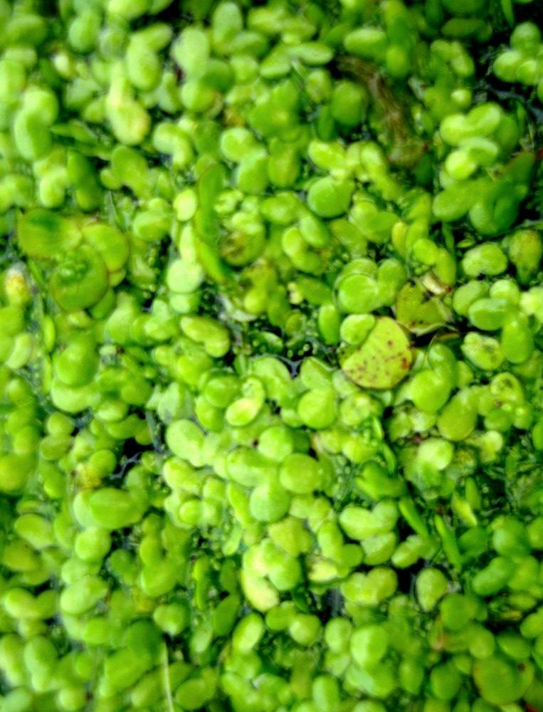
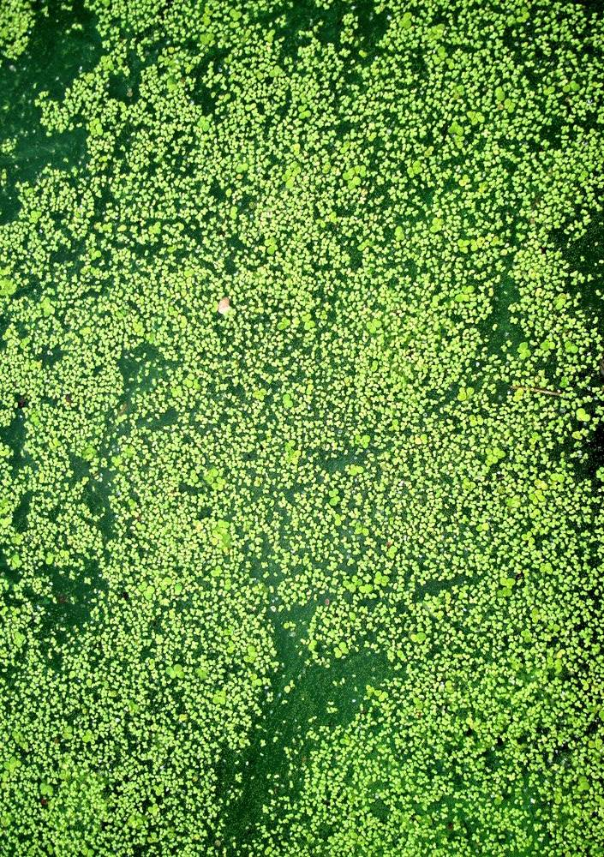
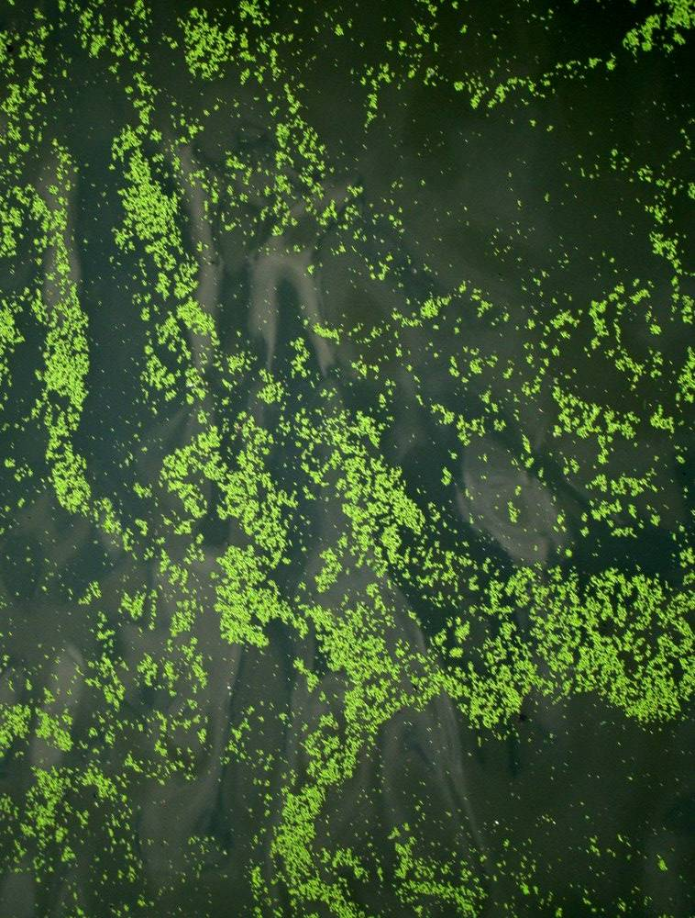
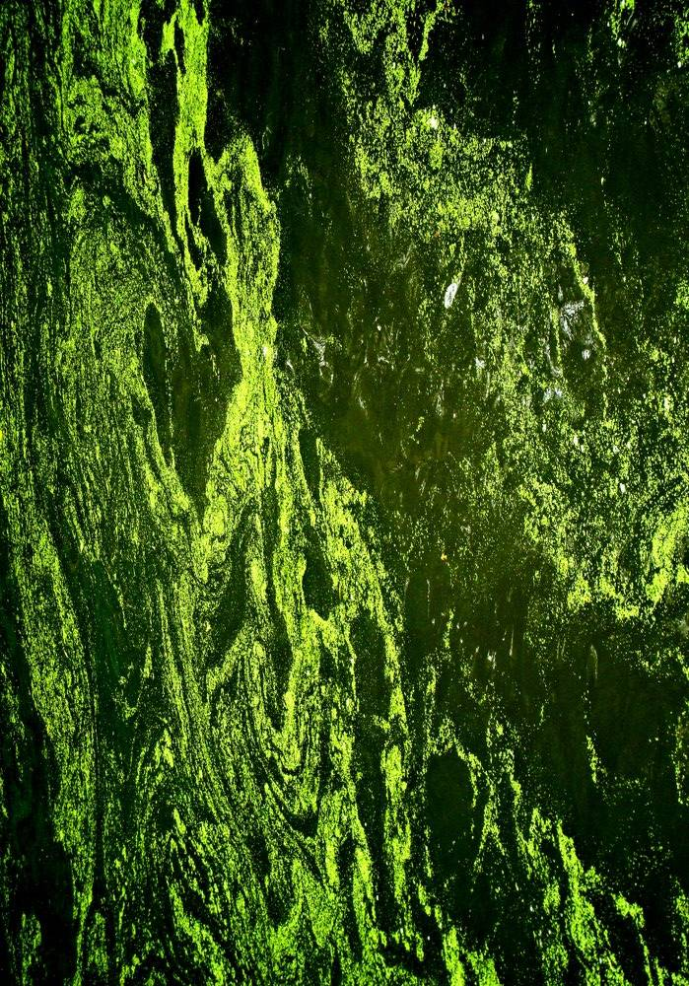
Annotating a single type of signal on a large-scale:
Clustering and Classifying Un-annotated Transcription
(TARs)
pers. photo, see streams.gerstein.info

Slide 28
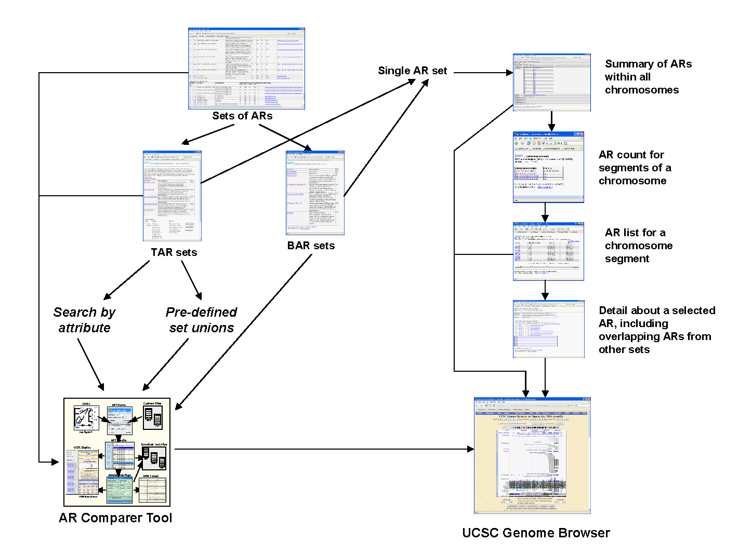
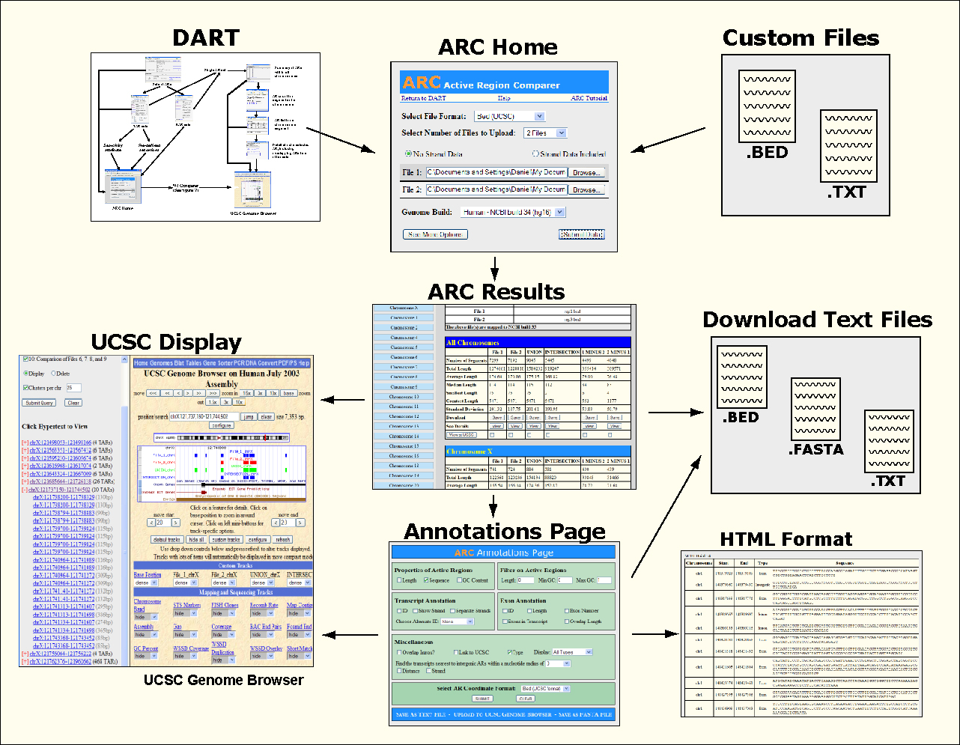
DART: Database & Tools
Interfaces with UCSC
Tools use Ensembl API
Rozowsky et al. Genome Research (2007)

Slide 29
DART Classification System
Set of All TARs
Exonic TARs
Novel TARs
Pseudo TARs
Intronic
Intergenic
ESTs
Proximal
Distal
Proximal
Distal
Rozowsky et al. Gen. Res. (2007)

Slide 30
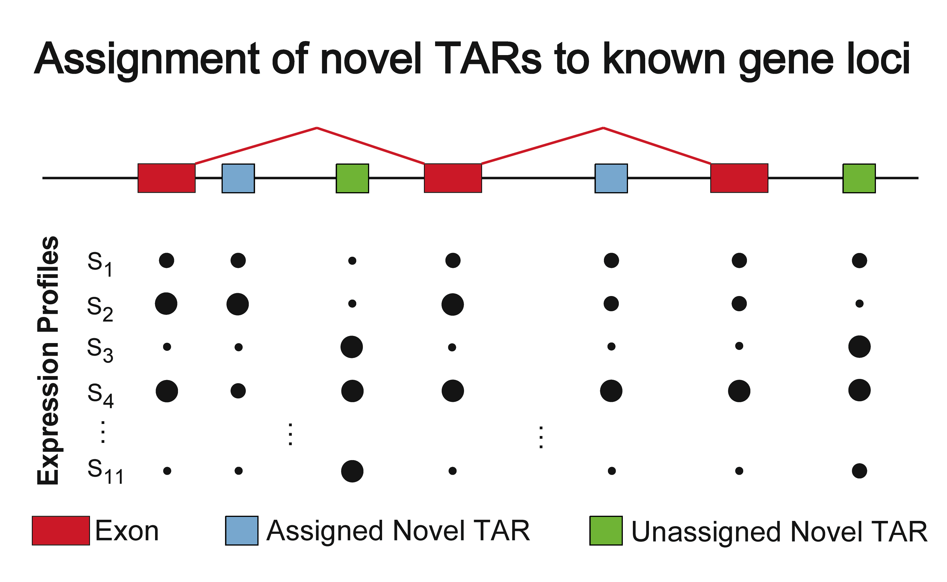
More Developed Annotation: Clustering and Classifying Blocks of Un-annotated Transcription into larger units
Production
Integrated
Phylogenetic Profiles
or
30 (c) Mark Gerstein, 2002, Yale, bioinfo.mbb.yale.edu
Rozowsky et al. Gen. Res. (2007)
Notes:
30

Slide 31
1.8 Mb
3,006 Intronic
Proximal
145 Kb
3,666
28 Mb
6,988
195
ENCODE Regions (30 Mb)
Locations of TARs
Of the approx 7,000 Novel TARs
  955 are assigned to known genes
  1,463 are clustered into ~200 Novel Loci
DART Classification has been experimentally validated with some small scale experiments
  RT-PCR & Sequencing
  18/46 (39%) confirmed by RT-PCR
  4/5 Sequenced Products Map uniquely to correct genomic region
Rozowsky et al. Genome Research (2007)

Slide 32
DART Classification has been experimentally validated with some small scale experiment
  RT-PCR & Sequencing
Results:
18/46 (39%) confirmed by RT-PCR
4/5 Sequenced Products Map uniquely to correct genomic region
Rozowsky et al. Genome Research (2007)

Slide 33
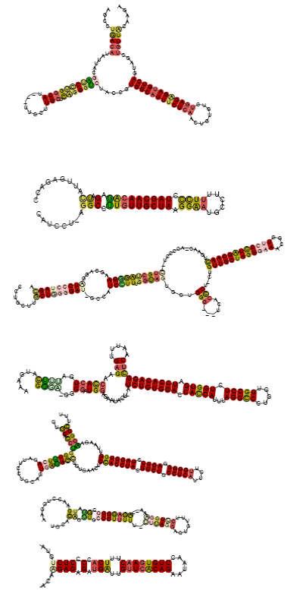
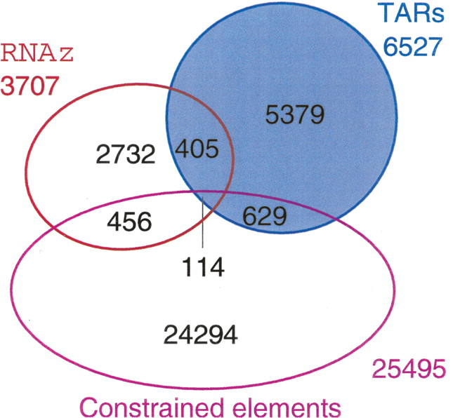
Overlap of predicted structured RNAs with the union of TARs/Transfrags and the "moderate" set of sequence-constrained elements
Example predicted
structured RNAs (using RNAz)
[>700 candidate structured RNAs predicted in 1% of the reference genome]
Stefan Washietl, Jakob Pedersen, Jan Korbel et al. (2007) Genome Res 17:852-864

Slide 34
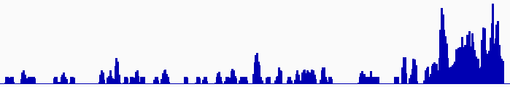
Discovering Transcriptionally Active Regions (novel RNA contigs)
Cluster reads setting minimum-run and maximum gap parameters for newly identified transcribed regions (TARs)
Assess exon discovery rates for known genes and noncoding RNAs
Known exon
Known exon
TAR
TAR
TAR
novel TAR
correct identification
possible exon extension
ENCODE RNA-Seq Data

Slide 35
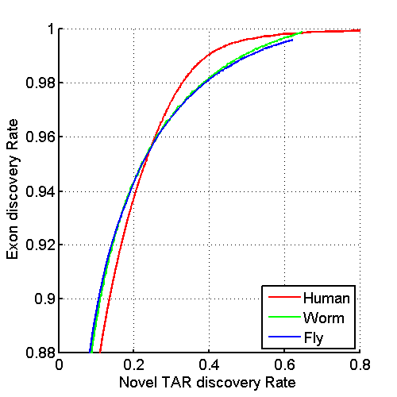
Uniform Annotation of non-coding Elements
Uniformly processed the RNA-seq expression compendium and for identification of pervasively transcribed regions
[Nature 512:445 ('14); doi: 10.1038/nature13424]

Slide 36
Annotated ncRNAs
 |  |  | Human |  |  | Worm |  |  | Fly
 |  |  | Elements | Genome Coverage |  | Elements | Genome Coverage |  | Elements | Genome Coverage
 |  |  |  | Kb | % |  | Kb | % |  | Kb | %
mRNAs (exons) |  |  | 20,007 | 86,560 | 3.0 | 21,192 | 34,437 | 34.3 | 13,940 | 35,970 | 28.0
Pseudogenes |  |  | 11,216 | 27,089 | 0.95 | 881 | 1,343 | 1.3 | 145 | 155 | 0.12
Annotated ncRNAs | Comparable ncRNAs | pri-miRNA | 58 | 1,158 | 0.04 | 44 | 16 | 0.02 | 43 | 300 | 0.23
 |  | pre-miRNAs | 1,756 | 162 | 0.006 | 221 | 20 | 0.02 | 236 | 22 | 0.02
 |  | tRNAs | 624 | 47 | 0.002 | 609 | 45 | 0.04 | 314 | 22 | 0.02
 |  | snoRNAs | 1,521 | 168 | 0.006 | 141 | 16 | 0.02 | 287 | 34 | 0.03
 |  | snRNAs | 1,944 | 210 | 0.007 | 114 | 14 | 0.01 | 47 | 7 | 0.006
 |  | lncRNAs | 10,840 | 10,581 | 0.37 | 233 | 184 | 0.18 | 852 | 868 | 0.68
 | Other ncRNAs |  | 5,411 | 3,268 | 0.11 | 40,104 | 2,329 | 2.3 | 376 | 2,103 | 1.6
 |  | nc-piRNA loci | 88 | 1,272 | 0.04 | 35,329 | 449 | 0.45 | 27 | 1,473 | 1.1
Total |  |  | 22,154 | 17,770 | 0.62 | 41,466 | 2,611 | 2.6 | 2,155 | 3,279 | 2.6
Identify non-canonical transcription in regions of the genome excluding mRNA exons, pseudogenes or annotated ncRNAs.
[Nature 512:445 ('14); doi: 10.1038/nature13424]

Slide 37
& Non-Canonical Transcription
 |  |  | Human |  |  | Worm |  |  | Fly
 |  |  | Elements | Genome Coverage |  | Elements | Genome Coverage |  | Elements | Genome Coverage
 |  |  |  | Kb | % |  | Kb | % |  | Kb | %
Total ncRNAs |  |  | 22,154 | 17,770 | 0.62 | 41,466 | 2,611 | 2.6 | 2,155 | 3,279 | 2.6
Regions Excluding mRNAs, Pseudogenes or Annotated ncRNAs |  |  | 283,816 | 2,731,811 | 95.5 | 143,372 | 63,520 | 63.3 | 60,108 | 89,445 | 69.6
 | Transcription Detected (TARs) |  | 708,253 | 916,401 | 32.0 | 232,150 | 37,029 | 36.9 | 83,618 | 44,256 | 34.5
 |  | Supervised Predictions | 104,016 | 13,835 | 0.48 | 2,525 | 392 | 0.39 | 599 | 164 | 0.13
Similar fraction of non-canonical transcription of non-canonical transcription in human, worm and fly
  32-37% of each genome
[Nature 512:445 ('14); doi: 10.1038/nature13424]

Slide 38
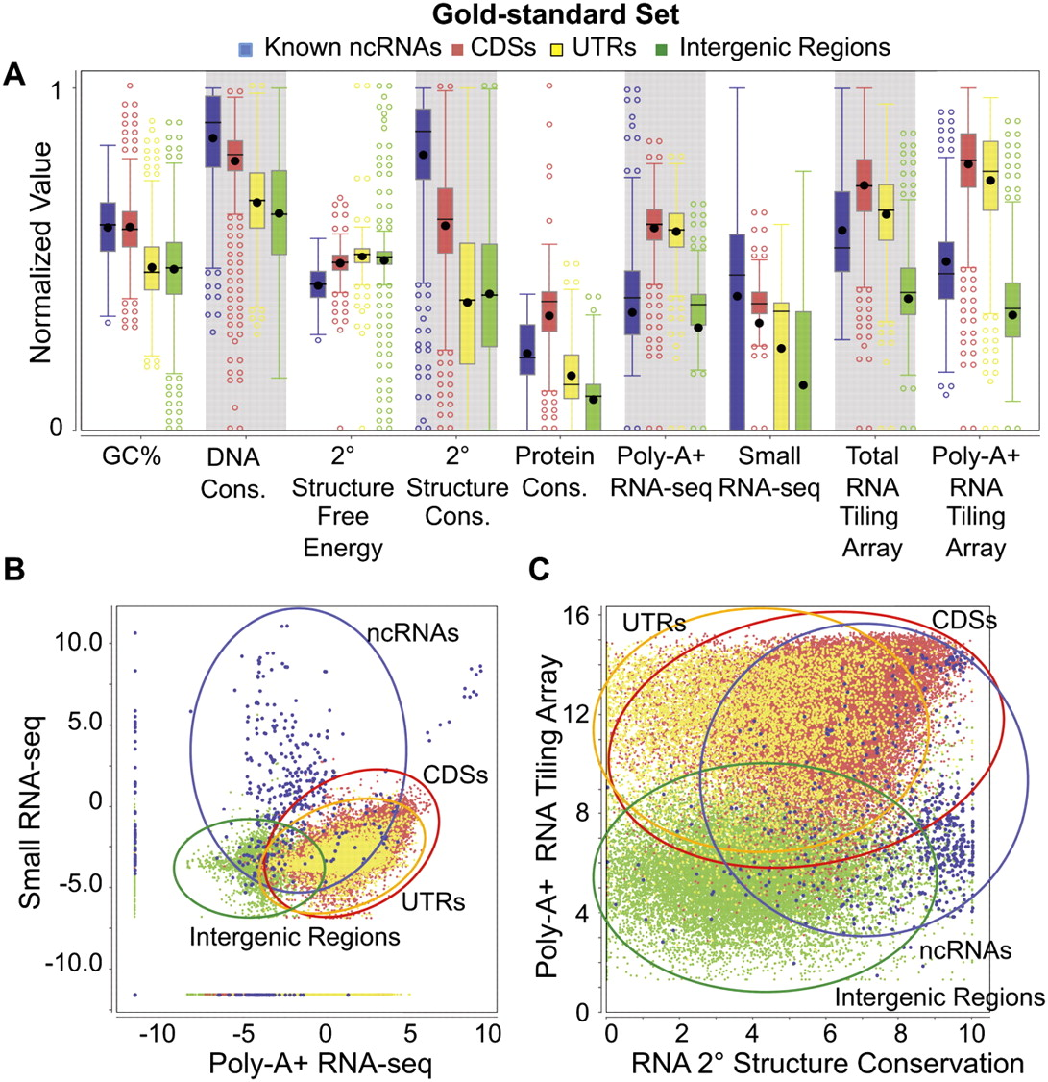
IncRNA:
Machine-learning Identification of many candidate ncRNAs through evidence integration
No single feature (e.g. expr. expts., conservation, or sec. struc.) finds all known ncRNAs => combine features in stat. model
90% PPV, 13 of 15 tested validate
[Lu et al. Genome Res. 2011;21:276-285]
Notes:
Distributions of nine genomic feature values. The distributions of values of the nine features are shown for the gold-standard set (for the definition of the gold-standard set, see Supplemental Methods) of the four types of genomic elements: known ncRNAs, coding sequences (CDSs), untranslated regions (UTRs), and intergenic regions. The values of each expression feature are the maximum of the corresponding values from all the expression data sets of the same type. (A) Box plots of individual features (normalized values). (B) Two-dimensional scatter-plot of the maximum small RNA-seq signal against the maximum poly-A+ RNA-seq signal. (C) Two-dimensional scatter-plot of the maximum poly-A+ RNA tiling array signal against the predicted secondary structure conservation. Expression values in B and C are the log-transformed normalized read counts (DCPM, depth of coverage per million reads).

Slide 39
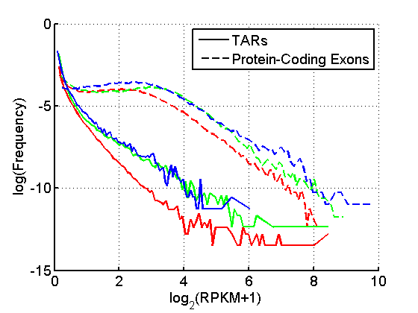
TAR Characterization
Non-canonical transcription (TARs):
Mostly transcribed at lower levels than protein-coding genes.
Enrichment for overlap of TARs with ENCODE enhancers and distal HOT regions -> potential enhancer RNAs (eRNAs).
Human, Worm & Fly
[ENCODE-modencode Transcriptome paper, Nature (in press), doi: 10.1038/nature13424]
HOT Regions = High TF Co-occupancy

Slide 40
Human Genome Analysis – SVs & Pseudogenes, Tricky but Crucial Genomic Features, Targeted by Long-read Sequencing: Current Short-read Results & Future Prospects
SV Breakpoints
  ~9K deletions with breakpoints & mechanism classification from 1000G
  Small subset of tot. deletions, which could be greatly expanded by long reads
  More nearby SNPs than genomic average.
  From methylation, Hi-C , & his mods, NAHR breakpoints associated with open chromatin (perhaps occurring w/o replication & division)
  NHR breakpoints associated w/ sequence microinsertions, templated from later replicating sites, spaced at 2 characteristic distances
Pseudogenes
  Fundamentally repetitive elements
  Collaborative assignment in results in ~14K
  Impact of lineage-specific retro-transpositional burst – ie human v other metazoans is dominated (~80%) by retro-duplication ~40 MYA (Ribo. Proteins).
Intersection of Pseudogenes & SVs
  Enrichment of SVs in pseudogenes v genes, particularly for NAHR
Novel Processed Pseudogenes as a Form of SV
  Not in reference but in human population – could be improved by long reads
  Now found w/ splice junction mapping + clustering of unmapped PEs
  ~8 per person, often pop. specific
  Associated w/ G1/M expressed genes
Many Pseudogenes with Low Levels of Biochemical Activity
  Conservative assignment, mis-map issue, could be improved by long reads
  ~15% transcribed &
  80% w/ some activity

Slide 41
Pseudogenes are among the most interesting intergenic elements
Formal Properties of Pseudogenes (ΨG)
  Inheritable
  Homologous to a functioning element – ergo a repeat!
  Non-functional
    No selection pressure so free to accumulate mutations
      Frameshifts & stops
      Small Indels
      Inserted repeats (LINE/Alu)
    What does this mean? no transcription, no translation?…
[Mighell et al. FEBS Letts, 2000]

Slide 42
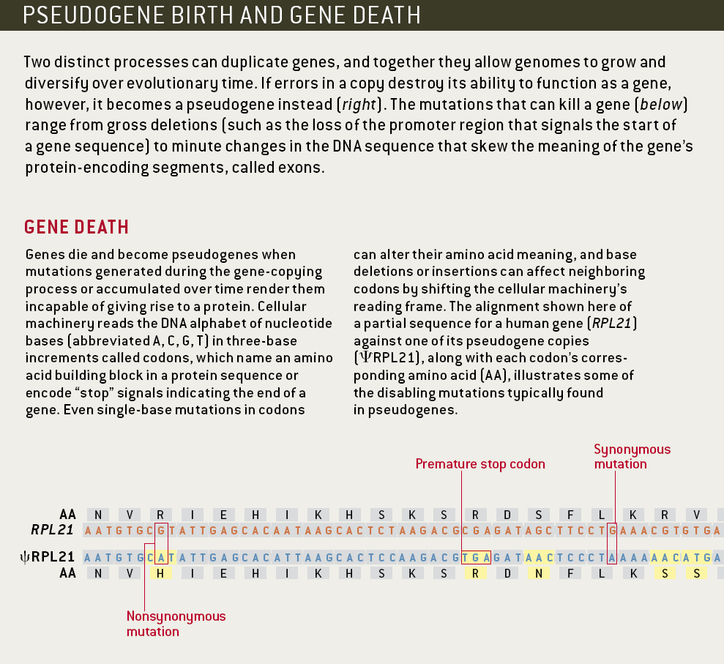
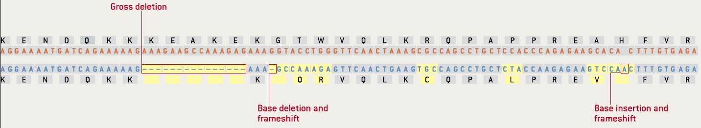
Identifiable Features of a Pseudogene (ψRPL21)
[Gerstein & Zheng. Sci Am 295: 48 (2006).]

Slide 43
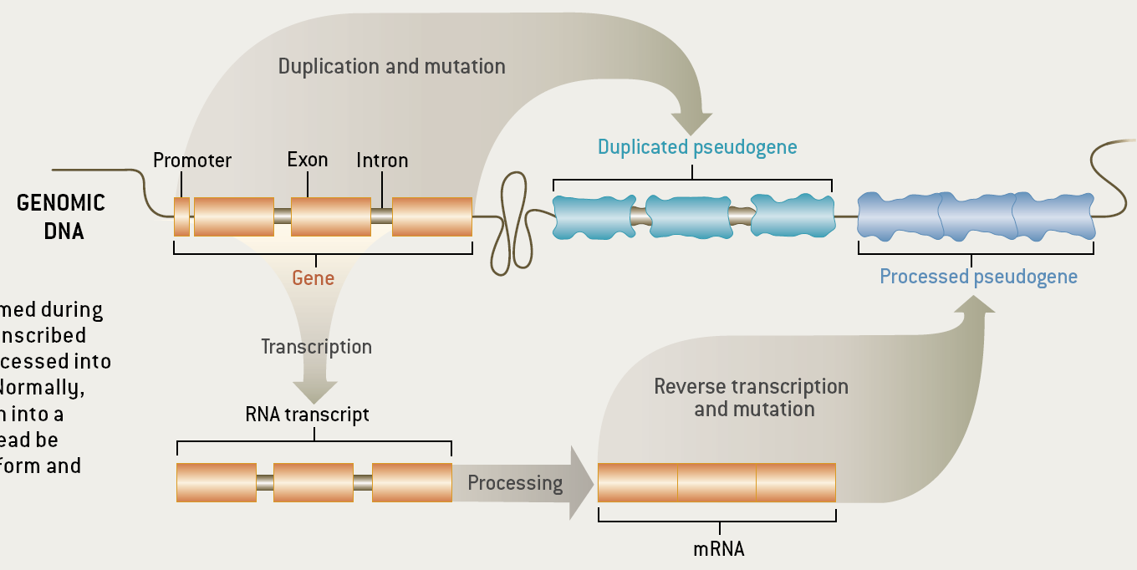
Two Major Genomic Remodeling Processes Give Rise to Distinct Types of Pseudogenes
[Gerstein & Zheng. Sci Am 295: 48 (2006).]

Slide 44
Genome-wide Annotation of Pseudogenes
Pseudogene Information Pool
PseudoPipe
16,653
14,520
14,206
PseudoPipe
RetroFinder
HAVANA
Protein
Sequence
Reference
Genome
2-way consensus
Six-frame blast
9,772
Feedback Loop
Eliminate redundant hits
Remove hits overlapping exon
````````
1000G
ENCODE
Δ2-way
Level 1
Level 2&3
Merge hits and identify parents
913
8,859
5,347
FASTA re-alignment
Polymorphic
Pseudogenes
45
````````
14,161
8,814 level 1
5,347 level 2&3
Processed
Pseudogenes
Duplicated
Pseudogenes
Pseudogene Decoration
Resource
12,358
[Pei et al., GenomeBiology (2012, 13:R51)]

Slide 45
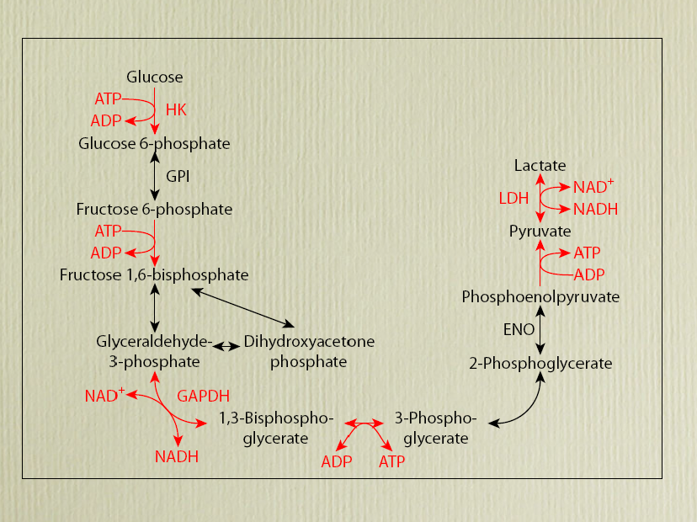
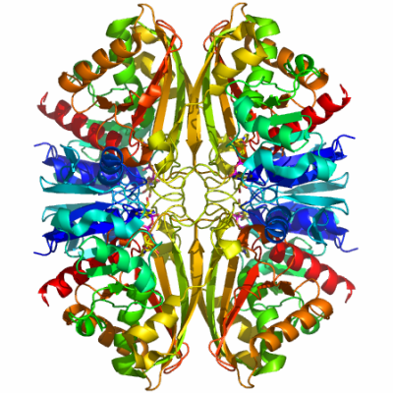

EX: Number of pseudogenes for each glycolytic enzyme
[Liu et al. BMC Genomics ('09)]
Large numbers of processed GAPDH pseudogenes in mammals comprise one of the biggest families but numbers not obviously correlated with mRNA abundance.
GAPDH
Processed/Duplicated
GAPDH

Slide 46
EX: Number of pseudogenes for each glycolytic enzyme
[Liu et al. BMC Genomics ('09)]
Large numbers of processed GAPDH pseudogenes in mammals comprise one of the biggest families but numbers not obviously correlated with mRNA abundance.
GAPDH
Processed/Duplicated
GAPDH
60 Proc/2 Dup

Slide 47

Distribution of human GAPDH pseudogenes
Large numbers of processed GAPDH pseudogenes in mammals comprise one of the biggest families but numbers not obviously correlated with mRNA abundance.
60 Proc/2 Dup
[Liu et al. BMC Genomics ('09, in press)]
Notes:
47

Slide 48

Annotation of Human Pseudogenes in Comparison to those in other Model Organisms
[Sisu et al. PNAS ('14); doi: 10.1073/pnas.1407293111 ]

Slide 49

Evolution
Human
Worm
Fly
[Sisu et al. PNAS ('14); doi: 10.1073/pnas.1407293111 ]

Slide 50

Great divergence in pseudogenes in terms of Orthologs & Paralogs
[Sisu et al. PNAS ('14); doi: 10.1073/pnas.1407293111 ]

Slide 51
Divergence but
More interpretable Patterns in terms of Families
[Sisu et al. PNAS ('14); doi: 10.1073/pnas.1407293111 ]

Slide 52
Human Genome Analysis – SVs & Pseudogenes, Tricky but Crucial Genomic Features, Targeted by Long-read Sequencing: Current Short-read Results & Future Prospects
SV Breakpoints
  ~9K deletions with breakpoints & mechanism classification from 1000G
  Small subset of tot. deletions, which could be greatly expanded by long reads
  More nearby SNPs than genomic average.
  From methylation, Hi-C , & his mods, NAHR breakpoints associated with open chromatin (perhaps occurring w/o replication & division)
  NHR breakpoints associated w/ sequence microinsertions, templated from later replicating sites, spaced at 2 characteristic distances
Pseudogenes
  Fundamentally repetitive elements
  Collaborative assignment in results in ~14K
  Impact of lineage-specific retro-transpositional burst – ie human v other metazoans is dominated (~80%) by retro-duplication ~40 MYA (Ribo. Proteins).
Intersection of Pseudogenes & SVs
  Enrichment of SVs in pseudogenes v genes, particularly for NAHR
Novel Processed Pseudogenes as a Form of SV
  Not in reference but in human population – could be improved by long reads
  Now found w/ splice junction mapping + clustering of unmapped PEs
  ~8 per person, often pop. specific
  Associated w/ G1/M expressed genes
Many Pseudogenes with Low Levels of Biochemical Activity
  Conservative assignment, mis-map issue, could be improved by long reads
  ~15% transcribed &
  80% w/ some activity

Slide 53





Fixed Genomic Variation
Alu
Gene
Non-allelic homologous recombination (NAHR)
Ancestral State
Alu
Gene
Alu
Gene
The Genome Remodeling Process
Segmental Duplication (SD)
Gene
Dup. Gene
Syntenic Ortholog
SD
Insertion
Insertion
Gene
Dup. Gene
VNTR
Pssd. ψgene
Paralog
duplicate
Deletion
Insertion
Gene
Dup. Gene
Dup. Gene
VNTR
L1
family
Retro-elements
Deletion
Inversion
Gene
Dup. ψgene
VNTR
Pssd. ψgene
Retro-transpose

Slide 54


Polymorphic Genomic Variation
Alu
Gene
Non-allelic homologous recombination (NAHR)
Ancestral State
Alu
Gene
Alu
Gene
The Genome Remodeling Process
Segmental Duplication (SD)
Gene
Dup. Gene
Syntenic Ortholog
CNV (type of SV)
Insertion
Insertion
Gene
Dup. Gene
VNTR
Pssd. ψgene
duplicate
Deletion
Insertion
Gene
Dup. Gene
Dup. Gene
VNTR
L1
Retro-elements
Deletion
Inversion
Gene
Dup. ψgene
VNTR
Pssd. ψgene
Retro-transpose
"Polymorphic" Genes & Pseudogenes

Slide 55
In comparison to other genomic elements, pseudogenes tend to overlap SVs
Structural variants are generally depleted for functional elements
[Khurana et al., Science (‘13)]

Slide 56

More detail on pseudogene overlap with SVs (enrichment wrt randomized control)
Duplicated Pseudogene | 1.14 | 9.94E-02
Processed Pseudogene | 1.46 | 1.14E-08
SVs are shuffled in the whole genome.
Significant P-values (<0.05) in black and bold
Significant enrichments in green
Significant depletions in red
[Mu et al., NAR (2011)]

Slide 57
Pseudogenes & CNVs
CNVs are the raw form of variation producing duplicated elements (SDs)
  SDs give rise to duplicated genes protein families
  SDs comprise ~5% of the human genome but contain ~18% genes, 46% duplicated and 22% processed pseudogenes
CNVs & SDs tend to be enriched in environmental response genes, matching patterns found for duplicated pseudogenes
Duplicated pseudogenes are associated in general with older SDs
[Lam et al., NAR DB Issue ('09)]
Duplicated pseudogenes
[Korbel et al., COSB ('08)]
[Kim et al. Gen. Res. ('08)]
Processed pseudogenes
Matching processed pseudogenes (sharing the parent gene) are enriched at SD junctions
Processed pseudogenes can serve
as repeats for mediating NAHR
Duplicated Segments
Matching pseudogenes
[Kim et al. Gen. Res. ('08)]

Slide 58
Human Genome Analysis – SVs & Pseudogenes, Tricky but Crucial Genomic Features, Targeted by Long-read Sequencing: Current Short-read Results & Future Prospects
SV Breakpoints
  ~9K deletions with breakpoints & mechanism classification from 1000G
  Small subset of tot. deletions, which could be greatly expanded by long reads
  More nearby SNPs than genomic average.
  From methylation, Hi-C , & his mods, NAHR breakpoints associated with open chromatin (perhaps occurring w/o replication & division)
  NHR breakpoints associated w/ sequence microinsertions, templated from later replicating sites, spaced at 2 characteristic distances
Pseudogenes
  Fundamentally repetitive elements
  Collaborative assignment in results in ~14K
  Impact of lineage-specific retro-transpositional burst – ie human v other metazoans is dominated (~80%) by retro-duplication ~40 MYA (Ribo. Proteins).
Intersection of Pseudogenes & SVs
  Enrichment of SVs in pseudogenes v genes, particularly for NAHR
Novel Processed Pseudogenes as a Form of SV
  Not in reference but in human population – could be improved by long reads
  Now found w/ splice junction mapping + clustering of unmapped PEs
  ~8 per person, often pop. specific
  Associated w/ G1/M expressed genes
Many Pseudogenes with Low Levels of Biochemical Activity
  Conservative assignment, mis-map issue, could be improved by long reads
  ~15% transcribed &
  80% w/ some activity

Slide 59
Retroduplication variation (RDV)
Retroduplications
(pot. retro-pseudogenes or retro-genes)
mRNA
Gene
Reference
…
Person 1
…
Person 2
…
Known retroduplication
Person 3
…
. . .
Reference
…
Person 1
…
Person 2
…
Novel retroduplication
Person 3
…
. . .
mRNA
[Abyzov et al. Gen. Res. ('13) ]

Slide 60
Gene
Novel retroduplication
Read pairs
1 2 3 4
…
…
Reference
Alignment to
the reference
…
3
1
Evidence
from alignment
Unaligned reads
Aligned
reads
Splice-junction library
…
2
4
Evidence
from cluster
1
[Abyzov et al. Gen. Res. ('13) ]
…
3
2 3 4
Evidence from
read depth
1
Pipeline to identify novel retro-dups. from 3 evidence sources
Zero level
Notes:
Split-read and paired-end approaches

Slide 61

A typical individual (NA12878) with
10 validated retrodups
(by RD & PCR)
Parent gene with predicted novel retroduplication | Additional support |  |  | PCR validation
 | Read depth support | Insertion point support | Found in Venter genome
CDC27 | Yes |  | Yes | UN
BCLAF1 | Yes |  | Yes | UN
LAPTM4B | Yes | Yes |  | Yes
MTCH2 |  |  |  | Yes
CBX3 | Yes | Yes | Yes | Yes
TMEM66 | Yes | Yes |  | Yes
TDG | Yes | Yes | Yes | Yes
BOD1 |  |  |  | Yes
CACNA1B |  | Yes |  | Yes
SKA3 | Yes | Yes |  | Yes
AP3S1 | Yes |  | Yes | Yes
AC131157 |  |  |  | N/A
AL590623 | Centromere
On avg. 6-10 novel Retrodups per person in 1000G dataset. Also, 147 total genes with retrodups
[Abyzov et al. Gen. Res. ('13) ]

Slide 62

Frequency of novel retroduplications by populations.
Abyzov A et al. Genome Res. 2013;23:2042-2052
Notes:
Frequency of novel retroduplications by populations. Most of the novel retroduplications are discovered in only one population (due to conservative calling) but are present in a few more as evident from genotyping. The phylogenetic tree was constructed based on the overlap of novel retroduplications between different populations. The tree shows that, except in one case, populations separate perfectly by continental groups. Outlier clustering of the Finnish population (FIN) is likely due to its distinct data properties allowing discovery of more unique retroduplications (see text). Admixed populations and the Iberian population (with just a few sequenced individuals) were excluded from phylogenetic analysis.

Slide 63

Hypothesis: retrotransposition is coupled to cell division (in germline)
[Abyzov et al. Gen. Res. ('13) ]

Slide 64
Human Genome Analysis – SVs & Pseudogenes, Tricky but Crucial Genomic Features, Targeted by Long-read Sequencing: Current Short-read Results & Future Prospects
SV Breakpoints
  ~9K deletions with breakpoints & mechanism classification from 1000G
  Small subset of tot. deletions, which could be greatly expanded by long reads
  More nearby SNPs than genomic average.
  From methylation, Hi-C , & his mods, NAHR breakpoints associated with open chromatin (perhaps occurring w/o replication & division)
  NHR breakpoints associated w/ sequence microinsertions, templated from later replicating sites, spaced at 2 characteristic distances
Pseudogenes
  Fundamentally repetitive elements
  Collaborative assignment in results in ~14K
  Impact of lineage-specific retro-transpositional burst – ie human v other metazoans is dominated (~80%) by retro-duplication ~40 MYA (Ribo. Proteins).
Intersection of Pseudogenes & SVs
  Enrichment of SVs in pseudogenes v genes, particularly for NAHR
Novel Processed Pseudogenes as a Form of SV
  Not in reference but in human population – could be improved by long reads
  Now found w/ splice junction mapping + clustering of unmapped PEs
  ~8 per person, often pop. specific
  Associated w/ G1/M expressed genes
Many Pseudogenes with Low Levels of Biochemical Activity
  Conservative assignment, mis-map issue, could be improved by long reads
  ~15% transcribed &
  80% w/ some activity

Slide 65

Examples & speculation on the function of pseudogene ncRNAs:
Regulating their parents
via acting as endo-siRNAs
[ex. in fly & mouse, ‘08 refs.]
via acting as miRNA decoys
[PTEN]
via inhibiting degradation of parent’s mRNA [makorin]
Functional candidates:
  SLIT-ROBO Rho GTPase activating protein 2B pseudogene
  PRKY-004, Y-linked protein kinase pseudogene
  Fer-1-like 4 (C. elegans), pseudogene
[Sasidharan & Gerstein, Nature ('08)]
Alternatively, just last gasps of a dying gene
Czech et al. Nature 453: 798 (‘08).
Ghildiyal et al. Science 320: 1077 (‘08).
Kawamur et al. Nature 453: 793 (‘08).
Okamura et al. Nature 453: 803 (‘08).
Tam et al. Nature 453: 534 (‘08).
Watanabe et al. Nature 453: 539 (‘08).
Poliseno et al. Nature 465:1033 (’10).

Slide 66

Pseudogene Transcription: interesting but tricky to ascertain
Difficulty in ascertainment because of mis-mapping v parent
One approach to this confound is look across mult. samples
[Science 330:6012]

Slide 67
Pseudogene Activity
H Highly-Active
P Partially-Active
D Dead
Yes
No
Human
Worm
Fly
[Sisu et al. PNAS ('14); doi: 10.1073/pnas.1407293111 ]
2381
1%
78%
21%
15% of pseudogenes are transcribed in each organism
4%
66%
30%
5%
63%
32%

Slide 68
Pseudogenes are among the most interesting intergenic elements
Formal Properties of Pseudogenes (ΨG)
  Inheritable
  Homologous to a functioning element
  Non-functional
    No selection pressure so free to accumulate mutations
      Frameshifts & stops
      Small Indels
      Inserted repeats (LINE/Alu)
    What does this mean? no transcription, no translation?…
[Mighell et al. FEBS Letts, 2000]

Slide 69
Identifiable Features of a Pseudogene (ψRPL21)
Gerstein & Zheng. Sci Am 295: 48 (2006).

Slide 70
Two Major Genomic Remodeling Processes Give Rise to Distinct Types of Pseudogenes
Gerstein & Zheng. Sci Am 295: 48 (2006).

Slide 71
Genome-wide Annotation of Pseudogenes
Pseudogene Information Pool
PseudoPipe
18,046
13,644
11,240
PseudoPipe
RetroFinder
HAVANA
Protein
Sequence
Reference
Genome
2-way consensus
Six-frame blast
9,093
Feedback Loop
~14K
total
Eliminate redundant hits
Remove hits overlapping exon
````````
1000G
ENCODE
Δ2-way
Level 1
Level 2
Merge hits and identify parents
1,907
7,186
4,054
FASTA re-alignment
Polymorphic
Pseudogenes
24
Surveyed Set
11,216
7,183 level 1
4,033 level 2
````````
Processed
Pseudogenes
Duplicated
Pseudogenes
Pseudogene Decoration
Resource
psiDR
[Pei et al., GenomeBiology ('12, submitted)]

Slide 72
Number of pseudogenes for each glycolytic enzyme
[Liu et al. BMC Genomics ('09)]
Large numbers of processed GAPDH pseudogenes in mammals comprise one of the biggest families but numbers not obviously correlated with mRNA abundance.
GAPDH
Processed/Duplicated
GAPDH

Slide 73
Number of pseudogenes for each glycolytic enzyme
[Liu et al. BMC Genomics ('09)]
Large numbers of processed GAPDH pseudogenes in mammals comprise one of the biggest families but numbers not obviously correlated with mRNA abundance.
GAPDH
Processed/Duplicated
GAPDH
62

Slide 74
Distribution of 62 human GAPDH pseudogenes
[Liu et al. BMC Genomics ('09, in press)]
Notes:
74

Slide 75

Dating of GAPDH pseudogenes, highlights their creation ~50 Mya
[Liu et al. BMC Genomics ('09)]
Age calculated based on Kimura-2 parameter model of nucleotide substitution
Burst of Retrotran-spositional Activity

Slide 76
Human Genome Analysis:
Classic Approach v Future Direction
  A Classic Story of “Linear Annotation” (“Junk => Part”)
  Identifying new pseudogenes in intergenic DNA
  Potentially ascribing “regulatory activity” to some of them
  Pseudogene population variation & relation to LOF events
  A Networks View on Organization of Genomic Elements (“Parts => system”)
  Understanding the human regulatory network
  as a hierarchy with information flow bottlenecks
  Understanding the impact of variation and constraint on the network
  Practical Application: Finding disease genes

Slide 77
IncRNA: Identification of many candidate ncRNAs through evidence integration
No single feature (e.g. expr. expts., conservation, or sec. struc.) finds all known ncRNAs => combine features in stat. model
90% PPV, 13 of 15 tested validate
[Lu et al. Genome Res. 2011;21:276-285]
Notes:
Distributions of nine genomic feature values. The distributions of values of the nine features are shown for the gold-standard set (for the definition of the gold-standard set, see Supplemental Methods) of the four types of genomic elements: known ncRNAs, coding sequences (CDSs), untranslated regions (UTRs), and intergenic regions. The values of each expression feature are the maximum of the corresponding values from all the expression data sets of the same type. (A) Box plots of individual features (normalized values). (B) Two-dimensional scatter-plot of the maximum small RNA-seq signal against the maximum poly-A+ RNA-seq signal. (C) Two-dimensional scatter-plot of the maximum poly-A+ RNA tiling array signal against the predicted secondary structure conservation. Expression values in B and C are the log-transformed normalized read counts (DCPM, depth of coverage per million reads).

Slide 78

Pseudogene Transcription
Total transcribed pseudogene: 863
RTPCR Experimental validated: 57 of 76
Different Tissues in Body Map
Simple & Complex Ex of Pseudo-gene Trans-cription
[Pei et al., GenomeBiology ('12, submitted)]

Slide 79
Partial Pseudogene Activity
Transcribed with Additional Activity
[Pei et al., GenomeBiology ('12, submitted)]
Partially Active

Slide 80



Signatures of Selection on Some Pseudogenes
Ka/Ks conventional measure of selection for genes,
shows no signal for pgenes
Signature for selection on some SD pgenes (16%),
derived from intersecting with UW SD DB & looking for differential conservation of neighborhood vs. center of pgene
Weak signature for greater selection on transcribed pgenes using 1000G polymorphisms
[Khurana et al, NAR (’10)]
Segmental duplication
Parent gene
Duplicated ψgene
167
[Mu et al. NAR 39: 7058]
Comparison of nucleotide substitutions per site (N) in ψgenes and SDs
N (ψgene)< N (SD)
N (ψgene) ≈ N (SD)
N (ψgene) > N (SD)
negative selection
neutral evolution
positive selection
4
139
24
Notes:
Layout the legend

Slide 81

Partial Activity for ~2.5K Pseudogenes
[Pei et al., GenomeBiology ('12, submitted)]

Slide 82
Examples & speculation on the function of pseudogene ncRNAs:
Regulating their parents
via acting as
endo-siRNAs
[Recent ex. in fly & mouse, ‘08 refs.]
via acting as
miRNA decoys
[PTEN]
via inhibiting degradation of parent’s mRNA [makorin]
[Sasidharan & Gerstein, Nature ('08)]
Alternatively, just last gasps of a dying gene
Czech et al. Nature 453: 798 (‘08).
Ghildiyal et al. Science 320: 1077 (‘08).
Kawamur et al. Nature 453: 793 (‘08).
Okamura et al. Nature 453: 803 (‘08).
Tam et al. Nature 453: 534 (‘08).
Watanabe et al. Nature 453: 539 (‘08).
Poliseno et al. Nature 465:1033 (’10)

Slide 83
Human Genome Analysis:
Classic Approach v Future Direction
  A Classic Story of “Linear Annotation” (“Junk => Part”)
  Identifying new pseudogenes in intergenic DNA
  Potentially ascribing “regulatory activity” to some of them
  Pseudogene population variation & relation to LOF events
  A Networks View on Organization of Genomic Elements (“Parts => system”)
  Understanding the human regulatory network
  as a hierarchy with information flow bottlenecks
  Understanding the impact of variation and constraint on the network
  Practical Application: Finding disease genes

Slide 84


76 Unitary pseudogenes
Unprocessed pseudogenes with no functional counterparts in the same genome
[Zhang et al. GenomeBiology ('10)]

Slide 85


11 Polymorphic pseudogenes:
Ex of SerpinB11
Gaa (E) => Taa (stop)
Freq. of this Mutation
in Various Human Populations
[Zhang et al. ('10) GenomeBiology]

Slide 86



LOF variants : creation of “pseudogenes” from annotated genes
[Balasubramanian et al., Genes Dev., ’11]

Slide 87
Human Genome Analysis – SVs & Pseudogenes, Tricky but Crucial Genomic Features, Targeted by Long-read Sequencing: Current Short-read Results & Future Prospects
SV Breakpoints
  ~9K deletions with breakpoints & mechanism classification from 1000G
  Small subset of tot. deletions, which could be greatly expanded by long reads
  More nearby SNPs than genomic average.
  From methylation, Hi-C , & his mods, NAHR breakpoints associated with open chromatin (perhaps occurring w/o replication & division)
  NHR breakpoints associated w/ sequence microinsertions, templated from later replicating sites, spaced at 2 characteristic distances
Pseudogenes
  Fundamentally repetitive elements
  Collaborative assignment in results in ~14K
  Impact of lineage-specific retro-transpositional burst – ie human v other metazoans is dominated (~80%) by retro-duplication ~40 MYA (Ribo. Proteins).
Intersection of Pseudogenes & SVs
  Enrichment of SVs in pseudogenes v genes, particularly for NAHR
Novel Processed Pseudogenes as a Form of SV
  Not in reference but in human population – could be improved by long reads
  Now found w/ splice junction mapping + clustering of unmapped PEs
  ~8 per person, often pop. specific
  Associated w/ G1/M expressed genes
Many Pseudogenes with Low Levels of Biochemical Activity
  Conservative assignment, mis-map issue, could be improved by long reads
  ~15% transcribed &
  80% w/ some activity

Slide 88
Human Genome Analysis – SVs & Pseudogenes, Tricky but Crucial Genomic Features, Targeted by Long-read Sequencing: Current Short-read Results & Future Prospects
SV Breakpoints
  ~9K deletions with breakpoints & mechanism classification from 1000G
  Small subset of tot. deletions, which could be greatly expanded by long reads
  More nearby SNPs than genomic average.
  From methylation, Hi-C , & his mods, NAHR breakpoints associated with open chromatin (perhaps occurring w/o replication & division)
  NHR breakpoints associated w/ sequence microinsertions, templated from later replicating sites, spaced at 2 characteristic distances
Pseudogenes
  Fundamentally repetitive elements
  Collaborative assignment in results in ~14K
  Impact of lineage-specific retro-transpositional burst – ie human v other metazoans is dominated (~80%) by retro-duplication ~40 MYA (Ribo. Proteins).
Intersection of Pseudogenes & SVs
  Enrichment of SVs in pseudogenes v genes, particularly for NAHR
Novel Processed Pseudogenes as a Form of SV
  Not in reference but in human population – could be improved by long reads
  Now found w/ splice junction mapping + clustering of unmapped PEs
  ~8 per person, often pop. specific
  Associated w/ G1/M expressed genes
Many Pseudogenes with Low Levels of Biochemical Activity
  Conservative assignment, mis-map issue, could be improved by long reads
  ~15% transcribed &
  80% w/ some activity

Slide 89


Consortium Acknowledgements
WashU - Ken Chen, Asif Chinwalla, Donald Conrad, Li Ding, Mike McLellan, John Wallis
WT Sanger Inst. – Ben Blackburne, Richard Durbin, Matt Hurles, Heng Li, Zemin Ning, Alywyn Scally, Klaudia Walter, Manuela Zanda, Yujun Zhang
Yale –Alexej Abyzov, Jieming Chen, Declan Clarke, Mark Gerstein, Rajini Haraksingh, Ekta Khurana, Joe Lee, Jing Leng, Cristina Sisu, Daifeng Wang
Stanford – Fabian Grubert Mark Kaganovich Phil Lacroute Hugo Lam Michael Snyder Alexander Urban
EMBL – Tobias Rausch, Andreas Schlattl, Adrian Stütz
Univ. of Washington – Tonia Brown, Arthur Ko, Peter Sudmant
EBI – Ewan Birney Laura Clarke Paul Flicek Matthias Haimel Paul Kersey Ilkka Lappalainen Lisa Skipper Richard Smith Daniel Zerbino Xiangqun Zheng-Bradley
Oxford – Zamin Iqbal, Gerton Lunter, Gil McVean
LSU – Mark Batzer, Miriam Konkel, Jerilyn Walker
Simon Fraser – Iman Hajirasouliha, Fereydoun Hormozdiari
Bilkent University – Can Alkan
Brigham – Xinghua Shi, Chengsheng Zhang
Cornell – Jeremiah Degenhardt
Harvard – Marcin Von Grotthuss
Rutgers – Jinchuan Xing
TGen – David Craig
AECOM – Kenny Ye
UCSD – Vineet Bafna, Jacob Michaelson, Jonathan Sebat
UCLA – Stan Nelson
Illumina – Bret Barnes, David Bentley, Michael Eberle, R. Keira Cheetham, Sean Humphray, Scott Kahn, Lisa Murray, Richard Shaw, Michael Stromberg
Life Tech. – Yutao Fu, Fiona Hyland, Heather Peckham, Yongming Sun, Daryl Thomas, Sowmi Utiramerur
BC – Erik Garrison Deniz Kural Wan-Ping Lee Gabor Marth Chip Stewart Alistair Ward Jiantao Wu
Broad Inst. – Guillermo del Angel, David Altshuler, Eric Banks, Mark DePristo, Menachem Fromer, Robert Handsaker, Chris Hartl, Steve McCarroll, James Nemesh, Khalid Shakir
Univ. of Michigan – Gonçalo Abecasis, Tom Blackwell, Jeffrey Kidd, Ryan Mills, Matthew Snyder
BGI – Yingrui Li, Srinka Ghosh, Aaron Halpern, Jason Laramie, Steve Lincoln
Leiden Univ. – Kai Ye
MS School of Medicine – Jayon Lihm, Vladimir Makarov, Elena Parkhomenko, Seungtai Yoon
Baylor – James Lu, Jeff Reid, Fuli Yu
Univ. of Maryland – Scott Devine
Univ. of Uath – David Witherspoon
Univ. of Virginia – Aaron Quinlan
NIH – Chunlin Xiao
Co-chairs – Charles Lee, Jan Korbel, Evan Eichler
Tim Hubbard, WT Sanger Inst.
Jennifer Harrow (lead PI), WT Sanger Inst.
Steve Searle, WT Sanger Inst.
Alexandre Reymond (PI), Univ. of Lausanne
Roderic Guigo (PI), CRG
David Haussler (PI), UCSC
Rachel Harte (Co-PI), UCSC
Manolis Kellis (PI), MIT
Mark Gerstein (PI), Yale
Alfonso Valencia (PI), CNIO
Michael Tress, CNIO

Slide 90

Acknowledgements
Breakpoints: A Abyzov, S Li, DR Kim, M Mohiyuddin, AM Stütz, NF Parrish, XJ Mu, W Clark, K Chen, M Hurles, JO Korbel, HY Lam, C Lee
GAPDH Pseudogene: Yuen-Jong Liu, Deyou Zheng, Suganthi Balasubramanian, Nicholas Carriero, Ekta Khurana, Rebecca Robilotto
Non-coding Variation: X Mu, Zhi J. Lu, Yong Kong, Hugo Y.K. Lam, Y Fu, E Khurana
Retroduplication Variation: A Abyzov, Yan Zhang, Shantao Li, Rebecca Iskow, Omer Gokcumen, David W. Radke, Suganthi Balasubramanian, Baikang Pei, Lukas Habegger, The 1000 Genomes Project Consortium, C Lee
Comparative Pseudogene: C Sisu, B Pei, Jing Leng, A Frankish, Yan Zhang, Suganthi Balasubramanian, Rachel Harte, Daifeng Wang, Michael Rutenberg-Schoenberg, Wyatt Clark, Mark Diekhans, Joel Rozowsky, Tim Hubbard, J Harrow
SV.gersteinlab.org + Pseudogene.org
Hiring Postdocs. See gersteinlab.org/jobs

Slide 91
Applications of Machine Learning for
Comparing Transcriptomes of Distant Organisms
Intro to Comparative ENCODE
  Lots of Matched Data for Comparative Analysis
App. #1: Characterizing ncRNAs & TARs
  Not much news in canonical gene models
  Simple contig search (TARs) finds uniform density of non-canonical transcription
  ML model shows few TARs similar to existing ones, but some enrichment for eRNAs
App. #2: Expression Clustering, Cross-species
  Potts-model optimization gives 16 conserved co-expression modules (which can potentially annotate ncRNAs/TARs)
  Developmental 'hourglass' genes in 12 of these. They also exhibit intra-organism hourglass behavior.
  Stage alignment of worm & fly development, strongest with hourglass genes
App. #3: HM Models Relating Gene Expression to Promoter Activity
  Works for ncRNAs as well as genes
  Universal cross-species model uses same set of parameters across diverse phyla
App. #4: Similarly constructed TF Models
  Variable importance of regions around genes for HMs & TFs
  TF & HM signals are redundant for ‘prediction'
  Surprisingly, a few TFs are quite predictive

Slide 92

Expression clustering:
revisiting an ancient problem
Species A
Species B
Clustering
algorithm
Clustering
algorithm
co-expressed genes
responsible for the same
function in a species
co-expressed genes
responsible for the same
function in a species
Eisen MB et al. PNAS 1998
Langfelder P et al. BMC Bioinfo. 2008
Tamayo P et al. PNAS 1999
Kluger Y et al. Genome Res. 2003
two independent sets
of modules
Cross species
co-expression modules

Slide 93
Expression clustering:
revisiting an ancient problem
Species A
Orthologous pairs
between species
Species B
A novel unified framework to integrate co-expression data across species
OrthoClust
cross species modules
Yan et al. Genome Biol. 2014
Cross species
co-expression modules

Slide 94



Network modularity
degree of node i
Newman Phy. Rev. E 2013
adjacency matrix
whether or not
i, j are in the
same module
number of edges
expected number of
edges between i and j

Slide 95

Network modularity
degree of node i
adjacency matrix
whether or not
i, j are in the
same module
number of edges
expected number of
edges between i and j

Slide 96

Network modularity
Optimization problem
degree of node i
adjacency matrix
whether or not
i, j are in the
same module
number of edges
expected number of
edges between i and j

Slide 97
A toy example [orthoclust]
[Yan et al. GenomeBiol 15:R100 ('14)]
2
Every node i is assigned with a spin value σ_{i} (labels of modules: 1,2,…q).
4
4
co-expressed
1
1
2
2
orthologs
Species A
3
3
Species B
reward an orthologous pair
with the same value
4
4
4
1
2
1
3
1
reward a co-expressed
pair with the same value
punish a non co-expressed
pair with the same value
Favorableness = "Modularity" in species A + "Modularity" in species B + consistency betw. A & B

Slide 98
A toy example [orthoclust]
[Yan et al. GenomeBiol 15:R100 ('14)]
2
2
4
co-expressed
2
4
2
4
orthologs
Species A
2
4
Species B
4
1
4
1
4
4
1
1
species A specific
conserved modules
species B specific
Use Potts model (generalized Ising model) to simultaneously cluster co-expressed genes within an organism as well as orthologs shared between organisms. Here, the ground state configuration correspond to three modules: 1, 2, 4.

Slide 99


Cross-species clusters for worm and fly
9
GO terms of conserved modules
Worm genes (20377)
Fly genes (13623)
GO terms of specific modules
worm specific | dauer entry
fly specific | chitin activities
co-association
frequency
Yan KK et al. Genome Biology. 2014

Slide 100

More conserved modules
Yan KK et al. Genome Biology. 2014

Slide 101

Separation of modules in terms of GO
Yan KK et al. Genome Biology. 2014

Slide 102

Application for more than 2 species
~55000 genes
[Nature 512:445 ('14); doi: 10.1038/nature13424]

Slide 103
ncRNAs associated with modules
Non-canonical transcription (TARs):
Identify TARs that are significantly correlated and anti-correlated with genes in the 16 modules.
Human, Worm & Fly
[Nature 512:445 ('14); doi: 10.1038/nature13424]

Slide 104



Conserved modules exhibit canonical hourglass behavior
Phylotypic stage
Expression divergence across species is minimized during phylotypic stage (Kalinka et al. Nature 2010)
Illustrations courtesy Naoki Irie
Canonical Inter-organism Behavior
“Hourglass hypothesis”: all organisms go through a particular stage in embryonic development ("phylotypic" stage) where
inter-organism expression differences of orthologous genes are smallest.
We identify modules (12 out of 16) which have this behavior at the phylotypic stage.
phylotypic stage
[Nature 512:445 ('14); doi: 10.1038/nature13424]

Slide 105



Hourglass Behavior
phylotypic stage
Intra-organism Behavior also Present
We observe that the expression of genes across 12 modules are the most tightly coordinated at the phylotypic stage (fly).
Strongly correlated correlation at phylotypic stage (worm).
[Nature 512:445 ('14); doi: 10.1038/nature13424]

Slide 106

Alignment of Developmental Time-Course
For worm & fly find stage-specific genes
We can align developmental stages using fraction of shared orthologs between worm and fly amongst these
Reuse of genes from LE in worm in fly pupa
Fly
Align developmental stages using shared orthologs between worm and fly
  Reuse of genes from LE in worm in fly pupa
Using only orthologs in hourglass modules we find similar behavior except for absence of genes at the phylotypic stage
primary alignment
secondary alignment
Worm
[Nature 512:445 ('14); doi: 10.1038/nature13424]

Slide 107
Alignment of Developmental Time-Course
Using only orthologs in 12 "hourglass" modules show stronger alignment except for absence of genes at the phylotypic stage
  By definition genes in hourglass modules are not phylotypic stage specific, hence the gap
[Nature 512:445 ('14); doi: 10.1038/nature13424]

Slide 108
Other applications and generalizations
expression networks:
worm vs fly vs human
orthology
relationship
￼
image courtesy http://muxviz.net/

Slide 109
Other applications and generalizations
orthology
relationship
use modules to refine
orthology relationship
use orthology to
define modules
modules
expression networks:
worm vs fly vs human
orthology
relationship
￼
image courtesy http://muxviz.net/

Slide 110
Other applications and generalizations
protein-protein interaction networks
evolution of protein complexes
orthology
relationship
￼
image courtesy http://muxviz.net/

Slide 111
Other applications and generalizations
Facebook
LinkedIn
same
individual
Family
￼
image courtesy http://muxviz.net/

Slide 112
Other applications and generalizations
oral cavity
stomach
same
bacterial
species
colon
￼
image courtesy http://muxviz.net/

Slide 113
Applications of Machine Learning for
Comparing Transcriptomes of Distant Organisms
Intro to Comparative ENCODE
  Lots of Matched Data for Comparative Analysis
App. #1: Characterizing ncRNAs & TARs
  Not much news in canonical gene models
  Simple contig search (TARs) finds uniform density of non-canonical transcription
  ML model shows few TARs similar to existing ones, but some enrichment for eRNAs
App. #2: Expression Clustering, Cross-species
  Potts-model optimization gives 16 conserved co-expression modules (which can potentially annotate ncRNAs/TARs)
  Developmental 'hourglass' genes in 12 of these. They also exhibit intra-organism hourglass behavior.
  Stage alignment of worm & fly development, strongest with hourglass genes
App. #3: HM Models Relating Gene Expression to Promoter Activity
  Works for ncRNAs as well as genes
  Universal cross-species model uses same set of parameters across diverse phyla
App. #4: Similarly constructed TF Models
  Variable importance of regions around genes for HMs & TFs
  TF & HM signals are redundant for ‘prediction'
  Surprisingly, a few TFs are quite predictive

Slide 114

Focus on Promoters
Active Promoter
Key Questions
  How do we define the active regions of promoter?
  For an active promoter, how do we relate it bound TFs, its epigenetic marks & its chromatin state to the level of transcription?
  Are these definitions & relationships conserved between very different species?
Histone modifications
Repressed Promoter
Zhou et al. Nat. Rev. Genetics 2011

Slide 115


Relating Genomic Inputs to Outputs
Cell Type 1
Cell Type 2

Slide 116

Y = aX₁ + bX₂ + c

Slide 117

Inputs v Outputs:
Upstream Binding/Modification v Expression
PCC: Pol II,
0.33; H3K4me3, 0.28
for Worm
[Nature 512:445 ('14); doi: 10.1038/nature13424]

Slide 118
Histone Modification (HM) model
TSS
TTS
Gene k
40
1
80
120
81
[Cheng et al. (’11) Genome Biol. 12: R15]
4 …
41 ….44
121
160
Bin 40-1
(TSS-4kb to TSS)
Bin 41-80
(TSS to TSS+4kb)
Bin 120-81
(TTS-4kb to TTS)
Bin 121-160
(TTS to TTS+4kb)
RNA-Seq data
Chromatin features:
Histone modifications
Prediction target:
Gene expression level
Predictors
~10000 refseq genes
HM1, 2, 3, ……
……
Bin 1
Bin 2
Bin160

Slide 119

His. mods around TSS & TTS are clearly related to level of gene expression, in a position-dependent fashion
START
STOP
Early work in '09/'10
Science 330:6012 [here]
Also:
Ouyang, Zhou, Wong (’09) PNAS;
Karlic et al. & Vingron (‘10) PNAS

Slide 120




Integrate all histone modifications to predict gene expression levels
Classify H/L genes (SVM)
Predict expression values
[Cheng et al. (’11) Genome Biol. 12: R15]
#Bin1
Magnitude of Prediction from a “bin” around the TSS

Slide 121

Human
ENCODE
Results
[Encode Consortium, Nature ('12)]

Slide 122
Comparison of Models for Gene Expression, Building a Universal Model
Human, Worm & Fly
Universal Model is Built Simultaneously on Data from all 3 Organisms & Predicts on all 3 with a Single Set of Parameters
-2Kb
TSS
+2Kb
[Nature 512:445 ('14); doi: 10.1038/nature13424]

Slide 123
Performance of Universal, cross-organism Model
Human
Worm
Fly
Fly
Worm
Human
works almost as well as species specific models
works for both mRNAs and ncRNAs
[Nature 512:445 ('14); doi: 10.1038/nature13424]

Slide 124
Applications of Machine Learning for
Comparing Transcriptomes of Distant Organisms
Intro to Comparative ENCODE
  Lots of Matched Data for Comparative Analysis
App. #1: Characterizing ncRNAs & TARs
  Not much news in canonical gene models
  Simple contig search (TARs) finds uniform density of non-canonical transcription
  ML model shows few TARs similar to existing ones, but some enrichment for eRNAs
App. #2: Expression Clustering, Cross-species
  Potts-model optimization gives 16 conserved co-expression modules (which can potentially annotate ncRNAs/TARs)
  Developmental 'hourglass' genes in 12 of these. They also exhibit intra-organism hourglass behavior.
  Stage alignment of worm & fly development, strongest with hourglass genes
App. #3: HM Models Relating Gene Expression to Promoter Activity
  Works for ncRNAs as well as genes
  Universal cross-species model uses same set of parameters across diverse phyla
App. #4: Similarly constructed TF Models
  Variable importance of regions around genes for HMs & TFs
  TF & HM signals are redundant for ‘prediction'
  Surprisingly, a few TFs are quite predictive

Slide 125

Doing a Model with TFs:
Positive and negative regulators from correlating TF signal at TSS with gene expression
worm TFs
[Nature 512:445 ('14); doi: 10.1038/nature13424]
[Cheng et al. (’11) PLOS CB]

Slide 126

Predictor v2:
2-levels, now with TFs
[Cheng et al. NAR ('11)]

Slide 127
Human Results
[Encode Consortium, Nature ( '12)]

Slide 128

Models Illuminates Different Regions of Influence for TFs vs HMs
Datasets
  ChIP-Seq for 12 TFs
  (Chen et al. 2008)
  ChIP-Seq for 7 HMs
  (Meissner et al.’08; Mikkelsen et al. ’07)
  RNA-Seq (Cloonan et al. 2008)
A TF+HM model that combine TF and HM features does NOT improve accuracy!
Cheng et al. 2011, Nucleic Acids Res.

Slide 129
TF model accuracy only needs a small number of TFs for high accuracy (>90%)
[Nature 512:445 ('14); doi: 10.1038/nature13424]

Slide 130
Applications of Machine Learning for
Comparing Transcriptomes of Distant Organisms
Intro to Comparative ENCODE
  Lots of Matched Data for Comparative Analysis
App. #1: Characterizing ncRNAs & TARs
  Not much news in canonical gene models
  Simple contig search (TARs) finds uniform density of non-canonical transcription
  ML model shows few TARs similar to existing ones, but some enrichment for eRNAs
App. #2: Expression Clustering, Cross-species
  Potts-model optimization gives 16 conserved co-expression modules (which can potentially annotate ncRNAs/TARs)
  Developmental 'hourglass' genes in 12 of these. They also exhibit intra-organism hourglass behavior.
  Stage alignment of worm & fly development, strongest with hourglass genes
App. #3: HM Models Relating Gene Expression to Promoter Activity
  Works for ncRNAs as well as genes
  Universal cross-species model uses same set of parameters across diverse phyla
App. #4: Similarly constructed TF Models
  Variable importance of regions around genes for HMs & TFs
  TF & HM signals are redundant for ‘prediction'
  Surprisingly, a few TFs are quite predictive

Slide 131
Applications of Machine Learning for
Comparing Transcriptomes of Distant Organisms
Intro to Comparative ENCODE
  Lots of Matched Data for Comparative Analysis
App. #1: Characterizing ncRNAs & TARs
  Not much news in canonical gene models
  Simple contig search (TARs) finds uniform density of non-canonical transcription
  ML model shows few TARs similar to existing ones, but some enrichment for eRNAs
App. #2: Expression Clustering, Cross-species
  Potts-model optimization gives 16 conserved co-expression modules (which can potentially annotate ncRNAs/TARs)
  Developmental 'hourglass' genes in 12 of these. They also exhibit intra-organism hourglass behavior.
  Stage alignment of worm & fly development, strongest with hourglass genes
App. #3: HM Models Relating Gene Expression to Promoter Activity
  Works for ncRNAs as well as genes
  Universal cross-species model uses same set of parameters across diverse phyla
App. #4: Similarly constructed TF Models
  Variable importance of regions around genes for HMs & TFs
  TF & HM signals are redundant for ‘prediction'
  Surprisingly, a few TFs are quite predictive

Slide 132



Acknowledgements
modENCODE/ENCODE Transcriptome subgroup
Joel Rozowsky, Koon-Kiu Yan, Daifeng Wang,
Chao Cheng, James B. Brown, Carrie A. Davis, LaDeana Hillier, Cristina Sisu, Jingyi Jessica Li, Baikang Pei, Arif O. Harmanci, Michael O. Duff, Sarah Djebali, Roger P. Alexander, Burak H. Alver, Raymond K. Auerbach, Kimberly Bell, Peter J. Bickel, Max E. Boeck, Nathan P. Boley, Benjamin W. Booth, Lucy Cherbas, Peter Cherbas, Chao Di, Alex Dobin, Jorg Drenkow, Brent Ewing, Gang Fang, Megan Fastuca, Elise A. Feingold, Adam Frankish, Guanjun Gao, Peter J. Good, Phil Green, Roderic Guigó, Ann Hammonds, Jen Harrow, Roger A. Hoskins, Cédric Howald, Long Hu, Haiyan Huang, Tim J. P. Hubbard, Chau Huynh, Sonali Jha, Dionna Kasper, Masaomi Kato, Thomas C. Kaufman, Rob Kitchen, Erik Ladewig, Julien Lagarde, Eric Lai, Jing Leng, Zhi Lu, Michael MacCoss, Gemma May, Rebecca McWhirter, Gennifer Merrihew, David M. Miller, Ali Mortazavi, Rabi Murad, Brian Oliver, Sara Olson, Peter Park, Michael J. Pazin, Norbert Perrimon, Dmitri Pervouchine, Valerie Reinke, Alexandre Reymond, Garrett Robinson, Anastasia Samsonova, Gary I. Saunders, Felix Schlesinger, Anurag Sethi, Frank J. Slack, William C. Spencer, Marcus H. Stoiber, Pnina Strasbourger, Andrea Tanzer, Owen A. Thompson, Kenneth H. Wan, Guilin Wang, Huaien Wang, Kathie L. Watkins, Jiayu Wen, Kejia Wen, Chenghai Xue, Li Yang, Kevin Yip, Chris Zaleski, Yan Zhang, Henry Zheng, Steven E. Brenner, Brenton R. Graveley, Susan E. Celniker, Thomas R Gingeras, Robert Waterston
Hiring Postdocs. See gersteinlab.org/jobs !

Slide 133

TF-v-expr:
Cheng C, Yan KK, Hwang W, Qian J, Bhardwaj N, Rozowsky J, Lu ZJ, Niu W, Alves P, Kato M, Snyder M
worm-HM:
Cheng C, Yan KK, Yip KY, Rozowsky J, Alexander R, Shou C
ENCODE:
Chao Cheng, Roger Alexander, Renqiang Min, Kevin Y. Yip, Jing Leng, Joel Rozowsky, Koon-kiu Yan, Xianjun Dong, Sarah Djebali, Yijun Ruan, Carrie A Davis, Piero Carninci, Timo Lassman, Thomas R. Gingeras, Roderic Guigó Serra, Ewan Birney, Zhiping Weng, Michael Snyder
Orthoclust :
KK Yan, D Wang, J Rozowsky, H Zheng, C Cheng
Models
Acknowledgements
Hiring Postdocs. See gersteinlab.org/jobs !

Slide 134
Default Theme
Default Outline Level 1
  Level 2

Slide 135
Info about content in this slide pack
PERMISSIONS: This Presentation is copyright Mark Gerstein, Yale University, 2012 (and beyond). Please read statement at
http://www.gersteinlab.org/misc/permissions.html . Feel free to use images in the talk with PROPER acknowledgement (via citation to relevant papers or link to appropriate place on gersteinlab.org).
Paper references in the talk were mostly from Papers.GersteinLab.org.
PHOTOS & IMAGES. For thoughts on the source and permissions of many of the photos and clipped images in this presentation see http://streams.gerstein.info . In particular, many of the images have particular EXIF tags, such as kwpotppt , that can be easily queried from flickr, viz: http://www.flickr.com/photos/mbgmbg/tags/kwpotppt

