Slide 1

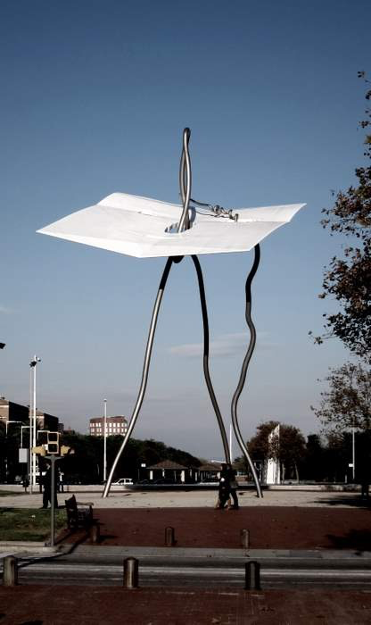
Personal Genomics:
Prioritizing High-impact Rare & Somatic Variants
Mark Gerstein, Yale
Slides freely downloadable from Lectures.GersteinLab.org
& “tweetable” (via @markgerstein). See last slide for more info.
Notes:
1

Slide 2
Increase in number of bases in SRA,
Peta-scale after ‘10
[Muir et al., GenomeBiol. (‘16)]

Slide 9
Large-scale Information:
Exponential Scaling of Data Matched by Development of Computer Technology
CPU vs Disk & Net
  As important as the increase in computer speed has been, the ability to store large amounts of information on computers is even more crucial
  Comparison with Moore’s Law
A Driving Force in Bioinformatics

Slide 10
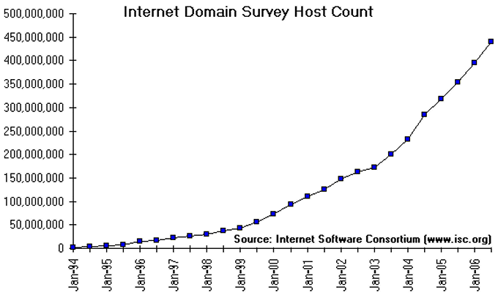
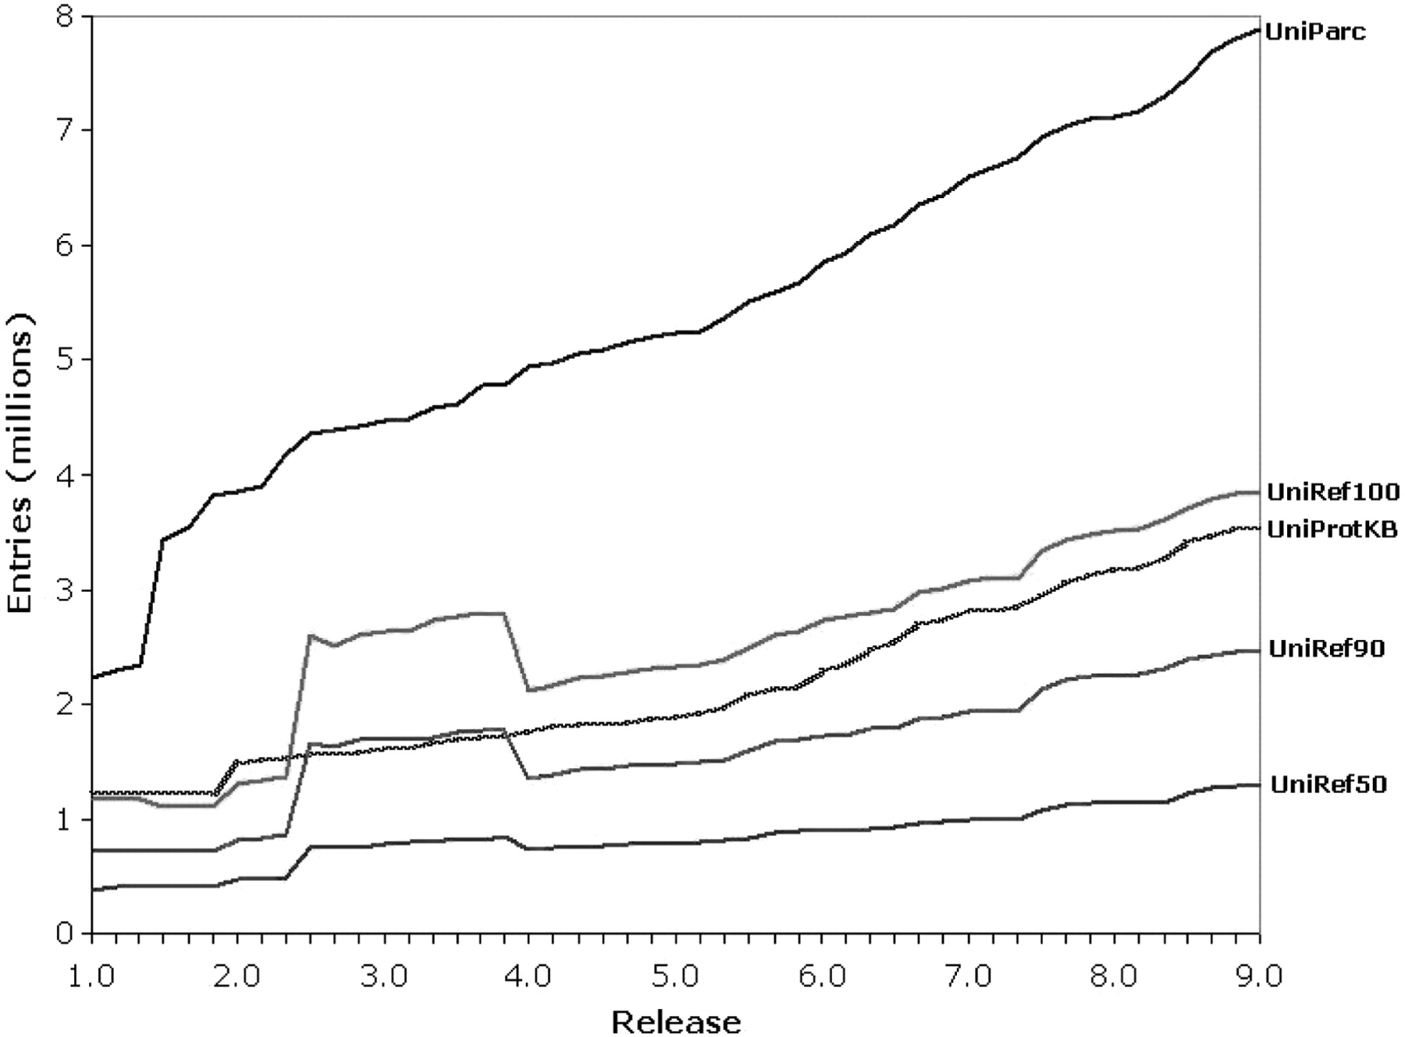
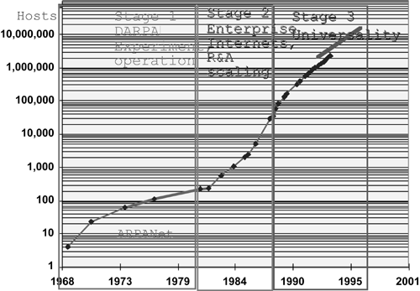
Internet Hosts (adapted from D Brutlag, Stanford & http://navigators.com/stats.html)
Proteins
Suzek, B. E. et al. Bioinformatics 2007 23:1282-1288; doi:10.1093/bioinformatics/btm098
'68
'95
'02
'06

Slide 11
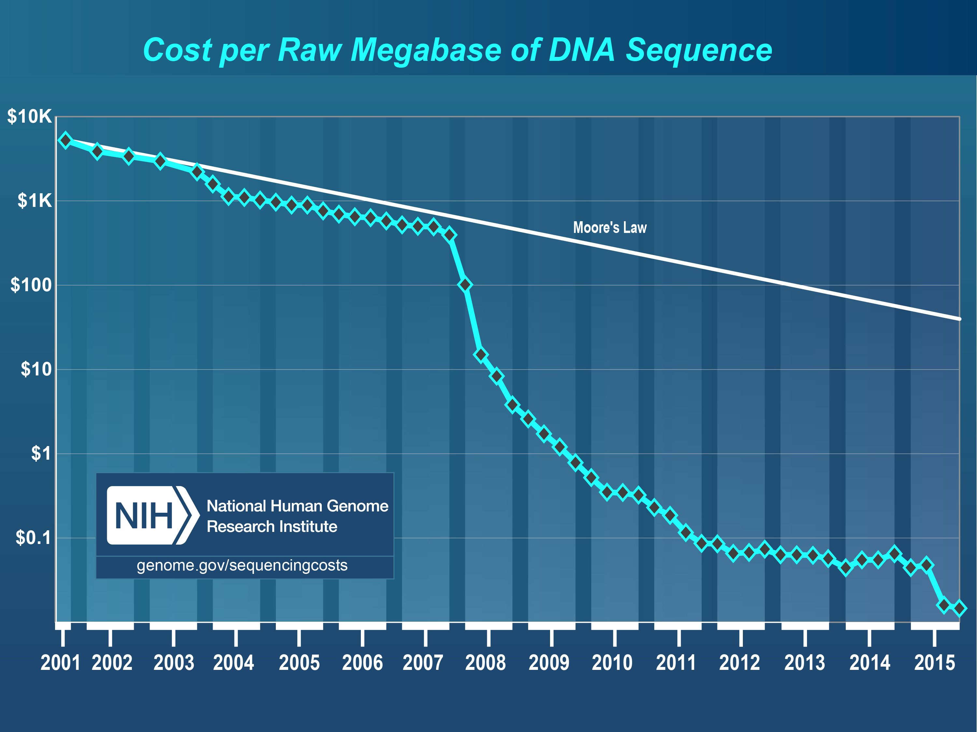
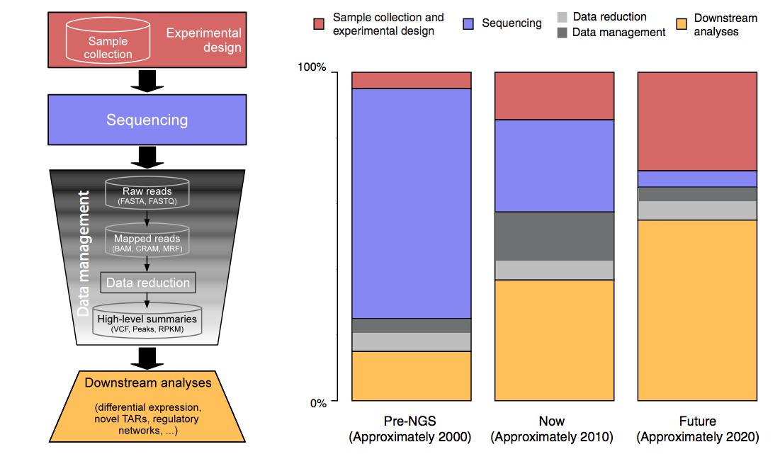
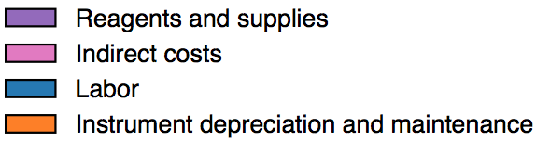
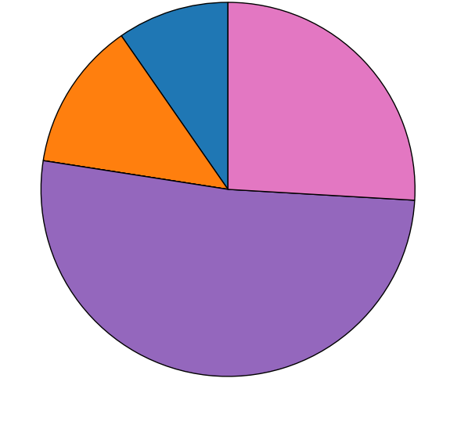
Sequencing Data Explosion: Going to
$0/base
2007
From ‘00 to ~’20,
cost of DNA sequencing expt. shifts from the actual seq. to sample
collection & analysis
[Sboner et al. (‘11), Muir et al. (‘15) GenomeBiology]

Slide 12
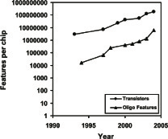
Features per Slide
transistors
Features per chip
oligo features
Chip Technology

Slide 13
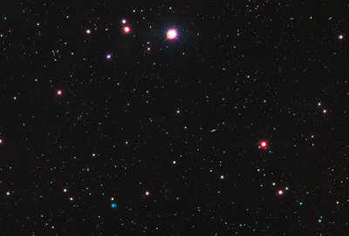











Seq Universe
[from Heidi Sofia, NHGRI]
SRA >1 petabyte
TCGA endpoint: ~2.5 Petabytes
~1.5 PB exome
~1 PB whole genome
TCGA 910Terabytes
in CGHub
Clinical
RNASeq
Epigenome
220 TB
miRNA
9
TB
16
TB
19 TB
ARRA
Autism
31 TB
2016
46 TB
32
TB
NHGRI LSSP
ADSP
NHLBI ESP
Star formation
100K Genomes England
Sofia, 2-28-14
Notes:
TCGA is the largest single project in the visible sequence universe to date and will reach 2.5 petabytes at the project end. Currently there over 900 terabytes deposited in the Cancer Genomics repository CGHub (https://cghub.ucsc.edu/summary_stats.html). This scale dwarfs its closest competitors:
1000G at 220 TB (634 in ftp://ftp-trace.ncbi.nih.gov/1000genomes/ftp/)
ADSP at 45 TB (http://www.ncbi.nlm.nih.gov/bioproject/202226)
NHGLBI Exome Sequencing program at 32 TB (http://www.ncbi.nlm.nih.gov/bioproject/165957)
NHGRI Large-scale sequencing program total at 31 TB (http://www.ncbi.nlm.nih.gov/bioproject?term=NHGRI%20Large%20Scale%20Sequencing%20Program%5BTitle%5D)
ARRA Autism at 16 TB (http://www.ncbi.nlm.nih.gov/bioproject/74861)
HMP at 19 TB (http://www.ncbi.nlm.nih.gov/bioproject/43021)
ENCODE at 13 TB (http://www.ncbi.nlm.nih.gov/bioproject/63441)
TCGA is also unique in the integration of data such as RNA-Seq, miRNA, methylation, and clinical data.
Projects just starting now, like 100K Genomes England, may eventually overtake TCGA.

Slide 14
Increasing diversity in sequence data sources
Journals not typically sequence-heavy
Non-human samples

Slide 15
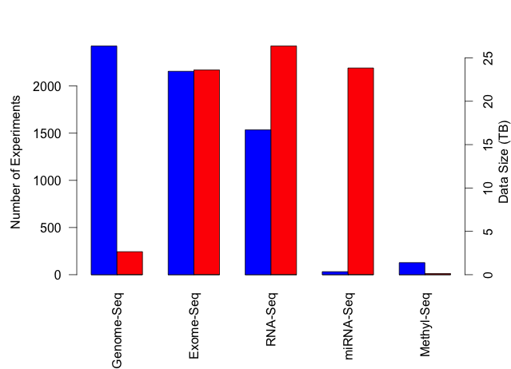
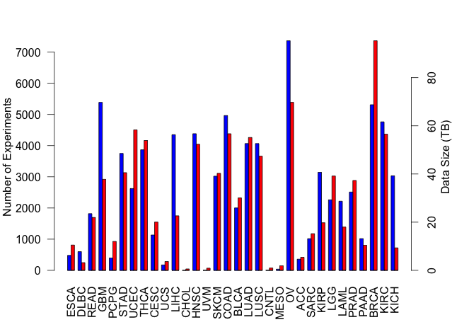
TCGA: What’s in a petabyte?
>73,000 Expt
34 Cancer Types
~5,000 Patients
Breast Cancer Experiment Types
Experiments
Data Size (TB)
TCGA Cancer Types
Breast Cancer Expt. Types
https://cghub.ucsc.edu/summary_stats.html
Notes:
----- Meeting Notes (9/23/14 17:02) -----
Make labels diagonal and bigger. Remove top panel. Arrow from BRCA to Breast Cancer expt. types.

Slide 16
Jobs: Bioinformatics is born!
Hires at 51 US universities in 3-year bins
http://jeffhuang.com/computer_science_professors.html

Slide 18
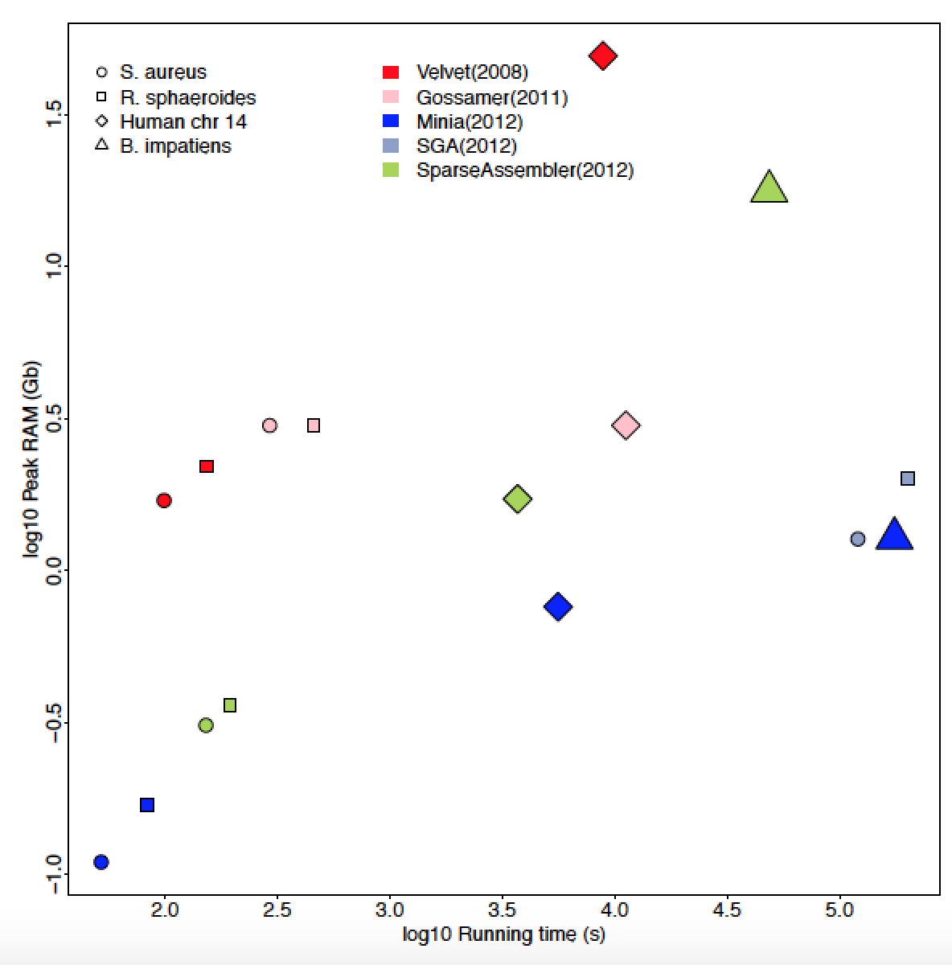
Algorithms keeping pace with data generation

Slide 19
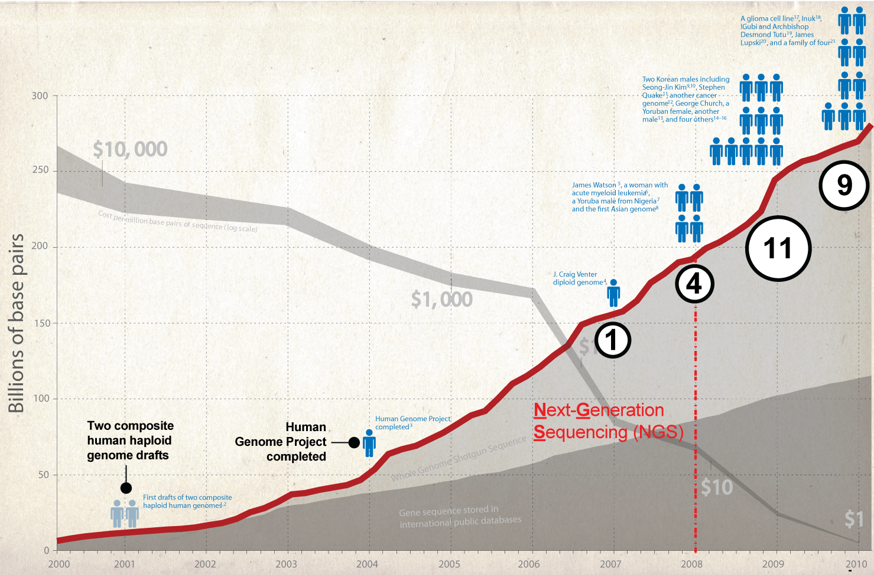
The Rise of the Personal Genome to ‘10
Adapted from Nature 2010

Slide 20
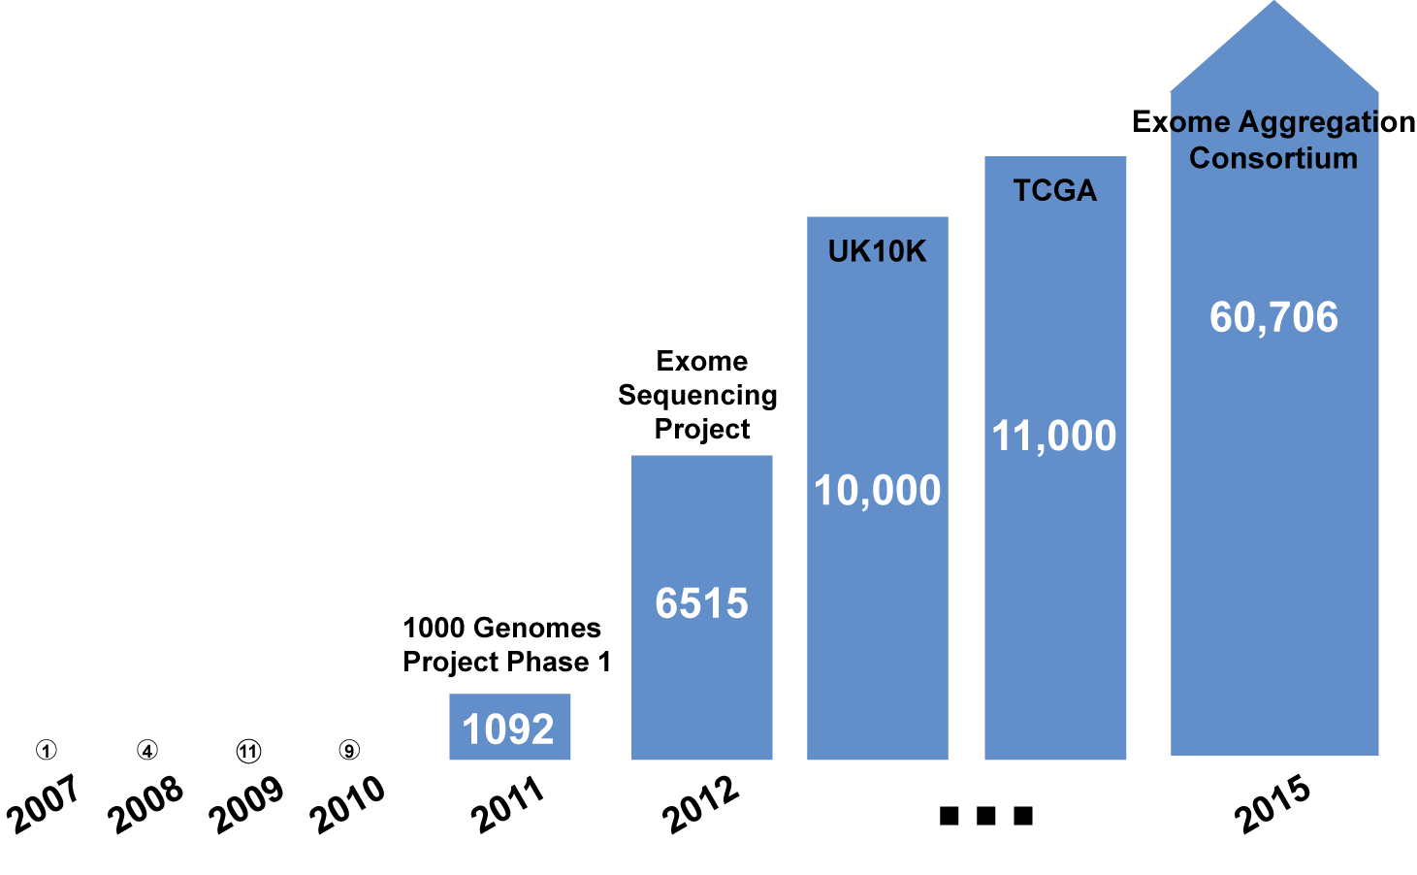
Number genomes exploding since ‘10

Slide 21
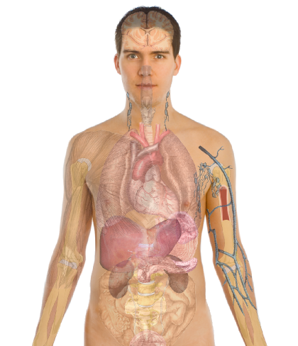
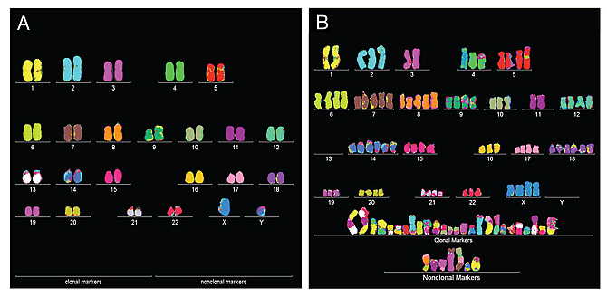

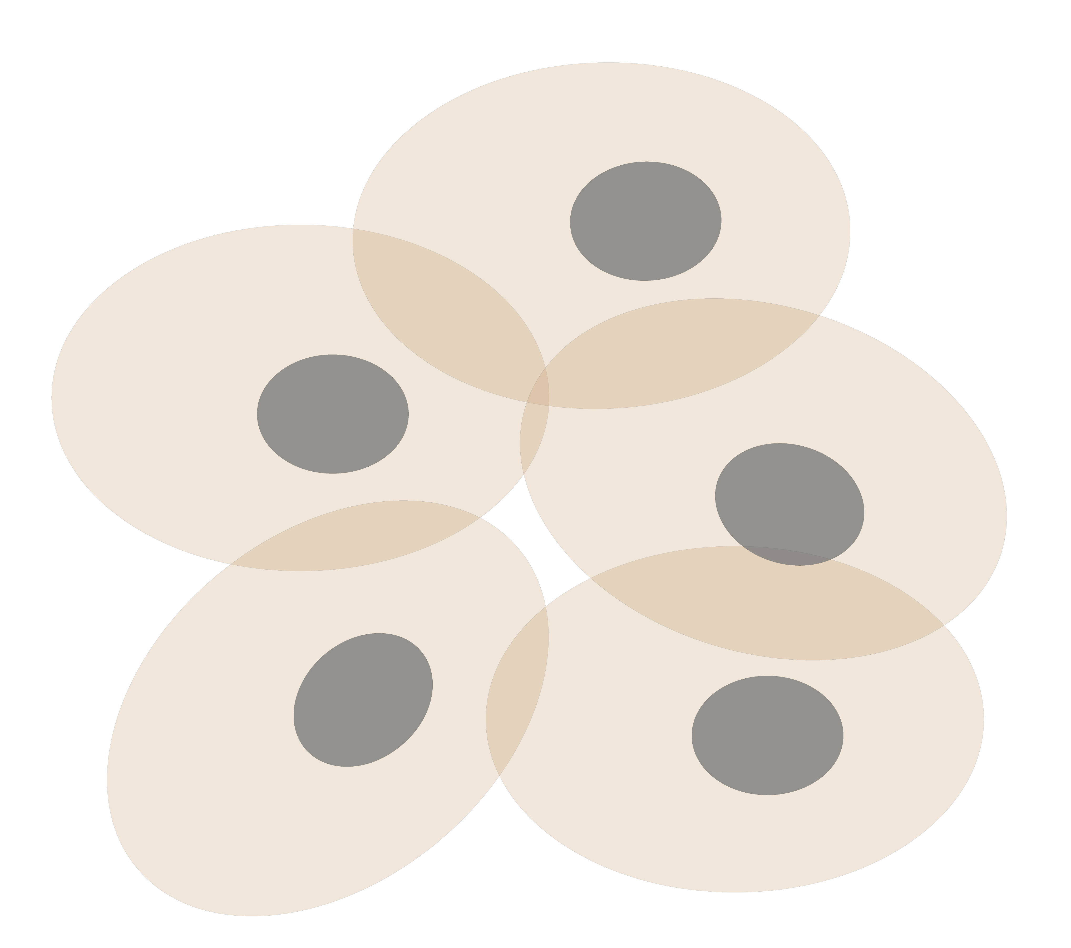
Personal Genomics
as a Gateway into Biology
Personal genomes soon will become a commonplace part of medical research & eventually treatment (esp. for cancer). They will provide a primary connection for biological science to the general public.
normal
tumor

Slide 22
Personal Genomics
as a Gateway into Biology
Personal genomes soon will become a commonplace part of medical research & eventually treatment (esp. for cancer). They will provide a primary connection for biological science to the general public.

Slide 23


Slide 24
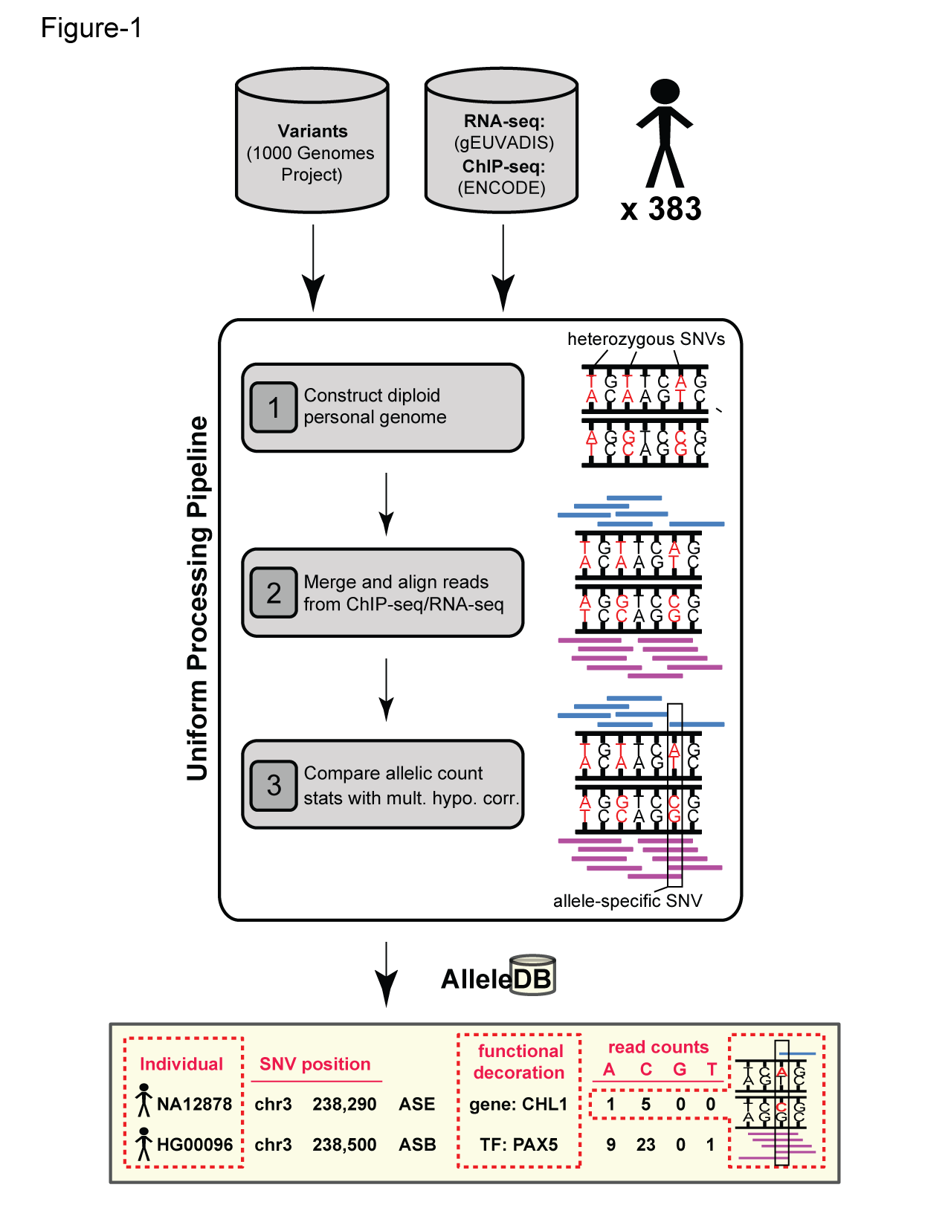
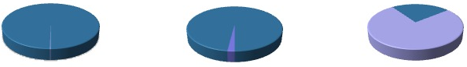
Human Genetic Variation
Population of
2,504 peoples
A Cancer Genome
A Typical Genome
Origin of Variants
Class of Variants
 | Coding | Non-coding
Germ-line | 22K | 4.1 – 5M
Somatic | ~50 | 5K
SNP | 3.5 – 4.3M
Indel | 550 – 625K
SV | 2.1 – 2.5K (20Mb)
Total | 4.1 – 5M
SNP | 84.7M
Indel | 3.6M
SV | 60K
Total | 88.3M
Prevalence of Variants
Common
Common
Passenger
Driver (~0.1%)
Rare* (1-4%)
Rare (~75%)
* Variants with allele frequency < 0.5% are considered as rare variants in 1000 genomes project.
The 1000 Genomes Project Consortium, Nature. 2015. 526:68-74
Khurana E. et al. Nat. Rev. Genet. 2016. 17:93-108

Slide 25

Finding Key Variants
Germline
CAN YOU FIND THE PANDA?
Common variants
  Can be associated with phenotype (ie disease) via a Genome-wide Association Study (GWAS), which tests whether the frequency of alleles differs between cases & controls.
  Usually their functional effect is weaker.
  Many are non-coding
  Issue of LD in identifying the actual causal variant.
Rare variants
  Associations are usually underpowered due to low frequencies.
  They often have larger functional impact
  Can be collapsed in the same element to gain statistical power (burden tests).
  In some cases, causal variants can be identified through tracing inheritance of Mendelian subtypes of diseases in large families.
McCarthy, M. et al. Nat. Rev. Genet. 2008. 9, 356-369, Zuk, O. et al. PNSA. 2014. Vol. 11, no. 4, MacArthur DG et al. Nature 2014. 508:469-476

Slide 26
Finding Key Variants
Somatic
CAN YOU FIND THE PANDA?
Overall
  Often these can be conceptualized as very rare variants
  A challenge to identify somatic mutations contributing to cancer is to find driver mutations & distinguish them from passengers.
Drivers
  Driver mutation is a mutation that directly or indirectly confers a selective growth advantage to the cell in which it occurs.
  A typical tumor contains 2-8 drivers; the remaining mutations are passengers.
Passengers
  Conceptually, a passenger mutation has no direct or indirect effect on the selective growth advantage of the cell in which it occurred.
Vogelstein B. Science 2013. 339(6127):1546-1558

Slide 27
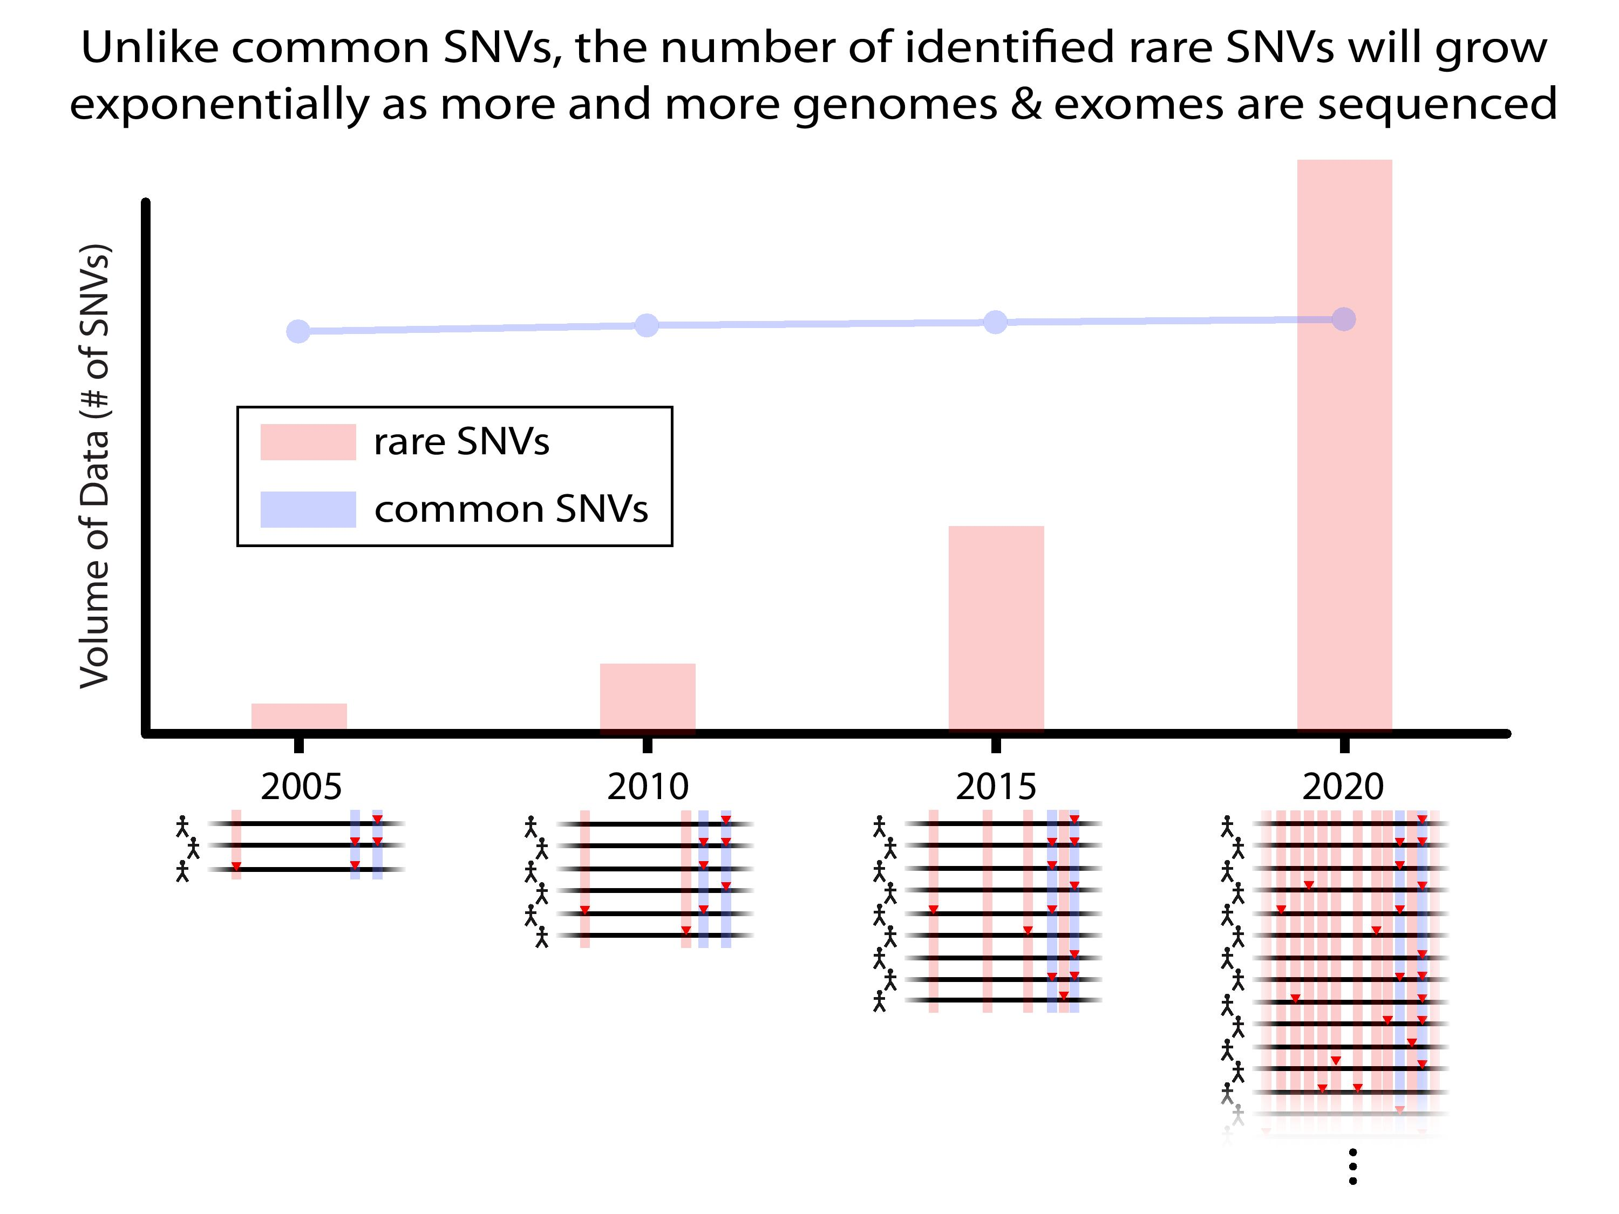

Slide 28
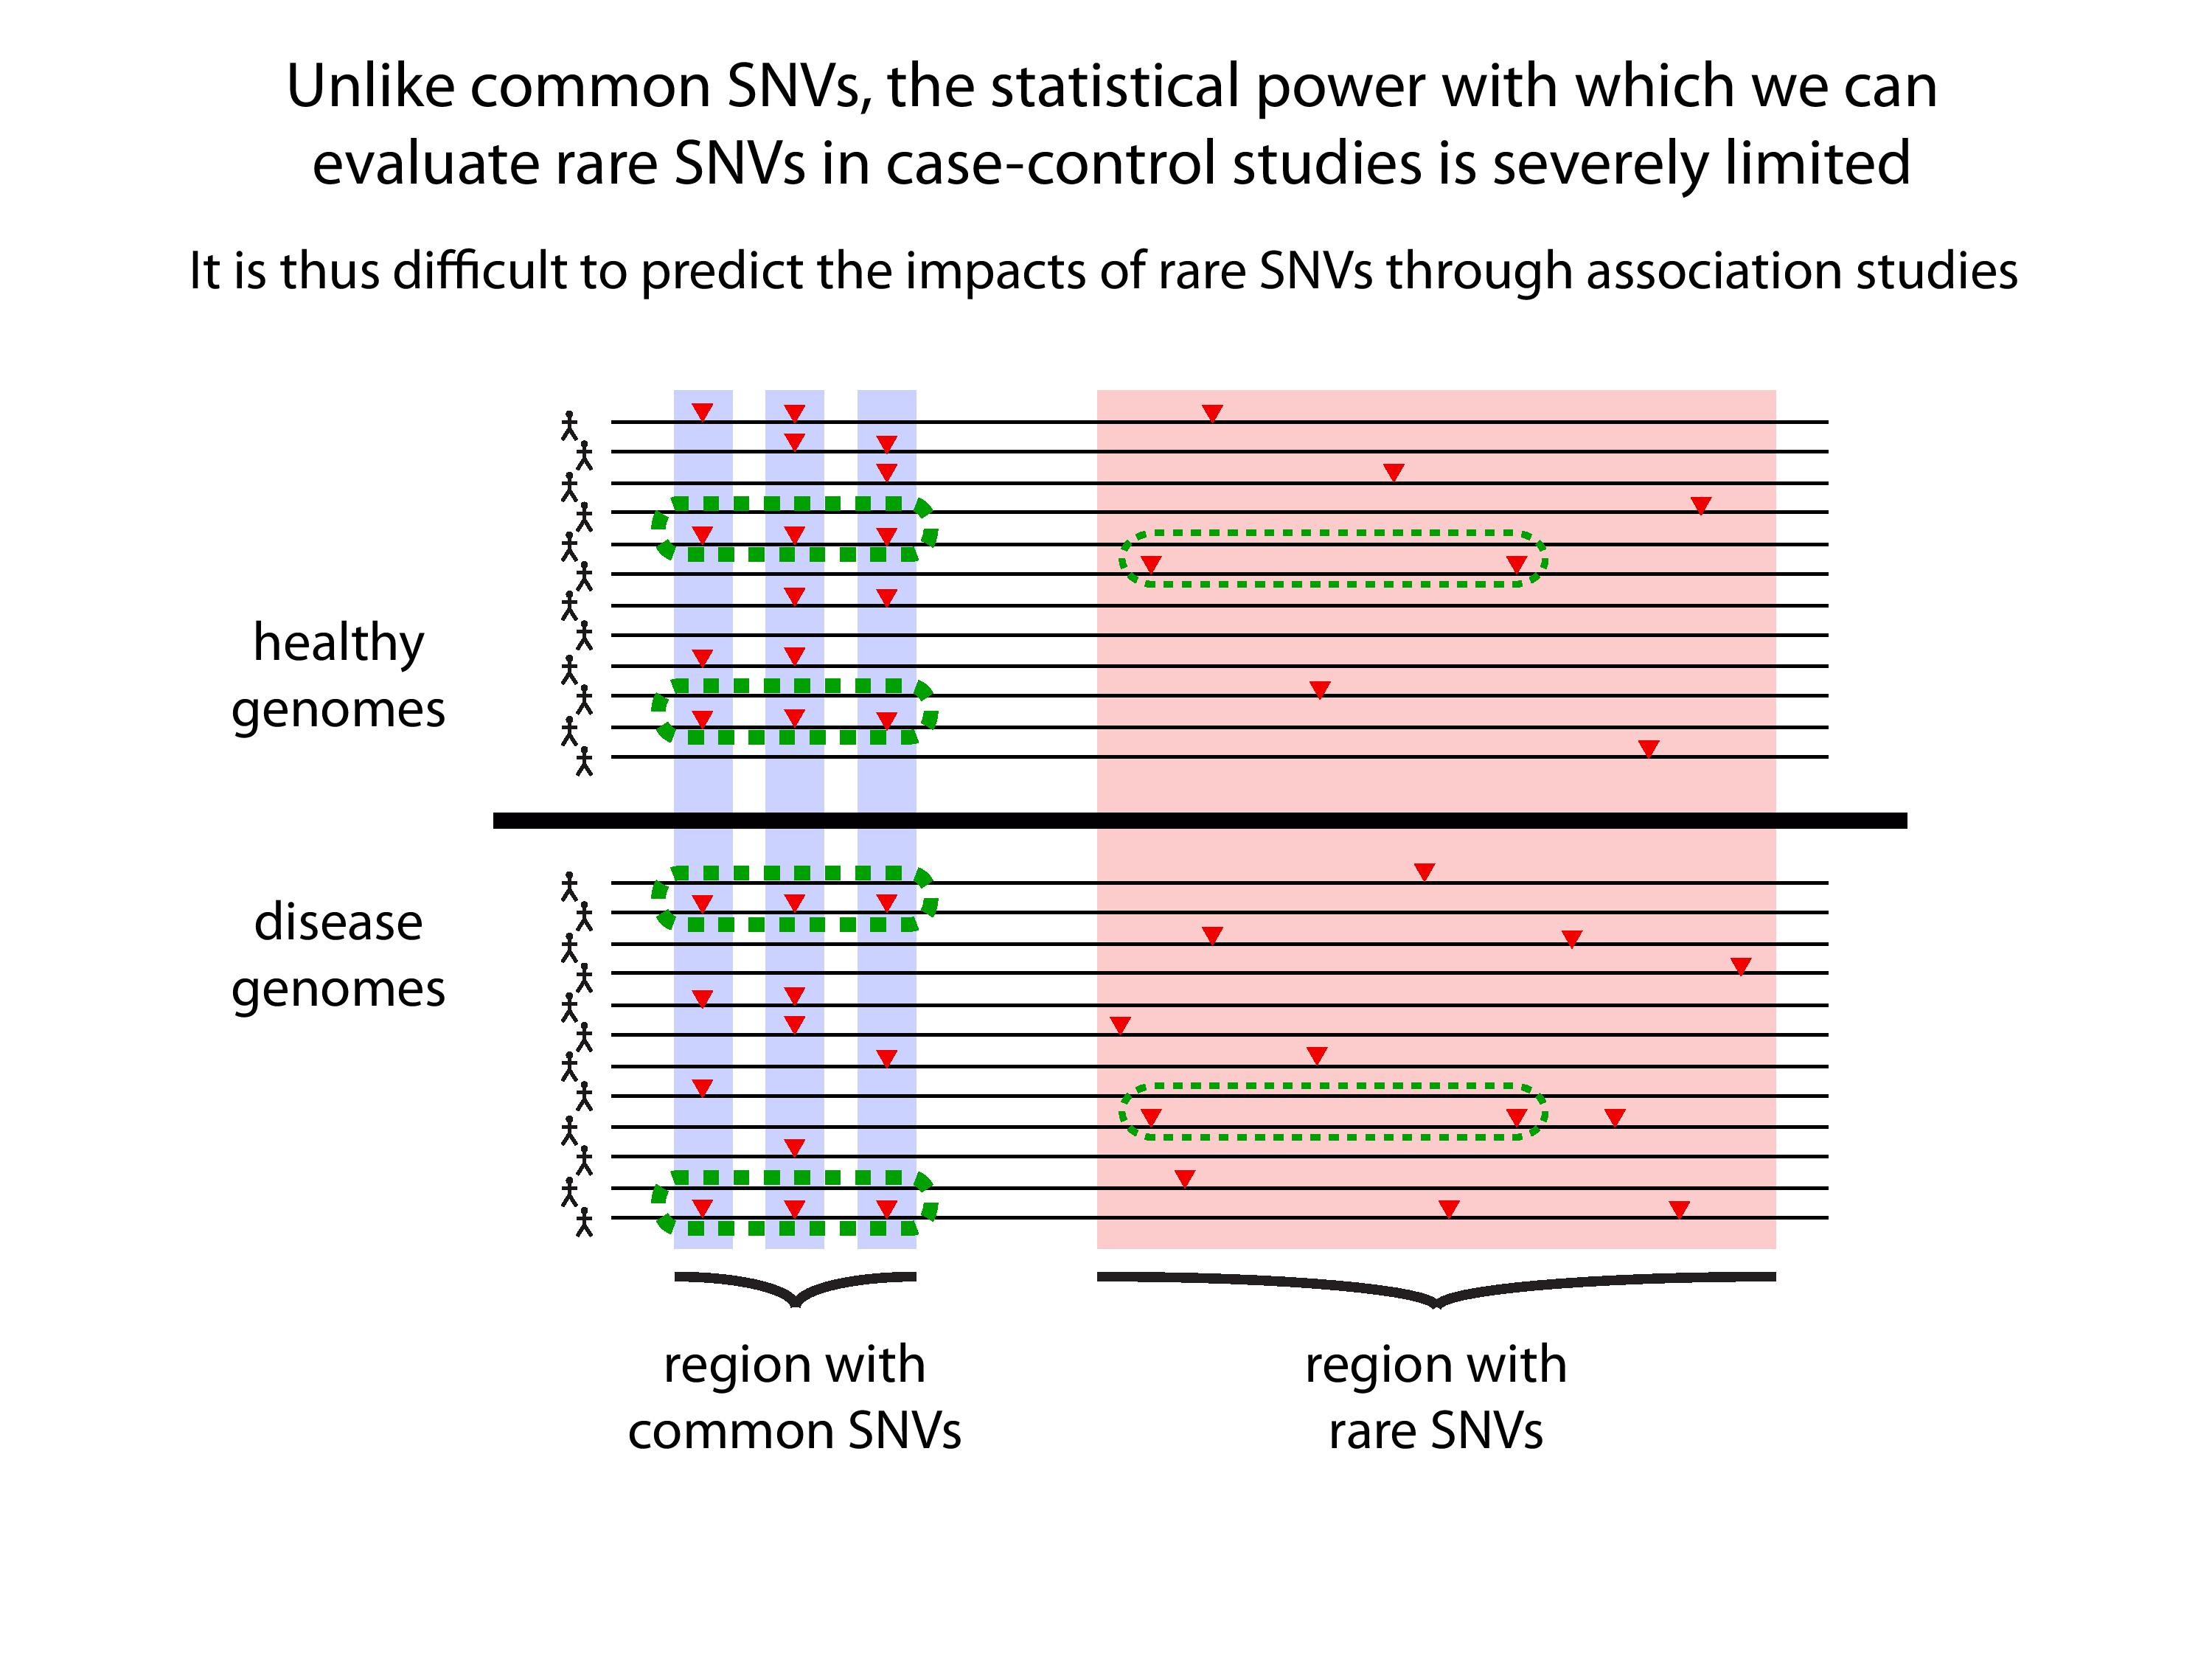

Slide 30
Association of Variants with Diseases
Common
Variants
Healthy
Rare or
Somatic
Variants
Pooled
Variants
High
Function
Impact
Diseased
Burden Test
GWAS Positive

Slide 31
Personal Genomics:
Prioritizing High-impact Rare & Somatic Variants
Introduction: the landscape of variants in personal genomes
Characterizing Rare Variants in Coding Regions
  Identifying with STRESS
  cryptic allosteric sites
    On surface & in interior bottlenecks
Non-coding Variants #1: Prioritizing rare variants with “sensitive sites”
(human-conserved)
Non-coding Variants #2:
Prioritizing using AlleleDB
in terms of allelic elements
  Having observed difference in molecular activity in many contexts
  Key technical Issue:
  Need to build personal genomes
    Assessing their quality via read mapping
Putting it together in workflows
  Integrating evidence on non-coding variants with FunSeq
    Systematically weighting all the features
    suggesting non-coding drivers
    Prioritzing rare germline variants
  Using Larva to do burden testing on non-coding annotation
    Need to correct for over-dispersion in bionomial
    Parameterized according to replication timing

Slide 32
Personal Genomics:
Prioritizing High-impact Rare & Somatic Variants
Introduction: the landscape of variants in personal genomes
Characterizing Rare Variants in Coding Regions
  Identifying with STRESS
  cryptic allosteric sites
    On surface & in interior bottlenecks
Non-coding Variants #1: Prioritizing rare variants with “sensitive sites”
(human-conserved)
Non-coding Variants #2:
Prioritizing using AlleleDB
in terms of allelic elements
  Having observed difference in molecular activity in many contexts
  Key technical Issue:
  Need to build personal genomes
    Assessing their quality via read mapping
Putting it together in workflows
  Integrating evidence on non-coding variants with FunSeq
    Systematically weighting all the features
    suggesting non-coding drivers
    Prioritzing rare germline variants
  Using Larva to do burden testing on non-coding annotation
    Need to correct for over-dispersion in bionomial
    Parameterized according to replication timing

Slide 33
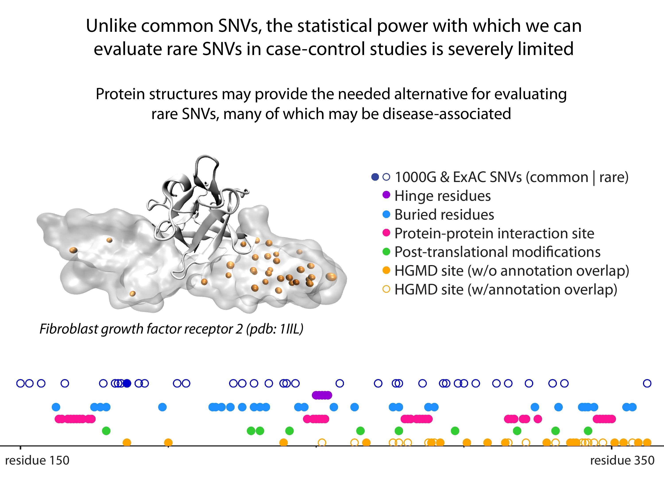
[Sethi et al. COSB (’15)]

Slide 34
Models of Protein Conformational Change
Motion Vectors from Normal Modes (ANMs)
PDB ID: 3RFU
Adapted from Fuglebakk et al, 2014
Characterizing uncharacterized variants
<= Finding Allosteric sites
<= Modeling motion

Slide 35
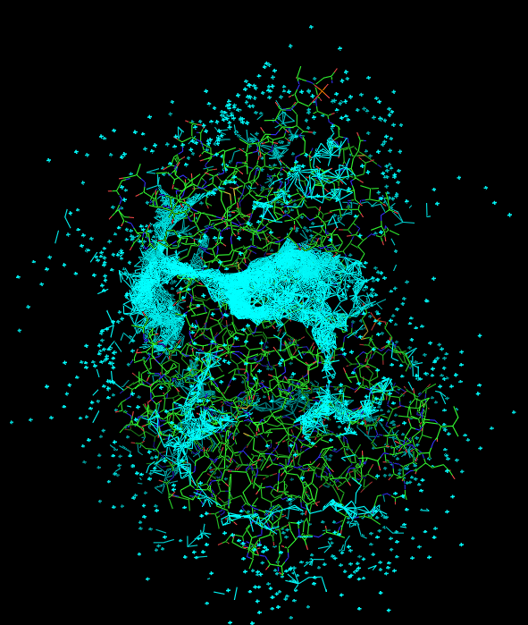
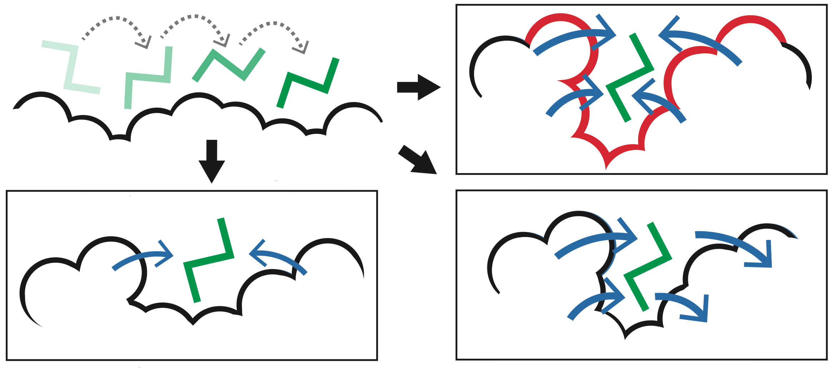
Predicting Allosterically-Important Residues at the Surface
MC simulations generate a large number of candidate sites
Score each candidate site by the degree to which it perturbs large-scale motions
Prioritize & threshold the list to identify the set of high confidence-sites
pdb 1J3H
Surface region with high
density of candidate sites
Surface region with low density of candidate sites
Adapted from Clarke*, Sethi*, et al (in press)

Slide 36
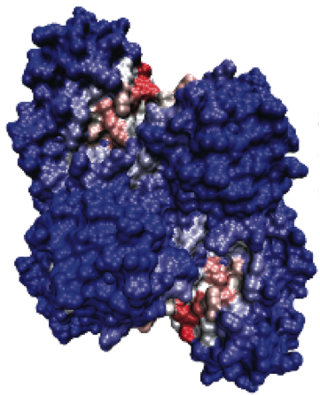
Predicting Allosterically-Important Residues at the Surface
PDB: 3PFK
Adapted from Clarke*, Sethi*, et al (in press)

Slide 37
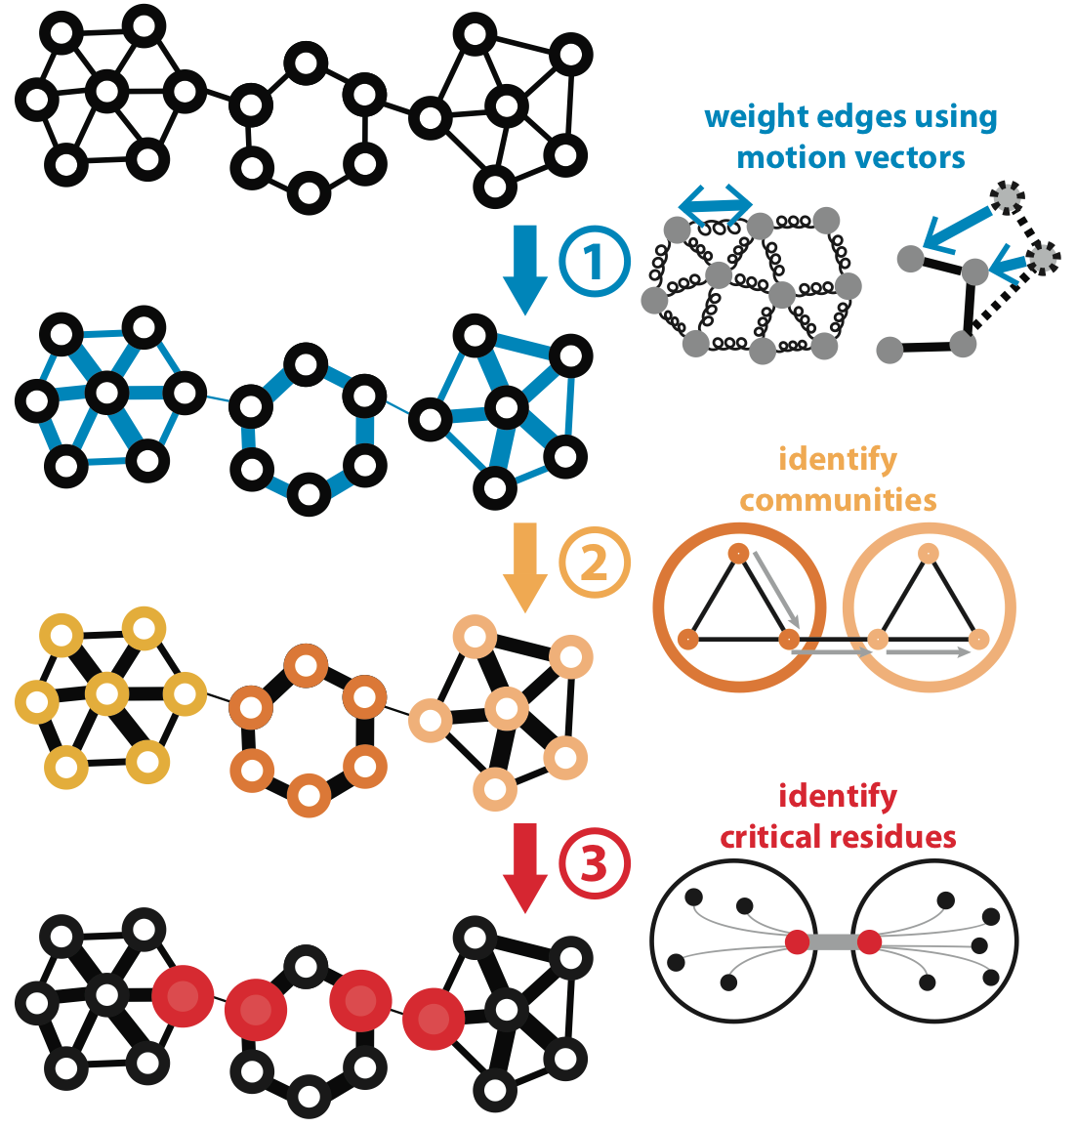
Predicting Allosterically-Important Residues within the Interior
Adapted from Clarke*, Sethi*, et al (in press)

Slide 38
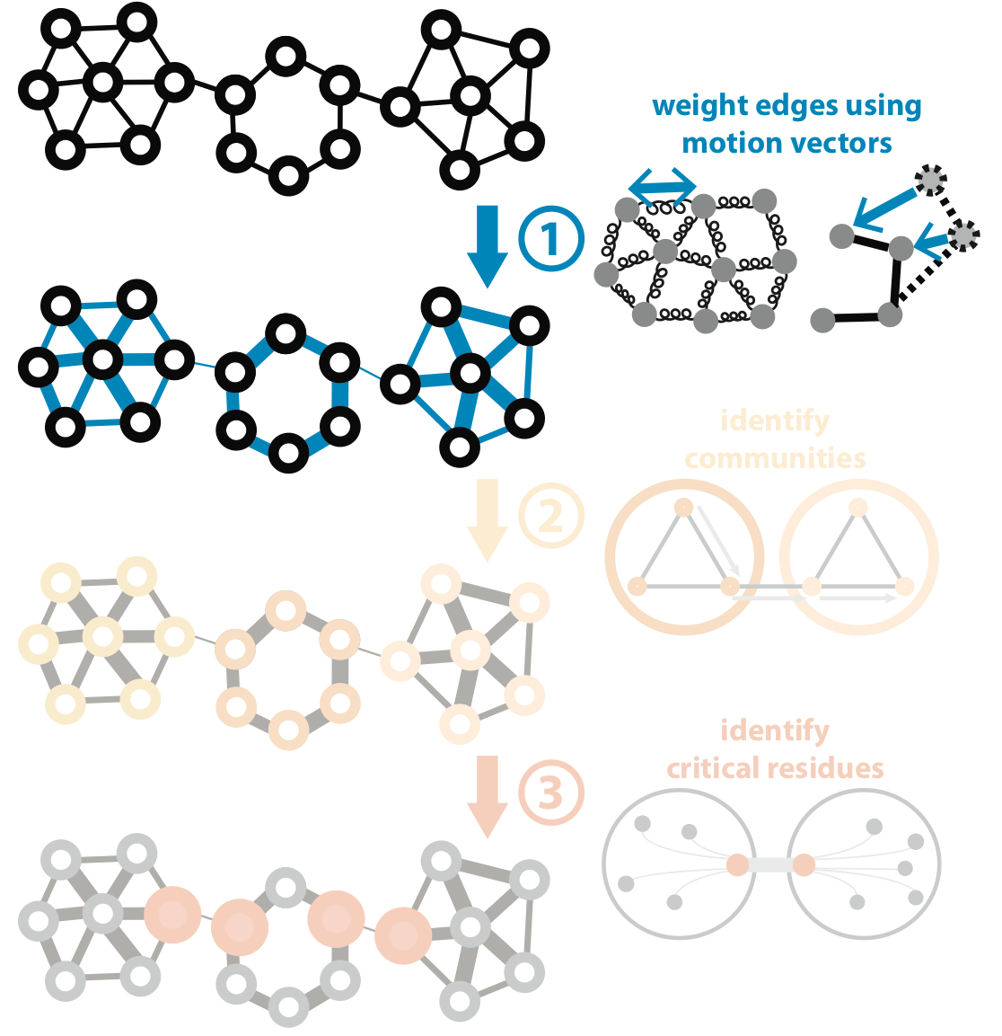
Predicting Allosterically-Important Residues within the Interior
Adapted from Clarke*, Sethi*, et al (in press)

Slide 39
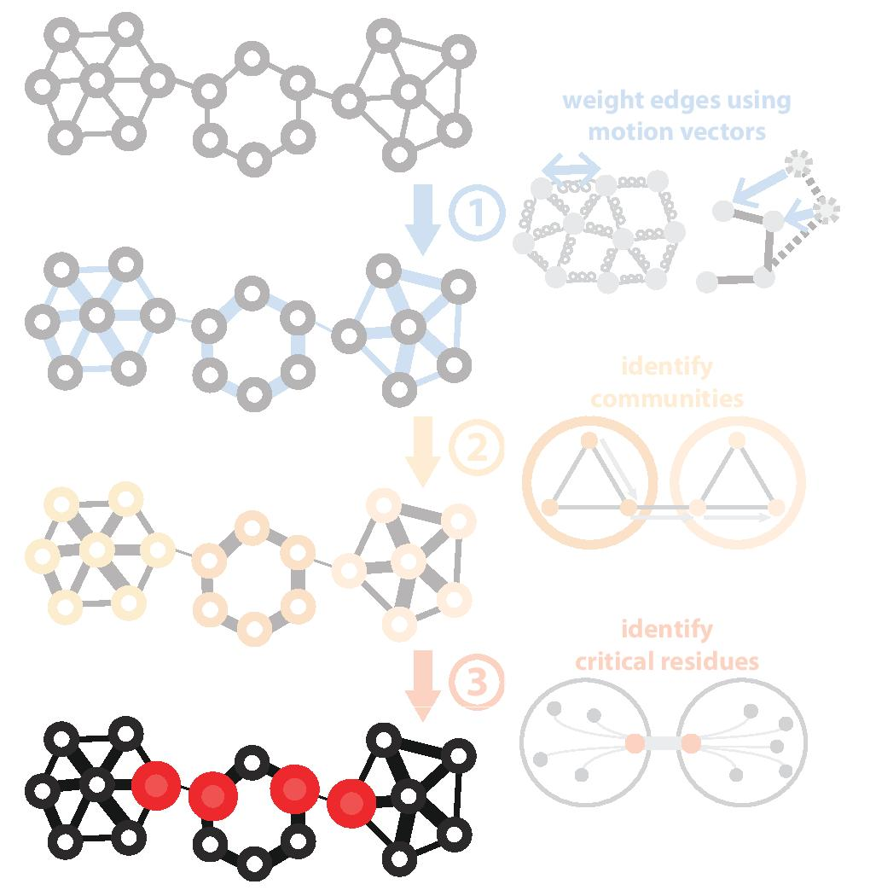
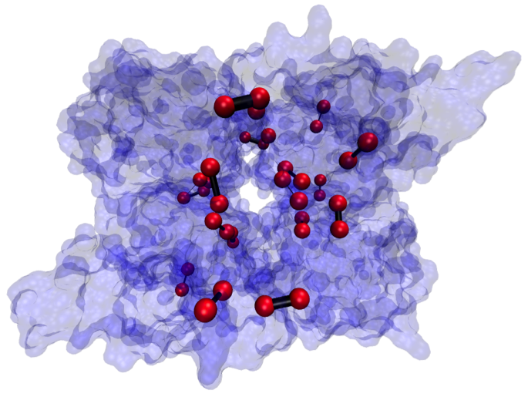
Predicting Allosterically-Important Residues within the Interior
PDB: 1XTT
Adapted from Clarke*, Sethi*, et al (in press)

Slide 40
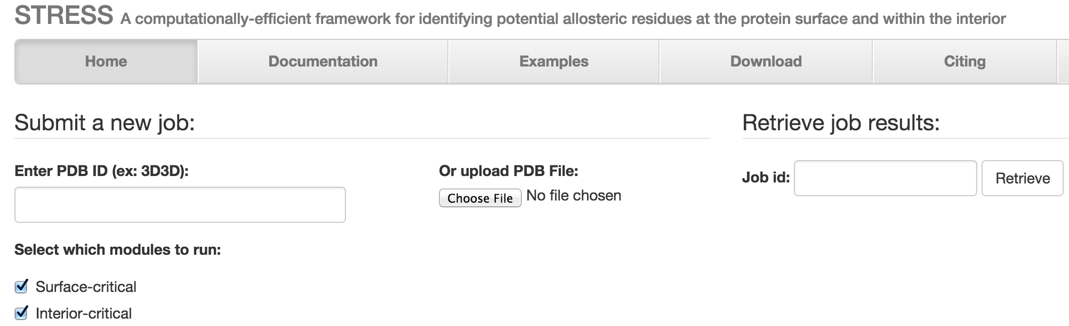
STRESS Server Architecture: Highlights
stress.molmovdb.org
A light front-end server handles incoming requests, and powerful back-end servers perform calculations.
Auto Scaling adjusts the number of back-end servers as needed.
A typical structure takes ~30 minutes on a E5-2660 v3 (2.60GHz) core.
Input & output (i.e., predicted allosteric residues) are stored in S3 buckets.
Adapted from Clarke*, Sethi*, et al (in press)

Slide 41
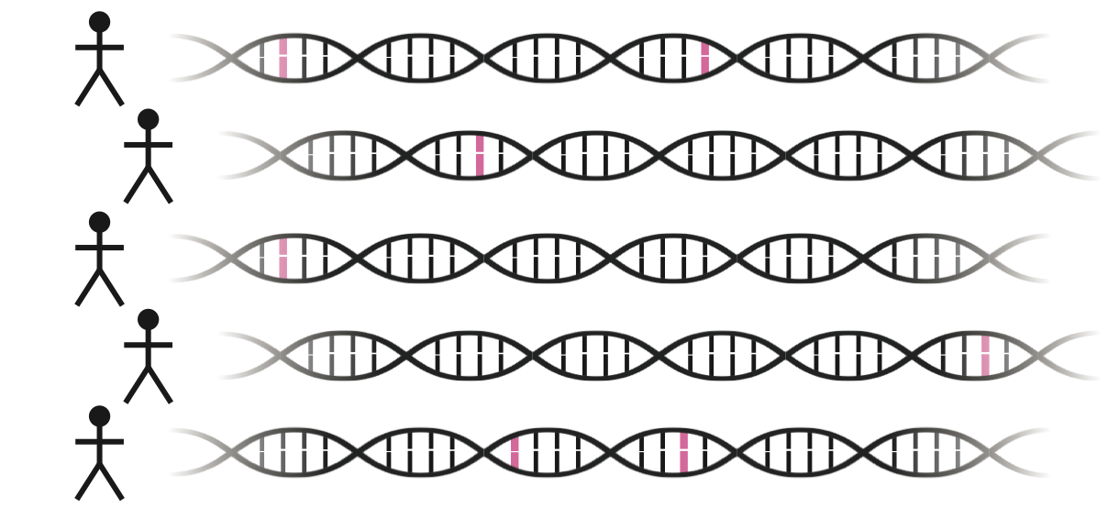
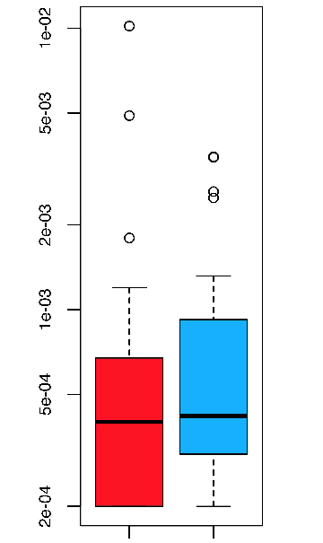
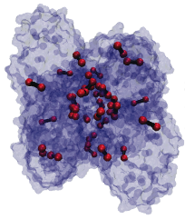
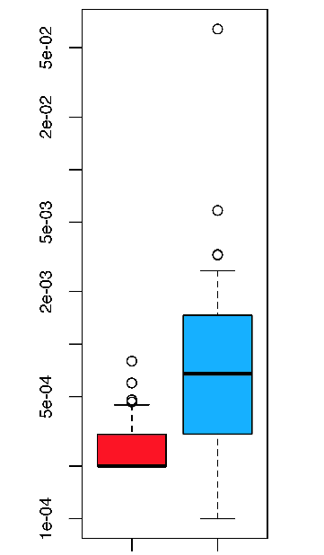
Intra-species conservation of predicted allosteric residues
1000 Genomes
Surface
Interior
Derived Allele Freq.
Derived Allele Freq.
p=0.309
p=1.80e-05
Adapted from Clarke*, Sethi*, et al (in press)

Slide 42
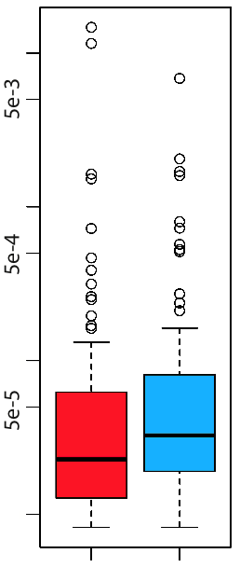
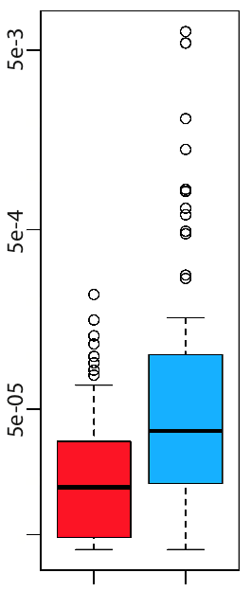
Intra-species conservation of predicted allosteric residues
ExAC
Surface
Interior
Minor Allele Freq.
Minor Allele Freq.
p=1.49e-3
p=7.98e-09
Adapted from Clarke*, Sethi*, et al (in press)

Slide 43
[Sethi et al. COSB (’15)]

Slide 44
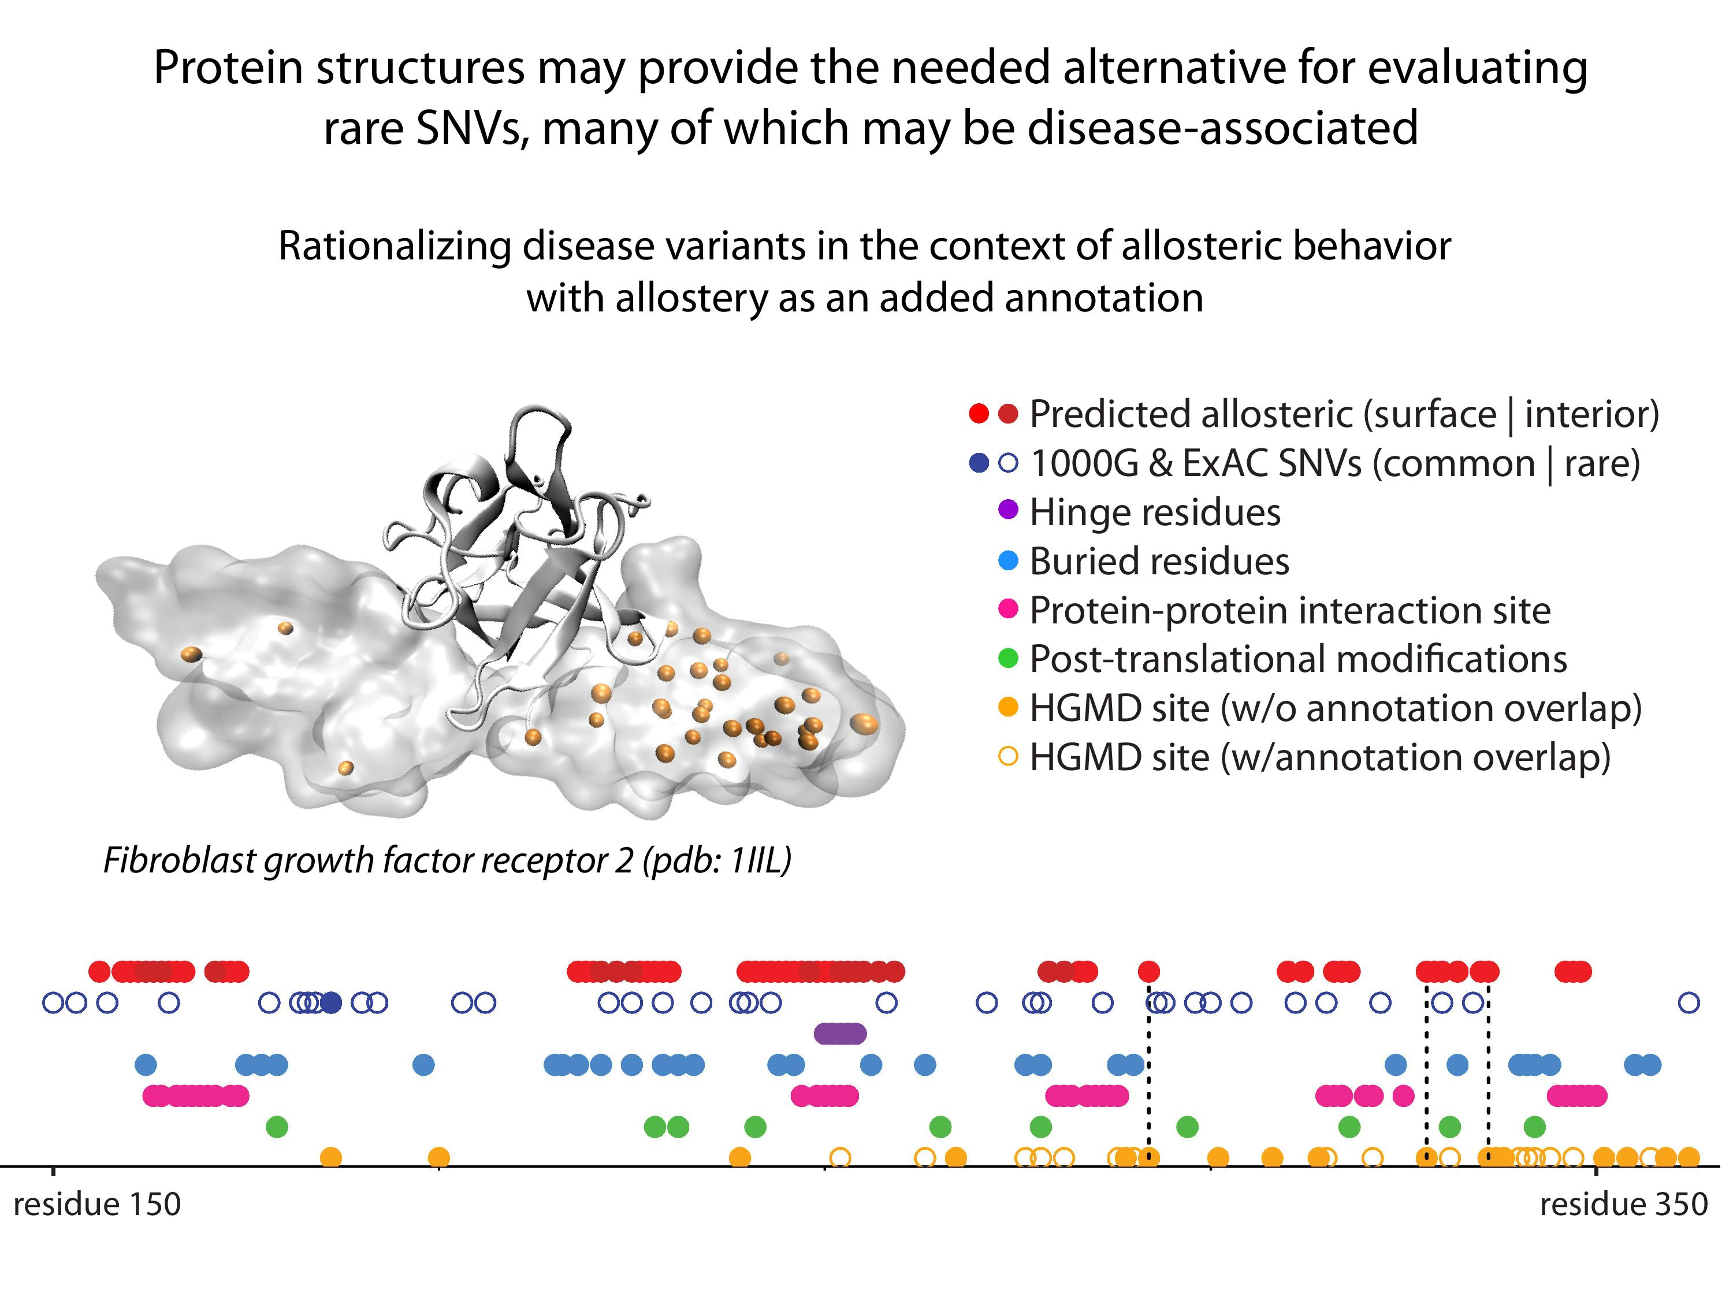
44
[Sethi et al. COSB (’15)]
Adapted from Clarke*, Sethi*, et al (in press)

Slide 45
Known binding sites constitute a subset of the allosteric sites on the protein surface – to what degree can they be found in a gold standard set?

Slide 46
Predicting Allosteric Sites at the Surface: Predicted & Known

Slide 47
Predicting Allosterically-Important Residues at
Surfaces within the Canonical Set
Statistics on the surfaces of apo structures

Slide 48
Personal Genomics:
Prioritizing High-impact Rare & Somatic Variants
Introduction: the landscape of variants in personal genomes
Characterizing Rare Variants in Coding Regions
  Identifying with STRESS
  cryptic allosteric sites
    On surface & in interior bottlenecks
Non-coding Variants #1: Prioritizing rare variants with “sensitive sites”
(human-conserved)
Non-coding Variants #2:
Prioritizing using AlleleDB
in terms of allelic elements
  Having observed difference in molecular activity in many contexts
  Key technical Issue:
  Need to build personal genomes
    Assessing their quality via read mapping
Putting it together in workflows
  Integrating evidence on non-coding variants with FunSeq
    Systematically weighting all the features
    suggesting non-coding drivers
    Prioritzing rare germline variants
  Using Larva to do burden testing on non-coding annotation
    Need to correct for over-dispersion in bionomial
    Parameterized according to replication timing

Slide 49
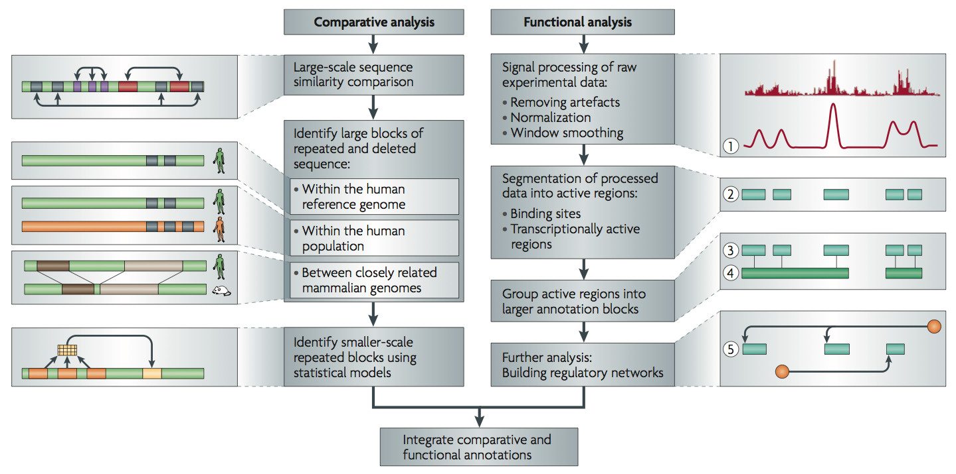
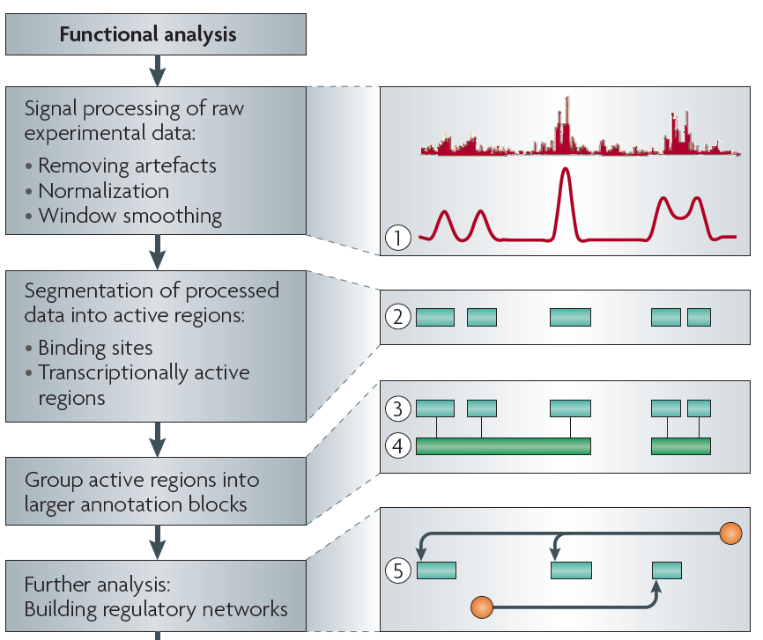
Non-coding Annotations:
Overview
Sequence features, incl. Conservation
Functional Genomics
Chip-seq (Epigenome & seq. specific TF) and ncRNA & un-annotated transcription
[Alexander et al., Nat. Rev. Genet. (’10)]

Slide 50
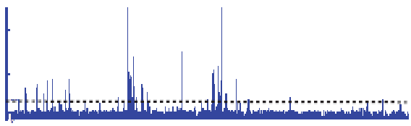

Summarizing the Signal:
"Traditional" ChipSeq Peak Calling
ChIP
Generate & threshold the signal profile to identify candidate target regions
  Simulation (PeakSeq),
  Local window based Poisson (MACS),
  Fold change statistics (SPP)
Threshold
Potential Targets
Normalized Control
Score against the control
Significantly Enriched targets
Now an update: "PeakSeq 2" => MUSIC
[Rozowsky et al. ('09) Nat Biotech]

Slide 51
Finding "Conserved” Sites in the Human Population:
Negative selection in non-coding elements based on
Production ENCODE & 1000G Phase 1
Broad categories of regulatory regions under negative selection
Related to:
ENCODE, Nature, 2012
Ward & Kellis, Science, 2012
Mu et al, NAR, 2011
(Non-coding RNA)
(DNase I hypersensitive sites)
(TFSS: Sequence-specific TFs)
(Transcription factor binding sites)
Depletion of Common Variants
in the Human Population
[Khurana et al., Science (‘13)]

Slide 52
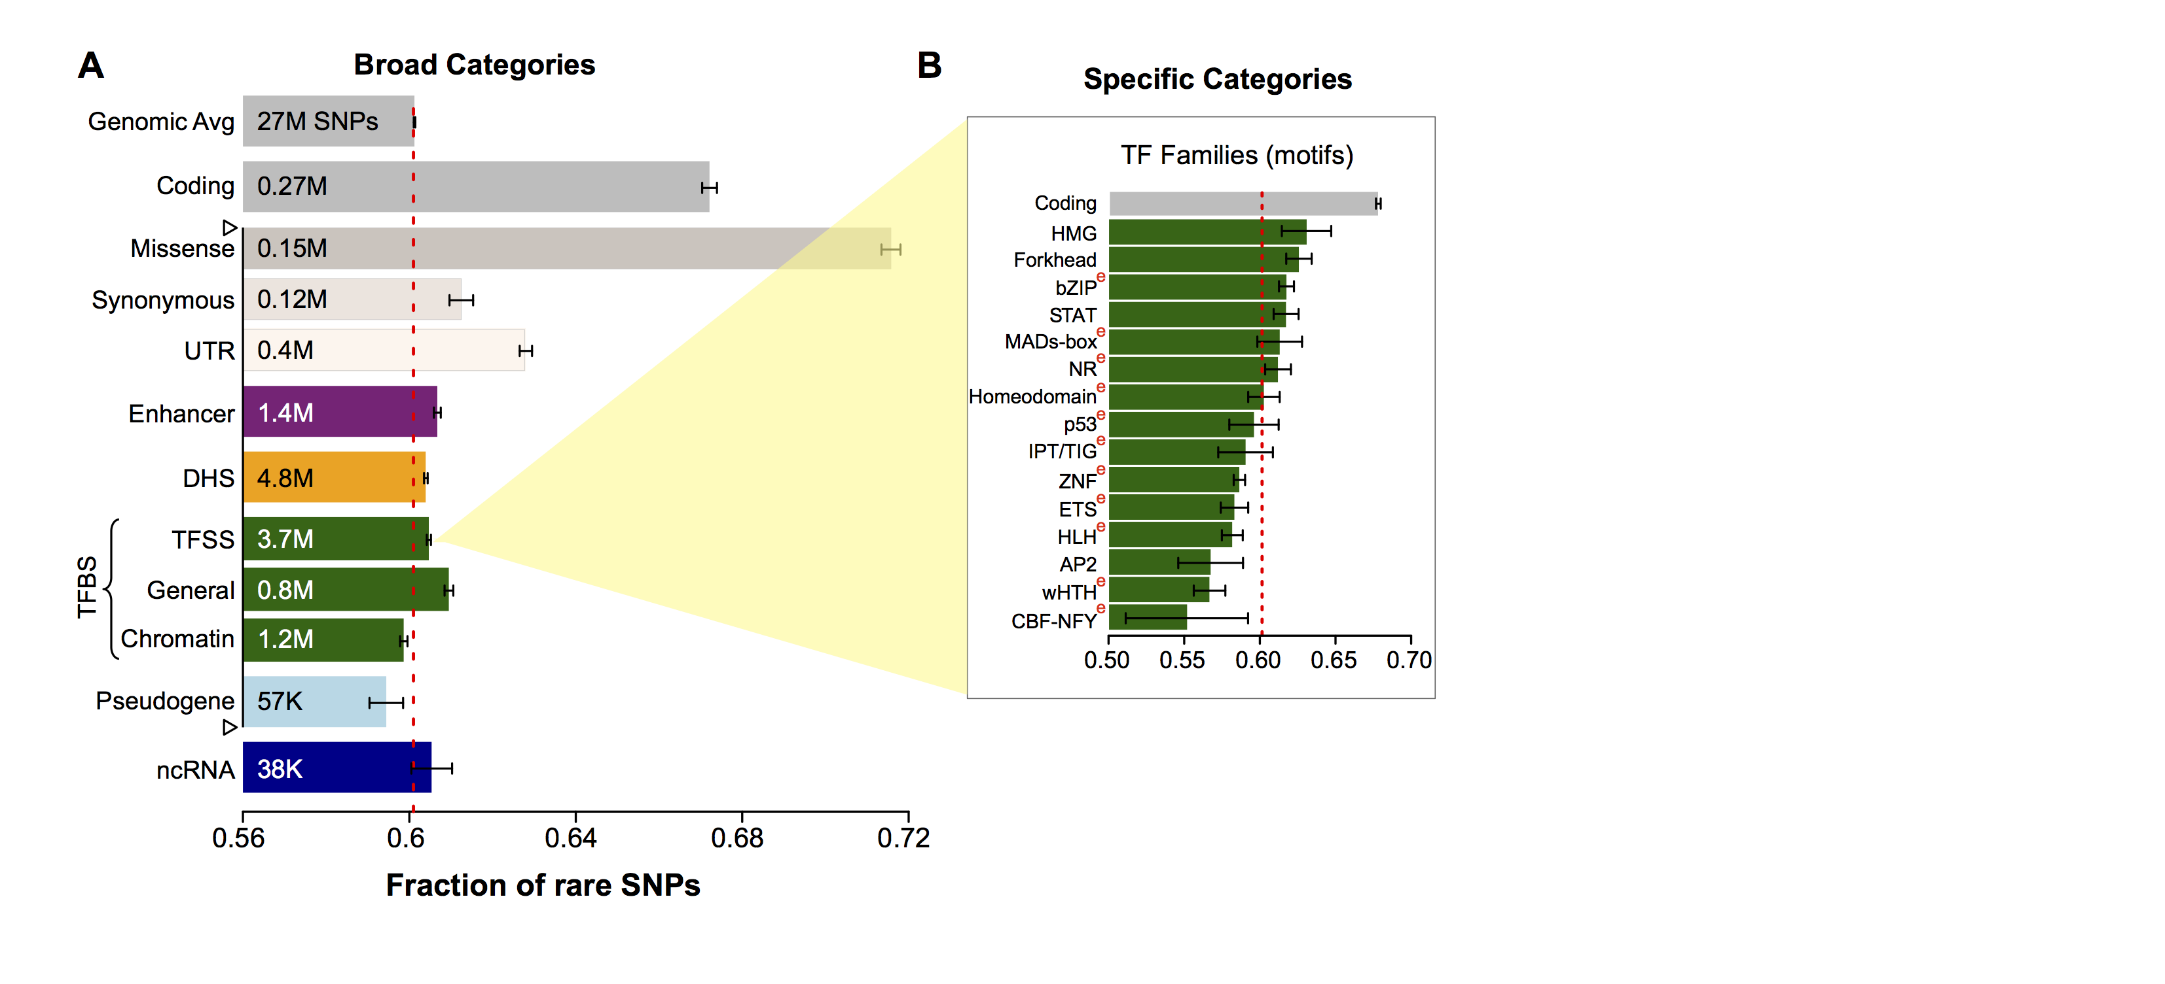
Differential selective constraints among specific sub-categories
Sub-categorization possible because of better statistics from 1000G phase 1 v pilot
[Khurana et al., Science (‘13)]

Slide 53
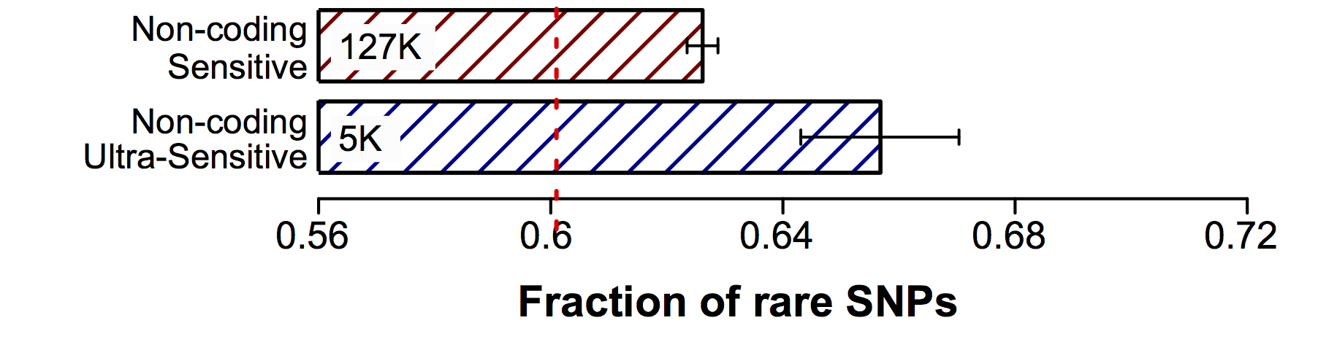
Defining Sensitive non-coding Regions
~0.4% genomic coverage (~ top 25)
~0.02% genomic coverage (top 5)
Start 677 high-resolution non-coding categories; Rank & find those under strongest selection
Sub-categorization possible because of better statistics from 1000G phase 1 v pilot
[Khurana et al., Science (‘13)]

Slide 54
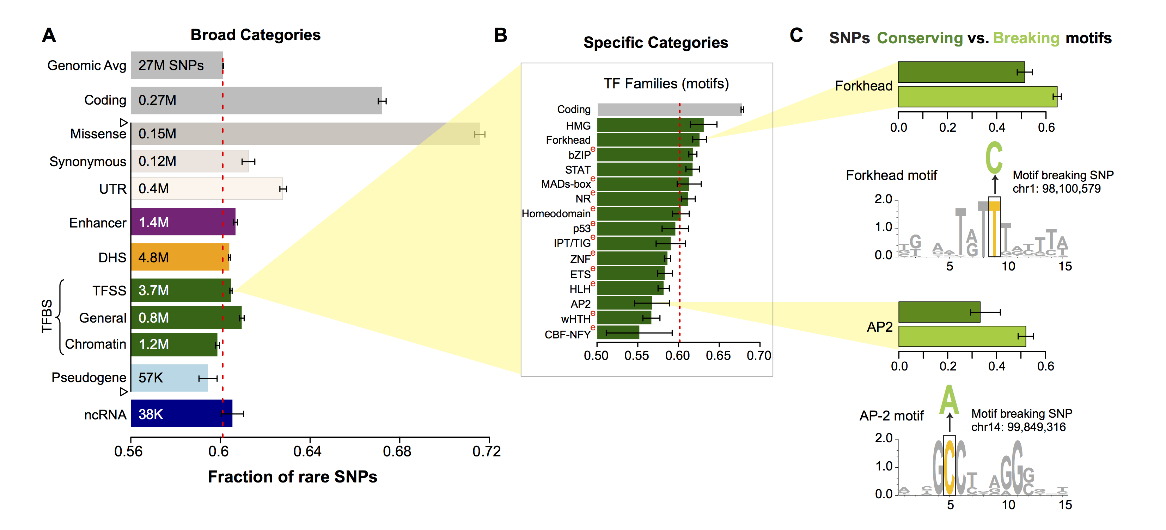
SNPs which break TF motifs are under stronger selection
[Khurana et al., Science (‘13)]

Slide 55
Personal Genomics:
Prioritizing High-impact Rare & Somatic Variants
Introduction: the landscape of variants in personal genomes
Characterizing Rare Variants in Coding Regions
  Identifying with STRESS
  cryptic allosteric sites
    On surface & in interior bottlenecks
Non-coding Variants #1: Prioritizing rare variants with “sensitive sites”
(human-conserved)
Non-coding Variants #2:
Prioritizing using AlleleDB
in terms of allelic elements
  Having observed difference in molecular activity in many contexts
  Key technical Issue:
  Need to build personal genomes
    Assessing their quality via read mapping
Putting it together in workflows
  Integrating evidence on non-coding variants with FunSeq
    Systematically weighting all the features
    suggesting non-coding drivers
    Prioritzing rare germline variants
  Using Larva to do burden testing on non-coding annotation
    Need to correct for over-dispersion in bionomial
    Parameterized according to replication timing

Slide 56
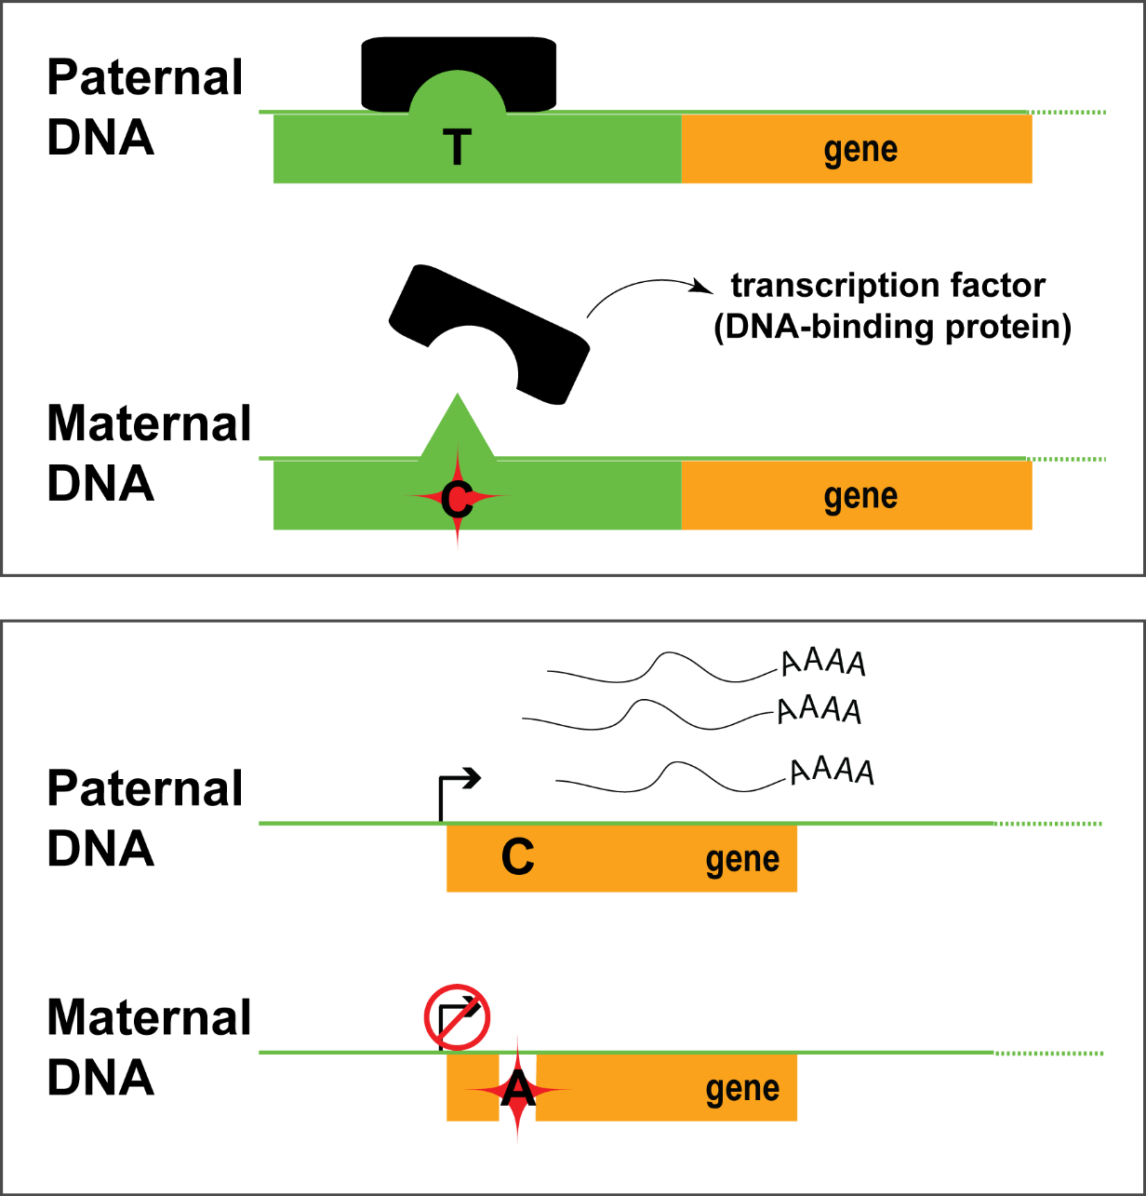
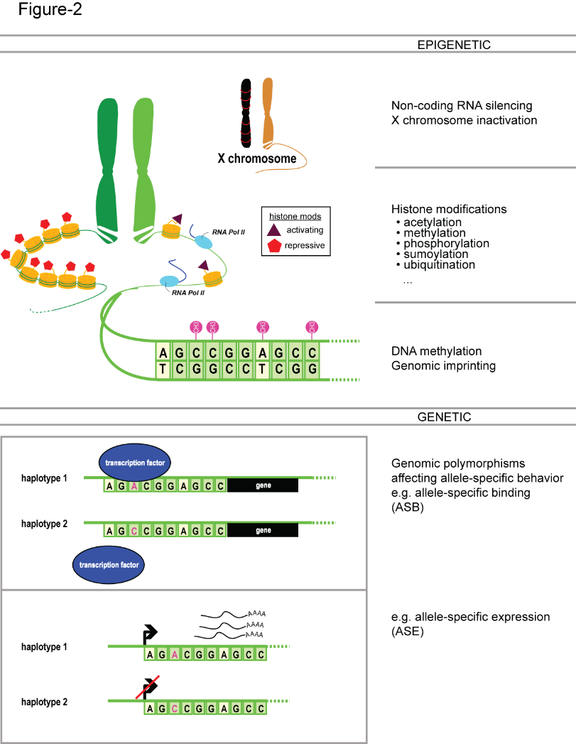
Allele-specific binding and expression
variants

Slide 57



Inferring Allele Specific Binding/Expression using Sequence Reads
RNA/ChIP-Seq Reads
ACTTTGATAGCGTCAATG
CTTTGATAGCGTCAATGC
CTTTGATAGCGTCAACGC
TTGACAGCGTCAATGCAC
TGATAGCGTCAATGCACG
ATAGCGTCAATGCACGTC
TAGCGTCAATGCACGTCG
CGTCAACGCACGTCGGGA
GTCAATGCACGTCGAGAG
CAATGCACGTCGGGAGTT
AATGCACGTCGGGAGTTG
TGCACGTTGGGAGTTGGC
10 x T
2 x C
…AACGC…
TF
…AATGC…
Haplotypes with a
Heterozygous Polymorphism
Interplay of the annotation and individual sequence variants
Does not format to std. theme

Slide 58
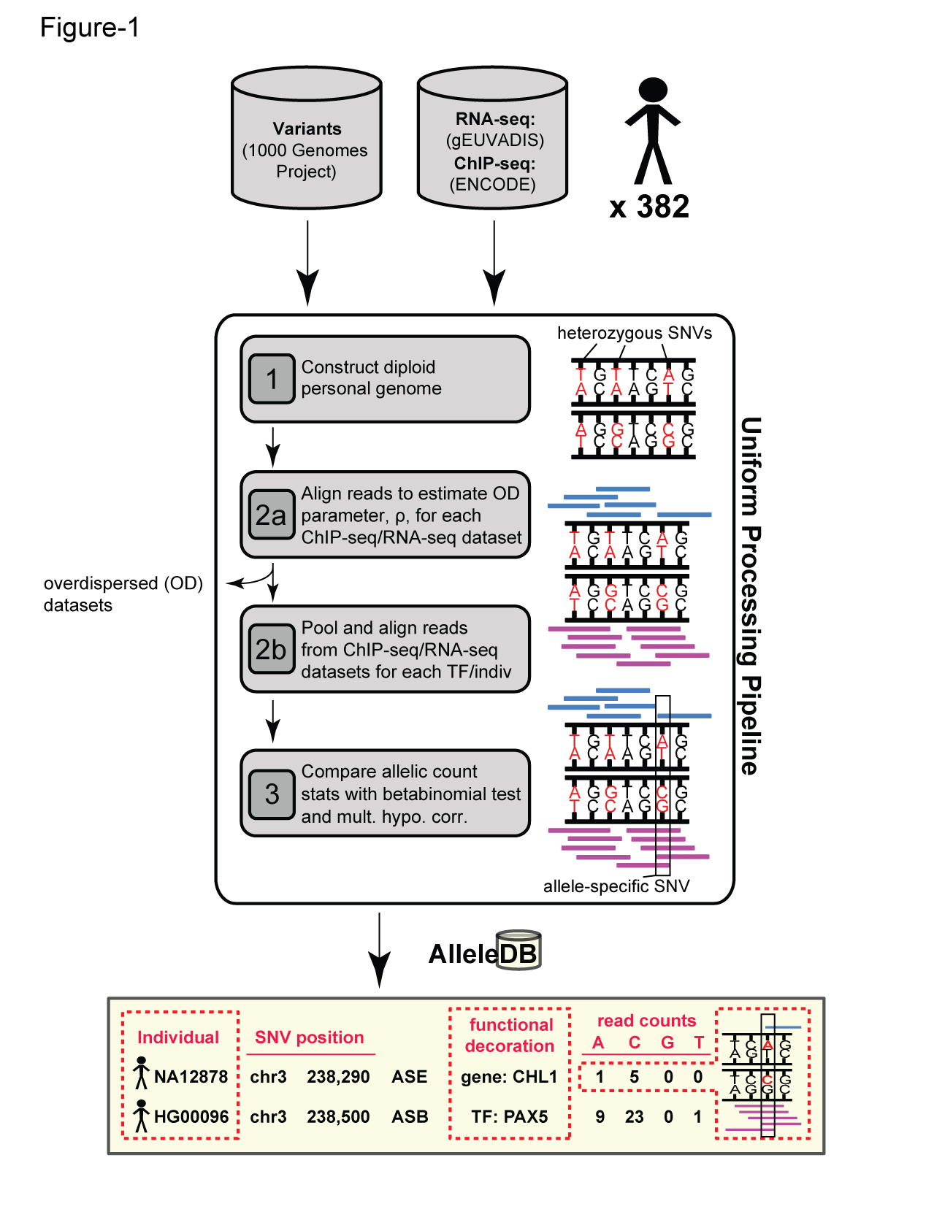
AlleleDB: Building 382 personal genomes to detect allele-specific variants on a large-scale
Build personal genomes
Align ChIP-seq & RNA-seq reads
Detect allele-specific variants
via a series of filters and tests
Many Technical Issues: Reference bias, Ambiguous mapping bias, Over-dispersed (non binomial null)
alleledb.gersteinlab.org
Chen J. et al. (Nature Commun, in press)

Slide 59
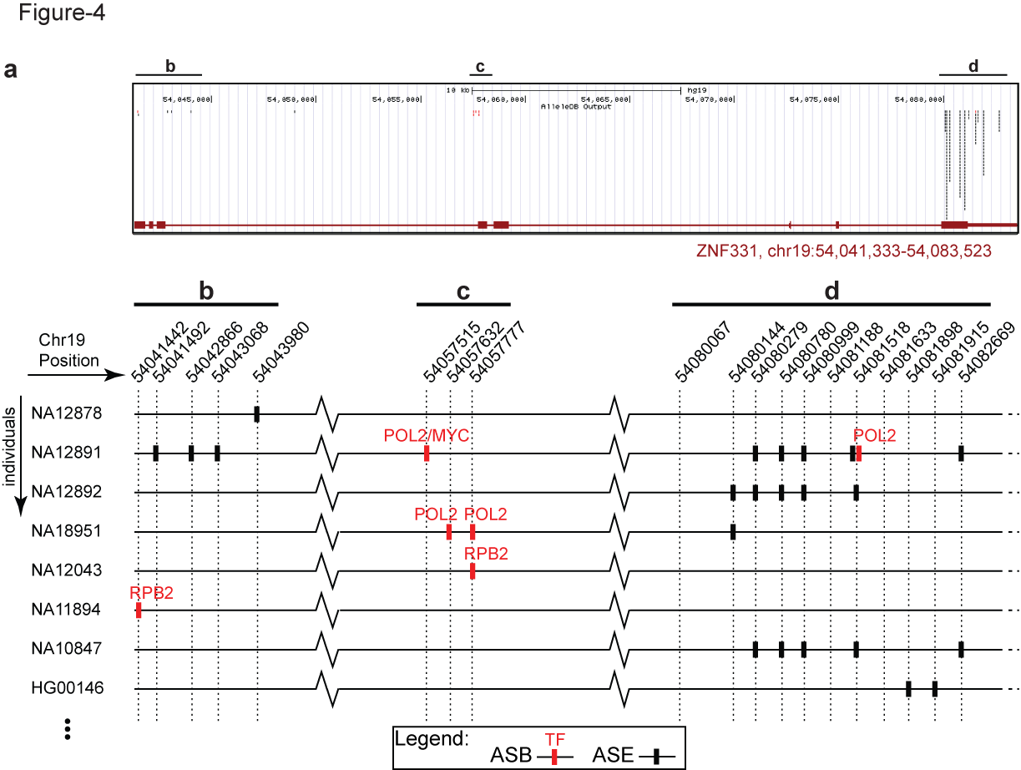
AlleleDB: Annotating rare & common allele-specific variants over a population
Interfaces with UCSC genome browser
Showing ZNF331 gene structure
AlleleDB output
UCSC track
alleledb.gersteinlab.org
Chen J. et al. (Nature Commun, in press)

Slide 60
AlleleDB: Annotating rare & common allele-specific variants over a population
Interfaces with UCSC genome browser
Showing ZNF331 gene structure
AlleleDB output
UCSC track
Allele-specific binding variants
Allele-specific expression variants
Chen J. et al. (Nature Commun, in press)

Slide 61



Collecting ASE/ASB variants into allele-specific genomic regions
Does a particular genomic element have a higher tendency to be allele-specific? Fisher’s exact test, for the enrichment of allele-specific variants in the element (with respect to non-allele-specific variants that could potentially be called as allelic)
allele-specific
non-allele-specific
Human reference
genome
alleledb.gersteinlab.org
Chen J. et al. (Nature Commun, in press)
Does not format to std. theme

Slide 62
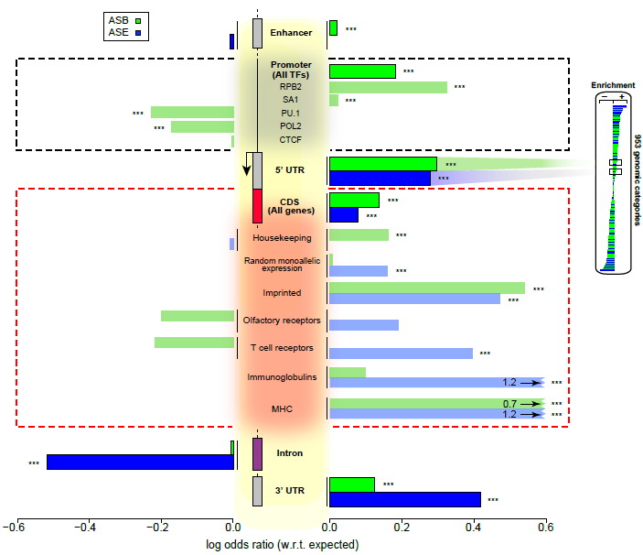
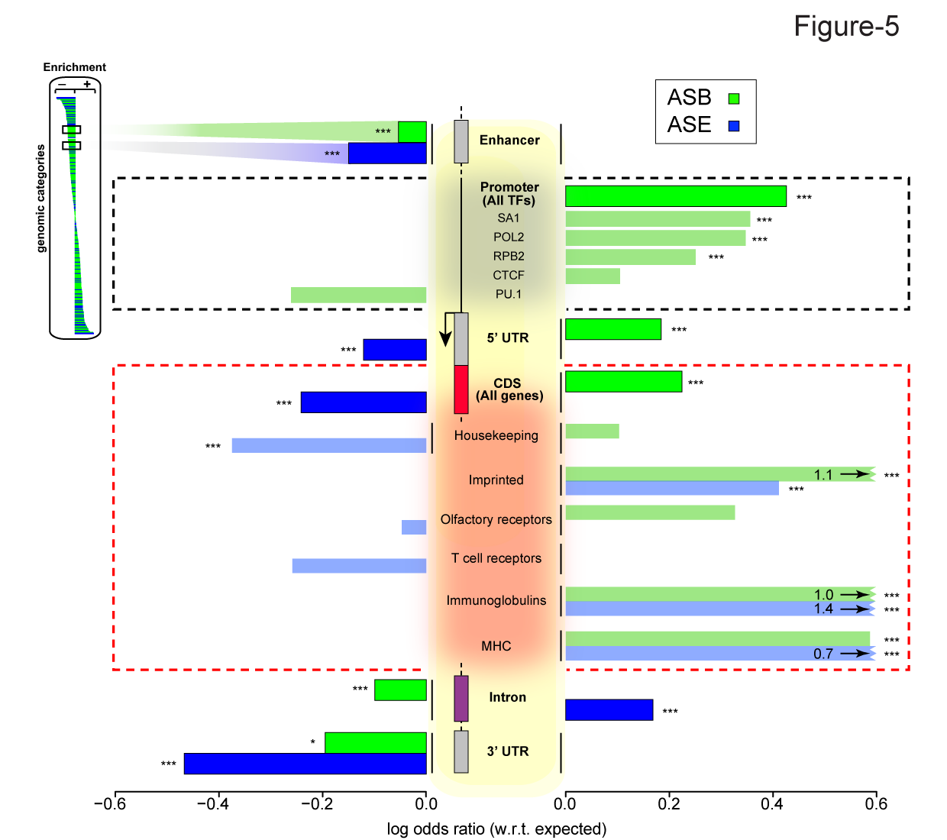
Groups of elements that are enriched or depleted in allelic activity
Chen J. et al. (Nature Commun, in press)

Slide 63
Personal Genomics:
Prioritizing High-impact Rare & Somatic Variants
Introduction: the landscape of variants in personal genomes
Characterizing Rare Variants in Coding Regions
  Identifying with STRESS
  cryptic allosteric sites
    On surface & in interior bottlenecks
Non-coding Variants #1: Prioritizing rare variants with “sensitive sites”
(human-conserved)
Non-coding Variants #2:
Prioritizing using AlleleDB
in terms of allelic elements
  Having observed difference in molecular activity in many contexts
  Key technical Issue:
  Need to build personal genomes
    Assessing their quality via read mapping
Putting it together in workflows
  Integrating evidence on non-coding variants with FunSeq
    Systematically weighting all the features
    suggesting non-coding drivers
    Prioritzing rare germline variants
  Using Larva to do burden testing on non-coding annotation
    Need to correct for over-dispersion in bionomial
    Parameterized according to replication timing

Slide 64

How to build a personal genome
(fasta; reference)
(vcf, variants
phased or unphased)
(fasta; for each
haplotype)
alleleseq.gersteinlab.org
Rozowsky et al. Mol Syst Biol (2011)
Notes:
Compatible subseq in downstream processing or analyses e.g with aligners for indexing

Slide 65
Why the personal genome (PG) should be the platform for functional genomics
Diploid
--Ability to incorporate private variants of any size
--exhibit phase information
Scale easily with more samples (v graph genome) and improving sequencing technologies: longer reads and more accurate phase information
Very useful in functional genomic assay analyses
a) read alignment
b) RNA-seq quantification
c) allele-specific analyses

Slide 66
Some construction considerations
1. Choice of call set(s)
-- e.g. different versions of 1000GP call sets
2. Choice of variants
-- e.g. SVs or indels or SNVs only
3. Choice of reference
-- choose the reference genome in which the call set is derived from
4. Assessment of call set quality
-- e.g. analysis of Mendelian inconsistency in family data
Notes:
Het/hom ratio
Ti/tv ratio

Slide 67
NA12878 family of PGs we already have
 | Source | Refgen | Depth | Variants
1 | 1000 Genomes Project (1000GP) pilot | hg18 | 60x | SNVs, indels, deletions (including 33 from fosmid sequencing)
2 | GATK Best Practices v3 (UnifiedGenotype) | hg19 | 64x | SNVs, indels
3 | GATK Best Practices v4 (HaplotypeCaller, PCR-free) | hg19 | 64x | SNVs, indels
4 | 1000GP Phase 3 SNVs-only | hg19 | 7.4x | SNVs
5 | 1000GP Phase 3 SNVs-indels | hg19 | 7.4x | SNVs, indels
6 | 1000GP Phase 3 SNVs-indels-SVs | hg19 | 7.4x | SNVs, indels, SVs

Slide 68
Alignment gets better as variant sets get more complete: NA12878 Pol2 ChIP-seq (ENCODE)
 | Ref genome | Pgenome: SNVs only | Pgenome: SNVs + indels only | Pgenome: SNVs + indels + SVs
Reads processed | 208,051,087
# reads uniquely aligned | 171,944,588 (82.65%) | 172,591,380 (82.96%) | 172,738,321 (83.03%) | 172,743,175 (83.03%)
# reads that multimap | 17,826,675 (8.57%) | 17,795,258 (8.55%) | 17,782,167 (8.55%) | 17,779,800 (8.55%)
Almost 1M increase in reads
Does not format to std. theme
Notes:
We observe that

Slide 69
Alignment gets better as variant sets get more complete: NA12878 RNA-seq (Kilpinen et al. 2013)
 | Ref genome | Pgenome: snvs only | Pgenome: snvs + indels only | Pgenome: snvs + indels + SVs
Reads processed | 37,558,398
# reads uniquely aligned | 25,303,498 (67.37%) | 25,486,837 (67.86%) | 25,538,449 (68.00%) | 25,568,042 (68.08%)
# reads that multimap | 4,041,495 (10.76%) | 4,010,417 (10.68%) | 4,012,297 (10.68%) | 3,972,990 (10.58%)
Over 260K increase in reads
Does not format to std. theme

Slide 70
PG alleviates reference bias in alignment

Slide 71
PG alleviates reference bias in alignment

Slide 72
Ambiguous mapping bias due to sequence similarity
For AS analyses, discard reads that multi-map

Slide 73
Account for ambiguous mapping bias
Using the reference genome, new simulated reads are created where alleles of the original reads are flipped (at het SNV positions)
Lappalainen et al. (2013)
Panousis et al. (2014)
Van de Geijn et al. (2015)
Notes:
There is currently a number of different methods that can help with this issue and one of more common methods is to do a simulation of flipped reads

Slide 74
PG facilitates the resolution of ambiguous mapping bias
Using the personal genome, we do not need to simulate reads.
We can directly test affected sites using multi-mapping read pile
Notes:
The flipping simulation can also be used in the

Slide 75
Personal Genomics:
Prioritizing High-impact Rare & Somatic Variants
Introduction: the landscape of variants in personal genomes
Characterizing Rare Variants in Coding Regions
  Identifying with STRESS
  cryptic allosteric sites
    On surface & in interior bottlenecks
Non-coding Variants #1: Prioritizing rare variants with “sensitive sites”
(human-conserved)
Non-coding Variants #2:
Prioritizing using AlleleDB
in terms of allelic elements
  Having observed difference in molecular activity in many contexts
  Key technical Issue:
  Need to build personal genomes
    Assessing their quality via read mapping
Putting it together in workflows
  Integrating evidence on non-coding variants with FunSeq
    Systematically weighting all the features
    suggesting non-coding drivers
    Prioritzing rare germline variants
  Using Larva to do burden testing on non-coding annotation
    Need to correct for over-dispersion in bionomial
    Parameterized according to replication timing

Slide 76

Identification of non-coding candidate drivers amongst somatic variants: Scheme
[Khurana et al., Science (‘13)]

Slide 77



Flowchart for 1 Prostate Cancer Genome (from Berger et al. '11)
[Khurana et al., Science (‘13)]
Notes:
Just have one path

Slide 78


Site integrates user variants with large-scale context
User
Variants
FunSeq.gersteinlab.org
[Fu et al., GenomeBiology ('14)]

Slide 79
Feature weight
- Weighted with mutation patterns in natural polymorphisms
(features frequently observed weight less)
- entropy based method
HOT region
Sensitive region
Polymorphisms
Genome
[Fu et al., GenomeBiology ('14)]
Notes:
Better schematic ….

Slide 80
Feature weight
- Weighted with mutation patterns in natural polymorphisms
(features frequently observed weight less)
- entropy based method
HOT region
Sensitive region
Polymorphisms
Genome
[Fu et al., GenomeBiology ('14)]
Notes:
Better schematic ….

Slide 81
Feature weight
- Weighted with mutation patterns in natural polymorphisms
(features frequently observed weight less)
- entropy based method
HOT region
Sensitive region
Polymorphisms
Genome
Feature weight:
p = probability of the feature overlapping natural polymorphisms
For a variant:
[Fu et al., GenomeBiology ('14)]
Notes:
Better schematic ….

Slide 82
Germline pathogenic variants show higher core scores than controls
3 controls with natural polymorphisms (allele frequency >= 1% )
1. Matched region: 1kb around HGMD variants
Matched TSS: matched for distance to TSS
Unmatched: randomly selected
Ritchie et al., Nature Methods, 2014
[Fu et al., GenomeBiology ('14, in revision)]

Slide 83
Personal Genomics:
Prioritizing High-impact Rare & Somatic Variants
Introduction: the landscape of variants in personal genomes
Characterizing Rare Variants in Coding Regions
  Identifying with STRESS
  cryptic allosteric sites
    On surface & in interior bottlenecks
Non-coding Variants #1: Prioritizing rare variants with “sensitive sites”
(human-conserved)
Non-coding Variants #2:
Prioritizing using AlleleDB
in terms of allelic elements
  Having observed difference in molecular activity in many contexts
  Key technical Issue:
  Need to build personal genomes
    Assessing their quality via read mapping
Putting it together in workflows
  Integrating evidence on non-coding variants with FunSeq
    Systematically weighting all the features
    suggesting non-coding drivers
    Prioritzing rare germline variants
  Using Larva to do burden testing on non-coding annotation
    Need to correct for over-dispersion in bionomial
    Parameterized according to replication timing

Slide 84


Mutation recurrence
Cancer Type 1
Cancer Type 2
Cancer Type 3
Does not format to std. theme

Slide 85
Mutation recurrence
Cancer Type 1
Cancer Type 2
Cancer Type 3
Early replicated regions
Late replicated regions
Does not format to std. theme

Slide 86
Noncoding annotations
Cancer Type 1
Cancer Type 2
Cancer Type 3
Early replicated regions
Late replicated regions
Does not format to std. theme

Slide 87
Noncoding annotations
Cancer Type 1
Cancer Type 2
Cancer Type 3
Early replicated regions
Late replicated regions
Does not format to std. theme

Slide 88
Cancer Somatic Mutational Heterogeneity, across cancer types, samples & regions
[Lochovsky et al. NAR (’15)]

Slide 89




Cancer Somatic Mutation Modeling
3 models to evaluate the significance of mutation burden
Suppose there are k genome elements. For element i, define:
  n_{i}: total number of nucleotides
  x_{i}: the number of mutations within the element
  p: the mutation rate
  R: the replication timing bin of the element
Model 1: Constant Background Mutation Rate (Model from Previous Work)
Model 2: Varying Mutation Rate
Model 3: Varying Mutation Rate with Replication Timing Correction
[Lochovsky et al. NAR (’15)]
Does not format to std. theme

Slide 90
LARVA Model Comparison
Comparison of mutation count frequency implied by the binomial model (model 1) and the beta-binomial model (model 2) relative to the empirical distribution
The beta-binomial distribution is significantly better, especially for accurately modeling the over-dispersion of the empirical distribution
[Lochovsky et al. NAR (’15)]

Slide 91
Adding DNA replication timing correction further improves the beta-binomial model
[Lochovsky et al. NAR (’15)]
Bottom 10% of rep. timing bins requires large correction
Top 10% of rep. timing bins
requires little correction

Slide 92

LARVA Implementation
http://larva.gersteinlab.org/
Freely downloadable C++ program
  Verified compilation and correct execution on Linux
A Docker image is also available to download
  Runs on any operating system supported by Docker
Running time on transcription factor binding sites (a worst case input size) is ~80 min
  Running time scales linearly with the number of annotations in the input

Slide 93
LARVA Results
TSS LARVA results
These have
literature-verified
cancer associations
β-binomial
noncoding annotation
p-values in sorted order
binomial
[Lochovsky et al. NAR (’15)]
Does not format to std. theme

Slide 94
Personal Genomics:
Prioritizing High-impact Rare & Somatic Variants
Introduction: the landscape of variants in personal genomes
Characterizing Rare Variants in Coding Regions
  Identifying with STRESS
  cryptic allosteric sites
    On surface & in interior bottlenecks
Non-coding Variants #1: Prioritizing rare variants with “sensitive sites”
(human-conserved)
Non-coding Variants #2:
Prioritizing using AlleleDB
in terms of allelic elements
  Having observed difference in molecular activity in many contexts
  Key technical Issue:
  Need to build personal genomes
    Assessing their quality via read mapping
Putting it together in workflows
  Integrating evidence on non-coding variants with FunSeq
    Systematically weighting all the features
    suggesting non-coding drivers
    Prioritzing rare germline variants
  Using Larva to do burden testing on non-coding annotation
    Need to correct for over-dispersion in bionomial
    Parameterized according to replication timing

Slide 95
Personal Genomics:
Prioritizing High-impact Rare & Somatic Variants
Introduction: the landscape of variants in personal genomes
Characterizing Rare Variants in Coding Regions
  Identifying with STRESS
  cryptic allosteric sites
    On surface & in interior bottlenecks
Non-coding Variants #1: Prioritizing rare variants with “sensitive sites”
(human-conserved)
Non-coding Variants #2:
Prioritizing using AlleleDB
in terms of allelic elements
  Having observed difference in molecular activity in many contexts
  Key technical Issue:
  Need to build personal genomes
    Assessing their quality via read mapping
Putting it together in workflows
  Integrating evidence on non-coding variants with FunSeq
    Systematically weighting all the features
    suggesting non-coding drivers
    Prioritzing rare germline variants
  Using Larva to do burden testing on non-coding annotation
    Need to correct for over-dispersion in bionomial
    Parameterized according to replication timing

Slide 96

AlleleDB.gersteinlab.org
J Chen, J Rozowsky,
TR Galeev, A Harmanci,
R Kitchen, J Bedford,
A Abyzov, Y Kong, L Regan
CostSeq2
P Muir, S Li, S Lou,
D Wang, DJ Spakowicz,
L Salichos, J Zhang, F Isaacs,
J Rozowsky
FunSeq.gersteinlab.org
- & -
FunSeq2.gersteinlab.org
Y Fu, E Khurana, Z Liu, S Lou, J Bedford, XJ Mu, KY Yip, V Colonna, XJ Mu, … , 1000 Genomes Project Consortium, et al
LARVA.gersteinlab.org
  L Lochovsky,
  J Zhang, Y Fu,
  E Khurana
STRESS.molmovdb.org
D Clarke, A Sethi, S Li, S Kumar, R W.F. Chang,
J Chen
Acknowledgments
Hiring Postdocs. See gersteinlab.org/jobs

Slide 97

Extra

