Slide 1
Variation graph tools, data model, and formats
Erik Garrison
SV group call
May 23, 2016

Slide 2
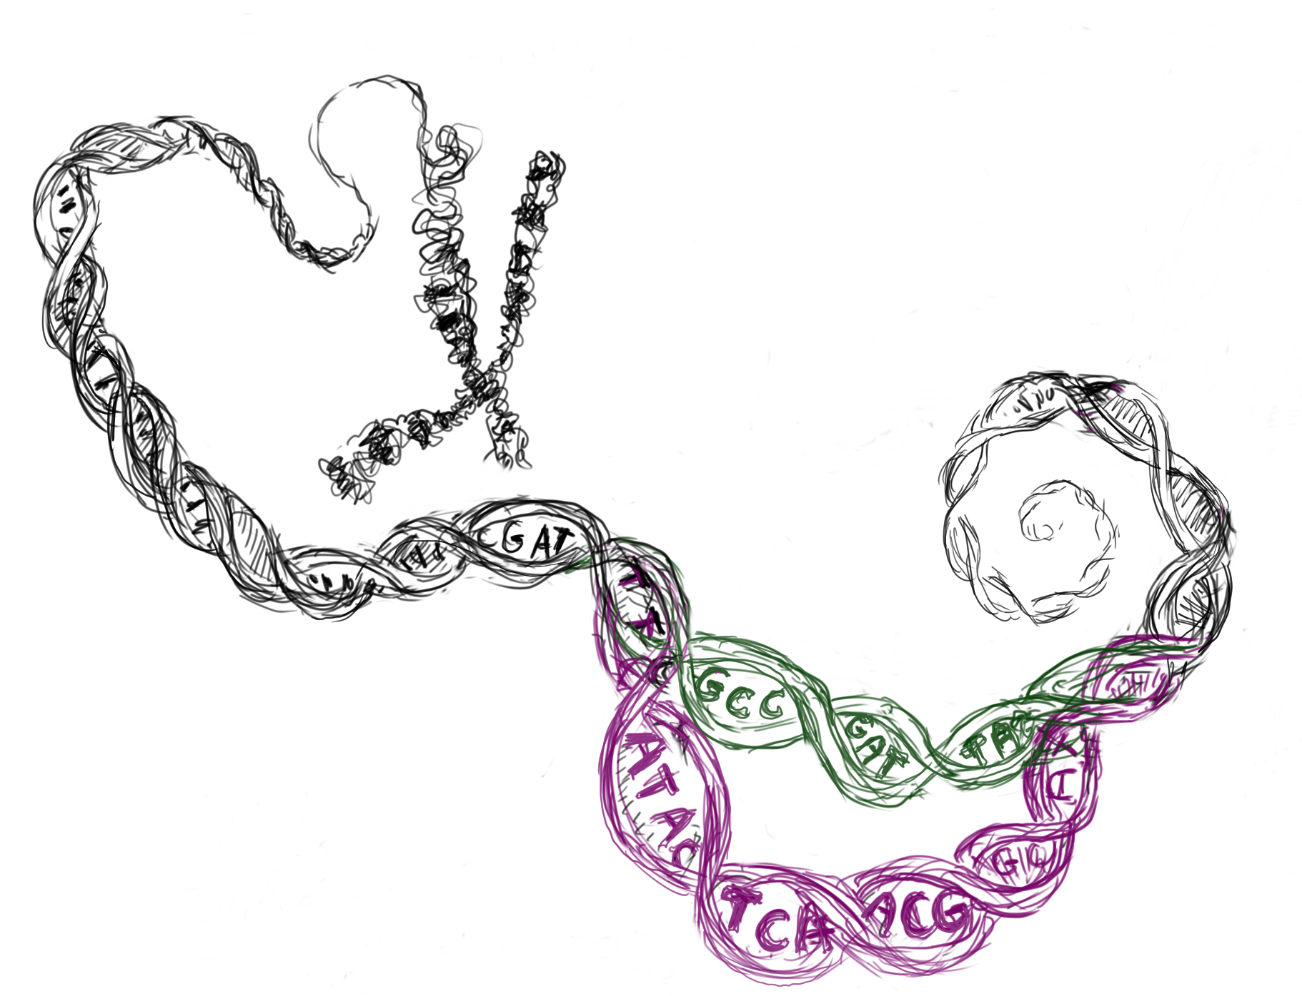
Genome variation graphs
A model that looks like DNA, but encodes alternative genomes in the same system.
Maciej Smuga-Otto http://www.smuga-otto.com/mso/

Slide 3
Genome variation graphs
A variation graph represents many genomes in the same context.
Nodes contain sequence and directed edges represent potential links between successive sequences.

Slide 4
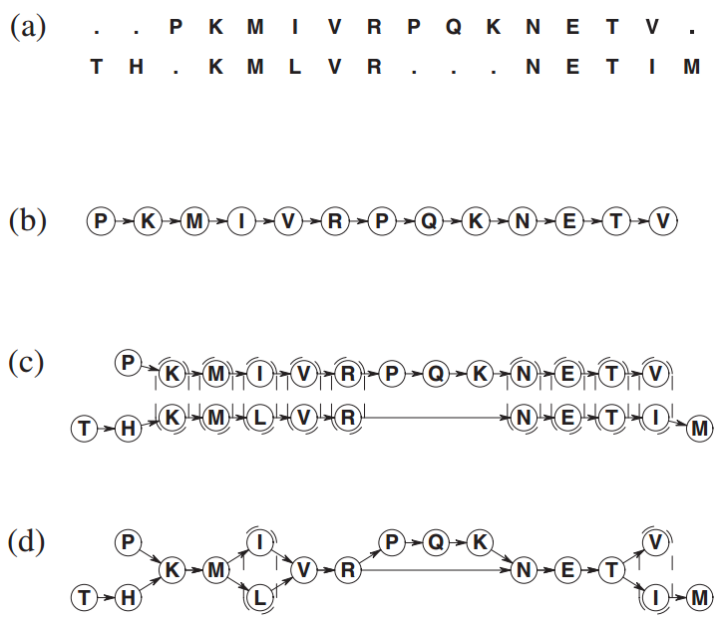
Multiple sequence alignments
~ variation graphs
traditional MSA
consensus sequence
positionally-matching regions aligned
multiple sequence alignment
Christopher Lee, Catherine Grasso, Mark F. Sharlow. Multiple sequence alignment using partial order graphs. Bioinformatics, 2002.

Slide 5
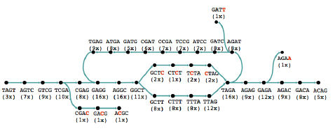
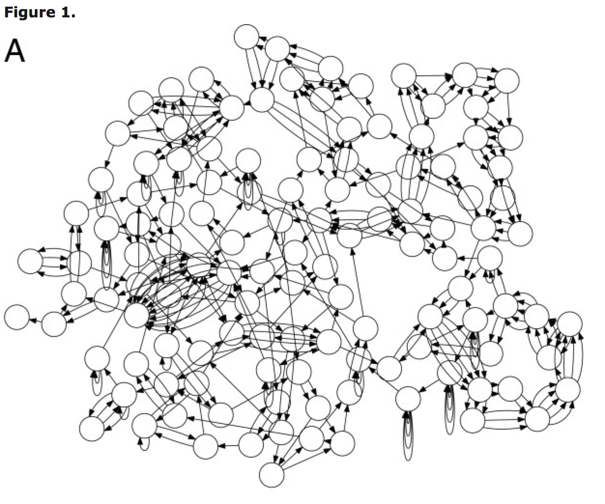
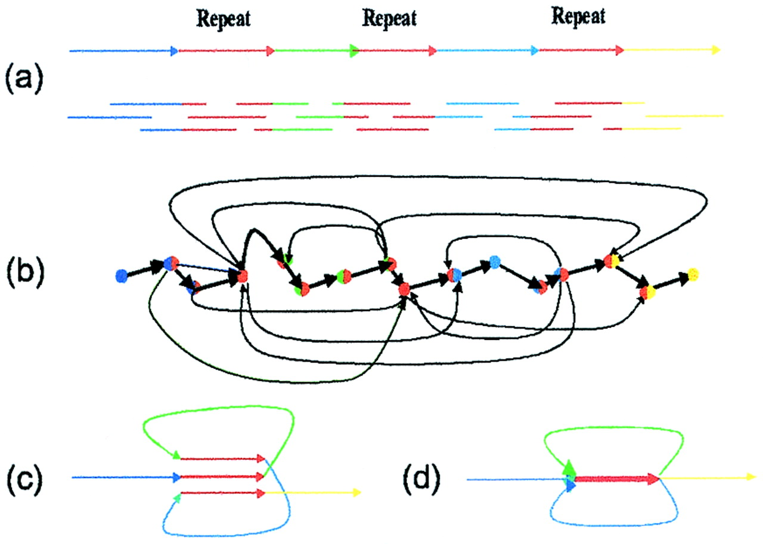
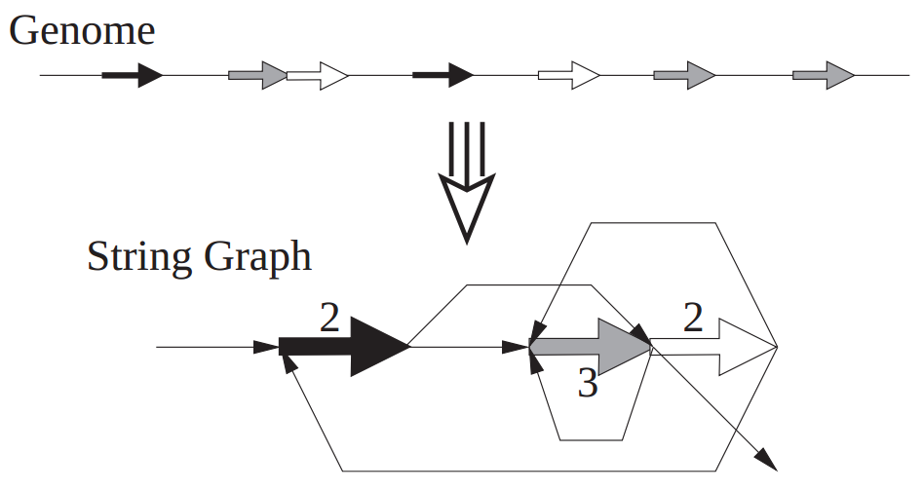
Assembly graphs ~ variation graphs
http://plus.maths.org/content/os/issue55/features/sequencing/index, credit Daniel Zerbino
Eugene Myers. The fragment assembly string graph. Bioinformatics, 2005.

Slide 6
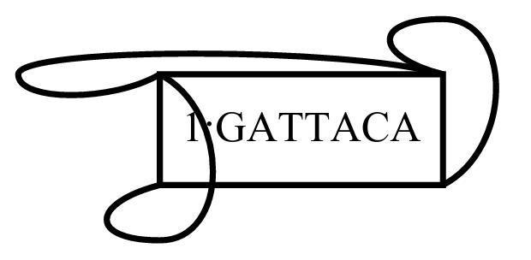
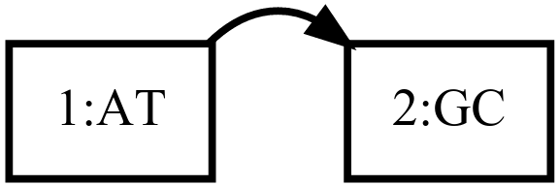
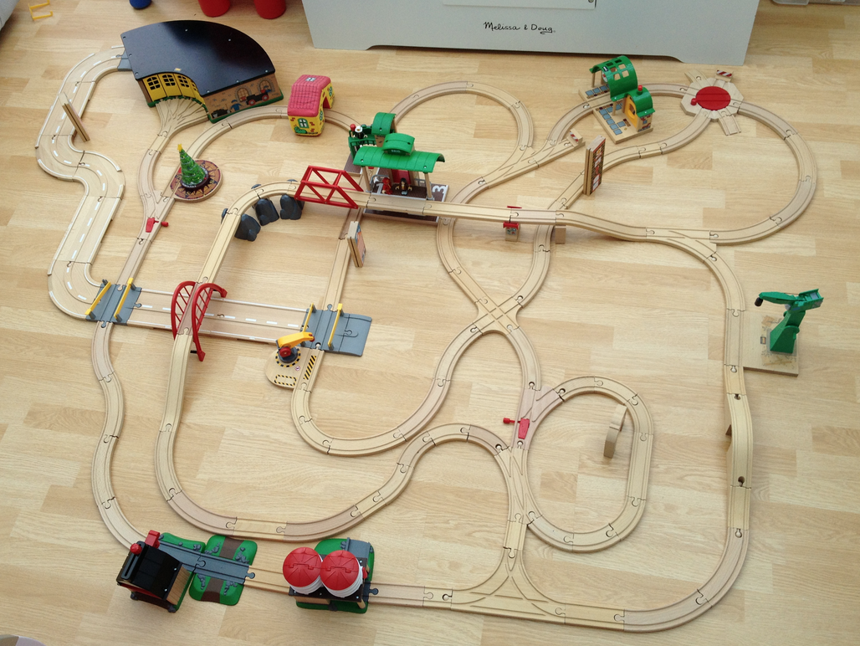
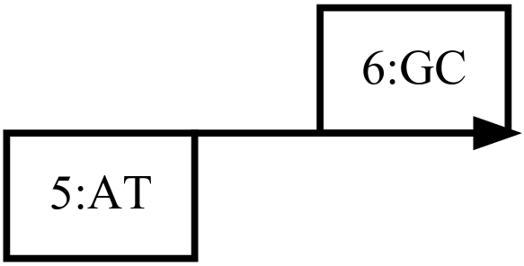
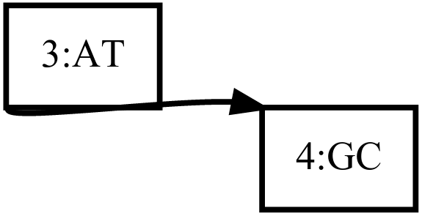
Train track graphs
forward
The graph is implicitly bidirectional, encoding both the forward and reverse complement.
Edges switching from the forward (+) to reverse (-) represent inversions.
+/+
reverse
+/-
-/+
-/-

Slide 7
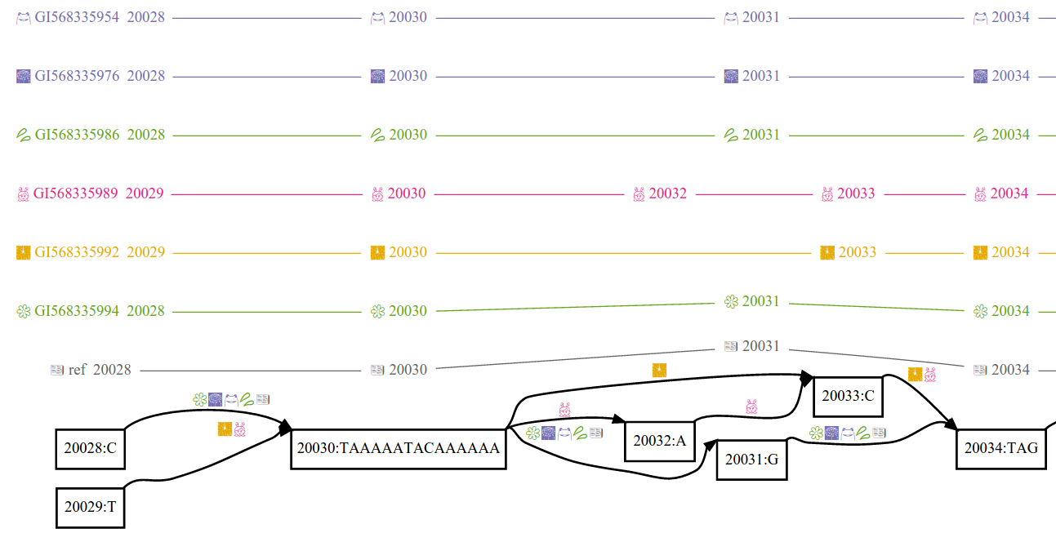
Essential components of a VG
*a fragment of the MHC

Slide 8
Data model
Basic entity is a Graph:
Graph
Paths
Edges
Nodes
Mappings
Mappings
Mappings
Mappings
Mappings
Implemented in vg using protobuf, JSON, RDF, and GFA

Slide 9
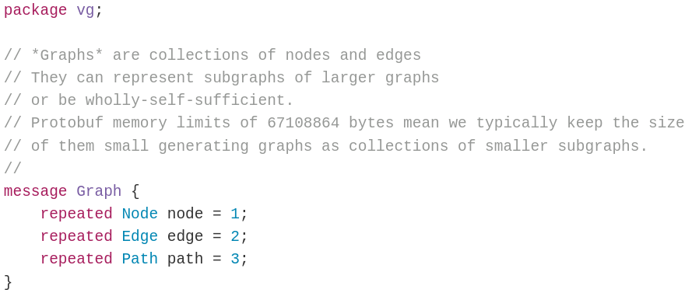
Graph
Encapsulates the entire variation graph.
https://github.com/ekg/vg/blob/master/src/vg.proto

Slide 10
Node
Contains sequences in the graph.

Slide 11
Edge
Describes linkages in the graph.

Slide 12
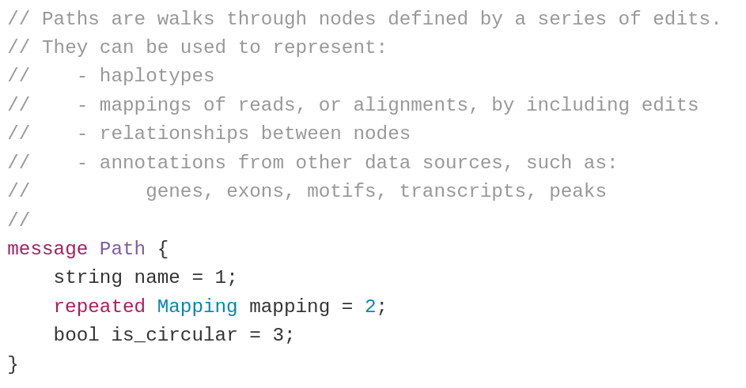
Path
Embedding of alignments, genomes, annotations

Slide 13
Mapping
Describes a function mapping a single sequence to a node.

Slide 14
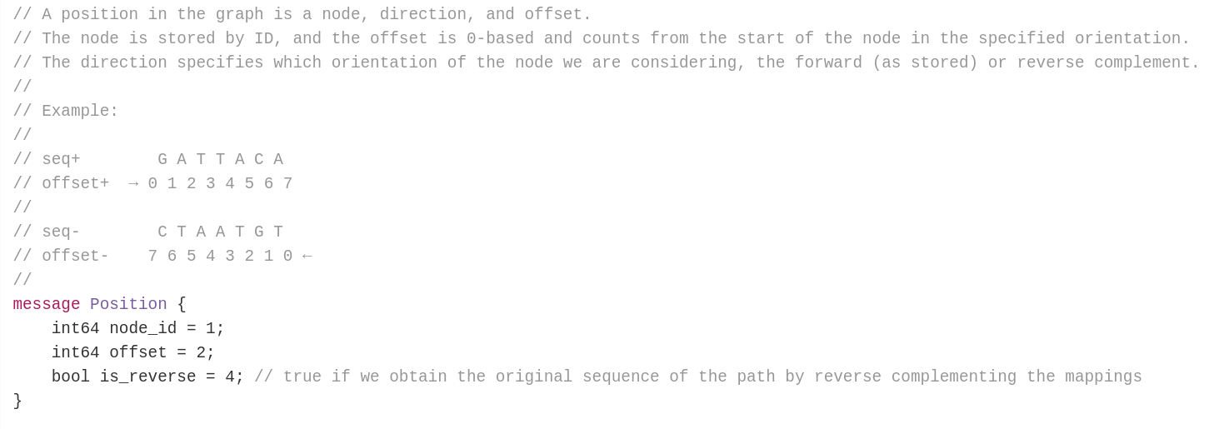
Position
Points to a location on a node in the bidirectional graph.

Slide 15
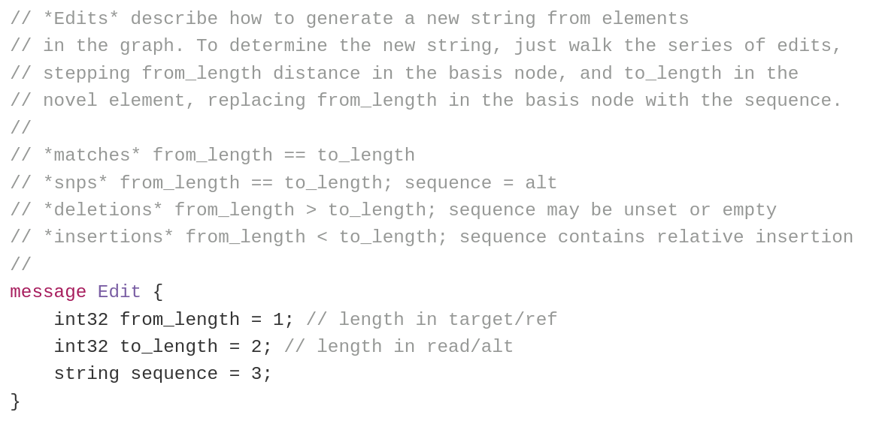
Edit
An edit operation describing part of the mapping from one sequence to another.

Slide 16
Serialization
To serialize the graph, we generate a stream of sub-graphs that can be reassembled into the whole.
Subgraph n
Graph
Paths
Paths
output
Edges
Nodes
Edges
Nodes
Mappings
Mappings
in memory
serialized stream

Slide 17
How to resequence using VG
Build a graph: vg msga
Import a graph: vg construct / vg view
Index it: vg index
Query it: vg find
Sample it: vg sim
Map to it: vg map
Call variants: vg call*

Slide 18
Components of the vg toolchain
Data model
https://github.com/vgteam/vg/blob/master/src/vg.proto
VG C++ API
https://github.com/vgteam/vg/blob/master/src/vg.hpp
XG (graph index)
https://github.com/vgteam/xg
GCSA2 (sequence path index)
https://github.com/jltsiren/gcsa2

Slide 19
vg is a Super-Maximal Exact Match mapper
In VG we map against GCSA2, which is capable of finding SMEMs in a linear scan through a query sequence.
vg find -M ACCGTTAGAGTCAG -g h.gcsa [["ACC",["1:-32"]],["CCGTTAG",["1:5"]],["GTTAGAGT",["1:19"]],["TAGAGTCAG",["1:40"]]]
ACGTGCCGTTAGCCAGTGGGTTAGAGTATCGATACAACTATAGAGTCAGAGCA
ACCGTTAGAGTCAG ACC CCGTTAG GTTAGAGT TAGAGTCAG
Sketch: backward search until we no longer match. Then execute parent() on the suffix tree node corresponding last non-empty BWT range to get a new range. Then continue backward searching to find the next SMEM.
with Jouni Sirén

Slide 20
vg calling pipeline
a
Sample graph
a
a
a
c
a
c
Read alignment
GAM format
from vg map
Variants
Augmented graph
Graph Pileup
VG pileup format
from vg pileup
VG format
from vg call
Calling pipeline is very similar to samtools, but also rudimentary (only toy examples at present).
Glenn Hickey

Slide 21
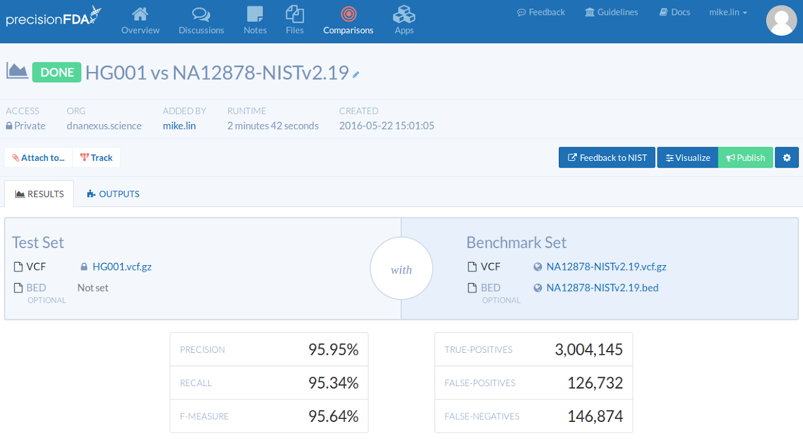
precisionFDA

Slide 22
Construction
POS ID REF ALT
...
For each variant
cut the reference path around the variant
add the novel (ALT) sequence to the graph

Slide 23
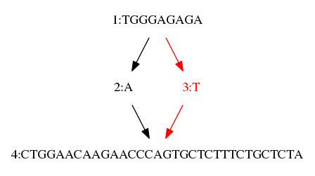
Construction
POS ID REF ALT
10 . A T
...
For each variant
cut the reference path around the variant
add the novel (ALT) sequence to the graph

Slide 24
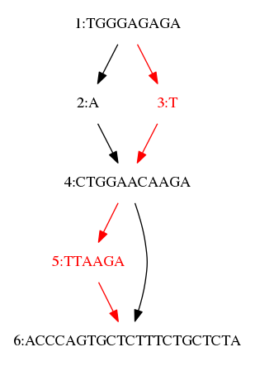
Construction
POS ID REF ALT
10 . A T
21 . A ATTAAGA
...
For each variant
cut the reference path around the variant
add the novel (ALT) sequence to the graph

Slide 25
Construction
POS ID REF ALT
10 . A T
21 . A ATTAAGA
31 . TCTTT T
For each variant
cut the reference path around the variant
add the novel (ALT) sequence to the graph
Bug: This link should be red

Slide 26
Deconstruction
If we have a recorded path that largely covers the bubbles of our graph, we can use it to extract a VCF representation from any VG using vg deconstruct.

Slide 27
Assembly graphs
VG can operate on any bidirectional assembly graph.
This means that if variation can be represented as a string graph, then it can be encoded in this data model, and we have existing implementations of it in protobuf (binary), JSON, RDF, and GFA.

Slide 28
Open problems
Imprecision
We represent some imprecision with overlap graphs.
However, many operations in VG do not work on imprecise graphs.
But… the data model can be augmented to handle this and other tools could implement it.
Variant calls
We can represent them as sets of paths (one for each allele per sample/genotype)
We don’t represent further annotations on them, or really anywhere in VG format.
This is surmountable because every data format we write into is extensible!

Slide 29
What representation problem could we try to solve with VG?
Suggestions very welcome.

Slide 31
Bonus slides

Slide 32
Long read assembly
vg can be used to make assemblies from sets of finished genomes:
index (make our xg/gcsa supports)
align (map a sequence to the graph)
edit (include alignment in graph)
repeat …
Next slides: bits of the MHC.

Slide 33
a 1000s of bp view of the MHC

Slide 34
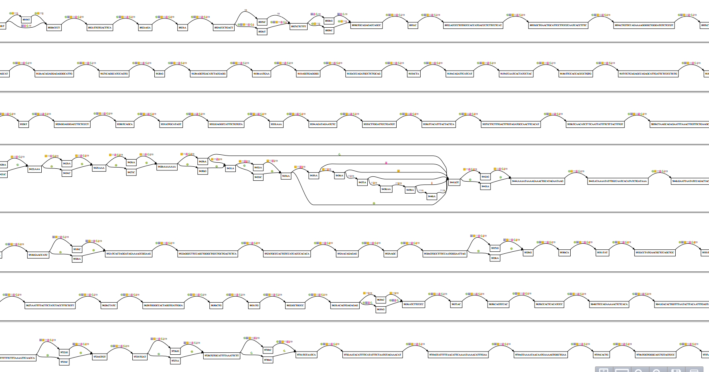
from 100s of bps

Slide 35
up close

Slide 36
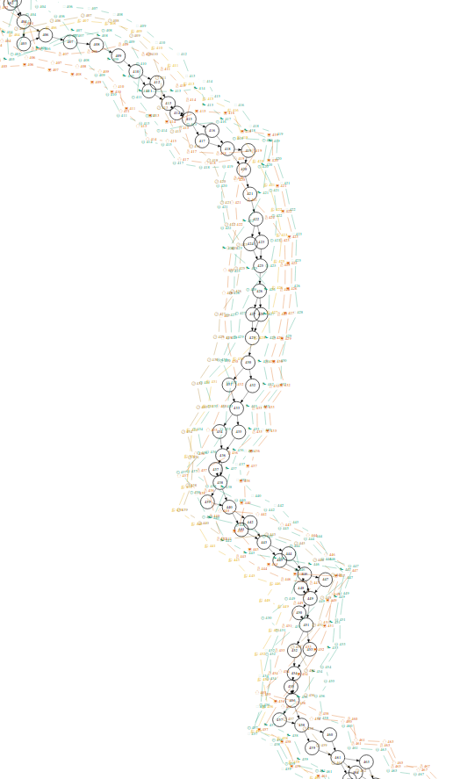
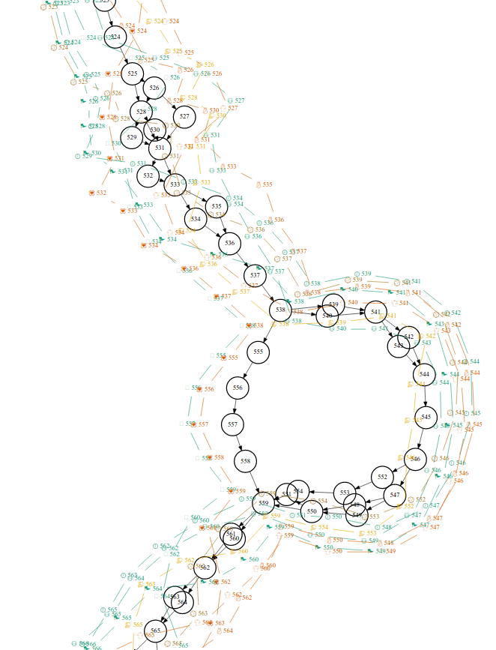
B-3106

Slide 37
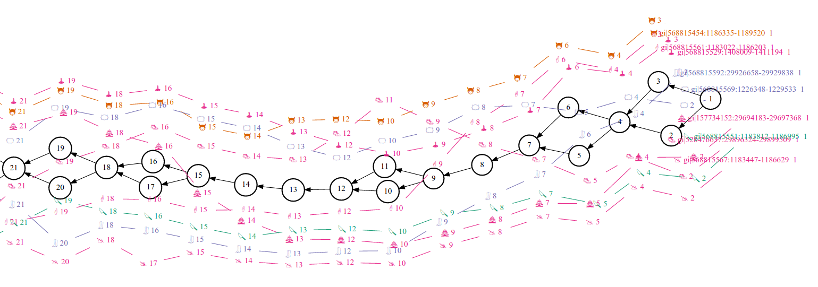
K-3138

Slide 38
DQA1-3117

Slide 39
DRB1-3123

Slide 40
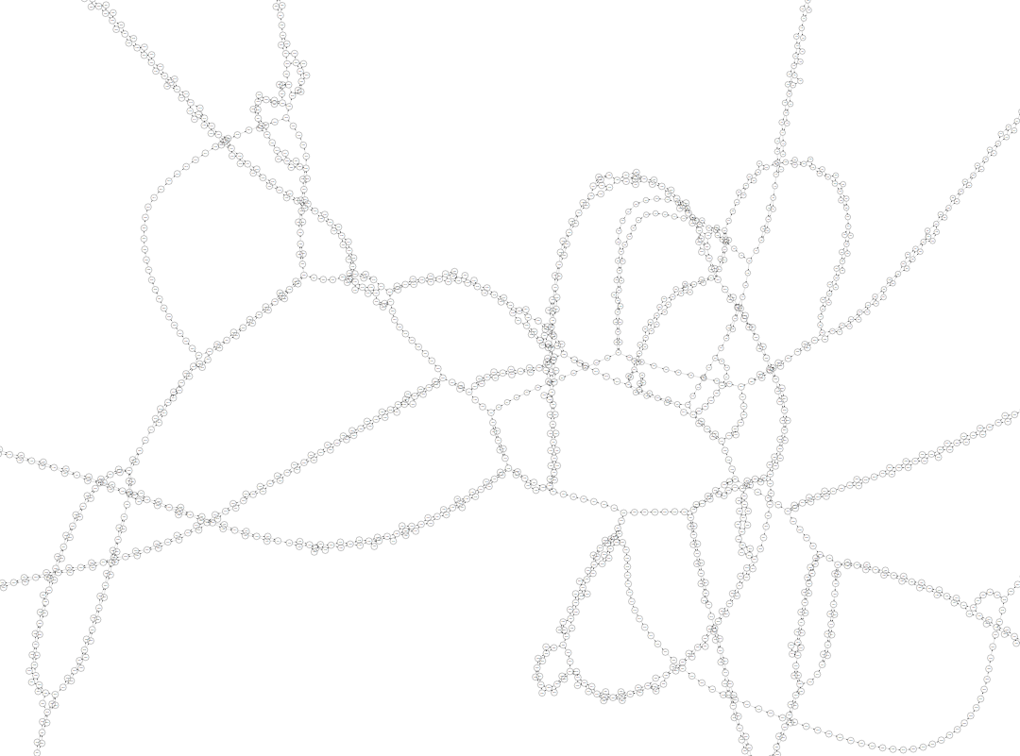
DRB1-3123

