Slide 1
Analysis of brain NGS data
Shuang Liu
Group Meeting
05/20/2016

Slide 2
Outline
Association of GWAS and Brainspan ChIP-Seq data
Comparison of ChIP-Seq data across projects
Analysis of PsychENCODE ChIP-Seq data
Future work

Slide 3
Outline
Association of GWAS and Brainspan ChIP-Seq data
Comparison of ChIP-Seq data across projects
Analysis of PsychENCODE ChIP-Seq data
Future work

Slide 4
Brainspan ChIP-Seq dataset
 | Age | Sex | Marker
HSB102 | 21 PCW | F | H3K27ac
HSB100 | 19 PCW | F | H3K27ac
HSB240 | 19 PCW | M | H3K27ac
HSB1296 | 98 days | M | H3K27ac
HSB1472 | 118 days | M | H3K27ac
HSB872 | 0 days | F | H3K27ac
HSB123 | 37 Y | M | H3K27ac | H3K4me3
HSB126 | 30 Y | F | H3K27ac | H3K4me3
HSB136 | 23 Y | M | H3K27ac | H3K4me3
HSB187 | 37 Y | F | H3K27ac | H3K4me3
Embryonic H3k27ac data from the paper (Reilly SK, Noonan JP et al. science 2015)
Notes:
embronic data

Slide 5
Association of ChIP-Seq peaks and GWAS SNPs of different diseases
Selected GWAS SNPs of 6 disorders
  3 brain related disorders: Schizophrenia, Bipolar disease and Parkinson's disease
  3 other disorders: Type 2 diabetes, Coronary artery disease and Asthma
ChIP-Seq data
  Brainspan: H3K27ac peaks (All, TS, Non TSS, DFC, CBC, Embryonic, Fetal and Adult) and H3K4me3 peaks
  Roadmap: active enhancers in 98 different tissues and cell lines
Notes:
Credible causal snps from PGC schizophrenia study and get same number of SNPs for the other disorders from GWAS

Slide 6
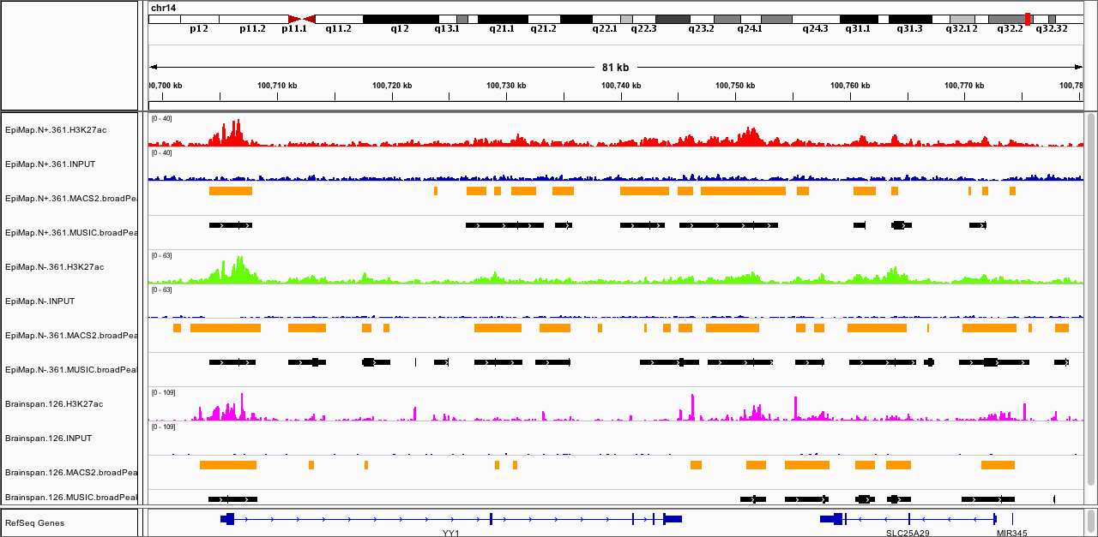
Association of ChIP-Seq peaks and GWAS SNPs of different diseases
H3K27ac peak
Mapped positionn | Disorder SNPs | Common 1000 genome SNPs | Row total
Maped to ChIP peaks | a | b | a+b
Not mapped to ChIP peaks | c | d | c+d
Column total | a+c | b+d | N=a+b+c+d
Enrichment = -log10(p value by one-tailed Fisher’s exact test)
http://www.rasadbsnp.com/images/SNPs.jpg

Slide 7
GWAS SNPs enrichment in ChIP-Seq peaks
Brainspan
Roadmap
Notes:
y axis are brain peaks from brainspan and enhancers of the other tissues from roadmap, x axis are different diseases. Compare the enrichment in two dimesions. Showed 10 out of 98 enhancers

Slide 8
Identification of super-enhancers
Super-enhancers -- a class of regulatory regions with unusually strong enrichment for the binding of transcriptional coactivators.
ROSE: RANK ORDERING OF SUPER-ENHANCERS
Master Transcription Factors and Mediator Establish Super-Enhancers at Key Cell Identity Genes Warren A. Whyte, David A. Orlando, Denes Hnisz, Brian J. Abraham, Charles Y. Lin, Michael H. Kagey, Peter B. Rahl, Tong Ihn Lee and Richard A. Young Cell 153, 307-319, April 11, 2013
H3K27ac enrichment
H3K27ac enrichment
Notes:
(a) Illustration of the three-step procedure to define super-enhancers. Step 1: enhancer loci are defined by calling peaks on ChIP-seq data for cell type–specific master transcription factors22. Step 2: enhancers within 12.5 kb of each…Step 3: ChIP-seq signal for Med1 for each enhancer region (both stitched and single enhancers) is calculated. All enhancer regions are ranked along the x axis on the basis of the Med1 enrichment plotted on the y axis. Super-enhancers are defined as regions to the right of the inflection point of the resulting curve (highlighted in gray).

Slide 9
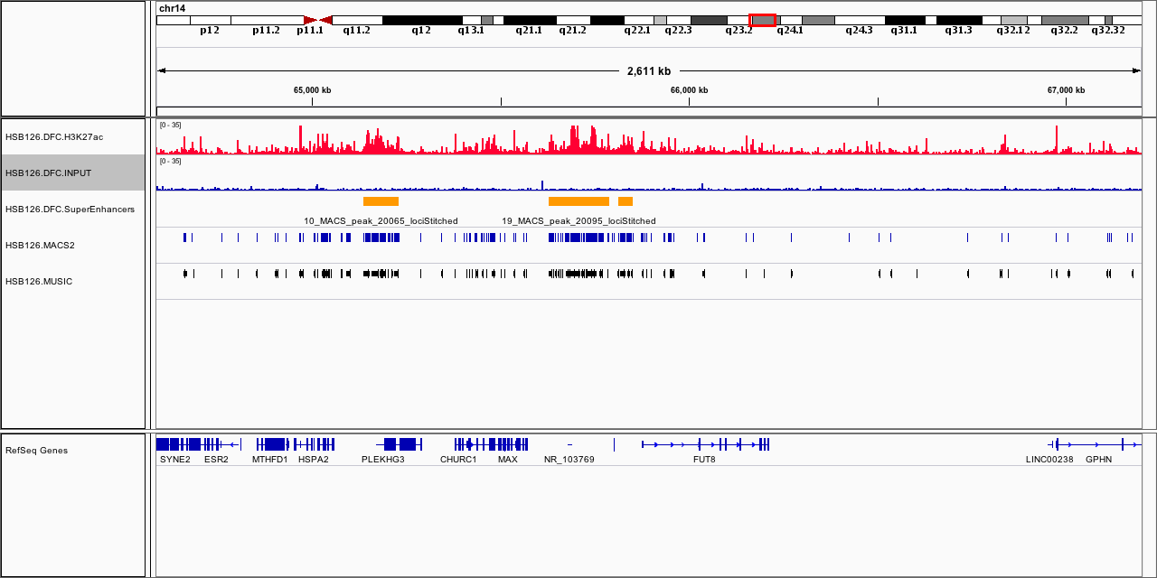
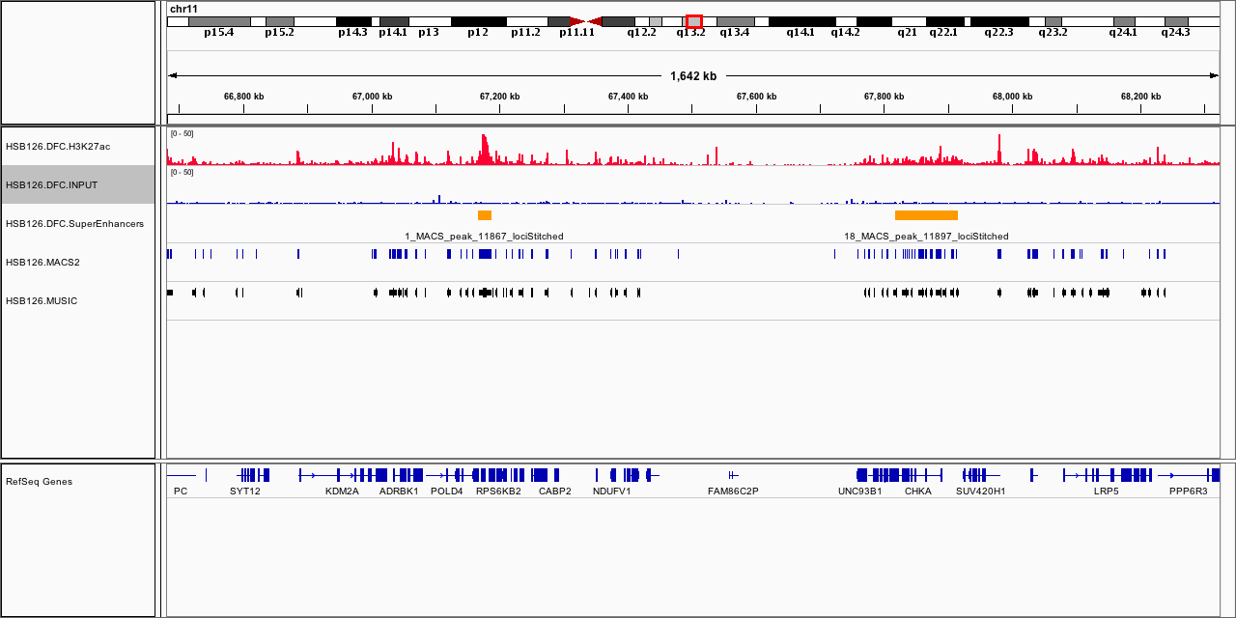
Super-enhancer example

Slide 10
Normal enhancer enrichment

Slide 11
Brain DNA Methylations
Postnatal brain (Brainspan, Illumina Infinium HumanMethylation450 BeadChip)
  22 samples
  11 regions
Prenatal brain (Helen Spiers et al. Genome Research 2015)
  179 samples

Slide 12
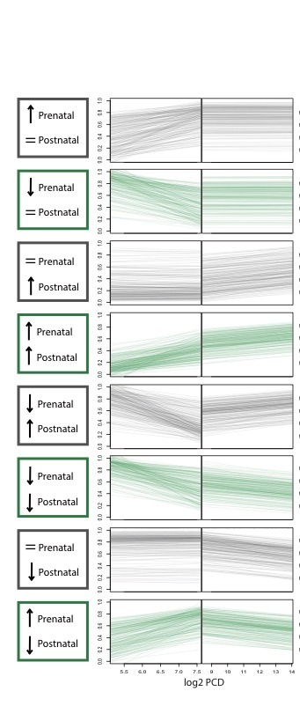
Association of GWAS SNPs and methylation trajectory categories
Methylation trajectory categories
CpG site
20k
20k
Mapped position | CpG sites from 8 categories | CpG sites on whole array | Row total
Maped to SNP 20k window | a | b | a+b
Not mapped to SNP 20k window | c | d | c+d
Column total | a+c | b+d | N=a+b+c+d
Enrichment = -log10(p value by one-tailed Fisher’s exact test)
http://www.rasadbsnp.com/images/SNPs.jpg

Slide 13
GWAS SNPs enrichment on methylation trajectory categories

Slide 14
Outline
Association of GWAS and Brainspan ChIP-Seq data
Comparison of ChIP-Seq data across projects
Analysis of PsychENCODE ChIP-Seq data
Future work

Slide 15
ChIP-Seq Datasets
Project Name | Brainspan | RoadMap | PsychENCODE EpiMap
Organism | Homo sapiens | Homo sapiens | Homo sapiens
Type of sample | Brain tissue | Brain Tissue | Brain NeuN+,NeuN-
Brain Region | Dorsolateral prefrontal cortex | Dorsolateral prefrontal cortex | Dorsolateral prefrontal cortex
Life stage | Adult | Adult | Adult
Disease or control | Control | Control | Control
Marker | H3K27ac | H3K27ac | H3K27ac
Number of samples | 3 | Consolidated | 1

Slide 16
Samples of each project
Brainspan
  HSB126, HSB136 and HSB187
Roadmap
  Single consolidated sample
PsychENCODE EpiMap
  NeuN+,NeuN- of 1 sample
  Combined NeuN+,NeuN- of this sample

Slide 17
ChIP-Seq analysis pipeline
Quality metrics of read counts
(Strand cross-correlation analysis, number of reads in the peaks, library complexity)
ChIP FastQ file
Quality metrics (FastQC)
Read mapping
(Bowtie)
Signal generation,
file format conversion
(samtools, bedtools, bedGraphToBigWig)
ChIP bigwig file
Control FastQ file
Quality metrics (FastQC)
Read mapping
(Bowtie)
Signal generation,
file format conversion
(samtools, bedtools, bedGraphToBigWig)
Control bigwig file
Check peak calling results
Peak calling
(MACS2, MUSIC)
ChIP-Seq peaks
Downstream analysis
(peak comparison, peak annotation, motif analysis)

Slide 18
Peak calling of H3K27ac
MACS2-- Model-based Analysis of ChIP-Seq
  Broad peak
MUSIC--MUltiScale enrIchment Calling (https://github.com/gersteinlab/MUSIC )
  Broad peak

Slide 19
Overlap of H3K27ac peaks
EpiMap
NeuN+
EpiMap
NeuN-
Brainspan
HSB126
>10% overlap for both peaks
Peak overlap

Slide 20
Number of overlapped H3K27ac peaks

Slide 21

Overlapped H3K27ac peak number fraction
$$\frac{Number of Overlapped peaks}{Number of peaks in the sample of the study}$$

Slide 22
Outline
Association of GWAS and Brainspan ChIP-Seq data
Comparison of ChIP-Seq data across projects
Analysis of PsychENCODE ChIP-Seq data
Future work

Slide 23
Analysis of PsychENCODE ChIP-Seq data
Induced pluripotent stem cell lines (iPSC)
PEC Reference brain

Slide 24
Tissue Collection Experimental Plan
Skull skin (4 fetuses)
RNA-seq:
iPSC (2/fetus) -episomal
-Sendai virus
ChIP-seq:
Neuronal differentiation
Day 0
Day 11
Day 30
H3K4me3
RNA-seq
Total RNA
ChIP-seq
H3K27ac
Cell Lysate or brain tissue
Unsorted nuclei
Unsorted nuclei

Slide 25
PEC iPSc ChIP-seq datasets 01
ID | Stage | CellType | Mark
310 | Fetal | IPS | H3K27ac
 | Fetal | IPS | H3K4me3
 | Fetal | IPS | INPUT
313 | Fetal | IPS | H3K4me3
 | Fetal | IPS | H3K27ac
 | Fetal | IPS | INPUT
320 | Fetal | IPS | H3K27ac
 | Fetal | IPS | H3K4me3
 | Fetal | IPS | INPUT
07-01 | Adult | IPS | H3K4me3
 | Adult | IPS | H3K27ac
 | Adult | IPS | INPUT
1120-01 | Adult | IPS | H3K4me3
 | Adult | IPS | H3K27ac
 | Adult | IPS | INPUT
1123-01 | Adult | IPS | H3K27ac
 | Adult | IPS | H3K4me3
 | Adult | IPS | INPUT

Slide 26
ChIP-Seq analysis pipeline
Quality metrics of read counts
(Strand cross-correlation analysis, number of reads in the peaks, library complexity)
ChIP FastQ file
Quality metrics (FastQC)
Read mapping
(Bowtie)
Signal generation,
file format conversion
(samtools, bedtools, bedGraphToBigWig)
ChIP bigwig file
Control FastQ file
Quality metrics (FastQC)
Read mapping
(Bowtie)
Signal generation,
file format conversion
(samtools, bedtools, bedGraphToBigWig)
Control bigwig file
Check peak calling results
Peak calling
(MACS2, MUSIC)
ChIP-Seq peaks
Downstream analysis
(peak comparison, peak annotation, motif analysis)

Slide 27
FASTQC & alignment using bowtie2
Basic Statistics
Measure | Value
Filename | aa759-21.Adult.07-01.H3K4me3.fastq.gz
File type | Conventional base calls
Encoding | Sanger / Illumina 1.9
Total Sequences | 8924929
Sequences flagged as poor quality | 0
Sequence length | 76
%GC | 44
Alignment Bowtie2 results:
45376752 reads; of these:
45376752 (100.00%) were unpaired; of these:
3160668 (6.97%) aligned 0 times
35387940 (77.99%) aligned exactly 1 time
6828144 (15.05%) aligned >1 times
93.03% overall alignment rate
Notes:
8924929
45376752

Slide 29
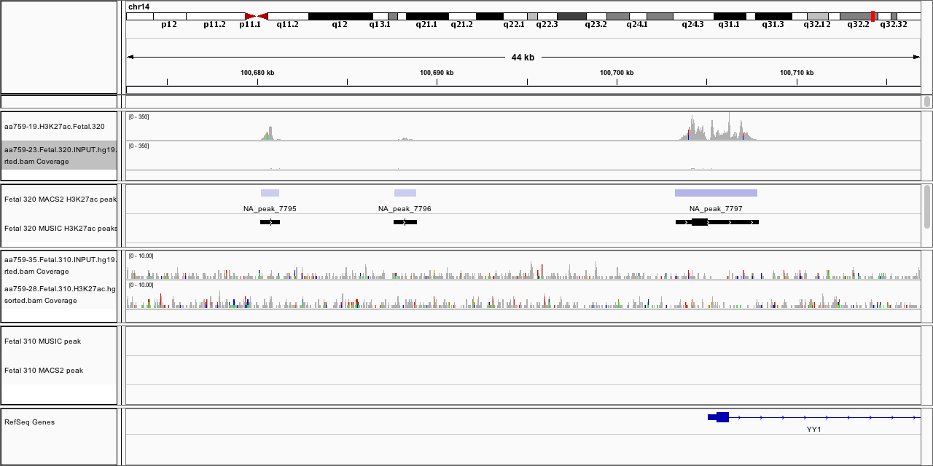
ChIP-seq H3K27ac peak calling results
Fetal 320 vs Fetal 310
Fetal 320
Fetal 310

Slide 30
Peak overlap between samples

Slide 31
iPSc ChIP-seq datasets 02
ID | Cell type | CellFraction | Marker
310#6 | TD 0 | nuclei | INPUT
310#6 | TD 0 | nuclei | H3K27ac
310#6 | TD 0 | nuclei | H3K4me3
310#6 | TD 15 | nuclei | INPUT
310#6 | TD 15 | nuclei | H3K27ac
310#6 | TD 15 | nuclei | H3K4me3
310#6 | TD 30 | nuclei | INPUT
310#6 | TD 30 | nuclei | H3K27ac
310#6 | TD 30 | nuclei | H3K4me3
310#4 | TD 30 | nuclei | INPUT
310#4 | TD 30 | nuclei | H3K27ac
310 | brain FR SVZ\VZ | nuclei | INPUT
310 | brain FR SVZ\VZ | nuclei | H3K27ac
310 | brain FR SVZ\VZ | nuclei | H3K4me3
310 | brain FR CP | nuclei | INPUT
310 | brain FR CP | nuclei | H3K27ac
310 | brain FR CP | nuclei | H3K4me3
Notes:
Frontal svz and frontal

Slide 34
Analysis of PsychENCODE ChIP-Seq data
Induced pluripotent stem cell lines (iPSC)
PEC Reference brain

Slide 35
PEC Reference brain (supplement)
Goal: to ensure uniformity of data collection and analyses with other consortium members.
HSB277
Sinai-sorted
450 mg tissue
1,500,000 NeuN+
1,500,000 NeuN-
Small piece unsorted tissue
RNA-seq
H3K27ac
Method A
Method S
NeuN+
NeuN-
NeuN+
NeuN-
RNA-seq
H3K27ac
RNA-seq
H3K27ac

Slide 36
Sample information
Sequencing sample name | Name given by Sequencing center | Cell type | Data
NK27_S | N_2b_ChIP_S_002 | NeuN+ | ChIP-Seq
NK27_A | N_2b_ChIP_A_005 | NeuN+ | ChIP-Seq
N-K27_A | N-ChIP_A_006 | NeuN- | ChIP-Seq
NInput | N_2b_ChIP_Input_012 | NeuN+ | ChIP-Seq
N-Input | N-ChIP_Input_019 | NeuN- | ChIP-Seq
277NK27 | 277N_2b_ChIP_002 | NeuN+ | ChIP-Seq
277N-K27 | 277N-ChIP_007 | NeuN- | ChIP-Seq
277Input | 277Input_019 | NeuN+ | ChIP-Seq

Slide 37
Peak overlap with PEC EPI map
Notes:
Sequence length

Slide 38
Peak overlap with Brainspan and Roadmap
Notes:
Sorted neucli Sequence length 100 bp, brainspan 76 bp, roadmap

Slide 39
Peak annotation for 277N+
G Yu, LG Wang, QY He. ChIPseeker: an R/Bioconductor package for ChIP peak annotation, comparison and visualization. Bioinformatics 2015, 31(14):2382-2383.

Slide 41
Future work
Annotation on iPS datasets
Super-enhancer identification
Possible analysis on Methylation and Super-enhancers
Brain ChIP-Seq dataset
Brain DNA Methylations
Super-enhancers
Brain regions
Development stages
Development stages
Brain Cancer
psychiatric disorder
Development stages analysis
Disease vs. control analysis

Slide 42
Acknowledgement
Gerstein Lab Members
  Mark Gerstein
  Arif Harmanci
  Anurag Sethi
  Daifeng Wang
  P2-TECH group
Sestan Lab Members
  Nenad Sestan
  Xuming Xu
  Sirisha Pochareddy
  Forrest Gulden
  Ying Zhu
  Mingfeng Li
  Jinmyung Choi
  Gabriel Santpere Baró
  Belen Lorente Galdos
http://brainspan.org/

Slide 43
Questions?

Slide 44
Results of Psychiatric Genomics Consortium
(PGC) Schizophrenia Working Group
Identified 108 physically distinct associated loci, 83 of which have not been previously implicated in schizophrenia
Identified a credible causal set of SNPs for each of the schizophrenia-associated loci
The credible sets of causal SNPs are mapped onto sequences with epigenetic markers characteristic of active enhancers in 56 different tissues and cell lines to calculate enrichment.
Schizophrenia Working Group of the Psychiatric Genomics C: Biological insights from 108 schizophrenia-associated genetic loci. Nature 2014, 511(7510):421-427.

Slide 45
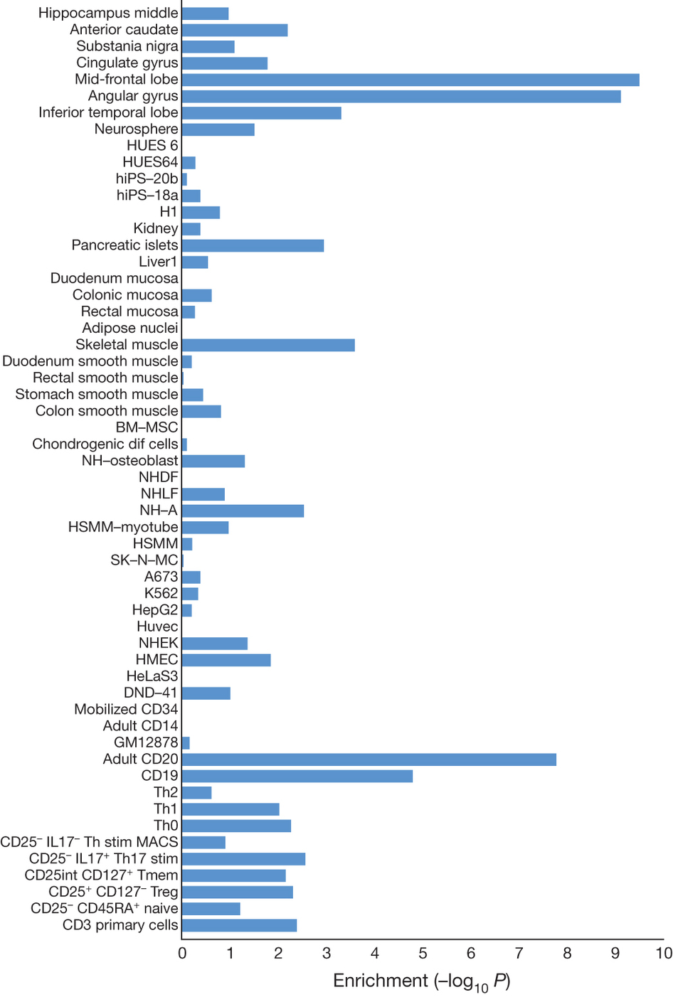
Enrichment in enhancers of credible SNPs of Schizophrenia
Schizophrenia Working Group of the Psychiatric Genomics C: Biological insights from 108 schizophrenia-associated genetic loci. Nature 2014, 511(7510):421-427.

Slide 46
Projects generating brain NGS datasets
Project name | Organism | Disease or control | Brain region | Datasets | Website Link
PsychENCODE | Homo sapiens, Rhesus macaque | Control, biopolar disorder, schizophrenia, Autism spectrum disorder | DFC,CBC,ACC,STR, HIP,AMY | RNA-Seq, ChIP-Seq,DNase-seq, ATAC-seq,DNase-seq,WGBS,NOMe-seq | http://psychencode.org/
CommonMind | Homo sapiens | Control, biopolar disorder, schizophrenia | DFC, CBC, STG | RNA-seq, ChIP-Seq, WGS, ATAC-Seq | http://commonmind.org/WP/
Psychiatric Genomics Consortium (PGC) | Homo sapiens | ADHD, autism, bipolar disorder, major depressive disorder, and schizophrenia | N/A | SNPs, CNVs | https://www.med.unc.edu/pgc
AMP Alzheimer’s disease Knowledge | Homo sapiens, iPSC,Mus musculus | Control, Alzheimer's Disease | 19 brain regions | RNA-Seq, ChIP-Seq, DNA Methylation | https://www.nia.nih.gov/alzheimers/amp-ad#amp-ad
Genome-wide association studies (GWAS) | Homo sapiens | all kinds of disorders | N/A | SNPs | http://grasp.nhlbi.nih.gov/Overview.aspx
Brainspan | Homo sapiens | Control | 16 brain regions | RNA-Seq, ChIP-Seq,Microarray, Methylation, MRI/DTI | http://brainspan.org/
Roadmap Epigenomics Mapping Consortium (Roadmap) | Homo sapiens | Control | 9 brain regions and cultured cells | ChIP-Seq, DNase , DNA methylation, RNA-Seq | http://www.roadmapepigenomics.org/
The Genotype-Tissue Expression (GTEx) project | Homo sapiens | Control | 13 brain regions | RNA-Seq, eQTLs | http://www.gtexportal.org/home/
TCGA | Homo sapiens | Cancer | Brain tunor | RNA-Seq
Notes:
Brainspan, psychencode include developing data/ our lab are invovle in these two projects

Slide 47
episomal
episomal
episomal
sandai
Episomal-sandai

Slide 48
Tissue Collection
Experimental Plan
Skull skin (4 fetuses)
RNA-seq:
iPSC (2/fetus) -episomal
-Sendai virus
ChIP-seq:
Neuronal differentiation
Day 0
Day 11
Day 30
H3K4me3
RNA-seq
Total RNA
ChIP-seq
H3K27ac
Cell Lysate or brain tissue
Unsorted nuclei
Unsorted nuclei

Slide 49
Peak overlap between MUSIC and MACS2
Fetal.320 MACS2 H3K27ac peaks
Fetal.320 MUSIC H3K27ac peaks
3,650
24,672
270

