Slide 1
A
B
C
Notes:
Figure 1. I[2_TD$DFF]Numbers of Consortium-Related Papers. (A) Numbers of PubMed indexed papers from 2004 to 2015. Blue circles represent the number of consortia papers indexed by PubMed (i.e., the author names on the paper appear as ‘consortium’ or ‘consortia’) per year from 2004 to 2015. The red squares represent the total number of papers indexed by PubMed per year from 2004 to 2015. (B) Paper distribution over author numbers driven by the ENCyclopedia Of DNA Elements (ENCODE) consortium until 2015. The x-axis represents the ranges in terms of numbers of authors per paper and the y-axis displays the numbers of ENCODE (blue) and non- ENCODE (red) papers. (C) Number of papers driven by ENCODE consortium from 2004 to 2015. The y-axis displays the numbers of ENCODE (blue) and non-ENCODE (red) papers in each year from 2004 to 2015. The non-ENCODE papers were those that were not directly funded by ENCODE but used ENCODE data.

Slide 2
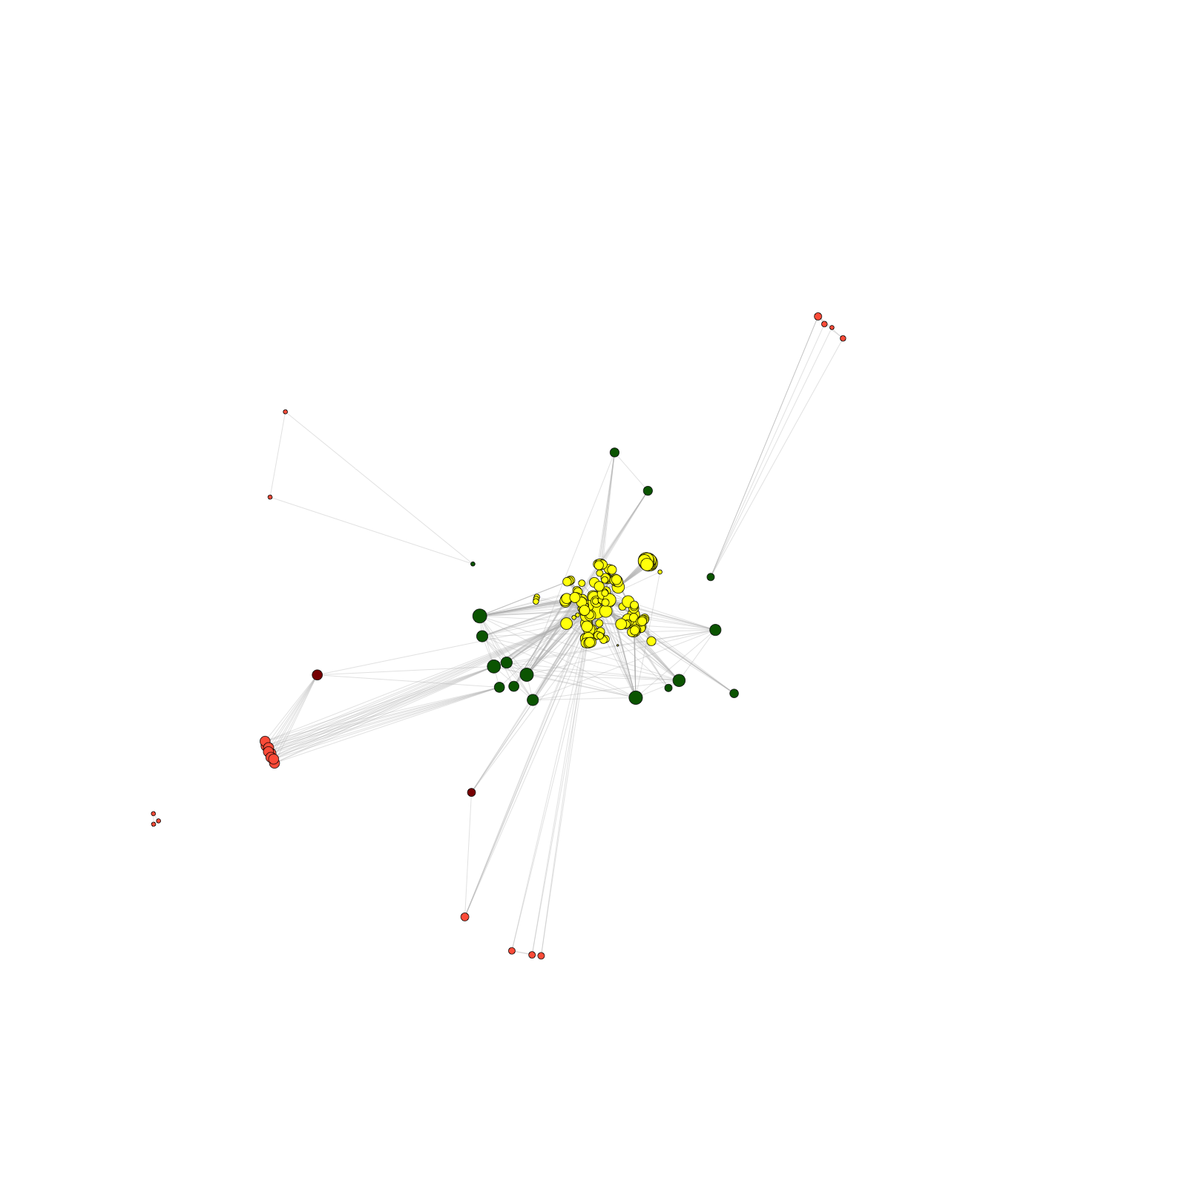
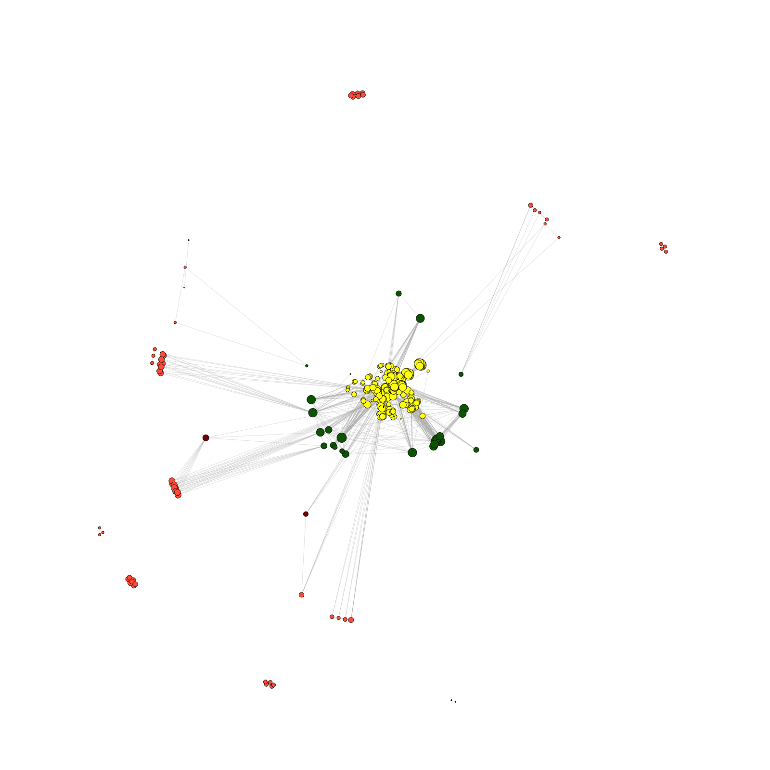
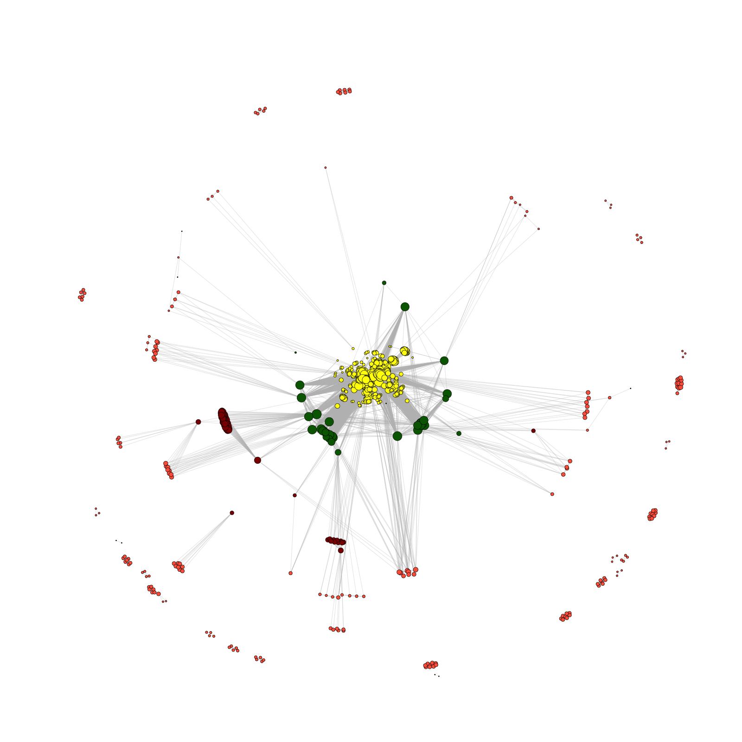
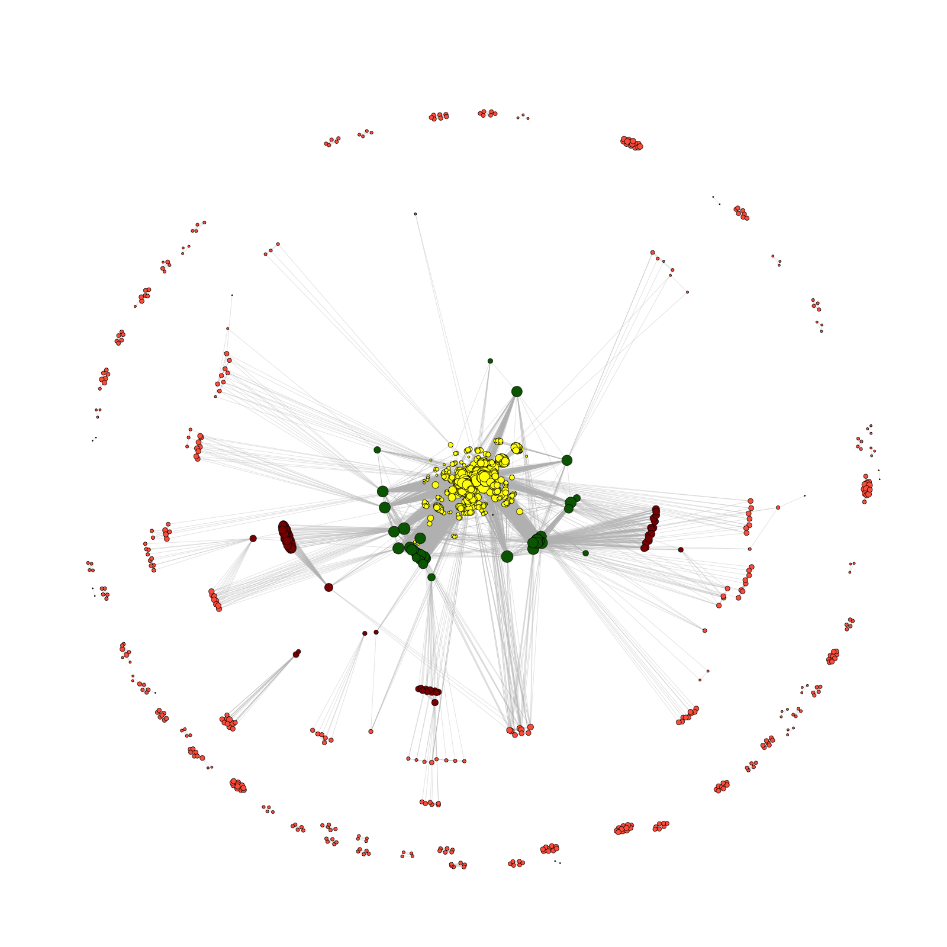
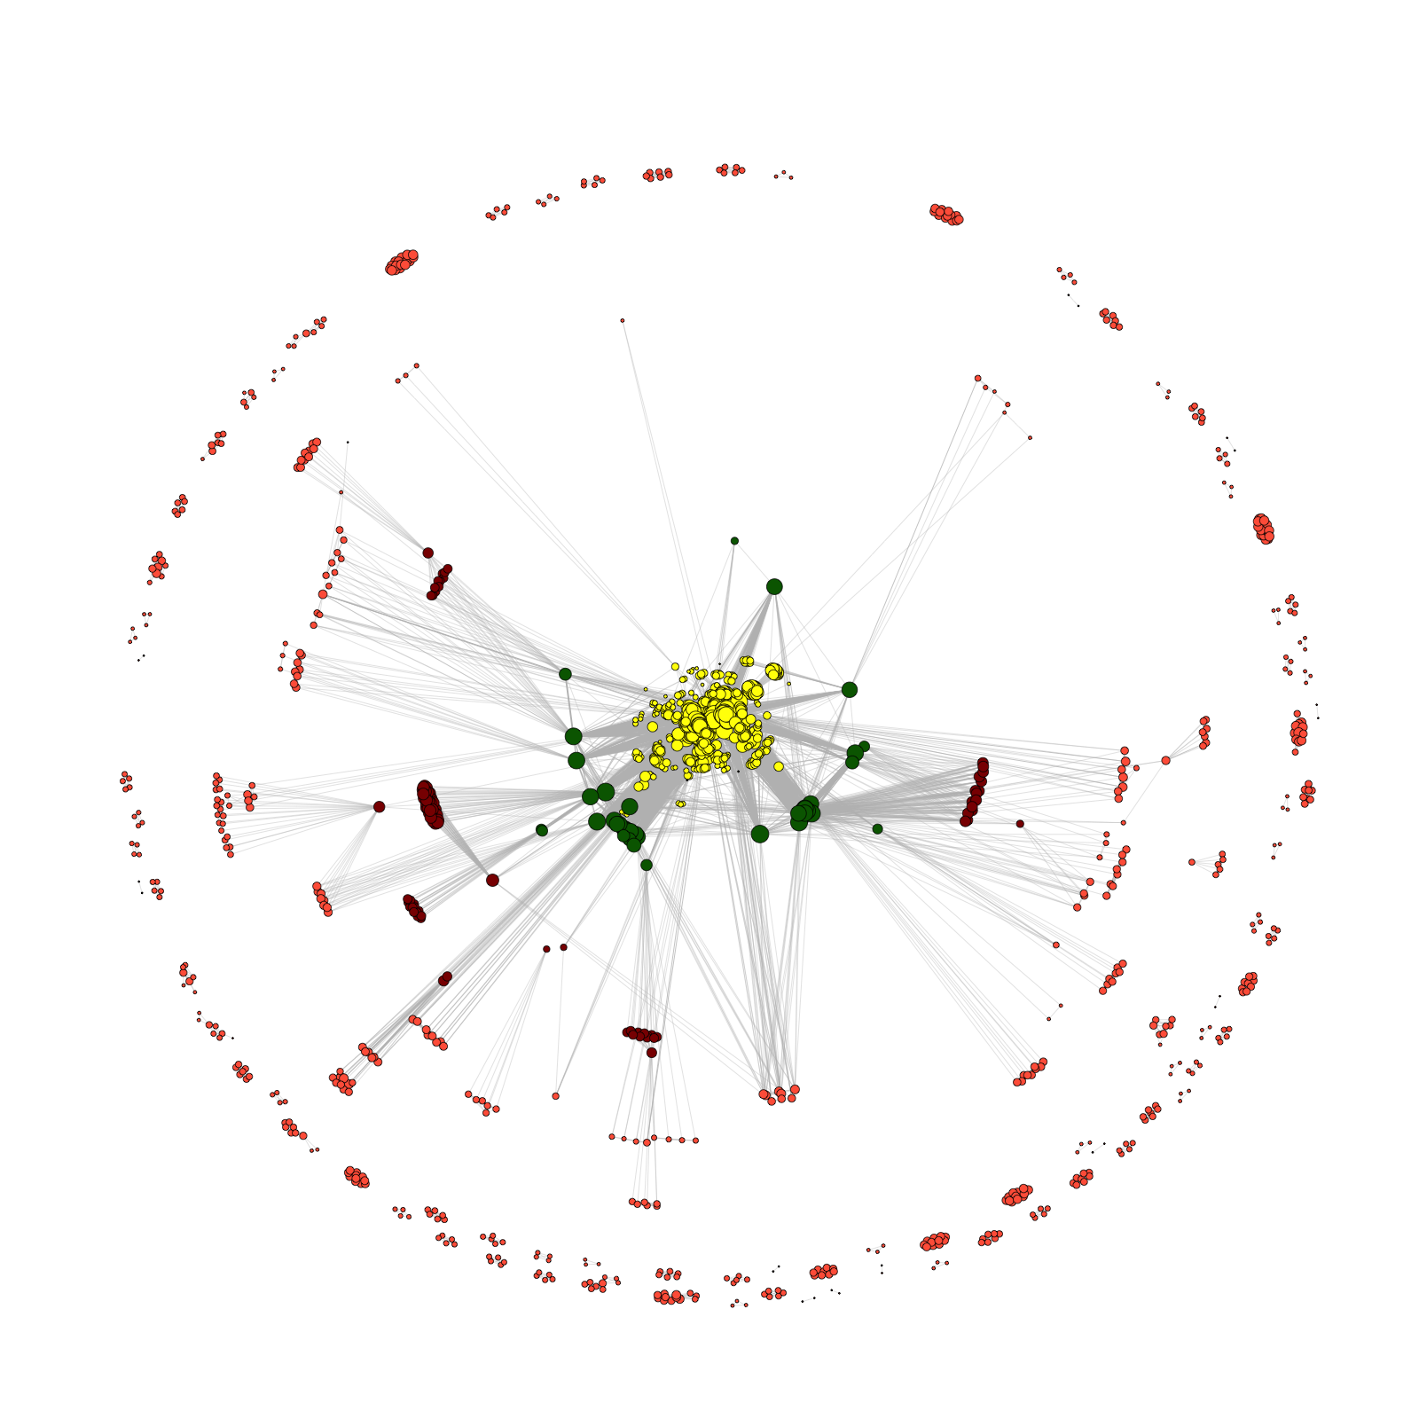
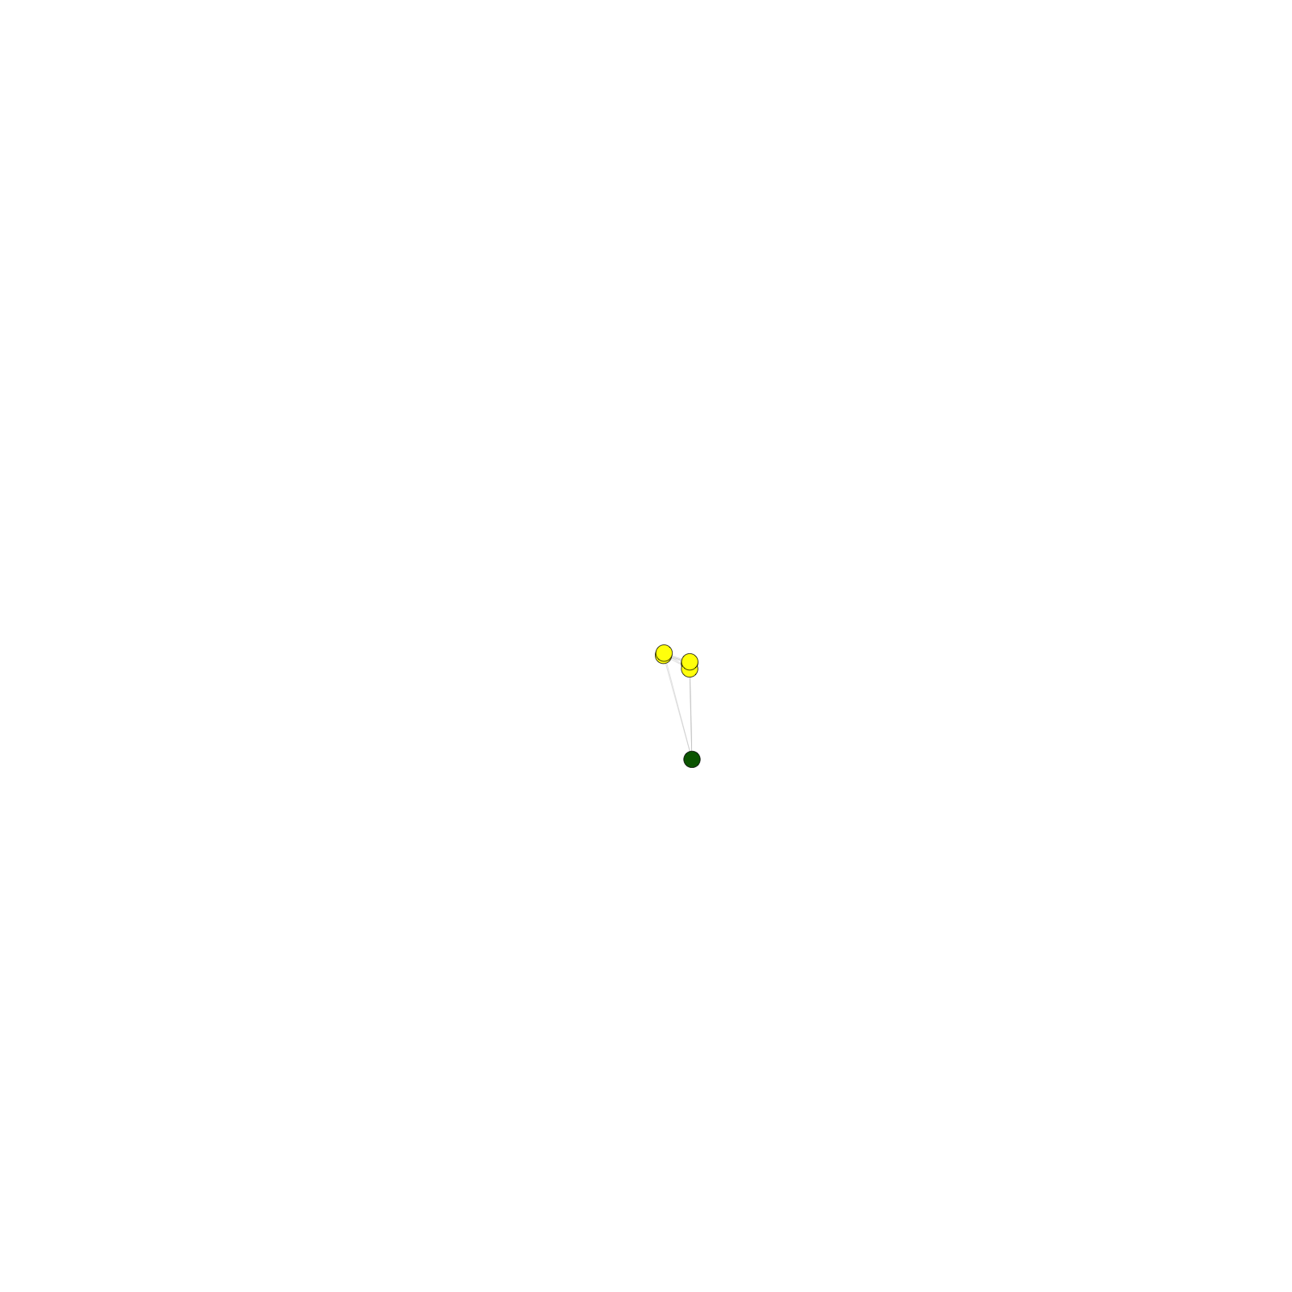
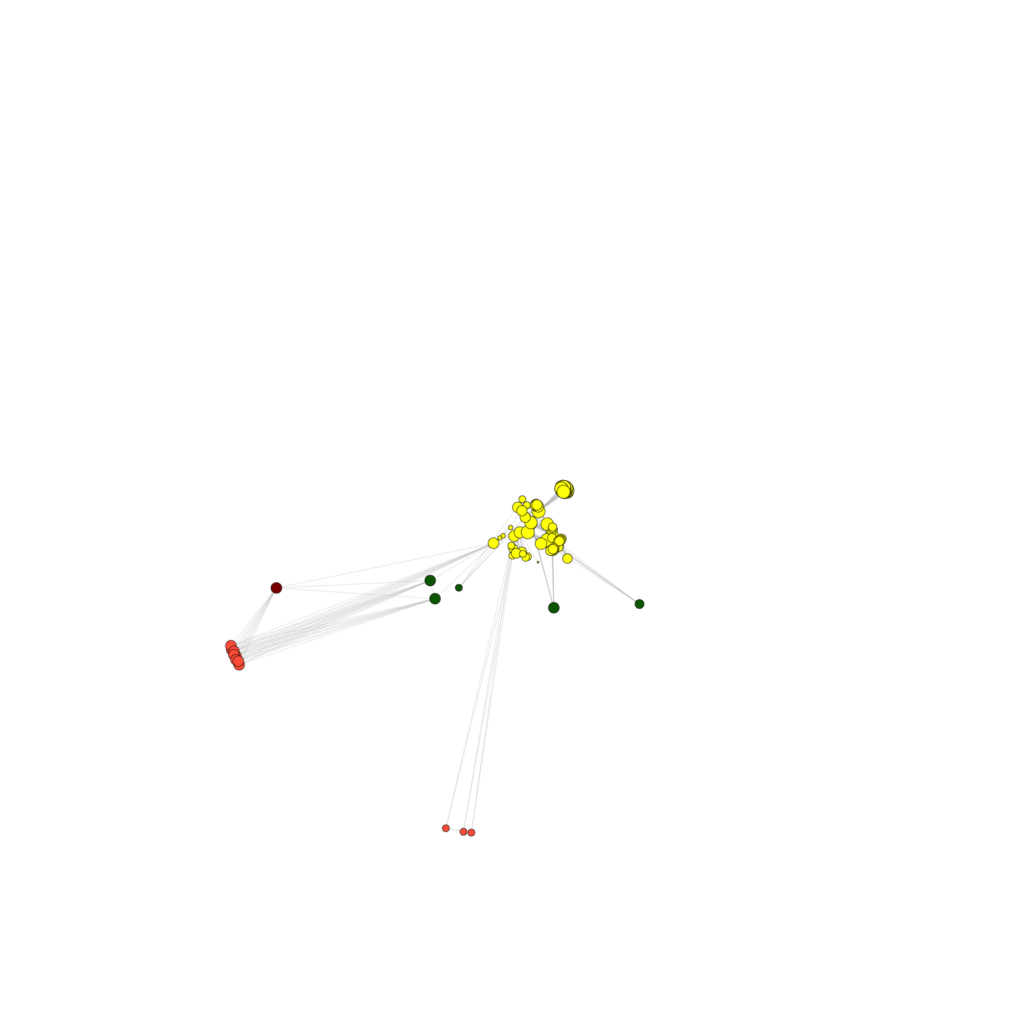
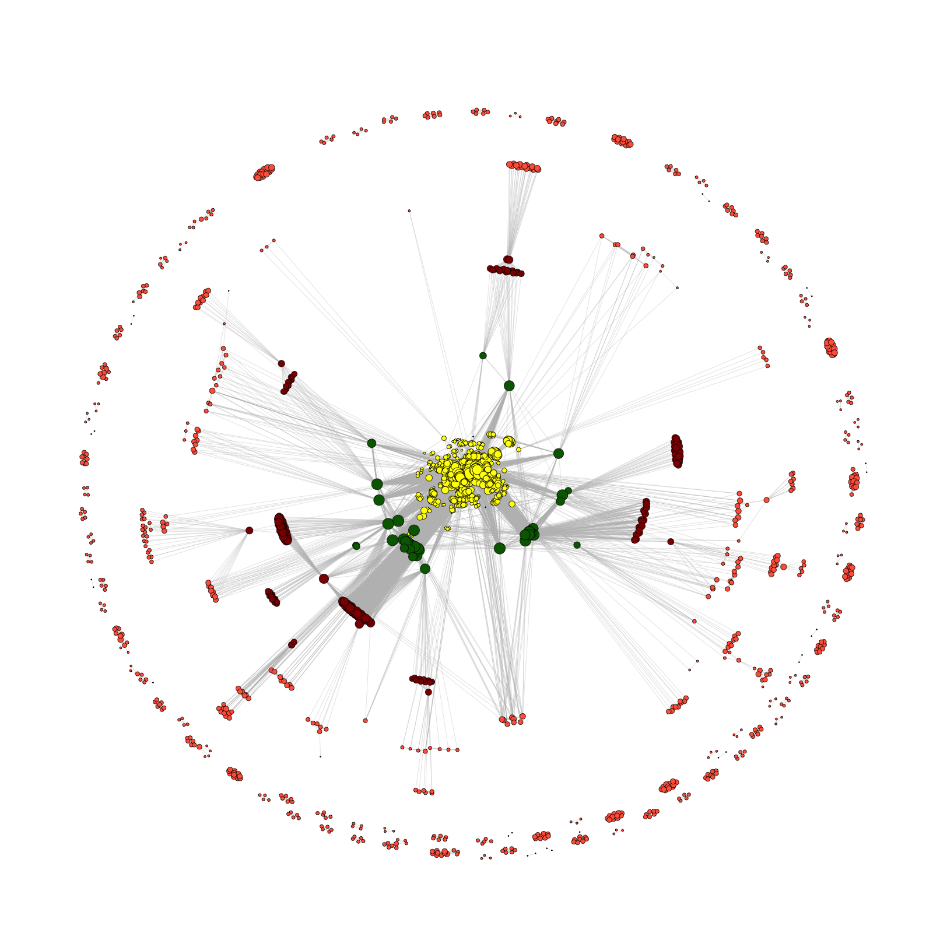
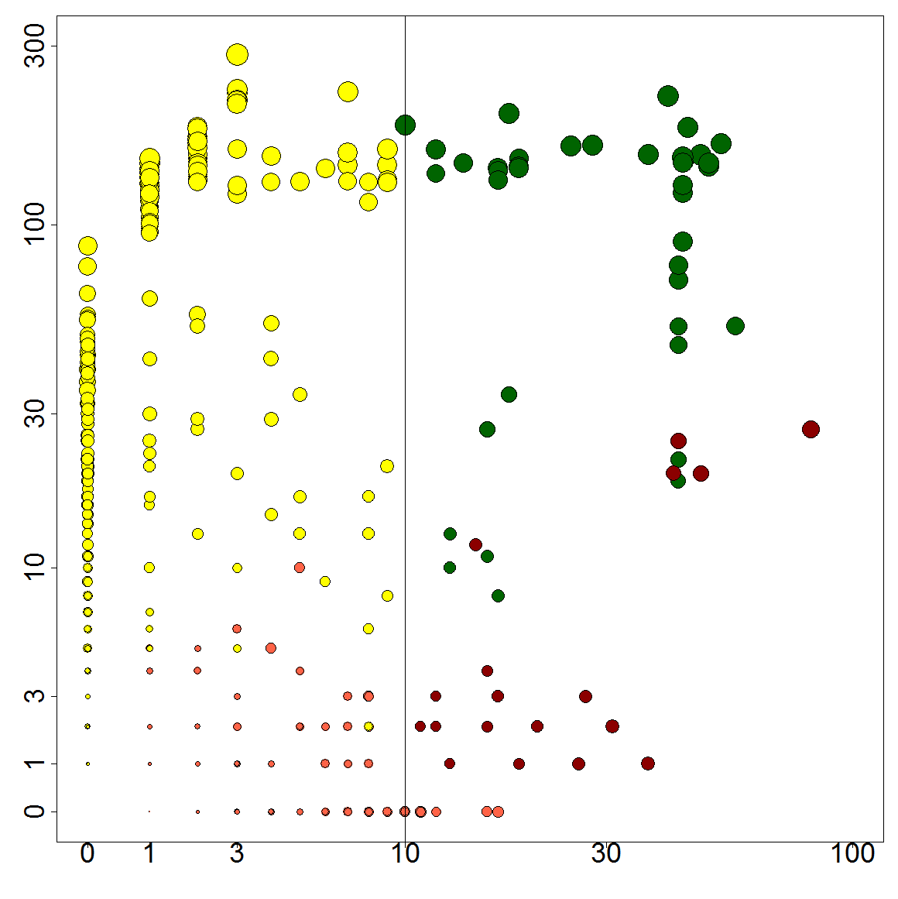
2014
2013
2012
2011
2010
2009
2008
2007
Number of member neighbors
modENCODE
Number of non-member neighbors

Slide 3
backup

Slide 4
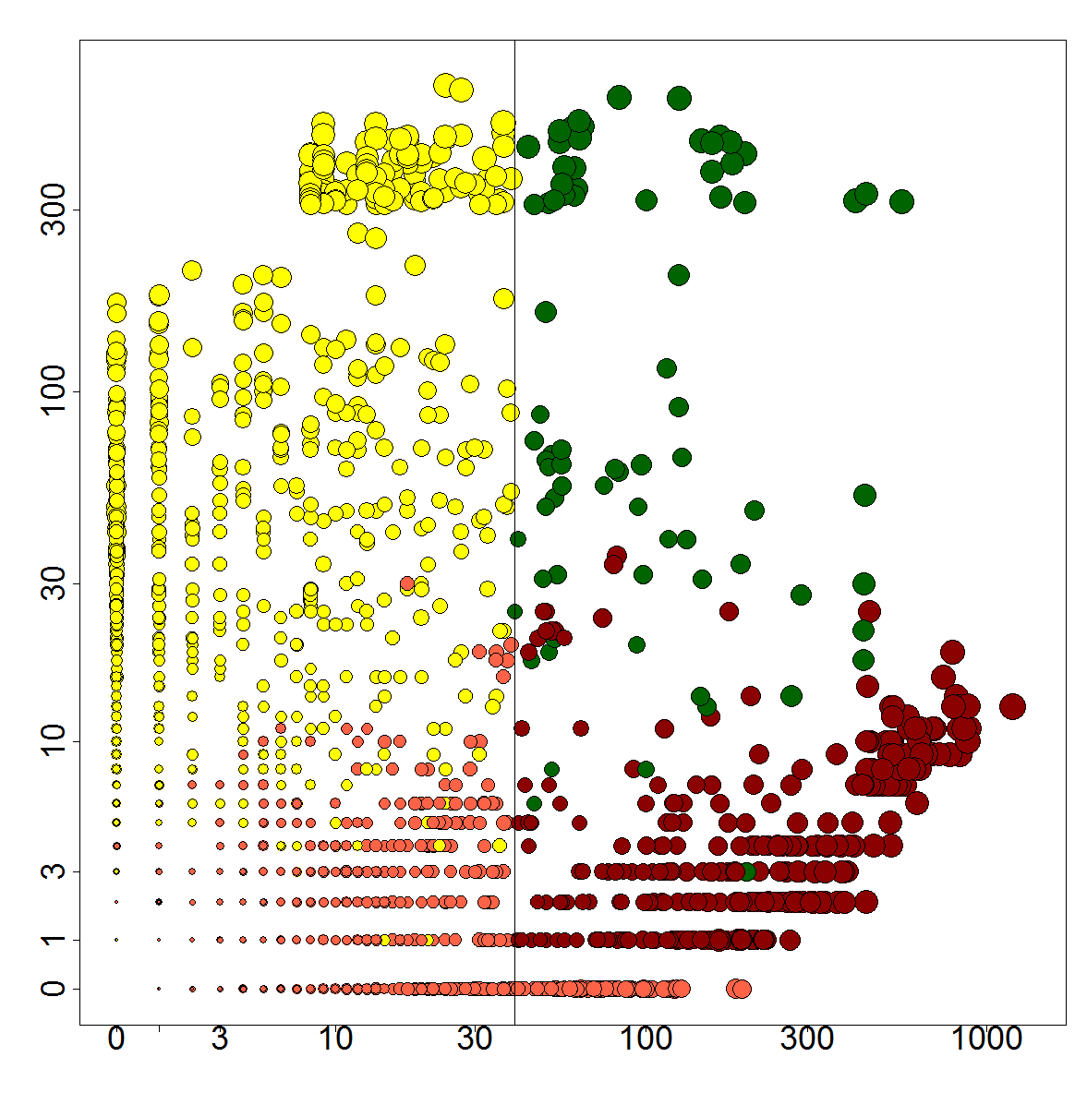
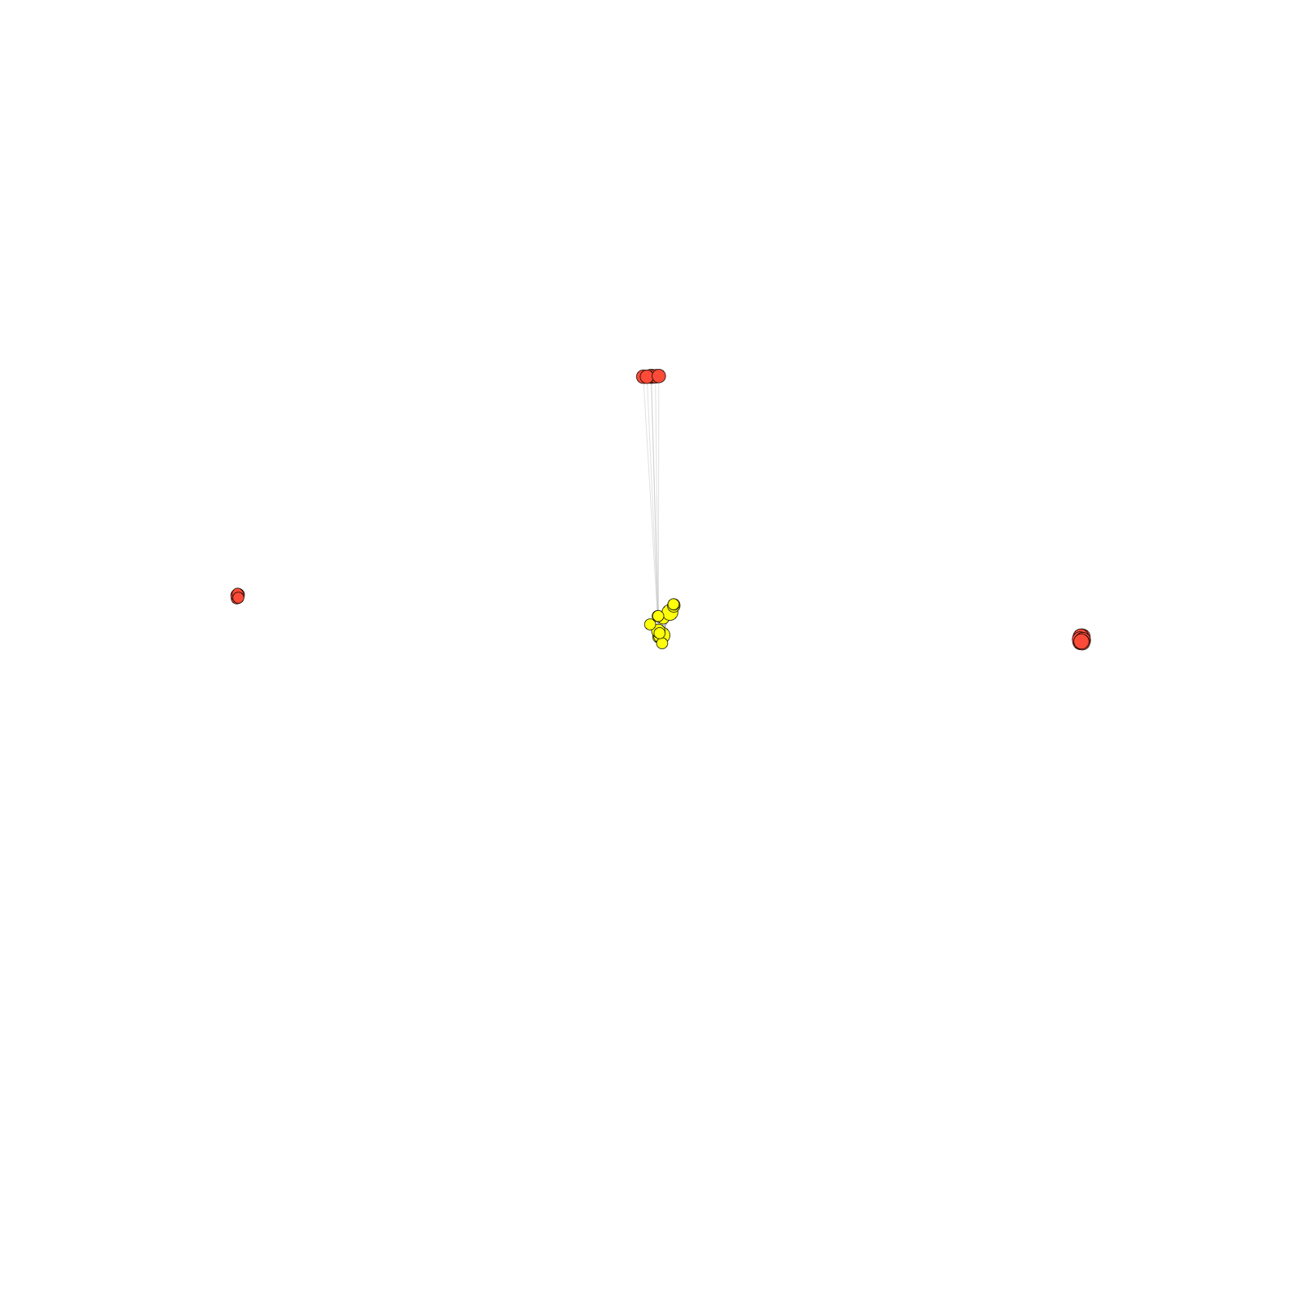
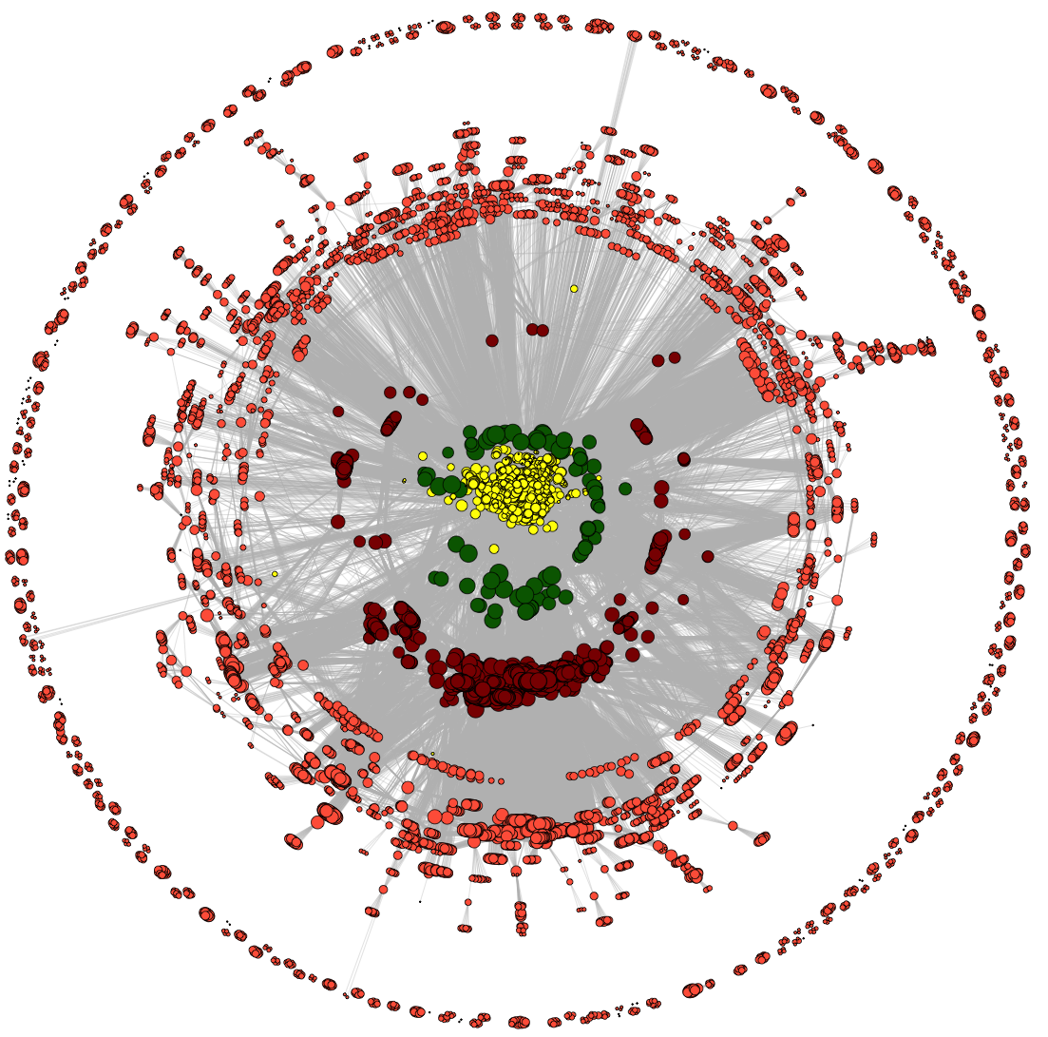
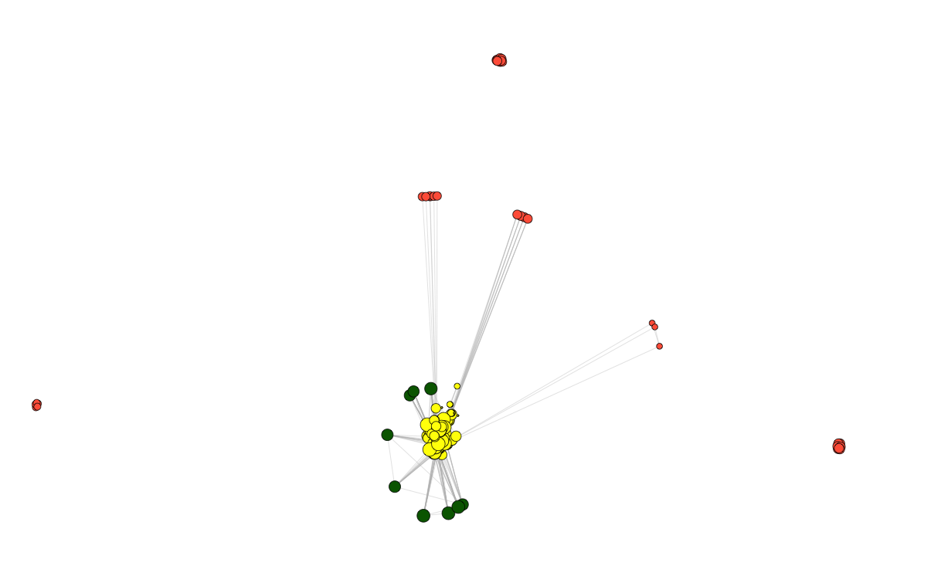
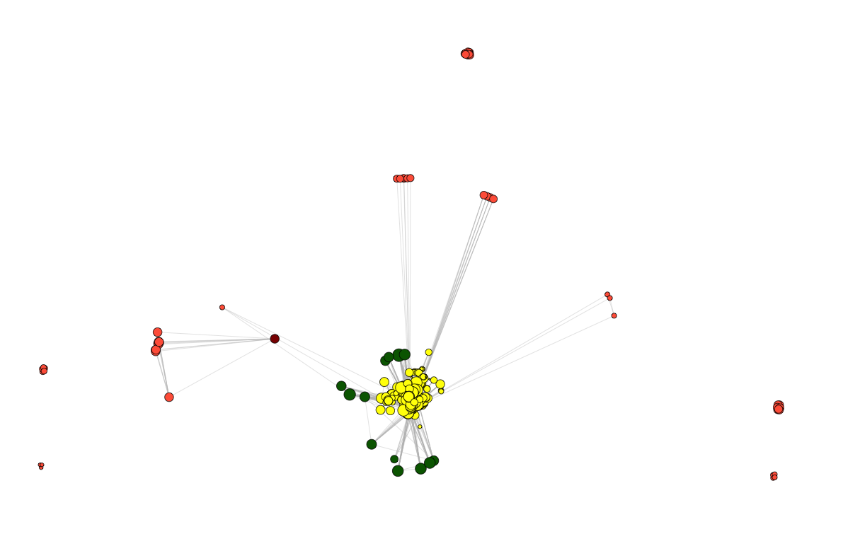
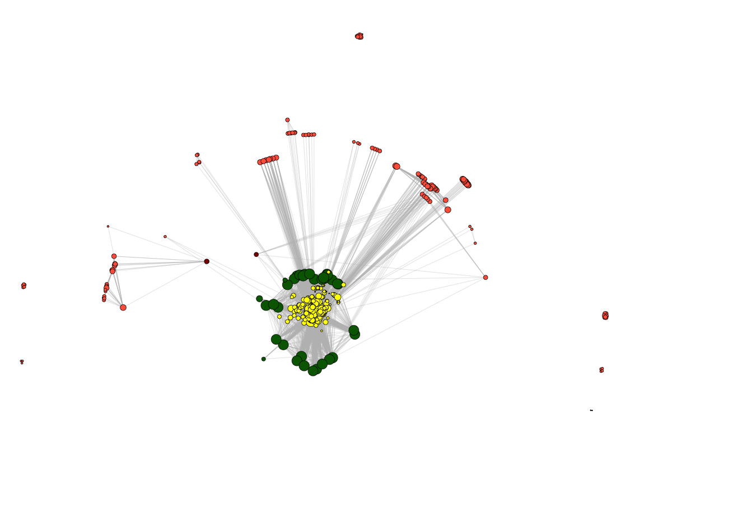
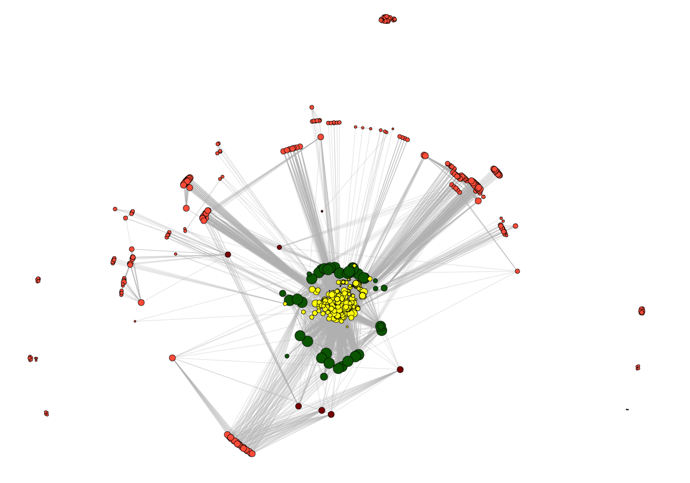
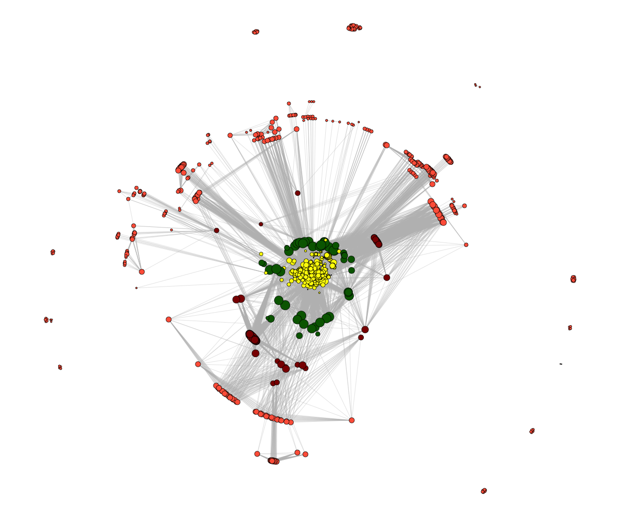
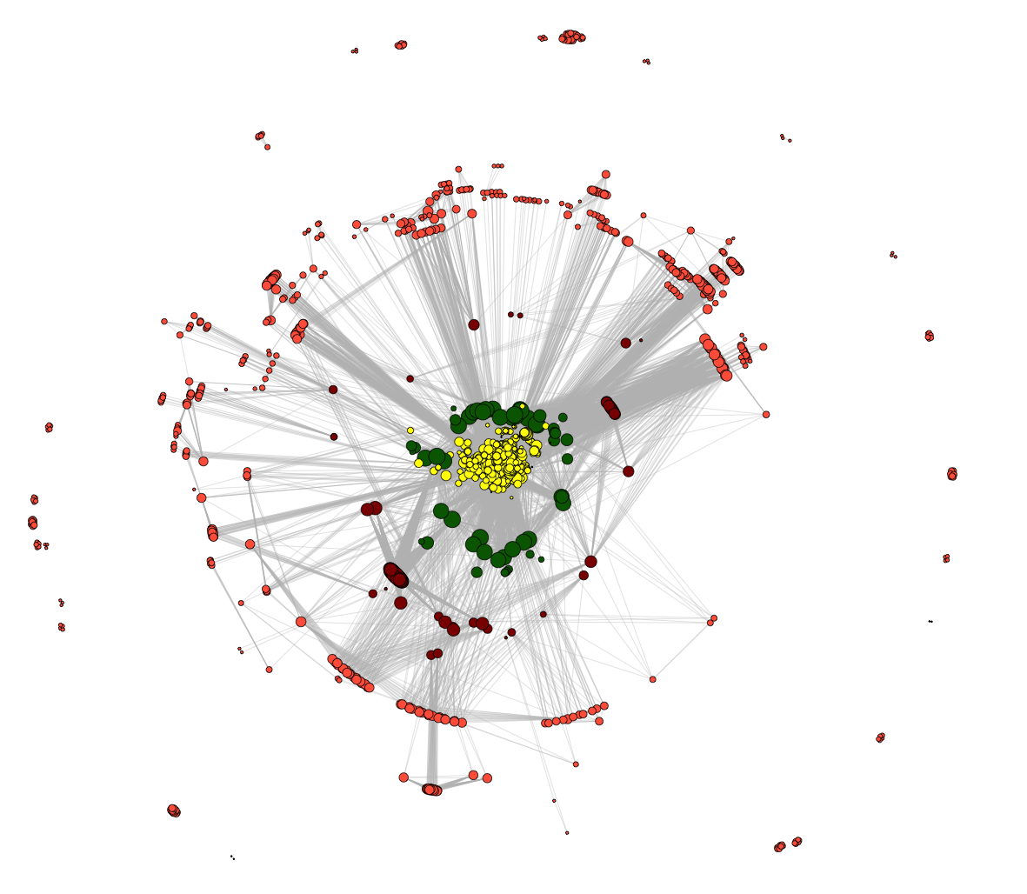
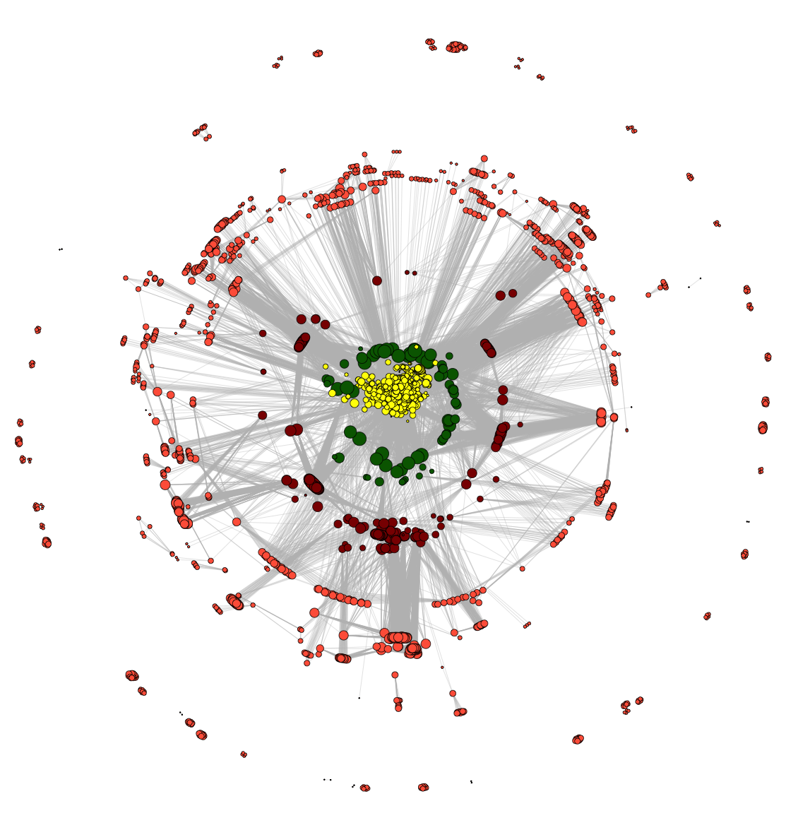
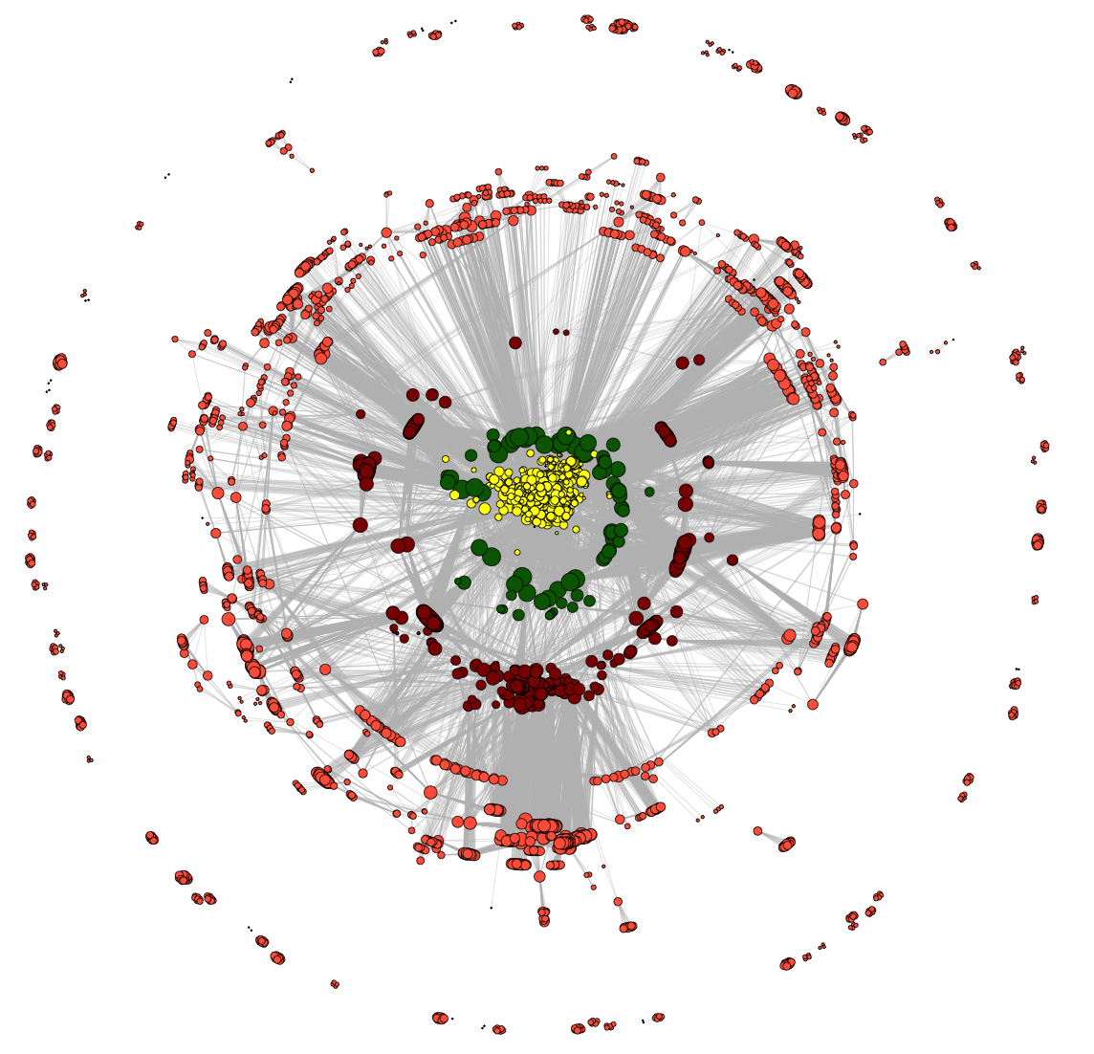
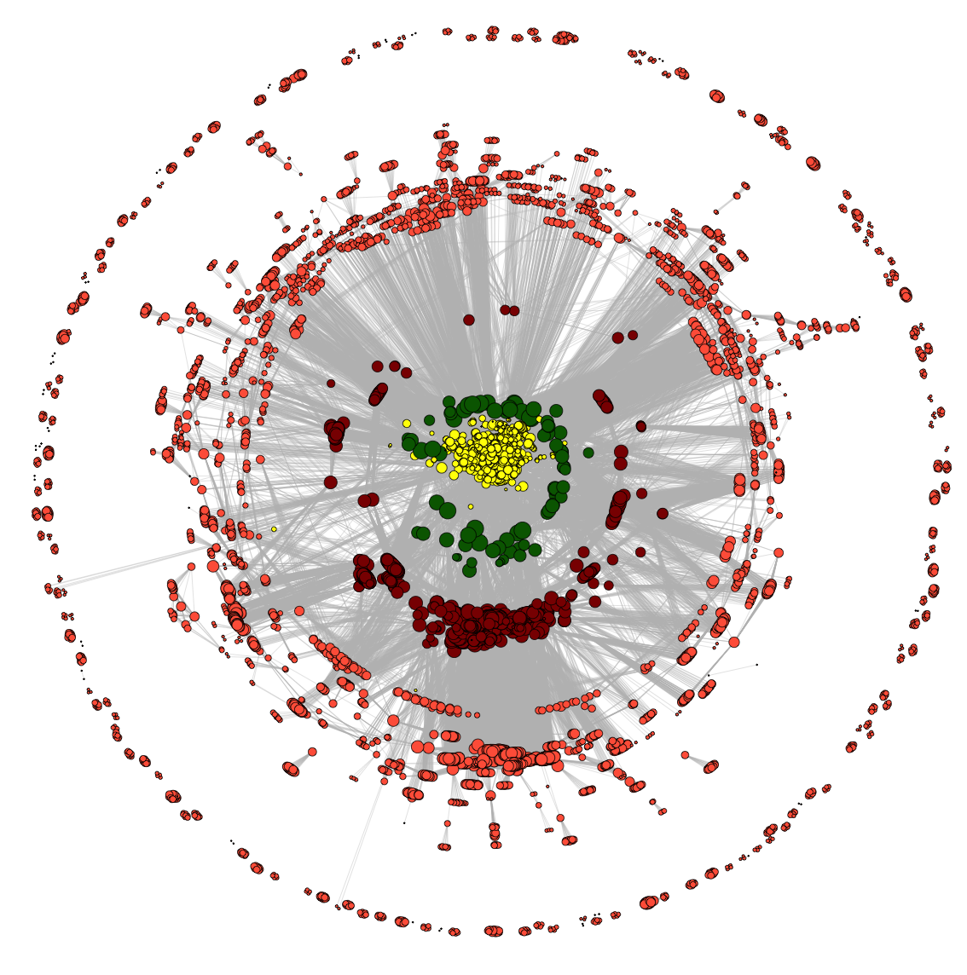
ENCODE
B
C
2004
2005
Number of member neighbors
2006
Number of non-member neighbors
A
2014
2013
2012
2011
2010
2009
2008
2007
D
E
F
Number of member neighbors
modENCODE
Number of non-member neighbors

Slide 5
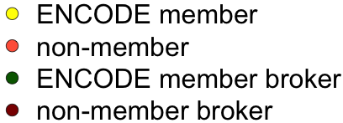
modENCODE member
2010
modENCODE member broker
2011
co-authorship
2009
2008
2012
2013
2007
modENCODE
2014

Slide 6
modENCODE stats
Modularity
Number of modules

