Slide 1
retroCNV (RDVs) calling pipeline 1000g-sv-Trio

Slide 2
“Available data”
Low coverage Illumina (phase3)
High Coverage Illumina
PacBio
Bionano 90x
Jumping library
Strand-Seq
10x Genomics
Moleculo
ACGH (array)
RNA-Seq (PacBio)
RNA-Seq (Illumina)

Slide 3
Intro RetroCNVs
Callset based on Low coverage Illumina WGS (phase3); High Coverage Illumina WGS; PacBio WGS.
RetroCNVs are duplications of messenger RNAs (mRNAs) mediated by L1 retrotransposons
  RetroCNVs are intronless copies of protein coding genes with polyA and direct repeats flanking the insertion.
  Some of these duplications are unfixed in human populations
Schrider, D. R., Navarro, F. C. P., Galante, P. A. F., Parmigiani, R. B., Camargo, A. A., Hahn, M. W., & de Souza, S. J. (2013). Gene copy-number polymorphism caused by retrotransposition in humans. PLoS Genetics,
Abyzov, A., Iskow, R., Gokcumen, O., Radke, D. W., Balasubramanian, S., Pei, B., et al. (2013). Analysis of variable retroduplications in human populations suggests coupling of retrotransposition to cell division. Genome Research.

Slide 4
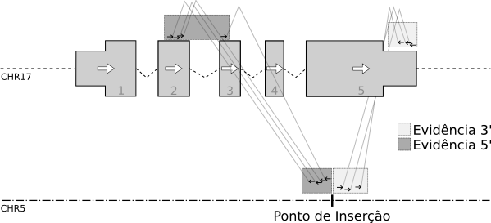
High coverage PCR free
CHS
PUR
YRI
11
10
12
13
14
14
HG00512
HG00513
HG00731
HG00732
NA19239
NA19238
ANPEP(HET)
BAZ2A(HET)
CBX3(HOP)
GCSH(HOP)
PCMTD1(HOP)
SET(HOP)
SKA3(HOP)
TDG(HOP)
RBMX (HET)
RALBP1 (HET)
P4HA1 (HET)
FTH1(HET)
ANPEP(HET)
CBX3(HOP)
GCSH(HOP)
PCMTD1(HOP)
TDG(HET)
BAZ2A(HET)
RBMX (HET)
RALBP1 (HET)
P4HA1 (HET)
FTH1(HET)
ANPEP(HET)
BAZ2A(HET)
GCSH(HOP)
PCMTD1(HOP)
RPL36(HET)
SET(HET)
TDG(HOP)
SET(HET)
RBMX (HET)
RALBP1 (HET)
P4HA1 (HET)
FTH1(HET)
BAZ2A(HET)
CBX3(HET)
GCSH(HOP)
HCAR2(HET)
PCMTD1(HOP)
SKA3(HET)
TDG(HOP)
TYRO3(HET)
SET(HET)
RBMX (HET)
RALBP1 (HET)
P4HA1 (HET)
FTH1(HET)
TDG(HOP)
BAZ2A(HET)
ATP9B(HET)
CBX3(HET)
GCSH(HOP)
MFF(HET)
PCMTD1(HOP)
RPLP0(HET)
SET(HET)
TMEM5(HET)
RBMX (HET)
RALBP1 (HET)
P4HA1 (HET)
FTH1(HET)
ATP9B(HET)
BAZ2A(HET)
CBX3(HET)
GCSH(HOP)
MFF(HET)
PCMTD1(HOP)
RPLP0(HET)
SET(HET)
TDG(HOP)
TMEM5(HET)
RBMX (HET)
RALBP1 (HET)
P4HA1 (HET)
FTH1(HET)
12
9
11
HG00514
HG00733
NA19240
ANPEP(HET)
BAZ2A(HET)
CBX3(HOP)
GCSH(HOP)
PCMTD1(HOP)
SET(HET)
SKA3(HET)
TDG(HET)
RBMX (HET)
RALBP1 (HET)
P4HA1 (HET)
FTH1(HET)
BAZ2A(HET)
CBX3(HET)
GCSH(HOP)
PCMTD1(HOP)
SKA3(HET)
TDG(HOP)
RALBP1 (HET)
P4HA1 (HET)
FTH1(HET)
TDG(HOP)
CBX3(HET)
GCSH(HOP)
PCMTD1(HOP)
RPLP0(HET)
SET(HET)
BAZ2A(HET)
FTH1(HET)
RALBP1 (HET)
RBMX (HET)
P4HA1 (HET)

Slide 5
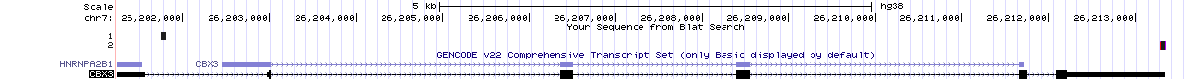
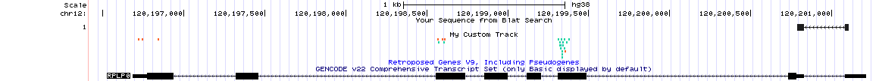
Breakpoint analysis
Illumina High Coverage
CBX3 inserted into chr15
chr15 40561981 0 313 CTTCGGATGTGGCTTGAGCTGTAGGCGCGGAGGGCCGGAGACGCTGCAGACCCGCGACCCGGAG
chr15 40561992 1 46 ATTTTTTTTTTTAAAGAAATATATAACTATTTATTAACCACTGTTCAGTATTTACAATAAAGTAAAC
RPLP0 inserted into chr11
chr11 60274156 0 6 TTTTTTTTTTTTTTTTTAAGAATTAAGCCTTTTTTTCTTTTTTTTTTAATTAAATCTGGCATAGTTGGTTATTTTTTGTGT chr11 60274167 0 55 CTCTCGCCAGGCGTCCTCGTGGAAGTGACATCGTCTTTAAACCCTGCGTGGCAATCCCTGACGCACCGCC
Breakpoints analysis is able to identify all insertions extremities,
as well as Target Site Duplications and poly(A)s

Slide 6
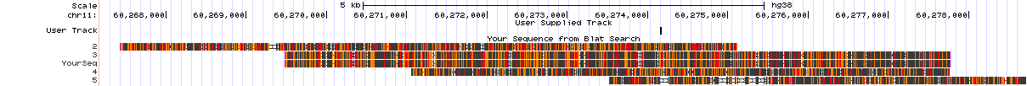
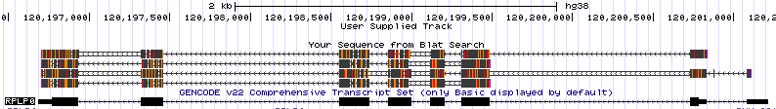
RPLP0 chr11:60274156-60274179
Insertion Point
Parental Gene
CTCTCGCCA GGggCgTCCT CaGTGGAAGT GACATCGcTC TTTAAACCCT 5050
GCGTGCAATC CCTGaACGCA CCGCCGTGAT GCCCAGGGAA GACAaGGGCG 5100
ACCTGGAAGT CCAACTACTT CTTAAGaATC ATCCAACTAa TGGATGATTA 5150
TCCgAAATGt TTTCATtGTG GGAGCAGACA ATGTGGGCTC CAAGCAGATG 5200
gCAGCAGATC CGaATGTCCC tTTCGCGGGA AGGctGTGGT GCTGATGGGC 5250
AAGAACACCA TGATGCGCAA GGCCATCCGA GGCACCTGGA AAACAACCCA 5300
GCTCTGagaA AACTGCTGCC TCgttTATCc GGGGGAATGT GGGCTTTGTG 5350
TTCACCAAGG AGGACCgtTC ACTGAaGATC AGGacCATGT TGCctggcCC 5400
…
ATgcagaCCC ATTCTAaTCA TCAACaGGGT AgCAAACGAG TCCTCCTTGT 5850
CTGTGGAGAC GGATTACACC TTCCAaTTGC TGAAgGTCAA GGCCTTCTTG 5900
GCTaCCATCT gGCCTTTGTG GCTGCcTGCC CCTGTGGCTG CTGCACCACA 5950
GCTCTCCaTG CTGCTGCaTG CAGcCCCCAG CTAAGGTTGA AGCCAAGGAA 6000
GAGTaGGAGG AGTCGGcacg aAGGATATGG GATTTGTCTC TTGACTAAat 6050
ACCAAAgcaa AcCCAACTct agGCCAGgtT TTATTTGCAA ACAAGAAATA 6100
AAGGCTTACT TCTTTAAAAA Aaaaaaaaaa aaaaaacttc cgaaactgaa 6150
gagcaaaagg gaaaaaaatg gaaaaaaaga agcagaacaa cccaaagtgc 6200

