Slide 1
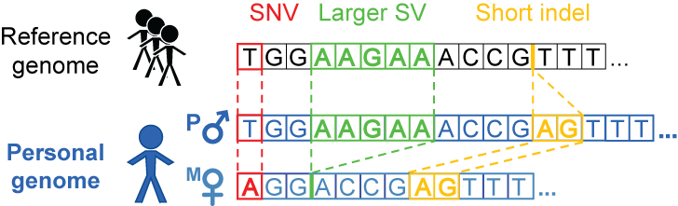
How to build a personal genome
(fasta; reference)
(vcf, variants
phased or unphased)
(fasta; for each
haplotype)
alleleseq.gersteinlab.org
Rozowsky et al. Mol Syst Biol (2011)
Notes:
Compatible subseq in downstream processing or analyses e.g with aligners for indexing

Slide 2
How we build a personal genome
reference, .fasta
personal diploid genome, .fasta
+
+
personal variants, .vcf
coordinate offset files, .chain
alleleseq.gersteinlab.org
Rozowsky et al. Mol Syst Biol (2011)
Notes:
Compatible subseq in downstream processing or analyses e.g with aligners for indexing

Slide 3
Why the personal genome (PG) should be the platform for functional genomics
Diploid
--Ability to incorporate private variants of any size
--exhibit phase information
Scale easily with more samples (v graph genome) and improving sequencing technologies: longer reads and more accurate phase information
Very useful in functional genomic assay analyses
a) read alignment
b) RNA-seq quantification
c) allele-specific analyses

Slide 4
Why the personal genome (PG) should be the platform for functional genomics
Diploid
--Ability to incorporate private variants of any size
--exhibit phase information
Scale easily with more samples and improve with development of sequencing technologies: longer reads and more accurate phase information
Very useful in functional genomic assay analyses
a) read alignment
b) RNA-seq quantification
c) allele-specific analyses

Slide 5
Some construction considerations
1. Availability and choice of call set (s)
-- e.g. different versions of 1000GP call sets
2. Choice of variants
-- e.g. SVs or indels or SNVs only
3. Choice of reference
-- choose the reference genome in which the call set is derived from
4. Assessment of call set quality
-- e.g. analysis of Mendelian inconsistency in family data
Notes:
Het/hom ratio
Ti/tv ratio

Slide 6
NA12878 family of PGs we already have
 | Source | Refgen | Depth | Variants
1 | 1000 Genomes Project (1000GP) pilot | hg18 | 60x | SNVs, indels, deletions (including 33 from fosmid sequencing)
2 | GATK Best Practices v3 (UnifiedGenotype) | hg19 | 64x | SNVs, indels
3 | GATK Best Practices v4 (HaplotypeCaller, PCR-free) | hg19 | 64x | SNVs, indels
4 | 1000GP Phase 3 SNVs-only | hg19 | 7.4x | SNVs
5 | 1000GP Phase 3 SNVs-indels | hg19 | 7.4x | SNVs, indels
6 | 1000GP Phase 3 SNVs-indels-SVs | hg19 | 7.4x | SNVs, indels, SVs

Slide 7
NA12878 family of PGs we already have
 | Source | Refgen | Depth | Variants
1 | 1000 Genomes Project (1000GP) pilot | hg18 | 60x | SNVs, indels, deletions (including 33 from fosmid sequencing)
2 | GATK Best Practices v3 (UnifiedGenotype) | hg19 | 64x | SNVs, indels
3 | GATK Best Practices v4 (HaplotypeCaller, PCR-free) | hg19 | 64x | SNVs, indels
4 | 1000GP Phase 3 SNVs-only | hg19 | 7.4x | SNVs
5 | 1000GP Phase 3 SNVs-indels | hg19 | 7.4x | SNVs, indels
6 | 1000GP Phase 3 SNVs-indels-SVs | hg19 | 7.4x | SNVs, indels, SVs
7 | 1000GP Phase 3 SNVs-indels-SVs | hg19 | 7.4x | Same as (6) + Pindel Complex SVs
8 | GIAB NA12878 pilot genome | hg19 |  | SNV, indels, preliminary SV calls

Slide 8
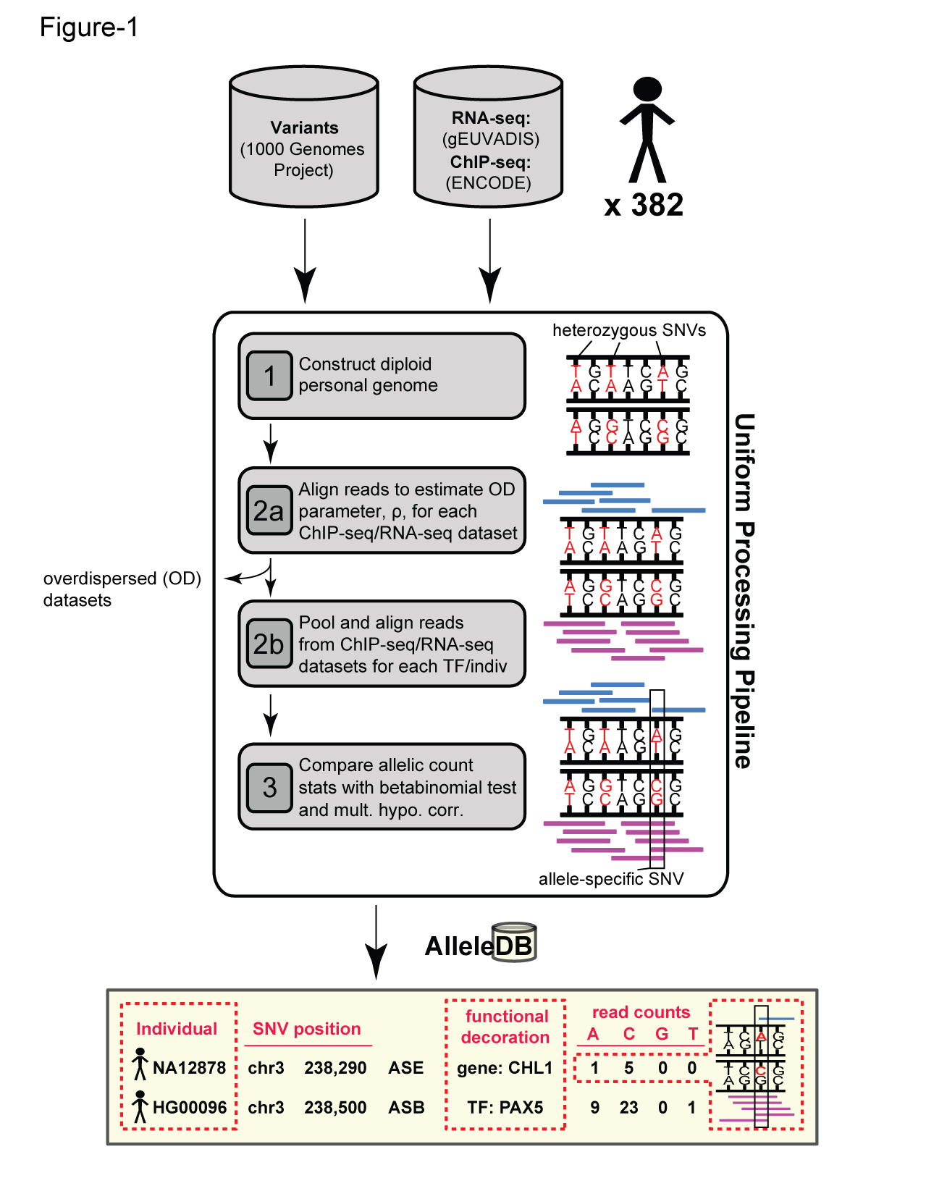
AlleleDB: Building 382 personal genomes to detect allele-specific variants on a large-scale
Build personal genomes
Align ChIP-seq & RNA-seq reads
Detect allele-specific variants
via a series of filters and tests
Many Technical Issues: Reference bias, Ambiguous mapping bias, Over-dispersed (non binomial null)
alleledb.gersteinlab.org
Chen J. et al. (Nature Commun, in press)

Slide 9

Personal Genomes of 382 1KGP individuals
- Construction of PGs is scalable:
We built PGs of 382 individuals using their Phase 1 1KGP variants and hg19
- Analyses of functional datasets based on allelic read counts are most sensitive to mapping biases:
We have developed approaches to account for reference bias, ambiguous mapping bias and read over-dispersion within the PG framework
- The PGs and allele-specific annotation of their variants are available from alleledb.gersteinlab.org
Chen J. et al. Nature Commun, 7:11101

Slide 10
PG alleviates reference bias in alignment

Slide 11
PG alleviates reference bias in alignment

Slide 12
Ambiguous mapping bias due to sequence similarity
For AS analyses, discard reads that multi-map

Slide 13
Ambiguous mapping bias
Ambiguous mapping bias (AMB): simple removal of multi-mapping reads may lead to false AS signal

Slide 14
Account for ambiguous mapping bias
Using the reference genome, new simulated reads are created where alleles of the original reads are flipped (at het SNV positions)
Lappalainen et al. (2013)
Panousis et al. (2014)
Van de Geijn et al. (2015)
Notes:
There is currently a number of different methods that can help with this issue and one of more common methods is to do a simulation of flipped reads

Slide 15
Account for ambiguous mapping bias: reference genome
Current approaches to deal with the reference and ambiguous biases commonly involve
Filtering sites with potential bias based on mapping of simulated reads generated from genomic sequence;
or
Using simulated reads obtained by flipping the alleles of original reads at hetSNV positions:
Lappalainen et al. (2013)
Panousis et al. (2014)
Van de Geijn et al. (2015)
Notes:
There is currently a number of different methods that can help with this issue and one of more common methods is to do a simulation of flipped reads

Slide 16
PG facilitates the resolution of ambiguous mapping bias
Using the personal genome, we do not need to simulate reads.
We can directly test affected sites using multi-mapping read pile
Notes:
The flipping simulation can also be used in the

Slide 17
Account for ambiguous mapping bias: personal genome
Using the personal genome, we do not need to simulate reads.
We can directly test affected sites using multi-mapping read pile
Notes:
The flipping simulation can also be used in the

Slide 18
Alignment gets better as variant sets get more complete: NA12878 Pol2 ChIP-seq (ENCODE)
 | Ref genome | Pgenome: SNVs only | Pgenome: SNVs + indels only | Pgenome: SNVs + indels + SVs
Reads processed | 208,051,087
# reads uniquely aligned | 171,944,588 (82.65%) | 172,591,380 (82.96%) | 172,738,321 (83.03%) | 172,743,175 (83.03%)
# reads that multimap | 17,826,675 (8.57%) | 17,795,258 (8.55%) | 17,782,167 (8.55%) | 17,779,800 (8.55%)
Almost 1M increase in reads
Does not format to std. theme
Notes:
We observe that

Slide 19
Alignment gets better as variant sets get more complete:
NA12878 Pol2 ChIP-seq (ENCODE)
 | Ref genome | Pgenome: SNVs only | Pgenome: SNVs + indels only | Pgenome: SNVs + indels + SVs
Reads processed | 208,051,087
# reads uniquely aligned | 171,944,588 (82.65%) | 172,591,380 (82.96%) | 172,738,321 (83.03%) | 172,743,175 (83.03%)
# reads that multimap | 17,826,675 (8.57%) | 17,795,258 (8.55%) | 17,782,167 (8.55%) | 17,779,800 (8.55%)
Almost 1M increase in reads
Does not format to std. theme
Notes:
We observe that

Slide 20
Alignment gets better as variant sets get more complete: NA12878 RNA-seq (Kilpinen et al. 2013)
 | Ref genome | Pgenome: snvs only | Pgenome: snvs + indels only | Pgenome: snvs + indels + SVs
Reads processed | 37,558,398
# reads uniquely aligned | 25,303,498 (67.37%) | 25,486,837 (67.86%) | 25,538,449 (68.00%) | 25,568,042 (68.08%)
# reads that multimap | 4,041,495 (10.76%) | 4,010,417 (10.68%) | 4,012,297 (10.68%) | 3,972,990 (10.58%)
Over 260K increase in reads
Does not format to std. theme

Slide 21
Alignment gets better as variant sets get more complete:
NA12878 RNA-seq (Kilpinen et al. 2013)
 | Ref genome | Pgenome: snvs only | Pgenome: snvs + indels only | Pgenome: snvs + indels + SVs
Reads processed | 37,558,398
# reads uniquely aligned | 25,303,498 (67.37%) | 25,486,837 (67.86%) | 25,538,449 (68.00%) | 25,568,042 (68.08%)
# reads that multimap | 4,041,495 (10.76%) | 4,010,417 (10.68%) | 4,012,297 (10.68%) | 3,972,990 (10.58%)
Over 260K increase in reads
Does not format to std. theme

