Slide 1
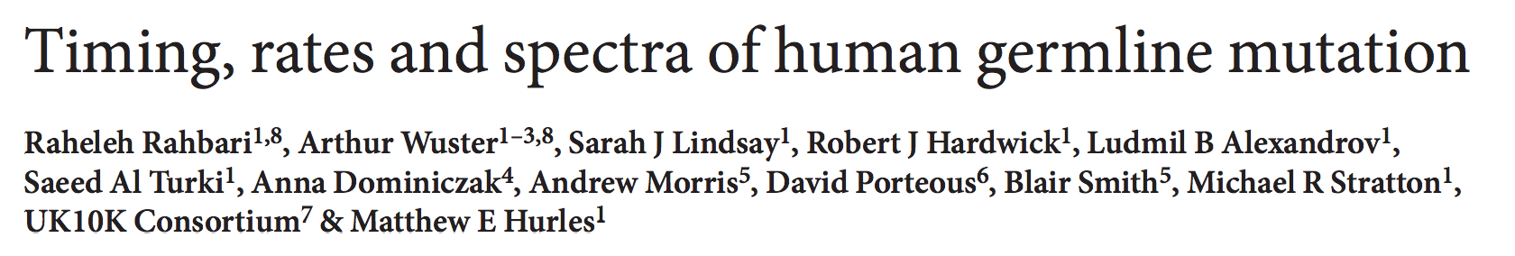

Slide 2
DNMs
De novo mutations
  ~70 per generation
  Slightly lower than theoretical results ~120
    Based on DNA pol error rate/number of cell replication
  The ultimate source of evolution
Selection should be strong …
  Survival bias
Sequencing of 3 families: siblings and parents

Slide 3
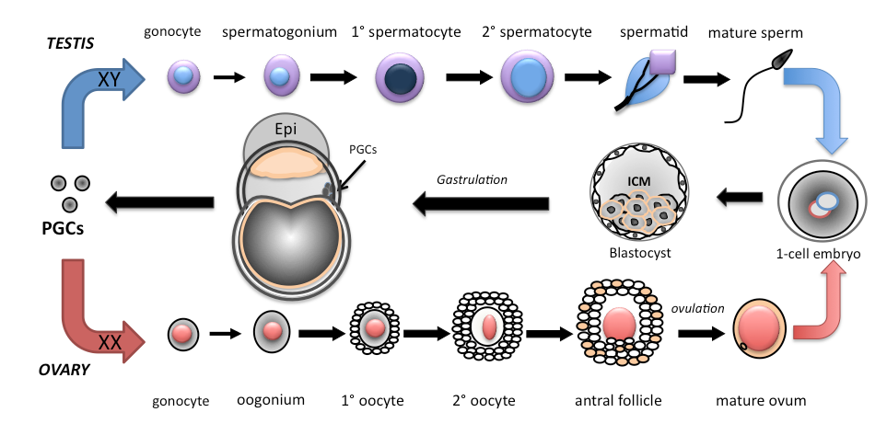
Cell Lineage
PGC: primordial germline cell
Gametogenesis
Ramathal et al.

Slide 4
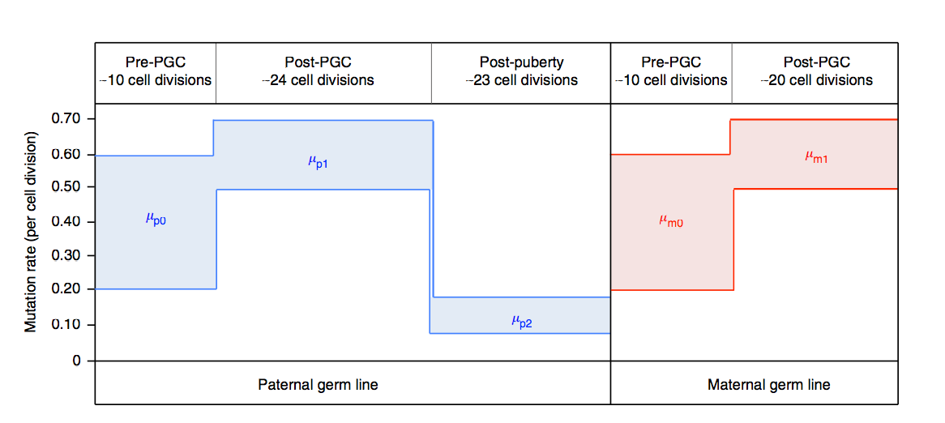
Post-puberty mutation rate lower in males

Slide 5
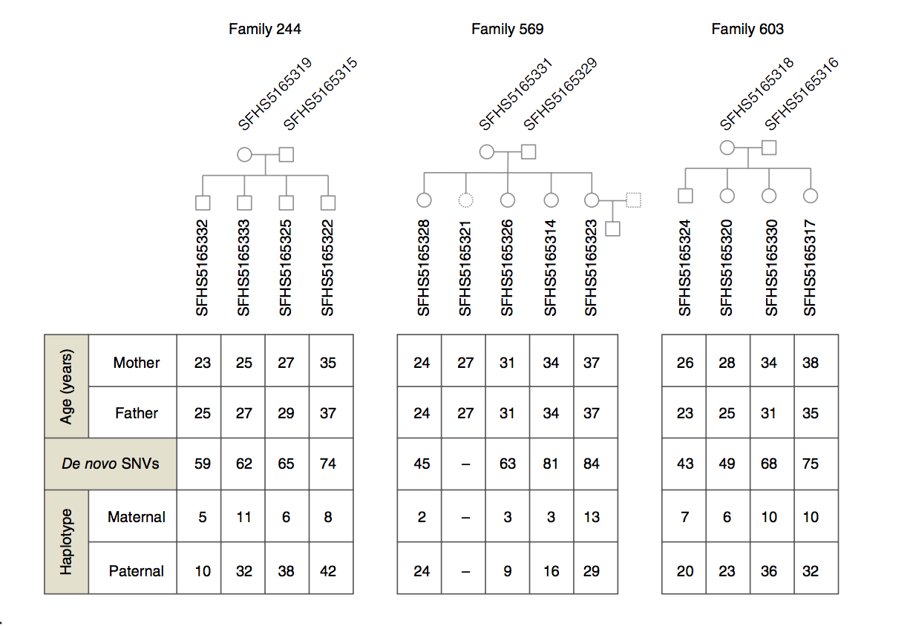
Research Subjects

Slide 6
Now recall your middle school SexEd …

Slide 7
Inference: STAGE 1
Any mutation after first division of the zygote causes somatic mosaicism
This also affect germline, if before PGC differentiation

Slide 8
Inference: STAGE 2
Any mutation after PGC differentiation will be absent from other somatic tissues
(e.g. Blood cells). But mutations in gamete precursors leads to recurrent DNMs in
offsprings

Slide 9
Inference: STAGE 3
Post-puberty divisions: mutations only effects the specific gamete

Slide 10
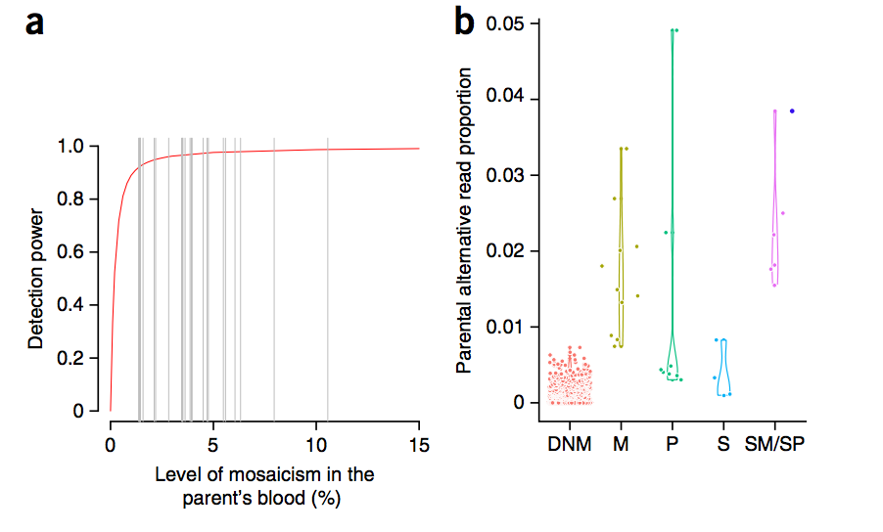
DNMs Inference
DNMs: found in offspring(s) but AF<10% in both parents
  Evidence for Parental Mosaicism
  Recurrence
  Reads supporting AA

Slide 11
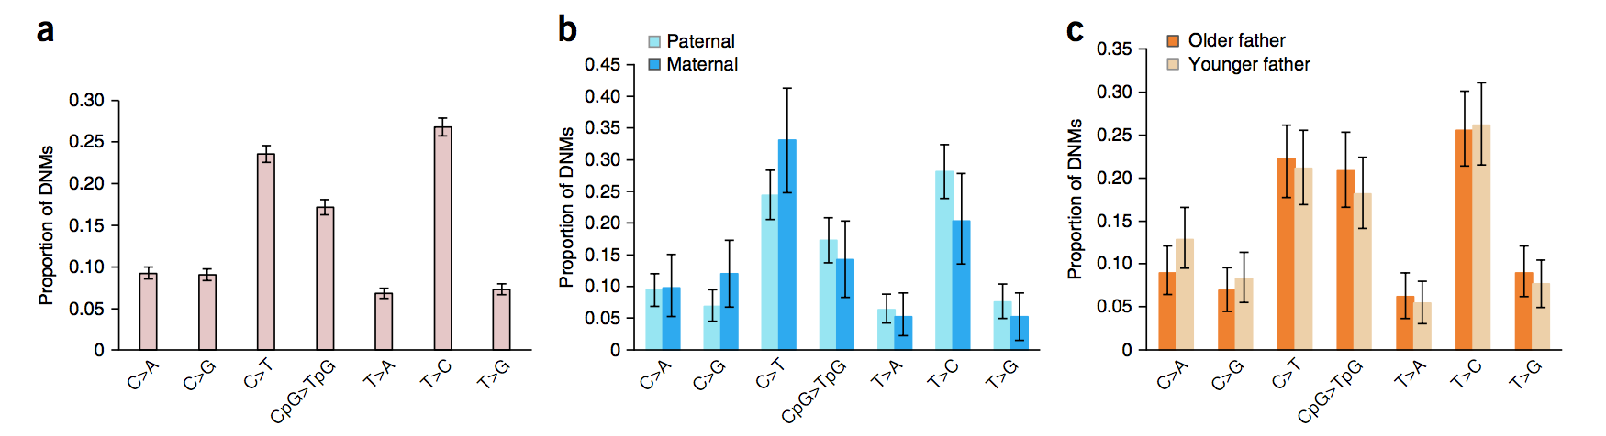
Mutation Spectra
Compiled 6,570 DNMs from 109 trios
  No pattern observed in low-res spectra

Slide 12
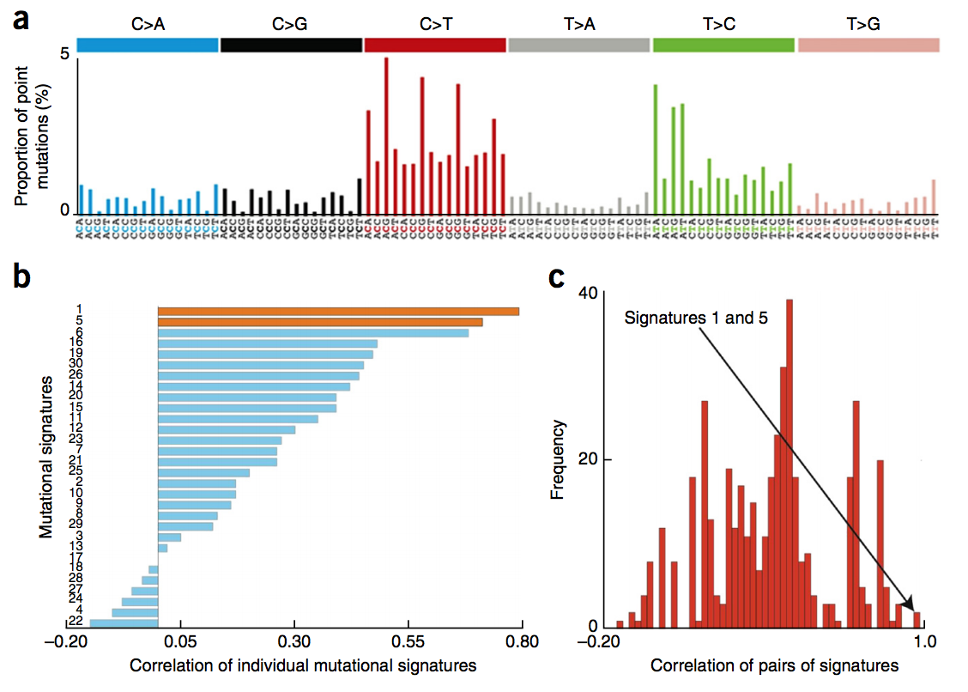
High-res Spctra

Slide 13
High-res Spctra
Spectrum consistent with LOW AF SNPs in UK10K
But lower C>T/T>C ratio decreases dramatically…why?
Signature 1 & 5 considered as “clock-like” signatures in cancer
Mostly C>T in CpG: Methylation driven

Slide 14
Finding Signatures
Problem: signatures known, fit a mutation spectrum
  How many signatures present(sparsity…)
  Which one and what weights(fitting)

Slide 15
Finding Signatures
 | Alexandrov et al., 13’ (Cell Reports) | Shirashi et al., 15’ (Plos Genetics) | Rosenthal et al., 16’ (Genome Biology) | Alexandrov et al., 15’ (Ncomm.) | Alexandrov et al., 15’ (DNMs, NGen.) | Our Method (a fancy one!)
Sparsity (finding K) | Statistical methods (AIC/BIC/CV); | Statistical methods (AIC/BIC/CV) | Stopping criteria & Exclude low sig. | Limiting the signature set based on bio. prior | Good fitting at K=2 (cor=0.98) | LASSO (nextGen?LDA with structure info.)
Fitting | NMF & Clustering; Sum square loss (SSE) | LDA (EM); Max likehood; | Forward selection; SSE | Linear programing; SSE | Exhaustive searching; L1 norm; | LASSO non-neg, zero-intercept fitting; SSE

Slide 16
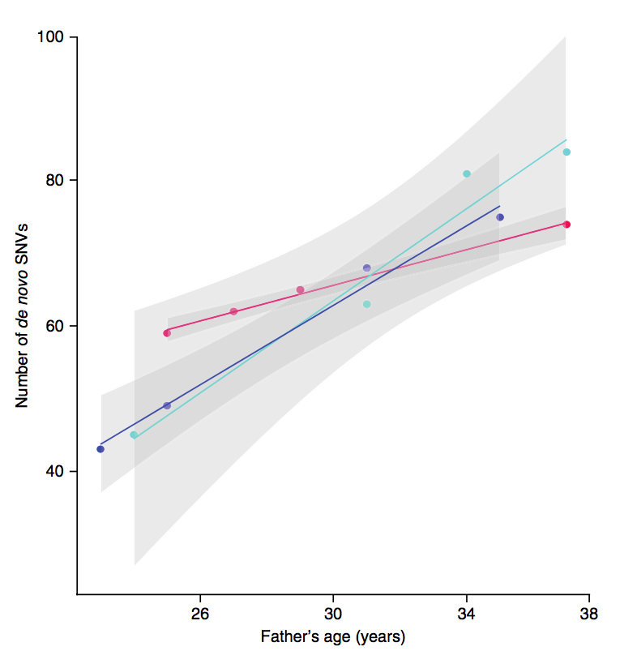
Carry them or freeze them?
2.87/yr.
    DNMs increase by
    50% in 10-15 years
Epigenetical effect?
Or just hand them
down early?

Slide 17
Implications
Genetic consulting
  Deep sequencing of DNM regions (>500X in this study)
  Sequence gametes directly
Only probed methylation only in testis?

