Slide 1
I0gsp16 slide guide
5/5/16

Slide 2
I0gsp16 presentations guide
D1S3_NHGRI_CMG_face-to-face_jrl2
Baylor-Hopkins Center for Mendelian Genomics
CNV detection in research and clinical WES
D1S6_CMG.and.ClinGen.Causalilty
CMG Causal Criteria
D2S4_Boerwinkle CCDG presentation 4 6 16
How to get value-added from a typical case-control study?
D2S4_NHGRI CCDG Slides (Broad)
‘Comprehensive Discovery’ of disease alleles across type, frequency, location – Power considerations
D2S5_Harvard GSPAC presentation
Analytic Challenges, Aims and Statistical Consideration, Joint GSP-TOPMed Analysis Retreat
Handling Non-Coding Regions and Cross-Phenotype Analysis
Hail (Cloud-Based Analytic Platform); Building Common Controls
D3S5_TOPMed overview NHGRI GSP
NHLBI Trans-Omics for Precision Medicine (TOP Med)

Slide 3
I0gsp16 presentations guide
D2S7_Boerwinkle NHGRI CCDG+CMG v4_dm
The Continuous Spectrum of Mutations Spanning Mendelian and Complex Disease
D2S9_GSP_DataWG_Progress_041216_v2
Data Working Group Progress Report
D2S10_CommonControls-Buyske-2016-04-09
Pooling Common Controls
D2S11.Rehm.Phenotype.CMG.CCDG
Phenotype Harmonization
D2S12_GSP data sharing Apr 2016 GSP meeting - Copy
Developing NHGRI GSP Data Sharing Agreement
D3S1_Neuropsych working group CCDG April 13 2016
CCDG NEUROPSYCHIATRIC WORKING GROUP NYGC
D3S4_GSP_depth_analyses
Read depth coverage for whole genome sequencing

Slide 4
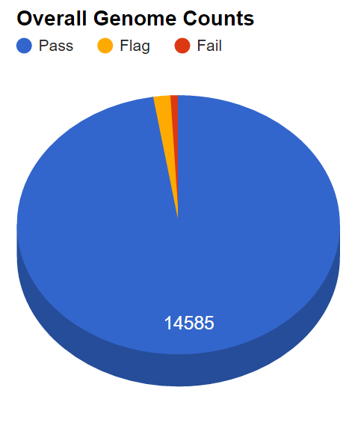
TOPMed WGS Data (Jan, 2016)
14,969 genomes
14,585 pass QC (97.4%)
Mean depth: 37.4x
Courtesy of Gonçalo Abecasis

Slide 5
Steps toward achieving the TOPMed Goals
Whole Genome Sequence
Collaboration with NHGRI
2015 generate 20,000 WGS
2016 planning to add up to 55,000 additional WGS
Currently have 62,000 samples sequenced or in the pipeline
Adding additional “omics” in 2016
3000 RNASeq
2000 genome wide methylation
2000 metabolomics
New Funding Opportunities for analysis and methods development
Partnering to develop the Data Commons to query and analyze data

Slide 6
Generating Data: Where we are headed
2016
Additional WGS (11,000 participants)
Omics Pilot Study
3,000 RNASeq
2,000 metabolomics
2,000 methylation
The Future: Beyond 2016
WGS targets – 120,000?
Omics targets ?
Beyond data generation to functional, systems biology and translation research

Slide 7
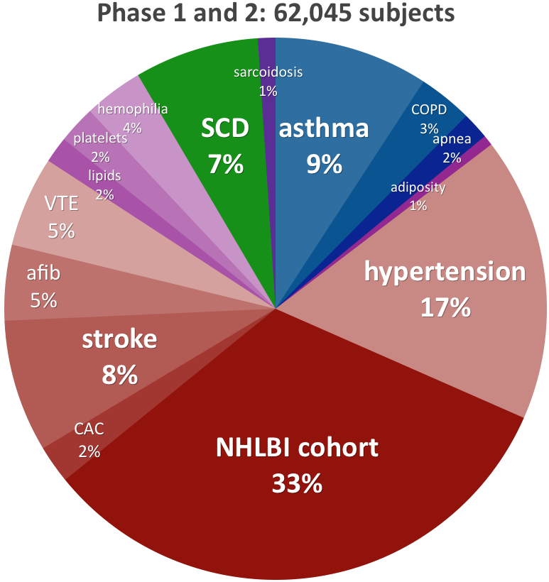
Where we are now: Phenotype focus of TOPMed
The NHLBI cohort
category counts participants with broad phenotypes that were not selected into TOPMed for a specific phenotype.
Phenotype focus
categories count
participants
selected into
TOPMed for a
specific phenotype
or enrollment
in a study of specific
phenotype focus

