Slide 1
A
C
B
P<0.0026
P<0.0015
P<0.016
D

Slide 2
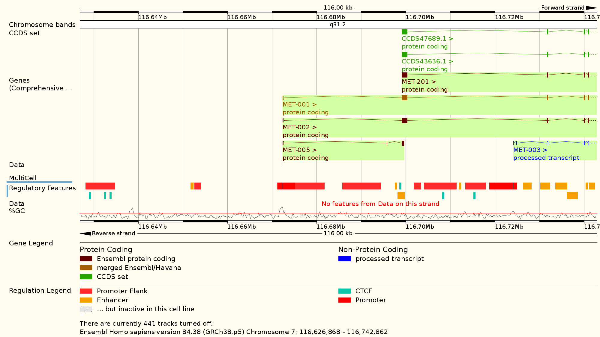
A
B

Slide 3
Probably also an overview table here

Slide 5
Supplements

Slide 6
No Effect on ERRFI1 RNA Expression
mut.
w.t.

Slide 7
No Effects on ERRs (RPPA)
mut.
w.t.

Slide 8
No Effects on Phosphorylation
mut.
w.t.

