Slide 1
NHLBI Trans-Omics for Precision Medicine (TOP Med)
Overview for NHGRI GSP meeting
April 11-13, 2016

Slide 2
NHLBI TOP Med Goals
Stimulate discovery in high impact disease areas
Build a Resource for the Scientific Community
Ensure well phenotyped and genotyped participants are chosen from traditionally underrepresented populations (diversity)
Stimulate Systems Medicine Approaches to health and disease research
To Enable / Facilitate Precision Medicine

Slide 3
NHLBI TOPMed Approach
Leverage existing deeply phenotyped studies
Cohorts
Families
Clinical - focus on a few high impact diseases
Longitudinal / Intervention studies
Layering in other high throughput molecular measures on top of sequence
RNASeq
Metabolomics
Methylation
Proteomics in the future

Slide 4
Steps toward achieving the TOPMed Goals
Whole Genome Sequence
Collaboration with NHGRI
2015 generate 20,000 WGS
2016 planning to add up to 55,000 additional WGS
Currently have 62,000 samples sequenced or in the pipeline
Adding additional “omics” in 2016
3000 RNASeq
2000 genome wide methylation
2000 metabolomics
New Funding Opportunities for analysis and methods development
Partnering to develop the Data Commons to query and analyze data

Slide 5
TOPMed Centers
Data Coordinating Center: U Washington
Informatics Research Center: U Michigan
Sequencing Centers:
The Broad
Baylor
NY Genome Center
U Washington
MacroGen
Illumina
RNASeq:
U Washington
The Broad
Metabolomics: MGH
Methylation: USC

Slide 6
2014 Participating Studies
PI Name(s) | Title | Institution | Disease/Phenotype | Sample Size to be sequenced | Populations
BLANGERO, JOHN CURRAN, JOANNE E; GLAHN, DAVID C | Whole Genome Sequencing to Identify Causal Genetic Variants Influencing CVD Risk | TEXAS BIOMEDICAL RESEARCH INSTITUTE | cardiometabolic risk factors | 1,142 | Mex Am in SAFHS extended pedigrees
SILVERMAN, EDWIN K | Genetic Epidemiology of COPD | BRIGHAM AND WOMEN'S HOSPITAL | Genetic risk & protective variants in COPD in AA & EA populations | 1,900 | 1,000 EA and 900 AA of extremely severe, early-onset COPD patients vs extreme healthy smokers
BURCHARD, ESTEBAN GONZALEZ | Pharmacogenomics of Bronchodilator Response in Minority Children with Asthma | UNIVERSITY OF CALIFORNIA, SAN FRANCISCO | racial and ethnic disparities in response to asthma treatment | 1,500 | 500 AA, 500 Puerto Rican, and 500 Mexican of extremely non-responding asthma patients.
MITCHELL, BRAXTON D. | Identification and Functional characterization of a gene influencing LDL-C on 5q | UNIVERSITY OF MARYLAND SCHOOL OF MEDICINE | cardiometabolic risk factors | 1,100 | Old Order Amish large extended pedigrees
BARNES, KATHLEEN C | New Approaches for Empowering Studies of Asthma in Populations of African Descent | JOHNS HOPKINS UNIVERSITY | asthma genetics in high prevalence populations of African descent. | 1,100 | African descent Barbados families with >40% of asthmatic members
ELLINOR, PATRICK THOMAS; BENJAMIN, EMELIA J.; LUNETTA, KATHRYN L | Identification of Common Genetic Variants for Atrial Fibrillation and PR Interval | MASSACHUSETTS GENERAL HOSPITAL | Early Atrial fibrillation | 2,799 | AF cases all EA (uses Framingham as controls)
WEISS, SCOTT T | The Genetic Epidemiology of Asthma in Costa Rica | BRIGHAM AND WOMEN'S HOSPITAL | asthma genetics in high prevalence Hispanic population | 1,000 | Costa Rica is a Special Hispanic population with asthma prevalence at 24%
RAMACHANDRAN, VASAN | Framingham Heart Study | BOSTON UNIVERSTIY | longitudinal cardiometabolic risk factors | 4,089 | 3 generation EA pedigrees
WILSON, JAMES | Jackson Heart Study | UNIVERSITY OF MISSISSIPPI | cardiometabolic risk factors | 3,500 | AA mixed family and population based
MCGARVEY, STEPHEN T. | Genome-Wide Association Studies of Adiposity in Samoans | BROWN UNIVERSITY | obesity & cardiometabolic | 384 | Samoan extended pedigrees
REDLINE, SUSAN S.; LIN, XIHONG | Leveraging Family Data to Identify Genetic Variants for Sleep Apnea | BRIGHAM AND WOMEN'S HOSPITAL | Sleep Apnea genetics in EA and AA populations | 1,000 | 500 EA and 500 AA from Cleveland Family Study of obstructive sleep apnea (OSA)
 |  |  | Total | 19,514

Slide 7
2015 Participating Studies
PI Name(s) | Title | Institution | Disease/Phenotype | Sample Size to be sequenced | Populations
Mathias, Rasika | Study of Athersclerosis Risk in Families (GeneSTAR) | Johns Hopkins Medical Institution | Coagulation, Longitudinal, iPSC, RNASeq | 1,400 | 700 EA & 700 AA
Arnett, Donna | Genetics of Left Ventricular Hypertrophy (HyperGen) | University of Alabama | LVH, imaging iPSC, RNASeq | 3,161 | AA Family
Arnett, Donna | Genetics of Lipid Lowering Drugs and Diet Network (GOLDN) | University of Alabama, Birmingham | Lipid Response, PGx, multi-Omics | 967 | EA Family
Rao, Dabeeru | Taiwan Study of Hypertension using Rare Variants (THRV) | Washington University | Hypertension, Longitudinal, multiple risk factors | 2,400 | 1200 Taiwan Family 1200 Unrelated Controls
Montgomery, Courtney | Genetics of Sarcoidosis in African Americans | Oklahoma Medical Research Foundation | Sarcoidosis | 650 | AA Family
Casella, James | Silent Cerebral Infarct Trial (SIT) | Johns Hopkins University | Sickle Cell Disease | 1,074 | AA Pediatric
Gladwin, Mark | Treatment of Pulmonary Hypertension and Sickle Cell Disease with Sildenafil Treatment (Walk-PHASST) | University of Pittsburgh Medical Center | Sickle Cell Disease | 720 | AA
Custer, Brian | Recipient Epidemiology and Donor Evaluation Study (REDS III) | Blood Systems Research Institute, UCSF | Sickle Cell Disease | 2,809 | Brazilian
Boerwinkle, Eric | Atherosclerosis Risk in Communities Exam 5 2011-2013 (ARIC) | University of Texas | VTE, Multiple Outcomes & Risk Factors, Longitudinal, Omics | 6,030 | 4977 EA 1053 AA
Rotter, Jerry | Multi-Ethnic Study of Athersclerosis (MESA visit 5) | Los Angeles Biomedical Research Institute | Multiple Outcomes & Risk Factors, Imaging, Air Pollution | 4,595 | 1233 AA 541 Asian 999 Hisp 1822 EA
He, Jiang | Genetic Epidemiology Network of Salt Sensitivity (GenSalt) | Tulane University | Hypertension, Salt Interv., Multi-Risk Factors, Longitudinal, Outcomes | 1,115 | Chinese (family can impute
Konkle, Barbara | Hemophilia Study | Blood Works Northwest | Severe Hemophilia A&B, Type, Severity, inhibitor formation, comorbidities | 2,188 | Majority EA
Taylor, Kent | African-American Coronary Artery Calcium Project (AA CAC) | Los Angeles Biomedical Research Institute | CAD, Controls, Multiple Longitudinal Risk Factors | 787 | AA (family can impute)
Kooperberg, Charles | Women's Health Initiative (WHI) | Fred Hutchinson Cancer Research Center | Stroke, Hypertension, VTE, Longitudinal, Clinical Trial, Multiple Risk Factors, Omics | 11,100 | Women Multiple Ethnicities
 |  |  | TOTAL | 38,996

Slide 8
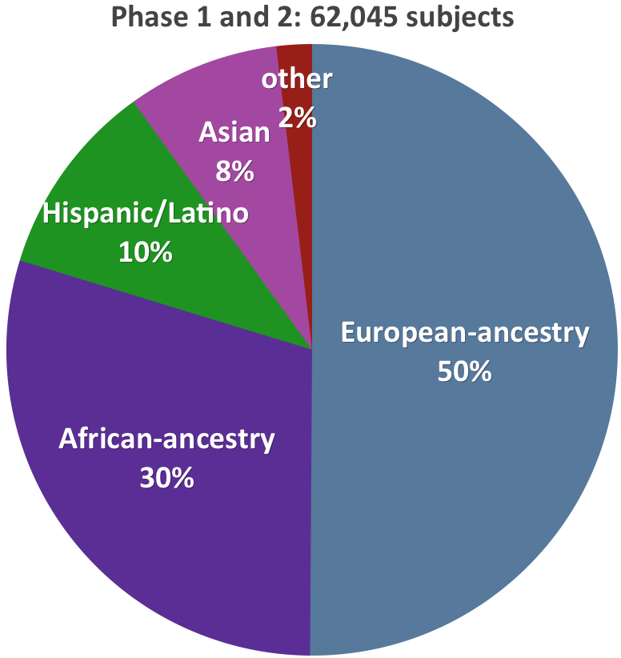
Where we are now: Racial/ethnic composition of TOPMed

Slide 9
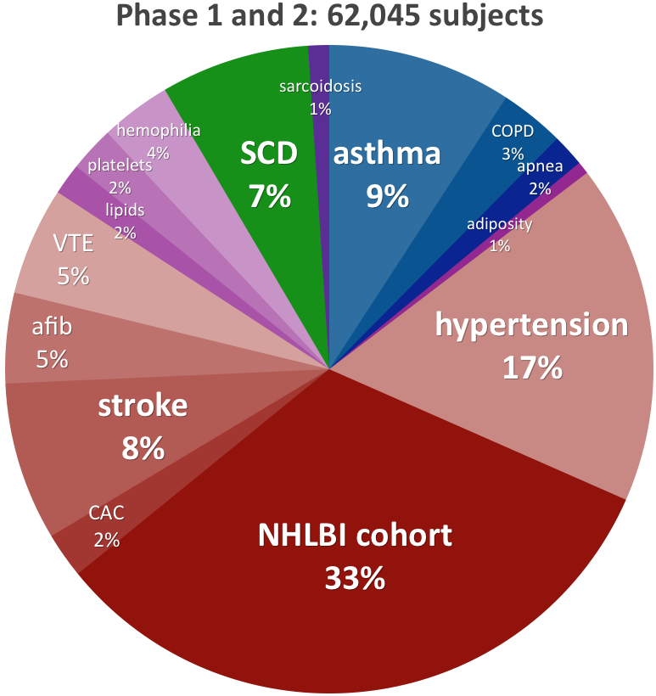
Where we are now: Phenotype focus of TOPMed
The NHLBI cohort
category counts participants with broad phenotypes that were not selected into TOPMed for a specific phenotype.
Phenotype focus
categories count
participants
selected into
TOPMed for a
specific phenotype
or enrollment
in a study of specific
phenotype focus

Slide 10
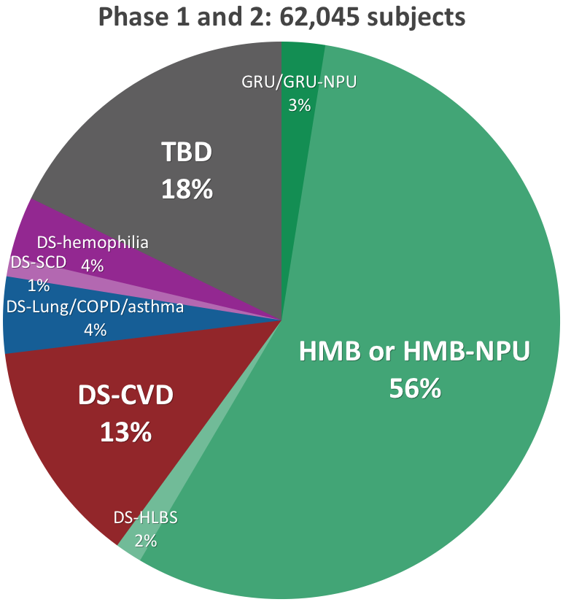
Where we are now: dbGaP consent composition of TOPMed
GRU = General Research Use
HMB = Health/Medical/Biomedical
NPU = Non-Profit Use
DS = Disease-Specific
HLBS = Heart, Lung, Blood, Sleep

Slide 11
TOPMed Sequencing Data & Information Flow
Study
DNA samples
Sequencing Center
sequence data
IRC
Michigan
study-specific call sets
joint genotype call sets
harmonized sequence data
NCBI
Study Coordinating Center
phenotypes
DCC UW
phenotypes
dbGaP
SRA
harmonized phenotypes
phenotypes,
genotypes,
sequence data
Scientific Community
Working Group
COPD
Working Group
atherosclerosis
Working Group
asthma
Study A analysis team
Study B analysis team
etc...
etc...
Cross study publications
Study-focused publications
Personalized Medicine

Slide 12
Generating Data: Where we are headed
2016
Additional WGS (11,000 participants)
Omics Pilot Study
3,000 RNASeq
2,000 metabolomics
2,000 methylation
The Future: Beyond 2016
WGS targets – 120,000?
Omics targets ?
Beyond data generation to functional, systems biology and translation research

Slide 13
TOPMed Implementation Group
Deborah Applebaum-Bowden
Kristi Cooper
Tom Croxton
Adam Felsenfeld
Weiniu Gan
Cashell Jaquish
Cheryl Jennings
James Luo
Teresa Marquette
Julie Mikulla
Mollie Minear
George Papanicolaou
Yasin Patel
Pankaj Qasba
Benjamin Sakovich
Pothur Srinivas
Jennifer Swift

