Slide 1
Read depth coverage for whole genome sequencing
Benjamin Neale, Ph.D.
GSP meeting

Slide 2
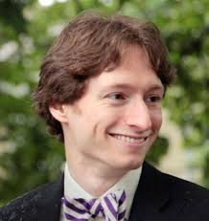
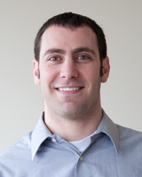
Acknowledgements
Jon Bloom
Tim Fennell
Yossi Farjoun
Stacey Gabriel
Eric Banks
Mauricio Carneiro
Sheila Fisher
Mark Daly

Slide 3
Why depth matters?
Lower depth -> more samples
Lower depth -> lower sensitivity
Common:
GWAS
De Novo
Mutations
2,000,000
Increased
risk
200,000
1.5
2
3
20,000
5
10
Number of CASES
20
100
2000
200
2%
0.2%
0.02%
0.002%
Combined frequency of rare disease alleles

Slide 4
Knowledge base for NA12878
Union of callsets:
OMNI, NIST and Mills datasets
hand-curated
90,549 SNPs
10,958 indels

Slide 5
Data and definitions
Took all (~11K) indels in our knowledge base that are heterozygous in NA12878
Made calls with the HaplotypeCaller for NA12878 (2x150bp, PCR+, 60x coverage) and PCR- 35x coverage
For each indel, we iteratively down-sampled until it was no longer callable with a Q50 confidence (Q30 is too low a cutoff because this is only a single sample), so we know the minimum coverage needed to call it
Stratified these observations by indel length
Eric Banks

Slide 6
For indels in the truth set, the mean number of reads to call was:
PCR free: 7.27
PCR plus: 7.73

Slide 7
Sensitivity for variants in knowledge base

Slide 8
de novo

Slide 9
Taiwanese trio callset
1,100 schizophrenia trios with all putative de novo calls
Used de novo finder to generate three classes of putative validation:
High [>90% validation]
Medium [>50% validation]

Slide 10
Minimum of 16x in the parent for confident de novo call

Slide 11
Global depth evaluation
These evolve as the technology continues to improve

Slide 12
Distribution of coverage
Sheila Dodge

Slide 13
Sample failures

Slide 14
Sample failures

Slide 15
Sample failures

