Slide 1







Harvard GSPAC Team
Xihong Lin, HSPH
Ben Neale, MGH
Shamil Sunyaev, BWH
Soumya Raychaudhuri
Manolis Kellis
Peter Kraft
Alkes Price

Slide 2
Presentation Today
Xihong Lin: Analytic Challenges, Aims and Statistical Consideration, Joint GSP-TOPMed Analysis Retreat
Shamil Sunyaev: Handling Non-Coding Regions and Cross-Phenotype Analysis
Ben Neale: Hail (Cloud-Based Analytic Platform); Building Common Controls

Slide 3
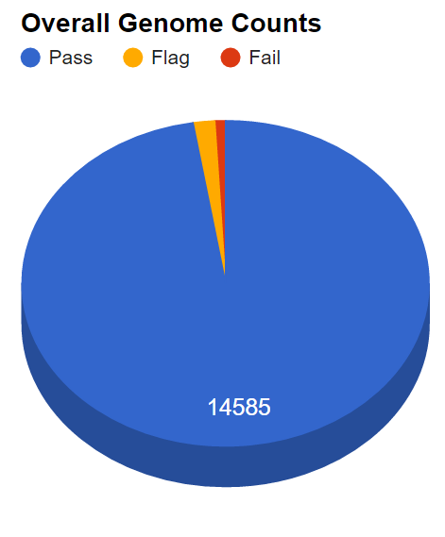
TOPMed WGS Data (Jan, 2016)
14,969 genomes
14,585 pass QC (97.4%)
Mean depth: 37.4x
Courtesy of
Gonçalo Abecasis

Slide 4
Allele Frequency of n=14,969 TOPMed Samples
Frequency | # SNPs (% Total)
Singletons | 60.6M (44%)
Doubletons | 19.2M (14%)
Doubletons - .1% | 32.0M (23%)
.1% - 1% | 13.6M (9.8%)
1 - 10% | 7.2M (5.2%)
> 10% | 5.7M (4.1%)
>90%
Rare
<10% common
Courtesy of Goncalo Abecasis

Slide 5
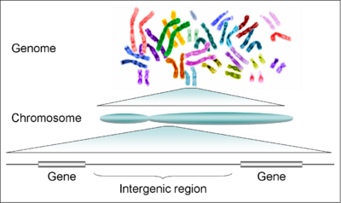
Analytic Challenges in WGS
SNP-set based, instead of single SNP analysis is needed.
Empower analysis by
  Advanced statistical inference
  Effective incorporation of functional information.
Analysis units and sizes not well defined:
Non-coding regions
Notes:
Enter one bullet a time.

Slide 6

Joint GSP-TOPMed Analysis Retreat
Nov, 4, Afternoon, 2016
In conjunction with the Harvard SPH
Program in Quantitative Genomics (PQG) Annual Conference on WGS Analysis - Nov, 3-4, 2016
http://www.hsph.harvard.edu/pqg/2016-pqg-conference
Harvard Medical School Conference Center

Slide 7
Specific Aims
Aim 1: (1) Build a massive control sample;
(2) develop the analytic methods to leverage these controls, e.g., control for population stratification and relatedness using logistic mixed models for binary traits.
Aim 2: (1) Powerful rare variation association analysis, e.g, regulatory constructs, and effective weighting, advanced statistical tests;
(2) Refine variant prioritization in Mendelian diseases in WGS studies

Slide 8
Specific Aims
Aim 3: (1) Multiple phenotype analysis;
Understand the phenotypic spectrum from Mendelian to complex traits;
Assess causality.
Aim 4: Share with the community
the assembled massive control data;
the developed functional annotation resources;
the analytic methods and tools.

Slide 9
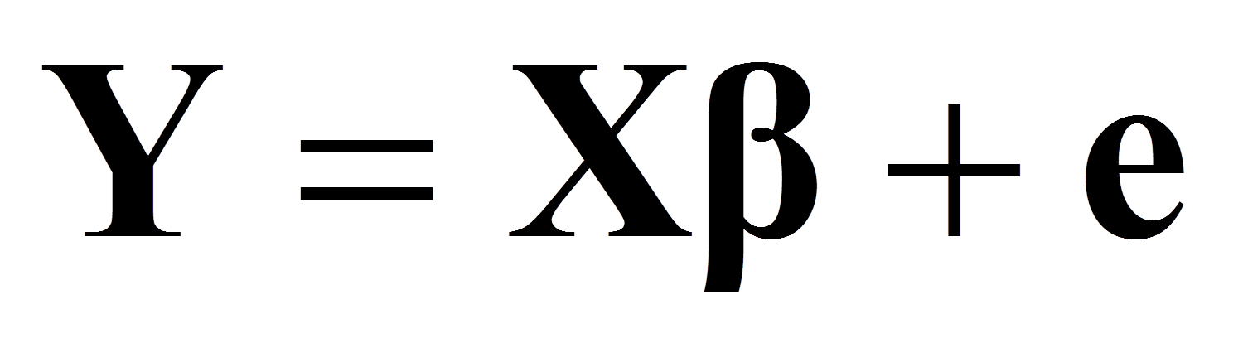
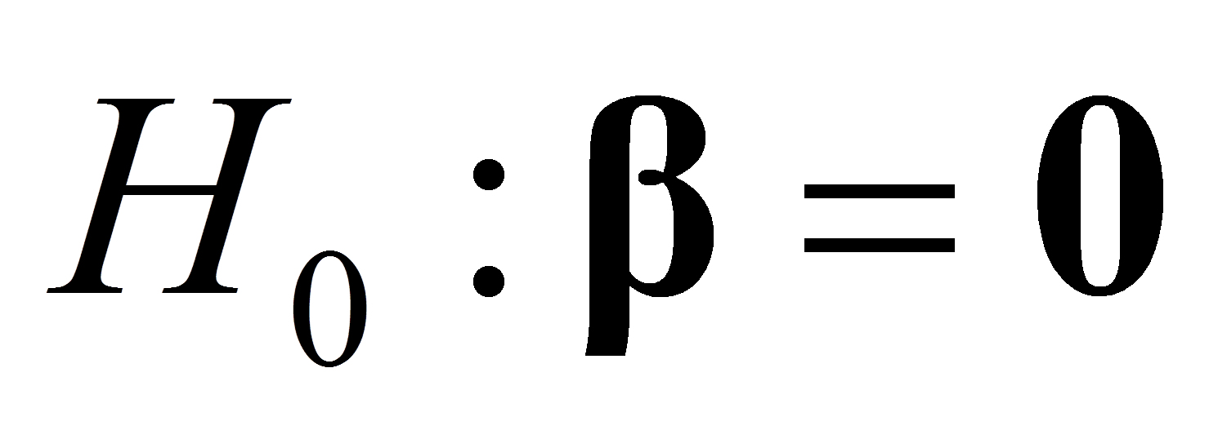
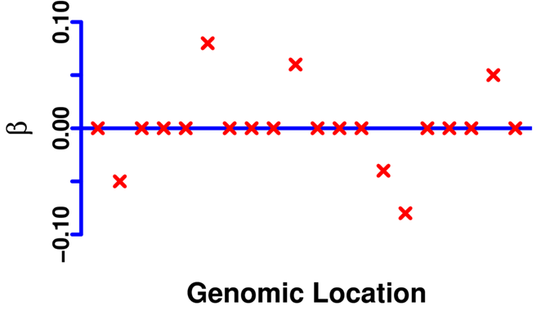
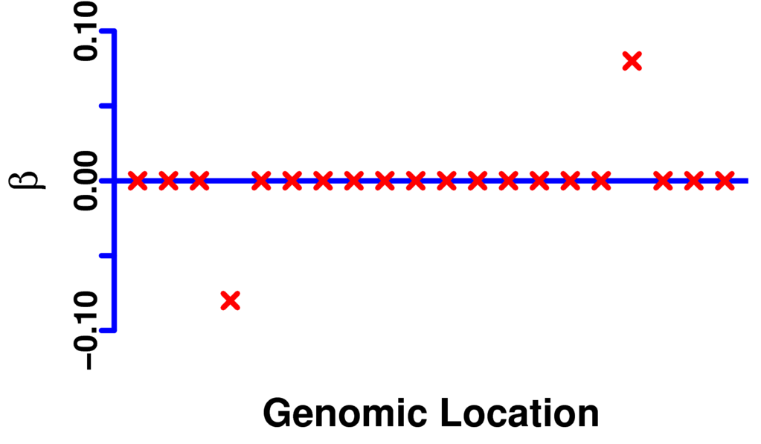
Set-Based Rare Variant Statistical Tests
Model:
Dense Signals
Sparse Signals
Existing Methods work pretty well:
Burden
SKAT
Generalized Higher Criticism:
Barnett, et al 2016 (JASA), in press.

Slide 10
Rare Variant Tests
Unit of the analysis, e.g, individual regulatory element; all elements controlling one gene; all elements controlled by one factor; sub-network.
Functional weights, relative importance of individual variants; direction of the effect; relevance to the phenotype.
Combine info to prioritize variants within the element
ACGAG(T/C)GTGC(C/T)GTG(T/C)
‘Deleteriousness’ scores
______-8________+6______-4__
TSS
Promoter active in tissue x
Regions of open chromatin
Enhancers active in tissue x

Slide 11
Understanding functional effects of non-coding variants
Collecting data – start with Mendelian phenotypes: Identifying non-coding variants using “exome-negative” cases guided by a strong hypothesis (linkage peak; compound heterozygosity).
Common phenotypes, search for functional features explaining most of heritability.
Phenotype-specific weights, analyzing heritability / enrichment for specific traits.

Slide 12
Features to consider
Epigenomic features: EpiGenome Roadmap and ENCODE projects. Chromatin accessibility and modification.
Comparative genomics, evidence from evolution.
Population genetics, evidence from human sequencing data (e.g. shared controls). Population genetics models aware of demographic history, BGC, background selection etc.
Statistical methods, outlier detection, tissue-specific weighting.

Slide 13
Analysis across phenotypes / pleiotropy
Global relationship, co-heritability, shared genetic risk.
Local relationship, finding pleiotropic loci.
Testing co-localization
Testing causal relationships
Mendelian randomization
Mediation Analysis

Slide 14
Analysis across phenotypes / pleiotropy
Molecular phenotypes
Mechanistic hypotheses
Mendelian vs. complex phenotypes
Strong genetic hypotheses

Slide 15

Current pipeline for WGS

Slide 16
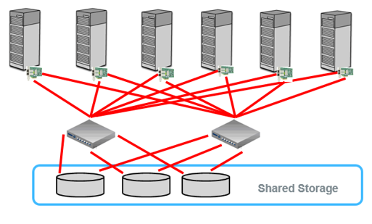
Old Model
Bring data to compute
Pro: standard filesystem interface (e.g., NFS)
Con: bottleneck for I/O-intensive workloads. Not what we prefer!

Slide 17
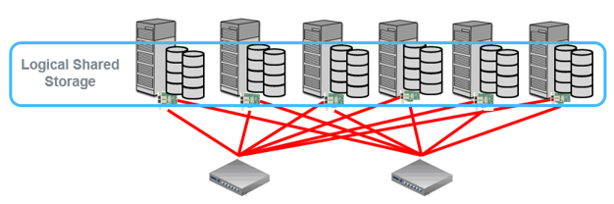
New model
Bring compute to data
Can use commodity (cheap) hardware, have to deal with failure
Pro: disk bandwidth scales linearly with cluster size
Con: non-standard interfaces; for performance, application must be aware of distribution of data

Slide 18
Benefits of new model – scaling!

Slide 19
Control harmonization – key elements
Base level processing achieving functional equivalence
Variant call sets using the same pipeline
Variant QC jointly performed
Technical harmonization
Principal components as an initial consideration
Mixed logistic regression to account for ancestry
Explore the impact of local ancestry estimation
Ancestry
matching

Slide 20
What does this mean for GSP?
Sequencing center B
Sequencing center A
Sequencing center C
Cloud repository
Analysis site A
Analysis site C
Analysis site B

