Slide 1
Common Controls
Steve Buyske
Rutgers University
GSPCC
Genome Sequencing Program Meeting, April 12, 2106

Slide 2
Outline
Context
Issues & Considerations
Current Proposed Counts
Discussion

Slide 3
Outline
Context
Issues & Considerations
Current Proposed Counts
Discussion

Slide 4
Traditional view of controls
Cases
Controls
Disorder A
Disorder B
Disorder C
Disorder D

Slide 5
Alternative: Pool controls*
Disorder A
Disorder B
Cases
Cases
Disorder D
*Or
“comparison
groups”
Disorder C
Cases
Family
Controls
Cases
Notes:
For disorders A, B, C can do sensitivity analyses using disorder-specific controls vs pooled controls
The study design for disorder D might involve controls useful only to the disorder
Even possible to include, say, individuals with disorder B as controls for disorder A

Slide 6
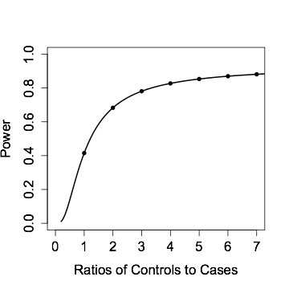
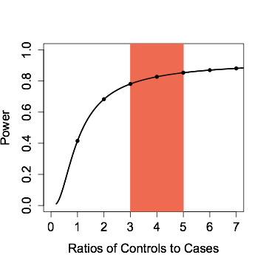
Power and control:case ratio
For a fixed number of cases, power grows with the control:case ratio, but the growth rate slows
Around 4:1 is an attractive ratio
(For a fixed number of samples, a 1:1 ratio has the greatest power.)
Fixed Number of Cases

Slide 7
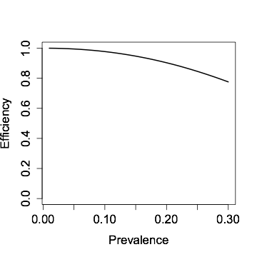
Types of controls
“Traditional controls” phenotyped for disorder and classified as a control
“Population controls” not phenotyped (or poorly phenotyped) for the disorder
Population controls lead to some loss in power—the power drops with the prevalence
Efficiency of Population Controls relative to Traditional Controls
Notes:
Any analysis using a mix of phenotyped controls and population controls will of course have an intermediate amount of power loss.
Note that population controls avoid the issue of ambiguously phenotyped controls, such as people age 50 with no T2D (yet)

Slide 8
However, deeply phenotyped controls are valuable
Desirable to have available
multi-omic data
risk factor data
incident and prevalent disease status
recontactable subjects
Analysis of intermediate phenotypes may lead to additional disease gene discovery

Slide 9
Outline
Context
Issues & Considerations
Current Proposed Counts
Discussion

Slide 10
Issues & Considerations
Principles for selection of controls
Other factors regarding controls
Pragmatic matters
Notes:
Want control selection to reduce bias

Slide 11
Considerations for
selection of controls 1/2
Balancing across sequencing centers
Balancing across recruiting study
Balancing across program year
Age distribution
Matching ancestry
Is self-described race/ethnicity sufficient?

Slide 12
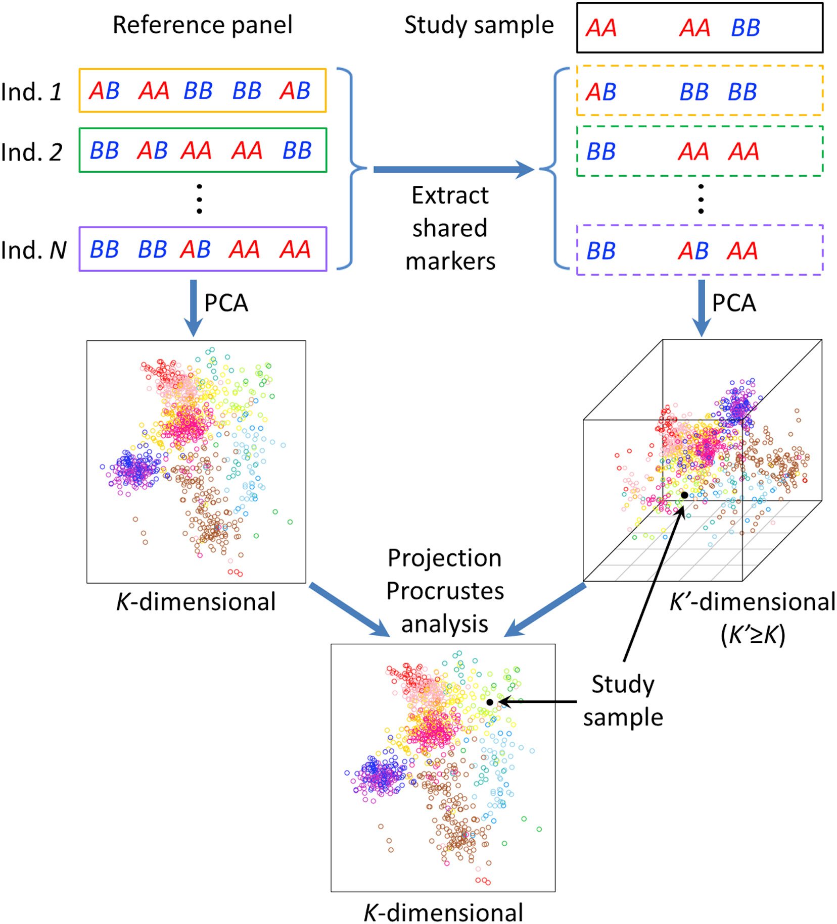
Aside on ancestry matching
Can use available genotypes to place cases and potential controls in PCA space (e.g., LASER/TRACER from Abecasis lab)
Algorithms exist to match cases and potential controls (e.g., Rosenbaum’s “full matching”)
Alternatively, given a collection of cases (with, say, a rare variant) can confirm that a collection of controls are from the same population (Bustamante lab)
C Wang, X Zhan, L Liang, GR Abecasis, X Lin (2015). Improved ancestry estimation for both genotyping and sequencing data using projection Procrustes analysis and genotype imputation. American Journal of Human Genetics, 96: 926-937.

Slide 13
Considerations for
selection of controls 2/2
Availability of phenotypes
How high a priority is deep phenotyping, and how deep?
What is the minimal set of phenotyping to be useful?
Consent
Exact level of consent, including consent for re-use
Details of institutional certifications for dbGap?

Slide 14
Other considerations
for the working group
Use of “super healthy” controls?
Analytic issues (e.g., should controls be considered to be matched to cases)
Do considerations change for rare variants compared to common variants?
Special need to match ancestry for recent variants?
Common control dataset as a community resource?

Slide 15
Pragmatic Issues
Possible coordination of selection of controls
Tools to do so
Tracking attributes of selected controls
Especially consent and approval for data sharing
Inclusion of controls from non-CCDG samples?
For GSP analyses
For broader community resource
Building the plane while flying it

Slide 16
Outline
Context
Issues & Considerations
Current Proposed Counts
Discussion

Slide 17
From Cardiovascular WG White Paper
Counts for first 2 years
EOCAD Controls | BCM | Broad | MGI
African American | 1,500 (Stroke controls) |  | 3,000
Finnish |  |  | 2,000
Non-Finnish European | 1,000
Hispanic American | 4,000
East Asian |  | 1,000
South Asian |  | 3,000

Slide 18
Controls from other WGs Years 1 & 2
Neuropsychiatric:
Autism: Controls as part of family-design (7,000 total samples)
Epilepsy: 3,500 exomes
Immune-Mediated: 5,000 total controls
Balanced across centers and T1D, IBD, and asthma
Emphasis on African-Americans for year 1
Emphasis on Hispanic and East Asian samples for year 2

Slide 19
Outline
Context
Issues & Considerations
Current Proposed Counts
Discussion

Slide 20
Summary of Issues for WG
Possible to coordinate sample selection for controls?
Pragmatics of how to do so?
What are the most important principles for selection of controls?
What are the most pressing practical issues?
“Just zip it up”
Selection of controls:
Balance with respect to:
Sequencing centers
Recruiting studies
Ancestry
Degree of phenotyping on controls
Consent

