Slide 1
CMG Causal Criteria
CMG Wide Working Group
UW-CMG
Mike Bamshad
Jessica Chong
Colleen Davis
BaylorHopkins-CMG
Dave Valle
Corrine Boehm
Nara Sobreira
Shalini Jhangiani
Tomasz Gambin
Yale-CMG
Shirkant Mane
Francesc Lopez
Kaya Bilguvar

Slide 2
Causal Criteria For Discoveries
A single kindred with high
impact variant(s) in a gene
Two or more kindreds with
variants in the same gene
Yes
Model organism recapitulates
phenotype
No
Robust mapping data
AND
Experimental evidence:
-gene in relevant pathway
-variant alters gene function/expression
Yes
No
Suggestive Discovery
(Tier 2)
Conservative Discovery
(Tier 1)

Slide 3
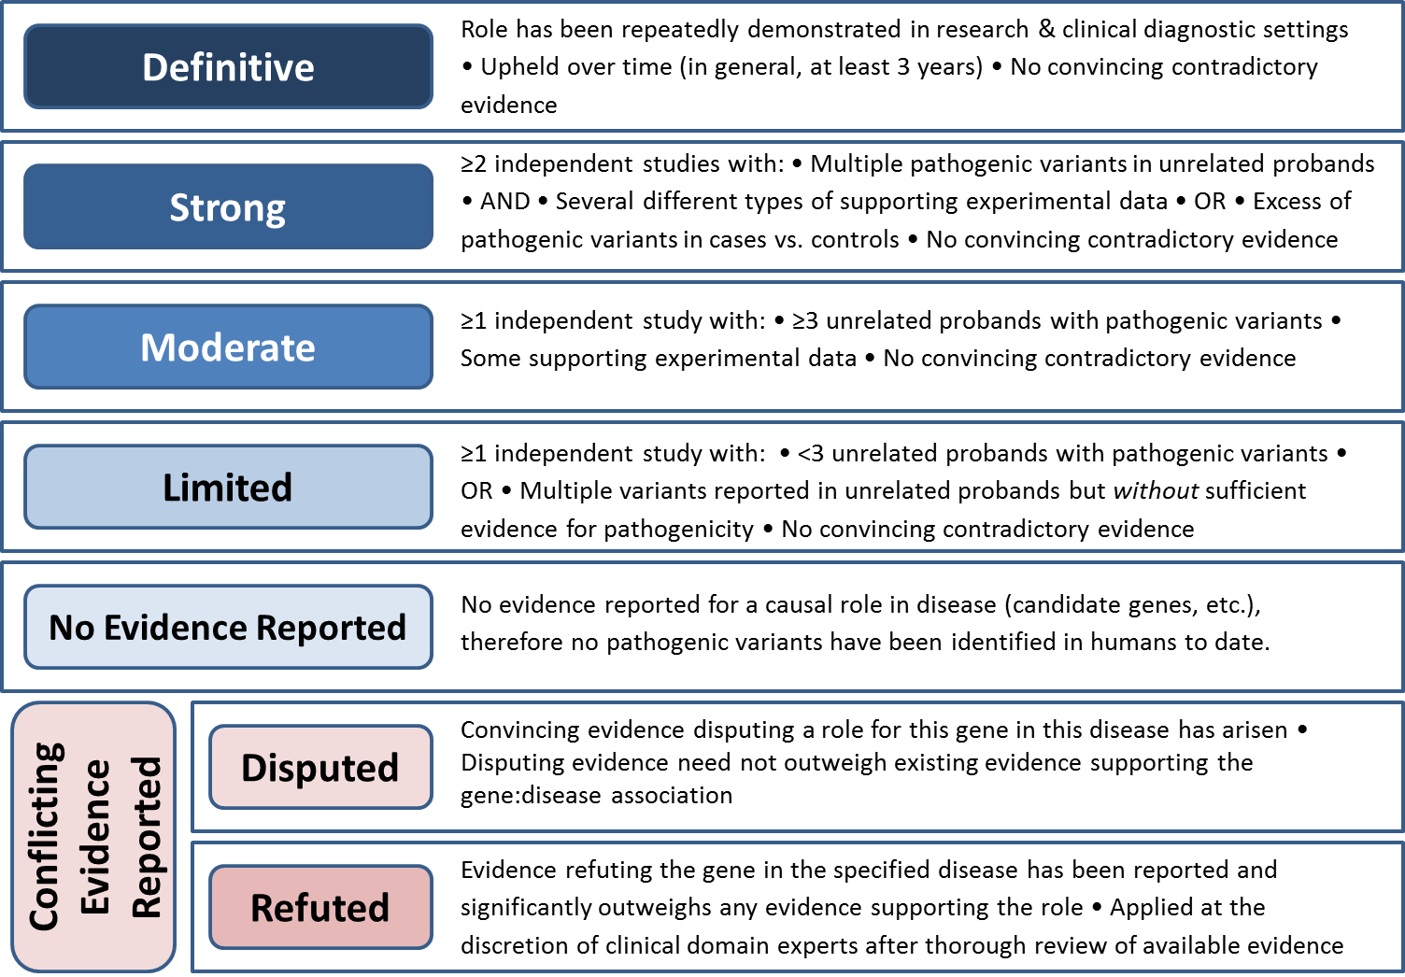
ClinGen Gene-Disease Validity Classification
http://www.clinicalgenome.org/knowledge-curation/gene-curation/
Notes:
Slide concept from Erin Riggs

Slide 4
ClinGen Gene-Disease Scoring Matrix

Slide 5
Genetic/Case Evidence Scoring

Slide 6
Experimental Evidence Scoring
Evidence types consistent with MacArthur et al. “Guidelines for investigating causality……” Nature. 2014;508(7497):469-76

Slide 7
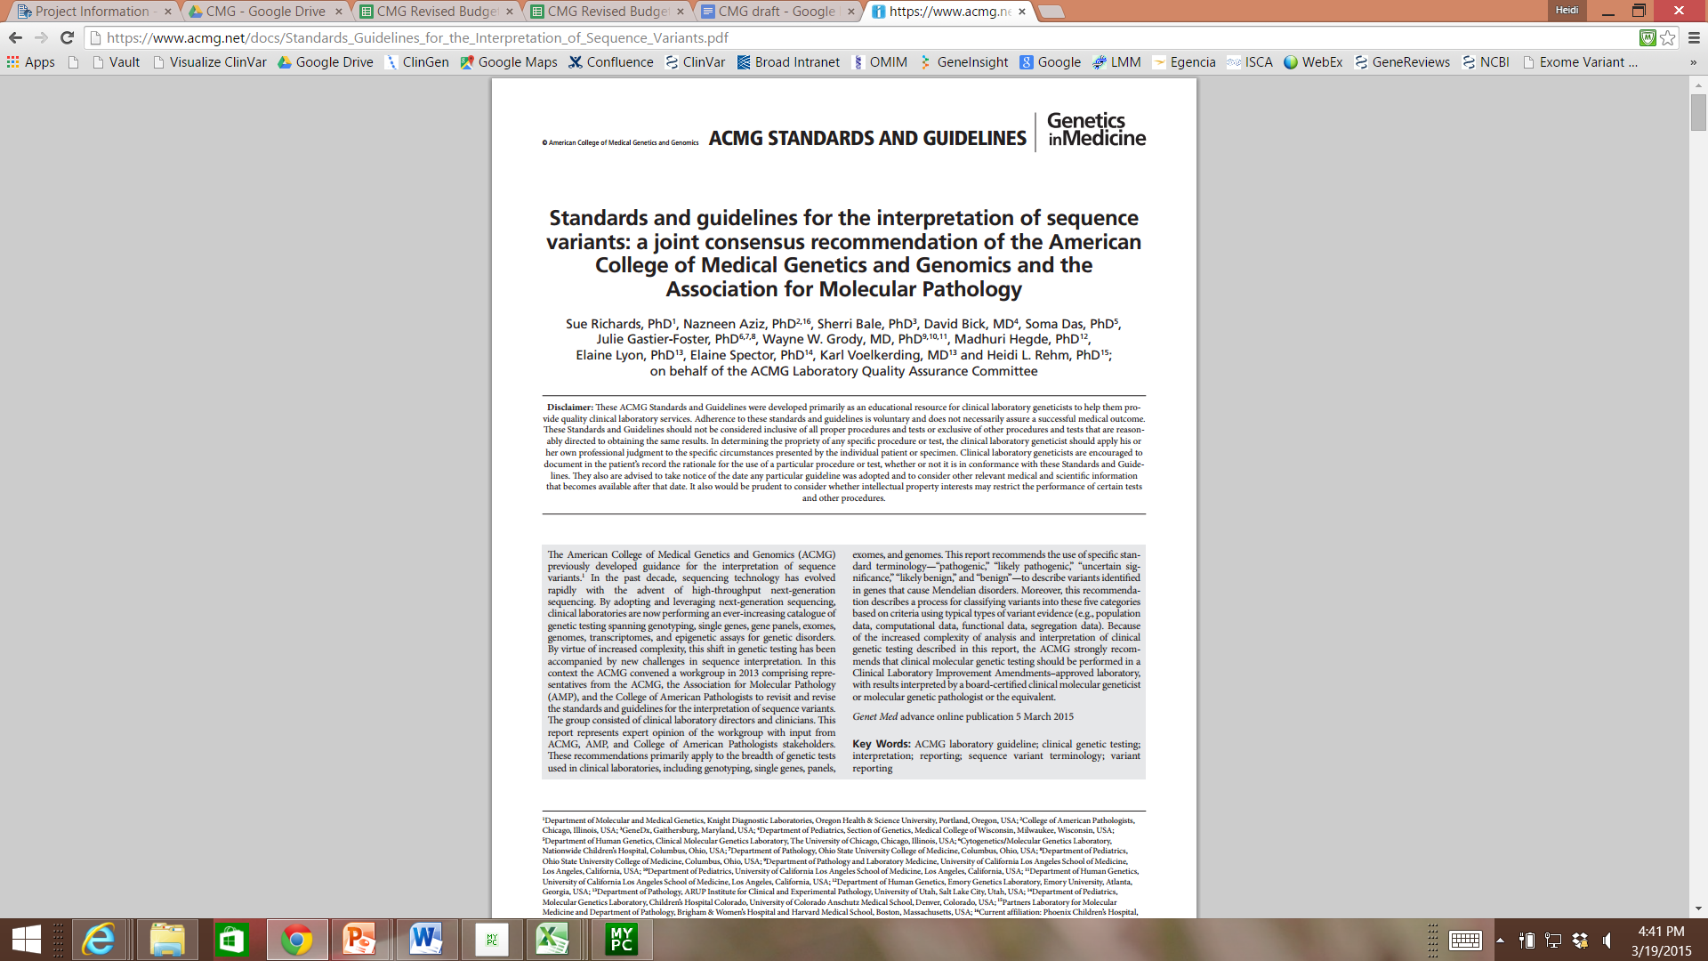
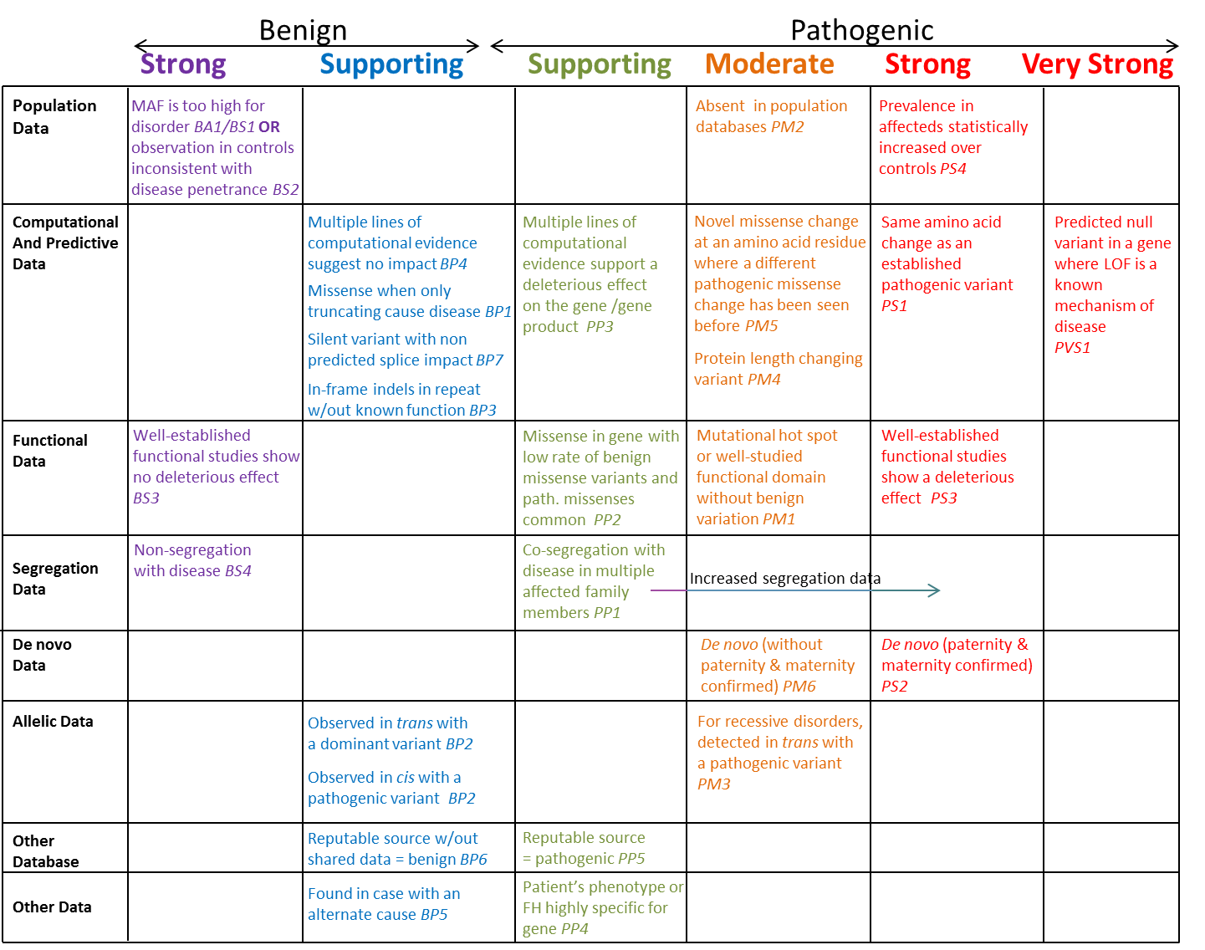
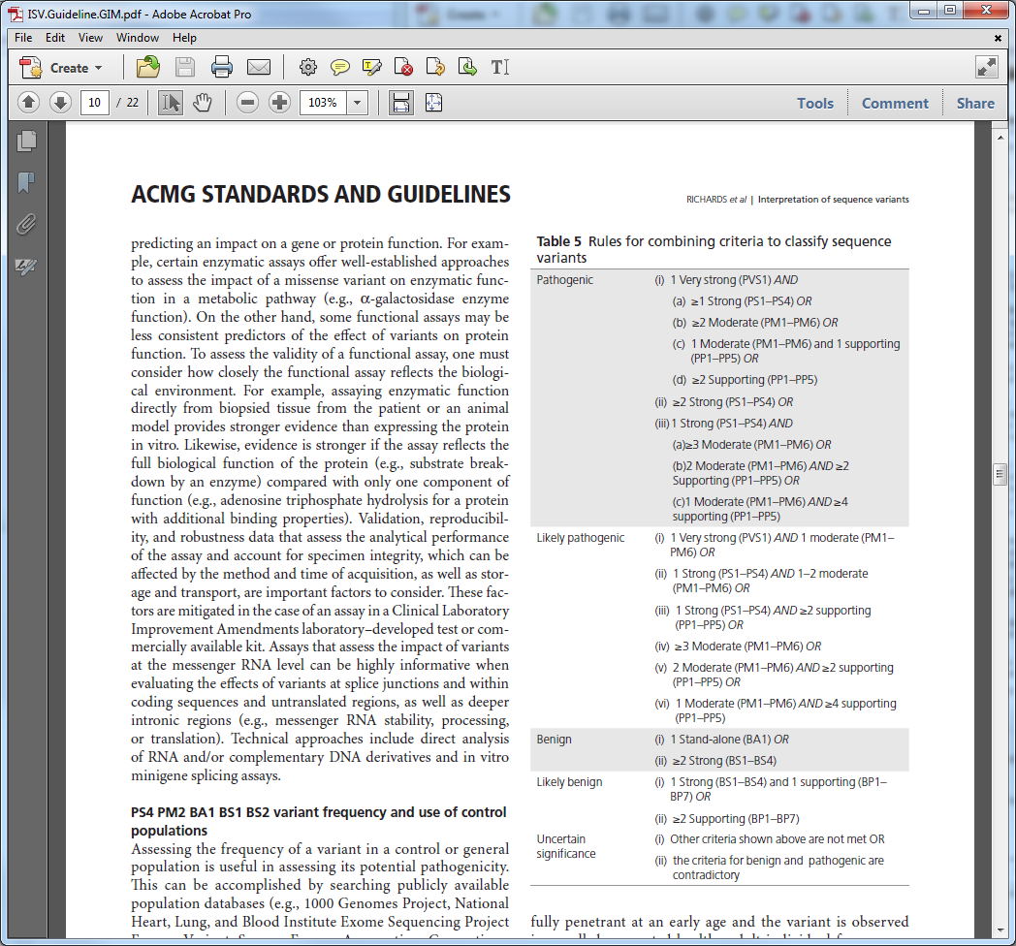
Pathogenic
Likely pathogenic
Uncertain significance
Likely benign
Benign
www.acmg.net

