Slide 1
EnhancerSeq
MGxKW

Slide 2
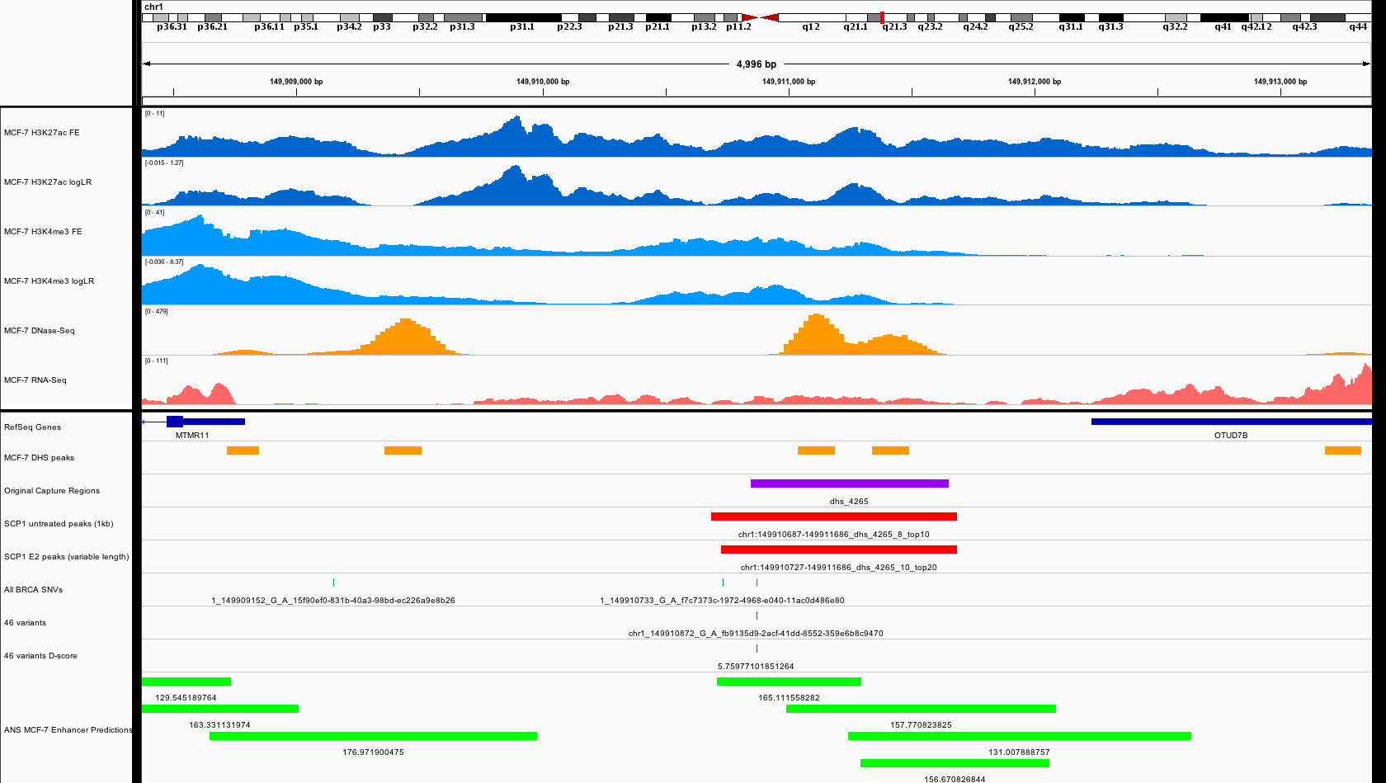
Notes:
DL: Good enhancer, Variant off centered
JZ: maybe too off the center, so not select during the 1st round

Slide 3
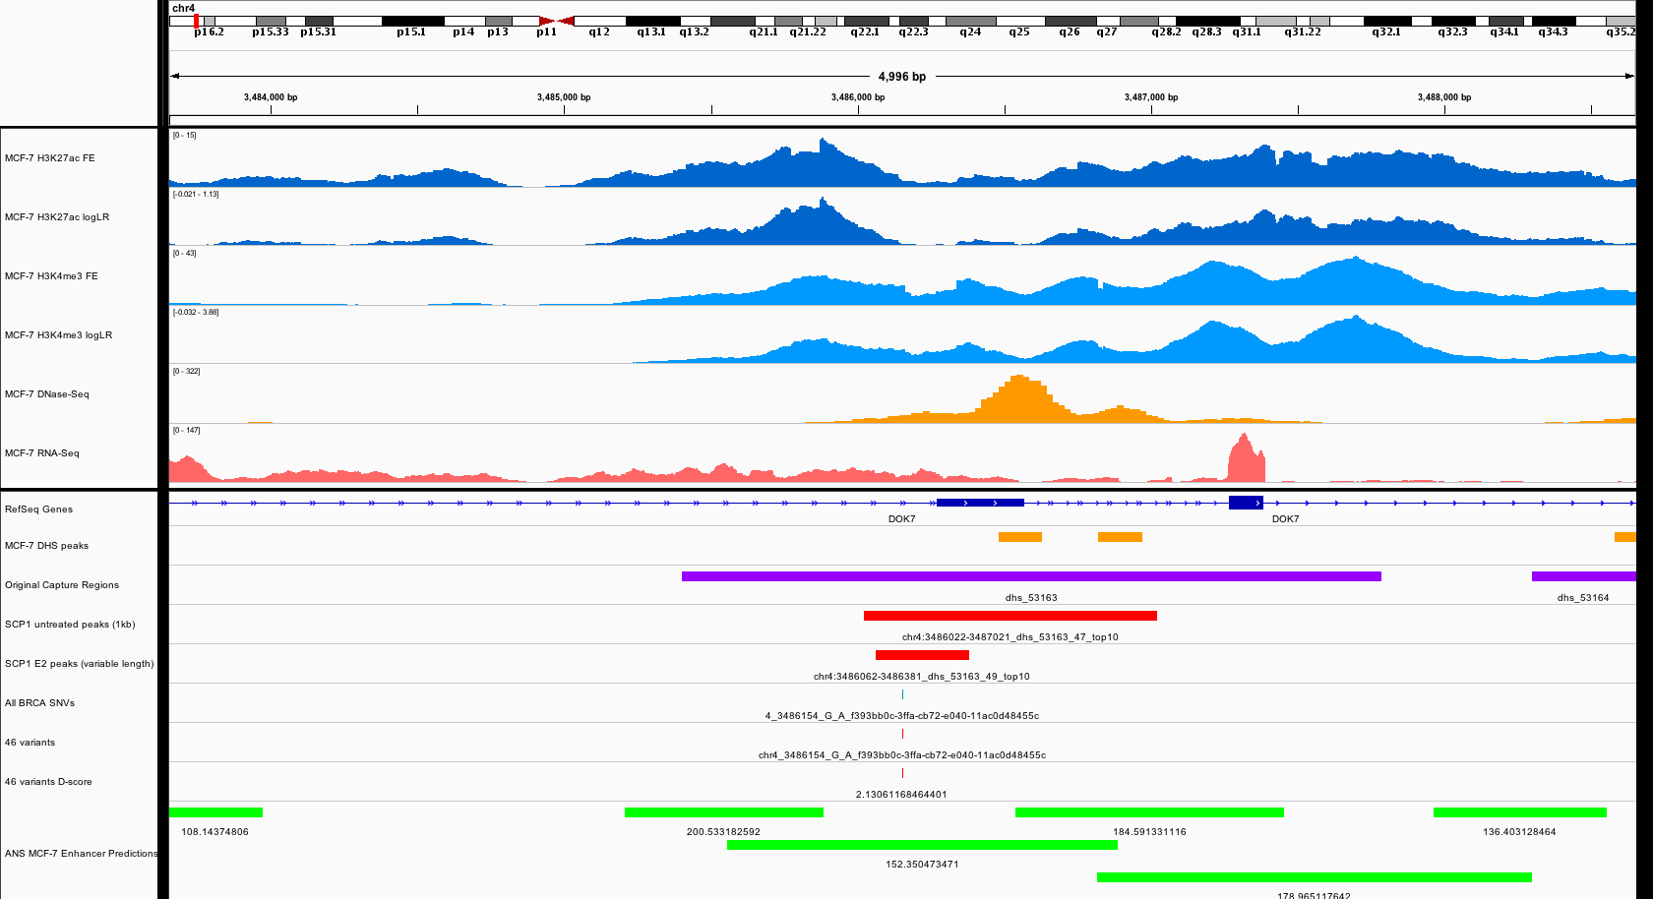
Notes:
DL: Variant off centered
JZ: do you think it might be in the center of another example?

Slide 4
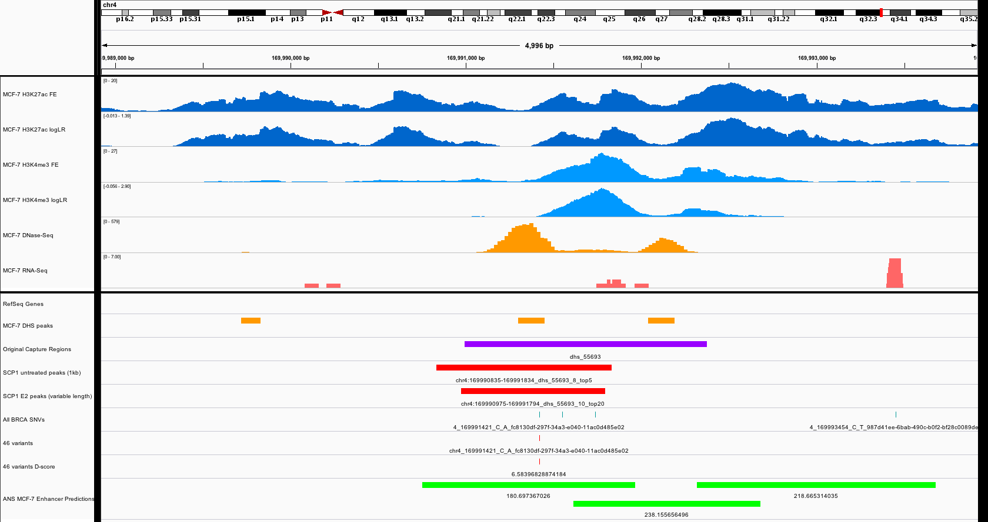
Notes:
DL: Good enhancer,Good variant, T1
JZ: Yes, T1_1, but may also test the other two as suggested by KW ppl

Slide 5
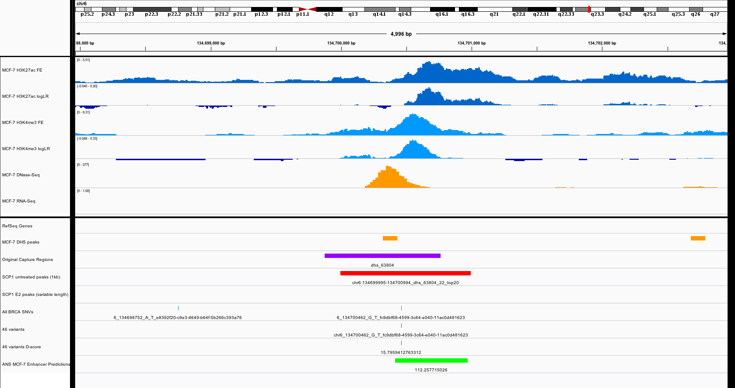
Notes:
DL: Good enhancer, Good variant, High d-score, T1
JZ: Yes, T1_2

Slide 6
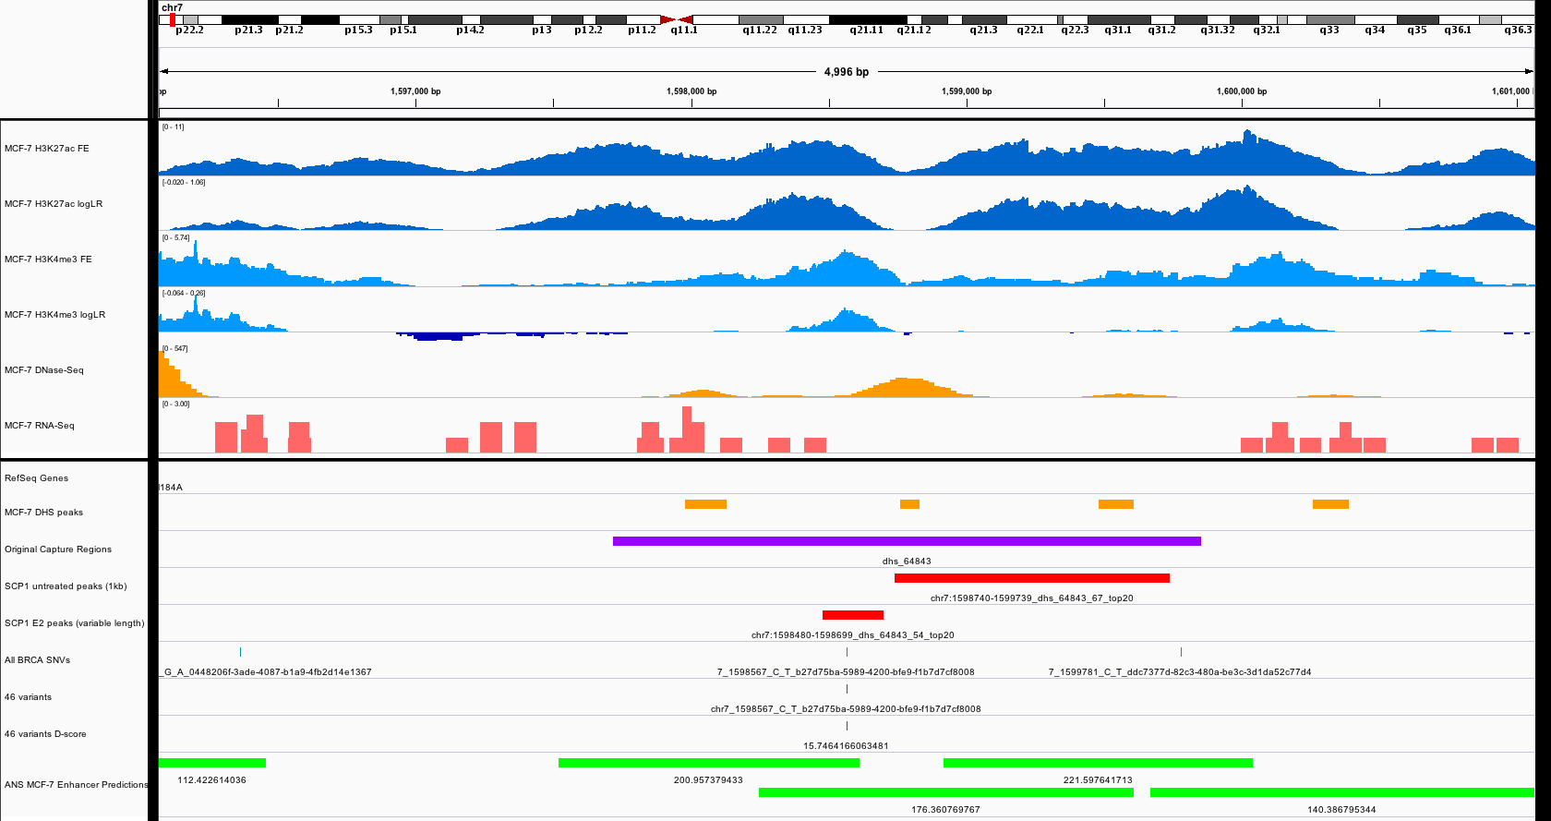
Notes:
DL: Peak off centered, Variant off centered, High d-score

Slide 7
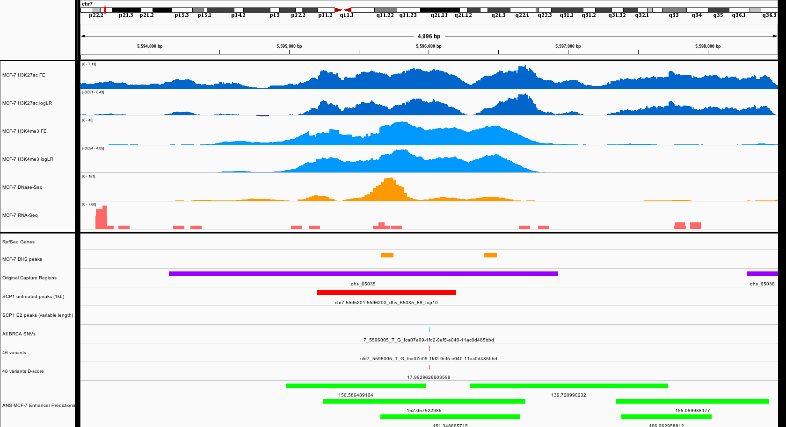
Notes:
DL: Good enhancer, Variant off centered

Slide 8
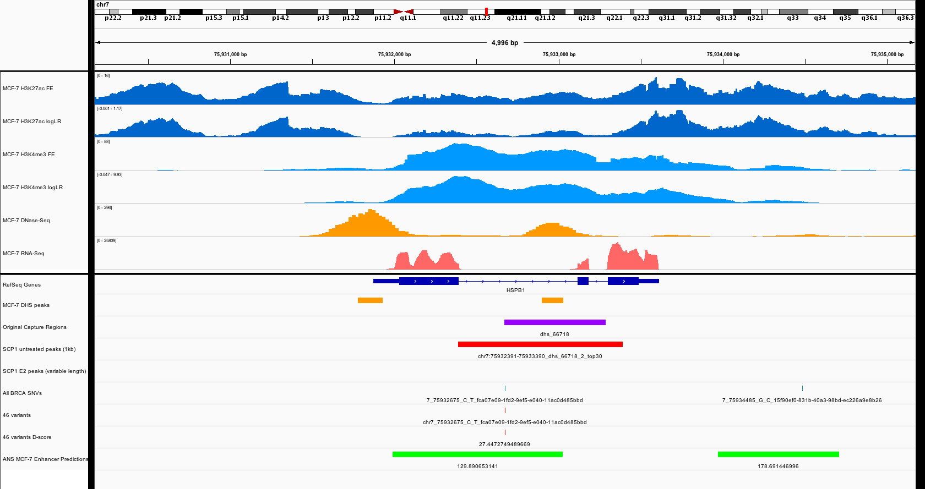
Notes:
DL: Bad enhancer, High d-score
JZ: first intron, and expressed gene, DHS is a little off the valley of double peak

Slide 9
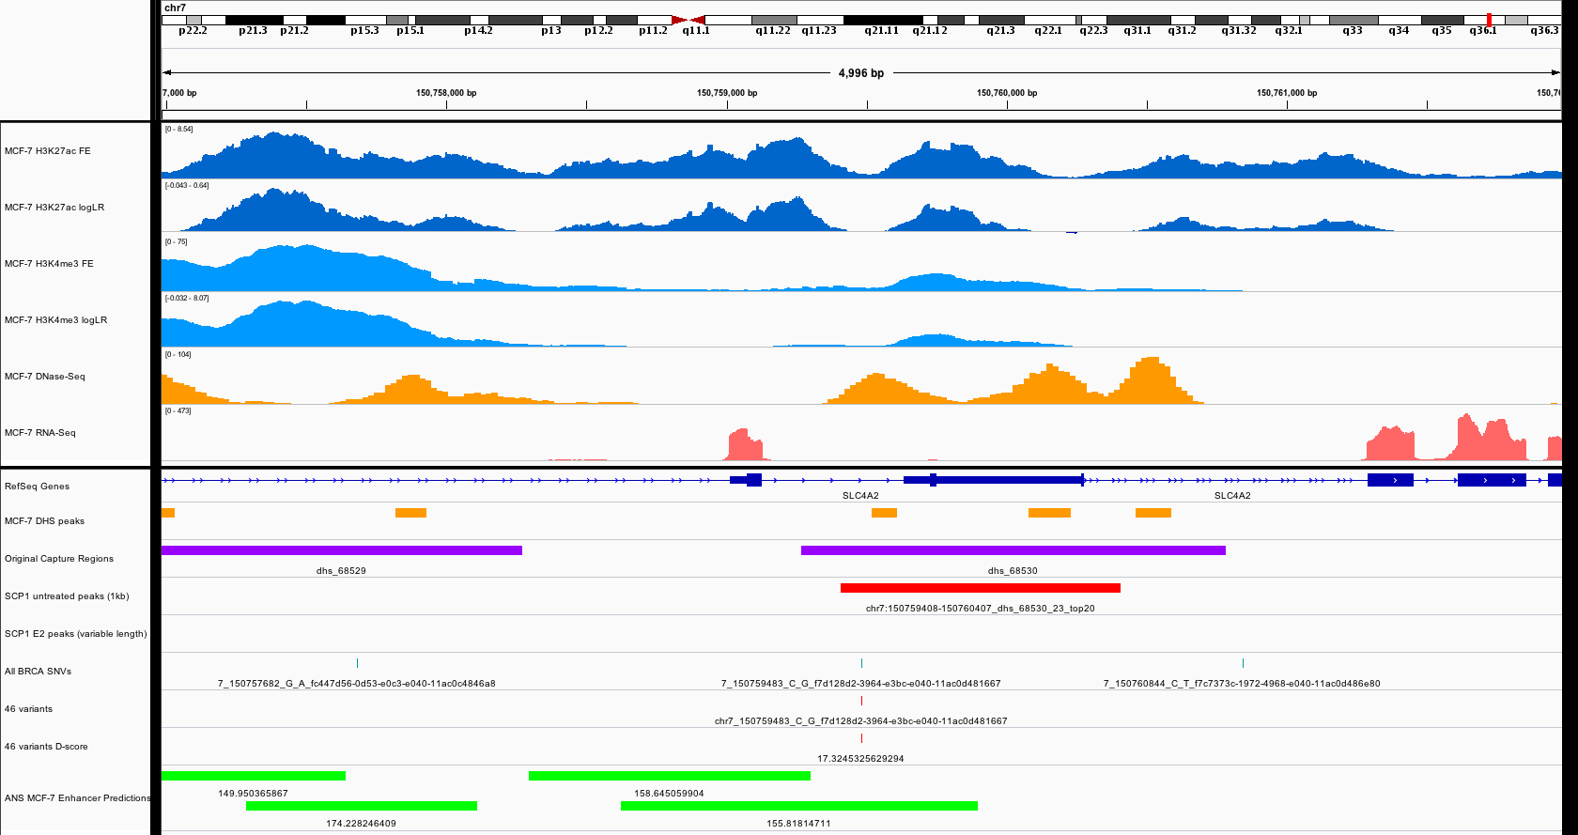
Notes:
DL: Peak off centered, Good variant, High d-score
JZ: maybe T2_1

Slide 10
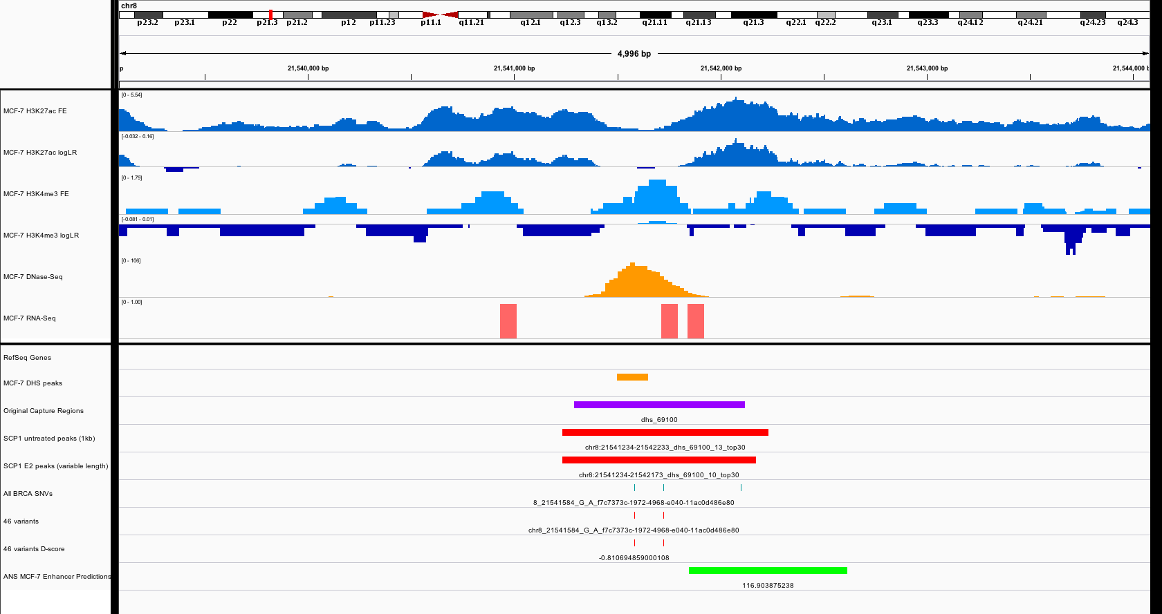
Notes:
DL: Good enhancer, Negative d-score
JZ: T1_3

Slide 11
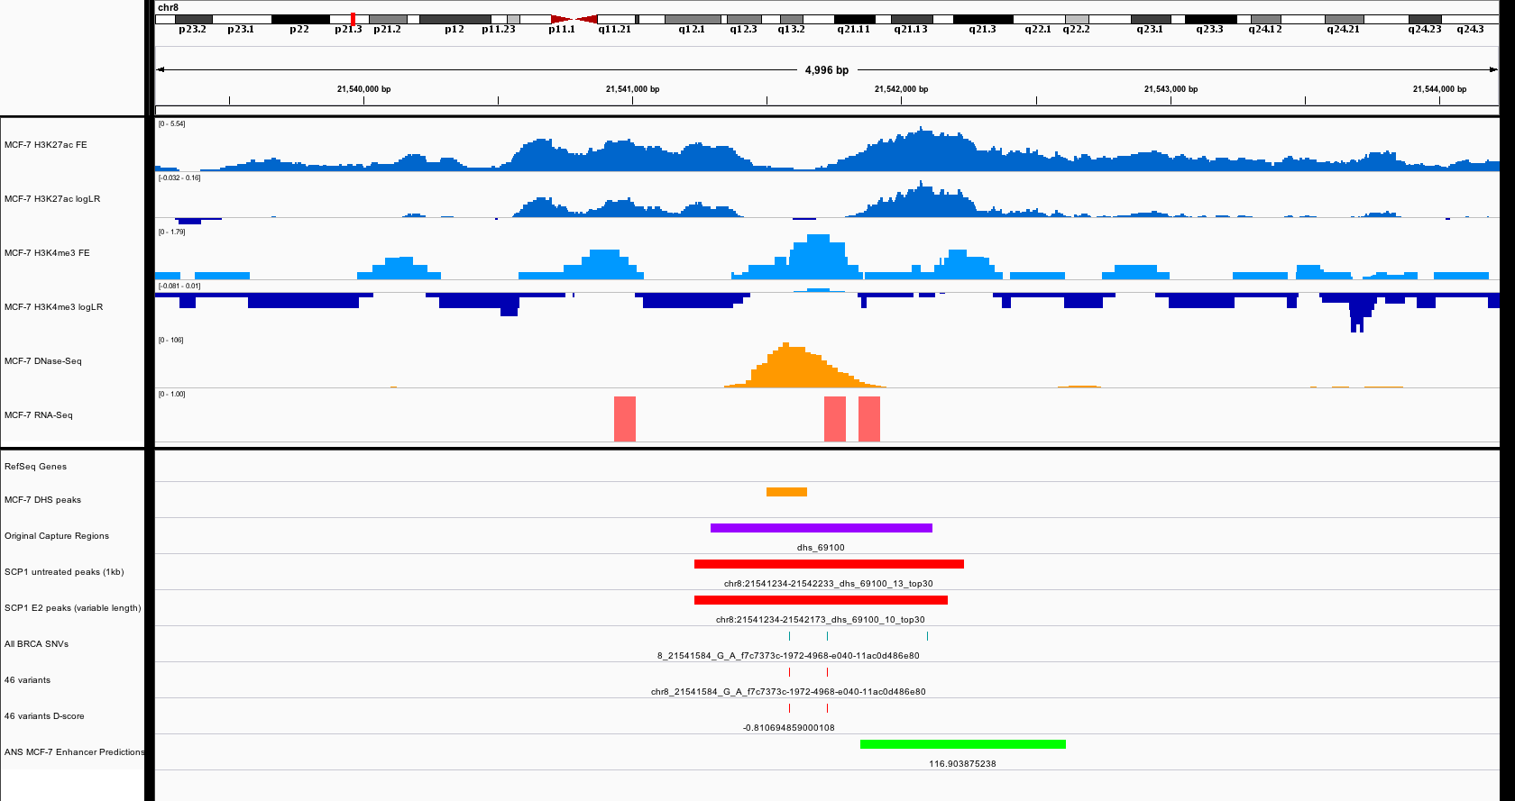
Notes:
DL: Good enhancer, Good variant, Positive d-score (not shown but it has good d-score ~27), T1
JZ: T1_4

Slide 12
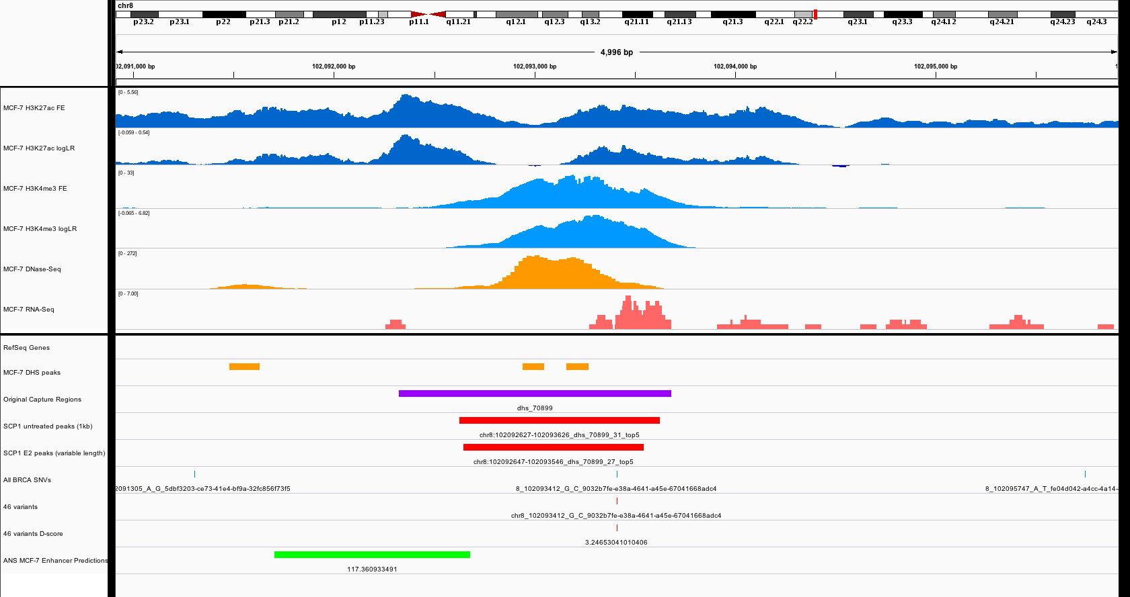
Notes:
DL: Good enhancer, Variant off-centered

Slide 13
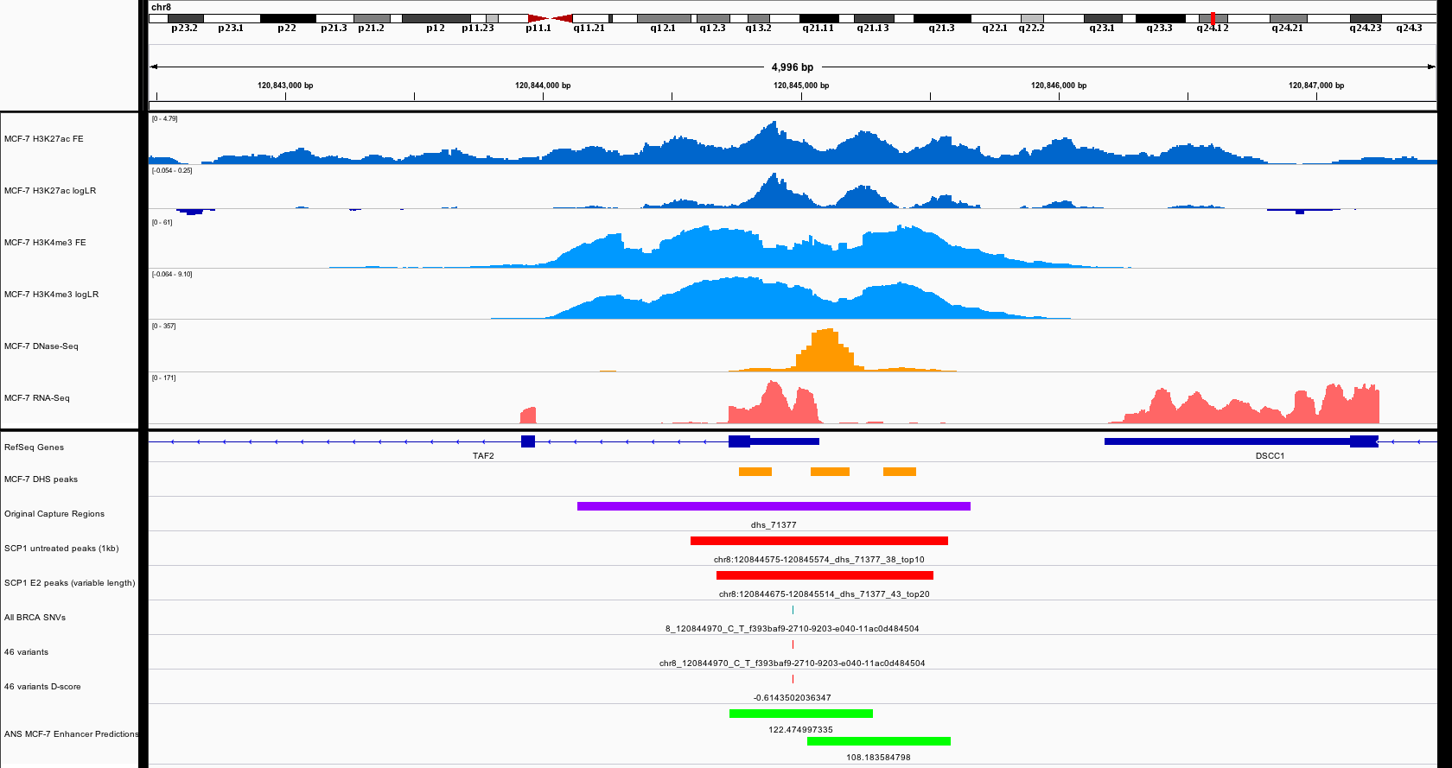
Notes:
DL: Might be a promoter, Negative d-score

Slide 14
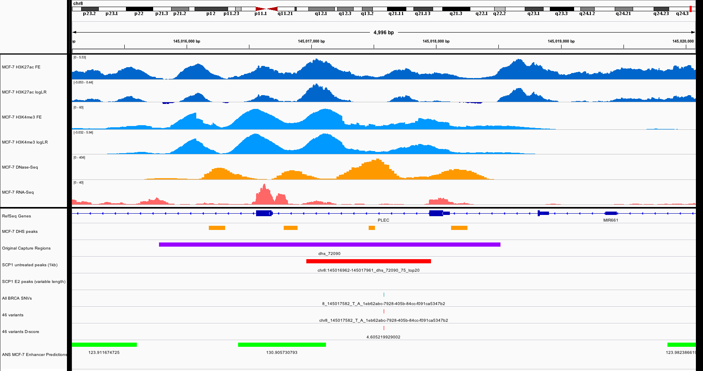
Notes:
DL: Good enhancer, Good variant, T1
JZ: T1_5

Slide 15
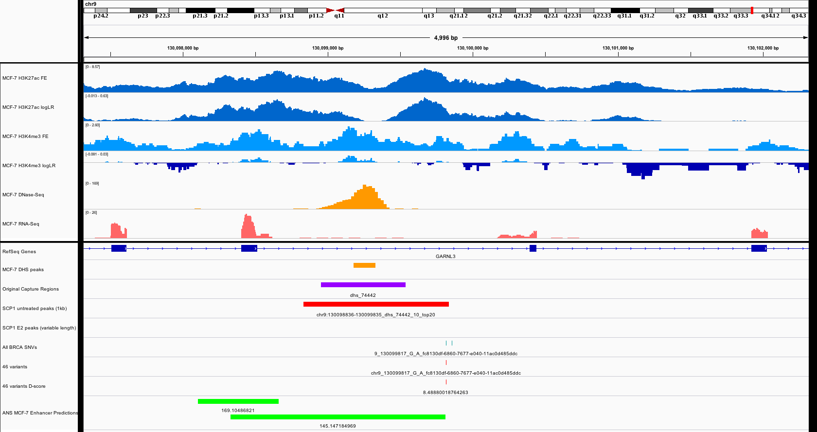
Notes:
DL: Good enhancer, Variant off-centered

Slide 16
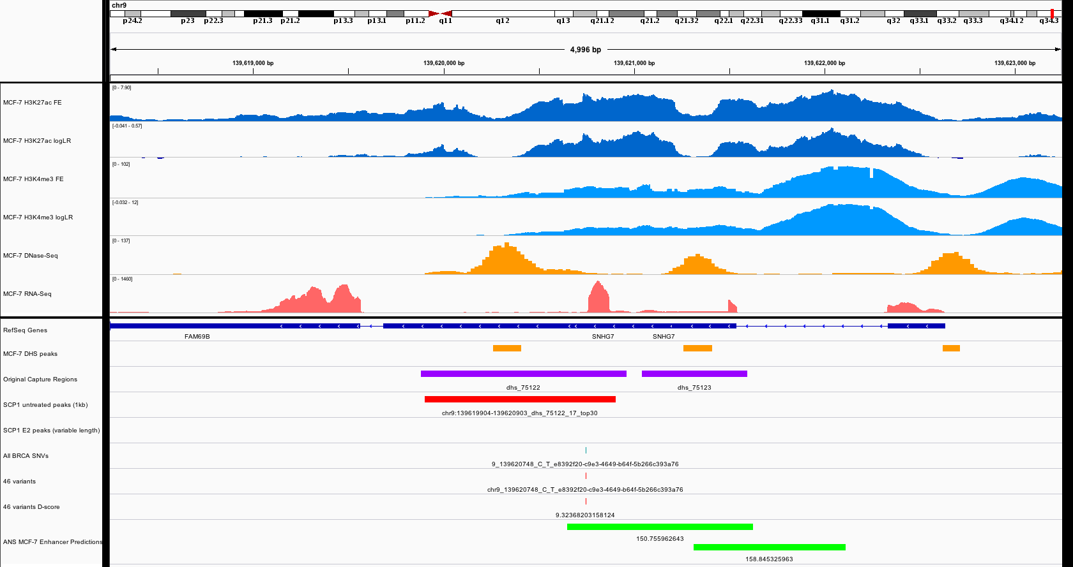
Notes:
DL: CDS?, Variant off-centered

Slide 17
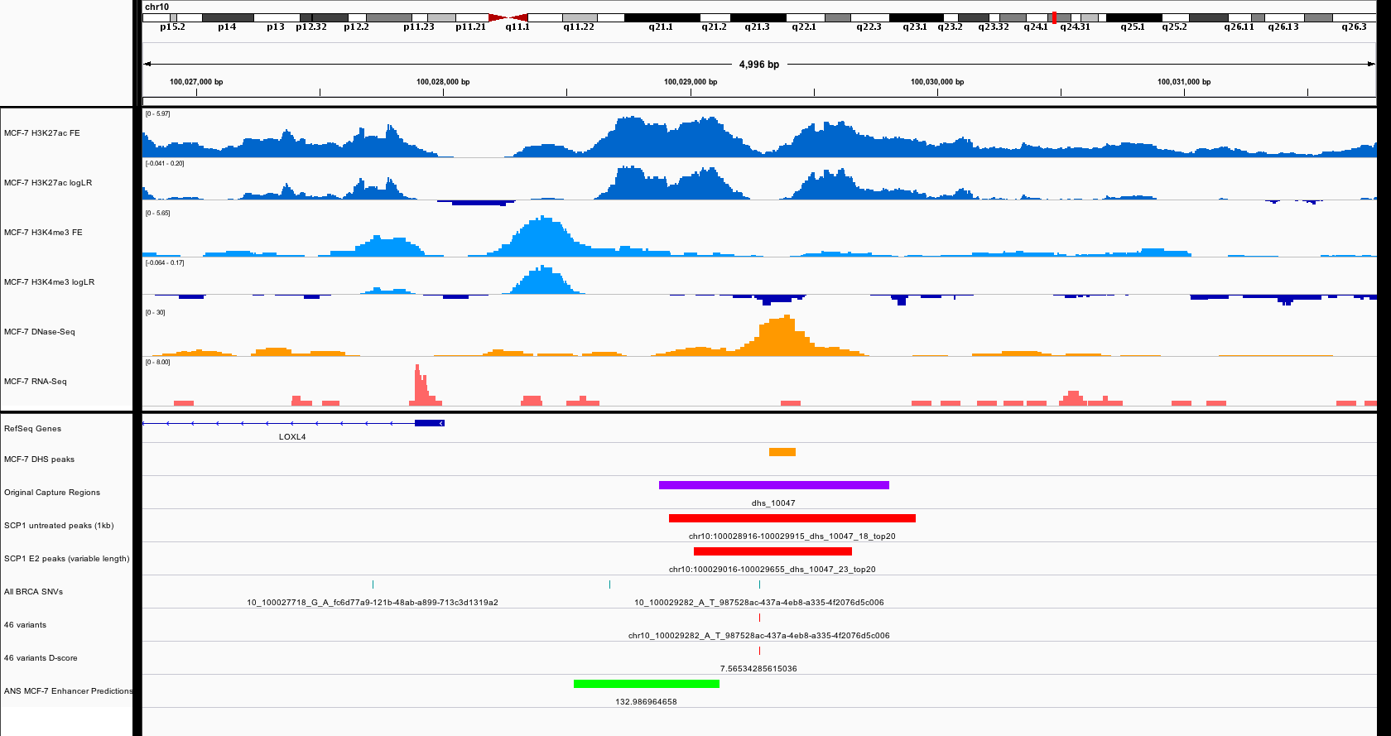
Notes:
DL: Good enhancer, Good variant, T1
JZ: T1_6

Slide 18
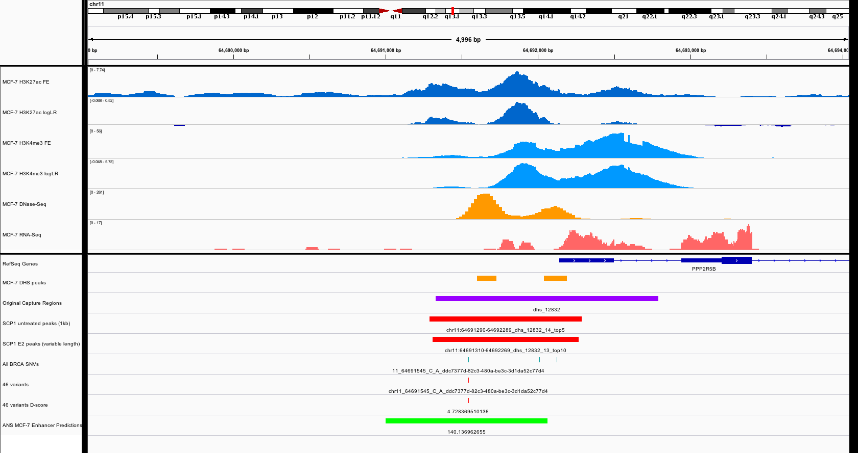
Notes:
DL: Good enhancer, Good variant, T1
JZ: T1_7

Slide 19
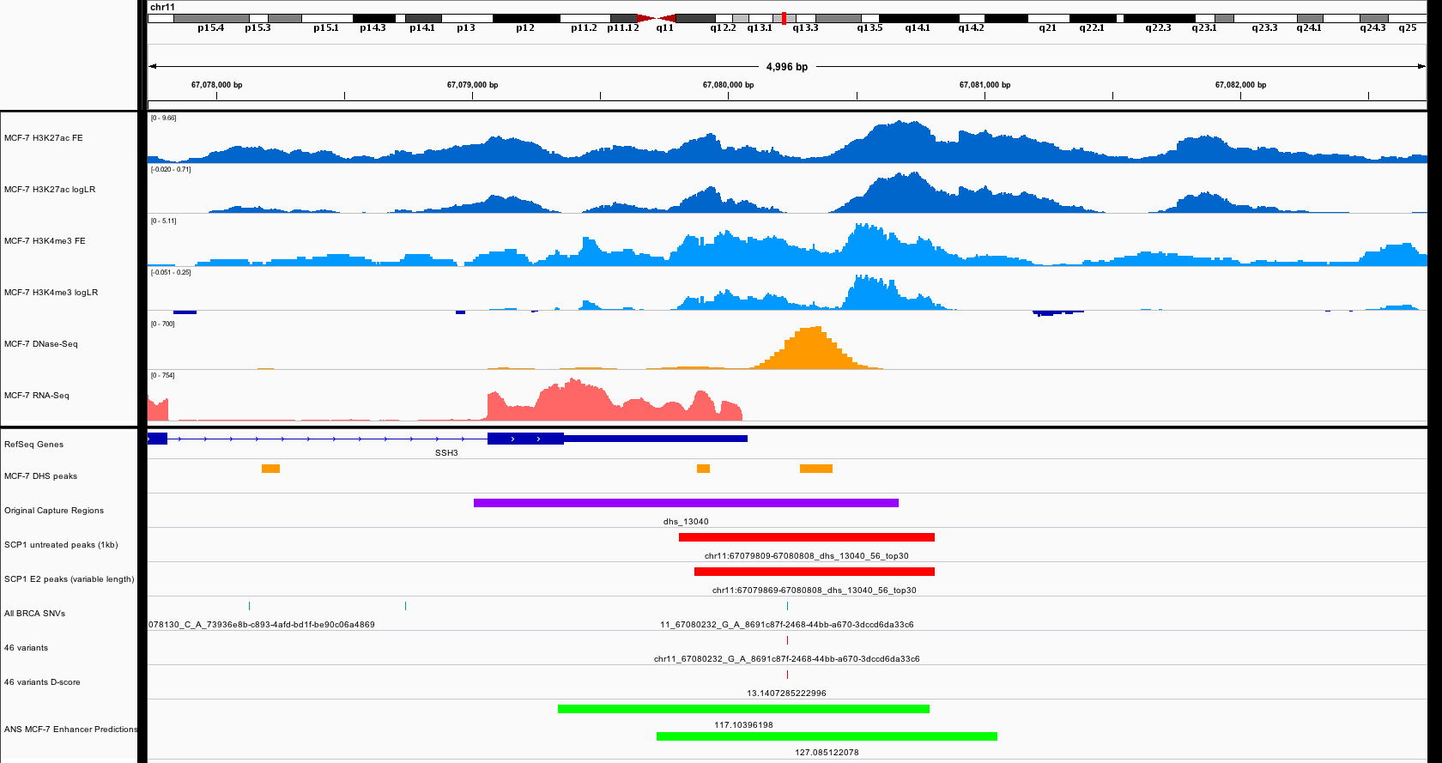
Notes:
DL: Good enhancer, Good variant, T1
JZ: T1_8

Slide 20
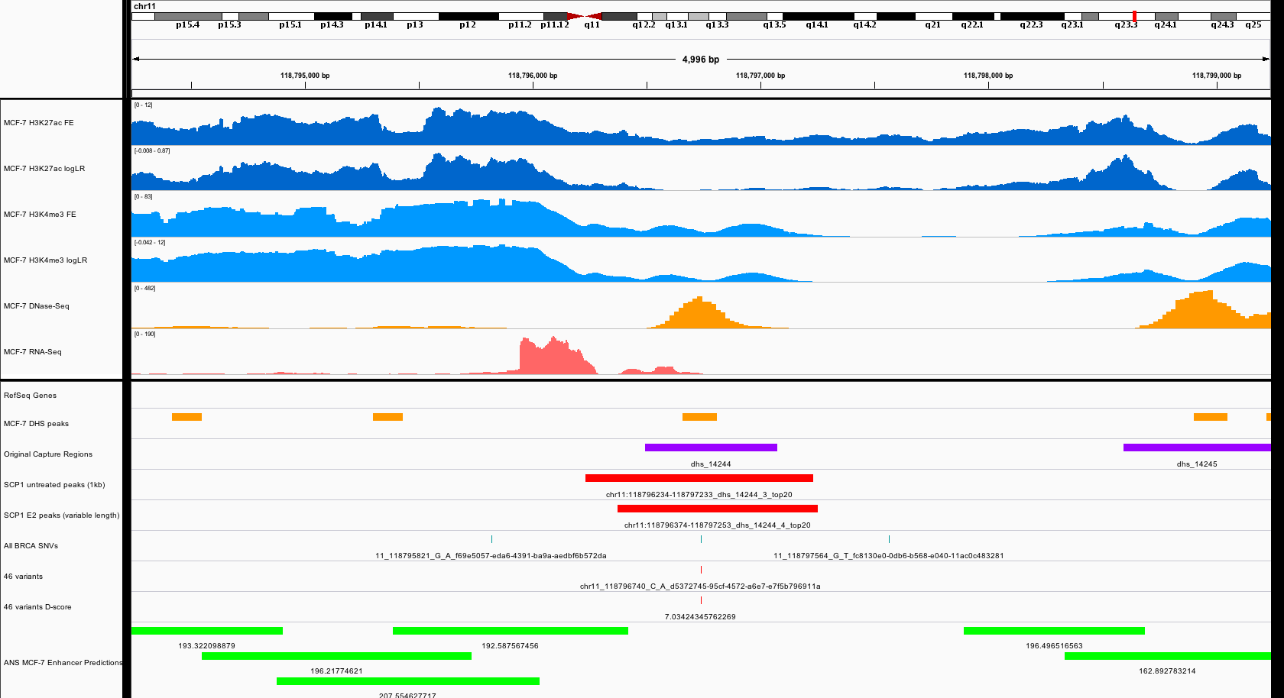
Notes:
DL: Bad enhancer? Interesting, Variant centered
JZ: need to discuss with MG & ANS

Slide 21
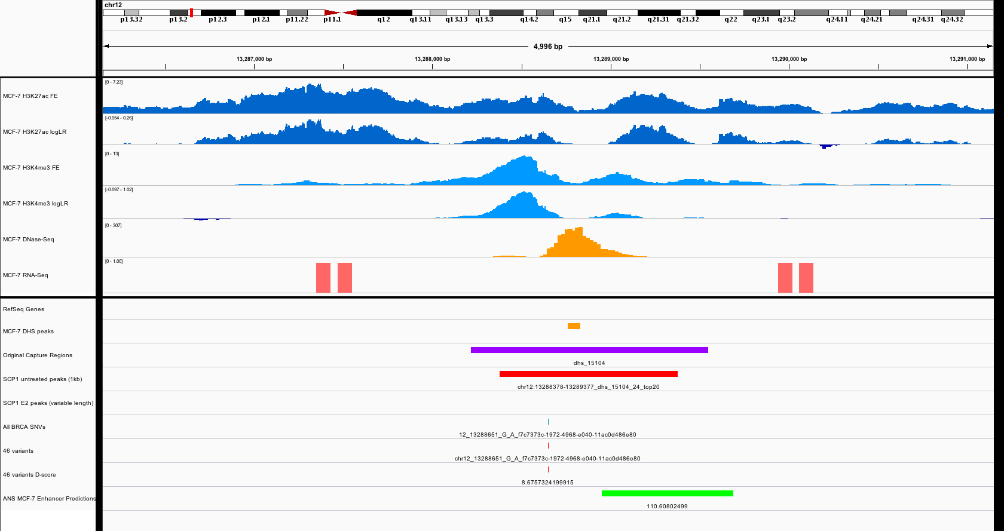
Notes:
DL: Good enhancer, Good variant, T1
JZ: T1_9

Slide 22
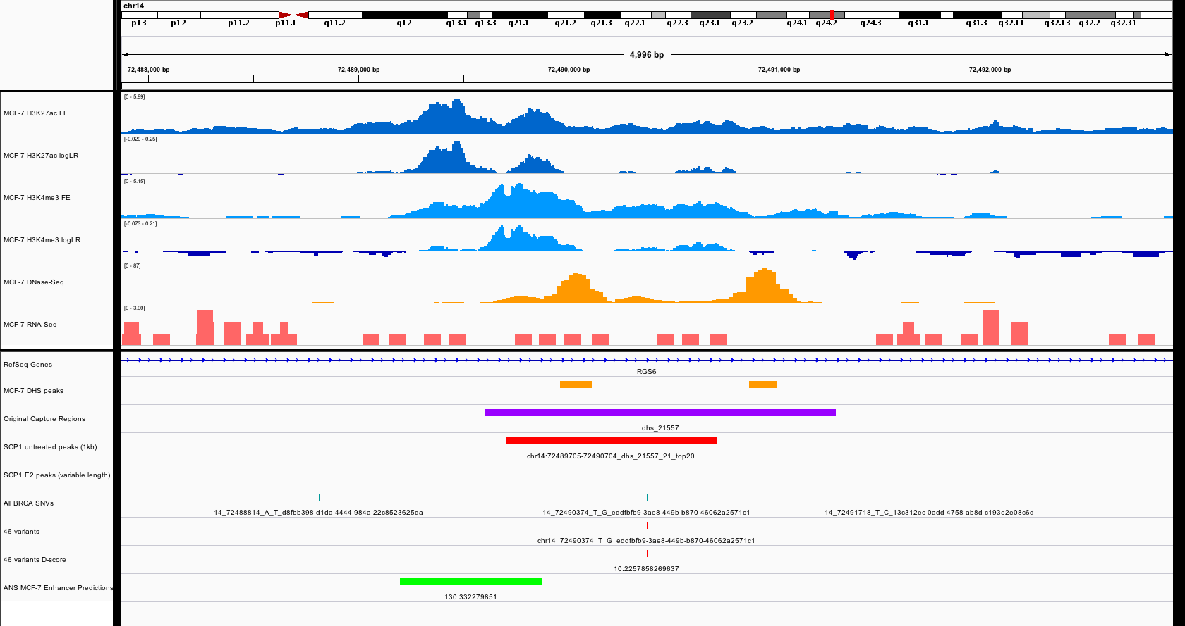
Notes:
DL: Bad enhancer?
JZ: enhancer on the left, shifted region

Slide 23
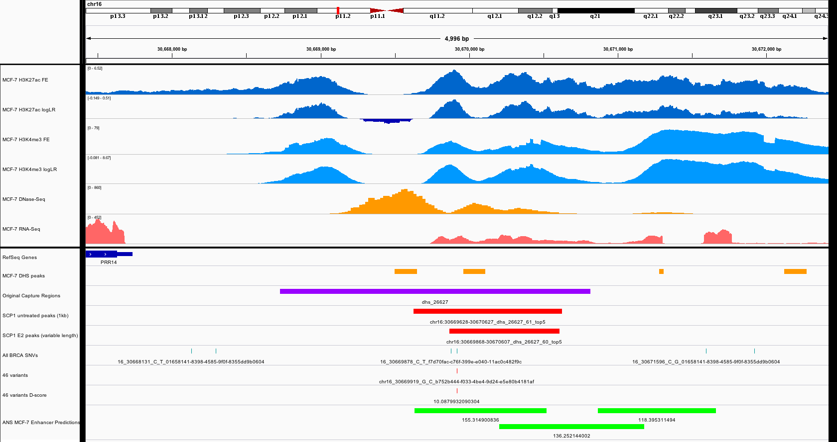
Notes:
DL: Bigger double peak to the left?
JZ: the selected region is also an enhancer? This is region is somehow burdened

Slide 24
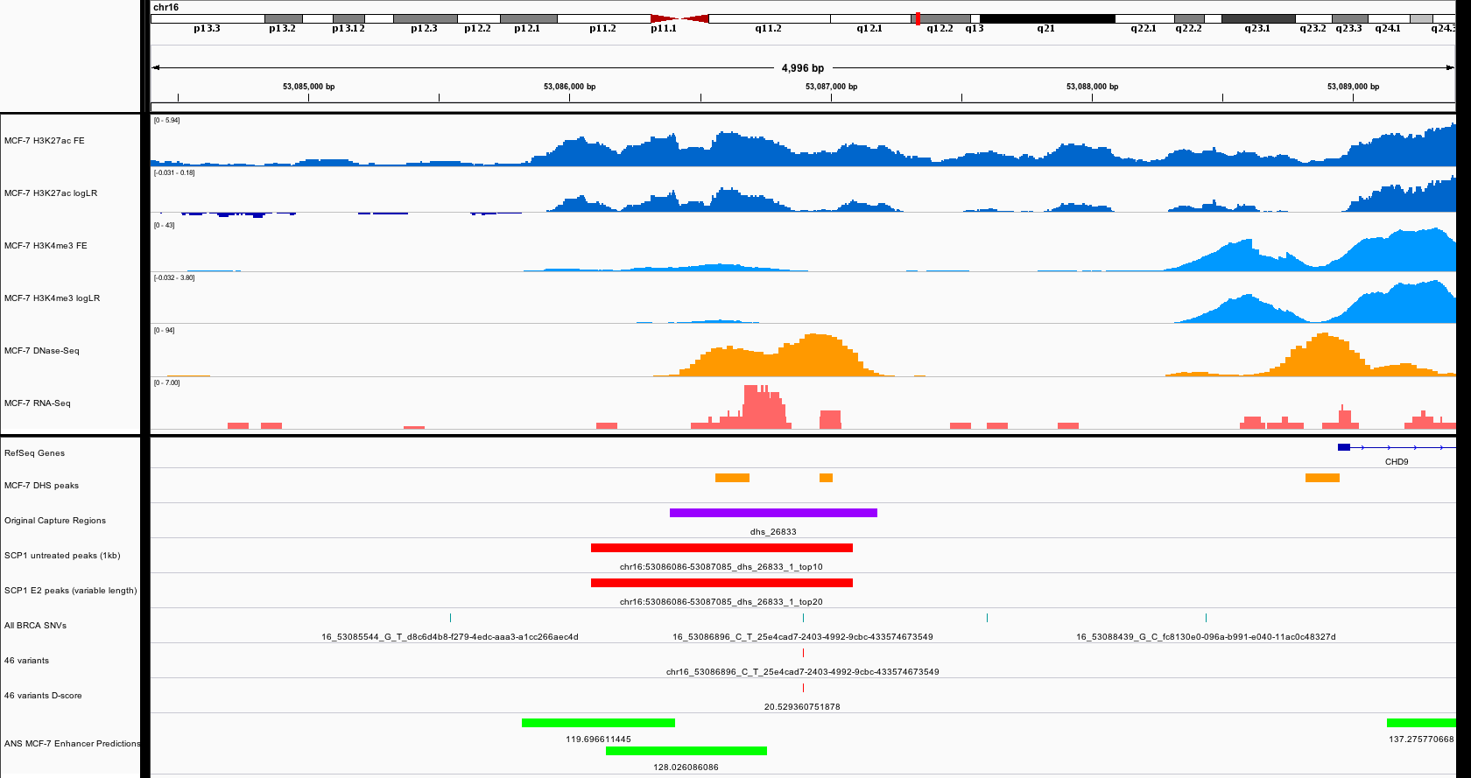
Notes:
DL: Peak off centered, High d-score
JZ: enhancer on the right? T1_10?

Slide 25
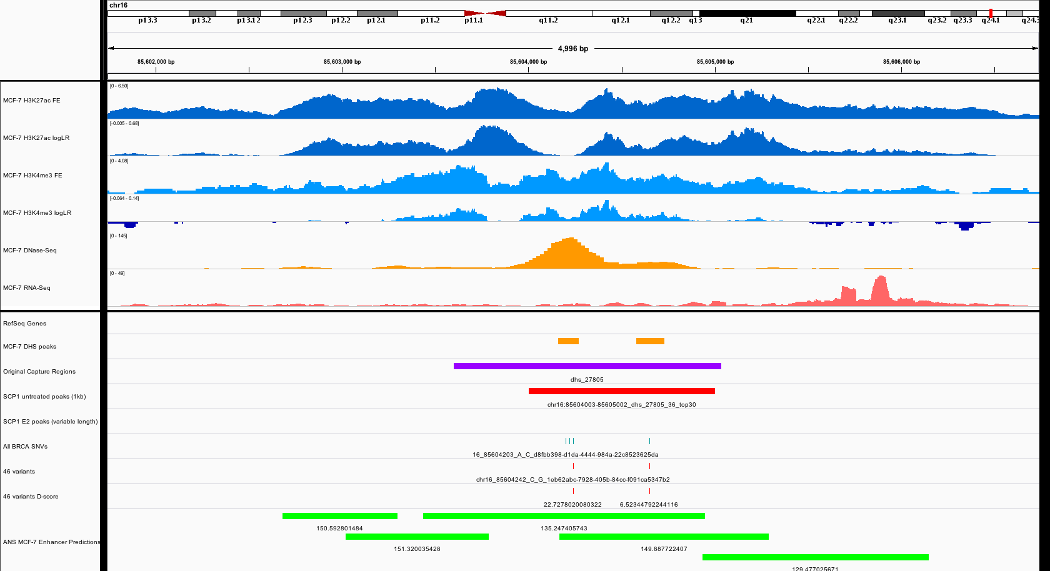
Notes:
DL: Good enhancer, High d-score, Two variants, T1
JZ: T1_11, highly burdened region

Slide 26
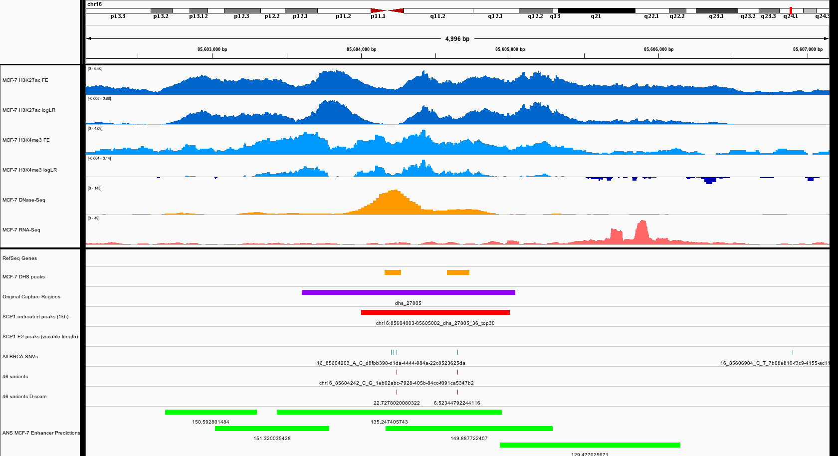
Notes:
DL: Good enhancer, Two variants
JZ: T1_12

Slide 27
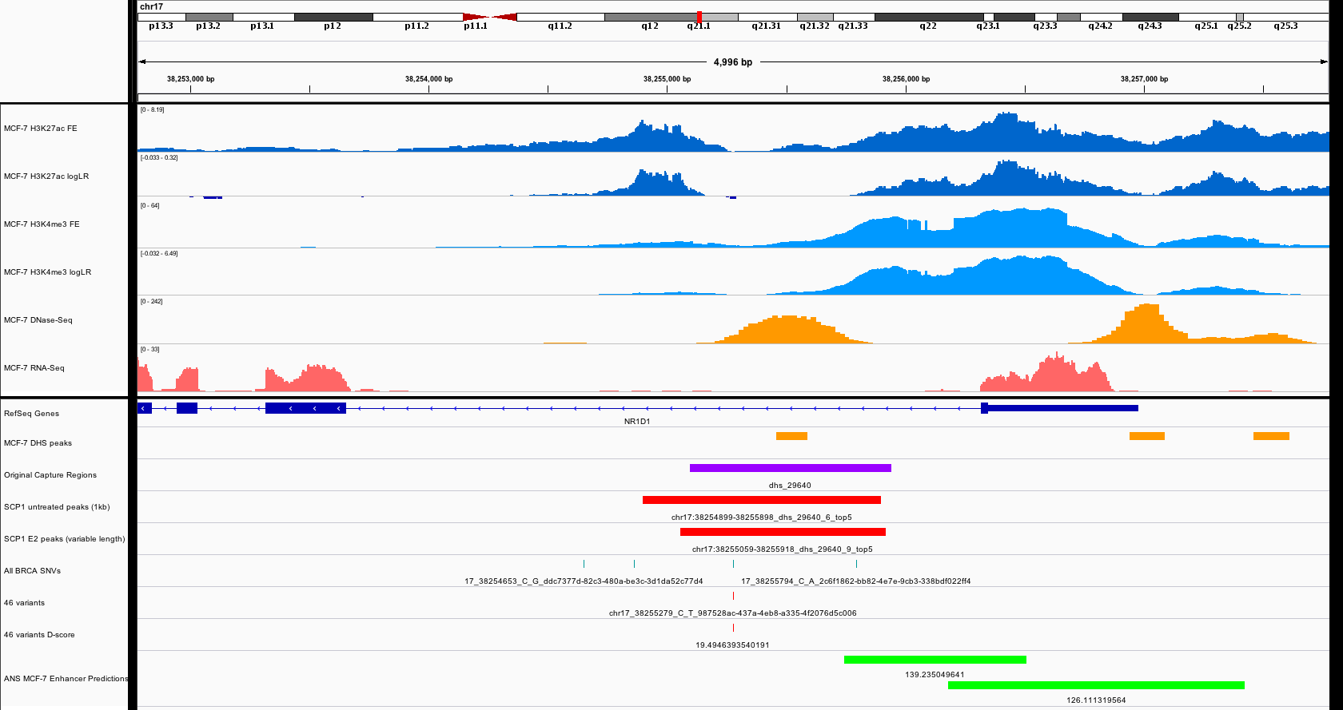
Notes:
DL: Good enhancer, High d-score
JZ: enhancer? A little bit off the center, but burdened region, T1_13?

Slide 28
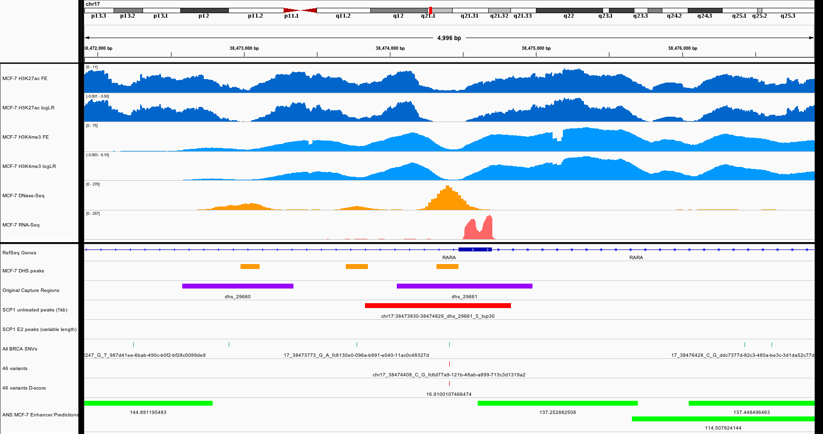
Notes:
DL: Close to expressed CDS, High d-score, Interesting
JZ: T1_14?

Slide 29
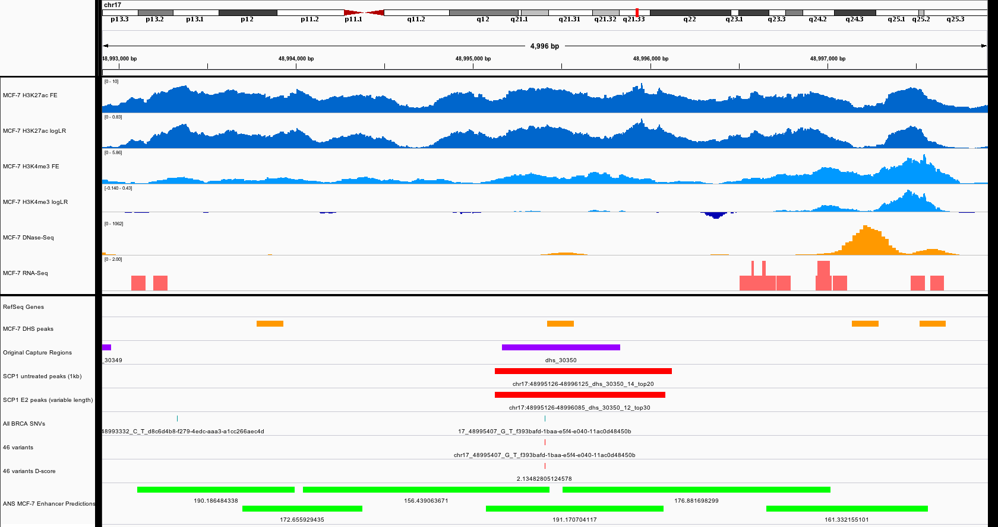
Notes:
DL: Good enhancer?, Good variant, T1?
JZ: hard to say, need disc?

Slide 30
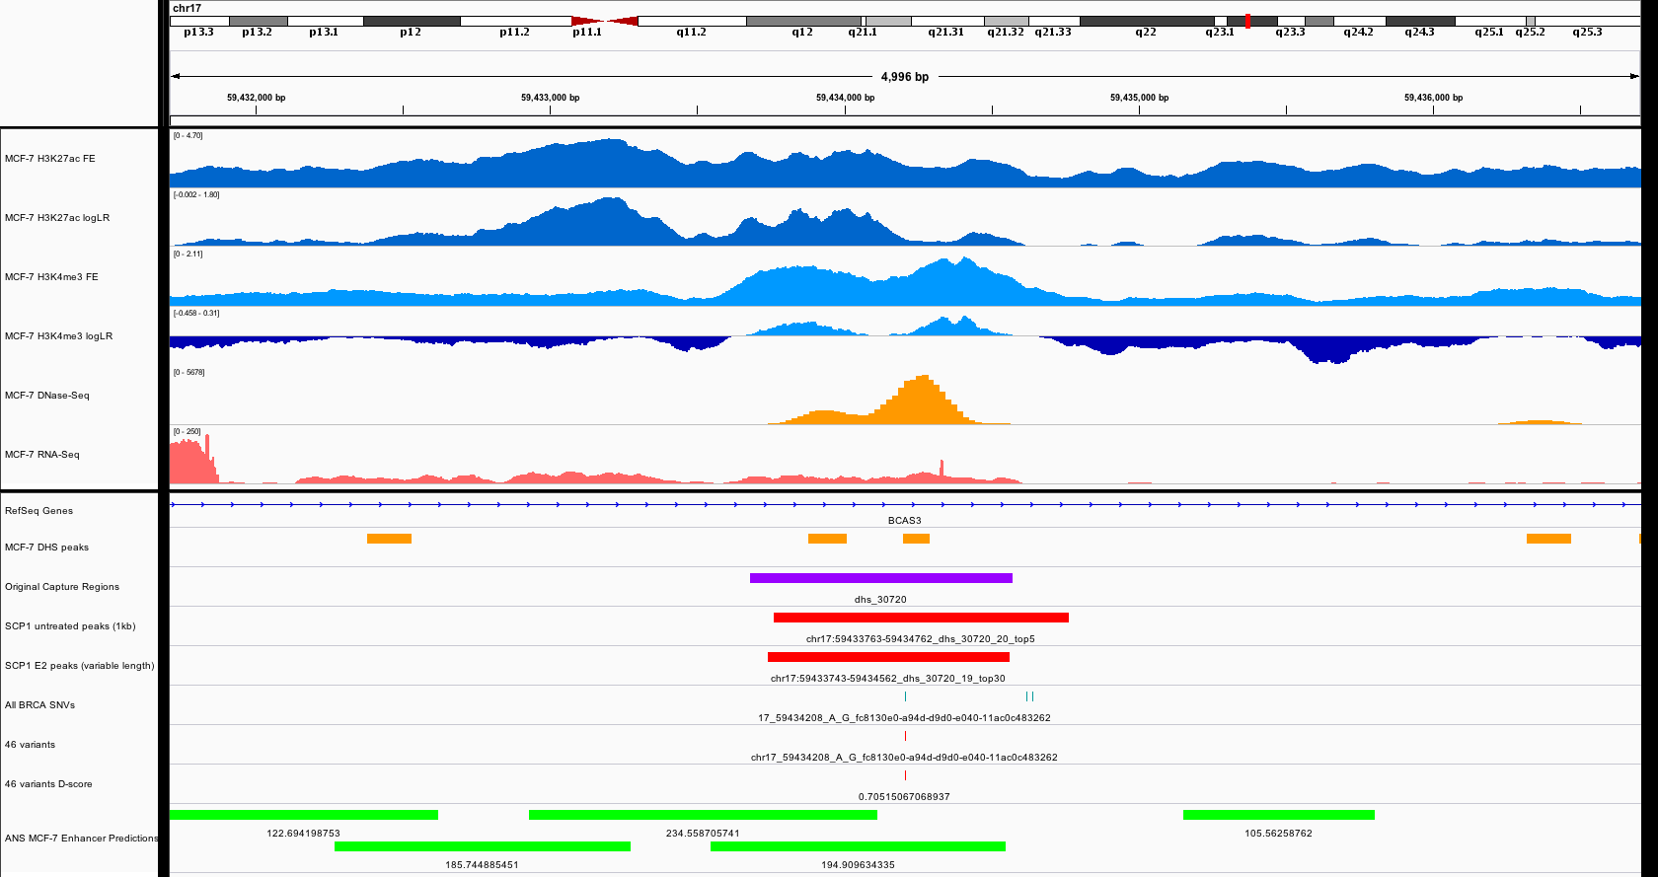
Notes:
DL: Okay enhancer, Variant centered
JZ: T1_14, burdened

Slide 31
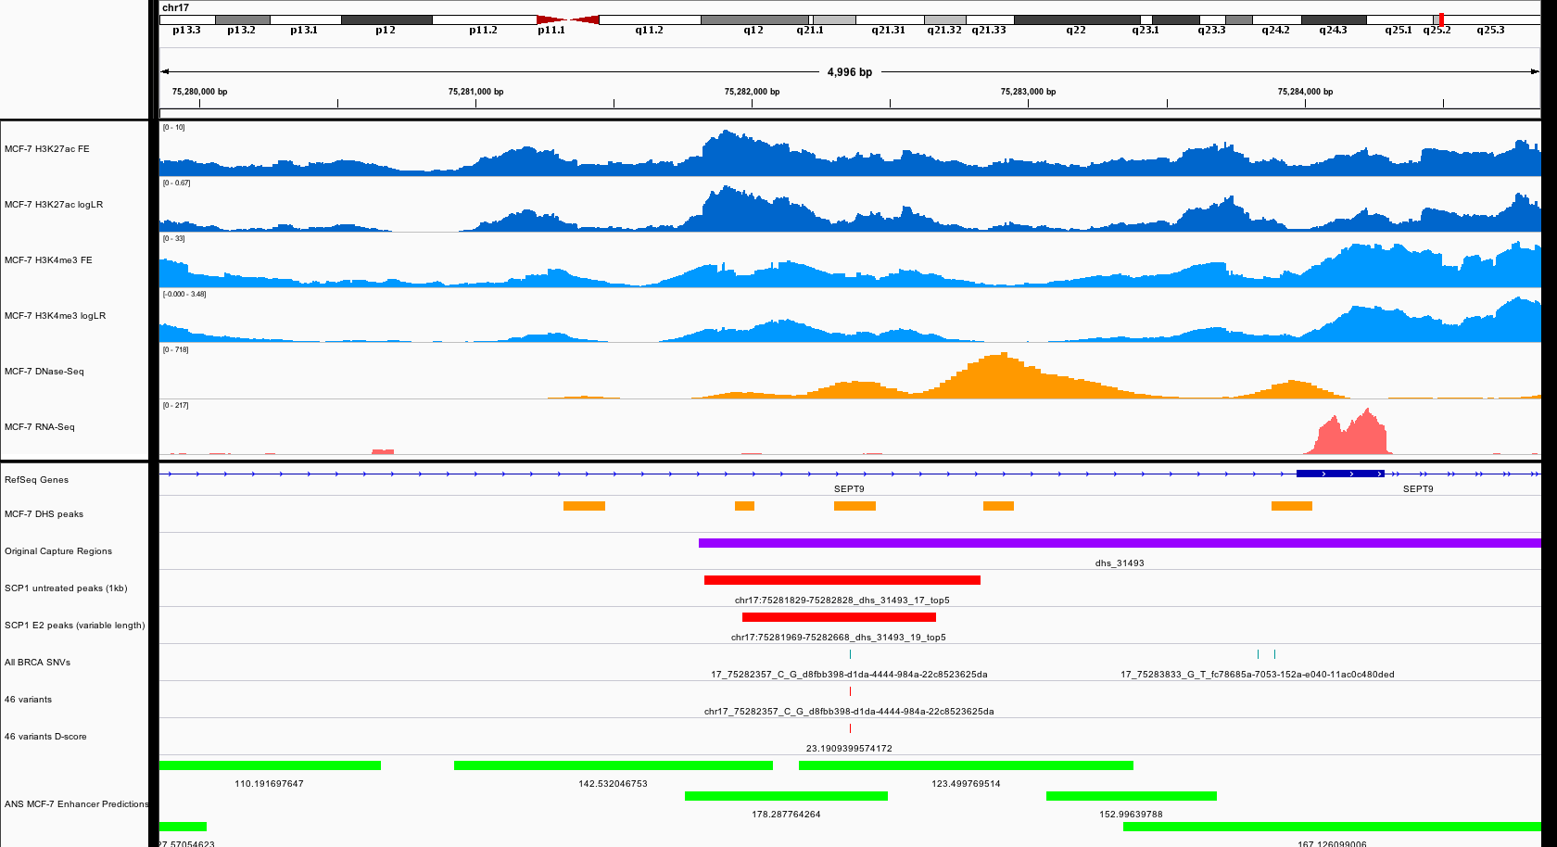
Notes:
DL: Bigger double peak to the right, Variant centered, High d-score

Slide 32
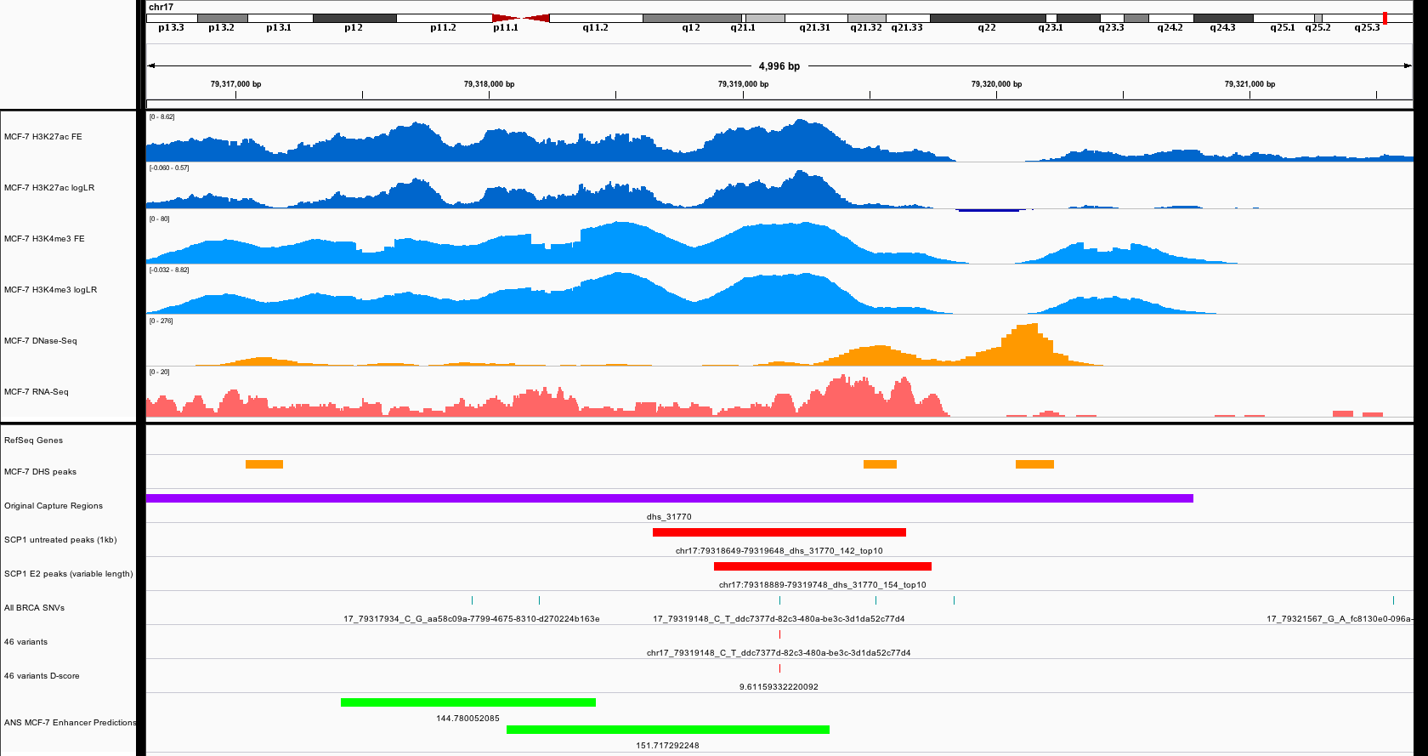
Notes:
DL: Bad enhancer (bigger double peak to the left)
JZ: select the right one?

Slide 33
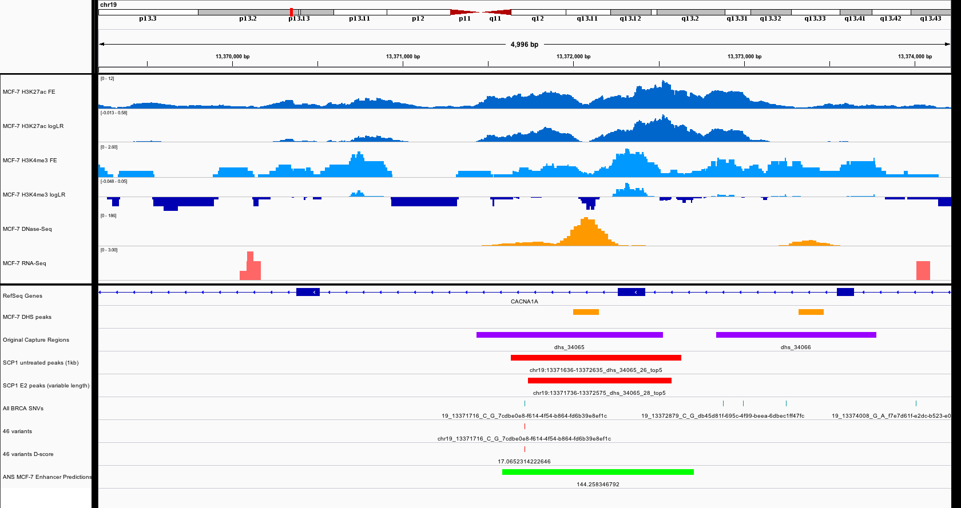
Notes:
DL: Variant off centered

Slide 34
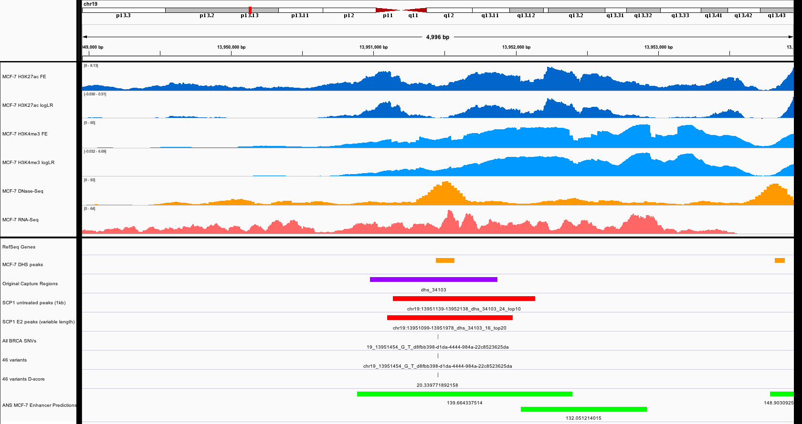
Notes:
DL: Good enhancer, Good variant, High d-score, T1
JZ: T1_15

Slide 35
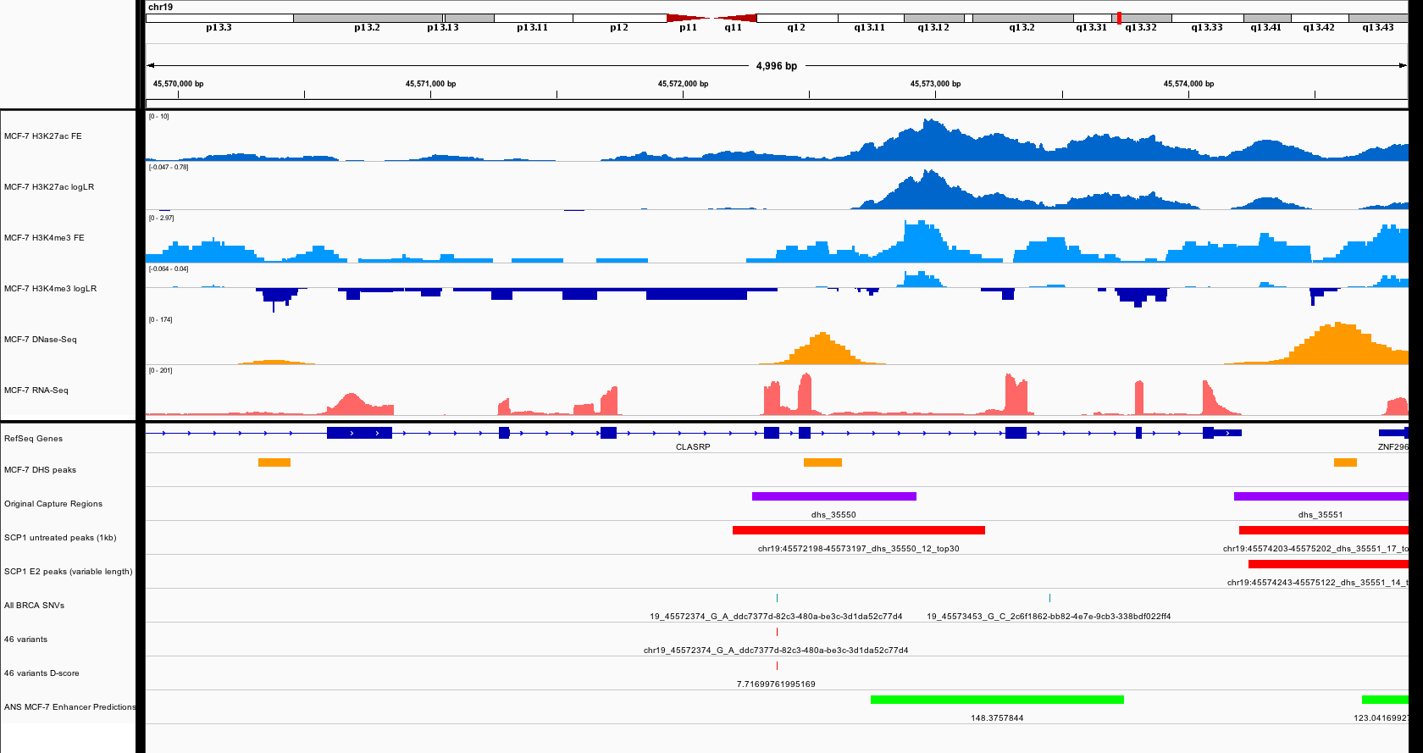
Notes:
DL: Variant within expressed CDS, T4

Slide 36
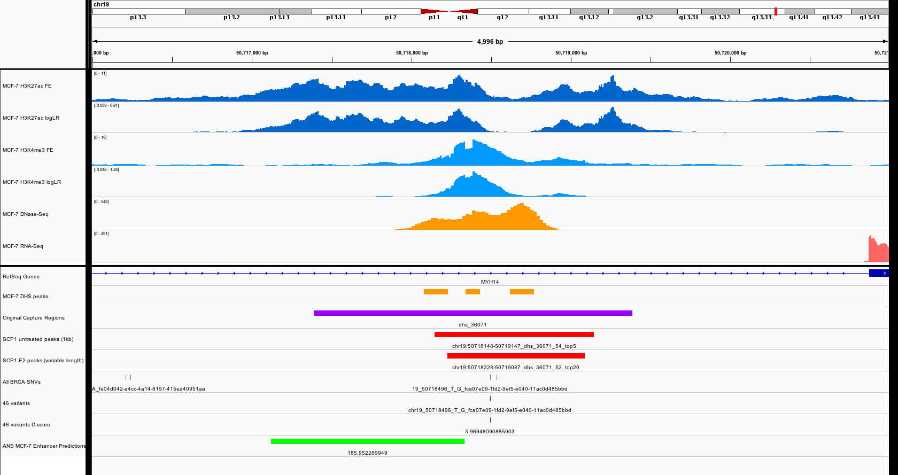
Notes:
DL: Good enhancer, Good variant, T1
JZ: T1_16

Slide 37
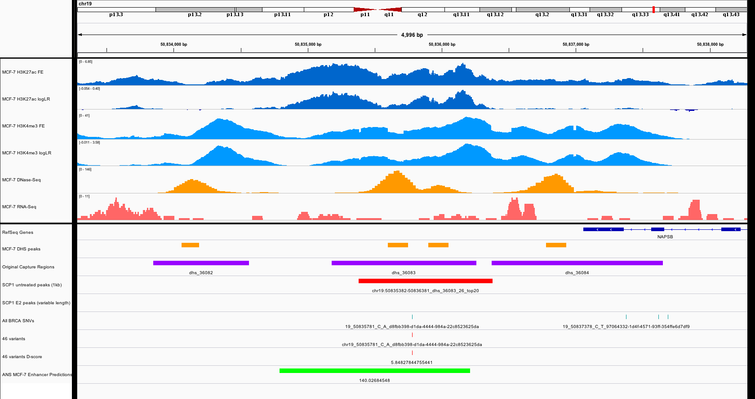
Notes:
DL: Good enhancer, Good variant, T1
JZ: T1_17

Slide 38
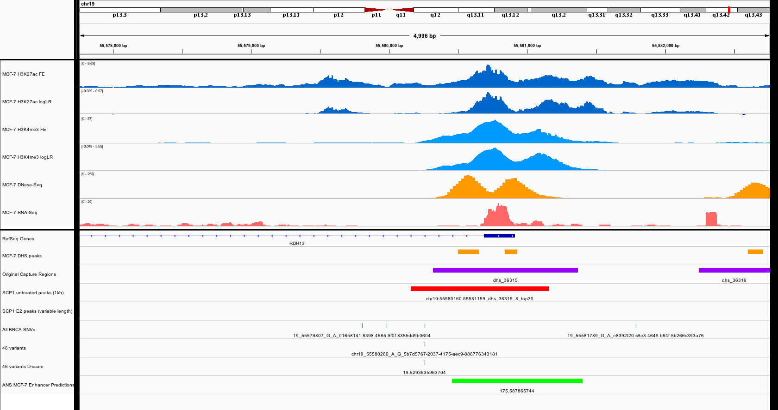
Notes:
DL: Maybe promoter, Variant off centered

Slide 39
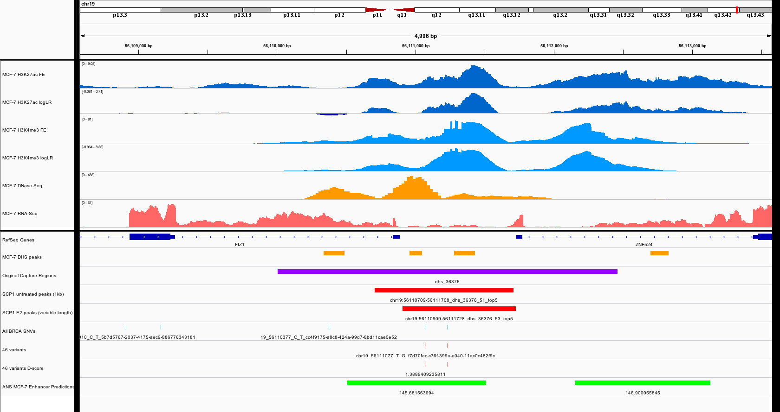
Notes:
DL: Might be a promoter, Two variants
JZ: T1_18

Slide 40
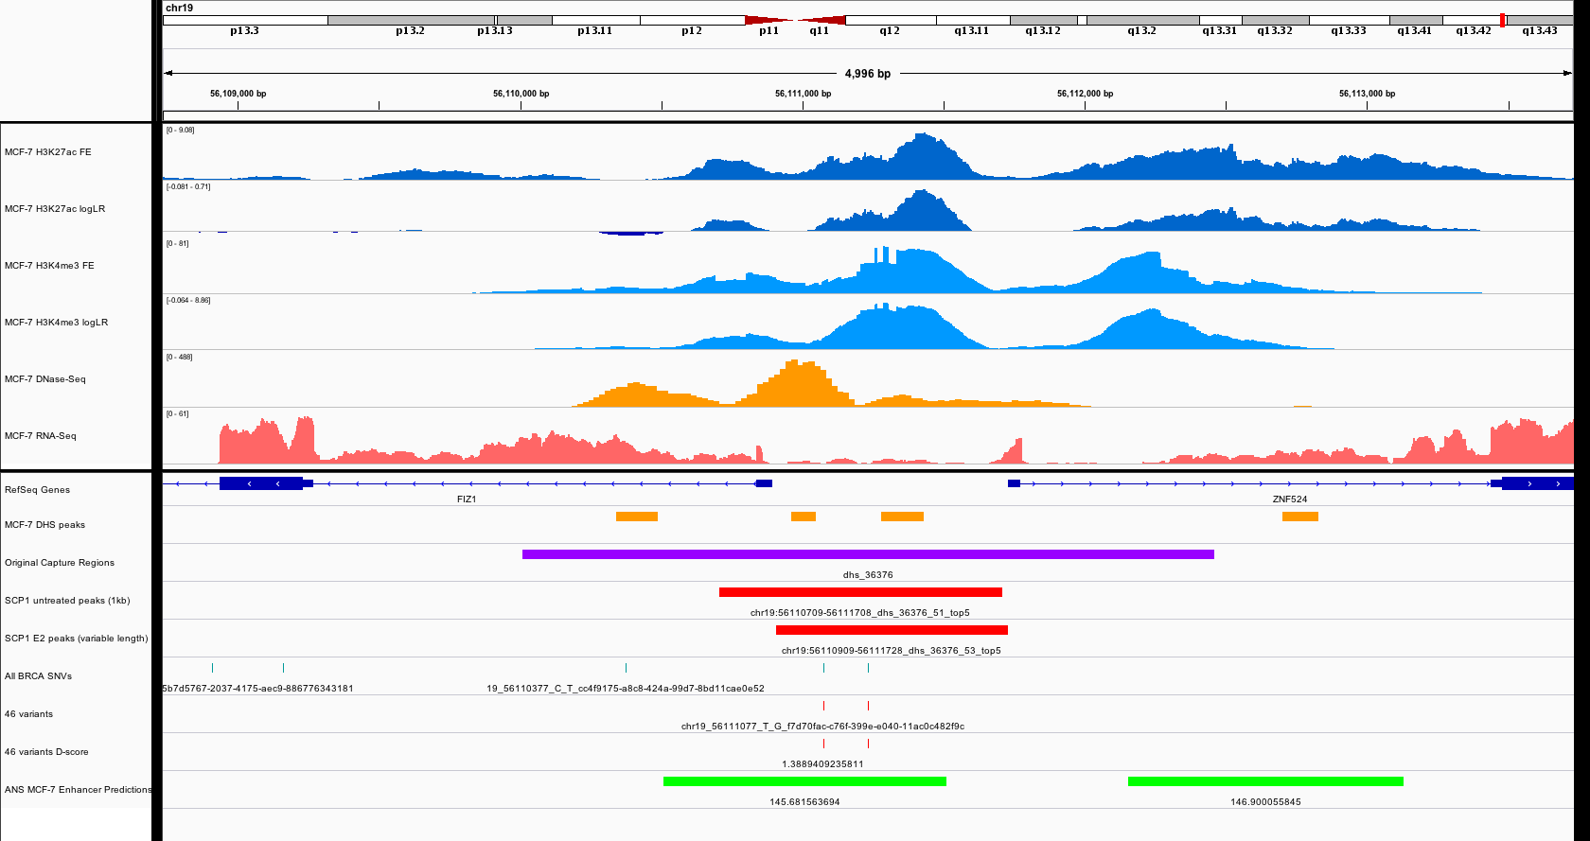
Notes:
DL: Might be a promoter, Two variants

Slide 41
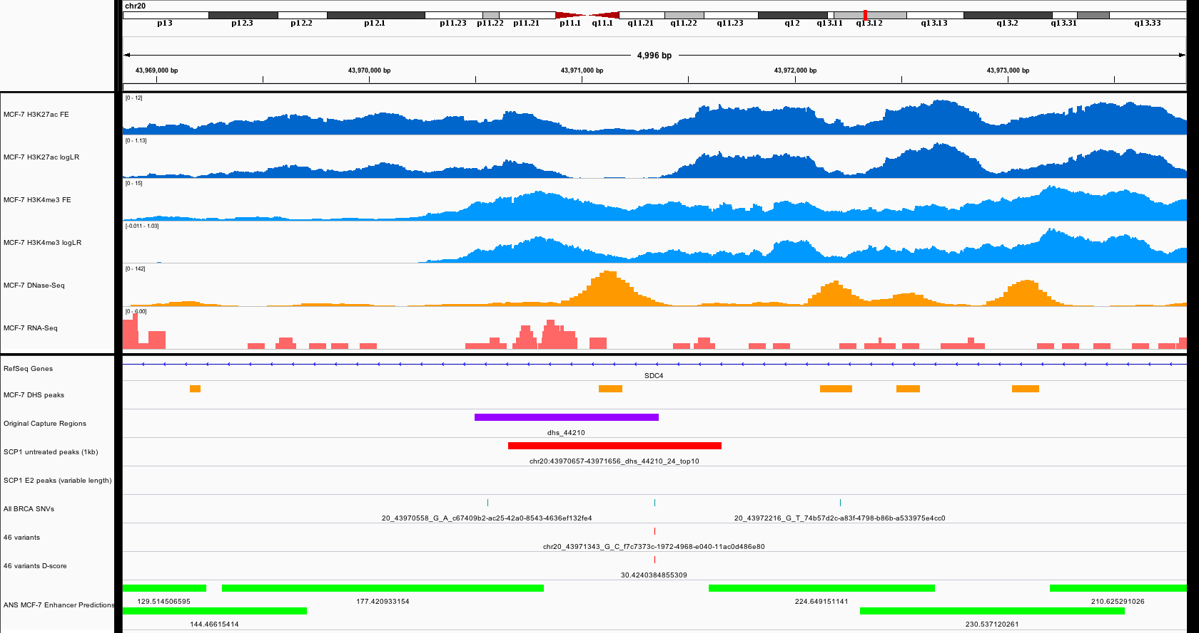
Notes:
DL: Good enhancer, High d-score, T1

Slide 42
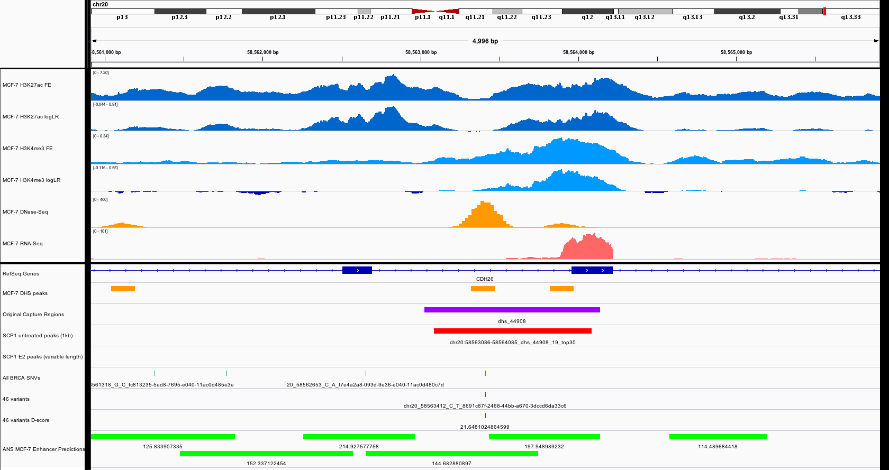
Notes:
DL: Good enhancer, High d-score, T1

Slide 43
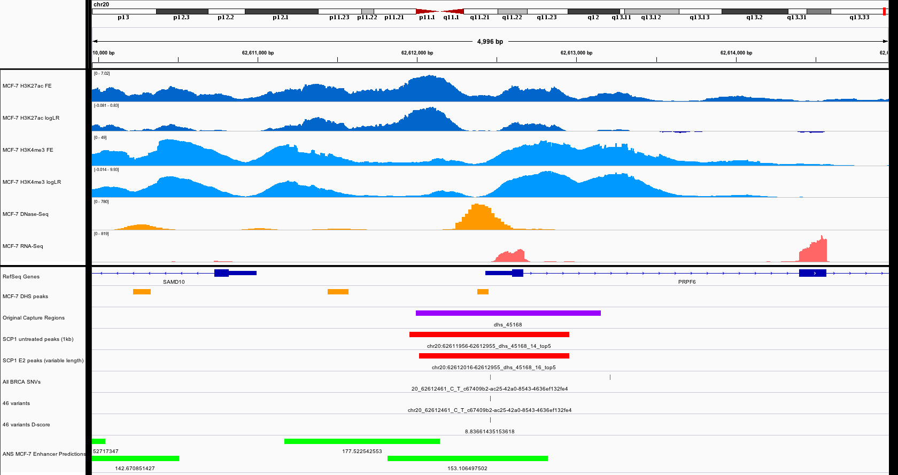
Notes:
DL: Might be a promoter
JZ: T1_19

Slide 44
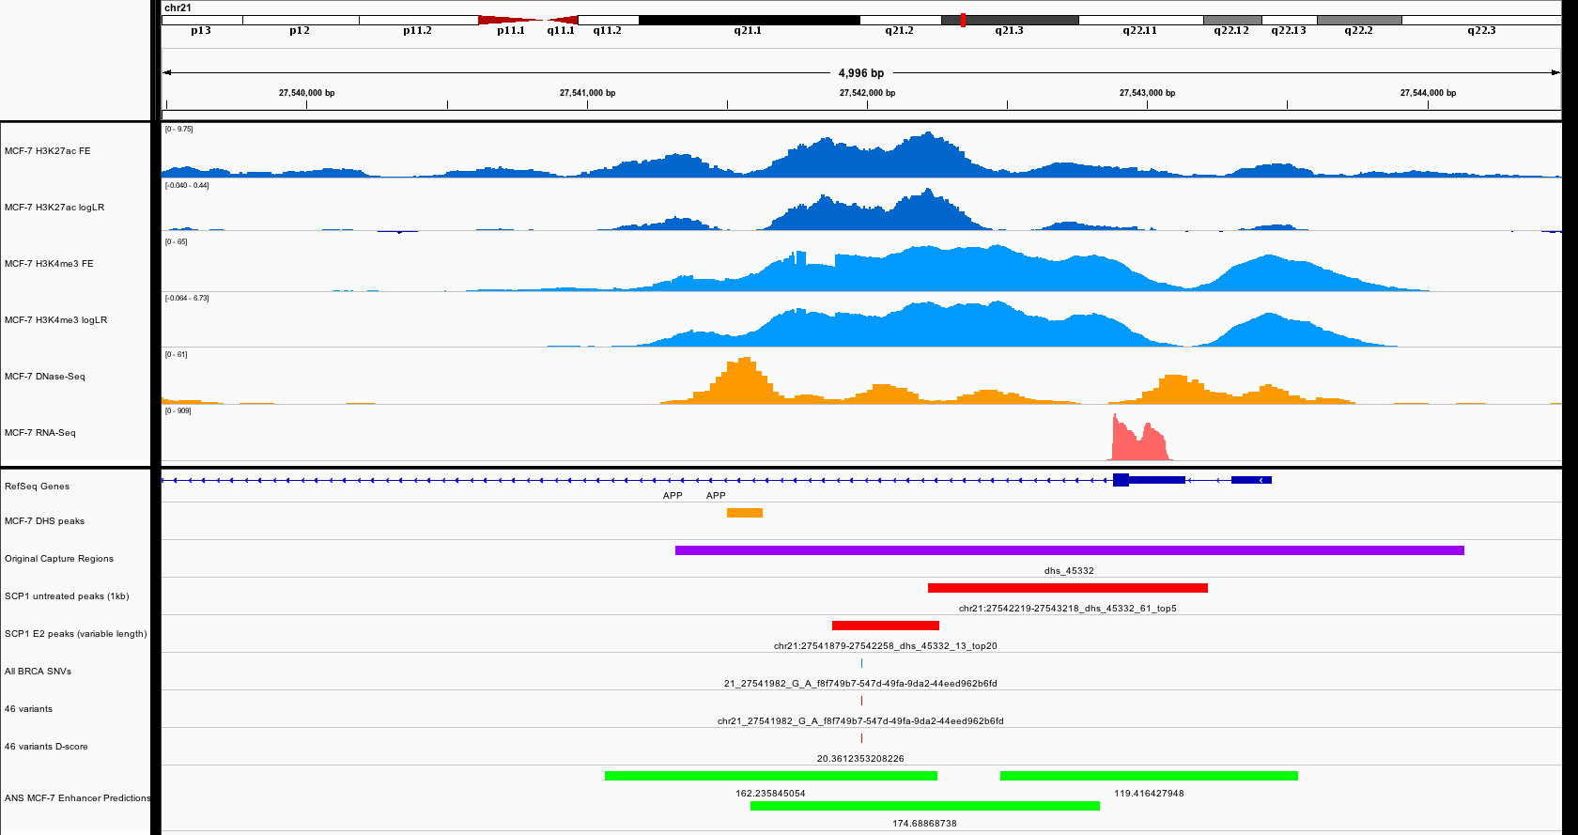
Notes:
DL: Okay enhancer, High d-score
JZ: T1_20

Slide 45
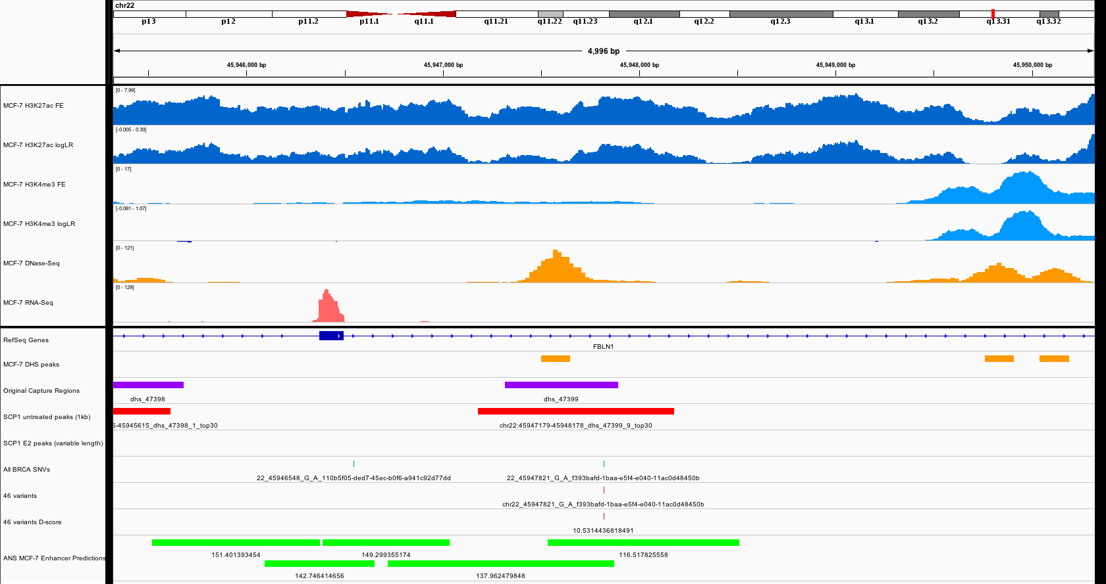
Notes:
DL: Good enhancer, Variant off centered

Slide 46
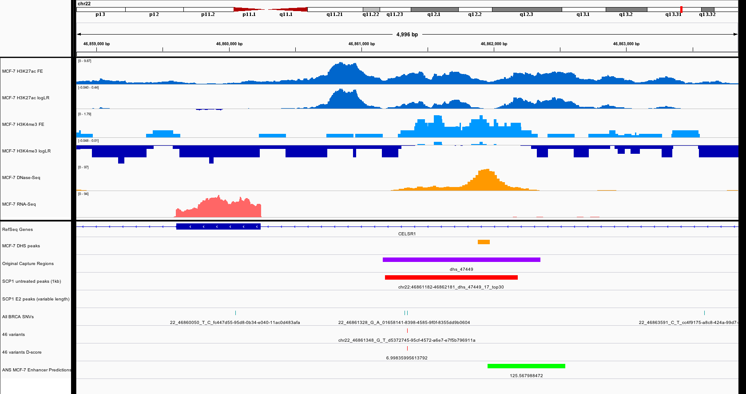
Notes:
DL: Good enhancer, Variant off centered

Slide 47
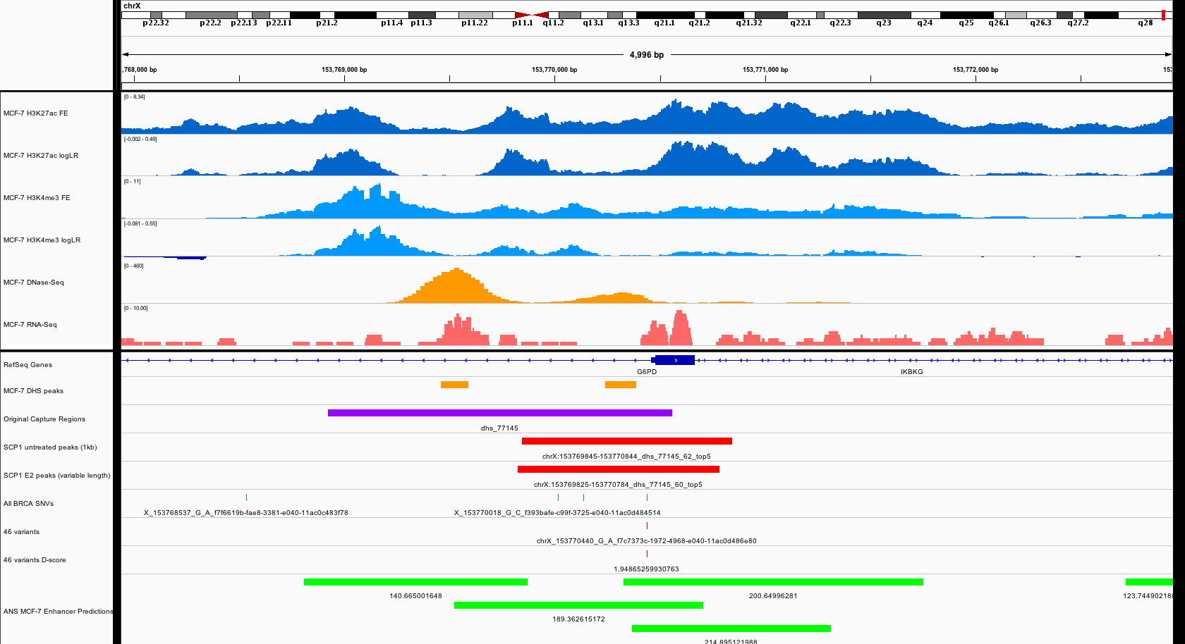
Notes:
DL: Bigger double peak to the left

