Slide 1
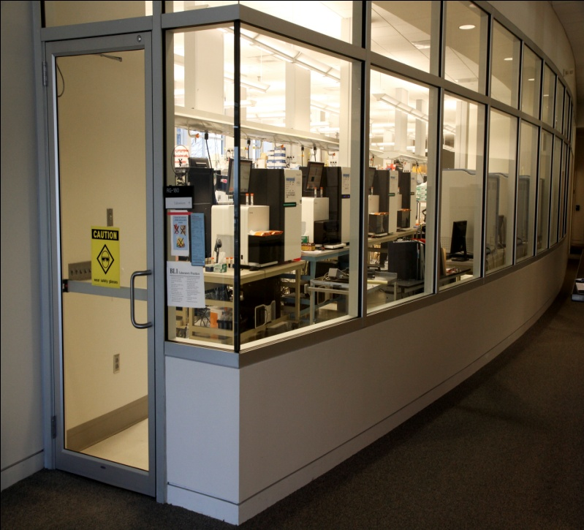
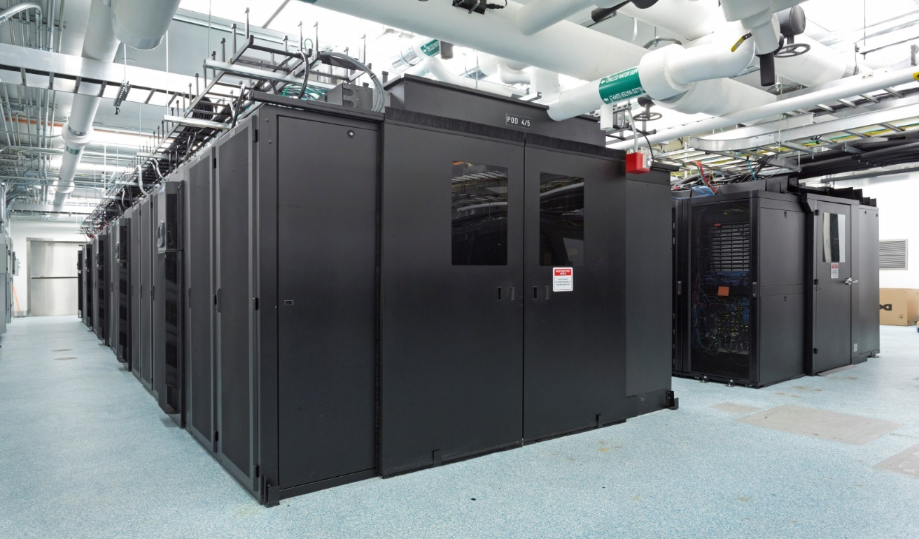
Yale Center for Genome Analysis
Production facility. 7,000 Sq Ft dedicated facility
5 Illumina 2500’s
2 Illumina 4000’s
1 Pac Bio
1 MiSeq
Dedicated computation infrastructure
3.5 Petabytes data storage
4500 cores HPC

Slide 2
Status of Mendelian Genetics, 2012
~20,000 Protein-coding genes in human genome
~3,000 different genes known to be mutated in
4,000 Mendelian phenotypes
Is that all there is?

Slide 3
Where are the ‘missing’ Mendelian traits?
  Unmapped/unrecognized Mendelian loci
    - Founder mutations that account for disease in
    population isolates
    - Dominant reproductive lethals caused
    by de novo mutations
  - Diseases with incomplete penetrance owing to obligatory environmental/genetic co-factor
  - Diseases caused by somatic mutations
  - Diseases with high locus heterogeneity

Slide 4
Exome Sequencing Costs, Fy 2016
Description | Exome Cost 14 samples/lane, 2x100 bp
Capture (7/one oligo pool)/Library Preparation cost
NimbleGen Capture Oligo Pool | $36
Labor | $57
Reagent and Supplies | $50
Instrument depreciation, Maintainance, Administration, IT etc | $12
Administrative/IT cost (3%) | $5
Sub Total Library Prep | $160
Sequencing Costs
Labor | $6
Sequencing reagents & supplies | $117
Instrument Depreciation | $24
Service contract, IT | $10
Primary data analysis/bioinformatics | $9
Administrative cost (3%) | $5
Sub Total Sequencing | $170
Grand total (Library+Sequencing) | $330

Slide 5
Partial list of YCMG Collaborators: Total 88 PIs, 66 institutions from 8 countries
Investigator | Institution Name | # of Projects | # of Samples
Ahmed, Zubair | Cincinnati Children's Hospt. | 1 | 58
Alp, Hande/Gunel, Murat | Guven Hospi./Yale Univ | 1 | 6
Aretz, Stefan | University Hospt-Bonn | 1 | 106
Ashley, Euan | Stanford Univ | 1 | 104
Brownstein, Catherine | Boston Children's Hospt. | 2 | 189
Choate, Keith | Yale Univ | 1 | 641
Choi, Murim | Seoul Univ. Hospt. | 1 | 127
Juhlin, Christopher | Karolinska Univ Hospt. Solna | 1 | 14
Chung, Wendy | Columbia Univ Med Ctr. | 5 | 188
Chung, Wendy & Various PIs/PCGC | Various | 1 | 287
Cotsapas, Chris | Yale Univ | 1 | 14
Crowley, William | Mass General Hospt. | 1 | 100
Dhawan/Mistry | King's College Hospt, London | 1 | 133
Elefteriades/Lifton | Yale Univ | 1 | 68
Fernandez/Bilguvar | Yale Univ | 1 | 13
Ferreira, Miguel | UnIGENe, IBMC, Univ. Porto | 1 | 10
Fingert, John | Univ of Iowa | 1 | 100
Garcia, Christine | UT Southwestern Med. Ctr. | 1 | 211
Gelb, Bruce | Mt. Sinai | 1 | 95
Gharavi, Ali | Columbia Univ | 1 | 960
Gleeson, Joseph | Univ of California, SD | 1 | 1140
Gorin, Michael | UCLA | 1 | 50
Grigorenko, Elena | Yale Univ | 2 | 21
Investigator | Institution Name | # of Projects | # of Samples
Gunel, Murat | Yale Univ | 7 | 1094
Hildebrandt, Friedhelm | Boston Children's Hospt | 1 | 1185
Hu, Jan | Univ of Mich Sch. of Dentistry | 1 | 33
Ishibe, Shuta | Yale Univ | 1 | 15
Karakaya/Seli/Gunel | Gazi Univ | 1 | 33
Knowles, Michael | UNC-Chapel Hill | 1 | 81
Kruer, Michael | Sanford Health | 2 | 102
Larsen, Chris | Nephropath | 1 | 14
LeMaire, Mathieu | Yale Univ | 2 | 89
Lifton, Richard | Yale Univ | 4 | 1281
Mani, Arya | Yale Univ | 1 | 220
Marshall, Jan | Jackson Lab | 1 | 36
Morris, Laila | UC Davis Health Sys. | 1 | 4
Muhammed, Tariq | Indiana University | 1 | 3
Parkeh, Rulan | Hospt.for Sick Children | 1 | 14
Pollak, Martin | Beth Israel Deaconess Med. Ctr. | 2 | 312
Sahin, Mustafa | Boston Children's Hospt. | 2 | 25
Sarfarazi, Mansoor | Univ of CT Health Ctr. | 1 | 150
Seidman, Christine | Brigham and Women's Hospt. | 1 | 212
Somlo, Stefan | Yale Univ | 1 | 160
Thaker, Vidhu | Boston Children's Hospt. | 1 | 50
Topaloglu, Kermal | Cukurova Univ | 1 | 29
Total |  | 65 | 9788

Slide 6
Summary of Years 1-4
Discovery type | Conclusive (TIER1) | Suggestive (TIER2) | Total
Total novel | 284 | 160 | 444
Novel gene | 205 | 140 | 345
Known gene, Novel/Unexplained phenotype | 33 | 5 | 38
Known gene, phenotype expansion | 46 | 15 | 61
Known gene, known phenotype | 225 | 32 | 257
Total number of discoveries | 509 | 192 | 701
# exomes completed | 9,749
Total Number of phenotypes | 366
Number of phenotypes related to NHLBI | 60
Number pf collaborating investigators | 80
Number of institutions | 66
Number of countries | 6
Total number of publications | 56

Slide 7
Data release/sharing
- dbGaP (v4, pending approval): 1929 samples have been submitted.
- GeneMatcher: 361 genes (all Tier-2 genes discovered) have been submitted.
- Geno₂MP: 1,338 samples have been submitted. 9749 samples have been recalled using our most current pipeline
- Published disease-causing mutations being put into ClinVar

Slide 8
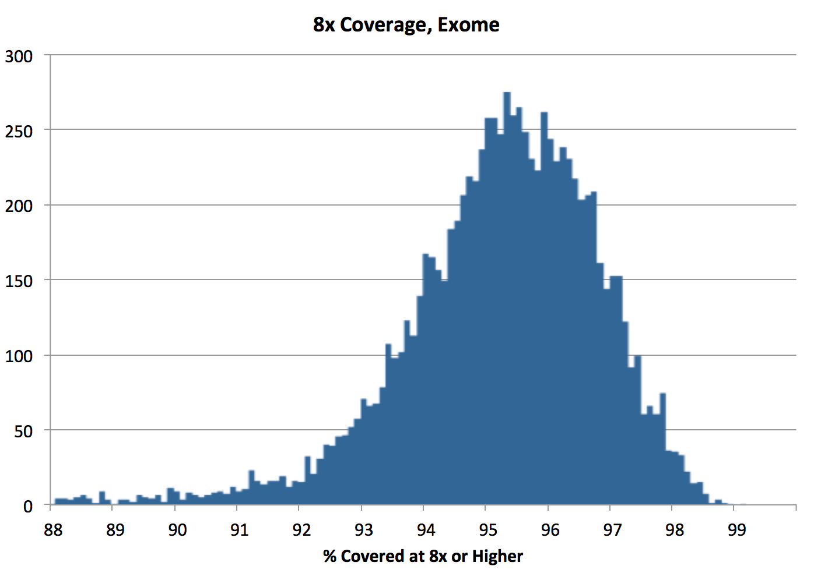
YCMG Exome Coverage
Exome coverage of 9,749 CMG exomes
  Percent of bases with > 8 independent reads
  (proxy for sensitivity for heterozygote detection)

Slide 9
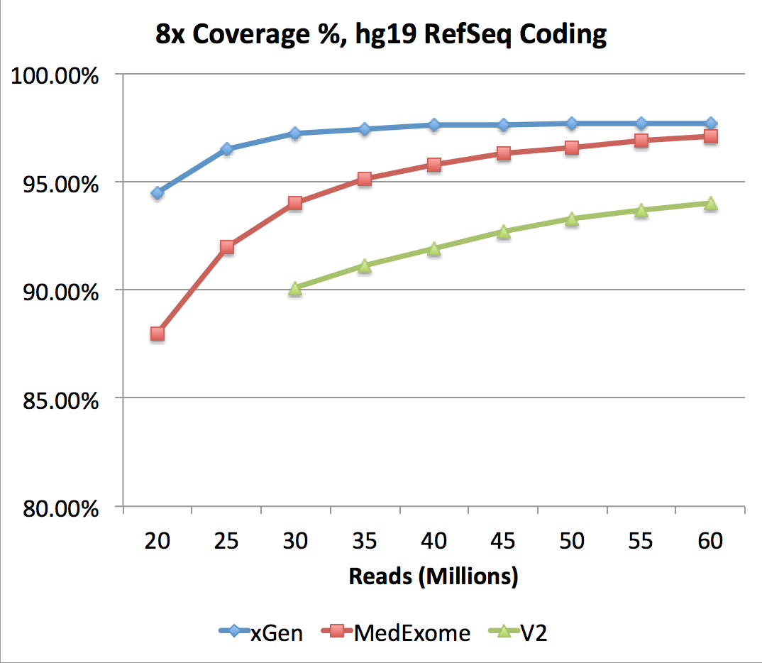
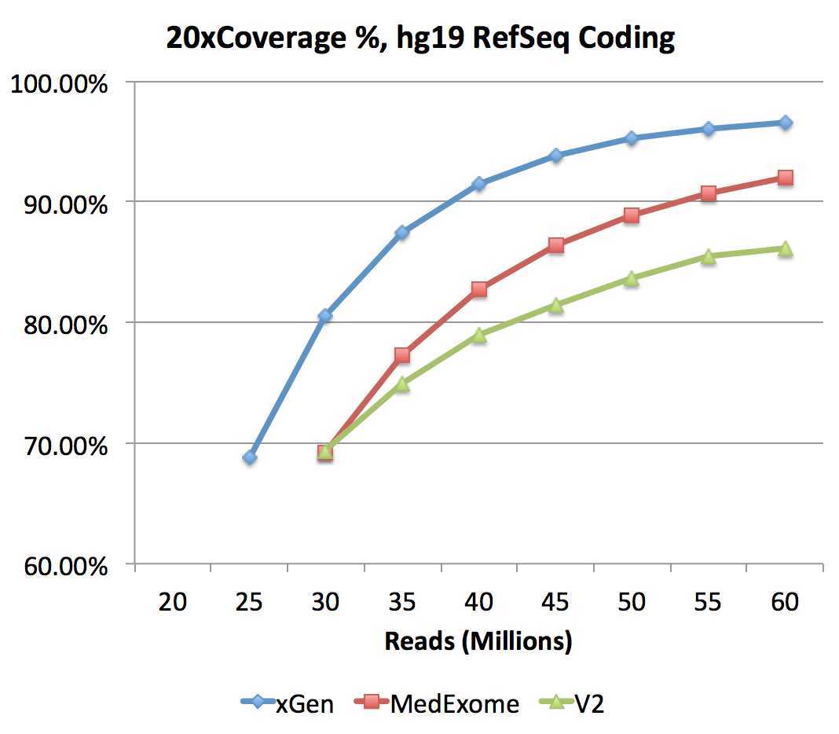
Exome Kits: V2, MedExome, xGen
Comparison of Nimblegen’s V2 and MedExome kits and IDT’s xGen kit

Slide 10
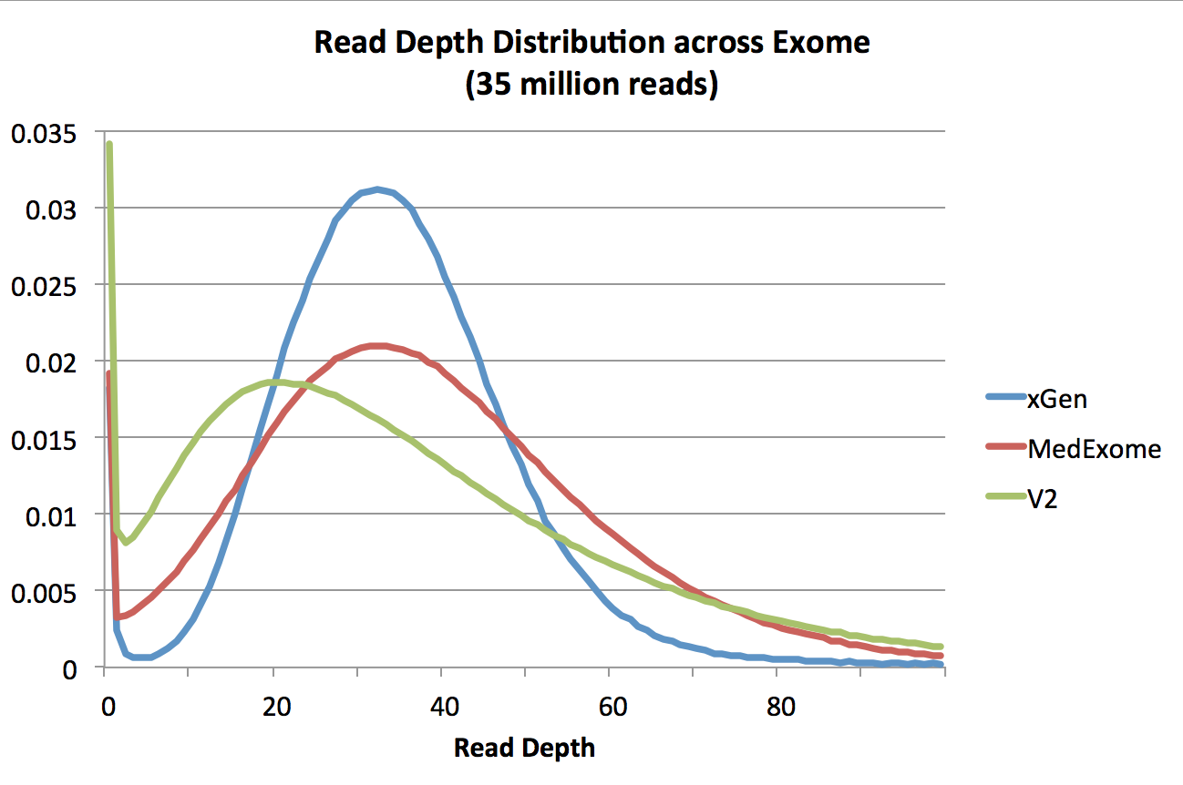
Exome Kits: V2, MedExome, xGen
Comparison of Nimblegen’s V2 and MedExome kits and IDT’s xGen kit

Slide 11
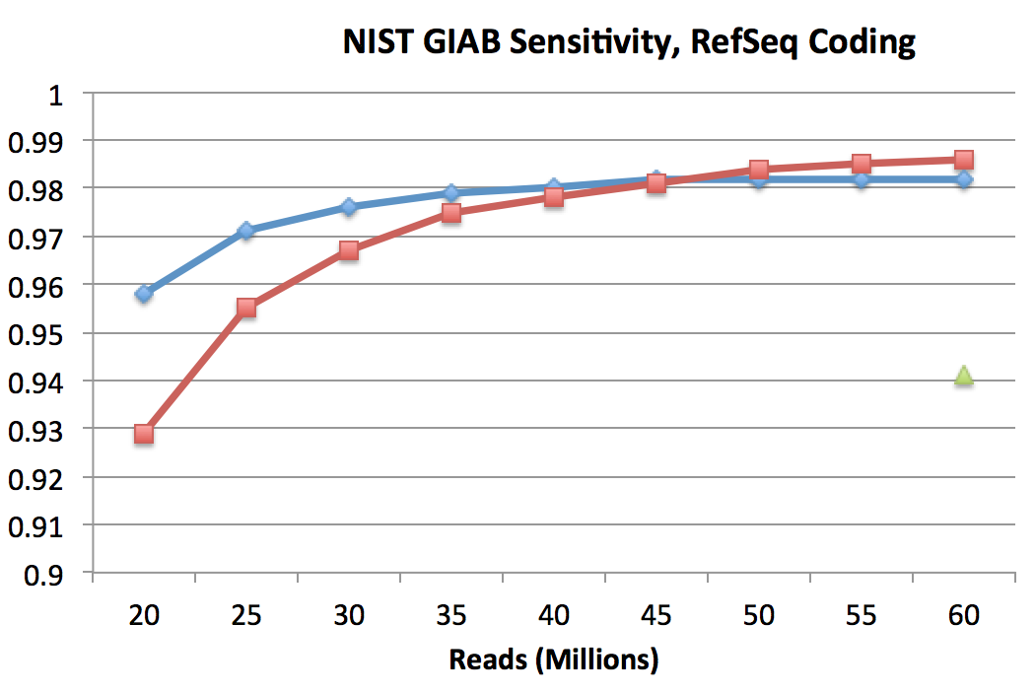
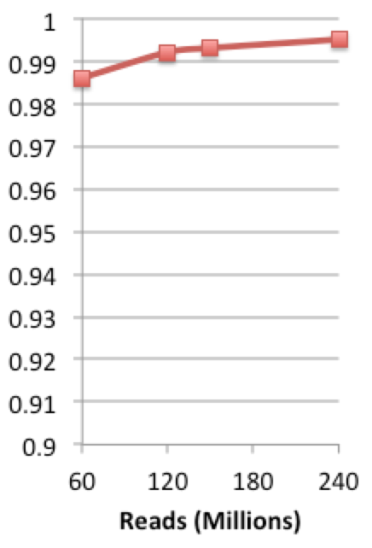
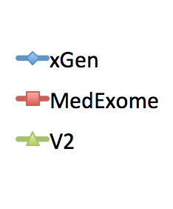
MedExome Coding Region Accuracy
Comparing NA12878 variant calls against NIST “Gold” standard
  Intersection of RefSeq coding regions and NIST high confidence regions
WGS
WGS

Slide 12
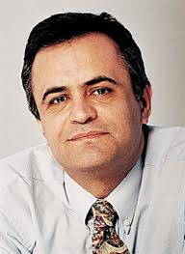
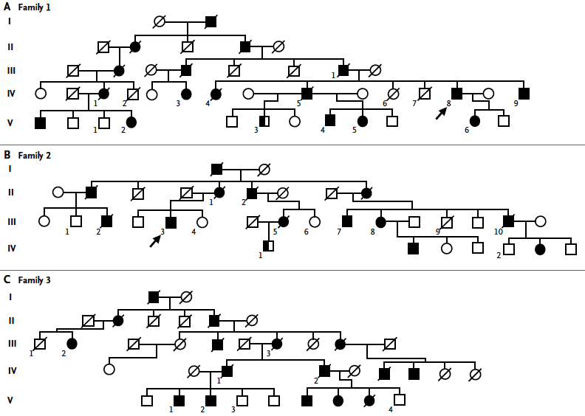
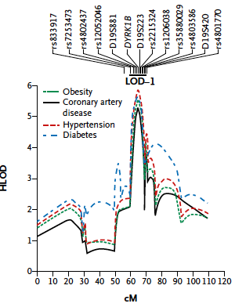
Founder mutation in DYRK1B causes early coronary artery disease, obesity, hypertension and diabetes
Early CAD (mean age onset 44)
Obesity (mean BMI 33)
Diabetes (mean FBS 175 mg/dl)
Hypertension (mean SBP 175 mg/dl)
Arya Mani
Keramati et al. NEJM, 2014

Slide 13
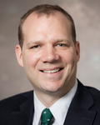
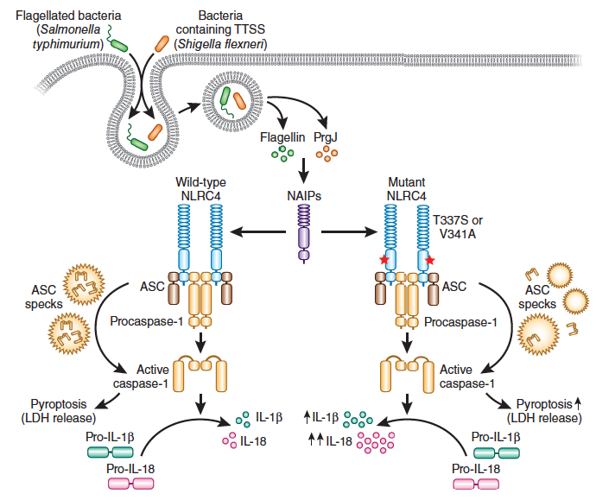
New autoinflammatory disease due to de novo mutation in NLRC4, a core inflammasome protein
Neil Romberg
Clinical features: neonatal enterocolitis with life-threatening
autoinflammation, periodic fevers, high serum IL-1β and IL-18
Gain of function mutation in NLRC4 results in constitutive inflammasome
formation, accounting for high cytokine levels, fever and inflammation
+/+
+/+
+/+
D/+
+/+
+/+
D/+
+/+
D/+
Nature Genetics, 2014

Slide 14
Mapping-free strategy for trait locus discovery
Sequence cohorts of probands with putative Mendelian trait
Identify rare de novo or transmitted LOF and damaging missense variants (e.g. allele frequency in outbred populations < 0.001 for recessive traits, < 1/50,000 for dominant traits).
Identify genes harboring significantly greater burden than expected by chance
Bias toward coding region for cost and yield

Slide 15
Mutations in adrenal glomerulosa K+ channels, Ca2+ channels and Cl- channels cause Mendelian hypertension
Resting
Normal activation
Mutant activation
Science, 2011, Nature Genetics 2013, eLife, 2015

Slide 16

Mendelian forms of steroid-resistant nephrotic syndrome
CoQ₁₀ biosynthesis
Nucleus
    Identification of single-gene disease-causes allowed the discovery of essential components of glomerular function.
RECESSIVE
NUP205
ADCK4
Mitochondria
WT1
DOMINANT
COQ6
COQ2
FH lab
LMX1B
NFX5
PDSS2
MTTL1
SMARCAL1
Actin regulation by
Rho/Rac/Cdc42
FH lab with Yale GC
NUP93
XPO5
Lysosome
New:
CRB2
Actin binding proteins
SCARB2
MAGI2
ITSN1
TENC1
ITSN2
Slit membrane
DLC1
CDK20
MYO1E
ARHGAP24
CRB2
FAT1
ARHGDIA
β-DG
V
Actinin-α4
MYH9
ANLN
CD2AP
Nephrin
KANK1,2,4
P
INF2
IQGAP
NEPH-1
PTPRO
T
Podocin
Nephrin
PLCE1
Rho/Rac/CDC42
NEPH -2
α-DG
EMP2
TRPC6
ITGB4
ITGA3
GBM
LAMB2
Integrin/Laminin
Endothelial Cell
Notes:
The acceleration of next generation sequencing identification has permitted identification of more than 40 monogenic causes of SRNS, and this number is rapidly increasing.
This slide depicts as red or blue labels, proteins encoded by monogenic genes that cause STEROID RESISTANT NEPHROTIC SYNDROME (SRNS), if mutated, where each single protein alone is essential to maintain glomerular function,
Red colored proteins are the products of recessive genes, blue proteins belong to dominant genes.
In this way, identification of monogenic disease genes allowed the assembly of essential components of glomerular function.
Genes discovered in FH lab in yellow font,
Genes discovered together with Yale GC in blue font (on red = recessive).
Fascinatingly, the encoded proteins begin to map back onto distinct structural protein complexes and signaling pathways that reveal what is essential for glomerular function.
These functional complexes include actin binding proteins, laminin/integrin signaling components, actin regulating small GTPases, lysosomal proteins, transcription factors, and more recently, proteins of Coenzyme Q10 biosynthesis.

Slide 17
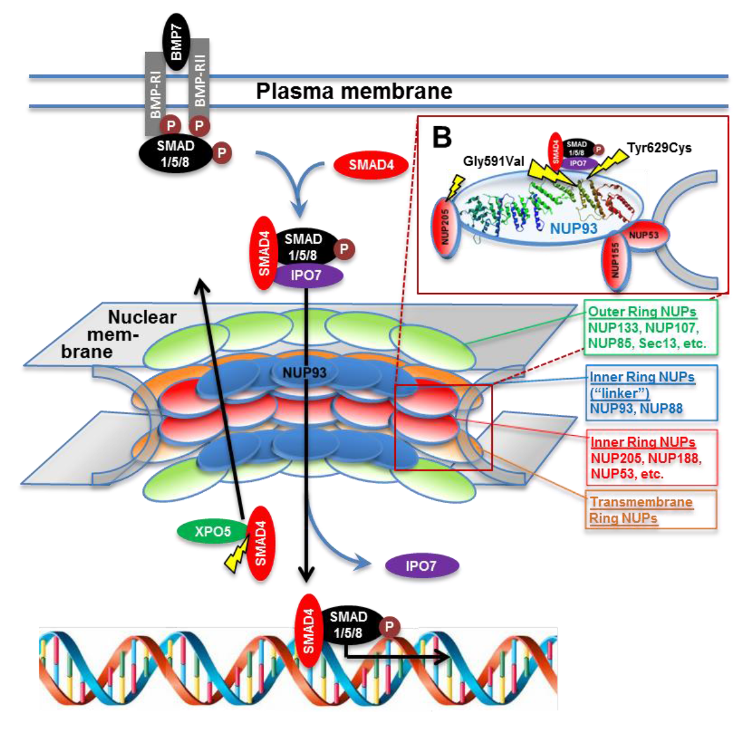
(Braun et al. Nat Genet 48:457-65, 2016)
Notes:
17
Supplementary Fig. 4. Interaction of nuclear pore complex (NPC) proteins NUP93 and NUP205 with SMAD, importin7 (IPO7), and exportin5 (XPO5) showing positions of mutations that abrogate interactions.
(A) Subcomplexes of the NPC are depicted and labeled in different colors.
(B) Inset from (A): NUP93 and NUP155 are tethered to the nuclear membrane by NUP53. 3D structure of NUP93 is shown in relation to likely positions of interaction with NUP205, IMP7 or SMADs. Position of NUP93 and NUP205 mutations that abrogate the interaction and were found in individuals with SRNS are marked by yellow lightning signs.
(C) BMP7 binding to its receptor causes phosphorylation of SMAD1/5/8, resulting in dissociation from the receptor and binding to SMAD4. The SMAD4/1/5/8 complex interacts with importin7, enabling the SMAD complex to enter the nucleus through the NPC via NUP93 interaction, bind to cognate DNA sites, and initiate transcription of SMAD downstream targets.
(D) XPO5 binds to SMAD4 for nuclear export. Deletion of the nuclear export signal of SMAD4 abrogates interaction with XPO5.

Slide 18
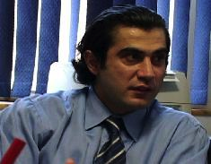
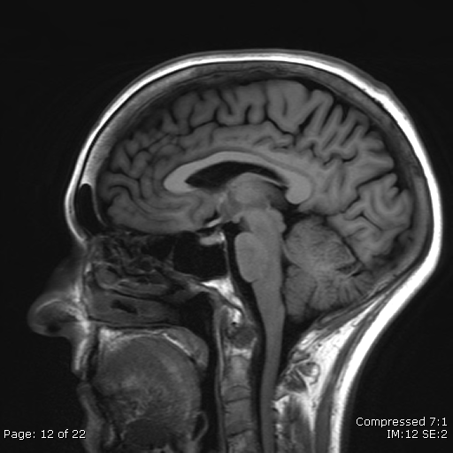
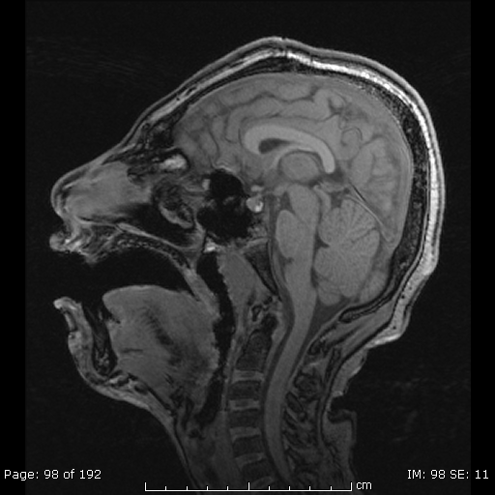
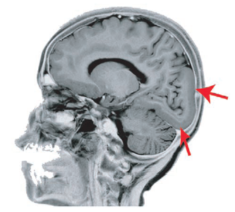
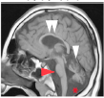
Genes essential for development of human neocortex identified by exome sequencing of subjects from consanguineous union
Normal 3 year-old
Murat Gunel
Joe Gleeson
Mutations in WDR62
Mutations in LAMC3
Mutations in CLP1

Slide 19
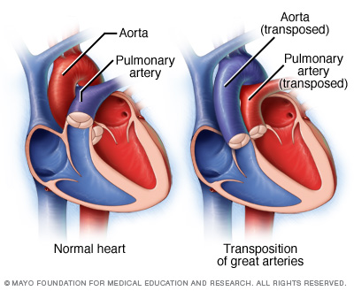
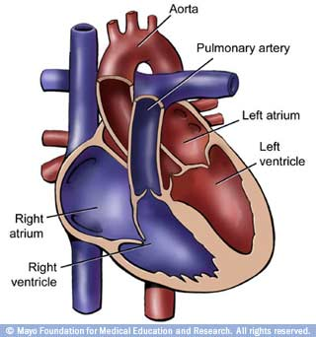
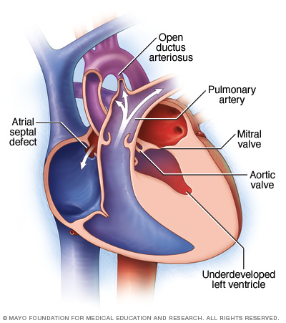
De novo mutations in congenital heart disease (NHLBI Pediatric Cardiac Genetics Consortium)
Normal heart
Transposition
Tetralogy of Fallot
Hypoplastic left heart syndrome
Most common birth defect (0.8% of live births)
Without intervention, severe cases (conotruncal defects, left ventricular outflow defects, left-right patterning defects) often fatal in first years of life
Many cases sporadic, suggesting role for de novo mutations
Sequenced 1228 case trios, 900 healthy control trios
- All singleton cases without family history
Identified de novo mutations

Slide 20
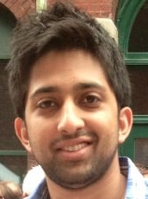
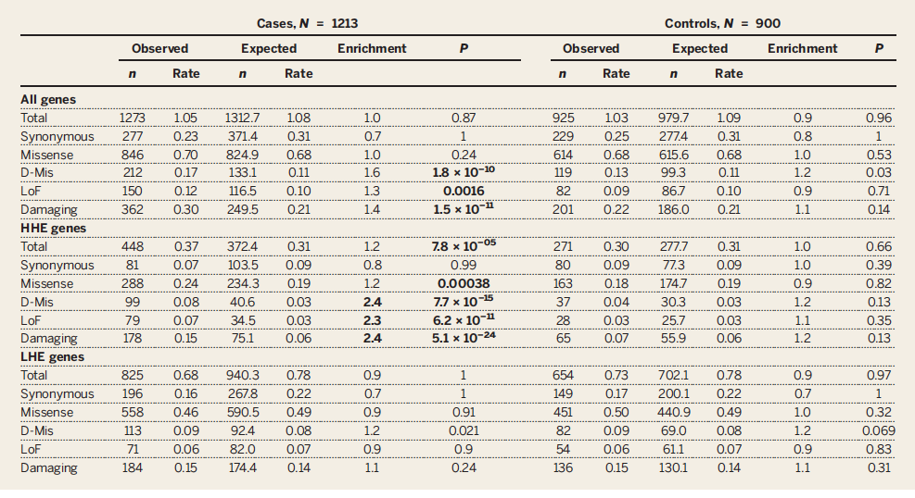
De novo mutations in congenital heart disease enriched in genes highly expressed in developing mouse and human heart
Nature, 2013; Science, 2015

Slide 21
Enrichment of de novo LOF mutations in chromatin modifying genes in CHD
- 153 LOF de novo mutations in CHD Cohort
- Most enriched term (GO): Histone modification, (FDR q = 9 x 10⁻⁵, Enrichment = 6.5)
De Novo Mutations in Chromatin Modification Genes | # of de novo variants |  | # of de novo variants per subject |  | Odds Ratio | P-value
 | CHD | Controls | CHD | Controls
 | N=1228 | N=900 | N=1228 | N=900
Silent | 1 | 4 | 0.001 | 0.004 | 1.0 | 0.17
Protein-Altering | 52 | 13 | 0.042 | 0.014 | 16 | 0.0002
Non-damaging MS | 13 | 6 | 0.011 | 0.007 | 8.7 | 0.49
Damaging MS | 16 | 6 | 0.013 | 0.007 | 10.7 | 0.2
Damaging. MS. and LOF | 39 | 7 | 0.032 | 0.008 | 22.3 | 0.00013
LOF | 23 | 1 | 0.019 | 0.001 | 92 | 4.1×10⁻⁵

Slide 22
21 genes have LOF mutations in both autism and CHD (p < 10⁻⁶); 66 have LOF or damaging missense mutations in both (p < 10⁻¹¹)
Chromatin Modification Gene
Gene | Intolerance (%) | Heart Expression (E14.5, %) | Brain Expression (PFC, periods 3-6 ,%) | Congenital Heart Disease (N=1,228) |  |  | Autism (N=3,874)
 |  |  |  | # of LOF + D-mis | # D-mis | # LOF | # of LOF + D-mis | # D-mis | # LOF
ARID1B | 0.8 | 82.7 | 73.0 | 1 | 0 | 1 | 6 | 1 | 5
KDM5B | 2.5 | 85.6 | 93.4 | 3 | 0 | 3 | 6 | 3 | 3
KDM6B | 4.8 | 94.5 | 88.0 | 1 | 0 | 1 | 3 | 1 | 2
EP300 | 0.3 | 87.8 | 80.5 | 1 | 0 | 1 | 2 | 1 | 1
MLL3 | 0.9 | 79.4 | 62.6 | 1 | 0 | 1 | 2 | 1 | 1
POGZ | 3.4 | 83.3 | 84.3 | 2 | 1 | 1 | 4 | 1 | 3
TLK2 | 34.3 | 70.7 | 60.9 | 1 | 0 | 1 | 2 | 1 | 1
KAT6A | 0.5 | 88.5 | 80.9 | 1 | 0 | 1 | 1 | 0 | 1
ASH1L | 2.2 | 86.6 | 74.9 | 1 | 0 | 1 | 2 | 0 | 2
WHSC1 | 4.5 | 88.6 | 77.7 | 1 | 0 | 1 | 1 | 0 | 1
CUL3 | 43.3 | 82.4 | 77.4 | 1 | 0 | 1 | 2 | 0 | 2
NAA15 | 10.3 | 96.7 | 66.8 | 2 | 0 | 2 | 2 | 1 | 1
NOTCH1 | 0.3 | 87.5 | 45.3 | 2 | 1 | 1 | 1 | 0 | 1
NCKAP1 | 5.8 | 91.3 | 96.2 | 1 | 0 | 1 | 2 | 0 | 2
UBR3 | 7.7 | 87.0 | 74.5 | 1 | 0 | 1 | 2 | 0 | 2
SPRED2 | 15.2 | 61.0 | 68.1 | 1 | 0 | 1 | 1 | 0 | 1
TANC2 | 0.7 | 83.9 | 90.0 | 1 | 0 | 1 | 2 | 1 | 1
LRRFIP1 | 83.0 | 96.3 | 49.6 | 1 | 0 | 1 | 1 | 0 | 1
CTNNB1 | 18.4 | 99.0 | 95.4 | 1 | 0 | 1 | 1 | 0 | 1
KIAA0100 | 73.4 | 95.2 | 88.4 | 1 | 0 | 1 | 1 | 0 | 1
ZNF292 | 6.3 | 76.5 | 80.3 | 1 | 0 | 1 | 1 | 0 | 1
Notes:
We therefore

Slide 23
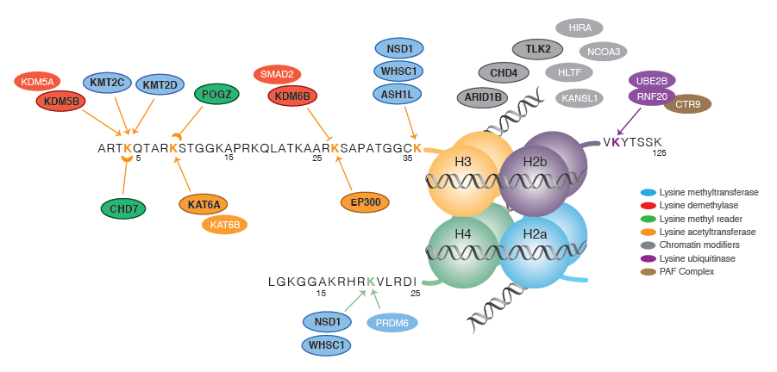
Chromatin modifiers with de novo mutations in CHD show striking overlap with genes mutated in autism

Slide 24
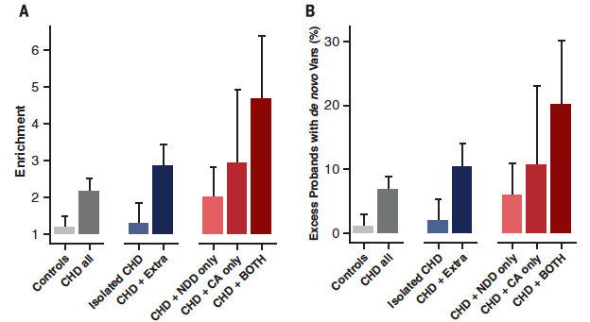
Enrichment for de novo damaging mutations restricted to CHD patients with neurodevelopmental and other congenital abnormalities
E-15
E-3
E-18
E-3
E-10
0.1
0.1

Slide 25
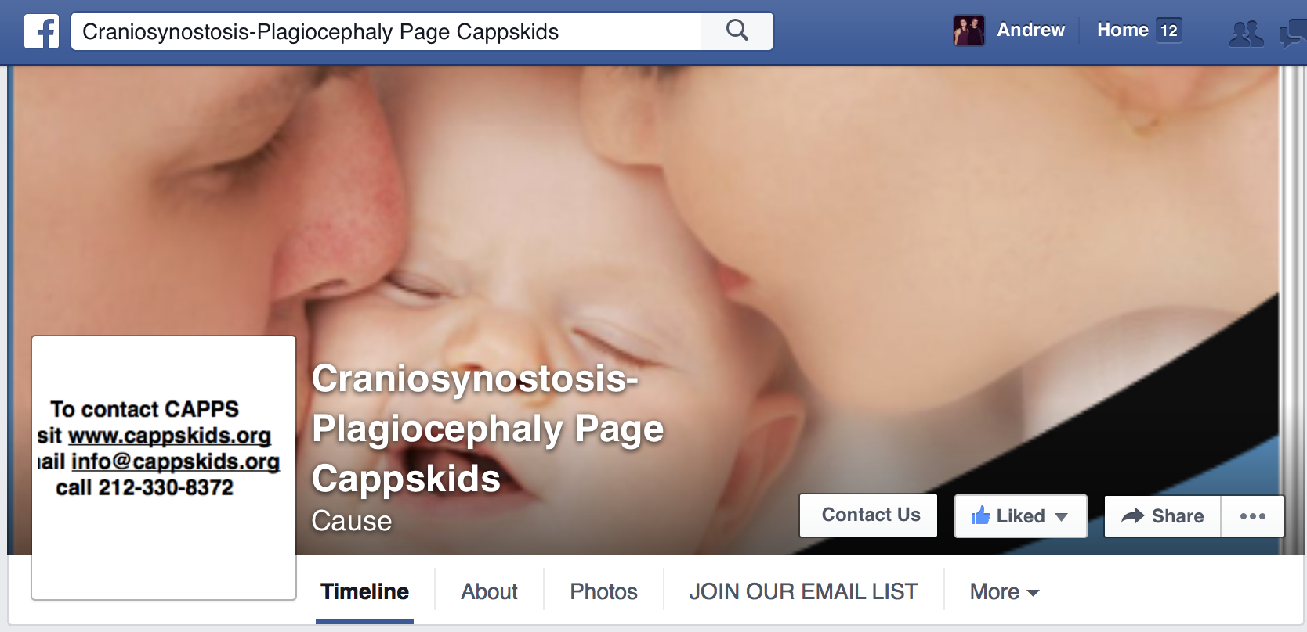

Patient Recruitment by Social Media

Slide 26
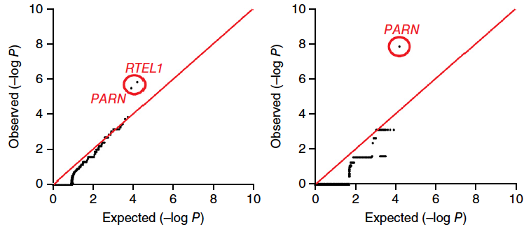
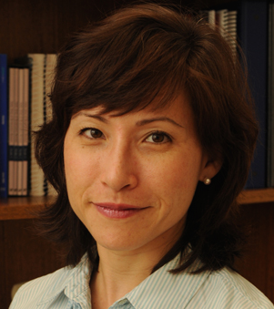
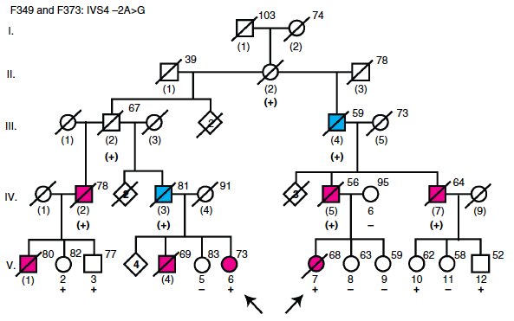
Gene-environment interaction: Mutations in PARN and RTEL1 cause pulmonary fibrosis and short telomeres
All protein-altering
Damaging only
Chrisitine Garcia
UTSW
Environmental exposures among affecteds: 60% smokers; chicken farmer/bird breeder (4), welder (2), mason (2), Feed miller (2), farmer (3), cattle farmer, other construction (2)
Nature Genetics, 2015

Slide 27
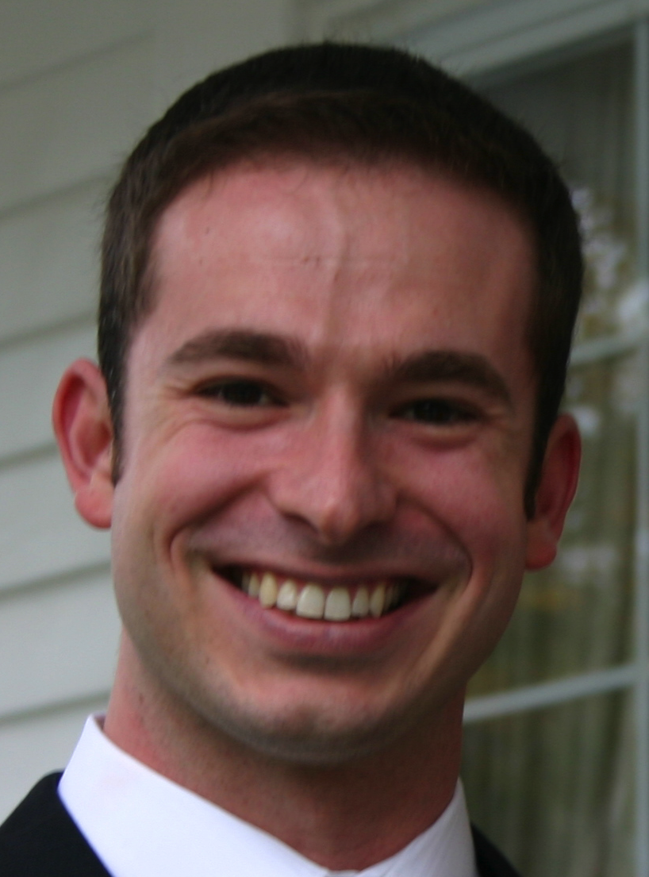
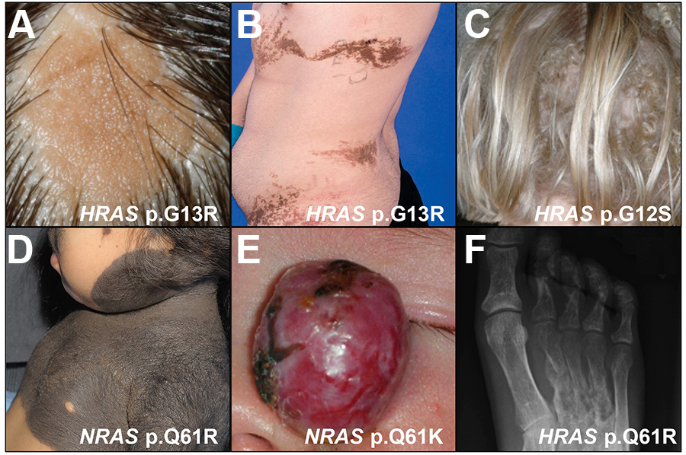
Somatic activating RAS mutations cause: a. nevus sebaceous; b. epidermal nevi; c. wooly hair-epidermal nevus syndrome; d. giant melanotic nevus; e. giant capillary hemangioma; f. cutaneous-skeletal hypophosphatemia
Keith Choate

Slide 28
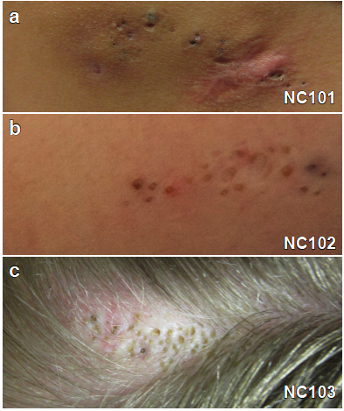
Nevus Comedonicus
Typically linear configuration of comedones which intermittently become inflamed.
Rarely syndromic with ipsilateral cataracts and skeletal abnormalities.
All subjects present at birth with a smooth patch, comedones develop in childhood.
Known causes of linear acne:
Munro’s acne nevus – FGFR2
Comedones are the primary lesions of common acne.

Slide 29
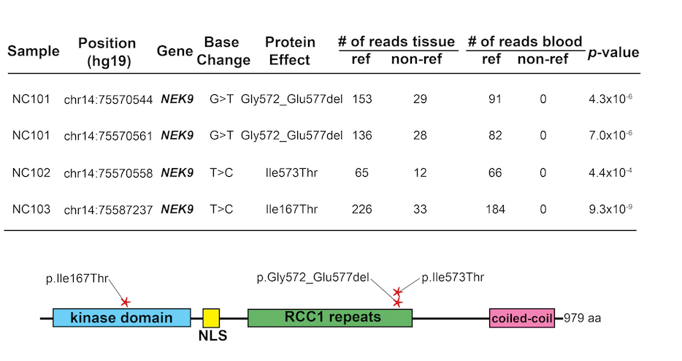
Somatic NEK9 mutations cause Nevus Comedonicus
RCC1 domain binds kinase domain; deletion increases activity.
Clustered mutations suggest gain of function

Slide 30
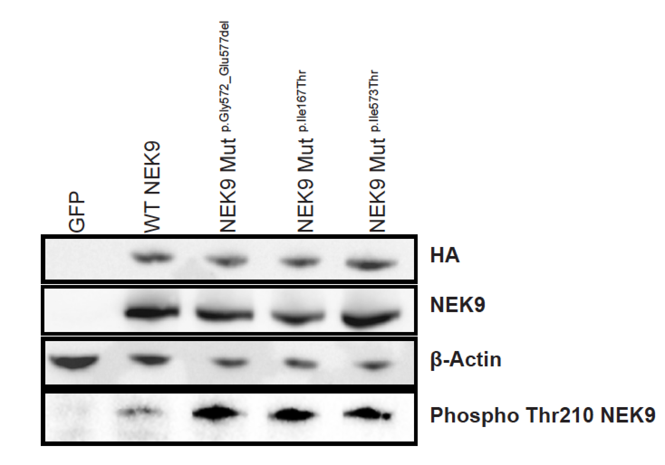
NEK9 Somatic Mutations Increase Activating Phosphorylation at Thr210
Kinase and RCC1 domain mutations lead
to increased phosphorylation.

Slide 31
Lessons learned and to do list
Vast majority of our new locus discoveries have come from families not previously recognized to segregate Mendelian traits
  Motivates ‘brute force’ strategy: sequence large numbers
  of probands, rely on mutation burden for statistical
  significance. Requires low cost per sample.
    - Prioritize extreme phenotypes
    Phenotypes in which Mendelian loci have been
    identified previously, remaining unsolved families
Path to determine the consequence of mutation of every
gene in the human genome and identify genes and pathways a with greatest potential for development of new diagnostics
and therapeutics

