Slide 1
Genomes to exomes (and other technologies): what and when?
Daniel MacArthur

Slide 2
What are we missing with exome?
Truly missed by exome:
  Non-coding/poorly-covered variants
  Many classes of structural variant
Needs better variant-calling:
  Structural variants generally
  Indels, especially medium-sized insertions
Needs better annotation:
  Many non-canonical splice variants
  Exotic annotation classes (e.g. start-gained)
Broader interpretation challenges:
  Mis-specified inheritance; digenic; etc.

Slide 3
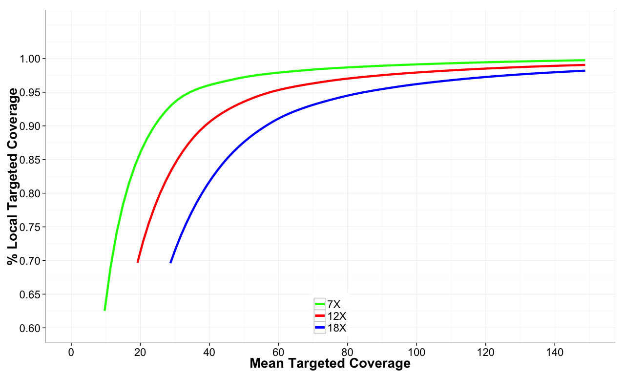
Exome coverage vs sensitivity
hom-ref calls
het indels
het SNPs

Slide 4

What do we gain from WGS?
Our experience so far: 110 genomes from
41 prior-unsolved families → 30X WGS
To date only 5 of these families has been solved:
  3 inversions with intronic breakpoints (one single-exon, two gene-breaking) – all DMD
  one single-exon duplication, missed by a prior MLPA screen (!) – in DMD
  one case where variant known but pathogenicity uncertain until WGS ruled out alternatives
WGS useful, but not transformative
Monkol
Lek

Slide 5
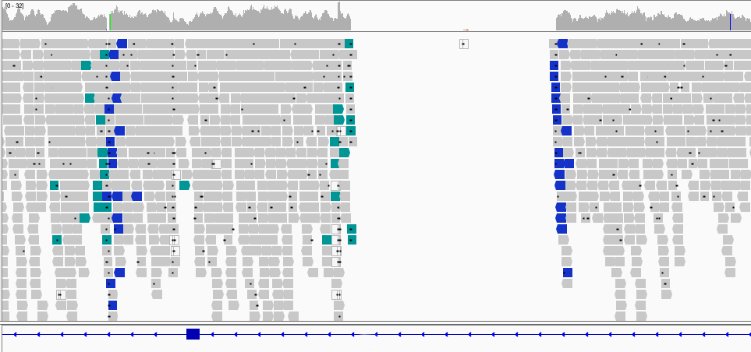
Complicated rearrangement involving
a single exon

Slide 6
Cause: an exon inversion
exon
Deletion ~3.5 kb
Deletion 42 bp
Inversion ~4.2 kb
exon

Slide 7

RNA sequencing
Our work: 38 exome-unsolved muscle
disease families, RNA from muscle biopsy
  RNA-seq solved 15/38 exome-unsolved cases with variants in known genes
  3 extended splice variants
  2 exonic splice variants (one missense, one silent)
  7 cases with 4 unique intronic splice-gain variants (4 cases with same independent de novo)
  3 cases pointing to SV, confirmed by WGS
  One additional likely new disease gene with de novo extended splice site variant → exon loss
but requires access to appropriate tissue
Beryl
Cummings

Slide 8
Discovery of intronic splice-creating variant
2 patients with “collagen 6 myopathy look alike” phenotypes that had gone through
clinical COL6 sequencing, deletion/ duplication testing and WES/WGS
168
Patient 1
215
27
43
159
151
Patient 2
214
14
37
163
47
Control
63
55
COL6A1
Notes:
Myopathy, elevated CK< contractures, distal hyperlaxiy

Slide 9
Discovery of intronic splice-creating variant
2 patients with “collagen 6 myopathy look alike” phenotypes that had gone through
clinical COL6 sequencing, deletion/ duplication testing and WES/WGS
168
Patient 1
215
27
43
159
151
Patient 2
214
14
37
163
47
Control
63
55
COL6A1

Slide 10
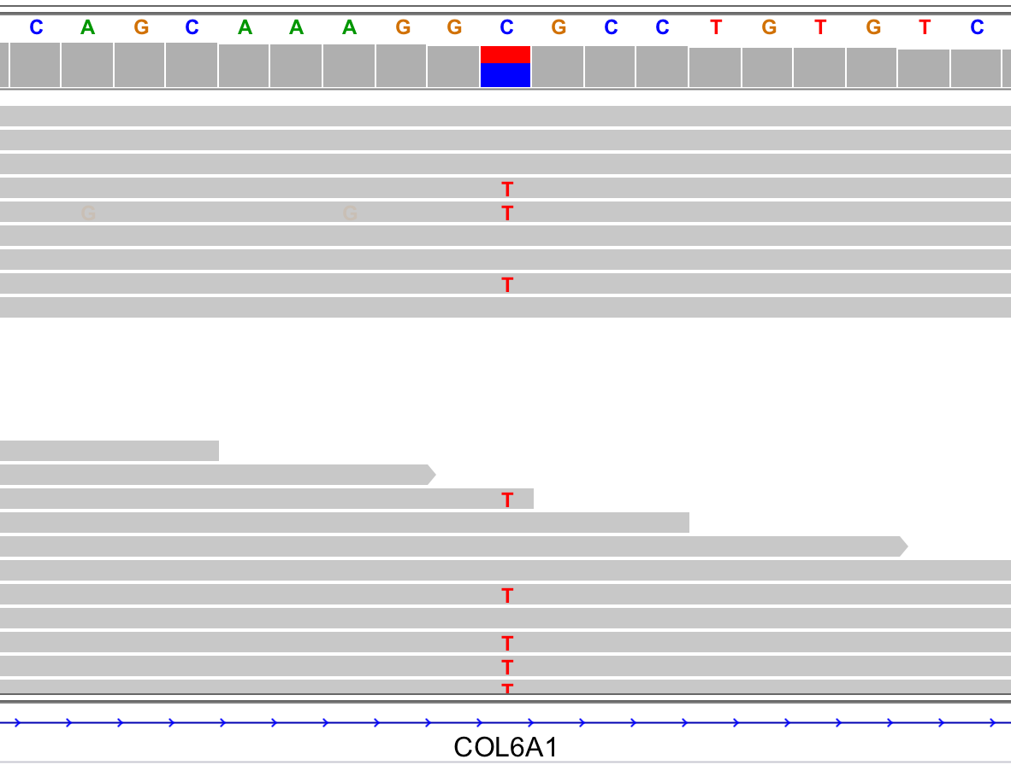
Discovery of intronic splice-creating variant
GC>GT variant
Creates donor splice site
168
Patient 1
215
27
43
159
151
Patient 2
214
14
37
163
47
Control
63
55
COL6A1

Slide 11
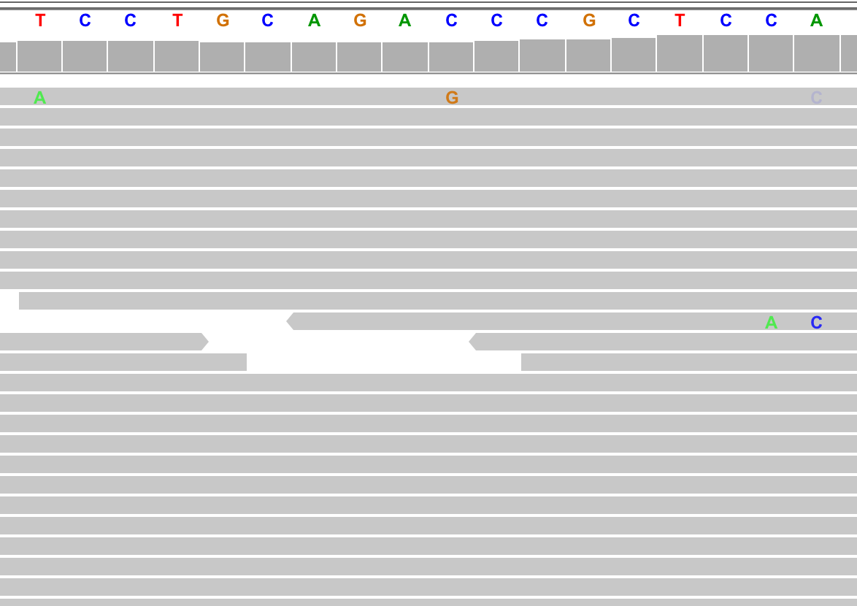
Discovery of intronic splice-creating variant
AG acceptor splice
site activated
GC>GT variant
Creates donor splice site
168
Patient 1
215
27
43
159
151
Patient 2
214
14
37
163
47
Control
63
55
COL6A1

Slide 12
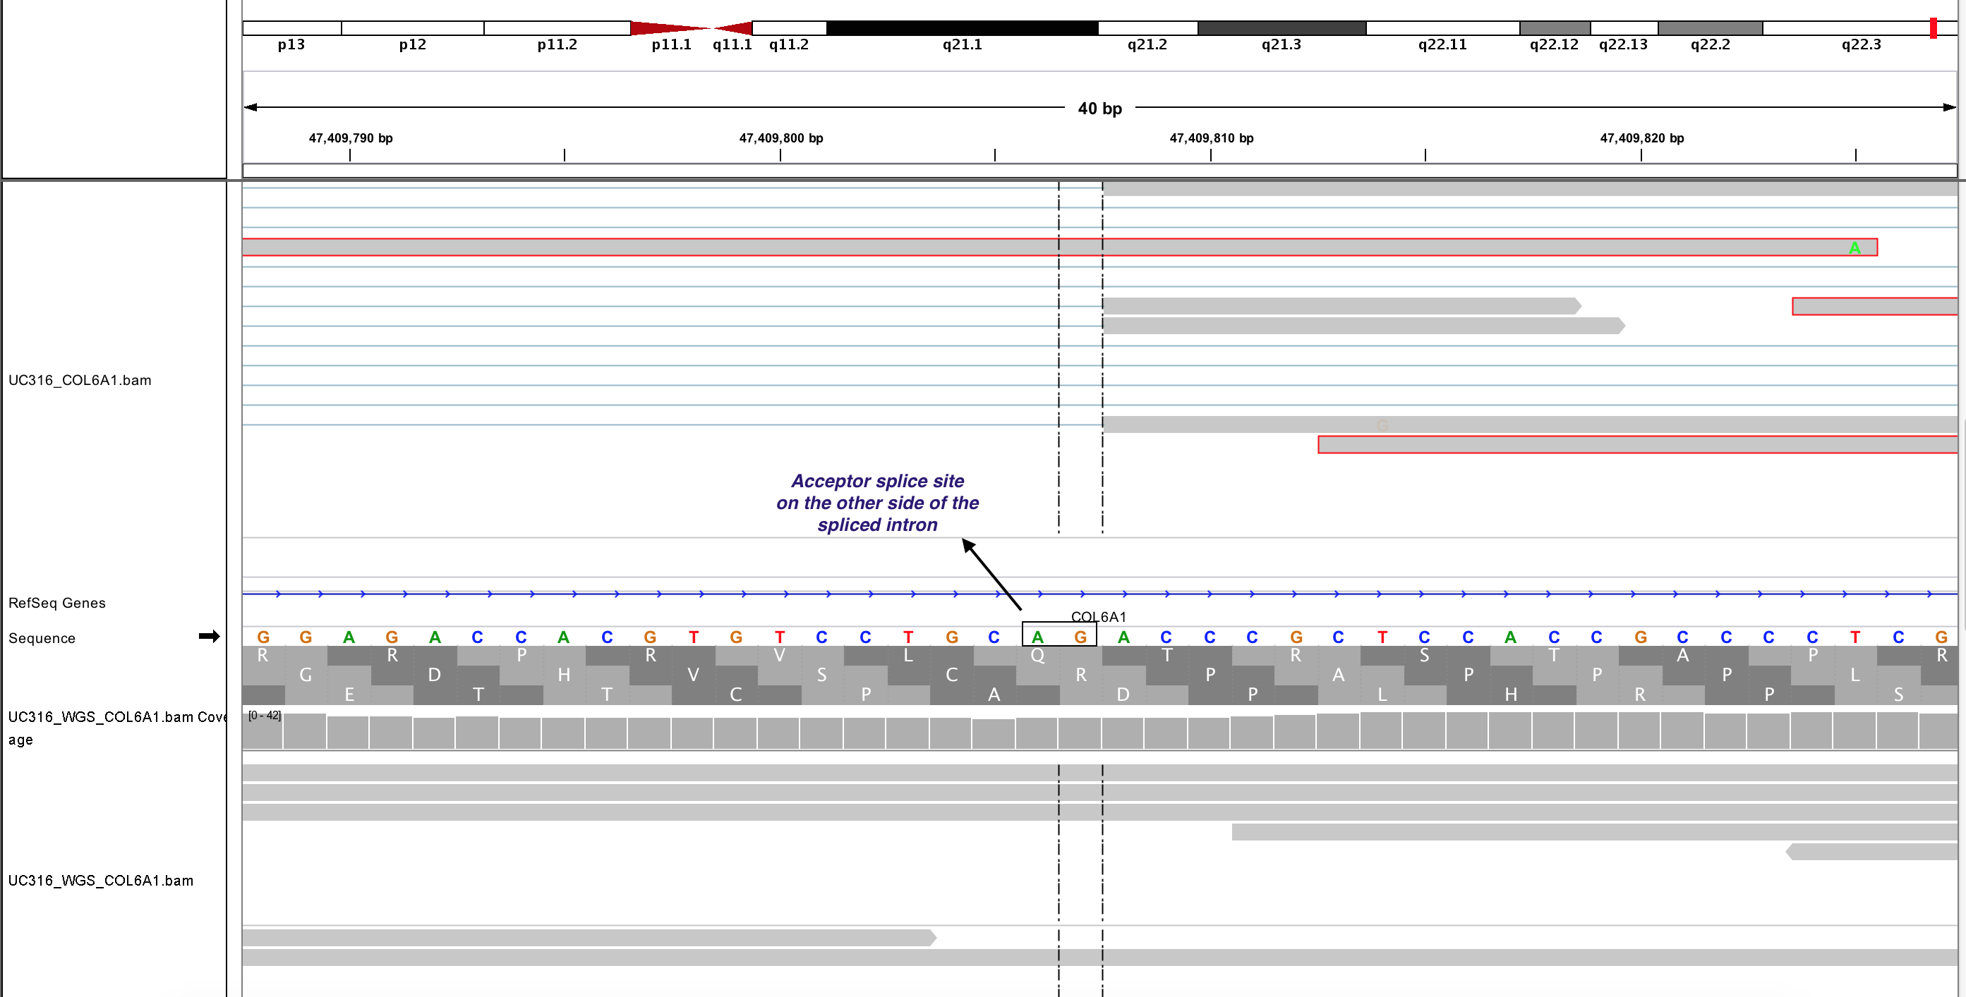
Discovery of intronic splice-creating variant
Intron inclusion disrupts glycine-glycine repeats in COL6A1
Beryl Cummings
168
Patient 1
215
27
43
159
151
Patient 2
214
14
37
163
47
Control
63
55
COL6A1

Slide 13
Discovery of intronic splice-creating variant
Intron inclusion disrupts glycine-glycine repeats in COL6A1
8 additional patients identified with the same pathogenic variant through screening a larger exome-unsolved collagen myopathy patient
Beryl Cummings
168
Patient 1
215
27
43
159
151
Patient 2
214
14
37
163
47
Control
63
55
COL6A1

Slide 14
Other technologies
10X Genomics:
  can be applied to both exome and genome
  dramatically improves phasing (virtually all genes completely phased)
  should hugely improve SV calls and mapping of genes with similar pseudogenes
  pilot currently under way: 50 cases with known SVs and causal variants in repeat regions
Other long reads: PacBio, Oxford Nanopore

Slide 15
Questions for today
What experiences have other centers had with WGS?
What factors need to be considered in deciding which exome-unsolved families to pursue with WGS?
When would WGS become the appropriate front-line test?
Any other technologies we should be considering as a consortium?

