Slide 1

Protein Design and Structure Prediction based on Evolutionary Information
Ngaam J. Cheung
Shanghai Jiao Tong University
James Frank Institute
The University of Chicago
Apr. 13th, 2016

Slide 2
Contents
What is Protein Design?
New Method to Improve a Protein
Protein Structure Prediction
What Will We Do In The Future?

Slide 3
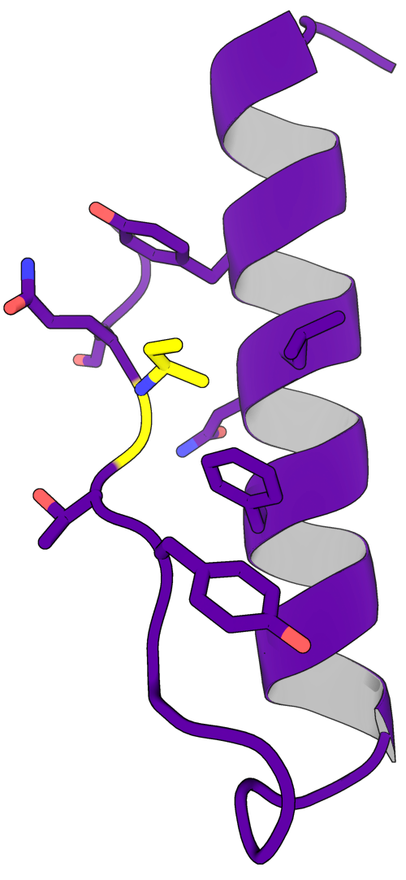
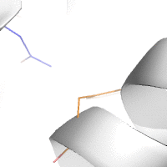
Protein Design
What is protein design?
Protein design is the rational design of new protein molecules to fold to a target protein structure, with the ultimate goal of designing better or novel function and/or behavior.
Also a great testing ground for our knowledge of protein physics.

Slide 4
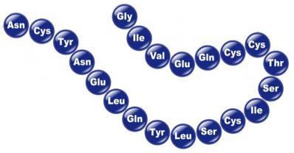
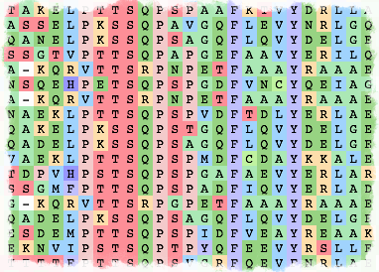
Protein Sequence and Multiple Sequence Alignment
What is protein sequence?
Protein sequence is the order in which amino acid residues, connected by peptide bonds, lie in the chain in peptides and proteins.
Transcription
Translation
DNA—>RNA
mRNA—>Protein
DNA
mRNA
Protein
What is multiple sequence alignment?
A multiple sequence alignment (MSA) is a sequence alignment of three or more biological sequences, generally protein, DNA, or RNA.
Protein MSA

Slide 5
Methods in Protein Co-evolution Analysis
Existing Methods
@Protein level
Detect interactions and functional relationships between proteins using genomic information.
@Residue level
Detect correlated amino acid changes in pairs of positions, which are found to correspond to spatially proximal residues in the protein structure.
Juan et al. (2013). Nature Reviews Genetics 14, 249–261.

Slide 6
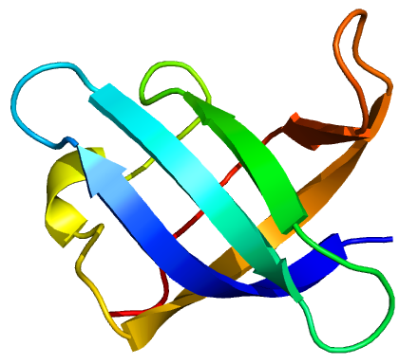
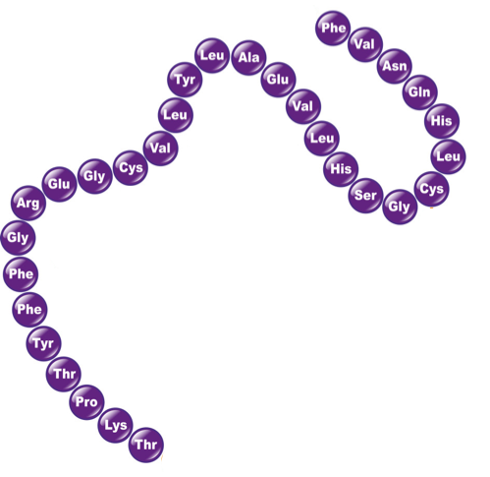
Better Way to Improve a Protein?
We already have
Structure
Are these information enough to design a more stable (and hopefully functional) protein?
Amino acid sequence
?
How to efficiently use evolutionary information?
Stable,
functional
Protein
MSA

Slide 7
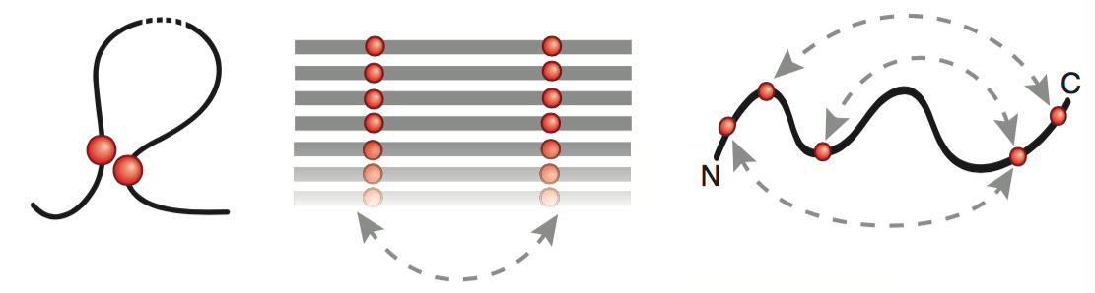
From Covariation to Contact
Couplings
Covariation
Evolutionary couplings
Physical contact
MSA
Covariation refers to the coordinated changes that occur in pairs of residues, typically to maintain protein stability, function or folding.
How to capture the evolutionary couplings?
There are two main statistical methods:
(1) Statistical Coupling Analysis (SCA)
(2) Direct Coupling Analysis (DCA)
Marks et al. (2012). Nat. Biotechnol. 30: 1072-80.

Slide 8
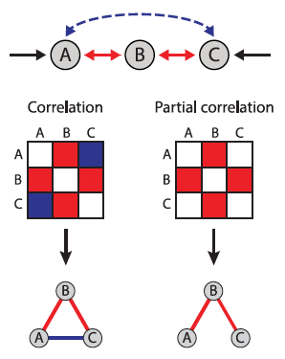

What is Direct-Coupling Analysis (DCA)?
Statistical model
— Normalization constant
— Pairwise coupling (two-body energy)
— Single site bias (one-body energy)
Analysis by Pearson’s correlation yields interactions associating all three compounds A, B, and C, in contrast to the partial correlation approach which omits the “false” link between A and C.
Marcos et al. (2011). PNAS 108(49), E1293–E1301.
Stein et al. (2015). PLoS Comput Biol 11(7): e1004182.

Slide 9
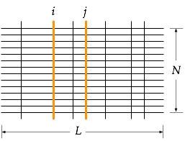


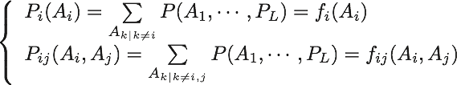


How to Get DCA Matrices?
Sequence statistics
— single site frequency
— pair frequency
— the Kronecker symbol
MSA:
Maximum entropy model
Maximize entropy S, we can get the statistical model P(A1, …, AL) with a partition function Z
Marcos et al. (2011). PNAS 108(49), E1293–E1301.

Slide 10

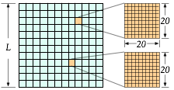





Can We Build a “Better” Protein
using MSA and DCA?
Our target
Single site bias
(one-body energies)
DCA
MSA
Covariance matrix
(2-body energies)
Pairwise coupling matrix
WT
Is the sequence with the lowest DCA energy ‘super stable’ and functional?
Substitutions
…
Get a seq. w/ the lowest energy
That’s our goal!

Slide 11
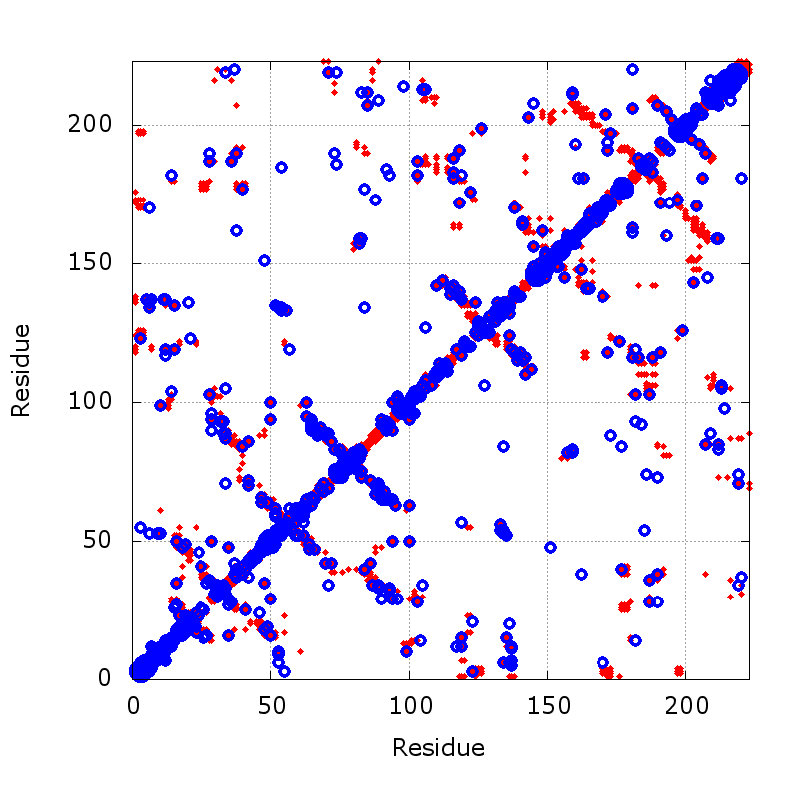
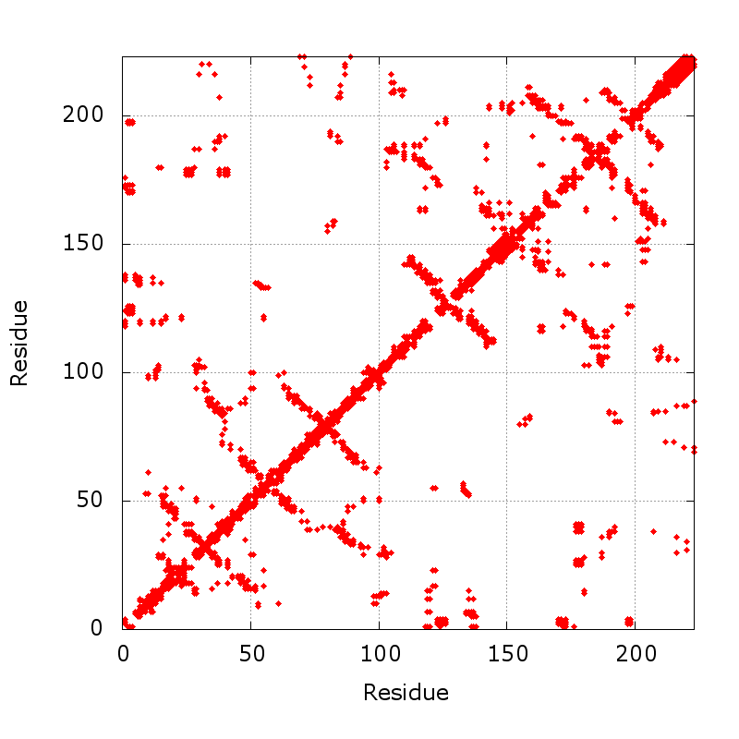
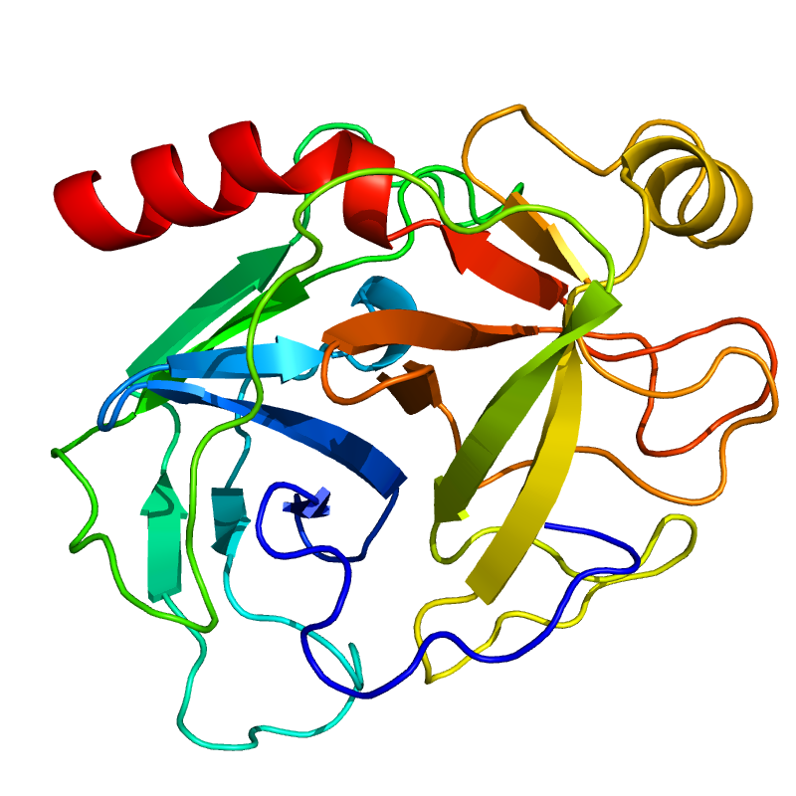
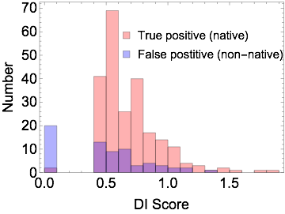

How well do DCA scores identity with residue-contacts?
3TGI—Anionic trypsin-2
Top 300
Direct Information
Native contacts
Predicted contacts (EVfold)

Slide 12
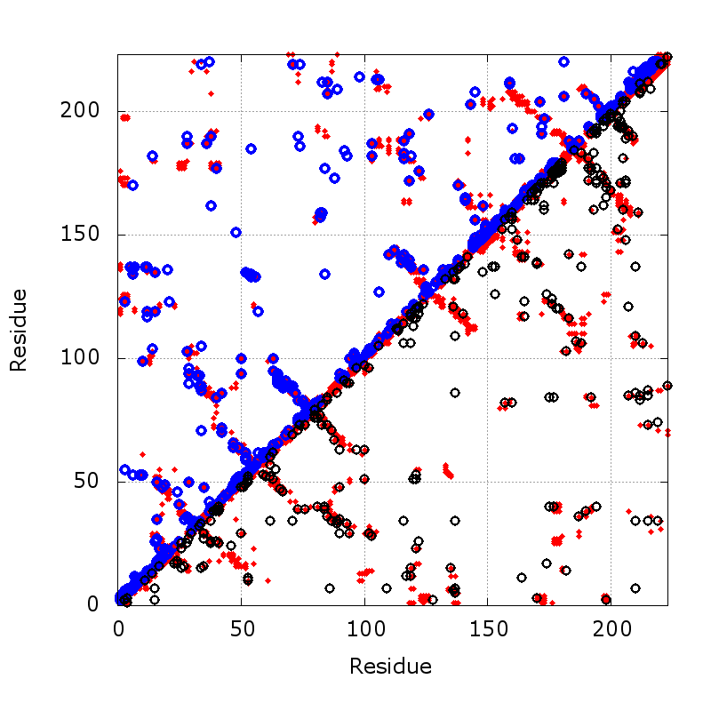
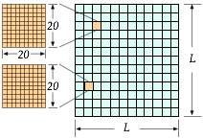
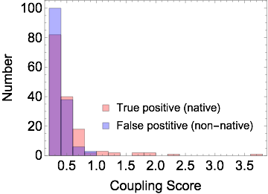
How well do DCA scores identity with residue-contacts?
3TGI—Anionic trypsin-2
Coupling score distribution
Native contacts
Predicted contacts (EVfold)
Coupling Scores

Slide 13
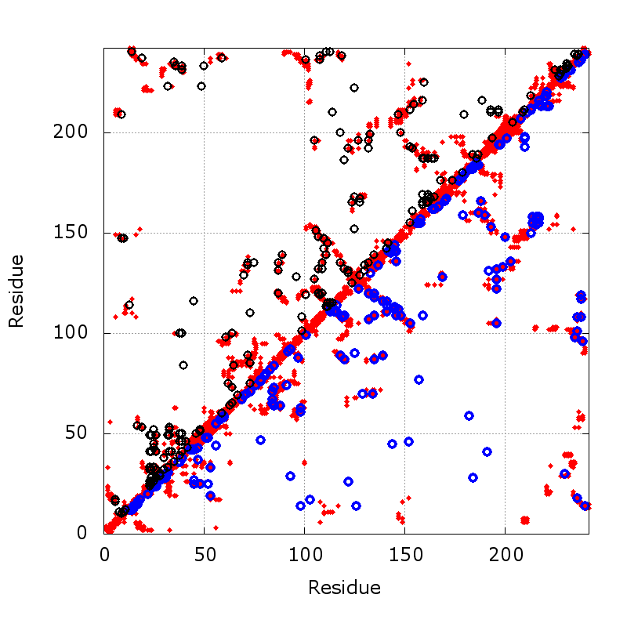
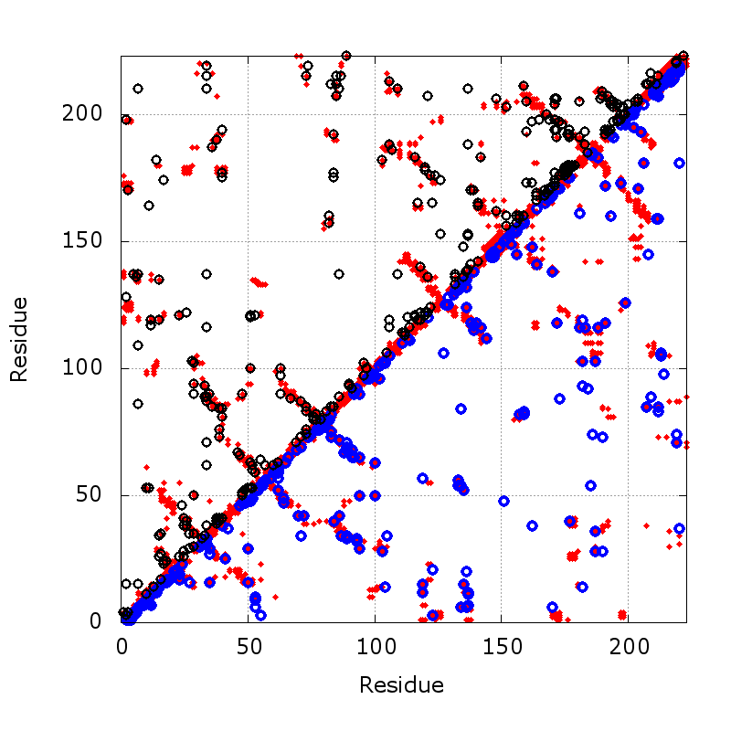
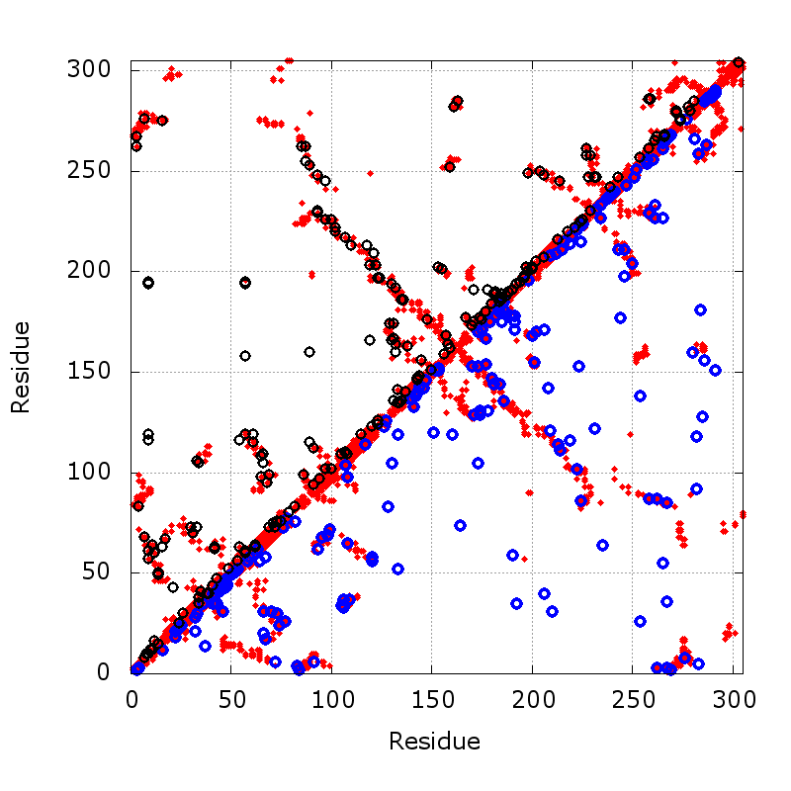
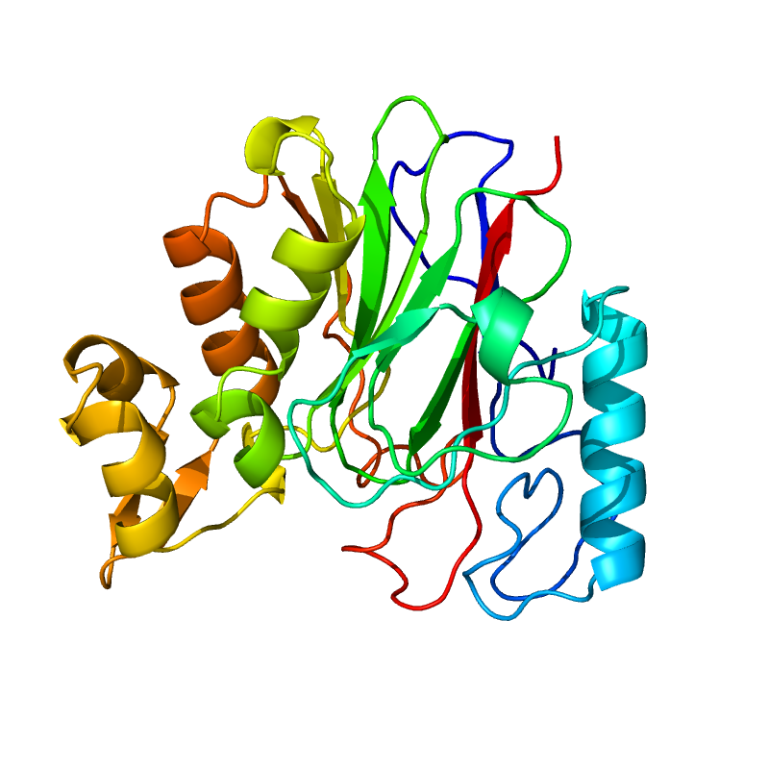
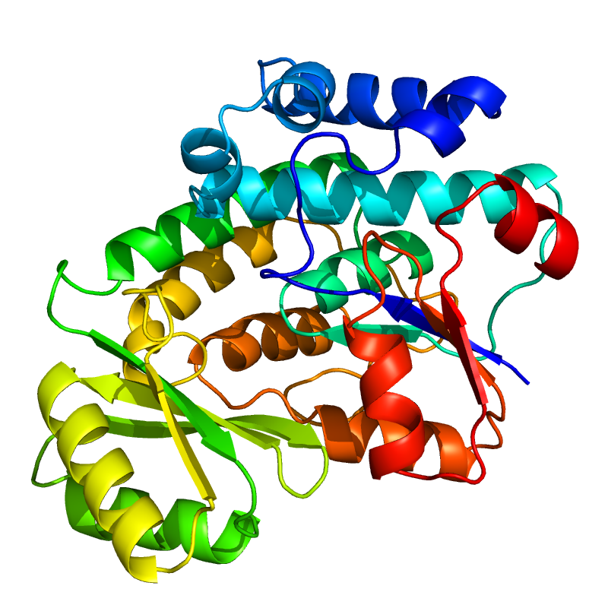
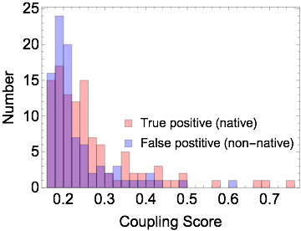
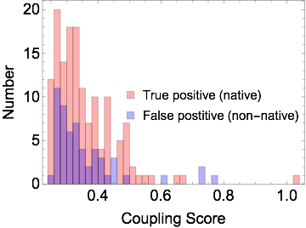
How well do DCA scores identity with residue-contacts?
1RV9—Neisseria meningitidis protein
3TGI—Anionic trypsin-2
1MLA—Escherichia coli malonyl-CoA
Top 200
Top 200
Top 300
Top 200
Top 300
Top 200
Native contact
Coupling Scores
Predicted contacts (EVfold)

Slide 14
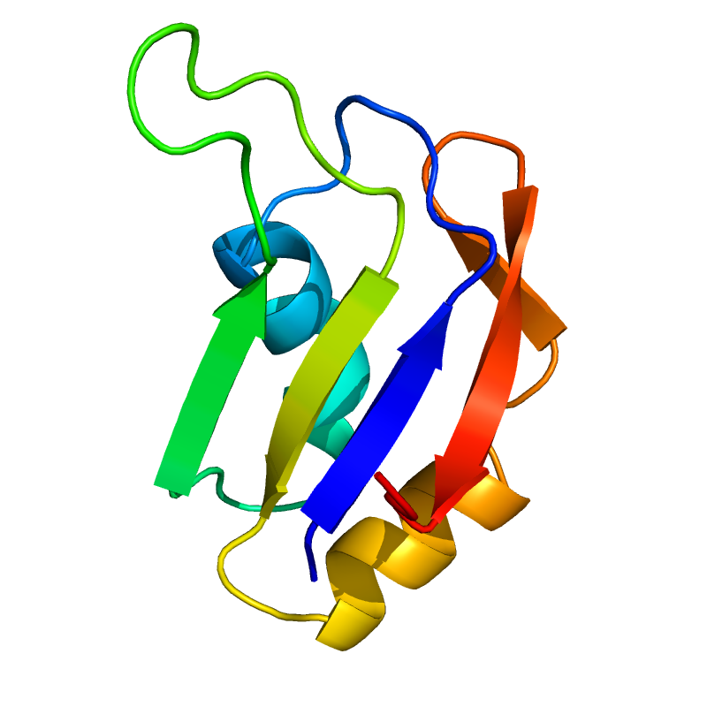
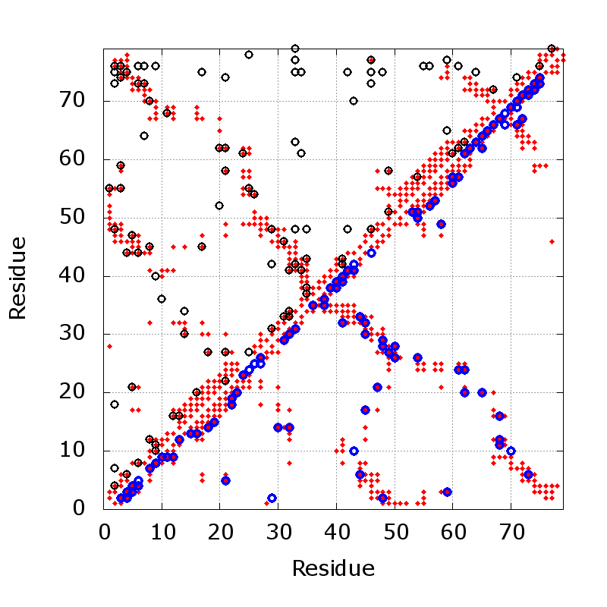
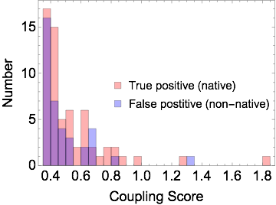
RNA Recognition Motif (RRM) Domain
RRM
Domain of the yeast poly(A)-binding protein.
Top 100
Native
Coupling Scores
Predicted contacts
(EVfold)
Top 100
RRM domain 2
(PDB ID: 1CVJ)
Globular domain
Composed of 4 antiparallel β sheets that are backed by 2 α-helices
Central two β-strands forms a trough-like surface that’s used for binding to the poly(A) oligonucleotides
The other face of the protein is free for PPIs

Slide 15
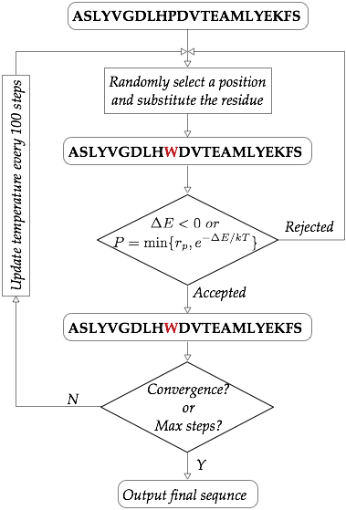
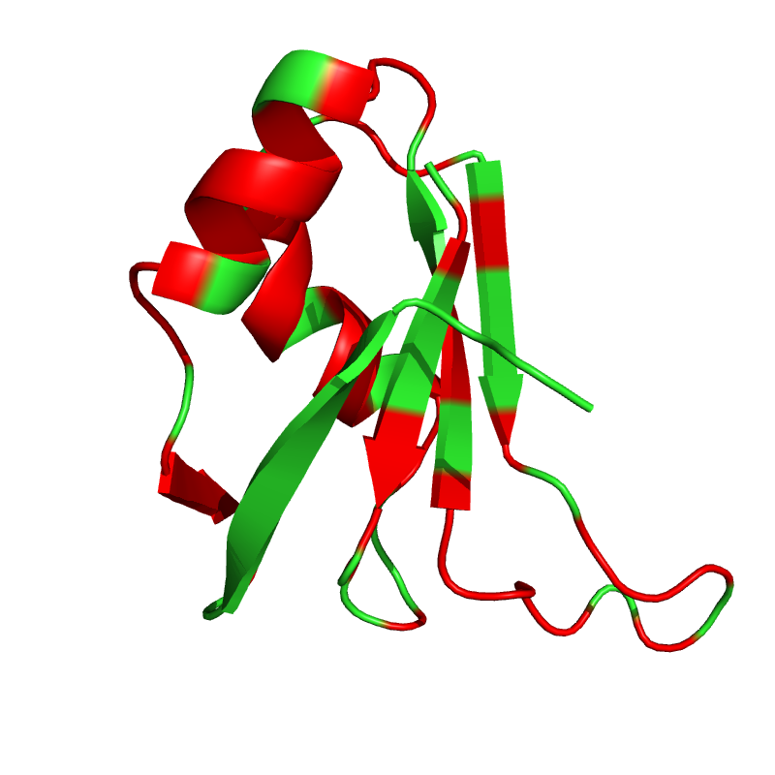
Designed RRM Domain
RRM
Identity: 29/79 (36.7%)
Similarity: 51/79 (64.6%)
Top-hit in BLAST: 65％
WT
Mutated
WT 1 ASLYVGDLHPDVTEAMLYEKFSPAGPILSIRVCRDMITRR
*:*:**:* *.** * * ** * : *::: ** * *
DES 1 ATLFVGNLPWDTTEEQLRELFSQFGKVKSVKIMRDRETGR
WT 41 SLGYAYVNFQQPADAERALDTMNFDVIKGKPVRIMWSQR
* *:.:*:*: :*::**:::* :.*: :*: :::*
DES 41 SRGFGFVEFETVEEAQKALEALNGTELDGRKIRVDFAKR
Monte Carlo Method
Notes:
Identity (*) : 29 is 36.71 %
Strongly similar (:) : 24 is 30.38 %
Weakly similar (.) : 3 is 3.80 %
Different : 23 is 29.11 %

Slide 16
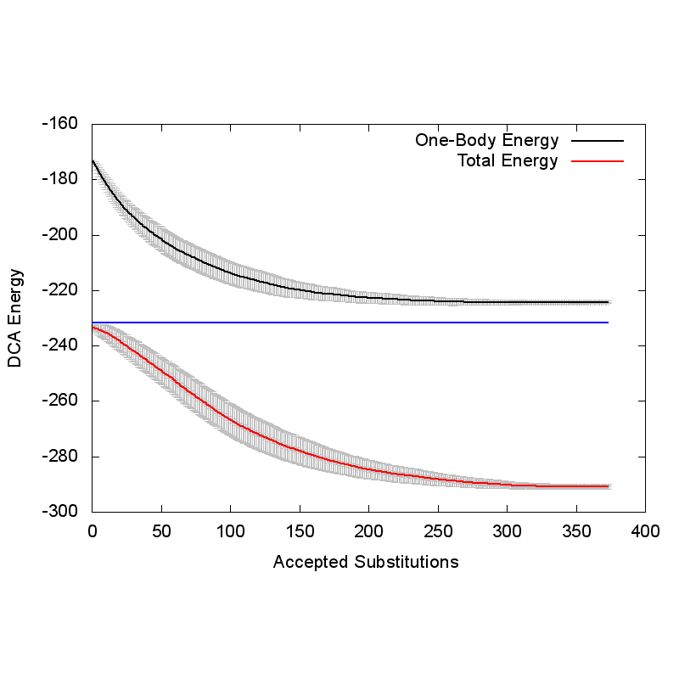

Designed RRM Domain
RRM
Identity: 29/79 (36.7%)
Similarity: 51/79 (64.6%)
Top-hit in BLAST: 65％
WT
One-Body Energy (WT)
Mutated
One-body Sequence
Total energy (WT)
WT 1 ASLYVGDLHPDVTEAMLYEKFSPAGPILSIRVCRDMITRR
*:*:**:* *.** * * ** * : *::: ** * *
DES 1 ATLFVGNLPWDTTEEQLRELFSQFGKVKSVKIMRDRETGR
WT 41 SLGYAYVNFQQPADAERALDTMNFDVIKGKPVRIMWSQR
* *:.:*:*: :*::**:::* :.*: :*: :::*
DES 41 SRGFGFVEFETVEEAQKALEALNGTELDGRKIRVDFAKR
Notes:
Identity (*) : 29 is 36.71 %
Strongly similar (:) : 24 is 30.38 %
Weakly similar (.) : 3 is 3.80 %
Different : 23 is 29.11 %

Slide 17
Sequence Comparison
MSA
One-body
Total
WT
SINGLE 1 ATLFVGNLPPDVTEEDLRELFSKFGPVKSVKIVRDKETGKSKGFAFVEFESPEDAEKALEALNGKKLDGRPLRVEFAKK 79
WT 1 ASLYVGDLHPDVTEAMLYEKFSPAGPILSIRVCRDMITRRSLGYAYVNFQQPADAERALDTMNFDVIKGKPVRIMWSQR 79
DES 1 ATLFVGNLPWDTTEEQLRELFSQFGKVKSVKIMRDRETGRSRGFGFVEFETVEEAQKALEALNGTELDGRKIRVDFAKR 79
*:*:**:* *.** * * ** * : *::: ** * :* *:.:*:*: :*::**:::* :.*: :*: ::::
MSA (80,878) got by:
Hidden Markov model (HMM) homology search tool jackhmmer against UniRef100 database.
sequence identity

Slide 18
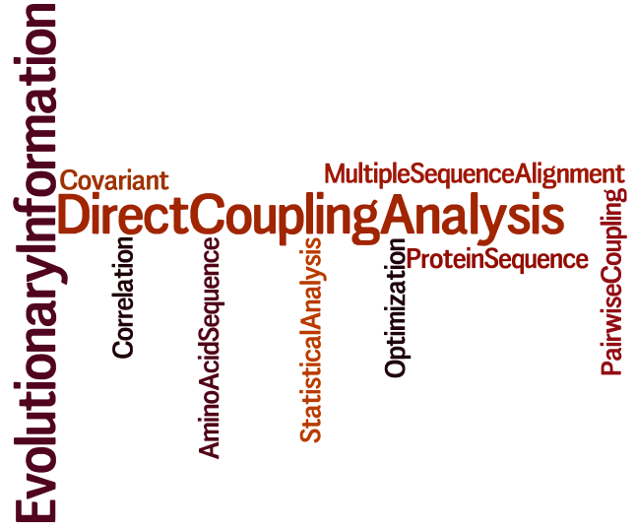
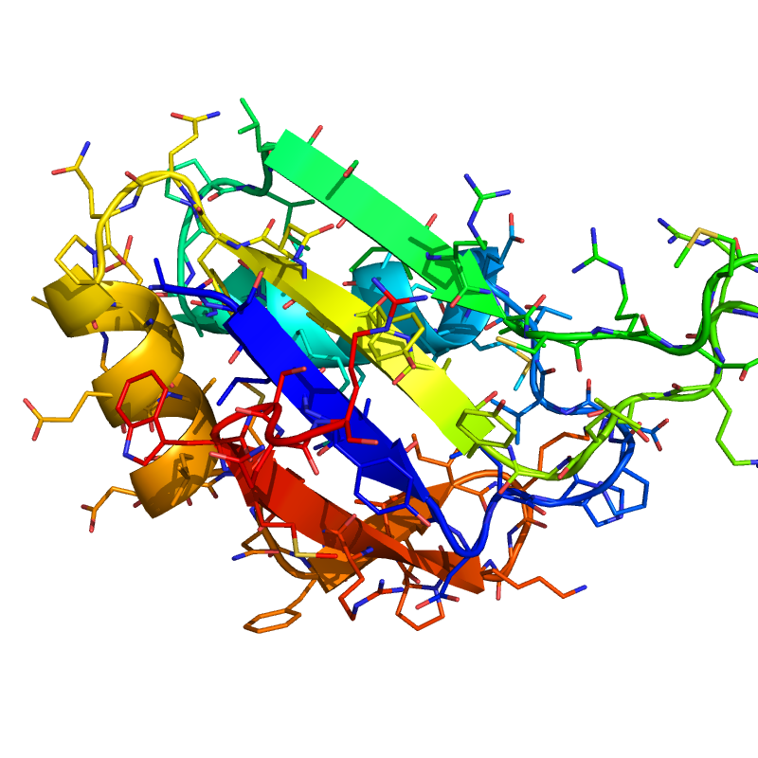
Am I right?
?
Is this designed protein better?
More stable?
Still functional?
Don’t know, but …

Slide 19
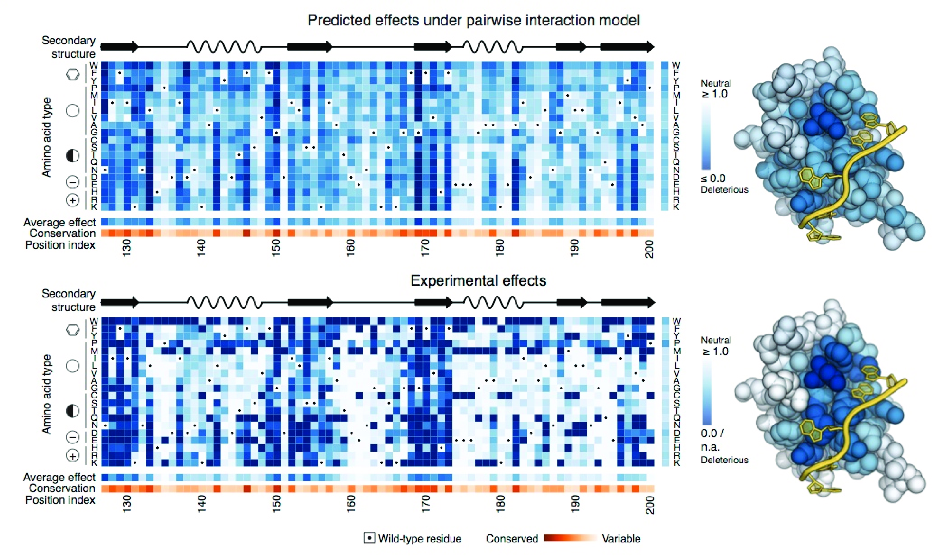
Quantification of Point Mutation Effect
Predicted
RNA ligand
Experimentally measured
Positional average effect of all 19 possible substitutions mapped on the structure of human PABP
Color: effect of mutation (white: neutral, blue: deleterious).
Effects of individual point mutations to an RNA recognition motif (RRM) domain of the yeast poly(A)-binding protein. (x-axis: RRM sequence, y-axis: amino acid substitutions)
Thomas et al. (2015). arXiv:1510.04612

Slide 20
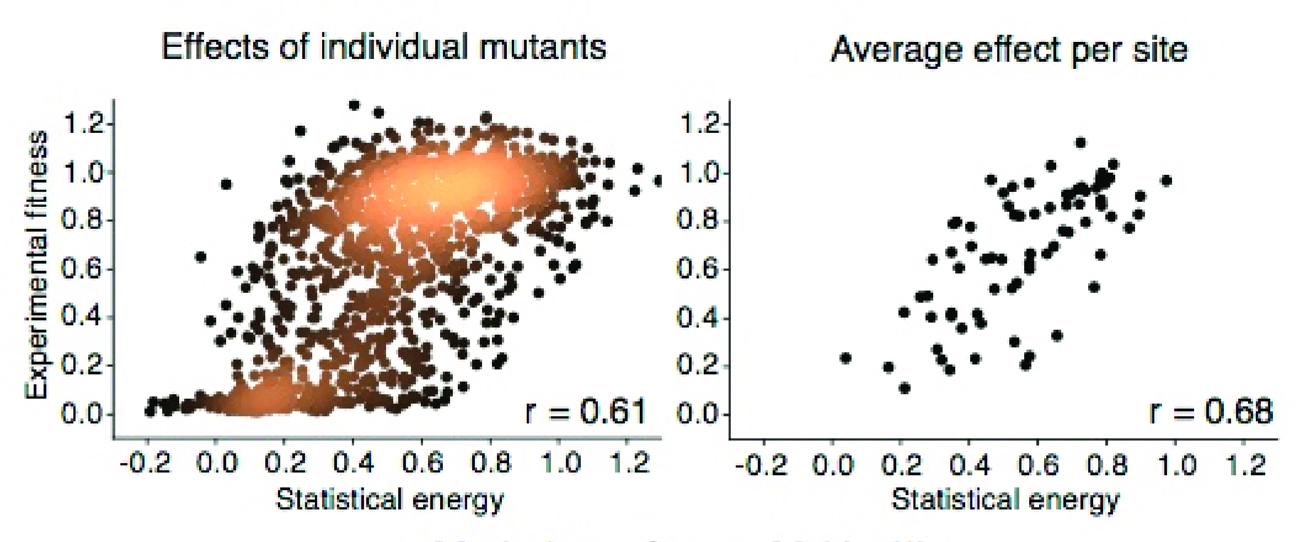

Quantification of Point Mutation Effect
Statistical energies correlate with experimentally measured growth phenotypes of RRM.
Thomas et al. (2015). arXiv:1510.04612

Slide 21
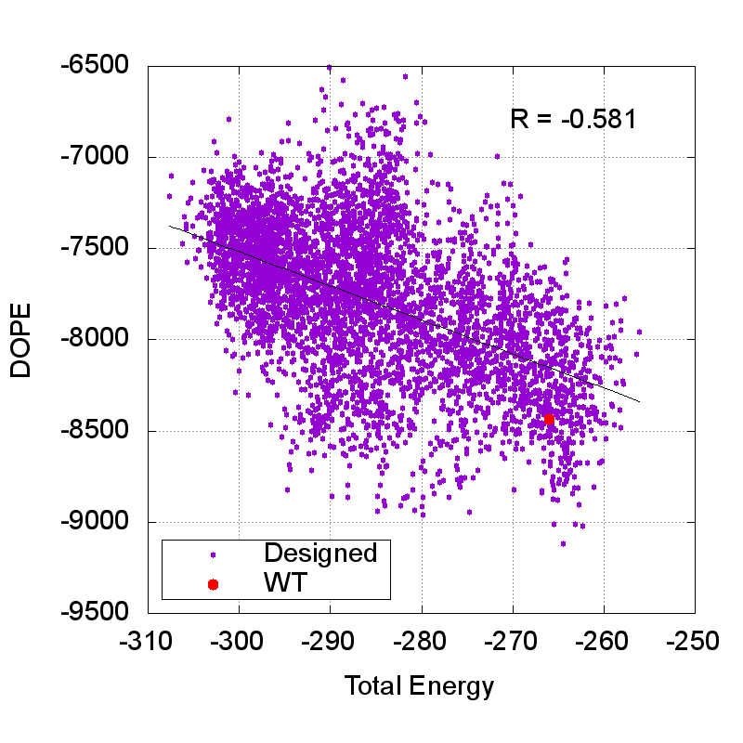
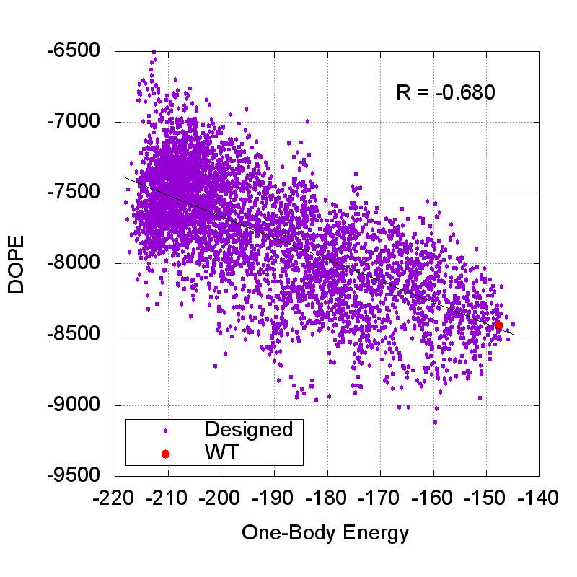
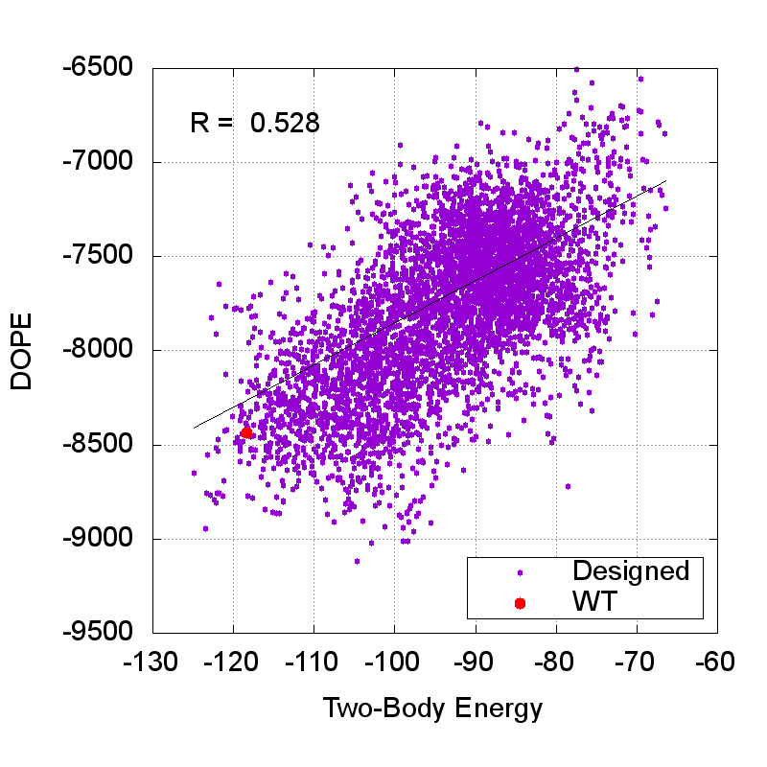
Correlation with a statistical potential: “DOPE”
Correlation
Top 20 trajectories

Slide 22
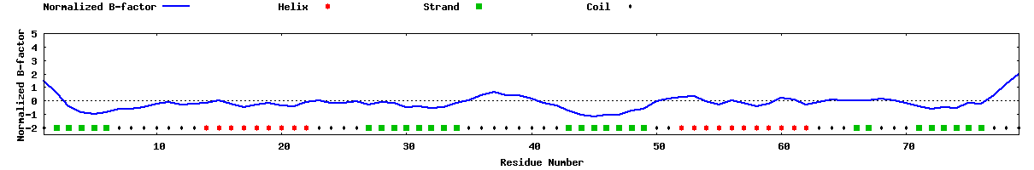
Predictions on the Designed RRM Domain
Predictions
I-TASSER
Predicted Secondary Structure
20 40 60
| | |
Sequence ATLFVGNLPWDTTEEQLRELFSQFGKVKSVKIMRDRETGRSRGFGFVEFETVEEAQKALEALNGTELDGRKIRVDFAKR
Prediction CSSSSSCCCCCCCHHHHHHHHHCCCCSSSSSSSSCCCCCCCCSSSSSSSCCHHHHHHHHHHHCCCSSCCCSSSSSSCCC
Conf.Score 9799928999889999999986259878999967499998655489998999999999998489977891979971159
Predicted Solvent Accessibility
20 40 60
| | |
Sequence ATLFVGNLPWDTTEEQLRELFSQFGKVKSVKIMRDRETGRSRGFGFVEFETVEEAQKALEALNGTELDGRKIRVDFAKR
Prediction 7411004032424373046214632514504124237343343102010636730440267147443742513044168
Values range from 0 (buried residue) to 9 (highly exposed residue)
B-factor is a value to indicate the extent of the inherent thermal mobility of residues/atoms in proteins

Slide 23
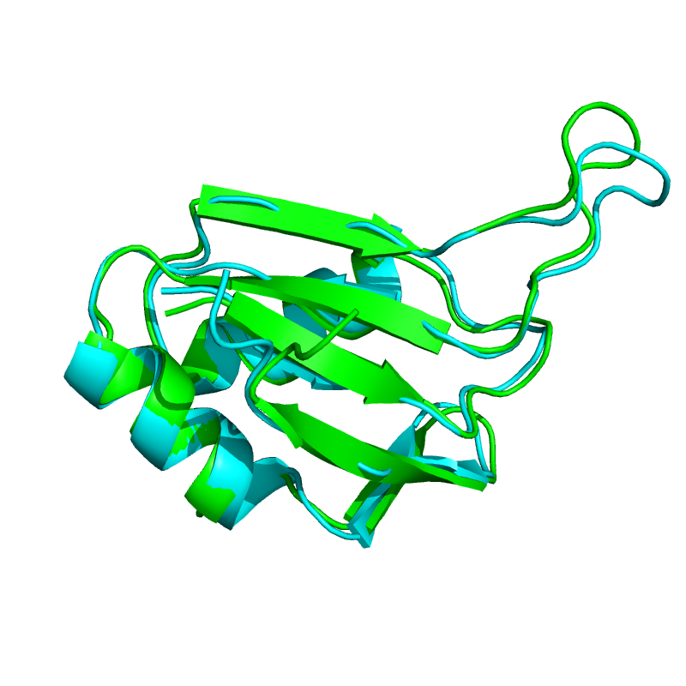
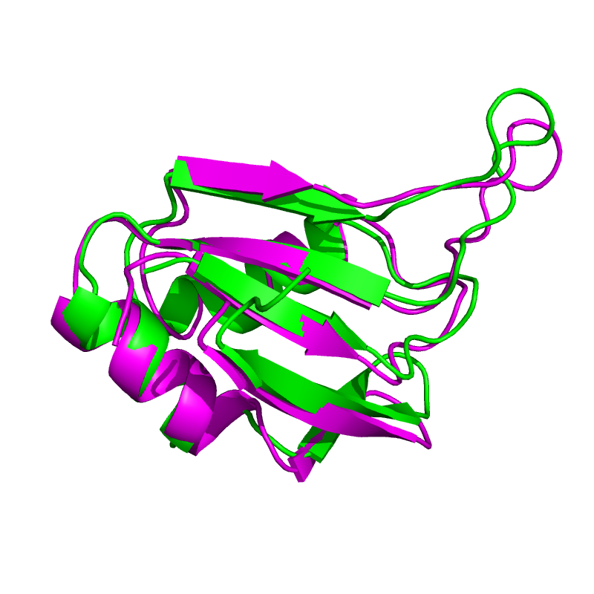
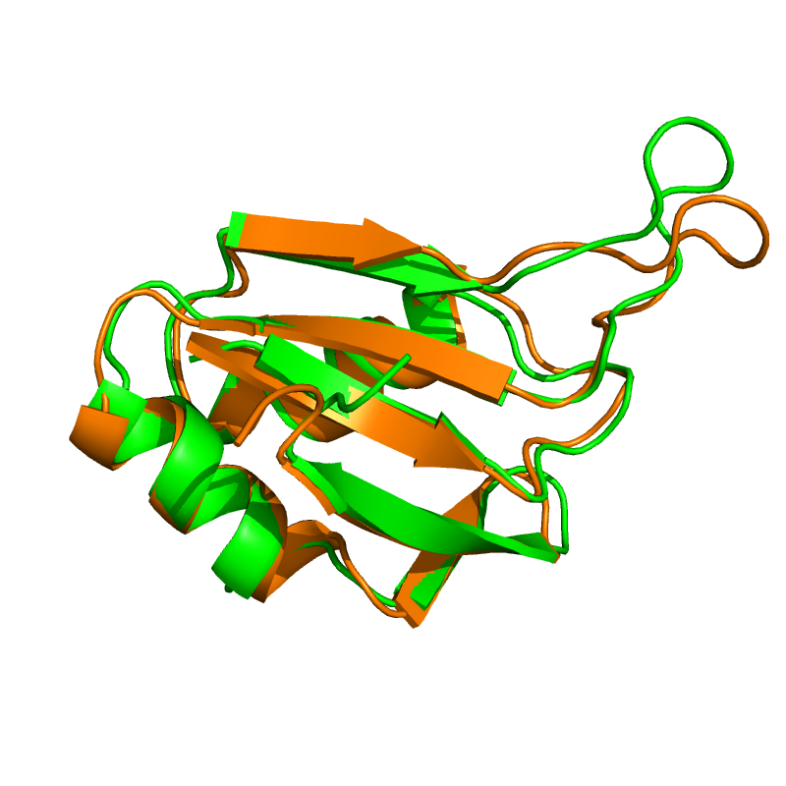
Predictions on the Designed RRM Domain
Predictions
I-TASSER predictions
Rosetta prediction
WT
WT
I-TASSER
2X1F
RMSD: 0.86Å
RMSD: 1.22Å
RaptorX prediction
WT
RaptorX
RMSD: 0.86Å

Slide 24
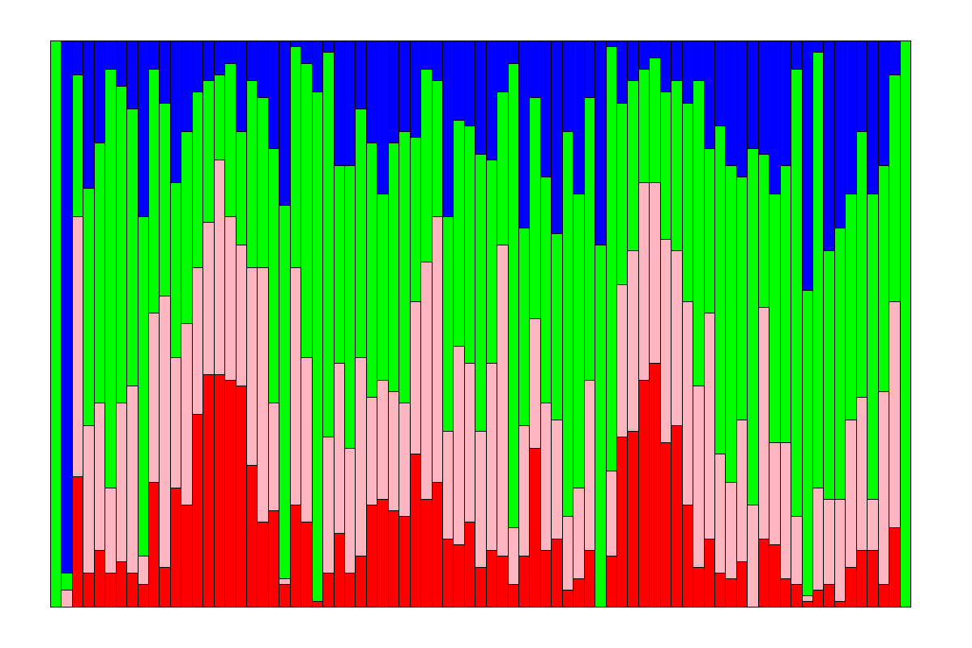
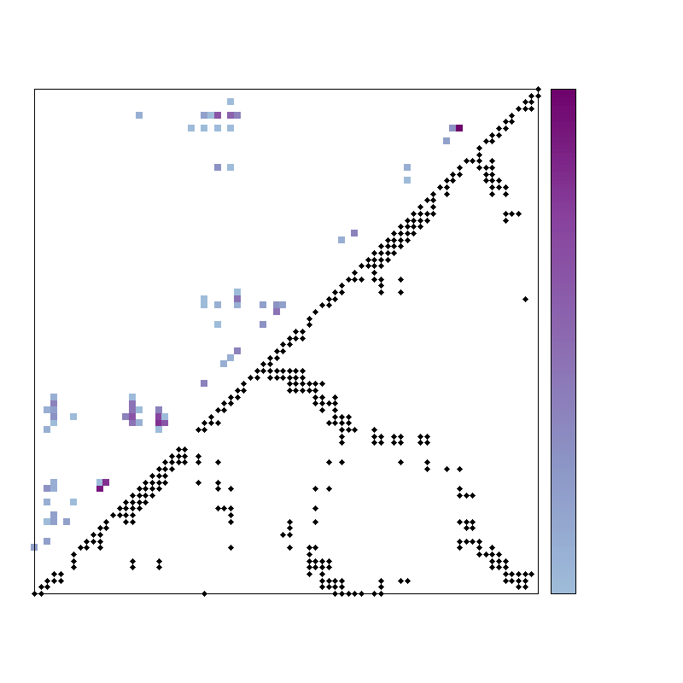
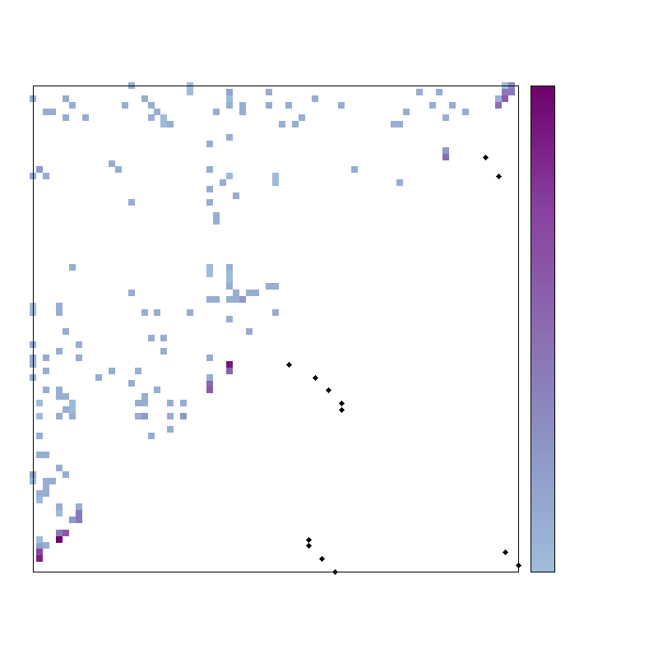
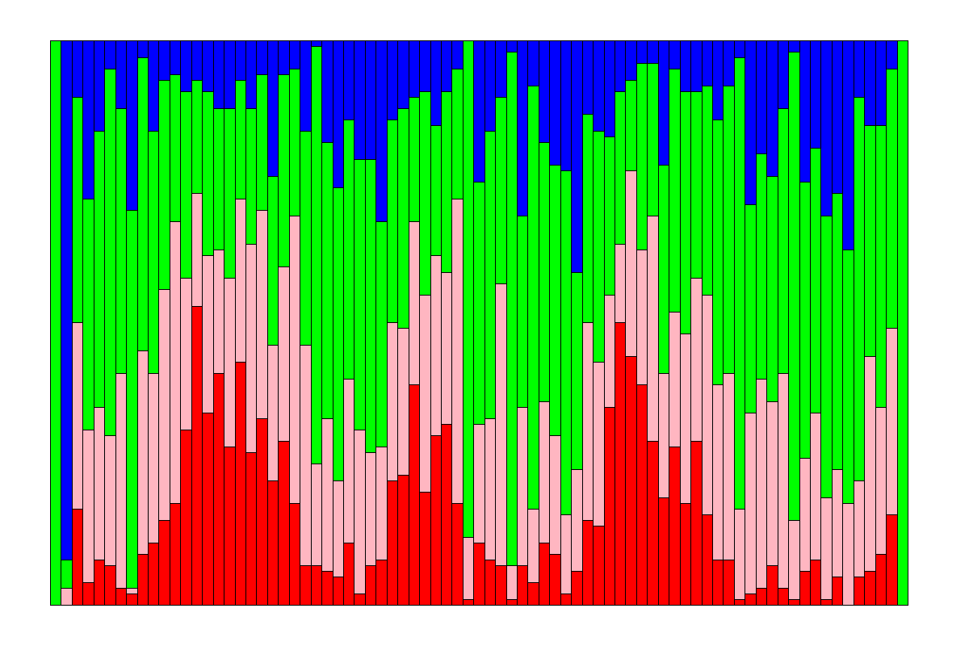
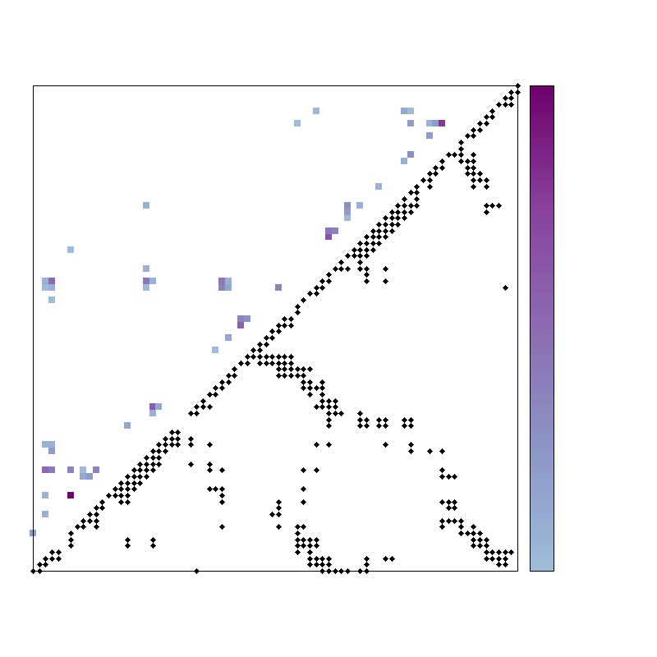
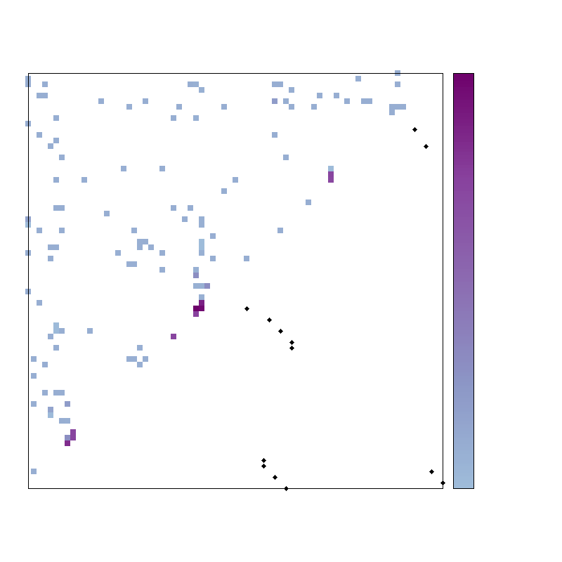
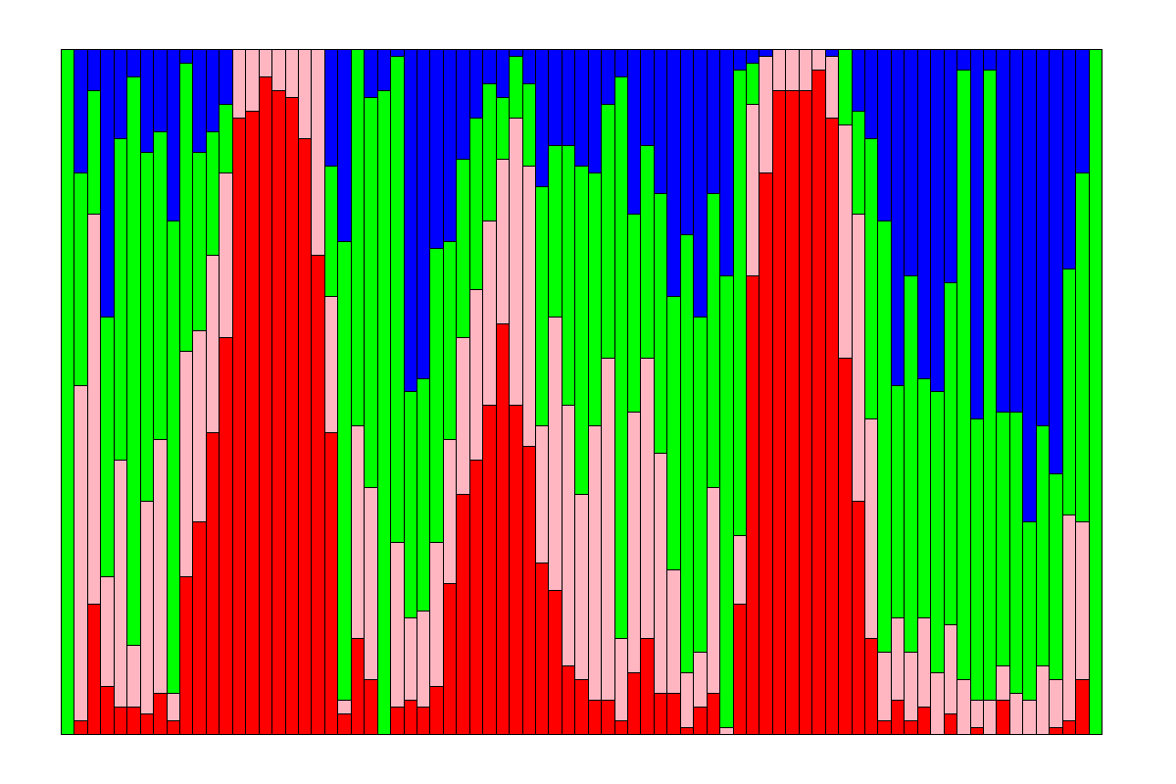
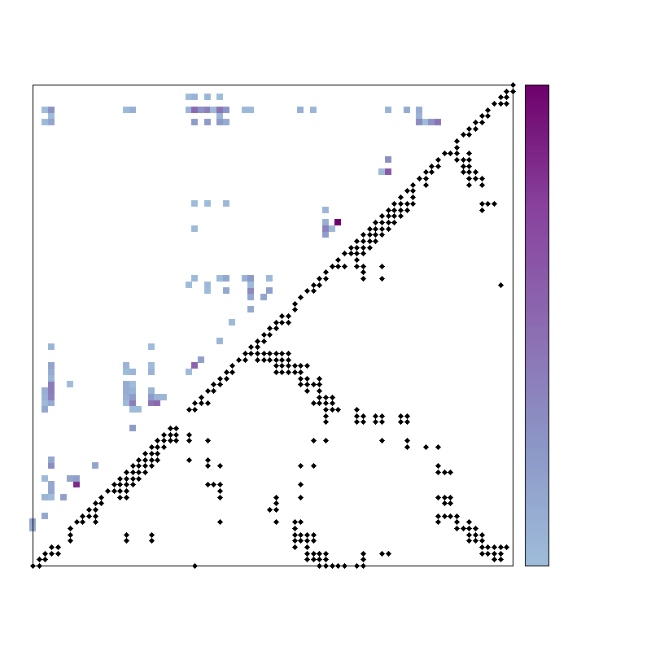










Folding using de novo Iterative Fixing “TerItFix”
on the Designed RRM Domain
Folding
WT RRM
Designed RRM
Sampling distribution
Contact map
Hydrogen-bond map
Sampling distribution
Contact map
Hydrogen-bond map
1
1
1
1
1
1
Round 1
Predicted
Predicted
Round 1
Predicted
Predicted
Native
Native
Native
Native
0
0
0
0
0
0
Round 2
Round 2
Round 3
Round 3
Helix core
Strand
Coil
Reset H basin
Adhikari et al. (2013). Phys. Rev. Lett., 111: 028103.
Adhikari et al. (2013). PNAS, 109(43):17442-7.

Slide 25



Protein Structure Prediction
What is protein structure prediction?
Protein structure prediction is the prediction of the three-dimensional structure of a protein from its amino acid sequence.
A major limitation
is the extraordinary amount of computer time required to successfully solve for the native confirmation of a protein.
Secondary
Structure
Amino acids
Primary Structure
Beta
Helix
In computational biology, de novo protein structure prediction refers to an algorithmic process by which protein tertiary structure is predicted from its amino acid primary sequence.
Tertiary Structure

Slide 26



Protein Structure Prediction “NiDelta”
Existing Methods
NiDelta
Contacted-based Molecular Dynamics:
Full-atom simulation
Native residue-contacts
Other existing methods:
Experimental information (NOE, NMR chemical shift): CS-RosettaCM, EC-NMR
Predicted secondary structures: I-TASSER
Evolutionary information: Evfold, EC_NMR
etc …
One Query, One Model:
Query-driven predictor (de novo)
Fast and accurate conformation search (now use Coarse Grained MD)
Without native information
Iteratively biasing (torsion angles and residue contacts)
Robust to noise
Torsion angles
Potentials for Contact
Shaw et al. (2016). Protein Science, 25: 19–29.
Shen and Bax (2015). Nature Methods, 12: 747–750.
Tang et al. (2015). Nature Methods, 12: 751–754.
Debora et al. (2012). Nature Biotechnology, 30: 1072-80.
Zhang (2008). BMC Bioinformatics, 9: 40.
Notes:
Nuclear Overhauser effect (NOE)

Slide 27


But Noise Always Exists …
Noise
Residue-contacts
Statistical background noise
Functional constraints may not be spatially close
Missing residue-contacts
Protein backbone torsion angles
Incorrect but close to native values
Totally incorrect predictions
Heffernan et al. (2015). Scientific Report, 2015 (5).

Slide 28
Protein Structure Prediction
NiDelta
One Query, One Model
Flowchart of NiDelta
Notes:
PSSM: position-specific scoring matrices
SS: secondary structure
SA: solvent accessibility

Slide 29





Different Paths to Fold
Paths
Centroid
Cluster 1
Centroid
…
Cluster 1
Unfolded
(extended)
w/ lowest energy
Cluster 2
Cluster 2
20%
structures
20%
structures
…
500 extended structures
…
…
Contact
matrix
Contact
matrix
…
Cluster 500
Cluster 500
…
The 1st round
The 2nd round
Output
Iteratively Predict Structure

Slide 30

Structure Clusters
Cluster
3.8Å
3.3Å
2K1S (141aa)
11Å

Slide 31



Example Prediction (1st round)
Prediction
PDB ID: 2K1S (141aa)
Tertiary Structure
Contact Map
Secondary Structure

Slide 32
What Will We Do in the Future?
Make a protein in vitro and validate it by various experimental tools, such as NMR, CD and so on.
Validate NiDelta in CASP12 by predicting de novo the structures of large proteins

Slide 33




Acknowledgements
Prof. Karl F. Freed
(UChicago)
Prof. Tobin R. Sosnick
(UChicago)
Prof. Hong-Bin Shen
(SJTU)
Dr. Sheng Wang
(TTI at Chicago)
Dr. Aashish Adhikari
(UC Berkeley)
Dr. Wookyung Yu
(UChicago)
John M. Jumper
(UChicago)
Joshua A. Riback
(UChicago)
All other members
in the groups

Slide 34
Thank You

