Slide 1
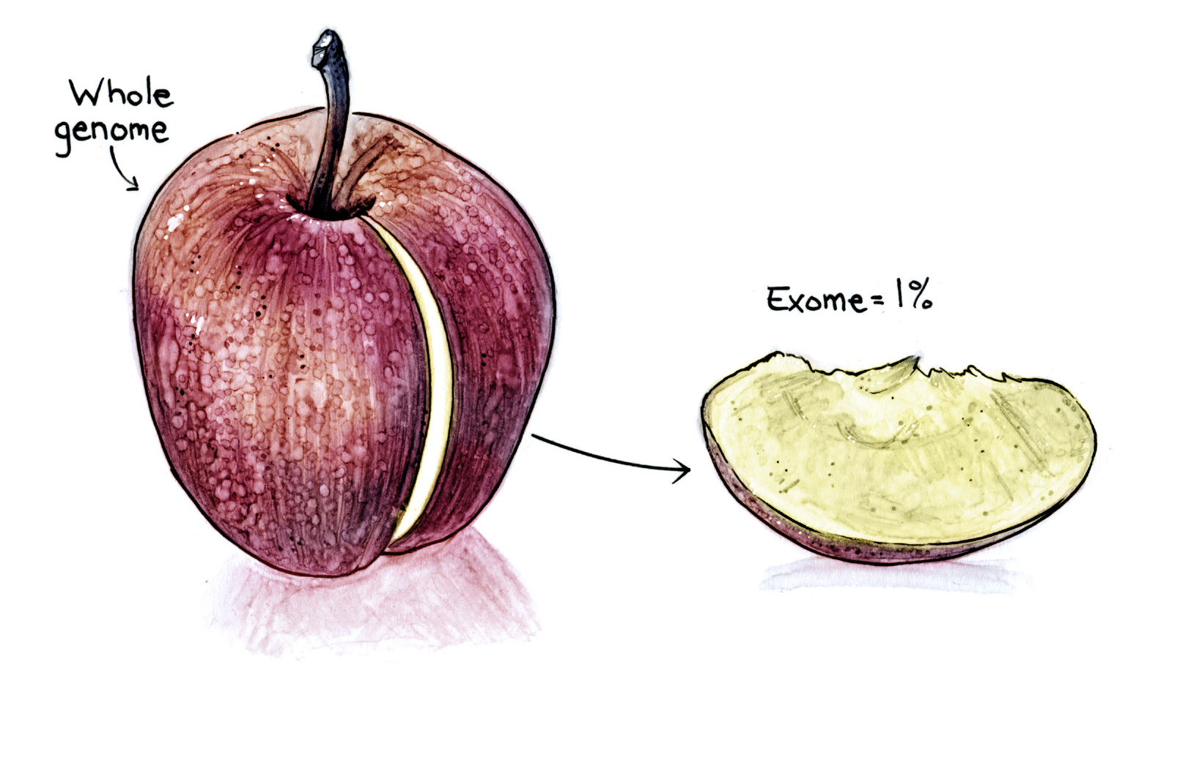
UW Center for Mendelian Genomics: Updates and
Scientific Highlights
Genome Sequencing Program Meeting
Washington DC, April 11-13, 2016

Slide 2
Engagement
357 unique projects
# investigators | 210 - >800
# institutions | 120+
# countries | 31+

Slide 3
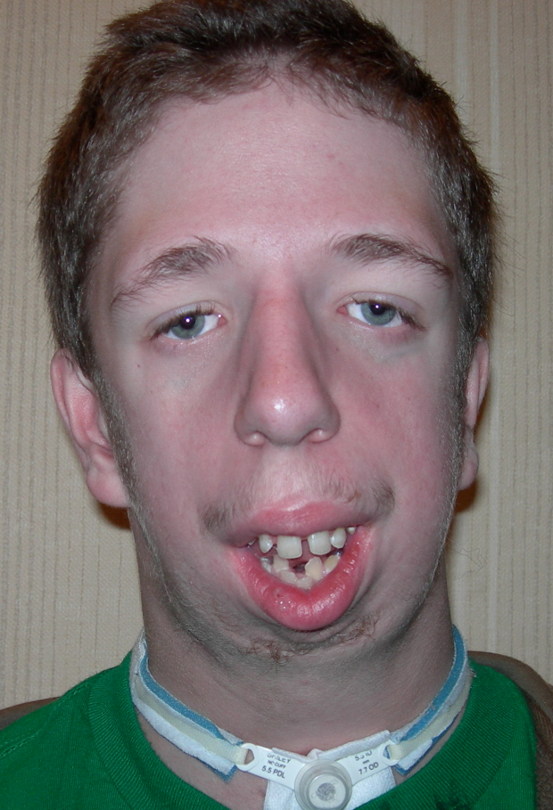
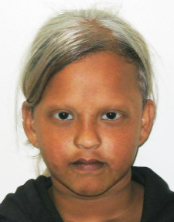
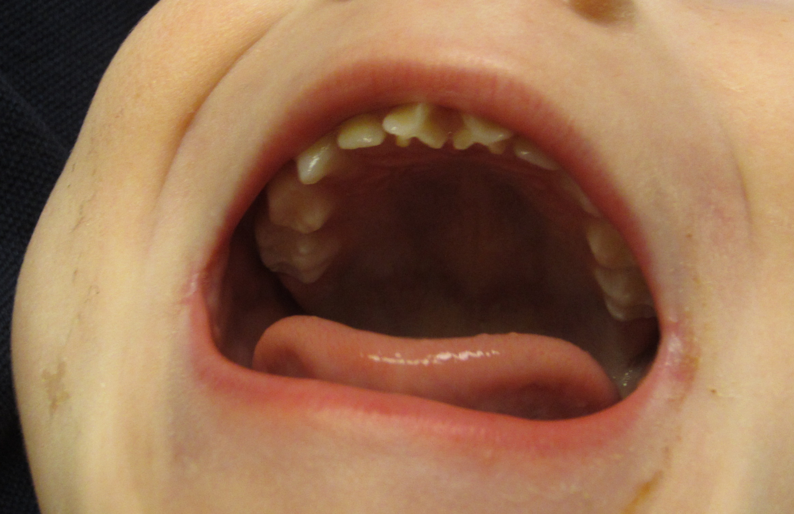
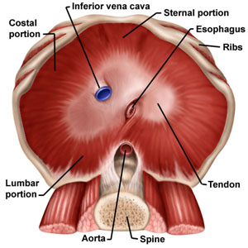
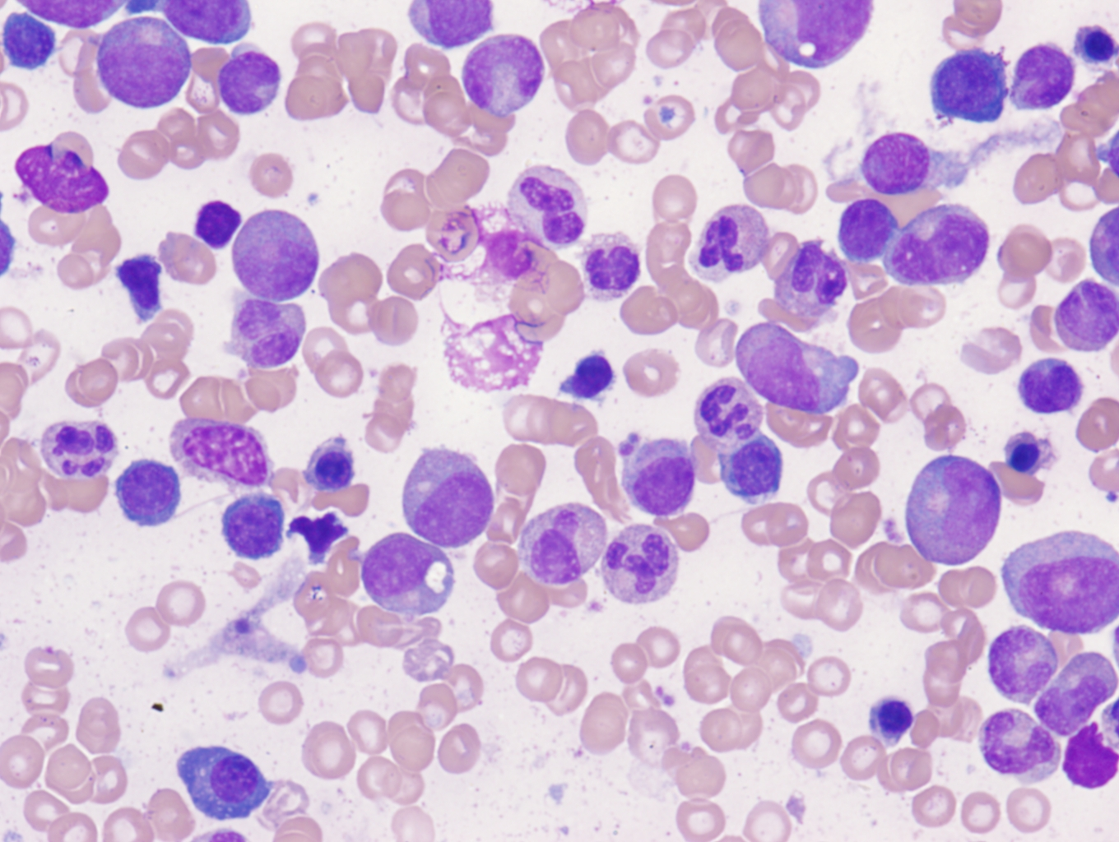
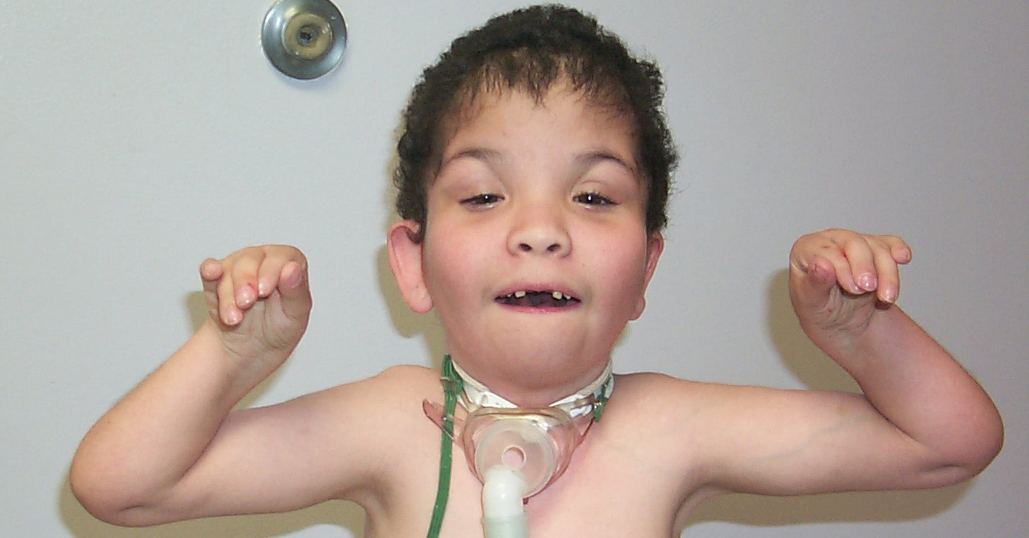
Phenotypes assessed
Phenotype class | Number
explained-known Mendelian (i.e., MIM #) | 169
unexplained-known Mendelian, | 130
expansion-known Mendelian | 62
known Mendelian conditions | 361 (59%)
novel Mendelian conditions (i.e., no MIM#) | 254 (41%)
Total | 615

Slide 4
Pipeline

Slide 5
Pre-pipeline contacts
Communication | Total
Emails | 36
Phone | 2
PhenoDB & pedigree review
resolving QC

Slide 6
Pre-pipeline processing
Mean | 4.2 months
Median | 4 months

Slide 7
Production
 | pre-pipeline | pipeline | released | total
Exomes | 1,174 | 578 | 5,420 | 7,172
Genomes | -- | 27 | 151 | 178
Genotyping | -- | -- | 723 | 723
BAM reprocessing | -- | -- | 2,258 | 2,258
Total | 1,174 | 605 | 8,552 | 10,331

Slide 8
Genome Sequencing
Phenotype | # | rationale | WGS findings
hereditary spastic paraplegia | 2 | (LOD 3.01); no candidate from ES | no candidates
Aicardi syndrome | 8 | mosaicism possible; limited DNA from affected tissue | no candidates
rhombencephalosynapsis | 4 | no candidate from ES | no candidates
Gomez Lopez Hernandez syndrome | 3 | no candidate from ES | no candidates
dystonia with progressive basal ganglia degeneration | 10 | no candidates from ES x 2 | no candidates; WGS x 2
split hand foot malformation with long bone Deficiency 1 | 7 | (LOD 3.8); no candidate from ES; non-coding vars known to cause phenotype | no candidates
AD partial epilepsy with auditory features | 1 | (LOD 3.41); no candidate from ES | 3'UTR candidate
nonsyndromic hearing impairment | 5 | (LOD 3.14, 2.41, 2.83, 11.60); nocandidate from ES | multiple candidates; segregation studies in progress
bilateral lambdoid and sagittal synostosis | 15 | no candidate from ES | no candidates
congenital disorders of glycosylation | 1 | no candidate from ES | de novo nonsense; new phenotype for gene underlying a recessive condition
amyotrophic Lateral Sclerosis | 12 | non-coding mutations known to cause phenotype | 3 possible candidates; functional studies underway
X-linked corneal dystrophy | 6 | (LOD 10.90); no candidates from ES x 2 | no candidates
tetramelic monodactyly | 5 | limited DNA; non-coding or SVs suspected to cause phenotype | no candidates
amelia of the upper limbs | 3 | no candidate from ES; non-coding mutations suspected to cause phenotype | no candidates
Holt-Oram syndrome | 2 | no candidate from ES; non-coding mutations suspected to cause phenotype | 2 candidates need Sanger validation
hearing impairment; foot deformity | 1 | strong linkage signal but no coding variants found by exome | many variants; segregation studies in progress
hypoplastic left heart syndrome | 25 | SV or non-coding suspected | in analysis
resistance to TSH | 18 | (LOD 14.55); non-coding mutations suspected to cause phenotype | 1 family explained by investigator's candidate; 3 non-coding candidates in other families; validation and segregation analysis in progress
pontine tegmental cap dysplasia | 26 | no candidate from ES | in analysis
Dravet Syndrome | 15 | no candidate from ES | in pipeline
acheiropodia | 3 | non-coding mutations suspected to cause phenotype | in pipeline
split hand foot malformation 2 | 3 | (LOD 5.13); no candidate from ES; non-coding variants known to cause phenotype | in pipeline

Slide 9
Resistance to thyrotropin (RSTH)
high TSH, low-normal thyroid hormones, normal / hypoplastic thyroid gland
linked to locus on ch. 15
no variants via ES; WGS identified non-coding variant in 2 families
UW-CMG did WGS on 6 additional families
  1x family has investigator's candidate variant (missed by Sanger?)
  2x families with shared non-coding variant nearby investigator's candidate
  1x family with SNV in microRNA possibly regulated by enhancer overlapping investigator's candidate

Slide 10
Expenditures
Cost per sample (exome)
$375 (+ indirects = $505)
Cost per sample (genome)
$1,343 (+ indirects = 1,481)
Cost per sample (processing)
 | exome | genome
merging / data QC | $4.75 | $87.68
variant calling | $1.75 | $26.15
data transmission | $1.50 | $23.96

Slide 11
Analysis

Slide 12
Analysis
extensive interaction with investigators to review experimental strategy, select samples to be sequenced, plan for analysis
most analyses done with investigators (>90%), frequently in parallel and interacting to provide guidance
generate at least one report per project; one month after data release

Slide 13
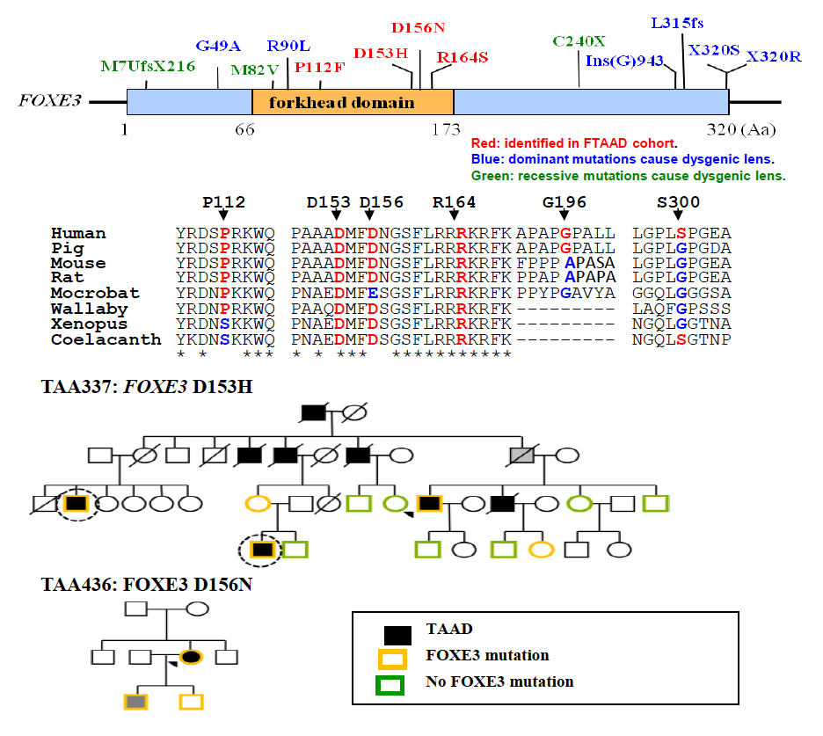
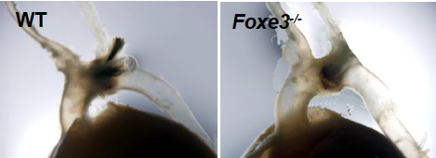
Discoveries: known gene / unexplained-known condition
gene manuscript
SMAD3 Regalado et al, Circ Res, 2011
TGFB2 Boileau et al., Nature Genet, 2012
PRKG1 Guo et al., Am J Hum Genet, 2013
MAT2A Guo et al., Am J Hum Genet, 2015
LOX Guo et al., Circ Res, 2016
FOXE3 Kuang et al., J Clin Invest, 2016

Slide 14
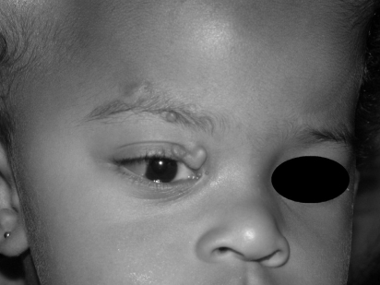
Discoveries: known gene / unexplained-known condition
Encephalocraniocutaneous lipomatosis (ECCL)
abnormalities of the brain, skin, and eyes
structural brain defects, multiple lipomas
3 simplex families
trio + multiple affected tissues
de novo missense variants in FGFR1 in 2/3 families
discordant MZ twins also with FGFR1 variant (FORGE)
encodes fibroblast growth factor receptor 1
variants occur at residues most commonly mutated in human cancers (mainly CNS tumors)
Koishi et al. 2008
Bennett et al. AJHG (2015)

Slide 15
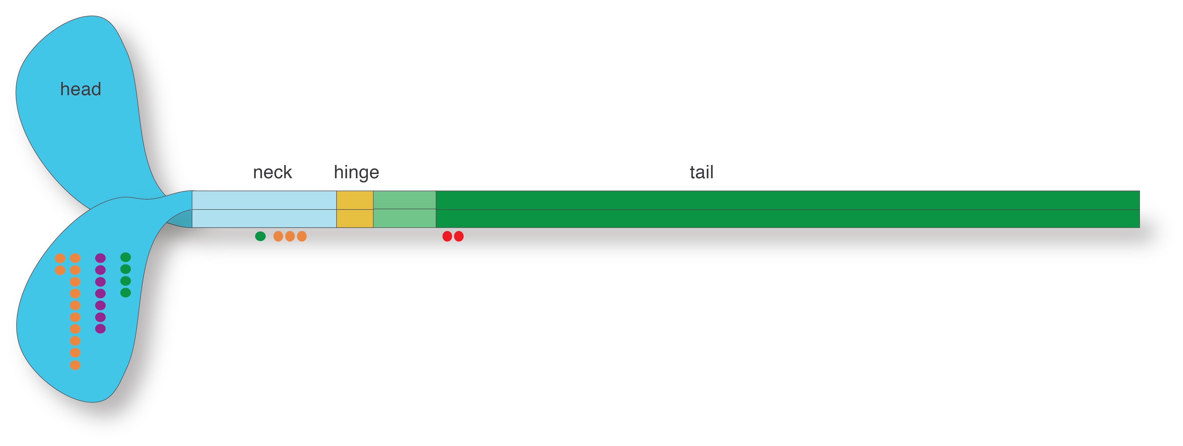
Discoveries: known gene / unexplained-known condition
3 families with ADMPS
mutations in MYH3 known to cause DA1, DA2A, DA2B
major phenotypic features:
  multiple pterygia
  severe scoliosis
  vertebral fusions
Chong et al. AJHG (2015)

Slide 16
Discoveries: known gene / unexplained-known condition
3 families
spondylocarpotarsal dysostosis
fusions of the spine, carpal, tarsal bones
mild camptodactyly, 5th digit clinodactyly
3 novel de novo missense mutations in MYH3
MYH3 expressed in muscles surrounding spine and intervertebral disks--may be expressed in carpal / tarsal spaces
hypothesize it disrupts TGF-β / BMP signaling
novel role for embryonic myosin in skeletal development
Krakow et al. (unpublished)

Slide 17
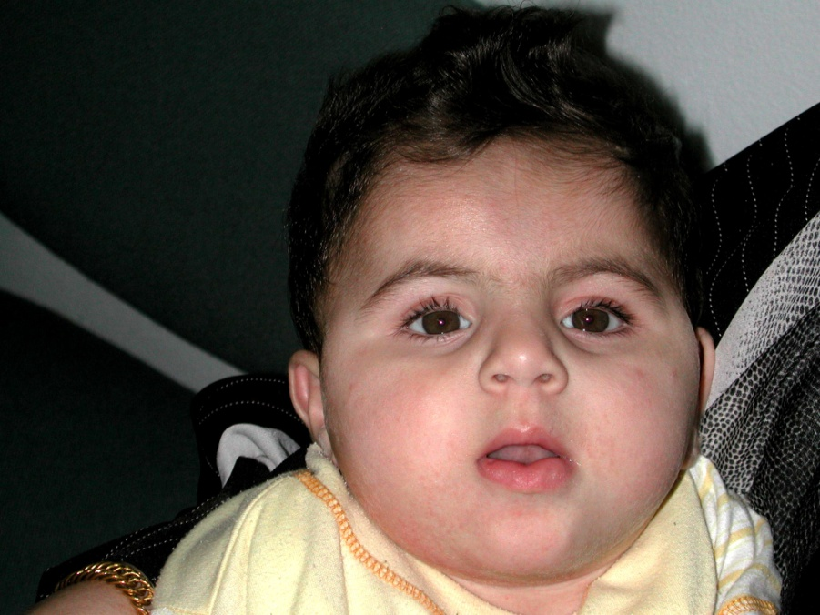
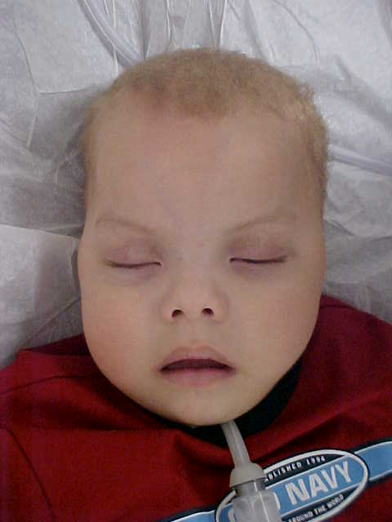
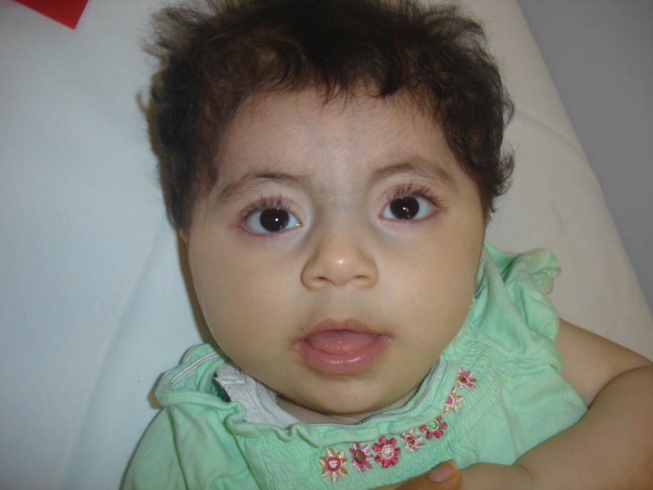
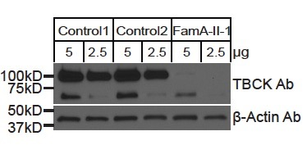
Discoveries: known gene / novel condition
4 families
profound developmental delay, hypotonia, seizures, brain atrophy, cerebellar vermis hypoplasia, facial dysmorphism
autosomal recessive
3 novel missense mutations in TBCK
encodes TBC1 domain-containing kinase
  Mutations predicted to result in LOF
phenotypes matched using Geno2MP
Chong et al. AJHG (in press)

Slide 18
rate of causal gene discovery
mean across all models is 0.50 genes discovered under conservative criteria per phenotype studied
under suggestive criteria, 0.78 genes discovered per phenotype studied

Slide 19
rate of novel causal gene discovery
novelty defined as:
  gene not previously associated with a Mendelian condition
  gene previously associated with a Mendelian condition but mode of inheritance different
  phenotype known but no causal gene known
  phenotype not previously delineated (i.e., no MIM #)
  phenotype studied has different clinical characteristics and / or natural history (phenotype extension)

Slide 20
rate of novel causal gene discovery
mean across all models is 0.50 novel genes discovered per solved phenotype studied
under suggestive criteria, 0.66 novel genes discovered per phenotype studied
  majority of these genes are "real" discoveries but only 1 family in UW-CMG
  require finding a second family to certain of correct gene and to meet journal publication requirements

Slide 21
Discoveries: summary
Discovery Type | Evidence of causality
 | Conservative | Suggestive | Total
known (n = 165)
known gene, explained-known MC | 155 | 10 | 165
novel (n = 317)
phenotypic expansion | 57 | 5 | 62
known gene, unexplained-known MC | 6 | 0 | 6
known gene, new MC | 26 | 47 | 73
novel gene, unexplained-known MC | 5 | 9 | 14
novel gene, new MC | 59 | 103 | 162
total | 308 | 174 | 482

Slide 22
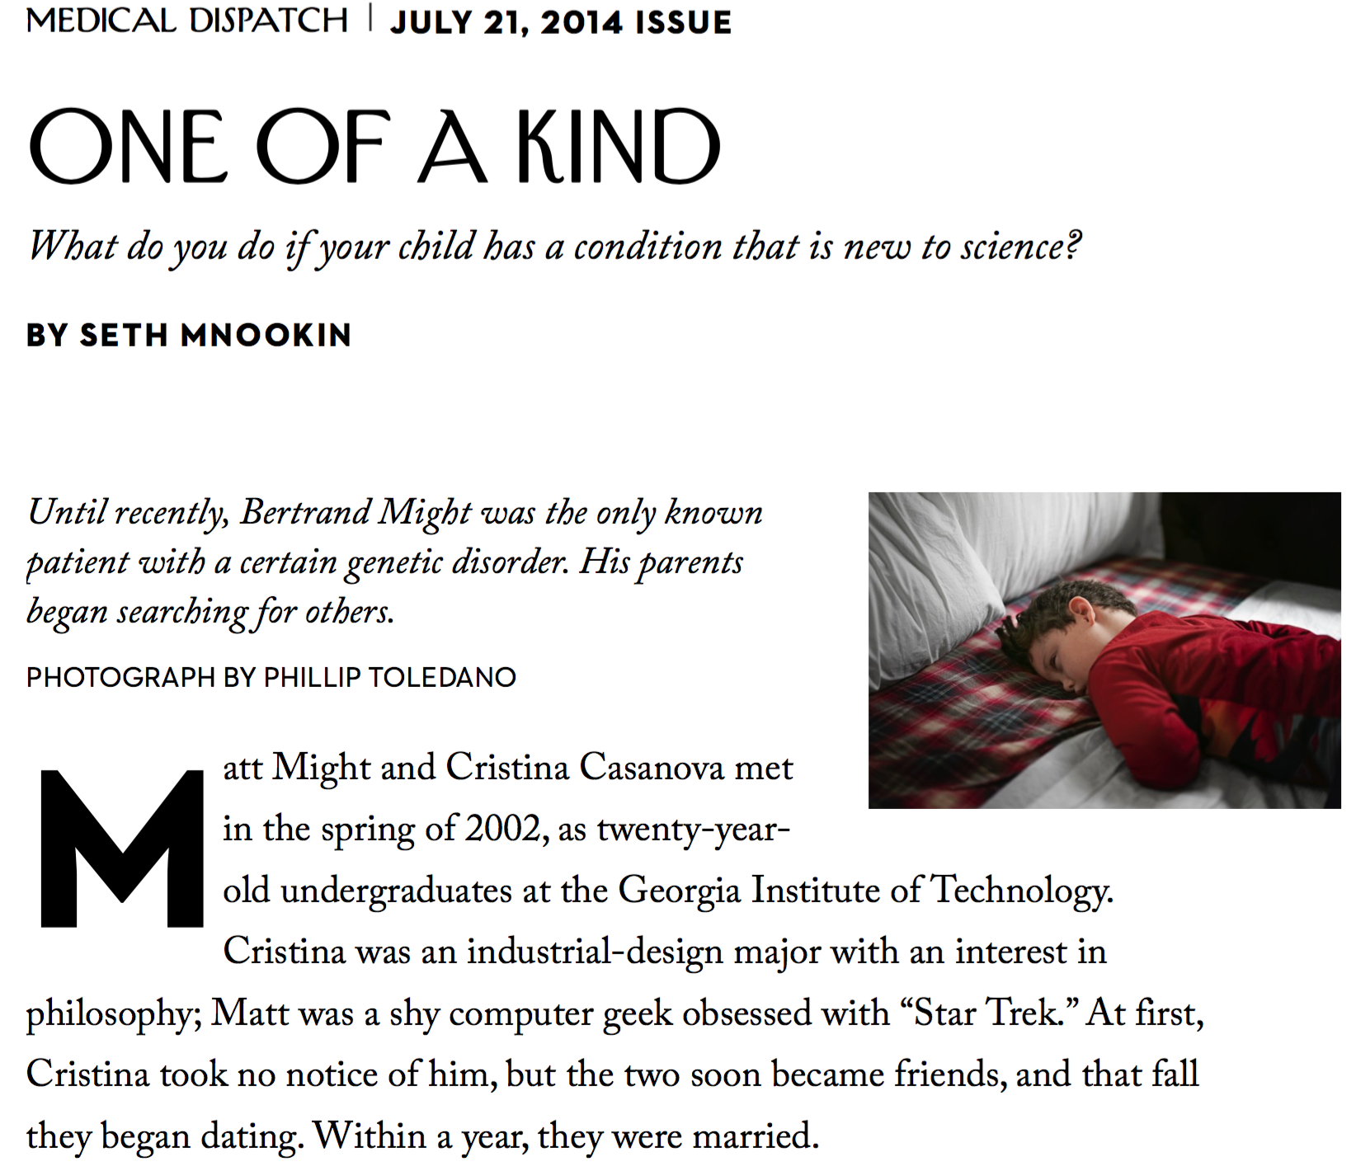
Gene discovery by social networking
long history in medical genetics — analog, slow, clinicians and researchers
faster pace in digital age with more leadership from families
popularity increased with press accounts of efforts of Matt and Cristina Might
  informed that NGLY1 was a candidate gene but no other families known
  created a blog that was found by a 2nd family in which NGLY1 was a candidate

Slide 23
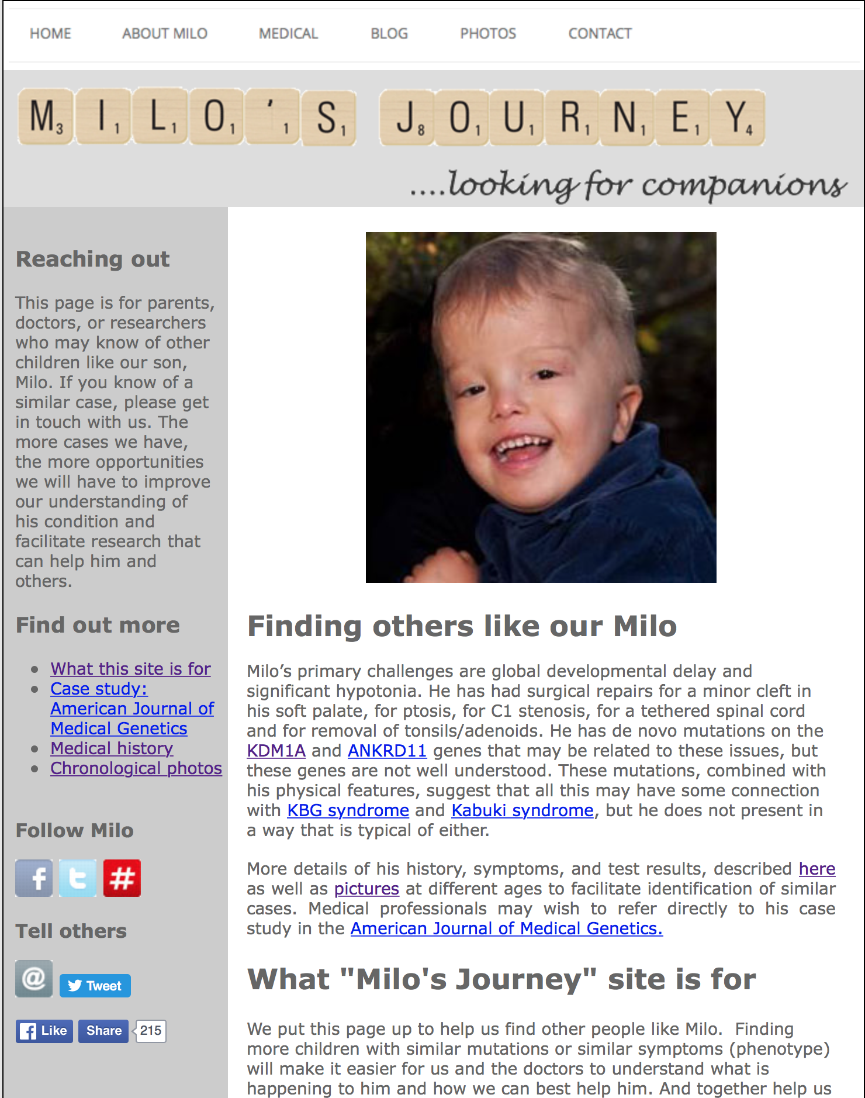
Gene discovery by social networking
inspired by the Might family, other families tried to replicate their success
Peter Lorentzen and Karen Park
  Son with undelineated condition
  Candidate variants in KDM1A and ANKRD11
  Created a blog

Slide 24
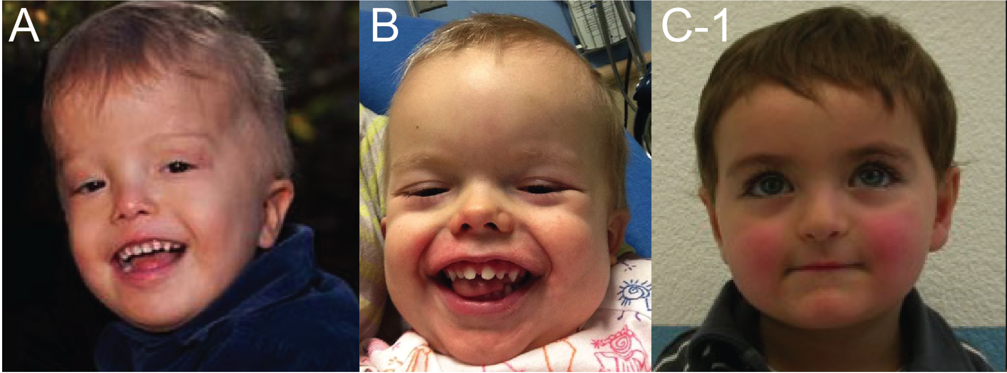
Gene discovery by social networking
4 days later contacted by a 2nd family in which KDM1A identified as a candidate
found 3rd case in supplemental data but investigator didn’t respond
contacted UW-CMG to confirm findings and help put story together
delineation of a novel syndrome caused by a novel gene

Slide 25
Gene discovery by social networking
Existing shortcomings
blogs / FB pages / websites require:
  technical knowhow
  education
  money
information fragmented
  not searchable (cannot just search for all families with mutations in a gene)
matching imprecise
  Information not standardized

Slide 26
MyGene2
family-facing, public, searchable

Slide 27
MyGene2: Family Profile

Slide 28
MyGene2: Family Profile

Slide 29
MyGene2: Family Profile

Slide 30
MyGene2: Family Profile

Slide 31
MyGene2: Family Profile

Slide 32
MyGene2: Family Profile

Slide 33
MyGene2: Family Profile

Slide 34
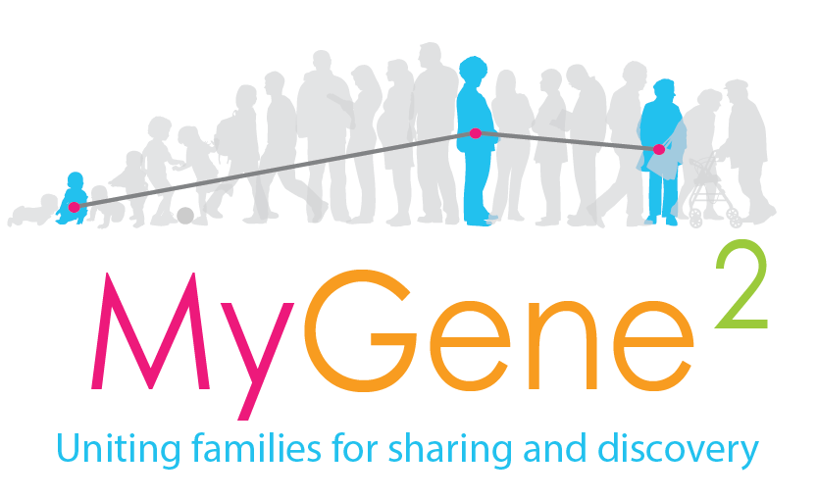
MyGene2: Family Profile
MyGene2 is family-facing, searchable, and browseable by everyone.
families, clinicians, and researchers enter the same type of data into the same database and have the same level of access to the data.
families choose how much data to share and can share only basic genetic information (e.g., a candidate gene) or all of their DNA sequence data (e.g., a VCF file).
families, clinicians, and researchers who contribute data to MyGene2 can contact one another.
MyGene2 users can choose to be notified automatically if another user enters the same candidate gene.
future directions
  implement API for MME
  MyGene2 case reports
  tools for viewing sequence data (gene.iobio)
  tools for analysis
  automated public discovery reporting

Slide 35
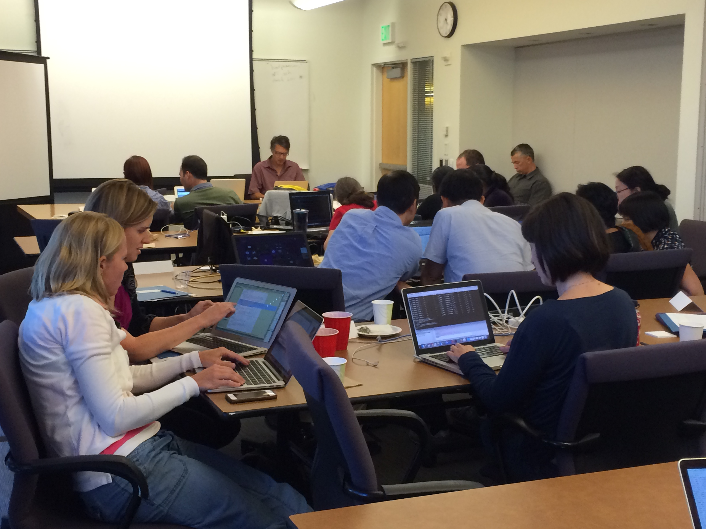
UW-CMG analysis workshop
August 8-12; 5 full days
attendance limited to 20 persons
minimum level of experience required
focused on analysis strategies-lecture followed by hands on exercises
using mock datasets and providing time to attendees to analyze their own data
analysis package used is GEMINI

Slide 36
What differences have the CMGs made?
Summary

Slide 37
diagnostic rate
causal gene identified in 42-60% of families
  advantage to analyze multiple families with same phenotype
34% total families could be explained by novel genes that currently only meet suggestive criteria

Slide 38
Definitions
Discovery
What is a novel phenotype?
  unexplained phenotype - aka OMIM entry says it is yet to be solved
  new phenotype - hasn't been described, no OMIM number
  phenotype extension - new, fewer, or more features for a known phenotype
  apparent novel phenotype
What is novel gene for a Mendelian condition?
  no Mendelian phenotype associated with gene as of project acceptance into CMG
What is solved?
  multiple families with variant(s) in the same gene is compelling by itself
  if variant found in only one family, then solved requires both:
    mapping data (sufficient to give high confidence variant must be in region)
    compelling molecular functional data (expression of gene in relevant tissue is not sufficient)
      for role of gene in phenotype; e.g. encoded protein involved in perturbed system
      for role of variant in altering gene's function; e.g. variant alters protein function
      recapitulation of phenotype in model organism; e.g. peroxisome biogenesis defect in both
    if compelling functional data generated as described above and mapping data not possible given family size, can consider solved anyway (?)

Slide 39
Methods
Discovery
only counting projects for which a “first pass” analysis is complete:
  excluding:
    PI hasn’t reported to CMG (i.e., gene found or not found) and project has been released <1 year
    first pass analysis is complete but Sanger validation pending
  including:
    analysis is complete with or without a gene found
    a project has been released for >1 year and PI hasn't reported (assume no gene found)
assess project submissions to determine how many phenotypes included
  default assumption is single phenotype/single gene
  some projects consist of multiple phenotypes (e.g., Joubert syndrome, distal arthrogryposis) and were grouped together for convenience
reviewed all reports by and correspondence between CMG and PI analysts to determine model of inheritance, names of causal genes, etc.

