Slide 1

Baylor-Hopkins
Center for Mendelian Genomics
David Valle, MD, PI
James Lupski, MD, PhD, co-PI
CMG Face to Face, 11 April 2016

Slide 2
BHCMG: Goals and Aims
Overall objective: To identify phenotypes and the molecular basis for more than half of our genes
To expand and enhance sample recruitment and phenotyping
  “Boots on the ground”
  Interact with international medical centers tied to BCM or JH
  Enhance referral pipeline from clinical WES labs
  Automated OMIM inquiries
  PhenoDB enhancements
Refine sequencing and analysis strategies
Improve dissemination of results
Develop reagents and strategies for scalable functional testing

Slide 3

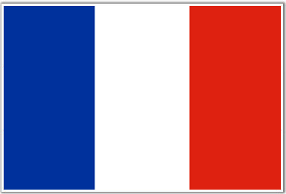

























BHCMG WES
01 April 2016
Consented Samples: 9032
Institutes: 159
Investigators: 403
Countries: 29
Norway:101
Canada: 30
France: 1
NL: 200
Macedonia: 4
UK: 74
Germany: 28
Poland: 455
Turkey: 644
USA: 6,827
Belgium: 280
Pakistan: 1
India: 1
Mexico: 11
Taiwan: 1
Colombia: 1
Australia: 107
Ecuador: 23
NZ: 1
Peru: 3
UAE: 15
Brazil: 110
Lebanon: 1
S. Arabia: 59
Oman: 1
Chile: 8
Argentina: 18
Italy: 12
Israel: 15

Slide 4
BHCMG Summary Data
Category | Number
Consented samples | 9032
Investigators | 403
Institutions | 159
Countries | 29
Phenotypes | 776
Novel | 56%
Known (in OMIM) | 44%

Slide 5
BHCMG Summary Data
Category | Number
Exomes | 6769
Disease genes -- total | 468 *
Novel | 222
Known | 246
Phenotypic expansion | 136 (55%)
* Y4Q4 data

Slide 6
BHCMG Data Release
Category | Number
Samples to dbGap | 968
Exomes to Geno2MP | 575*
Variants to ClinVar | 670
Genes to MME | 554
Papers
Published | 116
in Press | 8

Slide 7
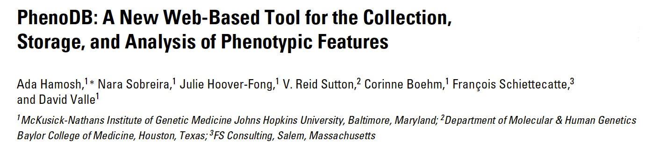
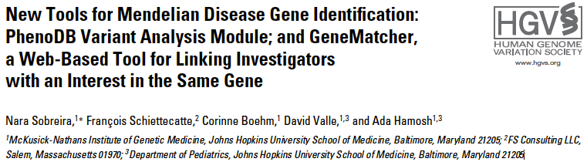
Hum Mut 34:561, 2013
Hum Mut 36:425, 2015
http://phenodbresearch.net
http://phenodb.org

Slide 8
PhenoDB* Status for BHCMG
Data on 4,426 projects including 53 cohorts ranging from 5-295 subjects/cohort
Phenotypic data from more than 10,284 individuals
WES VCF and ANNOVAR files on > 6,225 samples
Incorporates an analysis tool
Continually adding enhancements
PhenoDB has been downloaded by more than 367 centers
*
www.mendeliangenomics.org

Slide 9
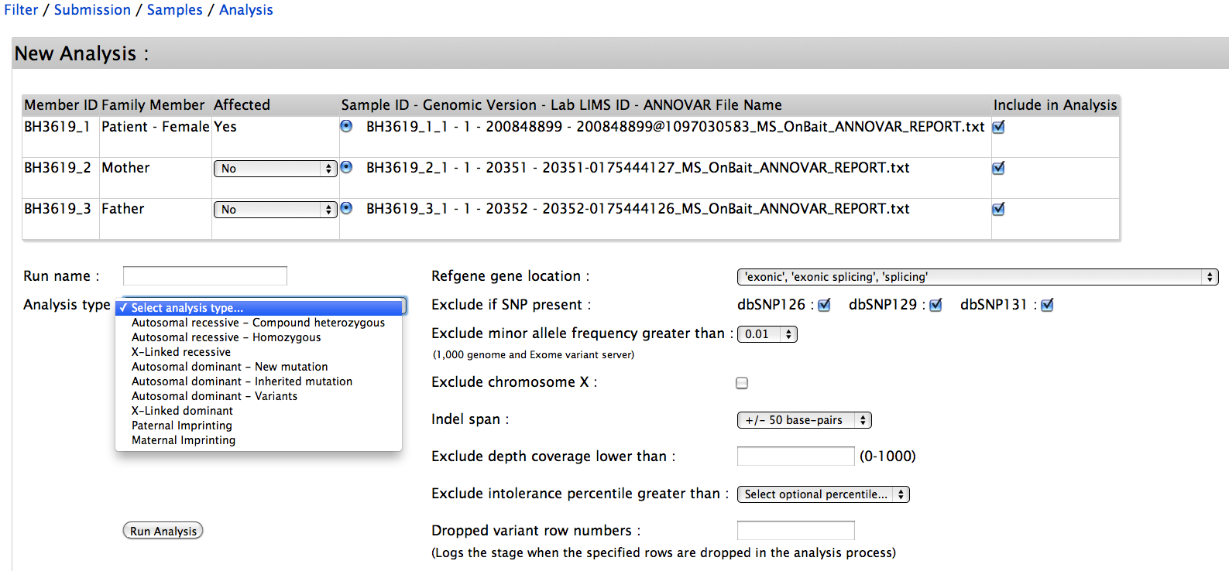
PhenoDB Variant Analysis Tool

Slide 10
PhenoDB Features
ANNOVAR files are created as VCFs are uploaded, and 3 standard analyses (AD, AR homozyg, AR cpd het) are generated
Automatically creates a file for pathogenic or likely pathogenic incidental findings in the ACMG 56 genes
Utilizes phenotypic info and OMIM algorithm to suggest possible diagnoses and to flag relevant known Mendelian disease genes in the candidate gene list
An API allows transfer of final results (gene names, genomic coordinates, features) from PhenoDB to GeneMatcher

Slide 11
PhenoDB Features (continued)
Proband information fully searchable including:
  One or a combination of clinical features
  Phenotypic features algorithm identifies other probands with similar features
  Selected by shared variants, genes, genomic coordinates
VCFs, analysis results files, final results files all searchable by genes or variants

Slide 12
PhenoDB Features in progress
Analyses are automatically repeated at monthly intervals with creation of new file if there are changes and notification of the administrator of entries with new files (pilot being tested)
APIs for automatic transfer of data to ClinVar, dbGaP and BEACON all in progress

Slide 13
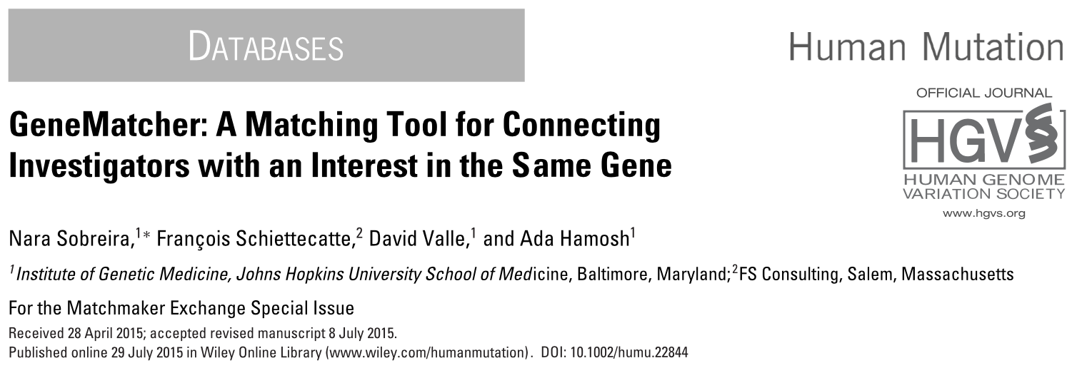
GeneMatcher
http://genematcher.org

Slide 14
GeneMatcher Overview
Designed to connect investigators (clinicians, basic scientists) with an interest in the same gene
All data de-identified so IRB not required
Automated and continuous matching
Submitters connected by a match can choose to collaborate at their own discretion
Matching on phenotypic features added on 1 Oct 2015
Connected to MME

Slide 15
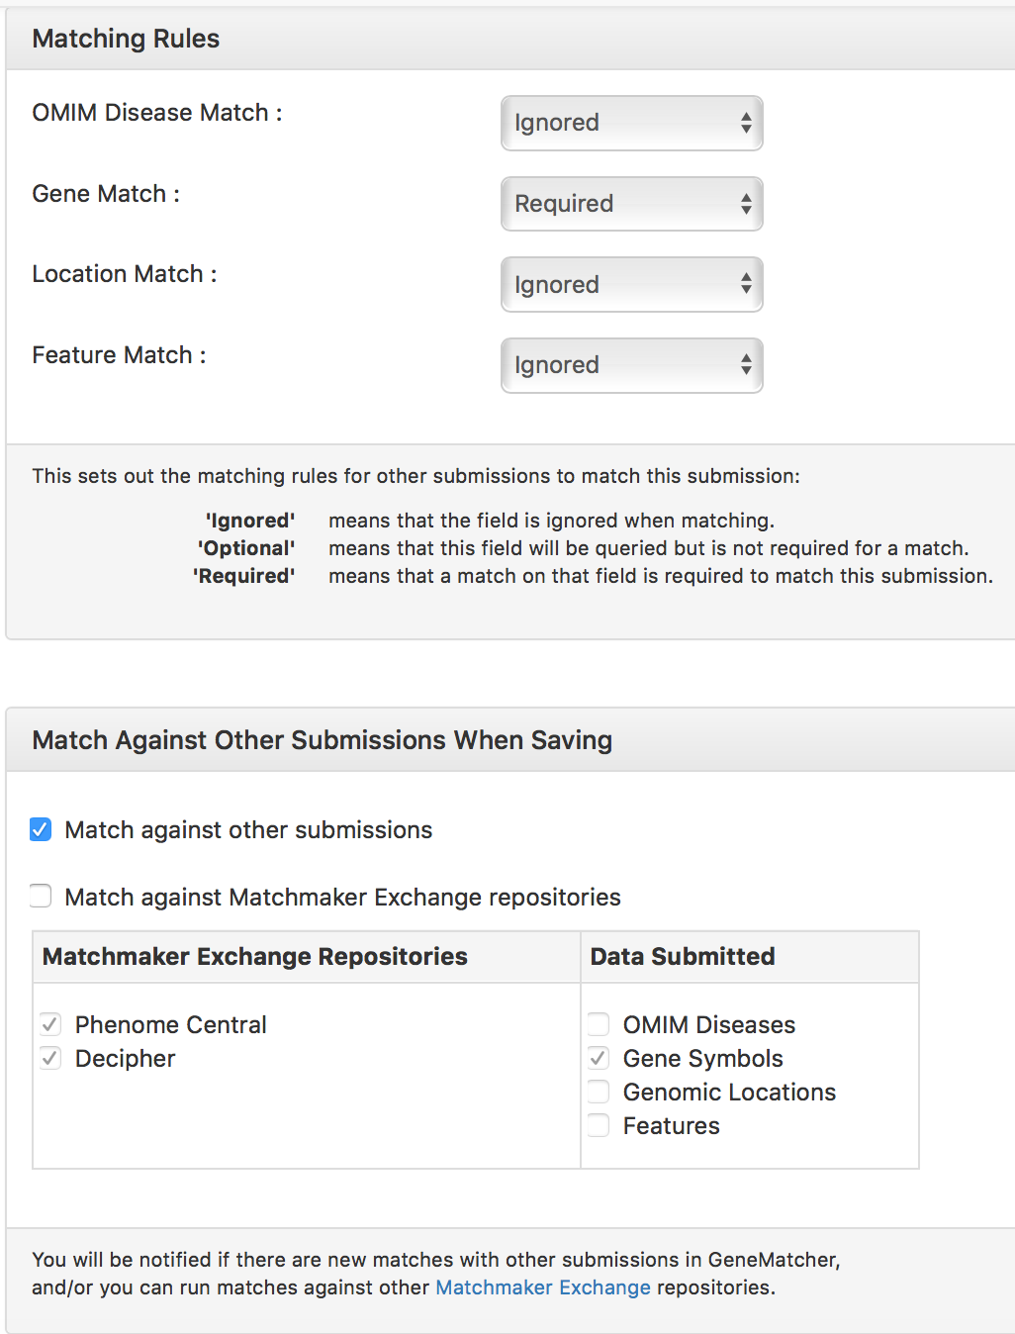
GeneMatcher: Matching Options

Slide 16
GeneMatcher: Growth in Genes & Matches
4247
1521 submitters
51 countries
2, 221 matches
2221
Number
Time

Slide 17
Origins of Submissions to GeneMatcher as of 4/1/16
Total of 5,672 submissions from 1,521 submitters in 51 countries

Slide 18
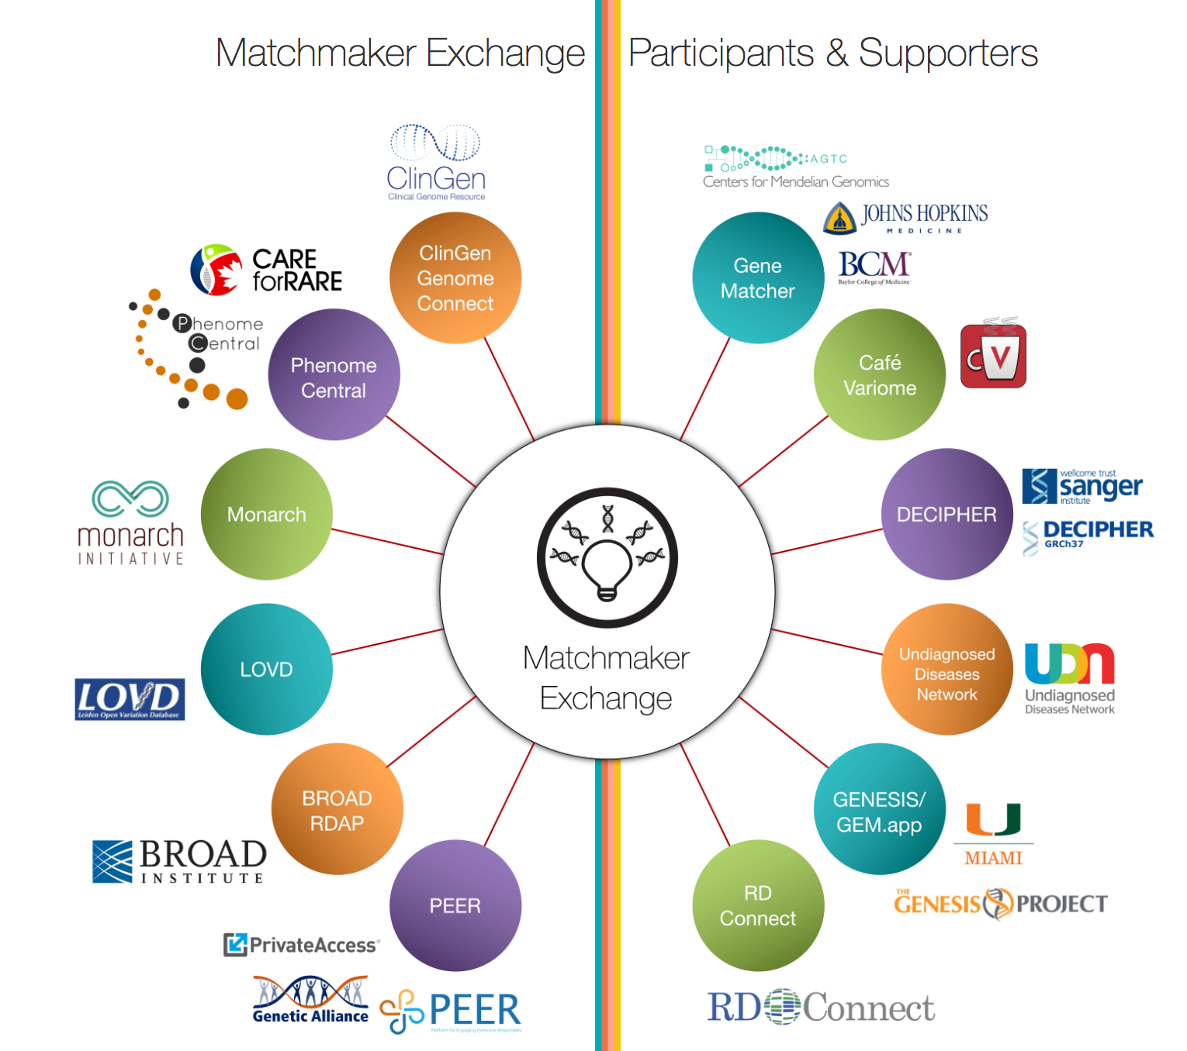
Canada
US
UK
As of April 1st 2016 GeneMatcher has:
81 matches with PhenomeCentral
74 matches with DECIPHER

Slide 19
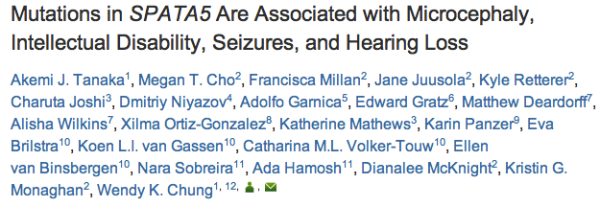
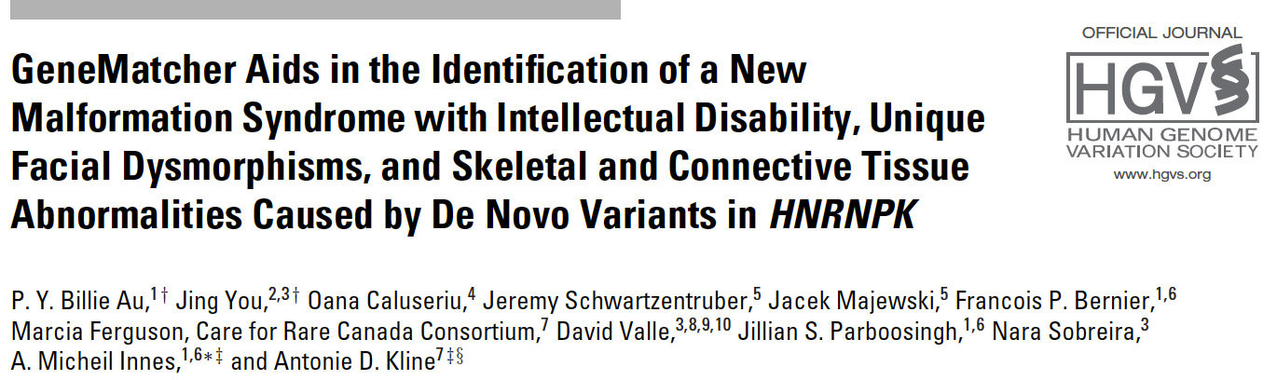
GeneMatcher: Some successes
AJHG 97:457-64, 2015
Hum Mutat. 36:1009-14, 2015

Slide 20
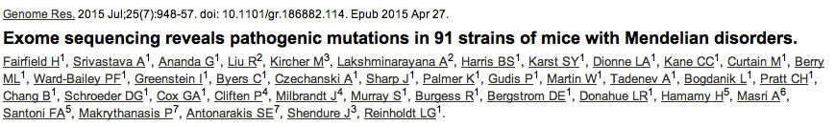
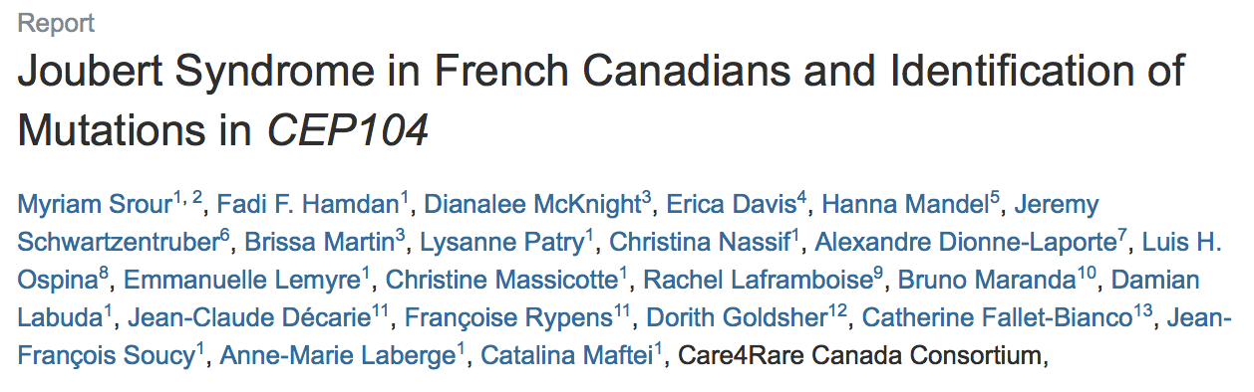
GeneMatcher: Some successes
Gen Res, 2015
Am J Hum Genet. 97:744-53, 2015

Slide 21
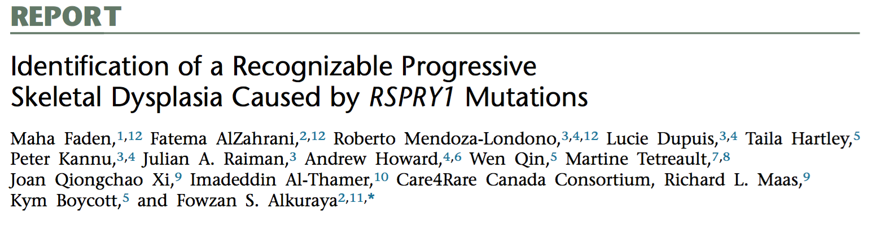
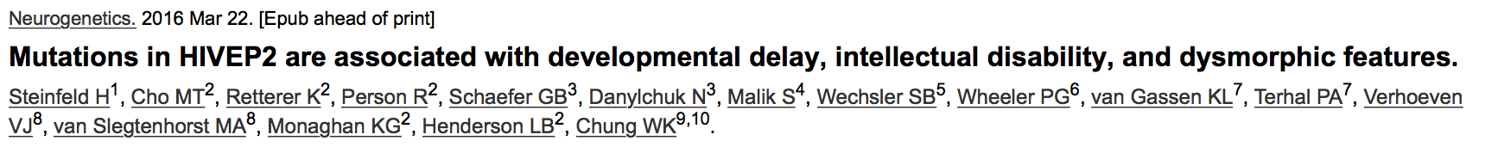
GeneMatcher: Some successes
AJHG 97: 608, 2015
Neurogenetics Mar22, 2016

Slide 22
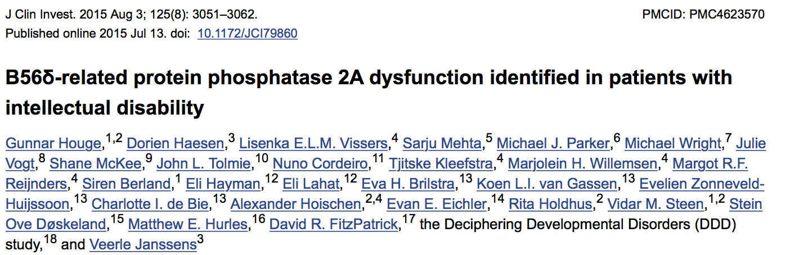
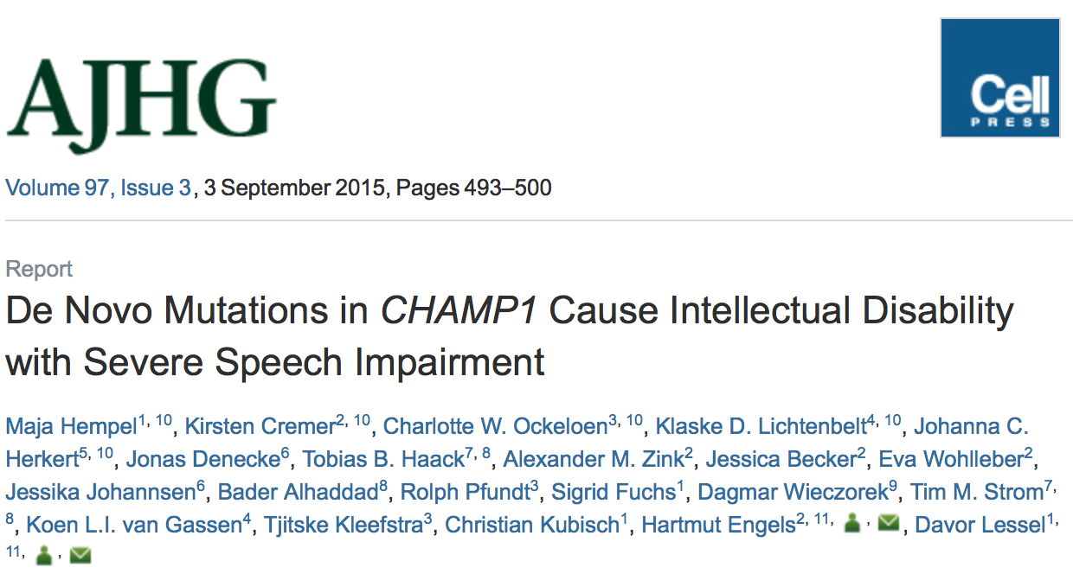
GeneMatcher: Some successes
JCI 125: 3051, 2015
AJHG, 97: 493, 2015

Slide 23
JH GeneMatcher Experience
Families under investigation -- 381
Submissions for -- 104
Genes submitted -- 280
Matches -- 314
  Genes -- 113 (40%)
  Submitters -- 76

Slide 24
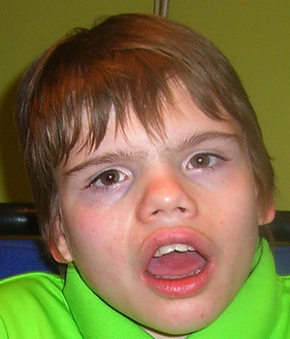
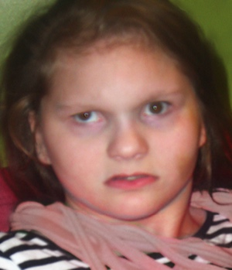
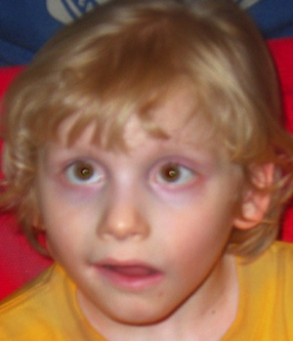
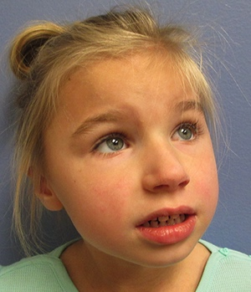

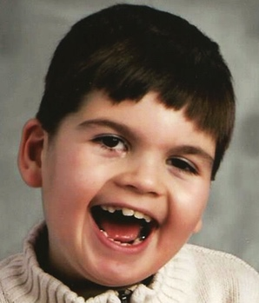
TELO2: Pedigrees and Clinical Features*
Family 1
Family 2
Family 3
Family 4
1
2
1
2
1
2
1
2
I
p.Cys367Phe/+
p.Asp720Val/+
p.Val766Met/+
p.Cys367Phe/+
p.Pro260Leu/+
p.Arg609His/+
p.Asp720Val/+
IVS16+1G>A,
p.Gln172X/+
II
1
2
3
4
1
2
3
1
1
p.Cys367Phe
p. Asp720Val
p.Cys367Phe
p.Asp720Val
p.Cys367Phe
p. Asp720Val
p.Cys367Phe
p.Val766Met
p.Pro260Leu
p.Arg609His
p.Asp720Val
IVS16+1G>A, p.Gln172X
B
Severe ID
Seizures
Abnormalities of the great vessels ?
* Jing You
Notes:
Protein has to be changed

Slide 25
TELO2 and the TTT Complex
TTI1
TTI2
R2TP complex
TTT
TELO2
P
P
Hsp90
Hsp90
CK2
Assembly and maturation
Phosphatidylinositol 3-kinase-related protein kinases (PIKKs)
ATM
ATR
PRKDC
mTOR
SMG1
TRRAP
DNA
DSB
repair
Replication stress
DNA DSB
repair
Cell
growth control
Nonsense mediated decay
Gene
expression control
Ataxia
Telangiectasia
Seckel
syndrome I
Lovejoy CA et al., 2009; Hořejší et al.,2010; Takai et al.,2007
Notes:
The interaction of the TTT complex with Hsp90 and the R2TP complex involves a covalent linkage of phosphorylated residue Ser492 in TELO2 to the Pih1 scaffold component of the R2TP complex and binding of the RPAP3 componenet of R2TP to the homodimerica Hsp90.
----- Meeting Notes (10/13/14 18:40) -----
family proteins
nonsense mRNA decay
----- Meeting Notes (10/16/14 19:34) -----
TTI1,2 differnet color
dashed lines to Hsp90
PIKKs black
boxes higher: DNA DSB repair
PIKK family members
ATR seckel syndrome
refence further
----- Meeting Notes (10/17/14 18:53) -----
the ttt complex shown here

Slide 26
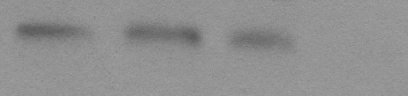
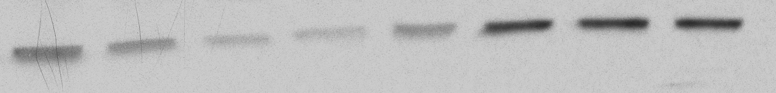
TELO2 variants affect the stability of TTT complex *
Family 1
Family 2
C.1 C.2 C.3 II-2 II-3 II-4
C.1 C.2 C.3 II-2
TELO2
TELO2
TTI1
TTI1
TTI2
TTI2
β-Actin
β-Actin
Family 1
C.1
I-1
II-2
II-3
II-4
I-2
C.2
C.3
TELO2
TTI1
***
TTI2
***
β-Actin
* In press, You et al., AJHG

Slide 27
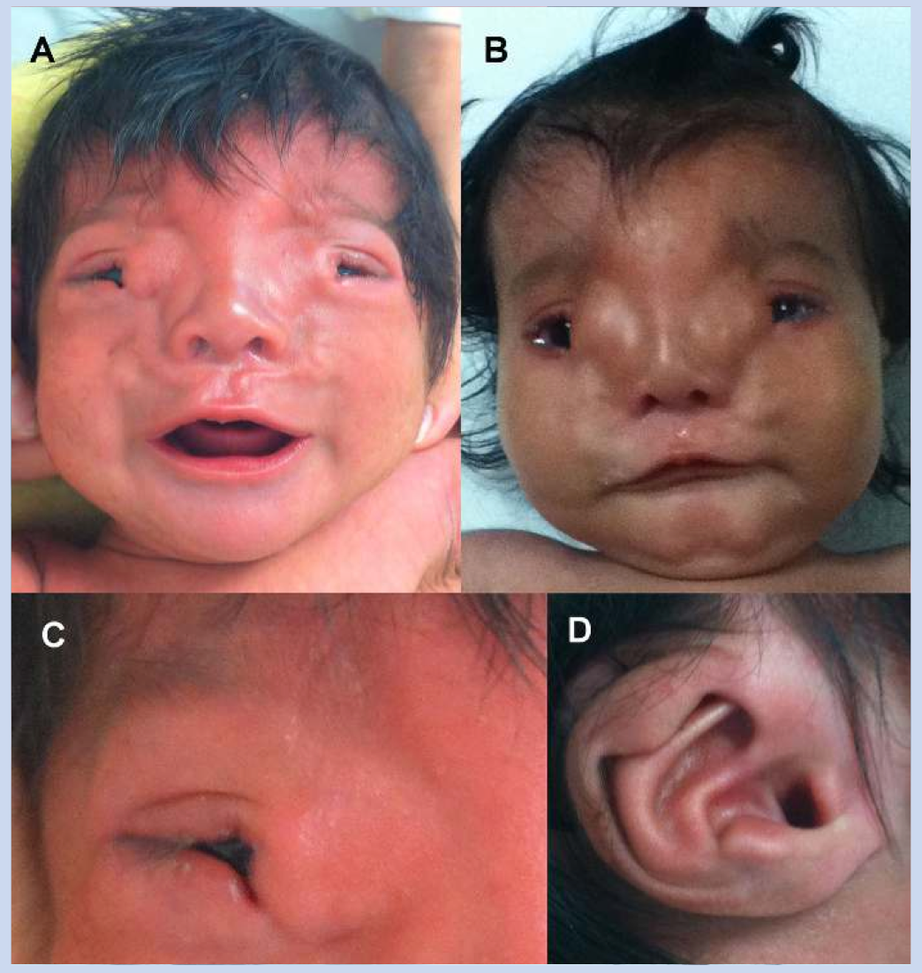
Using the imprinting tool in PhenoDB analysis
Palpebral coloboma-lipoma syndrome
Paternal de novo LOF heterozygous variant, c.6245_6246 insTT (p.H2082fs*67)
Maternal allele also with variant, N696H
ZDBF2 is imprinted and paternally expressed
* Chacon-Camacho et al., 2013

Slide 28
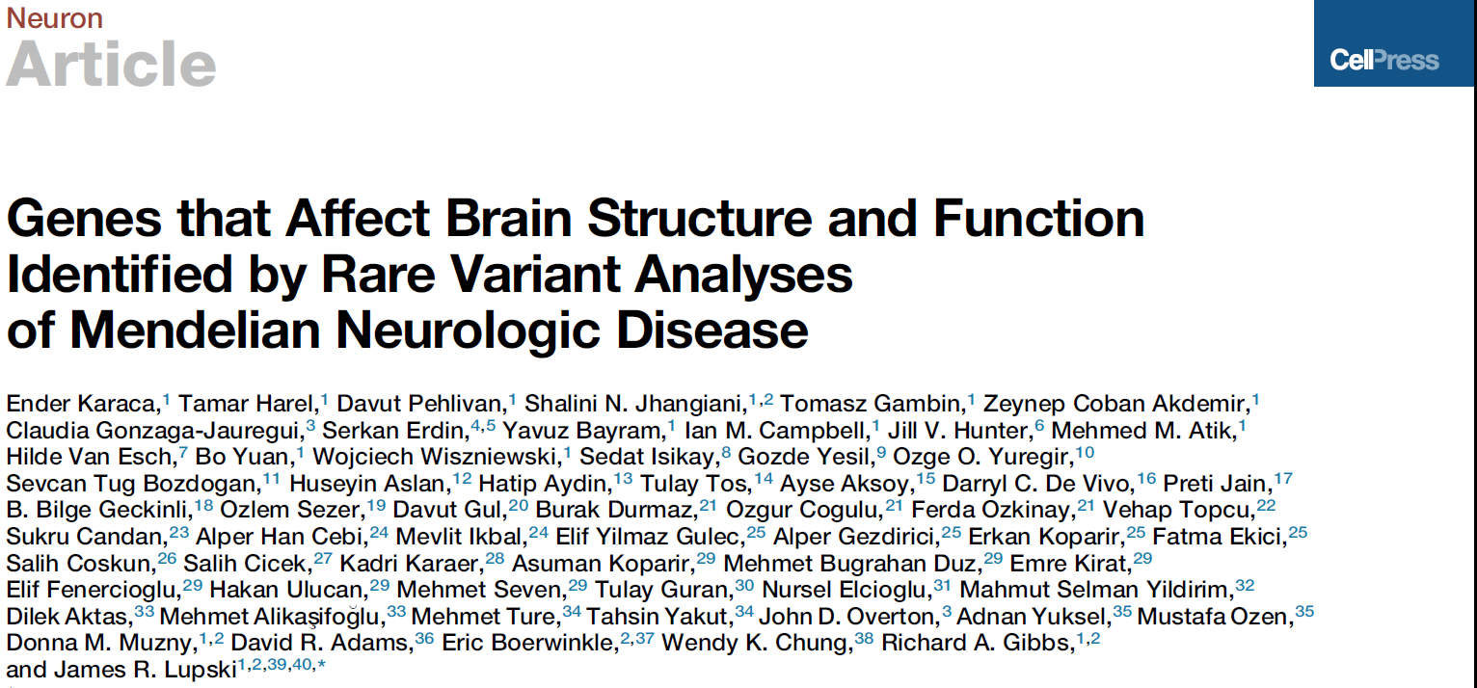
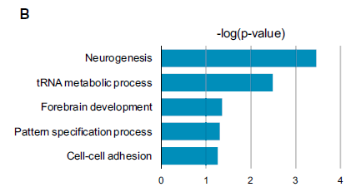
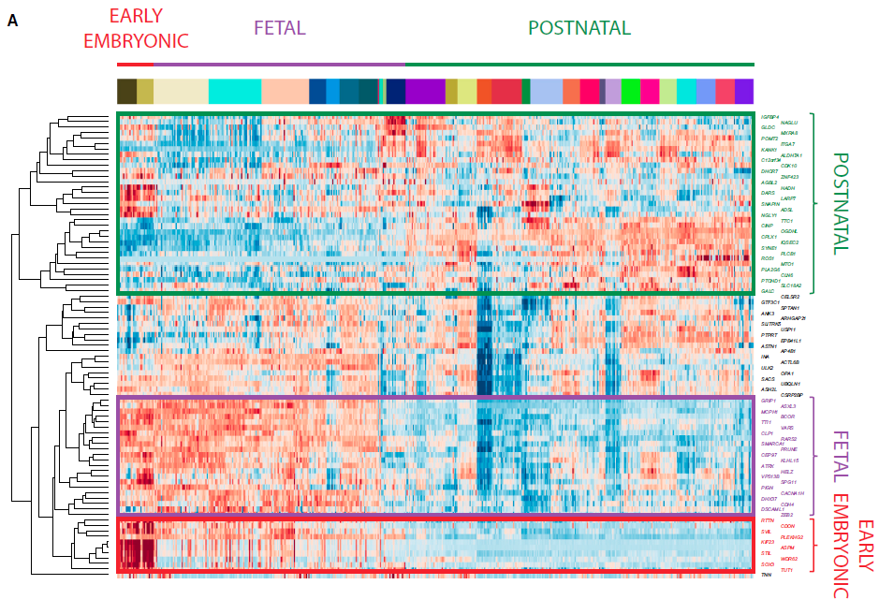
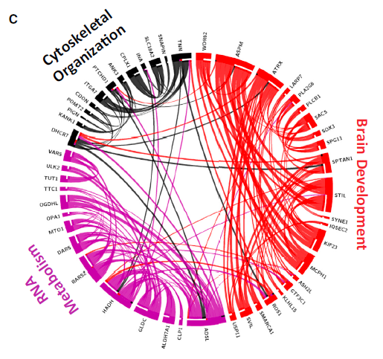

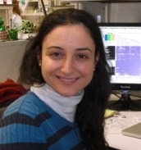
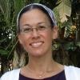
Neuron 88: 499-513
expression, annotation,
and pathway analysis
of known and
candidate brain genes
Zeynep
Coban Akdemir
Ender Karaca
Tamar Harel

Slide 29
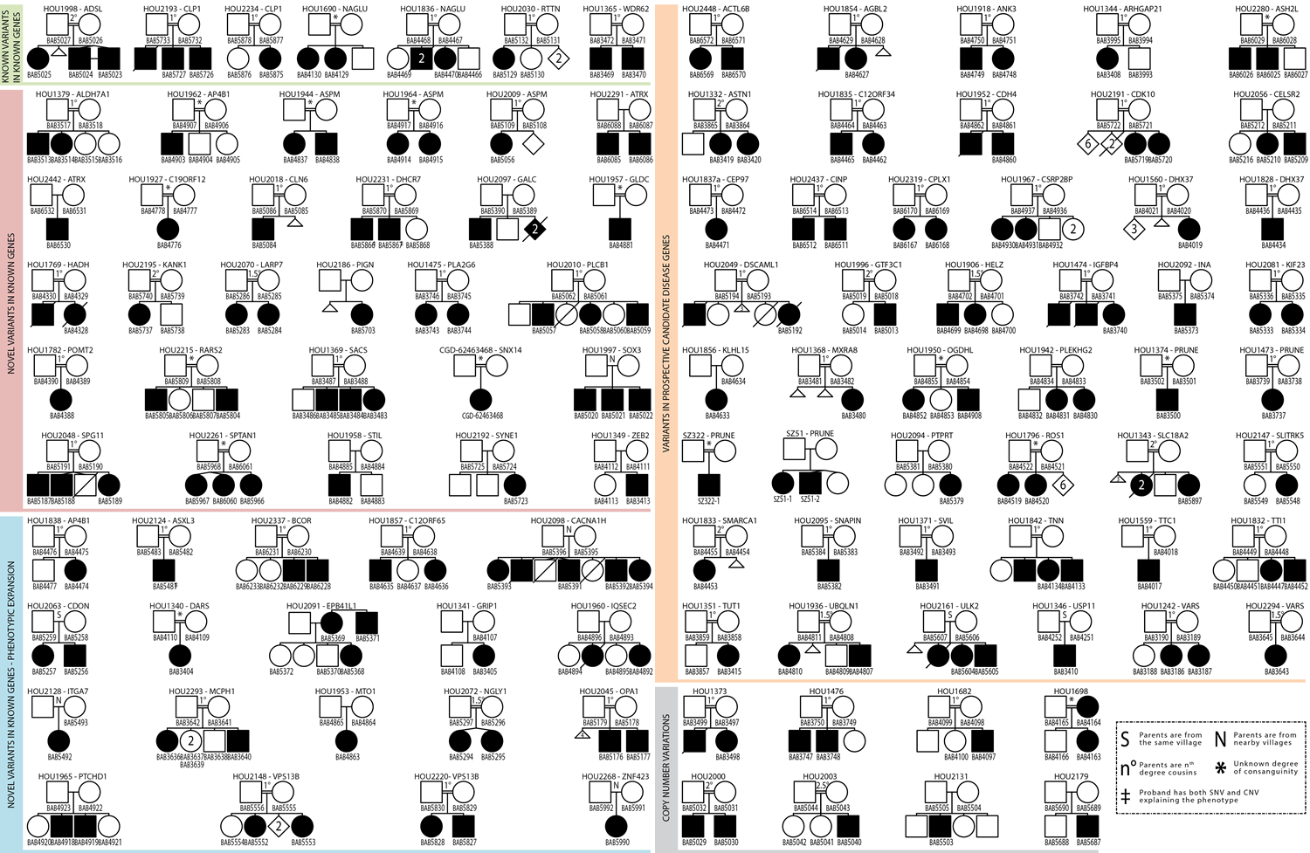
Pedigree structures of families enrolled in brain malformation study who were found to have candidate genes

Slide 30
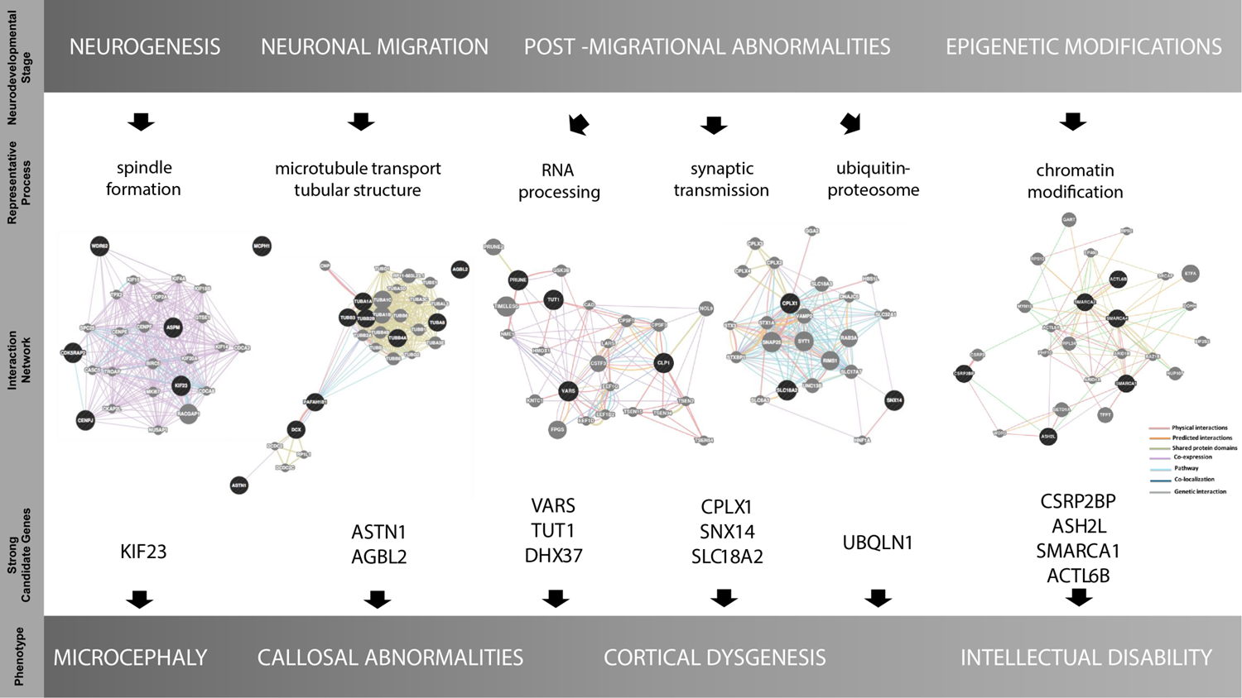
Suggested Correlation among Neurodevelopmental Stage, Representative Process, Strong Candidate Genes, and Phenotype

Slide 31
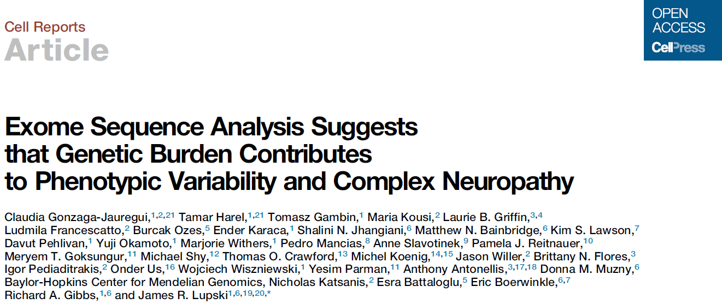
Gonzaga-Jauregui, et al (2015)
Cell Reports 12: 1169-1183
Highlights:
•WES of a neuropathy cohort identifies causal variants in ∼45% of patients
•Three candidate peripheral neuropathy disease genes
(PMP2, DNAJB5, SPTLC3) proposed
•Evidence for genetic mutation burden found in two independent cohorts
•Variant combinatorial effects may contribute to
clinical variability and expressivity

Slide 32
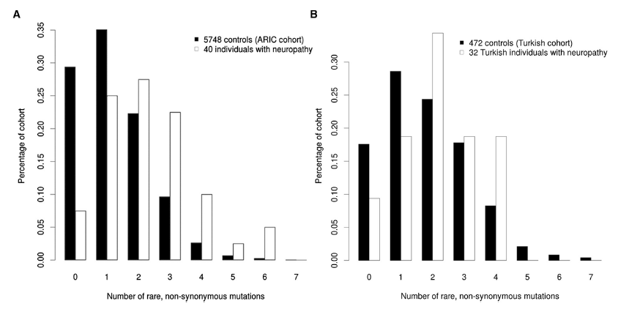
Rare Variant Distribution in Studied Individuals Suggests High Carrier Frequency for Rare Alleles in Neuropathy Genes in Exome Sequenced Neuropathy Cohort
HYPOTHESIS: Genetic architecture of Dz:
Rather than single-locus strong association across populations, each individual with a
common/complex trait may carry a ‘handful’ of rare/private vrnts (incl SNV + CNV) in
their personal genome that are important to the development of the Dz process

Slide 33
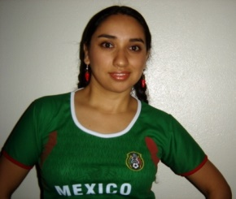

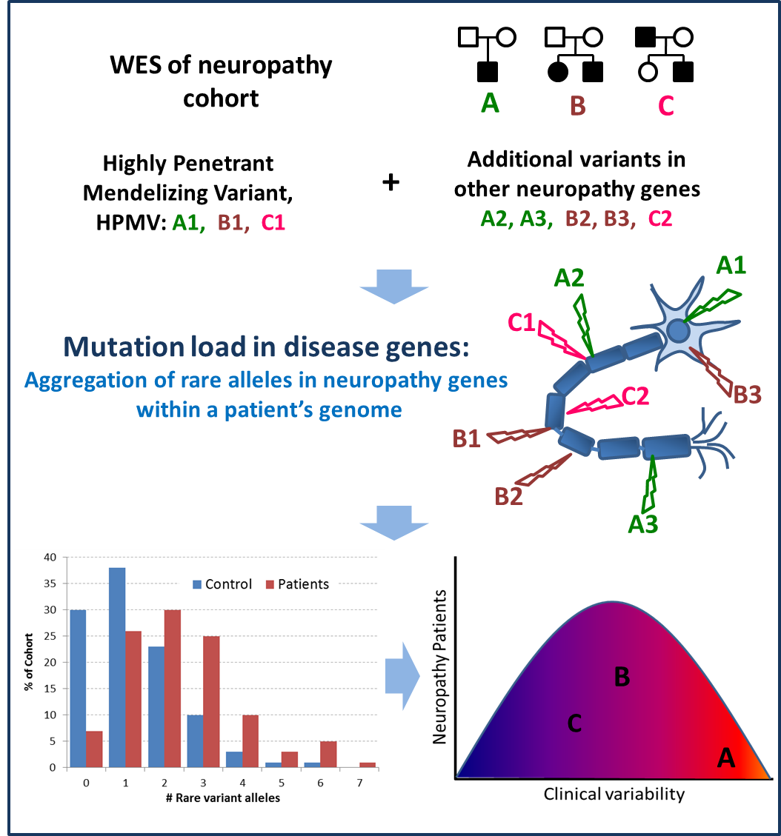


Mutation burden & Dz
Claudia
Gonzaga-
Jauregui
Tamar
Harel
37 unrelated families CMT-like
peripheral neuropathy
refractory to molecular Dx
WES, study rare vrnts in
neuropathy genes in
subjects vs cntrls
evidence for burden NA cohort
replicate in 2nd (Turkish) pt pop
Combinatorial effect of
rare variants contributes
to Dz burden & variable
expression of Dz
Gonzaga-Jauregui, Harel, et al.
(2015) Cell Reports 12:1169-1183
Gibbs, Battaloglu, Boerwinkle,
Katsanis & Lupski Labs
+
=
X
X
X
Sub-optimal dose
morpholino A1
Sub-optimal dose
morpholino A2
phenotype
Model genetic interactions in zebrafish

Slide 34
Thanks for your attention
BCM:
Jim Lupski
Richard Gibbs
Eric Boerwinkle
Shalini Jhangiani
Reid Sutton
Zeynep Coban Akdemir
Woj Wiszniewski
Wu-Lin Charng
Donna Muzny
Amy McGuire
Chad Shaw
Matt Bainbridge
Betty Fernandini
JH:
Ada Hamosh
Julie Hoover-Fong
Corinne Boehm
Dimitri Avramopoulos
Nara Sobreira
Dane Witmer
Kim Doheny
Kurt Hetrick
Hua Ling
Lee Watkins
Alan Scott
Aravinda Charavarti
Debra Mathews
Sandra Muscelli

