Slide 1
Datasets Summary Roadmap, GTEX, ENCODE, TCGA
Shuang Liu-P2 Tech
03/31/2016

Slide 2
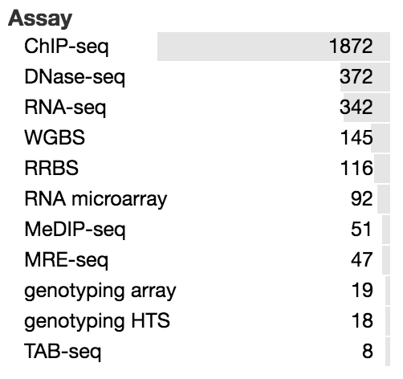
Roadmap Epigenomics Mapping Consortium
The current release 9 contains a total of 2,804 genome-wide datasets ( total of 150.21 billion mapped sequencing reads corresponding to 3,174-fold coverage of the human genome), including
1,821 histone modification datasets
360 DNase datasets
277 DNA methylation datasets
166 RNA-Seq datasets
https://www.encodeproject.org/search/?type=Experiment&replicates.library.biosample.donor.organism.scientific_name=Homo+sapiens
Notes:
Normal epigenomic data including chip seq and Methylation measurement /in brain middle/ 11 adult brain regions and some fetal brain 8 histone markers/129 tissue and cell type/
Release 9 includes a subset of 1,936 datasets grouped into 111 reference epigenomes where each reference epigenome contains a complete set of five core histone marks (H3K4me3, H3K4me1, H3K27me3, H3K9me3, and H3K36me3)(bam, bed, wig)

Slide 3
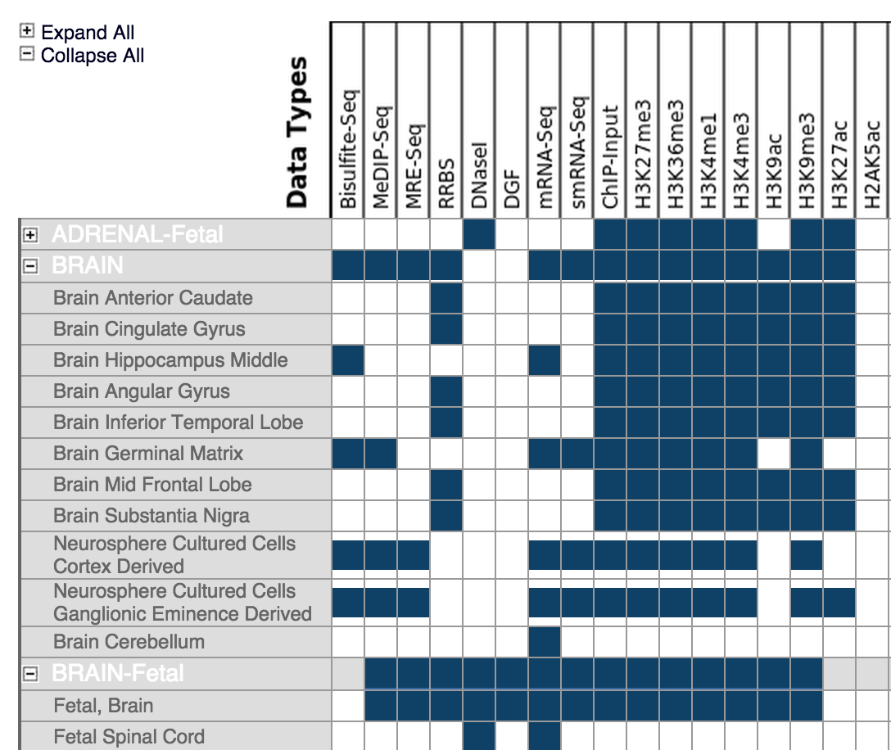
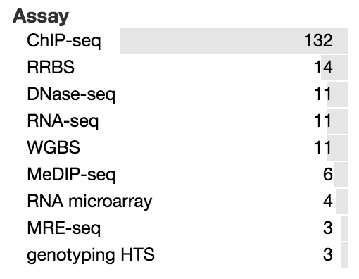
Roadmap human brain data
12 Adult brain regions

Slide 4
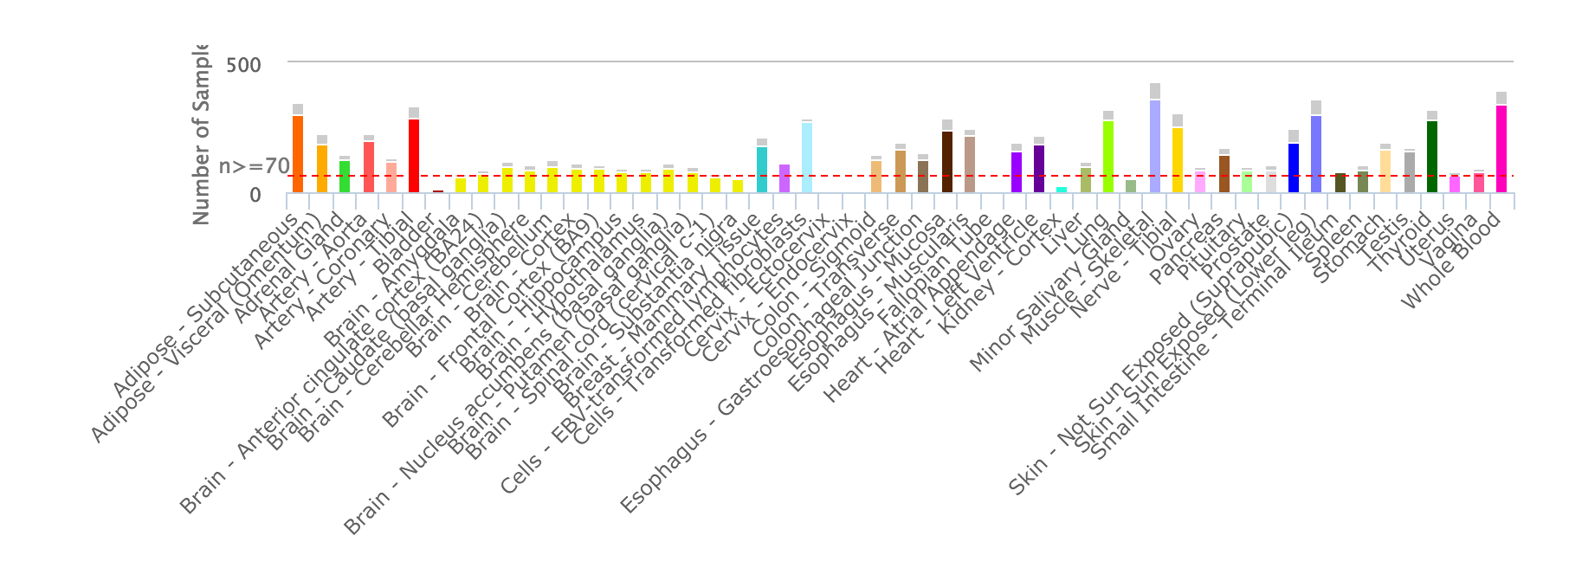
The Genotype - Tissue Expression (GTEx) Project
Notes:
Collect and analyze multiple human tissues from donors who are also densely genotyped, to assess genetic variation within their genomes. 13 brain regions. By analyzing global RNA expression within individual tissues , identified as expression quantitative trait loci, or eQTLs.

Slide 5
The Genotype - Tissue Expression (GTEx) Project
RNA-seq bam files
Tissue | Number of RNASeq and Genotyped samples | Number of RNASeq Samples | Number of eGenes
Brain - Cerebellum | 103 | 125 | 4163
Brain - Caudate (basal ganglia) | 100 | 117 | 2447
Brain - Cortex | 96 | 114 | 2567
Brain - Nucleus accumbens (basal ganglia) | 93 | 113 | 2019
Brain - Frontal Cortex (BA9) | 92 | 108 | 2009
Brain - Cerebellar Hemisphere | 89 | 105 | 3251
Brain - Putamen (basal ganglia) | 82 | 97 | 1588
Brain - Hypothalamus | 81 | 96 | 1157
Brain - Hippocampus | 81 | 94 | 1134
Brain - Anterior cingulate cortex (BA24) | 72 | 84 | 1212
Brain - Amygdala | 62 | 72 | null
Brain - Spinal cord (cervical c-1) | 59 | 71 | null
Brain - Substantia nigra | 56 | 63 | null
V6 Release | # Tissues | # Donors | # Samples
Total | 53 | 544 | 8555
With Genotype | 53 | 449 | 7333
Has eQTL Analysis* | 44 | 449 | 7051
Notes:
Total 572RNA-seq bam files

Slide 6
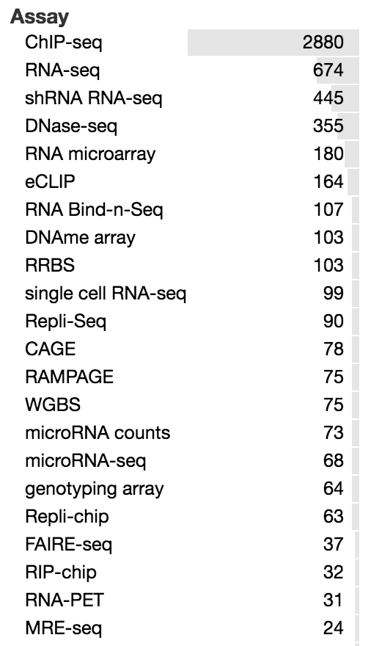
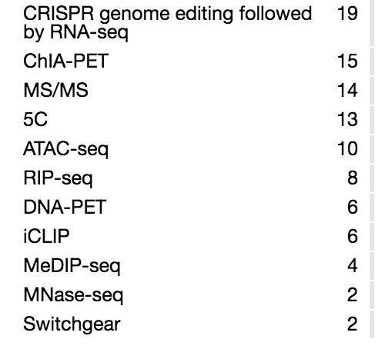
ENCODE total

Slide 7
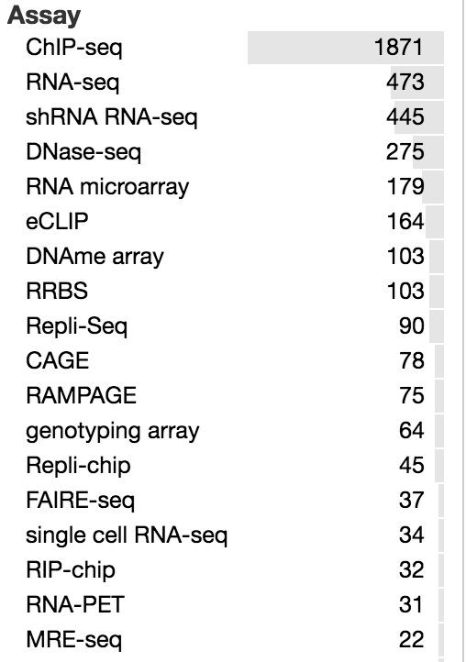
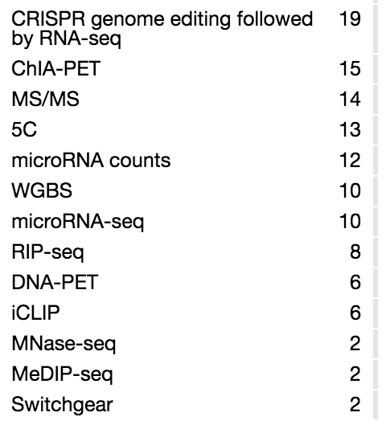
ENCODE Homo sapiens

Slide 8
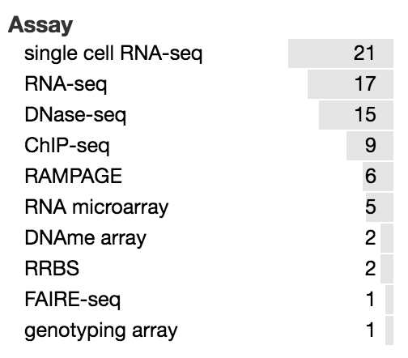
ENCODE Human brain

Slide 9
All human datasets
 | RNA-seq | ChIP-seq
Roadmap | 342 | 1872
GTEX | 8555 | NA
ENCODE | 473 | 1871
Human brain datasets
 | RNA-seq | ChIP-seq
Roadmap | 11 | 132
GTEX | 1259 | NA
ENCODE | 17 | 9
9370 | 3743
1287 | 141

Slide 10
TCGA data related to brain
Glioblastoma Multiforme
Glioblastoma Multiforme (GBM) is a fast-growing type of malignant brain tumor that is the most common brain tumor in adults.
Brain Lower Grade Glioma
Lower grade glioma is a type of cancer that develops in the glial cells of the brain.
Glioblastoma multiforme [GBM] | Total | Exome¹ | SNP | Methylation | mRNA | miRNA | Clinical
Cases | 528 | 512 | 523 | 524 | 508 | 496 | 523
Organ-Specific Controls² | N/A | N/A | N/A | N/A | N/A | N/A | N/A
Brain Lower Grade Glioma [LGG] | Total | Exome¹ | SNP | Methylation | mRNA | miRNA | Clinical
Cases | 516 | 516 | 515 | 516 | 516 | 512 | 515
Organ-Specific Controls² | N/A | N/A | N/A | N/A | N/A | N/A | N/A

Slide 11
PsychENCODE Human Studies
Study | Assay | Assay Target | Individuals | Samples | Disorder | Tissue | Cell Type | Data types
WGBS-Pilot | WGBS |  | 1 | 3 | Control | Dorsolateral Prefrontal Cortex | tissue homogenate | fastq, metRatio
EpiMap | ChIP-seq | H3K4me3, H3K27ac | 17 | 122 | Control | Dorsolateral Prefrontal Cortex, Anterior Cingulate Cortex | NeuN+, NeuN- | bam, bed, bigwig
HumanFC | ATAC-seq |  | 11 | 12 | Schizophrenia, Bipolar Disorder, Control | Dorsolateral Prefrontal Cortex | tissue homogenate | bam, bed, bigwig
BrainGVEX | RNA-seq |  | 220 | 229 | Schizophrenia, Bipolar Disorder, Control | Frontal Cortex | tissue homogenate | bam, fpkm
EpiGABA | ERRBS |  | 3 | 6 | Control | Orbitofrontal Cortex | GABA Neurons, GLU Neurons | fastq, differential methylation
EpiGABA | RNA-seq |  | 2 | 4 | Control | Orbitofrontal Cortex | GABA Neurons, GLU Neurons | fastq, differential expression
lncRNA-Pilot | IsoSeq |  | 1 | 4 | Control | Dorsolateral Prefrontal Cortex | tissue homogenate | fastq, bed
lncRNA-Pilot | RNA-seq |  | 2 cell lines | 8 |  |  | SH-SY5Y, A549 | bam
UCLA-ASD | RNA-seq |  | 79 | 205 | Autism Spectrum Disorder, Control | Cerebellum, Prefrontal Cortex, Temporal Cortex | tissue homogenate | fastq
UCLA-ASD | ChIP-seq | H3K27ac | 111 | 285 | Autism Spectrum Disorder, Control | Cerebellum, Prefrontal Cortex, Temporal Cortex | tissue homogenate | bam
CNON | ChIP-seq | H3K27ac, H3K4me3, H3K4me1, CTCF | 4 | 15 | Schizophrenia, Control | Olfactory Neuroepithelium | CNON | fastq, bam, bed, bigwig
Yale-ASD | ChIP-seq | H3K27ac | 9 | 18 | Control | Cerebellum, Dorsolateral Prefrontal Cortex | tissue homogenate | ChIP-enriched regions
iPSC | RNA-seq |  | iPSC derived organoids from 2 fetal and 1 adult individual, undifferentiated iPSC from 4 fetal and 2 adult individuals | 31 |  | Organoids | iPSC, NeuN+, NeuN- | bam

Slide 12
PsychENCODE Animal Models
Study | Species | Assay | Animals | Samples | Treatment | Tissue | Cell Type
MouseHAL | Mus musculus | ATAC-seq | 14 | 14 | haloperidol, placebo | Striatum | tissue homogenate | bam, bed, bigwig
NHP | Rhesus macaque | RNA-seq | 3 | 9 |  | Cerebellum, Dorsolateral Prefrontal Cortex, Striatum | tissue homogenate | bam

Slide 13
Roadmap by Study
GEO Accession | Title | SRA accession | Batch download | Samples
GSE16256 | UCSD Human Reference Epigenome Mapping Project | SRP000941 | sra bam,bed,wig | 856
GSE16368 | UCSF-UBC Human Reference Epigenome Mapping Project | SRP000930 | sra bam,bed,tab,wig | 428
GSE17312 | BI Human Reference Epigenome Mapping Project | SRP000996 | sra bam,bed,cel,wig | 632
GSE18927 | University of Washington Human Reference Epigenome Mapping Project | SRP001371 | sra bam,bed,cel,txt,wig | 758
GSE19465 | BI Human Reference Epigenome Mapping Project: ChIP-Seq in human subject | SRP001534 | bed,wig | 358
GSE25246 | BI Human Reference Epigenome Mapping Project: Characterization of DNA methylation by RRBS | SRP004506 | wig | 10
GSE25247 | BI Human Reference Epigenome Mapping Project: Characterization of DNA methylation by RRBS in human subject | SRP004244 | wig | 55
GSE25248 | BI Human Reference Epigenome Mapping Project: Characterization of DNA methylation by RRBS in HUES lines | SRP004245 | wig | 11
GSE25249 | BI Human Reference Epigenome Mapping Project: Characterization of chromatin modification by ChIP-Seq in human subject |  | bed,wig | 24

Slide 14
Projects generating brain NGS datasets
Project name | Organism | Disease or control | Brain region | Datasets | Website Link
PsychENCODE | Homo sapiens, Rhesus macaque | Control, biopolar disorder, schizophrenia, Autism spectrum disorder | DFC,CBC,ACC,STR, HIP,AMY | RNA-Seq, ChIP-Seq,DNase-seq, ATAC-seq,DNase-seq,WGBS,NOMe-seq | http://psychencode.org/
CommonMind | Homo sapiens | Control, biopolar disorder, schizophrenia | DFC, CBC, STG | RNA-seq, ChIP-Seq, WGS, ATAC-Seq | http://commonmind.org/WP/
Psychiatric Genomics Consortium (PGC) | Homo sapiens | ADHD, autism, bipolar disorder, major depressive disorder, and schizophrenia | N/A | SNPs, CNVs | https://www.med.unc.edu/pgc
AMP Alzheimer’s disease Knowledge | Homo sapiens, iPSC,Mus musculus | Control, Alzheimer's Disease | 19 brain regions | RNA-Seq, ChIP-Seq, DNA Methylation | https://www.nia.nih.gov/alzheimers/amp-ad#amp-ad
Genome-wide association studies (GWAS) | Homo sapiens | all kinds of disorders | N/A | SNPs | http://grasp.nhlbi.nih.gov/Overview.aspx
Brainspan | Homo sapiens | Control | 16 brain regions | RNA-Seq, ChIP-Seq,Microarray, Methylation, MRI/DTI | http://brainspan.org/
Roadmap Epigenomics Mapping Consortium (Roadmap) | Homo sapiens | Control | 9 brain regions and cultured cells | ChIP-Seq, DNase , DNA methylation, RNA-Seq | http://www.roadmapepigenomics.org/
The Genotype-Tissue Expression (GTEx) project | Homo sapiens | Control | 13 brain regions | RNA-Seq, eQTLs | http://www.gtexportal.org/home/
Notes:
Brainspan, psychencode include developing data/ our lab are invovle in these two projects

