Slide 1
Intro to ERCC DMRR Workshop
Joel Rozowsky
Yale University
ERCC DMRR Workshop, ISEV 2015
23 April 2015

Slide 2



Common Fund Programs
Extracellular RNA
Communication
Undiagnosed
Diseases
Program
Molecular
Libraries
and Imaging
Health
Economics
PROMIS:
Clinical
Outcomes
Assessment
Gulf Oil Spill
Long Term
Follow Up
Regulatory
Science
NIH
Center for
Regenerative
Medicine
Human
Microbiome
Building Blocks,
Biological Pathways
And Networks
Bridging
Interventional
Development
Gaps (BrIDGs)
NIH Medical
Research
Scholars
Protein
Capture
Clinical Science
and Translation
Awards (CTSAs)
Nanomedicine
HCS Research
Collaboratory
High-Risk
Research
Knockout
Mouse
Phenotyping
NIH
Common Fund
Pioneer Awards
New Innovator Awards
Transformative Research Awards
Early Independence Awards
Global
Health
Bioinformatics and
Computational Biology
Structural
Biology
Interdisciplinary
Research
Consortia
Science of
Behavior
Change
Metabolomics
Genotype-
Tissue
Expression
http://commonfund.nih.gov/
Epigenomics
Single
Cell
Analysis

Slide 3
ERCC Organization
Data Management & Resource Repository (DMRR)
DCC-Admin Core
RFA RM-12-011
Reference Profiles
RFA RM-12-012 Biogenesis, Biodistr, Uptake, and Effector Function
RFA RM-12-013
Clinical Utility
for Biomarkers
RFA RM-12-014
Clinical Utility for
Therapy Development
Curated Gene Context, Network Modules, Pathways
Scientific Outreach Component (SOC) David Galas, PI
Data Integration & Analysis Component (DIAC)
Mark Gerstein, PI
Data Coordination Center (DCC)
Aleks Milosavljevic, PI
Develop Metadata Stds
Create & Host exRNA Atlas
Data Analysis & Visualizaton
Develop Analysis Pipelines/Tools
Integrative Analysis
Profile/Gene/Network Modules

Slide 4

eXRNA Portal
www.exrna.org

Slide 5
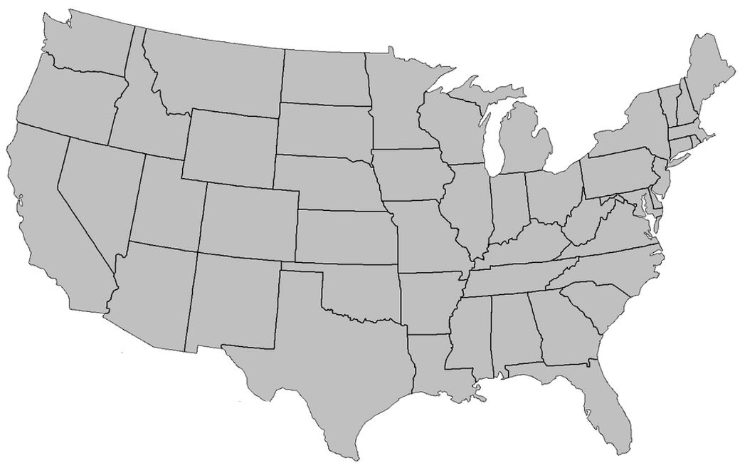

Regional exRNA Mapping Centers and
Data Coordination Center
Pacific Northwest Res. Inst.
(Seattle)
U. Mass Med School
(Worcester)
UC Michigan
UCSF
Beth Israel
(Boston)
UC San Diego
NCBI
Washington, D.C.
Baylor College
of Medicine (Houston):
Data Coordination Center

Slide 6
RNA-Seq Profiling of Human exRNAs –
Multiple Biological Fluids
Short & long non-coding, non-coding, circular coding
Plasma
Serum
Urine
Saliva
Cerebrospinal fluid
Cord blood
Seminal fluid
Bronchoaveolar fluid
Placenta
Endogenous vs exogenous (environment/diet)
Notes:
-The project undertook the epigenomic profiling of various human cell lines, primary cells, and tissues…
-It targeted several important epigenetic modifications, using different technologies
-The goal is to generate several methylomes, data from various histone marks…

Slide 7
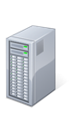
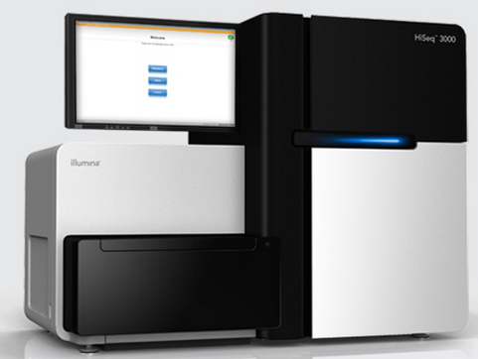
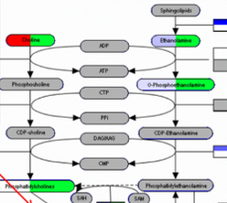
DMRR Analysis Infrastructure
Libraries
Sample
Preparation
Sequence
Small exRNA-Seq pipeline
Long exRNA-Seq pipeline
ExRNA Atlas
Genboree Workbench
WikiPathways
Cytoscape
PathVisio
BioGPS
Protocols, data, & pipelines at www.exrna.org

Slide 8
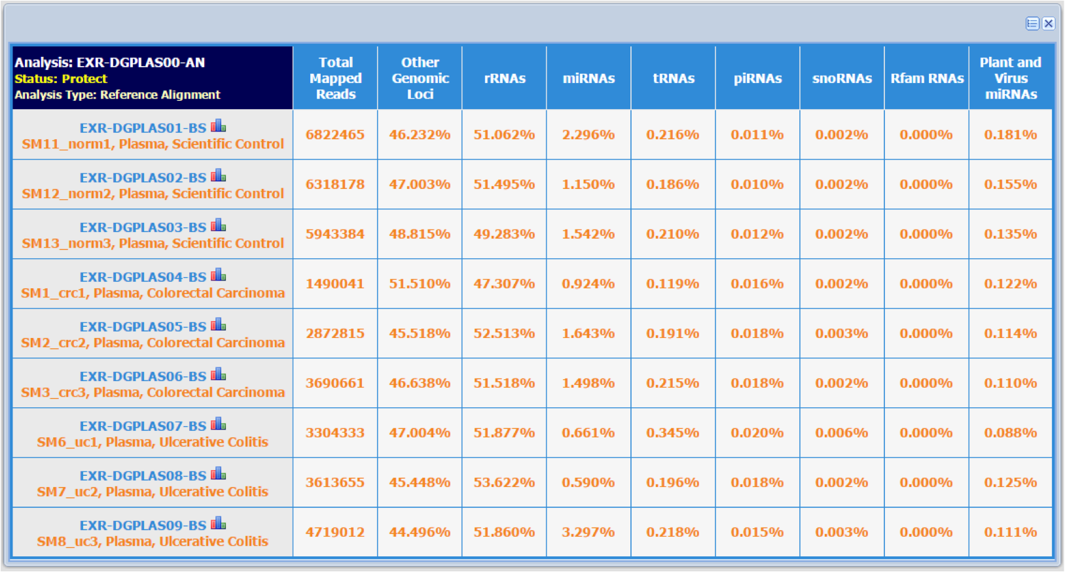
ExRNA Atlas

Slide 9
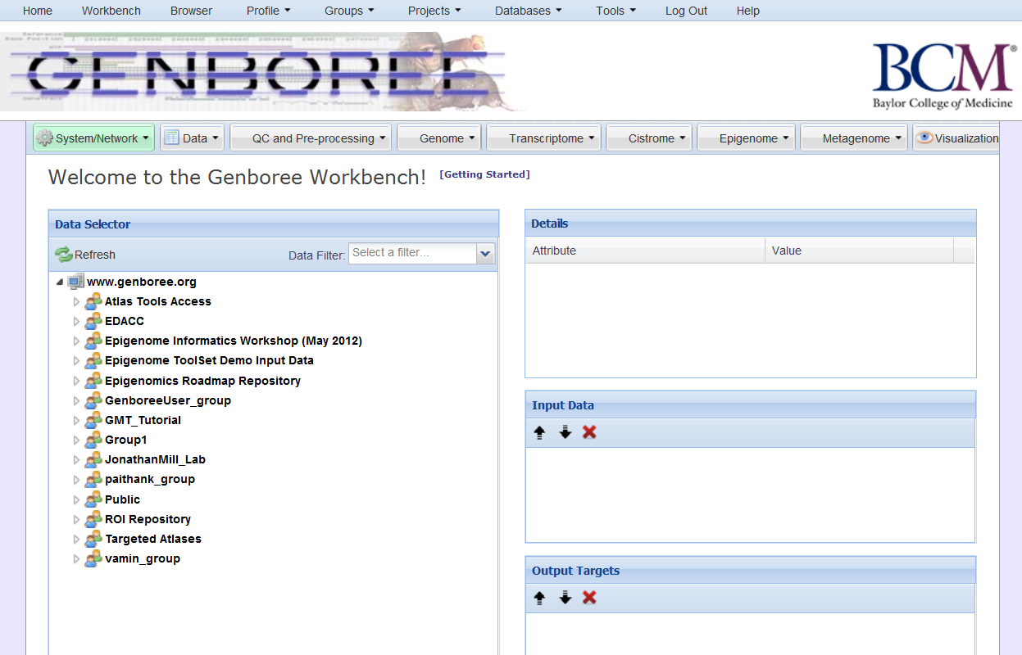
The Genboree Workbench: Web-based Data Management & Analysis
Specific information on files/samples selected in the “Data Selector”
Tells the tool to use this input data/file
Various Data Types
(tracks, files, ROIs, etc)
Tells the tool where to deposit results

Slide 10




Acknowledgements
Data Management & Resource Repository (DMRR)
Mark Gerstein
Joel Rozowsky
Rob Kitchen
Fabio Navarro
Aleksandar Milosavljevic
Matt Roth
Sai Lakshmi Subramanian
William Thistlethwaite
Andrew Jackson
Sameer Paithankar
Aaron Baker
Neethu Shah
Kevin Riehle
David Galas
Roger Alexander
Olivia Fong
Nikita Sakhanenko
Alton Etheridge
Alex Pico
Kristina Hanspers
Anders Riutta
Andrew Su
Chunlei Wu

Slide 11
Thoughts on Publication Rollout Structure for the ENCODE Project
M Gerstein
(Publication analysis done by
D Wang, KK Yan, J Rozowsky, E Pan)

Slide 12
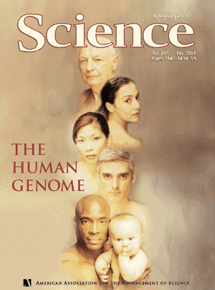
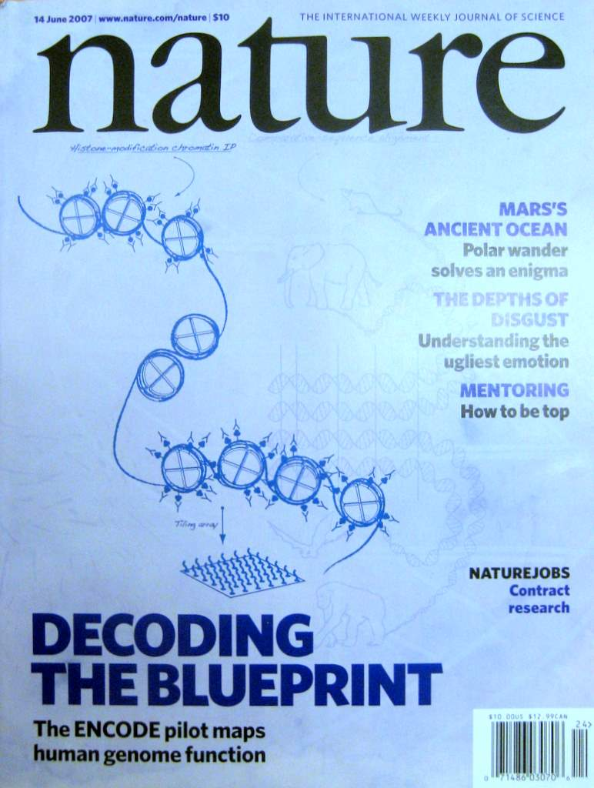
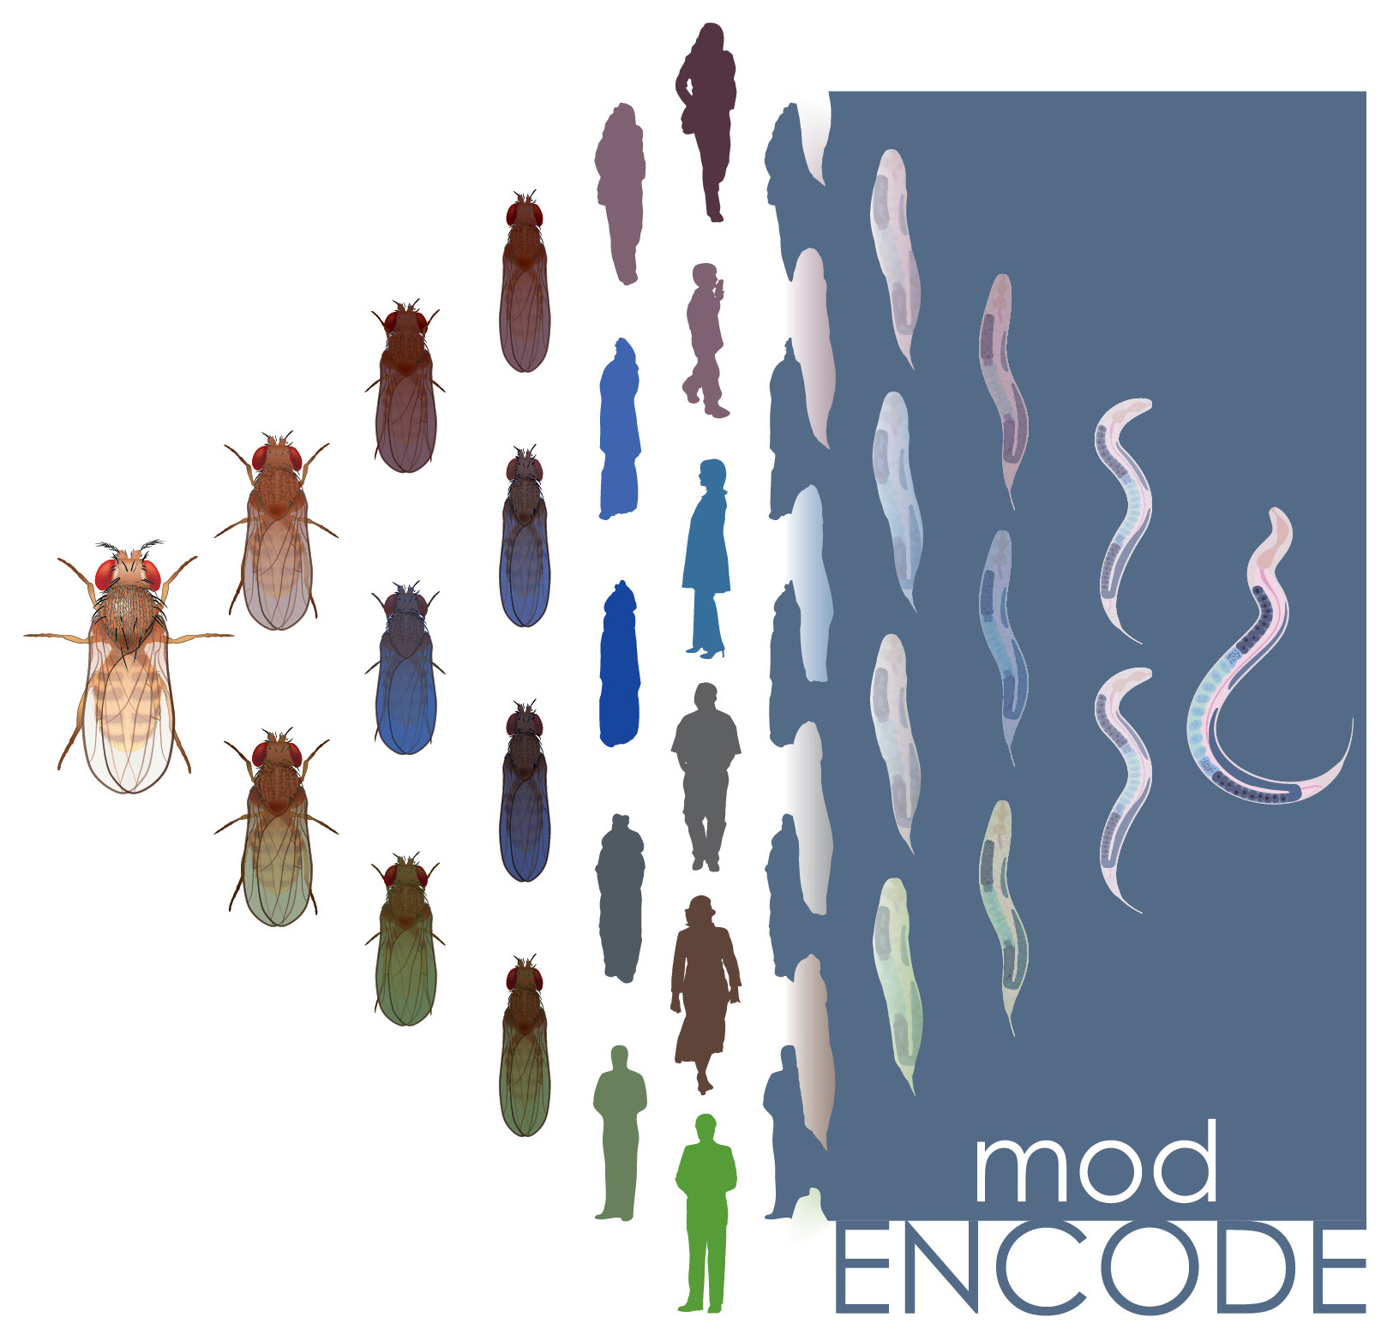
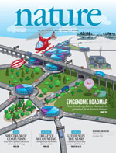
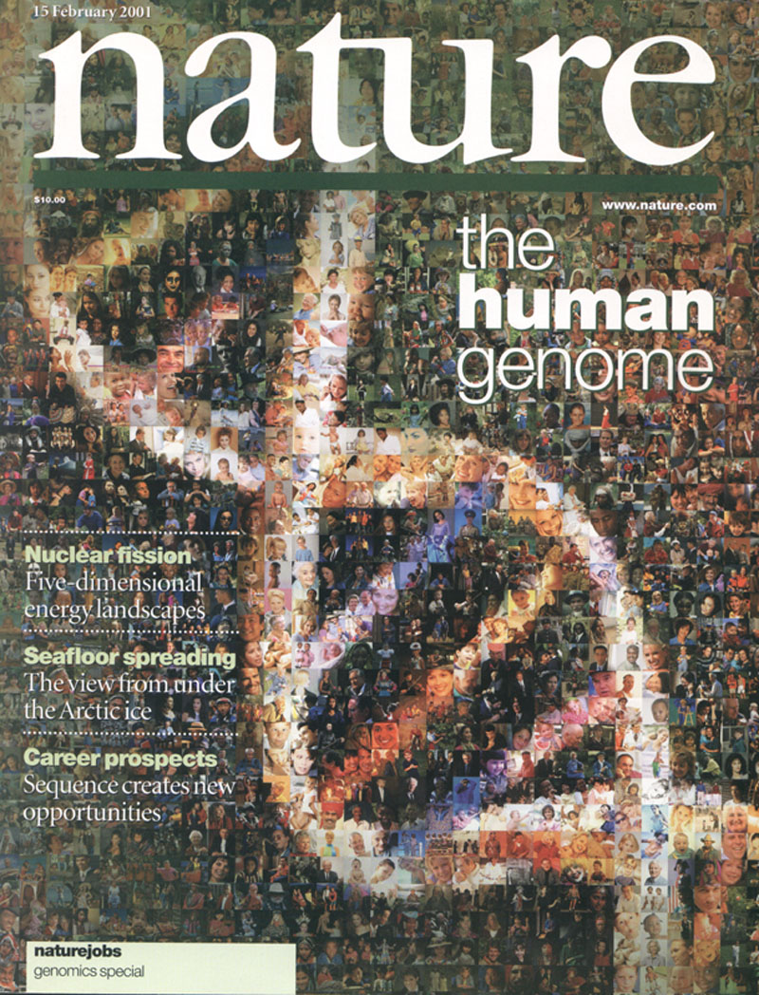



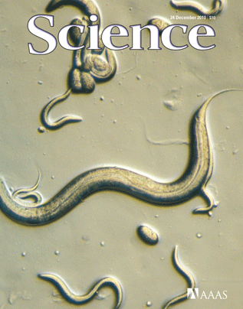

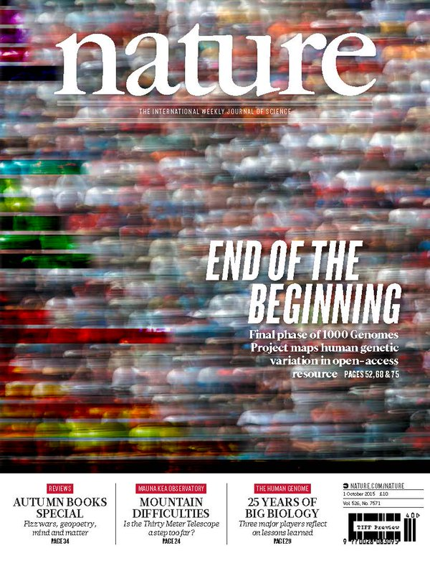

The Human
Genome Project
ENCODE
Pilot
ENCODE
Production
Comparative
ENCODE
Epigenome
Roadmap
2000
2005
2010
2015
Worm
Genome
modENCODE
1000 Genomes
Pilot
1000 Genomes
Phase 3
GTEx

Slide 13
Papers authored by ENCODE consortium members vs. those that use ENCODE data but were not funded by ENCODE
<= # Papers
# Authors Yr. (‘04 to ‘14)
[Wang et al., TIG (in rev.); lectures.gersteinlab.org]
Notes:
1 slides from dw encode authors

Slide 14
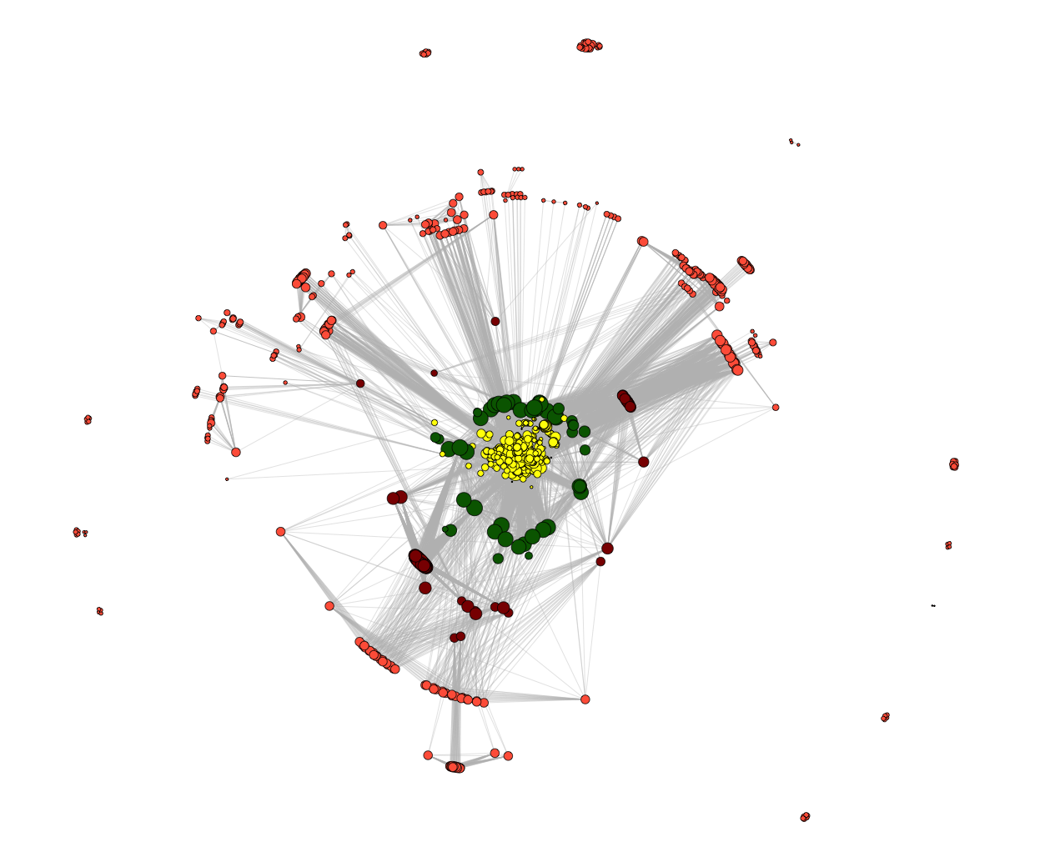
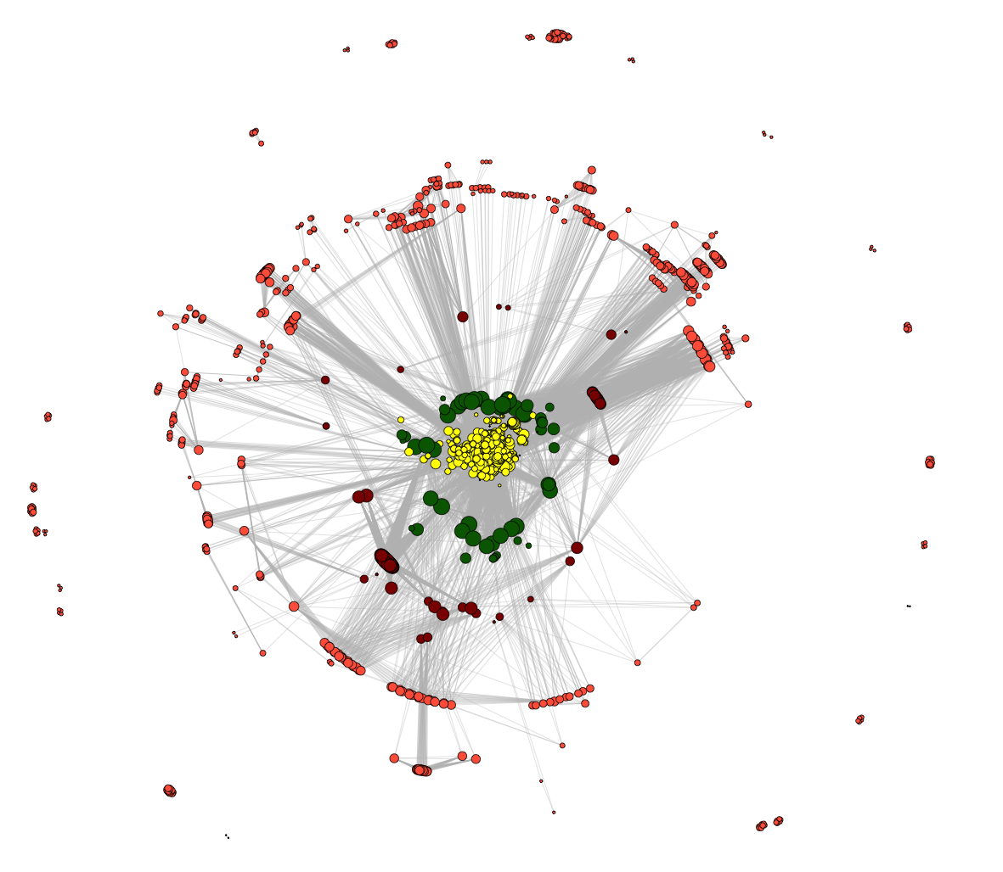
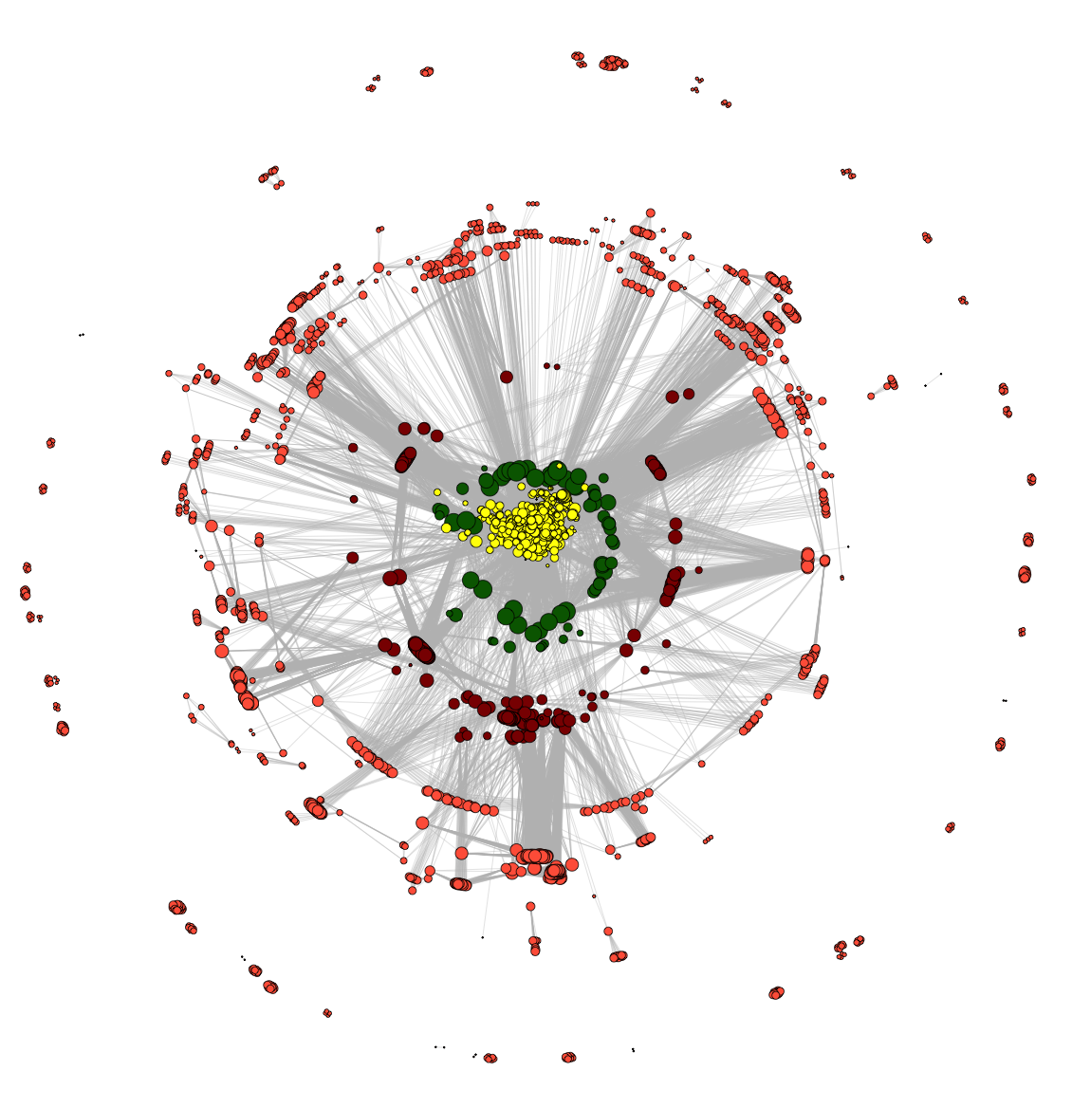
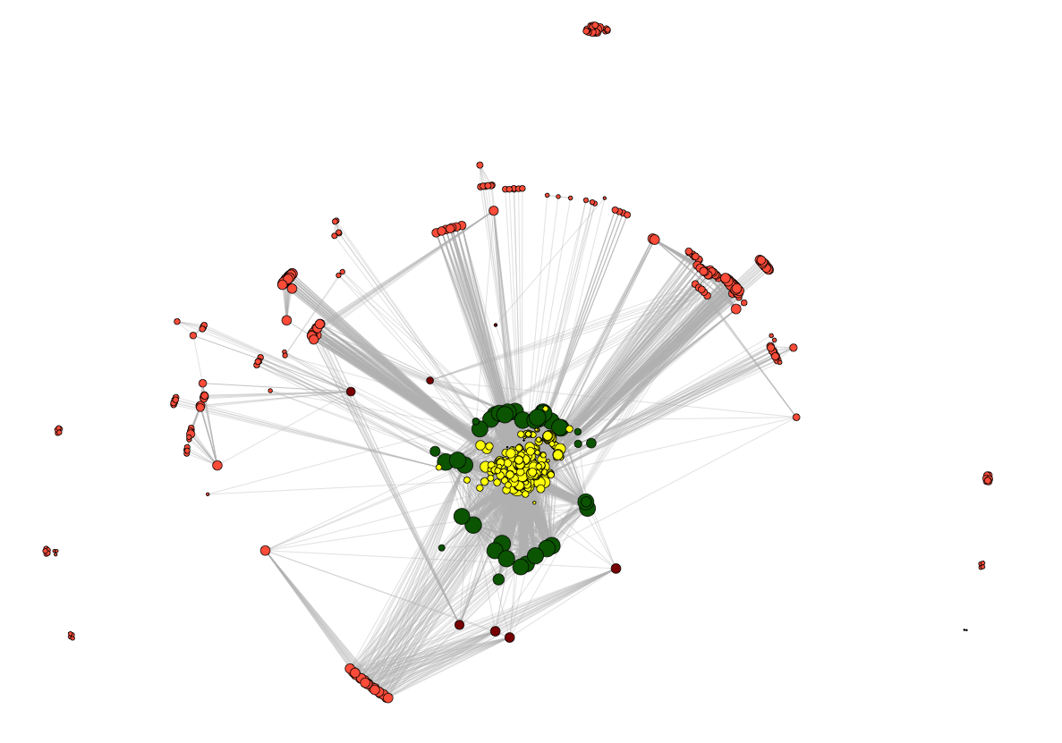
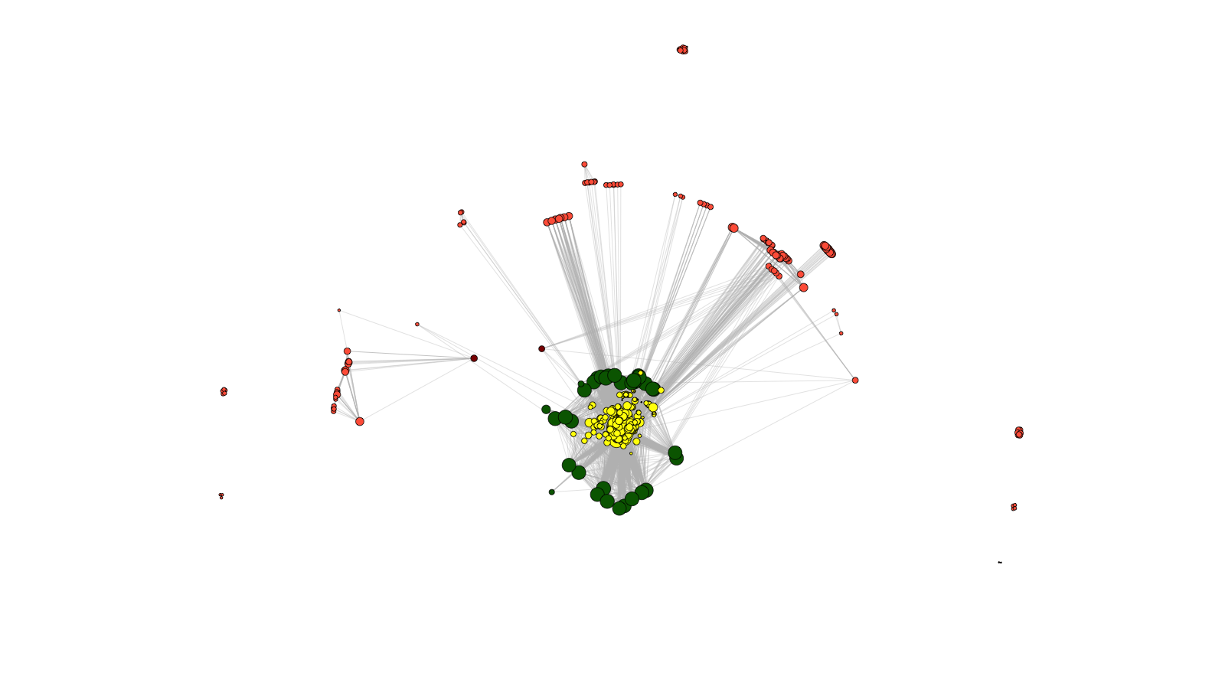
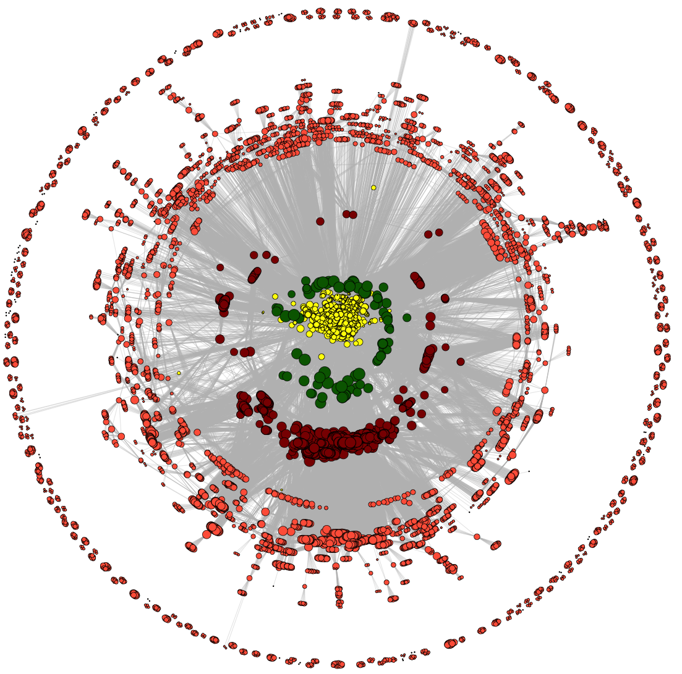
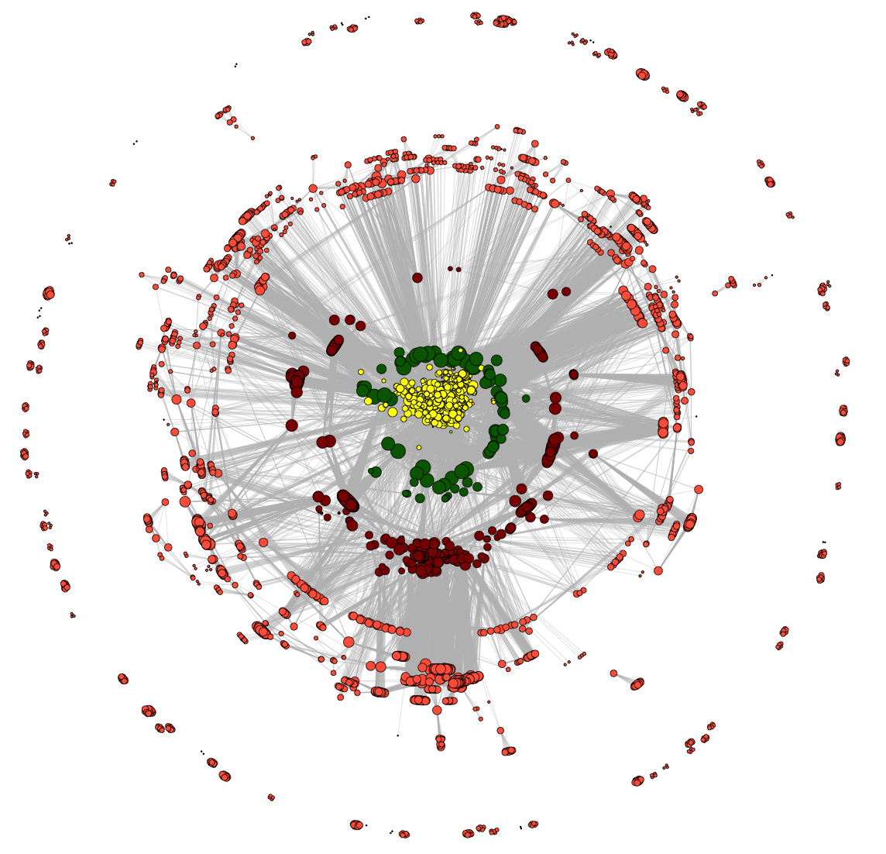
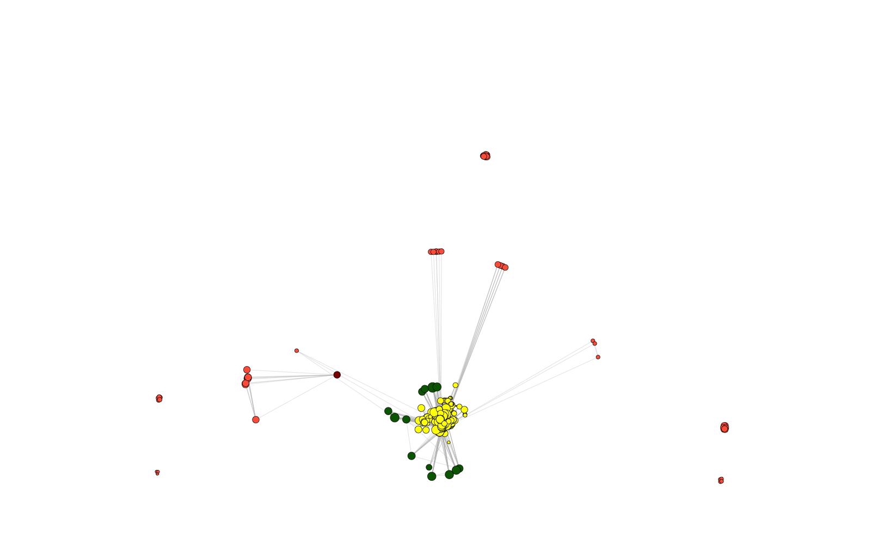
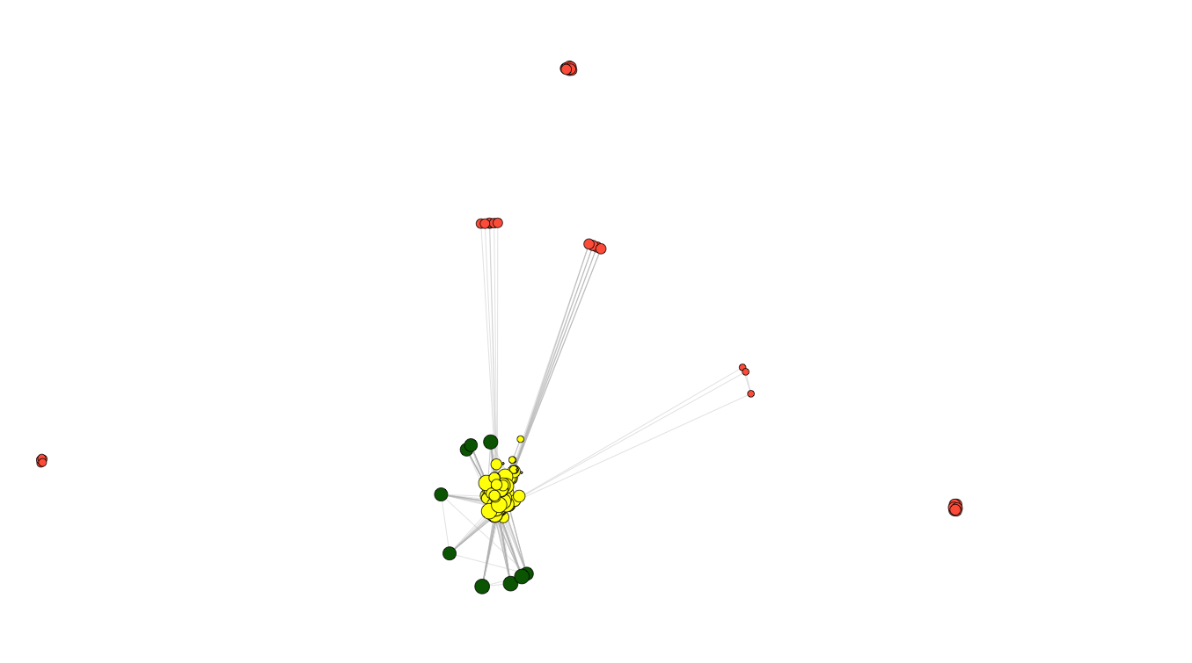
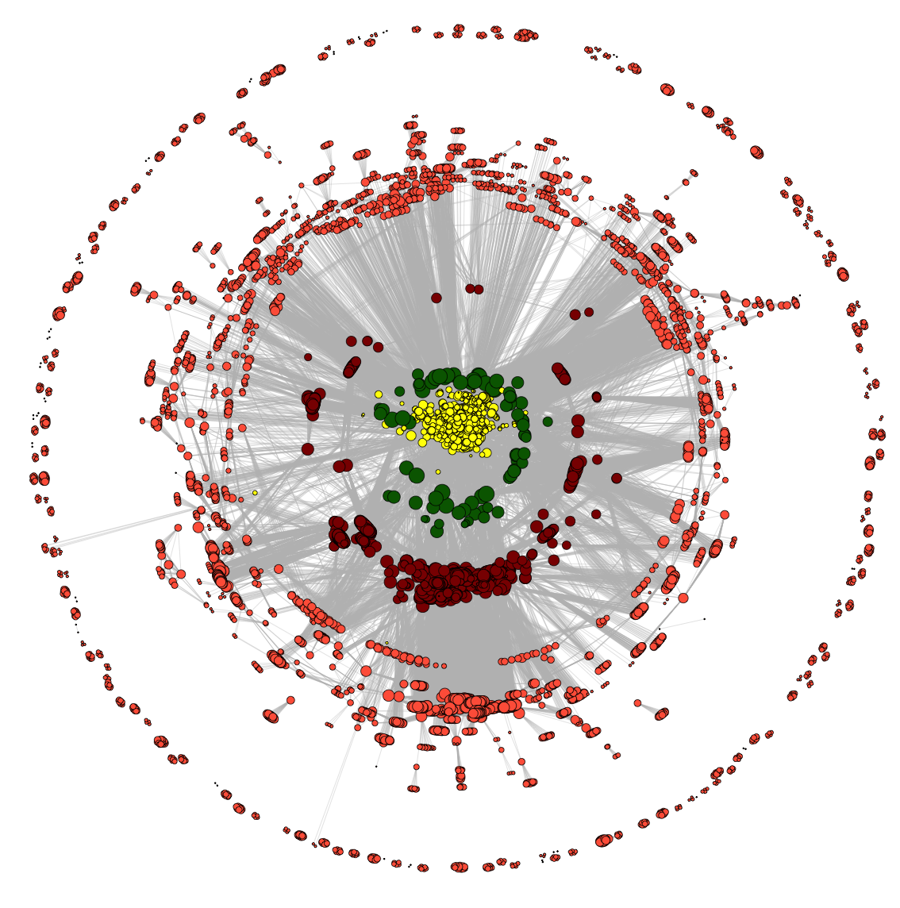
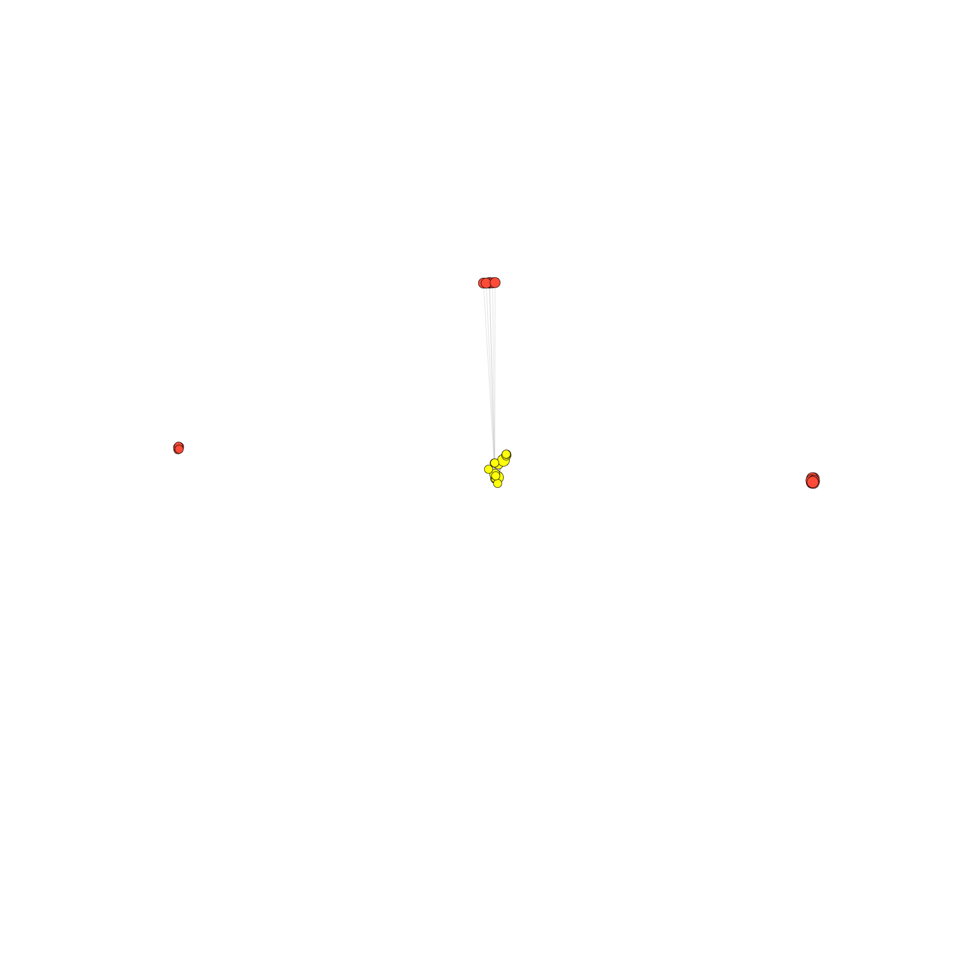
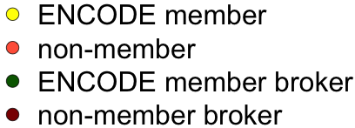
ENCODE co-authorship network
2009
2010
2011
2008
2007
2012
2006
2005
2013
2004
2014
co-authorship
[Wang et al., TIG (in rev.); lectures.gersteinlab.org]

Slide 15
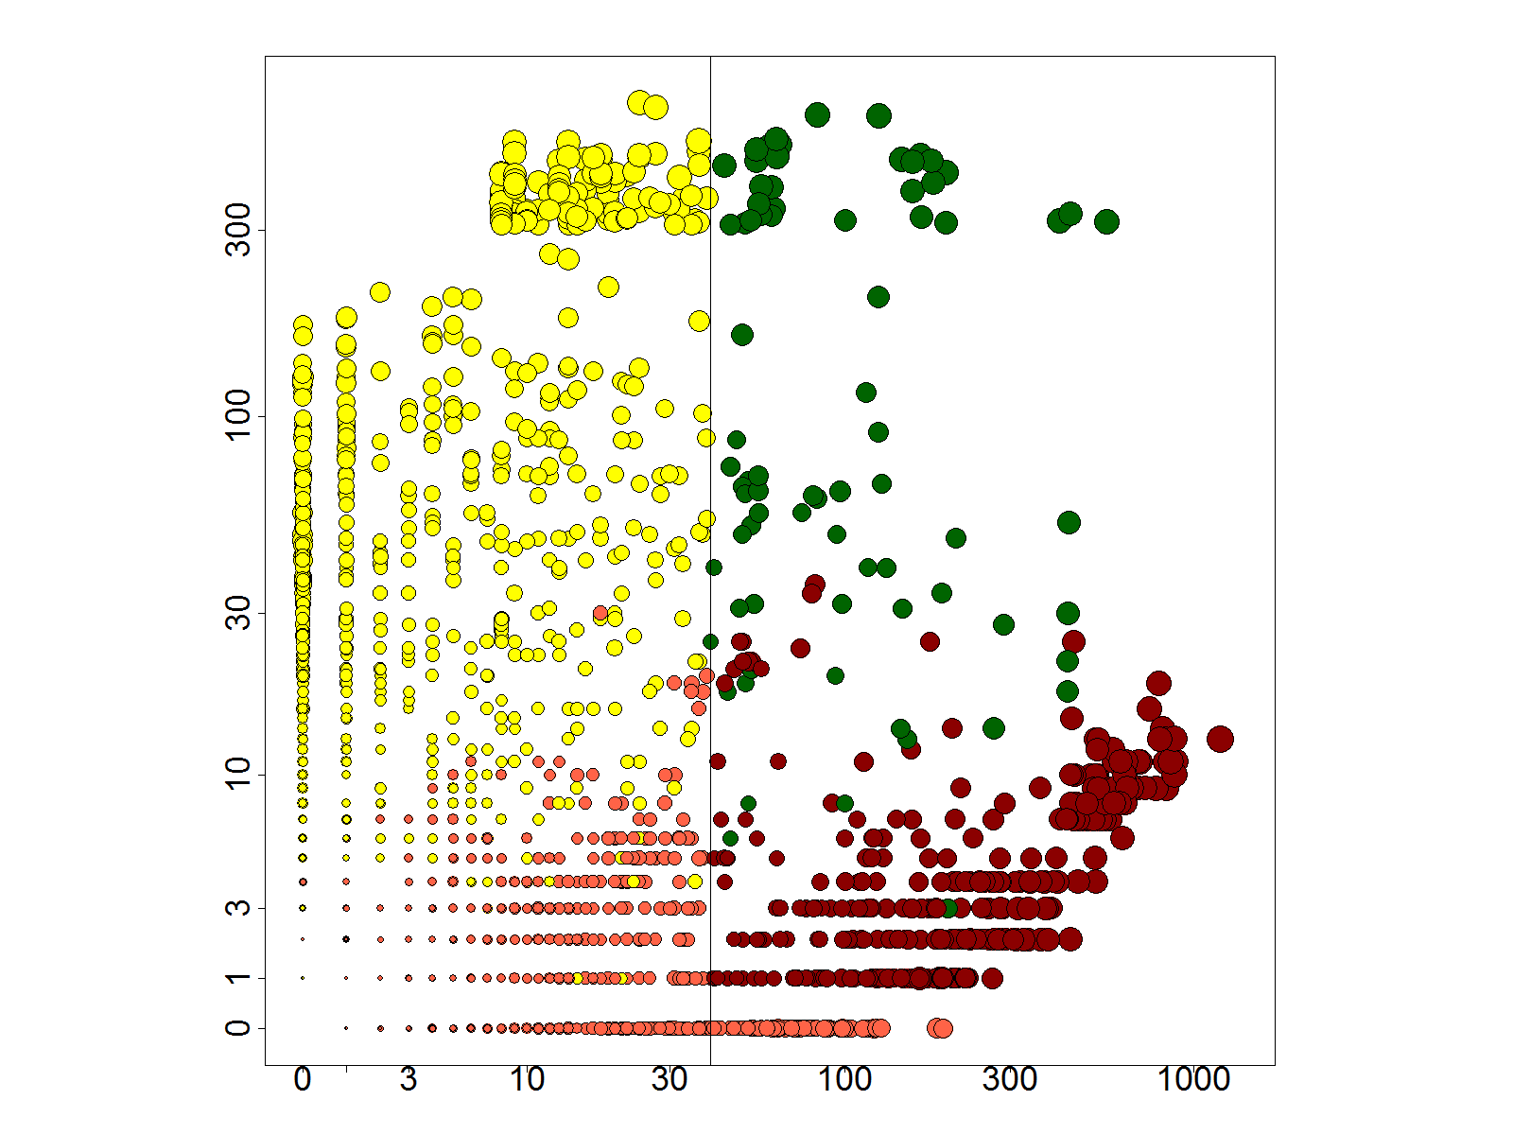
Network statistics highlight change in modularity with consortium rollouts (L)
& importance of broker role (R)
# neighbors: non-ENCODE v ENCODE
[Wang et al., TIG (in rev.); lectures.gersteinlab.org]

Slide 16
Large-scale Transcriptome Mining: Building Interpretative Models while Protecting Individual Privacy
The Dilemma of Genomic Privacy
  Fundamental, inherited info that’s very private vs the need for large-scale data-sharing to enable med. research
  Current Social & Tech Approaches
    Issues: burdensome security, inconsistencies + ways the solutions have been partially "hacked”
    Strawman Hybrid Soc-Tech Proposal (Cloud Enclaves. Quantifying Leaks, & Closely Coupled priv.-public data)
RNA-seq: How to Publicly Share Some of it
  Removing SNVs in reads using MRF
  Quantifying & removing variant info from expression levels + eQTLs
  Linking Attack using extreme expression levels
Large-scale Mining of RNA-seq to Determine State Space Models
  Using dimensionality reduction to help determine internal & external drivers
  Decoupling expression changes into those driven by worm-fly conserved genes vs species-specific ones. Also, Conserved genes have similar canonical patterns (iPDPs) in contrast to species specific ones (Ex of ribosomal v signaling genes)
  In human cell cycle, only conserved genes show matching periodic pattern

Slide 17

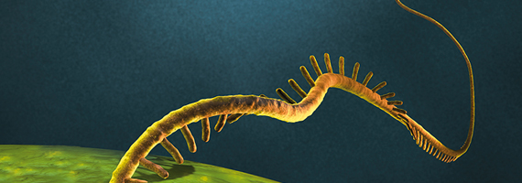
exRNA-seq analysis software
small RNA-seq
analysis toolkit
exceRpt
quantification (RPM) of
miRNA, tRNA, piRNA,
snoRNA, circularRNA,
& long transcript fragments
long RNA-seq
analysis toolkit
RSEQTools
quantification (RPKM) of
[multi-exon] transcripts
Notes:
images:miltenyibiotec

Slide 18
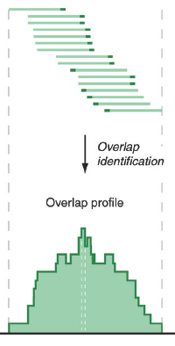
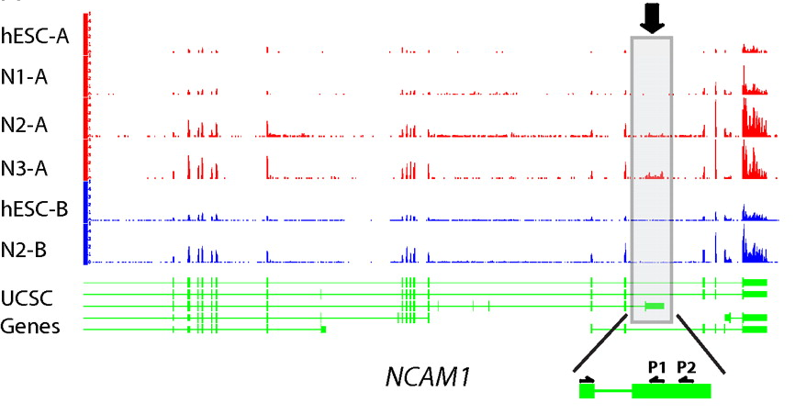
RNA-seq
RNA-seq uses next-generation sequencing technologies to reveal RNA presence and quantity within a biological sample.
ATACAAGCAAGTATAAGTTCGTATGCCGTCTT
GGAGGCTGGAGTTGGGGACGTATGCGGCATAG
TACCGATCGAGTCGACTGTAAACGTAGGCATA
ATTCTGACTGGTGTCATGCTGATGTACTTAAA
Reads (fasta)
－ Quality scores (fastq)
－ Mapping (BAM)
－ Contain variant information in transcribed regions
Quantitative information from RNA-seq signal: average signals at exon level (RPKMs)
Reads => Signal
[PLOS CB 4:e1000158; PNAS 4:107: 5254 ; IJC 123:569 ]

Slide 19
rseqtools

Slide 20
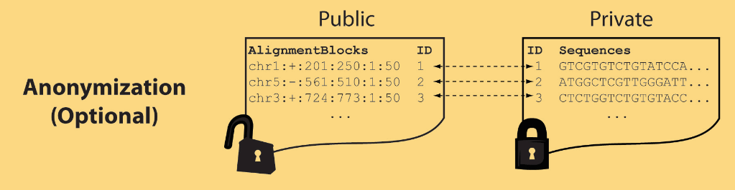
Light-weight formats
Some lightweight format clearly separate public & private info., aiding exchange
Files become much smaller
Distinction between formats to compute on and those to archive with – become sharper with big data
Reads
(linked via ID,
10X larger than
mapping coord.)
Mapping coordinates without variants (MRF)
[Bioinformatics 27: 281]

Slide 21
MRF Examples
chr2:+:601:630:1:30,chr2:+:921:940:31:50
TS
TE
TS
TE
Reference
AlignmentBlock 1
AlignmentBlock 2
10X Compression Ex.
Raw ELAND export file has uncompressed file size: ∼4 GB; total number of reads: ∼20 million; number of mapped reads: ∼12 million .
MRF file is significantly smaller (∼400 MB uncompressed, ∼130 MB compressed with gzip).
BAM file
has a size of ∼1.2 GB.
Splice junction Read
QS
QE/QS
QE
Legend: TS = TargetStart, TE = TargetEnd, QS = QueryStart, QE = QueryEnd
chr9:+:431:480:1:50|chr9:+:945:994:1:50
TS
TE
TS
TE
Reference
AlignmentBlock 1
AlignmentBlock 2
Reference based compression (ie CRAM) is similar but it stores actual variant beyond just position of alignment block
Paired-end Read
QS
QE
QS
QE
Legend: TS = TargetStart, TE = TargetEnd, QS = QueryStart, QE = QueryEnd
[Habegger et al., Bioinformatics (‘11)]

Slide 22
Large-scale Transcriptome Mining: Building Interpretative Models while Protecting Individual Privacy
The Dilemma of Genomic Privacy
  Fundamental, inherited info that’s very private vs the need for large-scale data-sharing to enable med. research
  Current Social & Tech Approaches
    Issues: burdensome security, inconsistencies + ways the solutions have been partially "hacked”
    Strawman Hybrid Soc-Tech Proposal (Cloud Enclaves. Quantifying Leaks, & Closely Coupled priv.-public data)
RNA-seq: How to Publicly Share Some of it
  Removing SNVs in reads using MRF
  Quantifying & removing variant info from expression levels + eQTLs
  Linking Attack using extreme expression levels
Large-scale Mining of RNA-seq to Determine State Space Models
  Using dimensionality reduction to help determine internal & external drivers
  Decoupling expression changes into those driven by worm-fly conserved genes vs species-specific ones. Also, Conserved genes have similar canonical patterns (iPDPs) in contrast to species specific ones (Ex of ribosomal v signaling genes)
  In human cell cycle, only conserved genes show matching periodic pattern

Slide 23
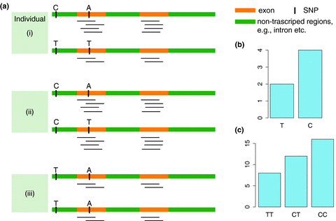
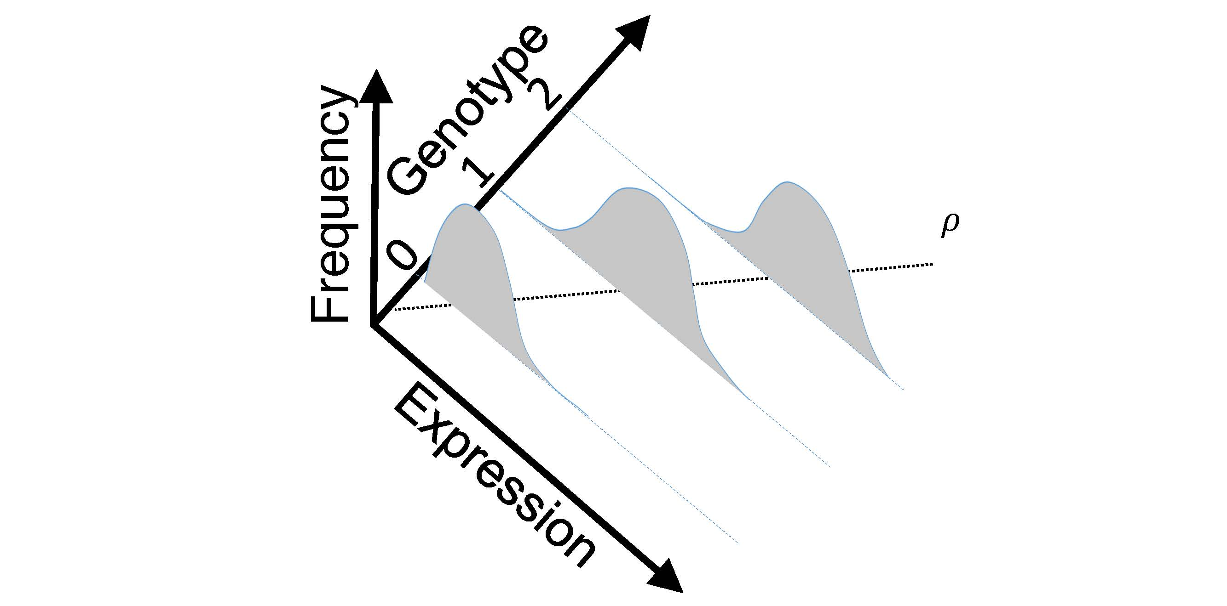
eQTL Mapping Using RNA-Seq Data
eQTLs are genomic loci that contribute to variation in mRNA expression levels
eQTLs provide insights on transcription regulation, and the molecular basis of phenotypic outcomes
eQTL mapping can be done with RNA-Seq data
[Biometrics 68(1) 1–11]
Notes:
A diagram to illustrate the RNA‐seq count variation of one gene due to an cis‐eQTL. (a) RNA‐seq measurements of a hypothetic gene with two exons in three diploid individuals. The target SNP which we test for association has the genotype CT, CC, and TT for the three individuals. There is an SNP on the first exon, which has genotype AT, AT, and AA for the three individuals. ASE can be measured by those sequence reads that overlap with a heterozygous exonic SNP. Therefore we can measure ASE for individuals (i) and (ii). However, association testing by ASE is only possible if the target SNP is heterozygous, thus only individual (i) can be used to test for eQTL by ASE (b) ASE measurements for individual (i). (c) TReC measured for the three individuals across the two exons of this gene.
© IF THIS IMAGE HAS BEEN PROVIDED BY OR IS OWNED BY A THIRD PARTY, AS INDICATED IN THE CAPTION LINE, THEN FURTHER PERMISSION MAY BE NEEDED BEFORE ANY FURTHER USE. PLEASE CONTACT WILEY'S PERMISSIONS DEPARTMENT ON PERMISSIONS@WILEY.COM OR USE THE RIGHTSLINK SERVICE BY CLICKING ON THE 'REQUEST PERMISSION' LINK ACCOMPANYING THIS ARTICLE. WILEY OR AUTHOR OWNED IMAGES MAY BE USED FOR NON-COMMERCIAL PURPOSES, SUBJECT TO PROPER CITATION OF THE ARTICLE, AUTHOR, AND PUBLISHER.

Slide 24
Information Content and Predictability
[Harmanciet al. Nat. Meth. (in revision)]

Slide 25

Representative Expression, Genotype, eQTL Datasets
mRNA sequencing for 462 individuals
  Publicly availableQuantification for protein
  coding genes
Approximately 3,000 cis-eQTL (FDR<0.05)
Genotypes are available from the 1000 Genomes Project

Slide 26
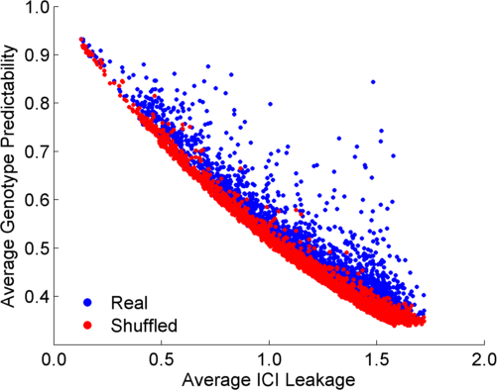
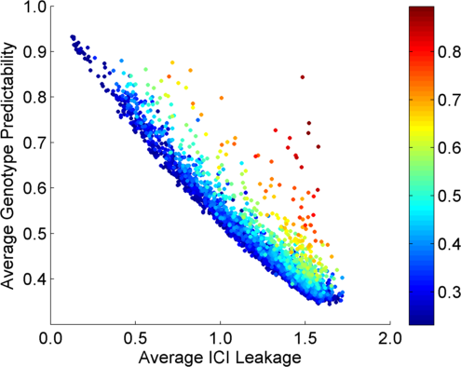
Per eQTL and ICI Cumulative Leakage versus Genotype Predictability
Colors by absolute correlation
Absolute Correlation
[Harmanciet al. Nat. Meth. (in revision)]

Slide 27
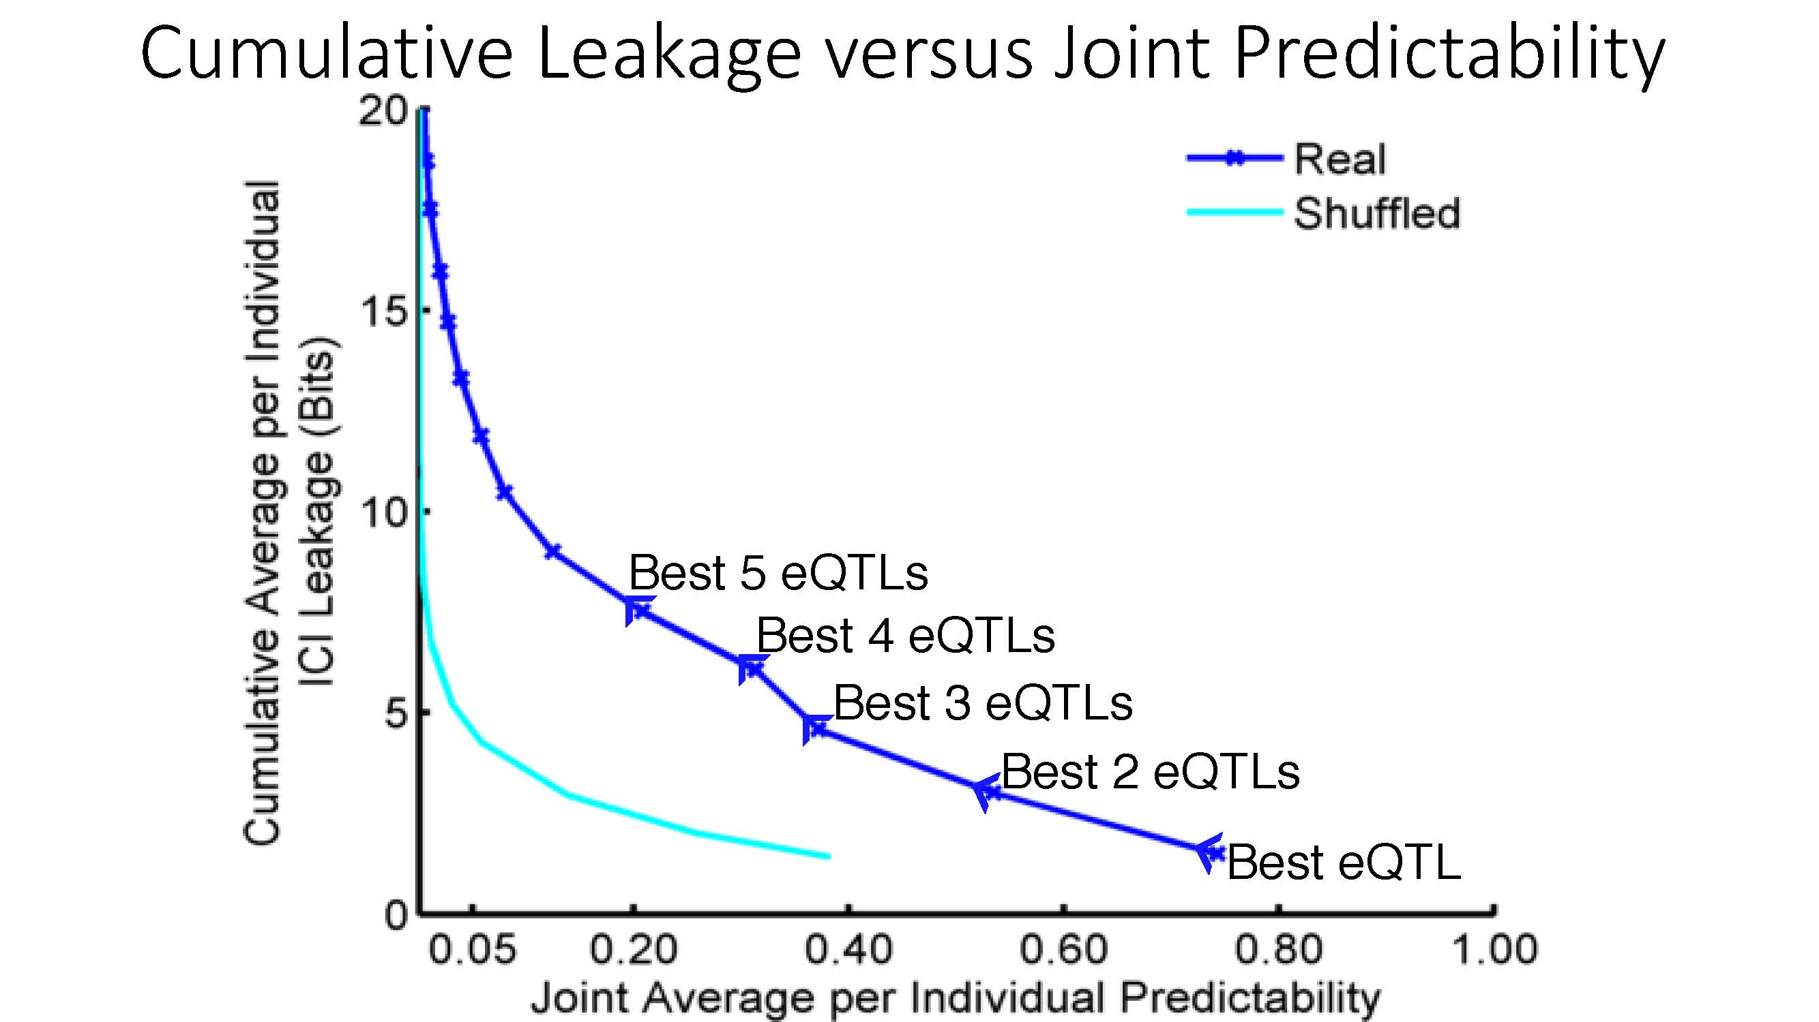
Cumulative Leakage versus Joint Predictability
[Harmanciet al. Nat. Meth. (in revision)]

Slide 28
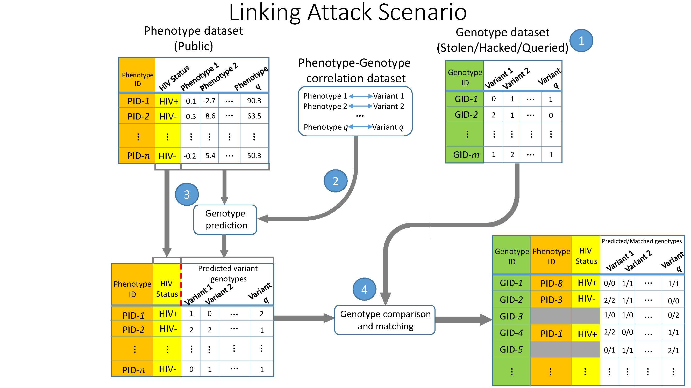
Linking Attack Scenario
[Harmanciet al. Nat. Meth. (in revision)]

Slide 29
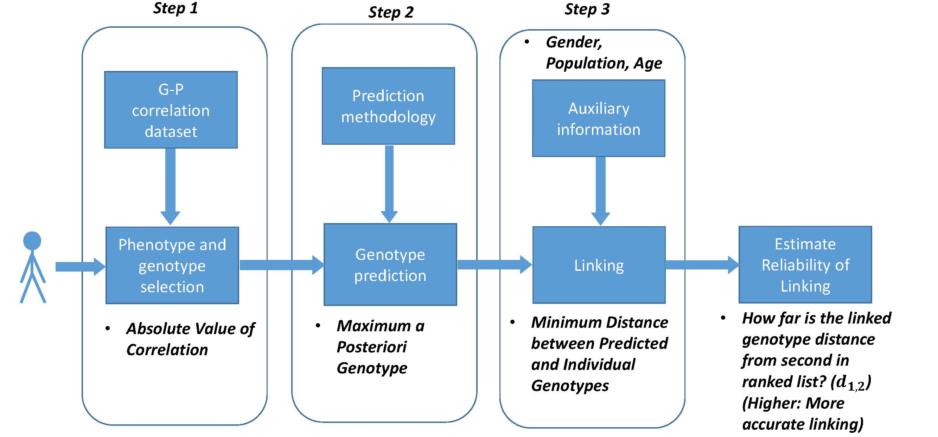
Steps in Instantiation of a (Mock) Linking Attack
[Harmanciet al. Nat. Meth. (in revision)]

Slide 30
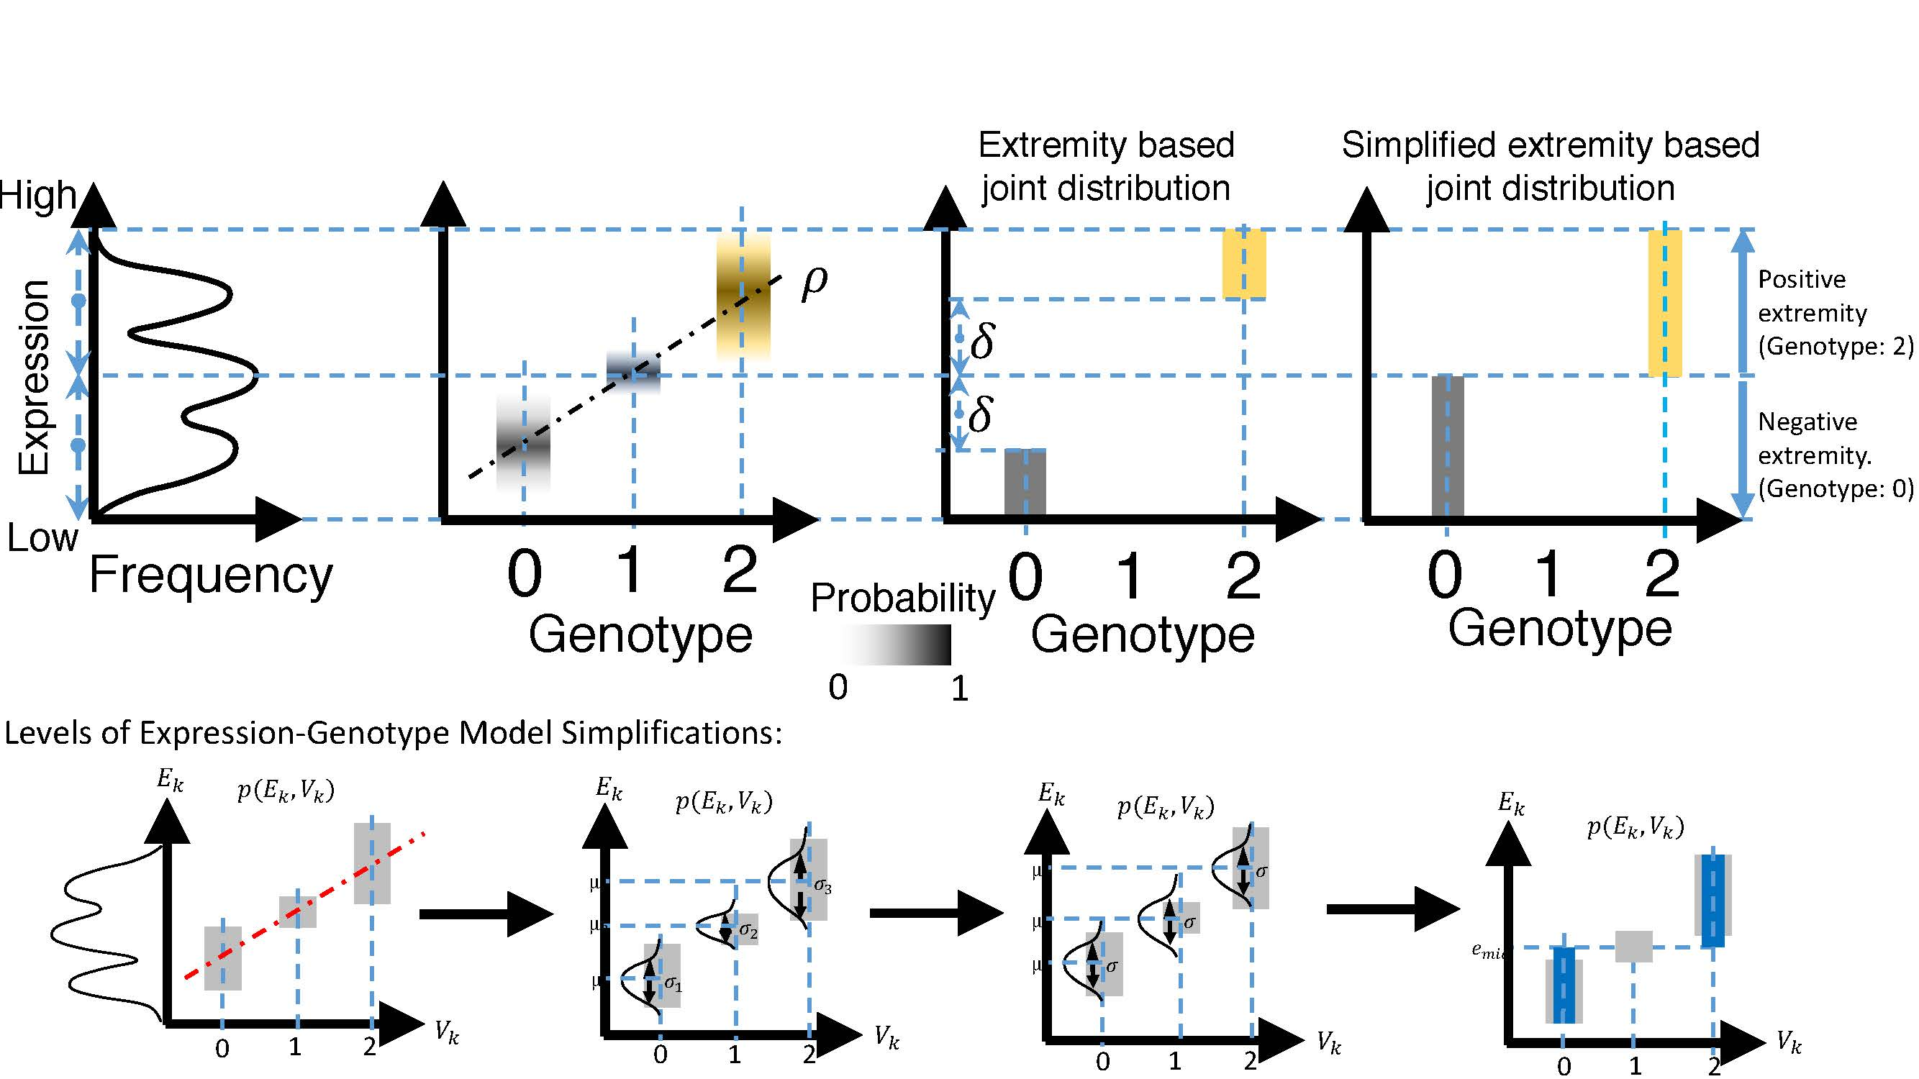
[Harmanciet al. Nat. Meth. (in revision)]

Slide 31
Large-scale Transcriptome Mining: Building Interpretative Models while Protecting Individual Privacy
The Dilemma of Genomic Privacy
  Fundamental, inherited info that’s very private vs the need for large-scale data-sharing to enable med. research
  Current Social & Tech Approaches
    Issues: burdensome security, inconsistencies + ways the solutions have been partially "hacked”
    Strawman Hybrid Soc-Tech Proposal (Cloud Enclaves. Quantifying Leaks, & Closely Coupled priv.-public data)
RNA-seq: How to Publicly Share Some of it
  Removing SNVs in reads using MRF
  Quantifying & removing variant info from expression levels + eQTLs
  Linking Attack using extreme expression levels
Large-scale Mining of RNA-seq to Determine State Space Models
  Using dimensionality reduction to help determine internal & external drivers
  Decoupling expression changes into those driven by worm-fly conserved genes vs species-specific ones. Also, Conserved genes have similar canonical patterns (iPDPs) in contrast to species specific ones (Ex of ribosomal v signaling genes)
  In human cell cycle, only conserved genes show matching periodic pattern

Slide 32
exceRpt a comprehensive method for the analysis of smallRNA-seq data, cellular expression profiles, & exogenous sequence detection
Rob Kitchen
Yale
2015 - 04 - 25

Slide 33

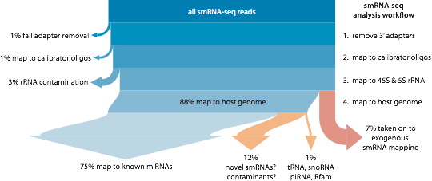
for a typical cellular sample…
exRNA samples typically much noisier
cascade of read-alignment steps mitigates contamination

Slide 34

extra-cellular RNA processing toolkit
standard formats
.fq
.fq.gz
.sra
input
automatic pre-processing and QC of sequence reads
explicit filtering of contaminants & rRNA
quantification of spike-in sequences and many different smallRNA biotypes
choice of 3 end-points:
remove adapters
+ primers
sequenced read (50nt)
smallRNA (~20-30nt)
AGATCGGAAGAGCACACGTCTGAACTCCAGTCAC
adapter (~20-30nt)
read-quality filter
fastQC
read length analysis
preprocessing
filtering
QC
for reads >15nt
map using bowtie2
(faster, allows indels)
optional: map to spike-in library
unmapped reads
map to UniVec contaminants
unmapped reads
map to 45S, 5S, & mitochondrial rRNAs
unmapped reads
bowtie1 alignments
genome
miRNA
(mirBase)
tRNA
(gtRNAdb)
piRNA
(RNAdb)
longRNA
(gencode)
circRNA
(circBase)
endogenous
alignment
(human
&
mouse)
parallel mapping
using bowtie1
hierarchical quantification based on user preferences
engine workflow:
assign reads to
highest rank library
resolve genome vs. library-only alignments
overlap mature+hairpin
miRNA alignments
re-format gencode IDs
[count random barcodes]
accepted alignments & [barcode statistics]
1
miRNA counts
2
tRNA counts
1
3
piRNA counts
4
gencode counts
5
circRNA counts
unmapped reads
endogenous only
exogenous miRNA+rRNA
exogenous genomes
map using bowtie2
map to endogenous genome (again!)
and repetitive elements
filtering
1
2
unmapped reads
map using
bowtie & STAR
map to exogenous
miRNAs and rRNAs
2
exogenous
alignment
3
unmapped reads
map using STAR
map to all genomes in ensembl & NCBI
3

Slide 35

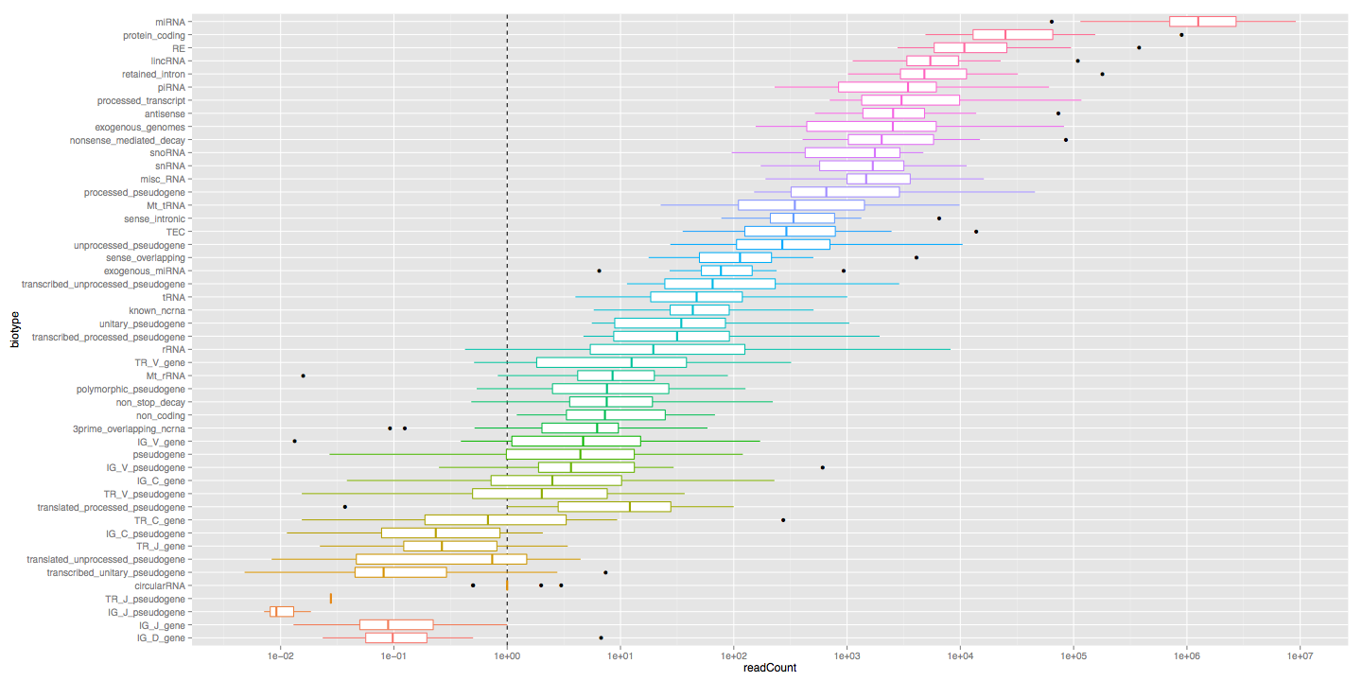
total reads by biotype
large contribution from miRNA and mRNA
also some signal from exogenous sequences
read count

Slide 36

exceRpt @ Genboree.org
input
output
extremely simple to use (1 input, 1 output)
can process multiple samples in parallel
very customisable (choice of smRNA libs, calibrators, etc)
Notes:
demonstration(s) at: ? ?

Slide 37

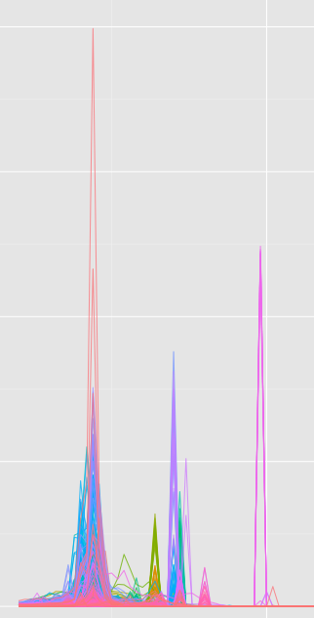
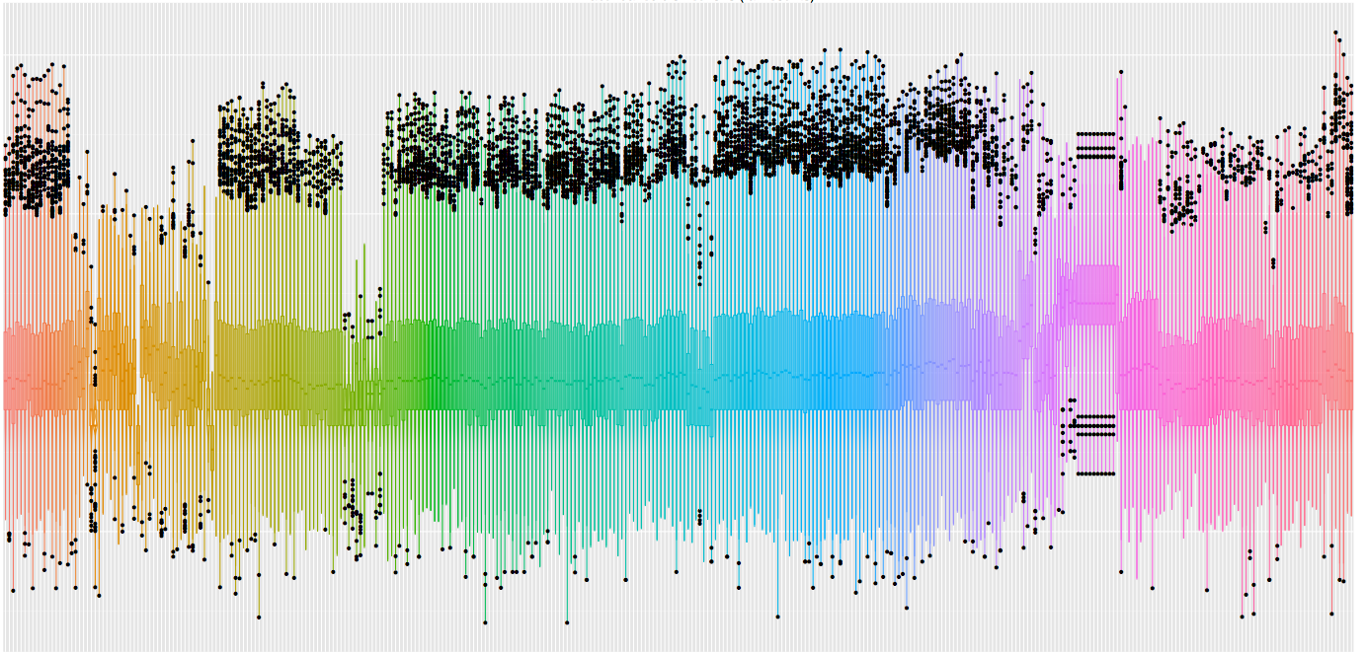
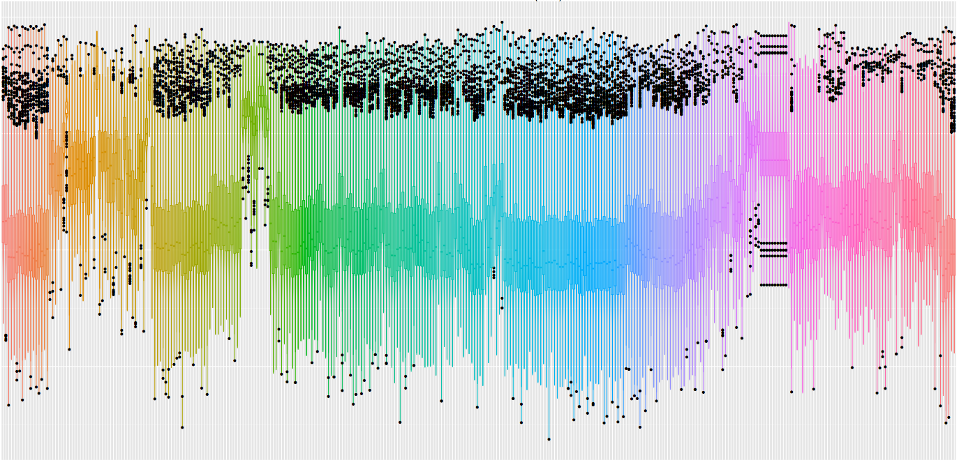
downstream analysis
exceRpt output from multiple samples can be combined, compared, and tested for differential abundance
features:
- intuitive QC visualisations
- filtering & normalisation
- differential expression
processed expression data
are excel, R, matlab, &
geneSpring compatible
read length
miRNA count
miRNA RPM
Notes:
now have an app for this!

Slide 38

exceRpt
automatic pre-processing and QC of sequence reads
absolute quantitation by quantification of exogenous spike-in sequences
explicit rRNA filtering & QC
quantify many different smallRNA types
choice of 3 end-points
standard formats
.fq
.fq.gz
.sra
input
remove adapters
+ primers
sequenced read (50nt)
smallRNA (~20-30nt)
AGATCGGAAGAGCACACGTCTGAACTCCAGTCAC
adapter (~20-30nt)
read-quality filter
fastQC
read length analysis
for reads >15nt
map using bowtie2
optional: map to spike-in library
preprocessing
filtering
QC
unmapped reads
map to UniVec contaminants
unmapped reads
map to 45S, 5S, & mitochondrial rRNAs
unmapped reads
hierarchical mapping
using bowtie
choreographed
by sRNABench
map to host genome
(hg19 hg38 mm10)
map to
endogenous miRNAs
endogenous
alignment
sRNABench
unmapped reads
map to
tRNAs, piRNAs, & gencode
1
unmapped reads
map to
exogenous miRNAs
2
exogenous
alignment
1
2
3
unmapped reads
map using STAR
map to all genomes in ensembl & NCBI
3

Slide 39

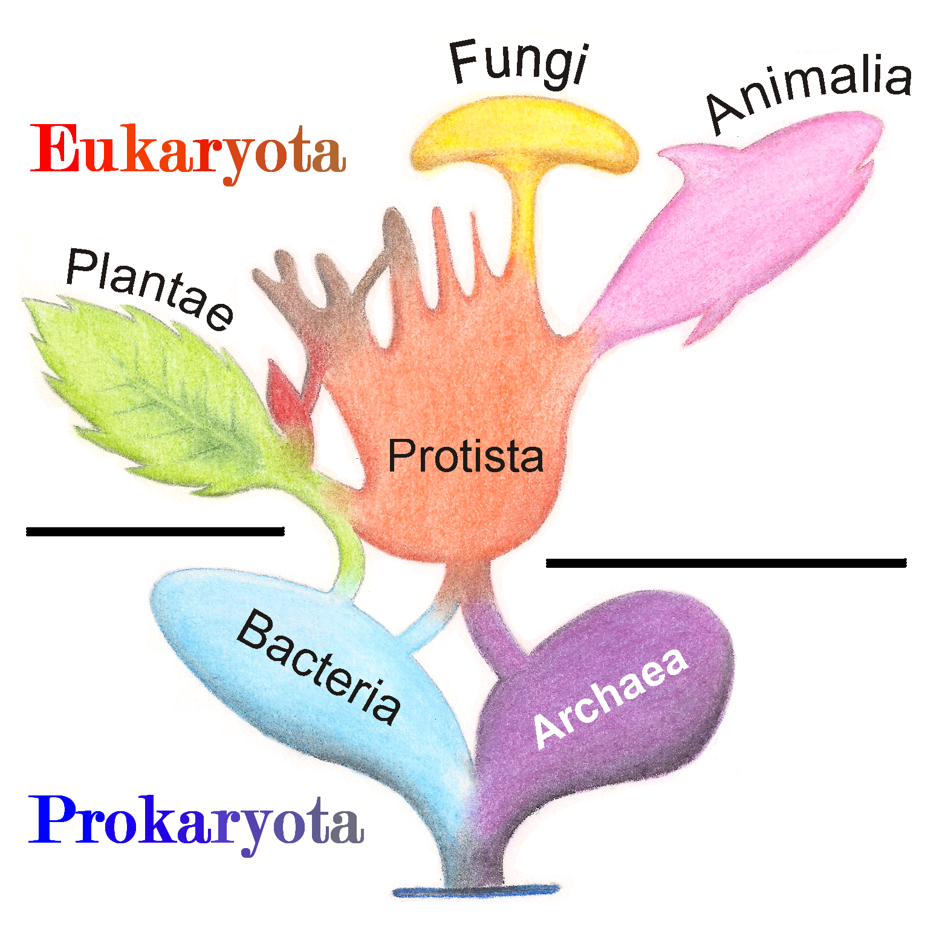
exogenous genomic alignment
for reads that do not align to:
contaminants or endogenous sequences
exogenous miRNAs
competitively align to all known*
bacteria, fungi, plant, protist,
vertebrate genomes in ensembl
and all viral genomes in NCBI
1
2
chicken
cod
cow
dog
duck
frog
horse
rabbit
pig
sheep
tilapia
turkey
3
5,242 bacteria
52 fungi
40 plants
32 protists
12 vertebrates
5,758 viruses
Notes:
* except birds/mammals
(hg38+junctions ~30GB)

Slide 40

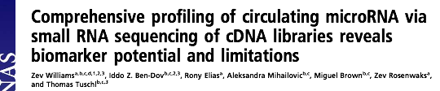

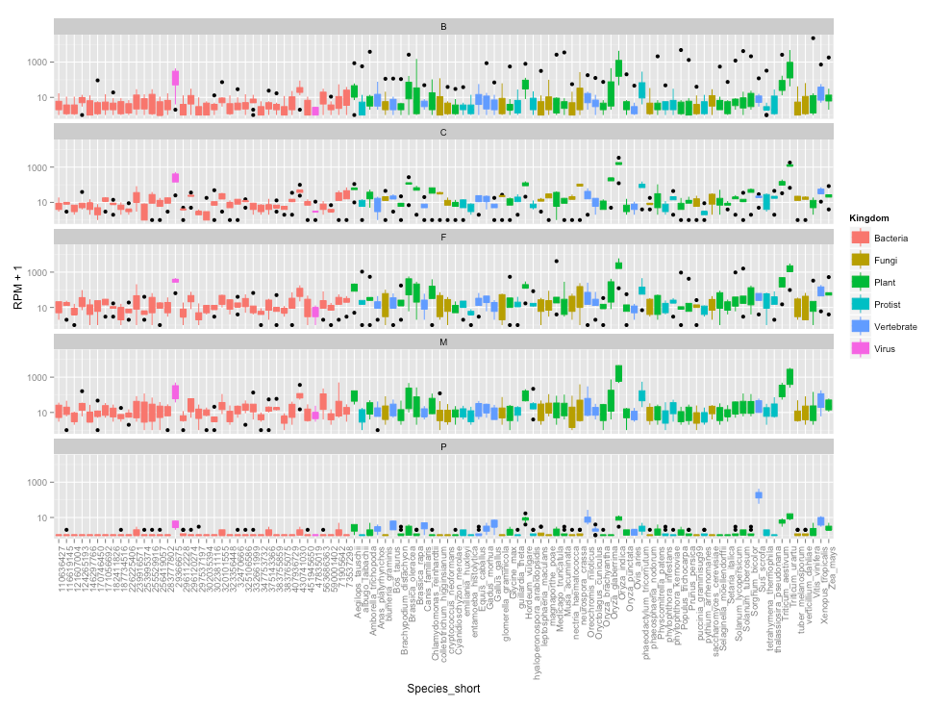
ex-exRNA
paternal blood
maternal blood
Reads per million
placenta

Slide 41

Extracellular RNA Communication
NIH Common Fund
> data management
> reference profiles
> exRNA biogenesis
> exRNA biomarker
> exRNA therapy
currently 30 funded projects
exRNA.org

Slide 42
cellular smallRNA atlas
Extracellular RNA Communication
NIH Common Fund
> data management
> reference profiles
> exRNA biogenesis
> exRNA biomarker
> exRNA therapy
currently 30 funded projects
exRNA.org
ERCC will construct an exRNA atlas using data processed with exceRpt
our goal: build a uniformly-processed database of smallRNA abundance across healthy human tissues
why?!
1 in which tissues is my miRNA expressed?
2 which miRNAs are predominantly expressed in my tissue?
3 what are the most likely tissue(s) producing the miRNAs in my exRNA sample?

Slide 43


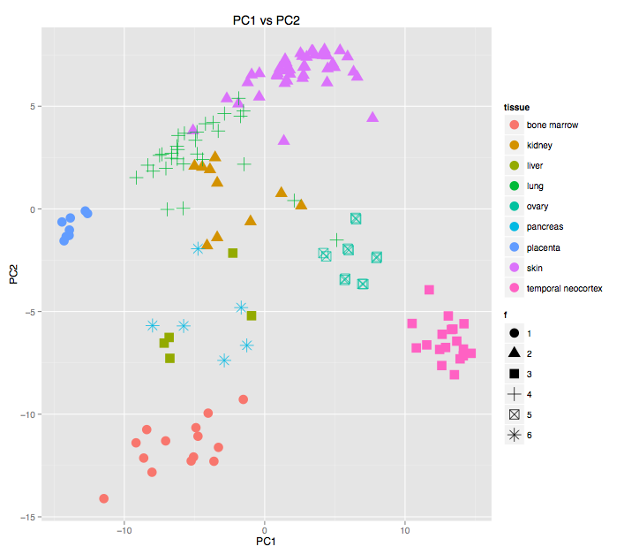
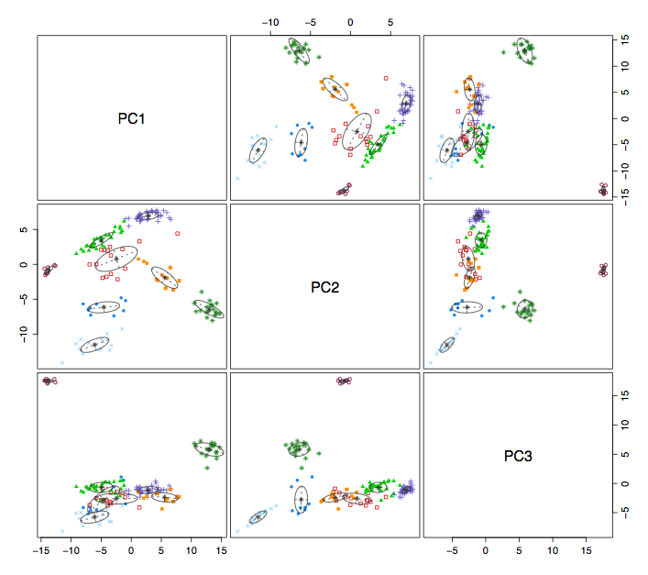
clustering - all smRNAs
unsupervised
clustering
PCA
much better separation of tissues by PCA when we
include tRNAs and piRNAs
Notes:
pancreas+liver difficult to resolve
excellent separation of the brain, lung, marrow, ovary, placenta, skin,

Slide 44
summary
trivial to use exceRpt thanks to:
- automated, linear workflow
- GUI, processing, & data/result storage on Genboree
we have processed almost 700 smRNA-seq samples,
(totalling some 6.8 billion reads) to create the cellular mRNA atlas
aligning reads to all* available genomes is extremely fast (~90mins per sample)
genboree.org
exRNA.org

Slide 45
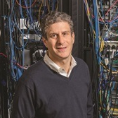
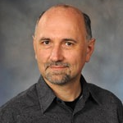




Acknowledgements
Mark Gerstein
Aleks Milosavljevic
Joel Rozowsky
Matt Roth
Sai Lakshmi
Subramanian
William
Thistlethwaite
Fabio
Navarro
Alex Pico
Data Integration and Analysis Component (DIAC) members of the Data Management Resource and Repository (DMRR)

Slide 46


Extremity based linking with
homozygous genotypes
Attacker can estimate the
reliability of linkings
Sensitivity: Fraction of correctly linked
Individuals among all individuals
PPV: Fraction of correctly linked individuals
among selected individuals
[Harmanciet al. Nat. Meth. (in revision)]

