Slide 1
GWAS SNP enrichment on ChIP-Seq data
SL- P2-tech

Slide 2
ChIP-Seq analysis pipeline
Quality metrics of read counts
(Strand cross-correlation analysis, number of reads in the peaks, library complexity)
ChIP FastQ file
Quality metrics
(FastQC, FASTX)
Read mapping
(Bowtie)
Signal generation,
file format conversion
(samtools, bedtools, bedGraphToBigWig)
ChIP bigwig file
Control FastQ file
Quality metrics
(FastQC, FASTX)
Read mapping
(Bowtie)
Signal generation,
file format conversion
(samtools, bedtools, bedGraphToBigWig)
Control bigwig file
Check peak calling results
Peak calling
(MACS2, MUSIC)
ChIP-Seq peaks
Downstream analysis
(peak comparison, peak annotation, motif analysis)

Slide 3
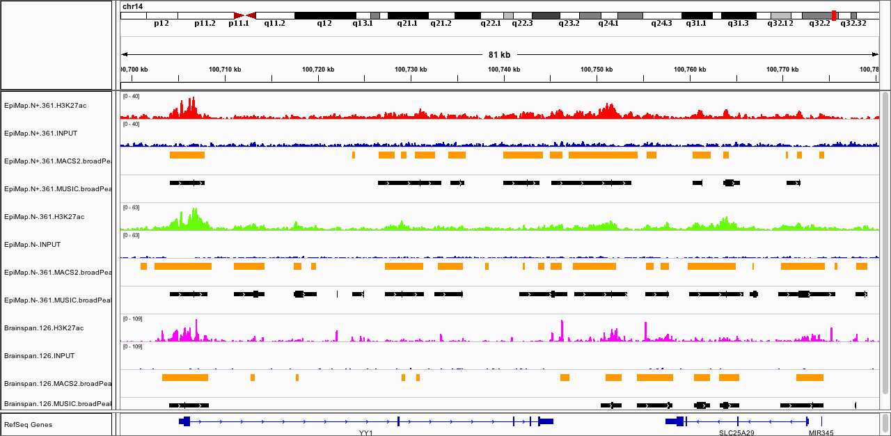
Association of ChIP-Seq peaks and GWAS SNPs of different diseases
H3K27ac peak
Mapped positionn | Disorder SNPs | Common 1000 genome SNPs | Row total
Maped to ChIP peaks | a | b | a+b
Not mapped to ChIP peaks | c | d | c+d
Column total | a+c | b+d | N=a+b+c+d
Enrichment = -log10(p value by one-tailed Fisher’s exact test)
http://www.rasadbsnp.com/images/SNPs.jpg

Slide 4
GWAS SNPs enrichment in ChIP-Seq peaks
Brainspan
Roadmap
Notes:
y axis are brain peaks from brainspan and enhancers of the other tissues from roadmap, x axis are different diseases. Compare the enrichment in two dimesions. Showed 10 out of 98 enhancers

Slide 5
ChIP-Seq analysis pipeline
Quality metrics of read counts
(Strand cross-correlation analysis, number of reads in the peaks, library complexity)
ChIP FastQ file
Quality metrics
(FastQC, FASTX)
Read mapping
(Bowtie)
Signal generation,
file format conversion
(samtools, bedtools, bedGraphToBigWig)
ChIP bigwig file
Control FastQ file
Quality metrics
(FastQC, FASTX)
Read mapping
(Bowtie)
Signal generation,
file format conversion
(samtools, bedtools, bedGraphToBigWig)
Control bigwig file
Check peak calling results
Peak calling
(MACS2, MUSIC)
ChIP-Seq peaks
ROSE: Rank ordering of super-enhancers
Super-enhancers

Slide 6
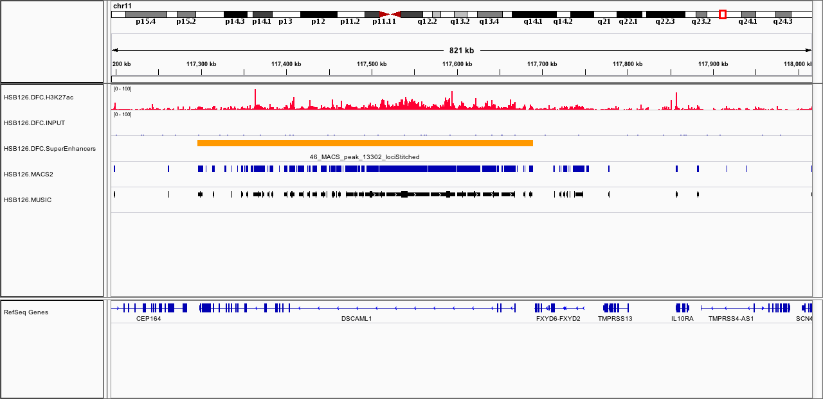
Super-enhancers

Slide 7
Notes:
it is likely that super-enhancers identify enhancers that function in the regulation of tissue-specific transcription. Enhancers are generally enriched for disease-associated variants, and this association is strongest in tissues implicated in the corresponding disease17,46–48.

