Slide 1
Variant annotation using AlleleDB

Slide 2
The Rise of the Personal Genome
Adapted from Nature 2010

Slide 3
Number of DNA sequences exploding out of control in recent years

Slide 4
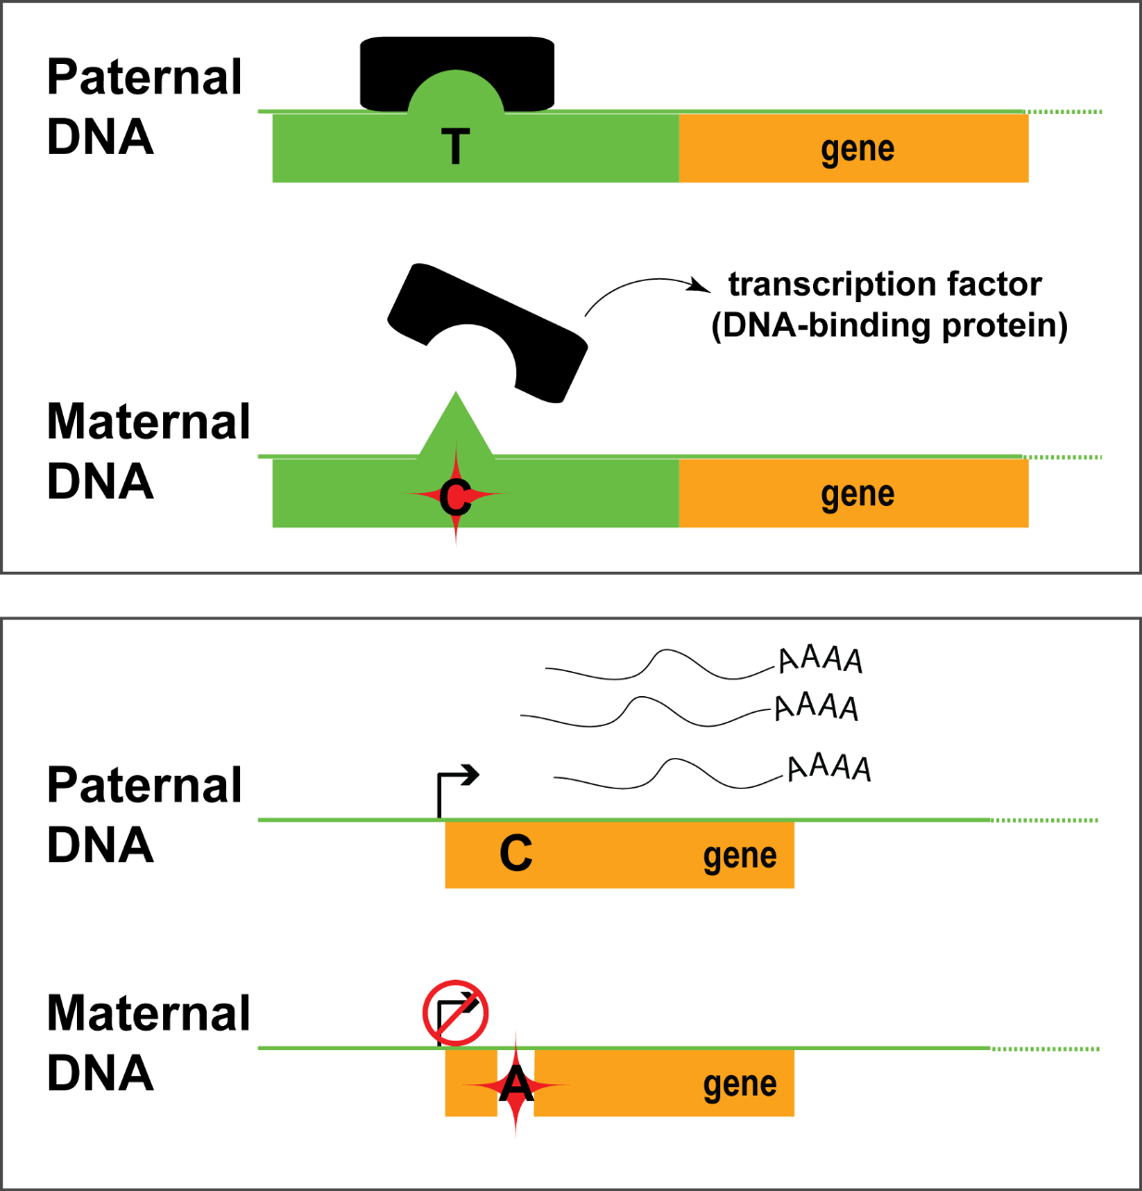
Variants involved in Allele-specific binding and expression
P
variants
M
P
M

Slide 5
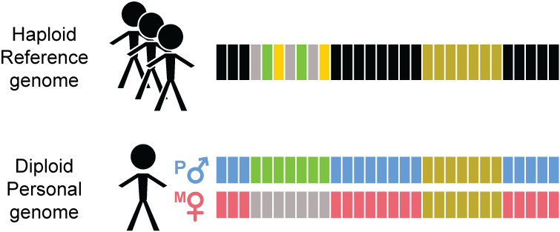
Diploid personal genome important in assessing allele-specific behavior

Slide 6
How to build a personal genome
(fasta; reference)
(vcf, variants phased or unphased)
(fasta; for each haplotype)
alleleseq.gersteinlab.org
Rozowsky et al. Mol Syst Biol (2011)
Notes:
Compatible subseq in downstream processing or analyses e.g with aligners for indexing

Slide 7
Compute allelic ratio (i.e. read difference at the 2 alleles)
e.g. a SNV @ chr 7 position 4345325
e.g. a SNV @ chr 5 position 12455
RNA-/ChIP-Seq Reads
ACTTTGATAGCGTCAACG
CTTTGATAGCGTCAACGC
CTTTGATAGCGTCAACGC
TTGACAGCGTCAATGCAC
TGATAGCGTCAATGCACG
ATAGCGTCAACGCACGTC
TAGCGTCAATGCACGTCG
CGTCAACGCACGTCGGGA
GTCAATGCACGTCGAGAG
CAATGCACGTCGGGAGTT
RNA-/ChIP-Seq Reads
ACTTTGATAGCGTCAATG
CTTTGATAGCGTCAATGC
CTTTGATAGCGTCAATGC
TTGACAGCGTCAATGCAC
TGATAGCGTCAATGCACG
ATAGCGTCAATGCACGTC
TAGCGTCAATGCACGTCG
CGTCAACGCACGTCGGGA
GTCAATGCACGTCGAGAG
CAATGCACGTCGGGAGTT
5 x T
5 x C
------
9 x T
1 x C
------
(ref)
(ref)
Allelic ratio = 0.5
(i.e. ‘null’ expectation)
Allelic ratio = 0.9
T
T
C
C
Notes:
In allele-specific analyses what people do conventionally is aligning the reads to the respectively alleles at positions with heterozygous SNVs

Slide 8
Binomial model on observed distribution
ASE/ASB Example:
…GTCAATGCAC
…GTCAATGCACG
…GTCAATGCACGTC
…GTCAATGCACGTCG
…GTCAACGCACGTCGGGA
GTCAATGCACGTCGAGAG
CAATGCACGTCGGGAGTT
AATGCACGTCGGGAGTTG
Non-allele-specific variants
e.g. allelic ratio = 0.5
Allele-specific variants
e.g. allelic ratio = 0.9
Observed
Binomial
Null Example:
ACTTTGATAGCGTCAATG
CTTTGATAGCGTCAACGC
TTGACAGCGTCAATGCAC
ATAGCGTCAATGCACGT…
TAGCGTCAACGCACGT…
CGTCAACGCACGT…
CAATGCACGT…
AATGCACGT…
Alt
Ref

Slide 9
Binomial model on observed distribution

Slide 10
AlleleDB: Build 382 personal genomes to detect allele-specific variants
Build 382 personal genomes
Align ChIP-seq reads for 14 individuals Align RNA-seq reads for 382 individuals
Detect allele-specific variants Via a series of filters and tests
alleledb.gersteinlab.org
Chen J. et al. (Nature Commun, in press)

Slide 11
AlleleDB: Annotating rare and common allele-specific variants
alleledb.gersteinlab.org
Chen J. et al. (Nature Commun, in press)

Slide 12
AlleleDB: Annotating rare and common allele-specific variants
Interfaces with UCSC genome browser
Showing ZNF331 gene structure
AlleleDB output
UCSC track
alleledb.gersteinlab.org
Chen J. et al. (Nature Commun, in press)

Slide 13
AlleleDB: repository and visualization for allele-specific variants
Interfaces with UCSC genome browser
Showing ZNF331 gene structure
AlleleDB output
UCSC track
Allele-specific binding variants
Allele-specific expression variants
Chen J. et al. (Nature Commun, in press)

Slide 14
Further annotating allele-specific genomic regions
Does a particular genomic element have a higher tendency to be allele-specific?
-- Fisher’s exact test, for the enrichment of allele-specific variants in the element (with respect to non-allele-specific variants)
allele-specific
non-allele-specific
Human reference
genome
alleledb.gersteinlab.org
Chen J. et al. (Nature Commun, in press)

Slide 15
AlleleDB: Annotating non-coding genomic regions for allele-specific activity
alleledb.gersteinlab.org
Chen J. et al. (Nature Commun, in press)

Slide 16
AlleleDB: Annotating coding regions for allele-specific activity
SNURF imprinted and implicated in Prader-Willi/Angelman Syndrome
KCNQ1 is an imprinted gene
alleledb.gersteinlab.org
Chen J. et al. (Nature Commun, in press)

Slide 17
Some issues in AS analyses
Reference bias
Ambiguous mapping bias
Over-dispersion

Slide 18
Reference bias (naïve alignment to the human reference genome)

Slide 19
PG alleviates reference bias in alignment

Slide 20
PG alleviates reference bias in alignment

Slide 21
Some issues in AS analyses
Reference bias
Ambiguous mapping bias
Over-dispersion

Slide 22
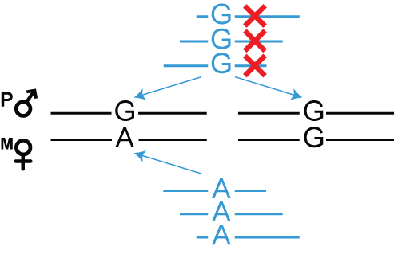
Ambiguous mapping bias due to sequence similarity
For AS analyses, discard reads that multi-map

Slide 23
Account for ambiguous mapping bias
Using the reference genome, new simulated reads are created where alleles of the original reads are flipped (at het SNV positions)
Lappalainen et al. (2013)
Panousis et al. (2014)
Van de Geijn et al. (2015)
Notes:
There is currently a number of different methods that can help with this issue and one of more common methods is to do a simulation of flipped reads

Slide 24
PG facilitates the resolution of ambiguous mapping bias
Using the personal genome, we do not need to simulate reads.
We can directly test affected sites using multi-mapping read pile
Keep track of they multi-map
Notes:
The flipping simulation can also be used in the

Slide 25
Some issues in AS analyses
Reference bias
Ambiguous mapping bias
Over-dispersion

Slide 26
Binomial model on observed distribution

Slide 27
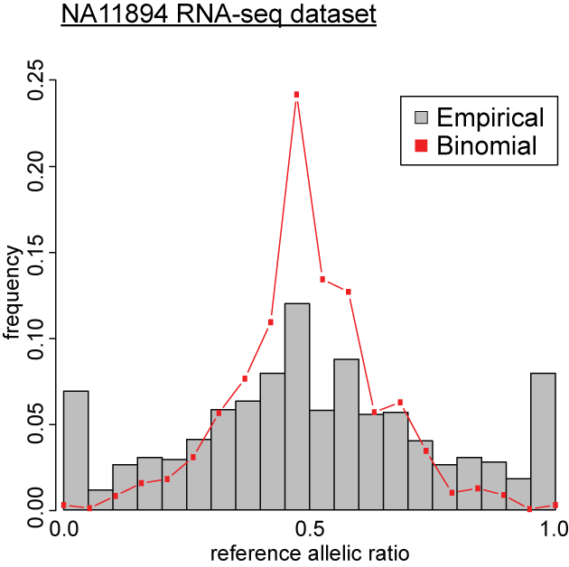
Over-dispersion – broader distribution than expected
Binomial distribution insufficient to explain over-dispersed observed distribution
Observed
Binomial
)
Alt
Ref

Slide 28
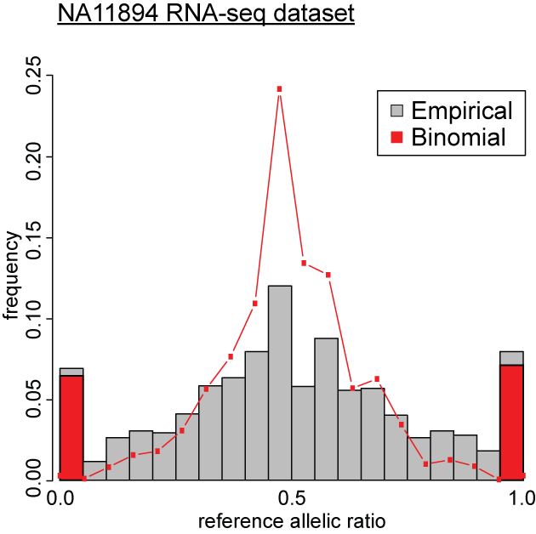
Over-dispersion – broader distribution than expected
Binomial distribution insufficient to explain overdispersed empirical distribution
Binomial test over-calls allele-specific variants
Observed
Binomial
Alt
Ref
Notes:
non-optimal antibodies in ChIP-seq experiments
read mapping variability
true biological variation in factor binding or expression
etc. etc.

Slide 29
Beta-binomial distribution – to account for over-dispersion
Binomial | Beta-binomial
2 parameters -- X ~ (n,k) | 4 parameters -- X ~ (n,k) -- k ~ Beta(α,ß)
n = total number of reads k = allelic ratio | n = total number of reads k = allelic ratio accounting for the overdispersion of allelic ratio distribution
Notes:
The default model is eta1 =logit(mu) and eta2 = logit(rho) because both parameters lie between 0 and 1. The mean (of Y) is p = mu = alpha / (alpha + beta) and the variance (of Y) is mu(1-mu)(1+(N-1)rho)/N. Here, the correlation rho is given by 1/(1 + alpha + beta) and is the correlation between the N individuals within a litter. A litter effect is typically reflected by a positive value of rho. It is known as the over-dispersion parameter.

Slide 30
Accounting for overdispersion: Binomial VS Beta-binomial
Observed
Binomial
Betabinomial
Alt
Ref

Slide 31
Accounting for overdispersion: Binomial VS Beta-binomial
Observed
Binomial
Betabinomial
over-calls by binomial
Alt
Ref
Alt
Ref

Slide 32
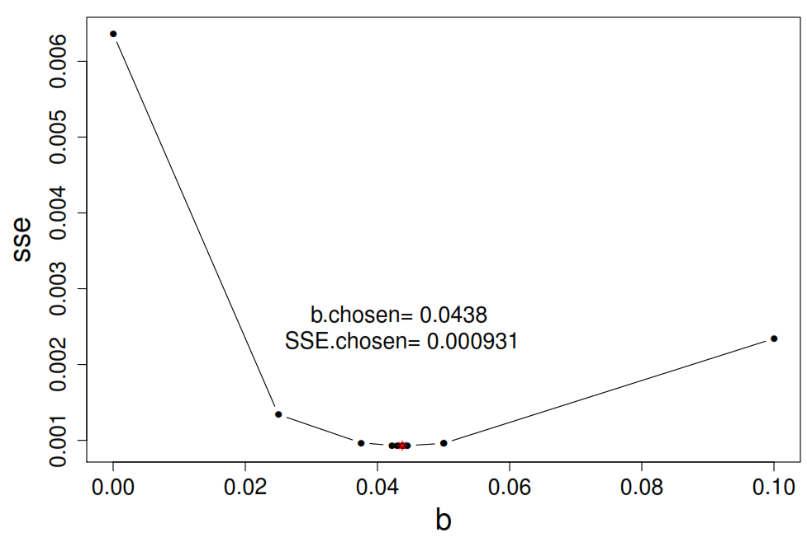
Bisection method : Fix a, scan for b, fit the distribution by using Least Sum Squared Errors between empirical and fitted distributions

Slide 33
ChIP-seq sets have more varied overdispersion

Slide 34
Overdispersion parameter (ρ) as a useful QC metric for data harmonization
Curated 987 RNA-seq datasets from eight different studies (including ENCODE) -- removed 32 datasets with ρ ≥ 0.125 (1 sd from ρ_{mean})
Overdispersion parameter, ρ
ρ = 0.125

Slide 35
Accounting for overdispersion: Binomial VS Beta-binomial
Observed
Binomial
Betabinomial
ρ=0.123
over-calls by binomial
Alt
Ref
Alt
Ref

Slide 36
Acknowledgement
Yale University
Jieming Chen
Joel Rozowsky
Timur Galeev
Arif Harmanci
Rob Kitchen
Mark Gerstein
EMBL-EBI
Oliver Stegle
Mayo Clinic
Alexej Abyzov

