Slide 1
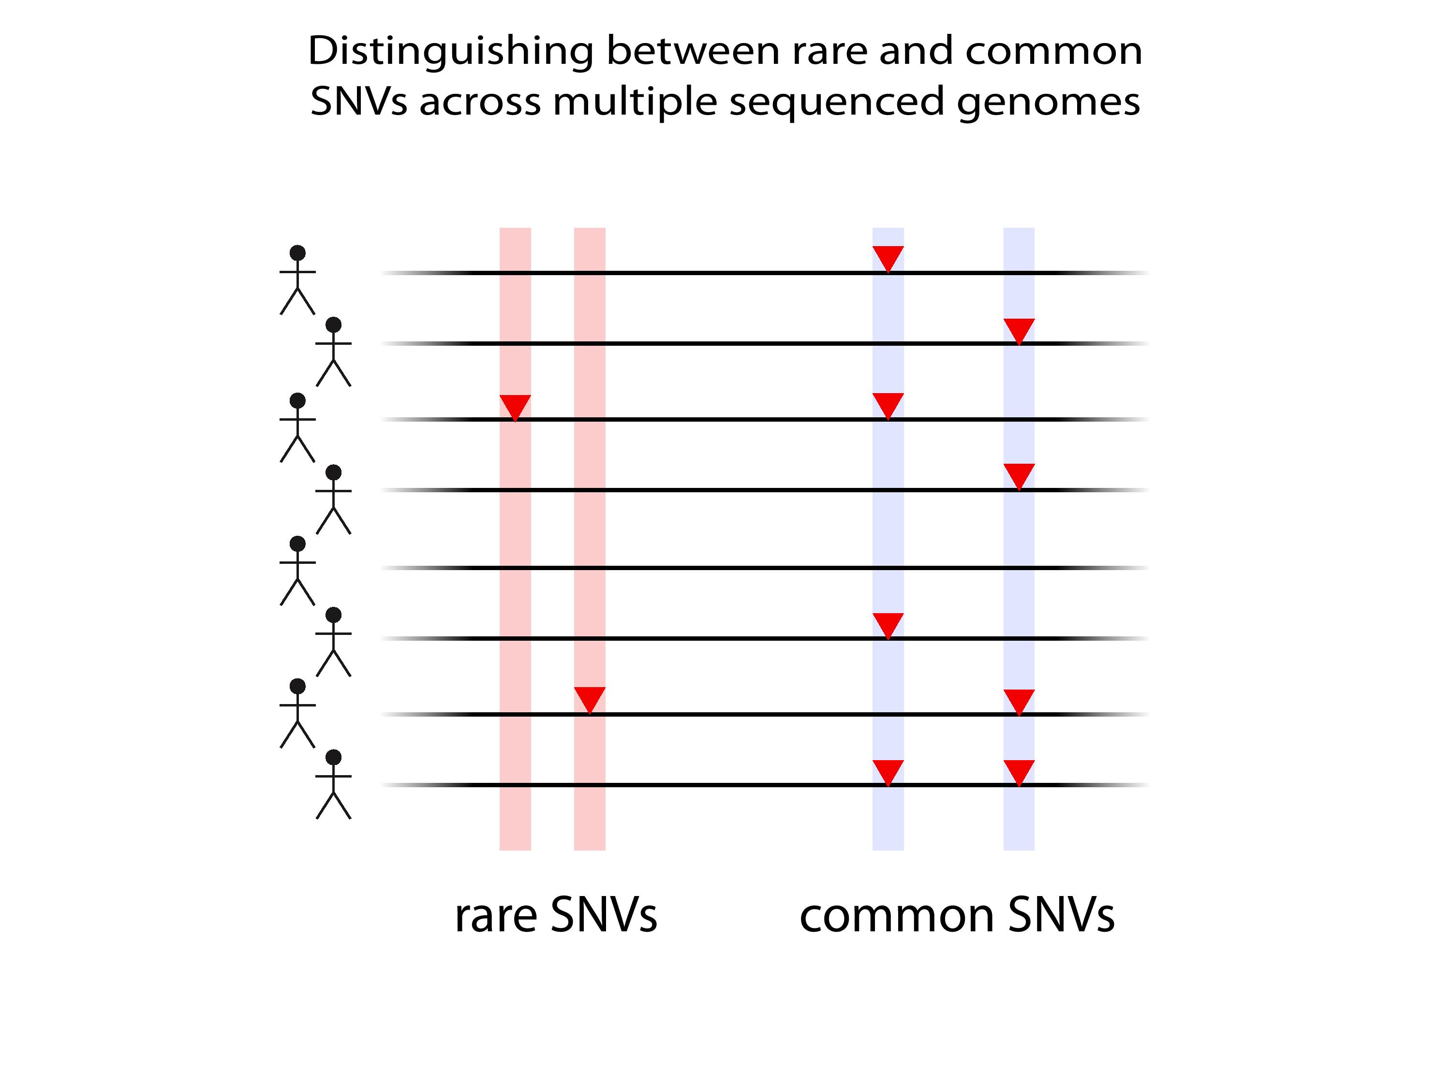

Slide 2
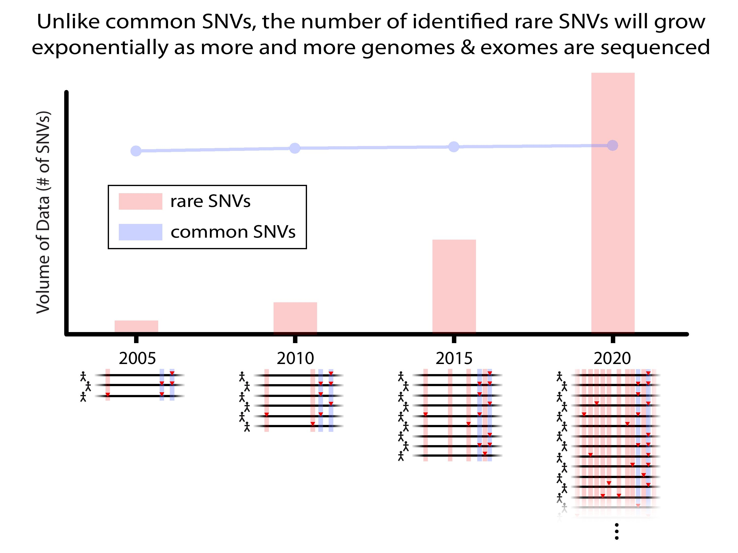

Slide 3
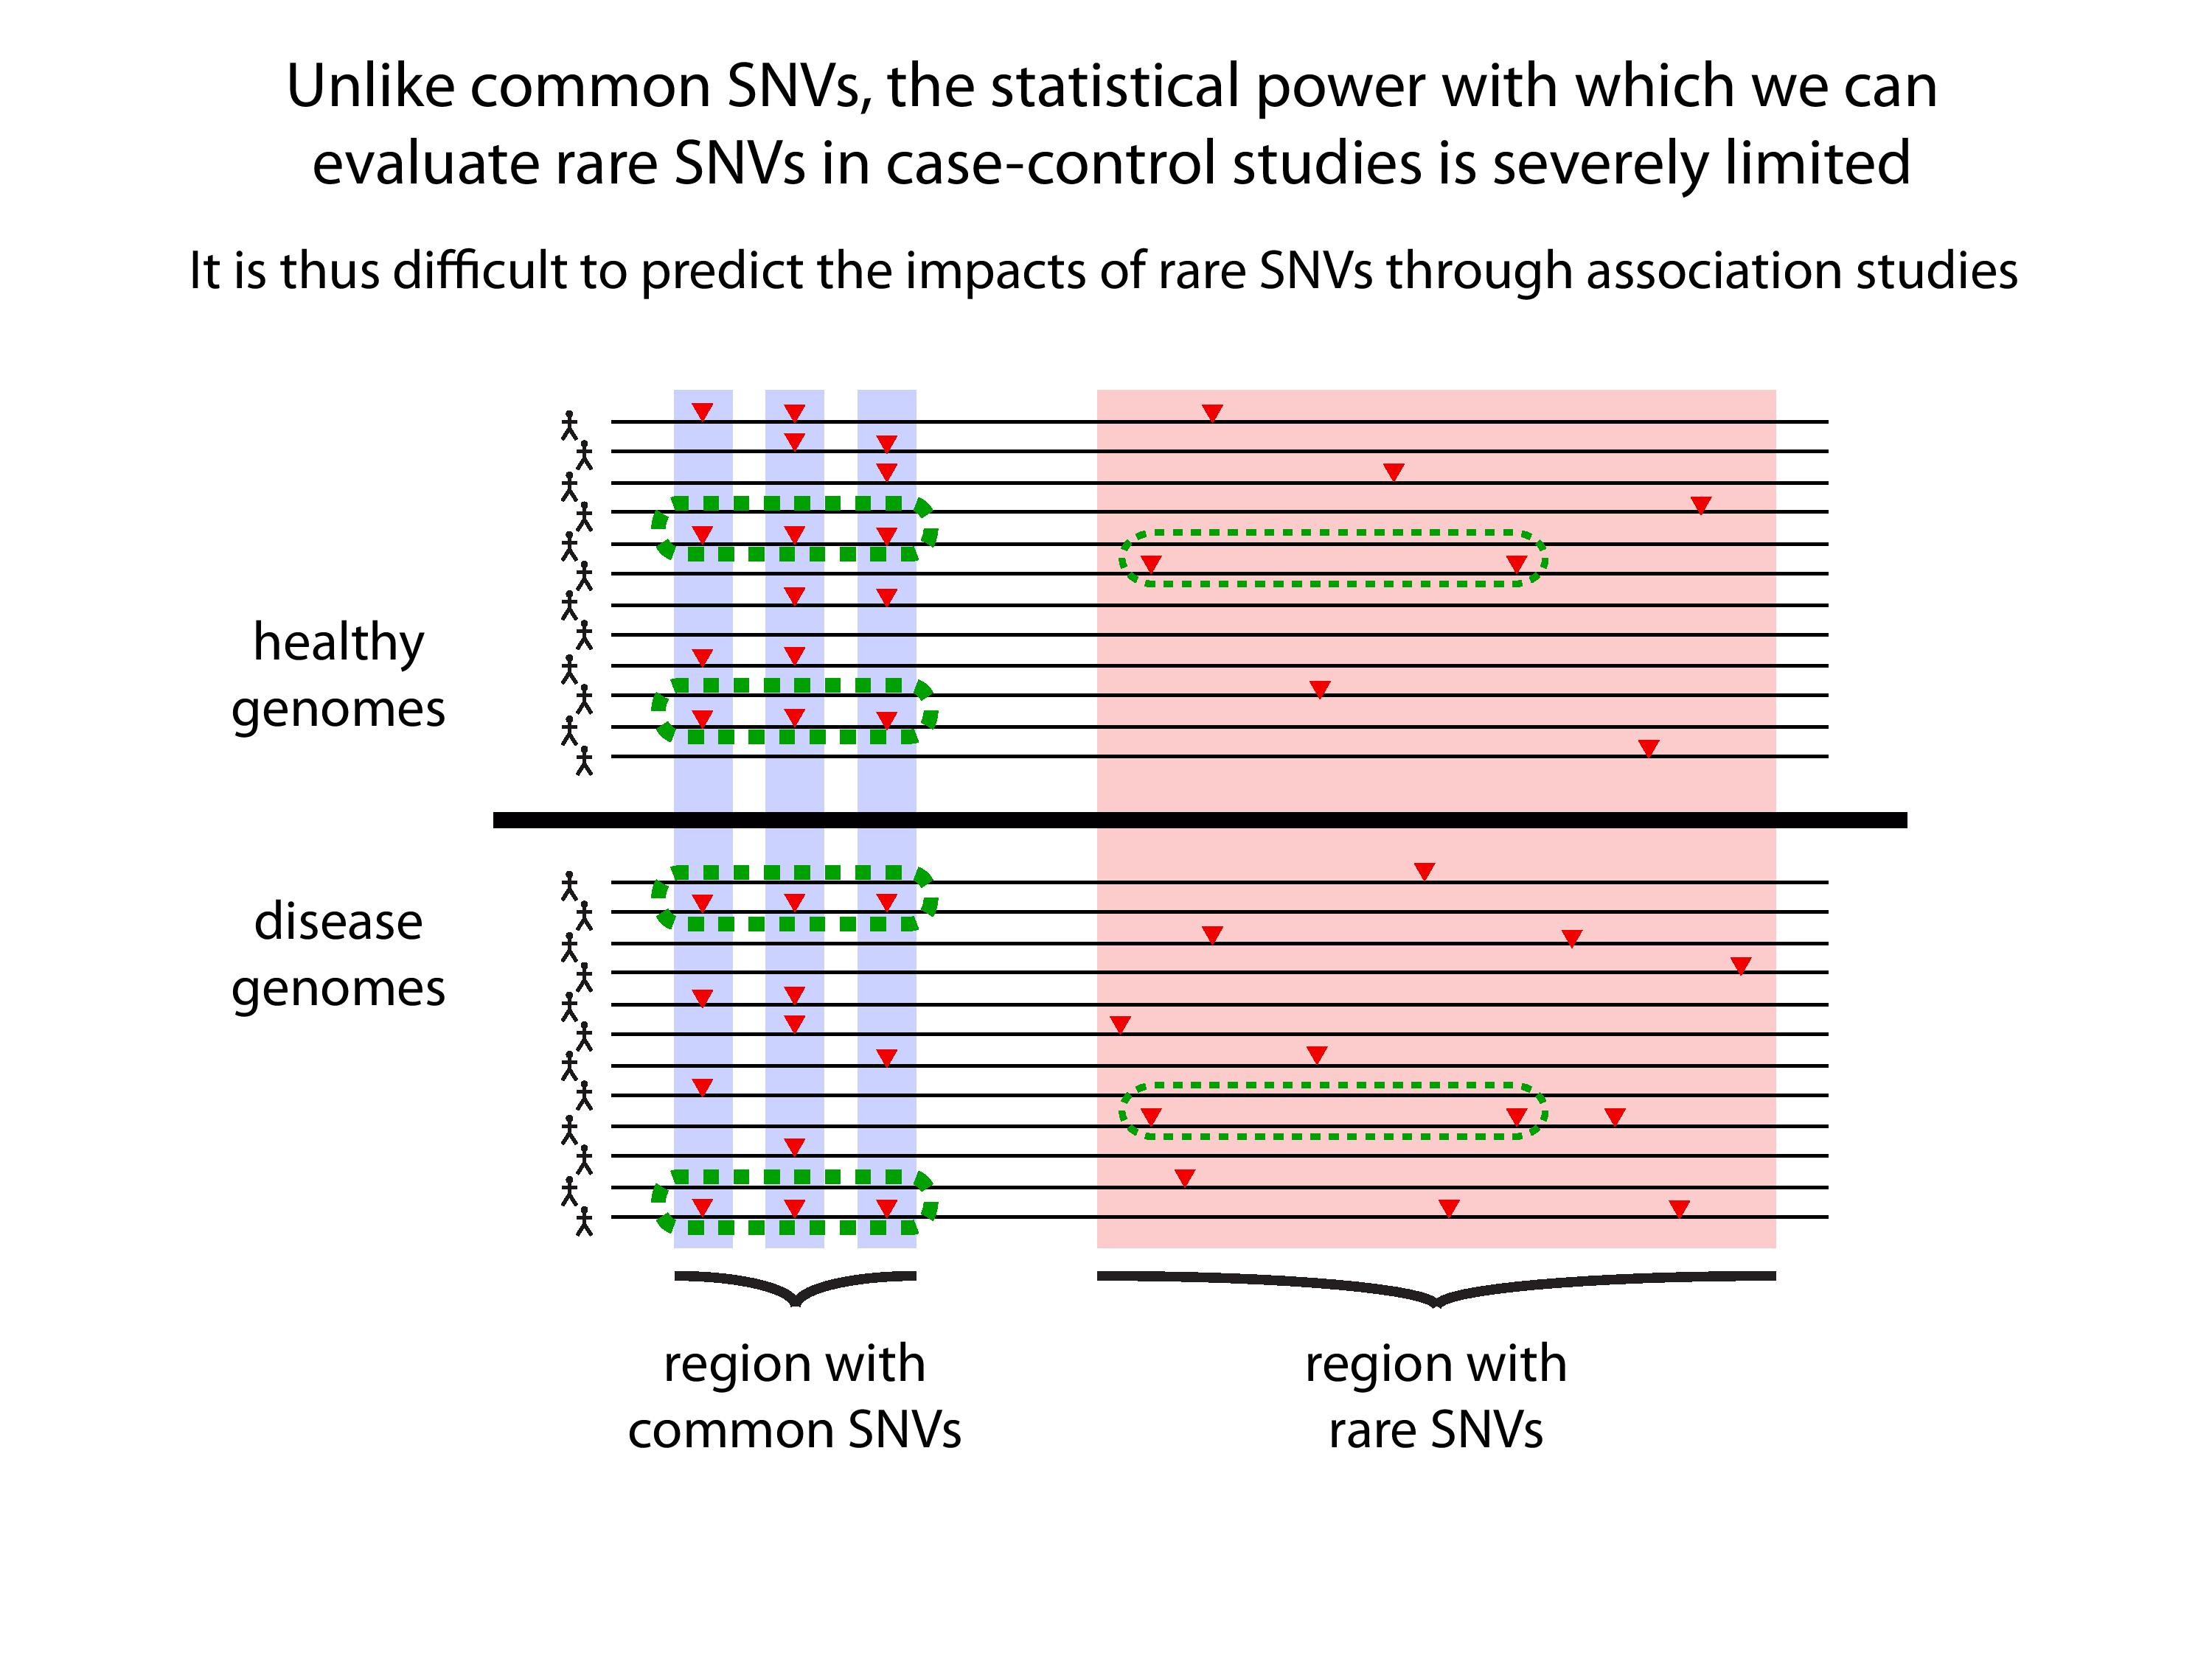

Slide 5
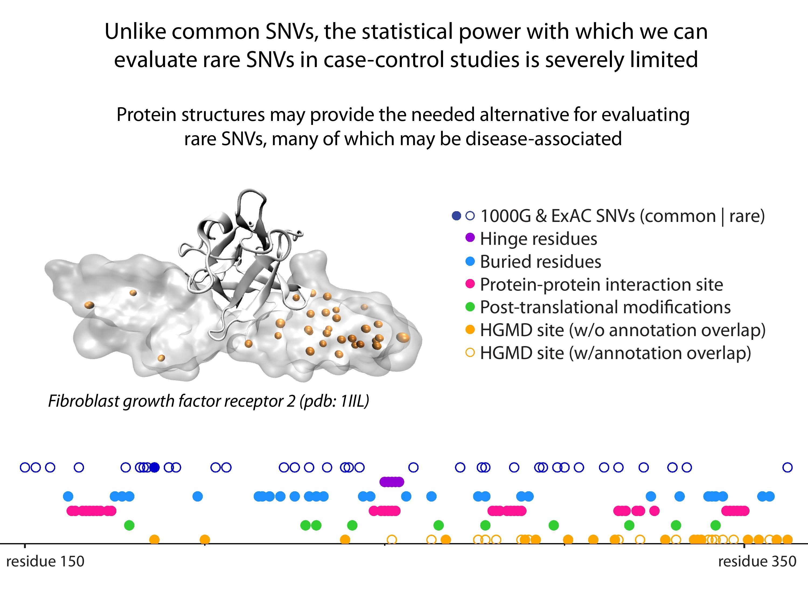

Slide 6
Models of Protein Conformational Change
Motion Vectors from Normal Modes (ANMs)
PDB ID: 3RFU
Adapted from Fuglebakk et al, 2014

Slide 7
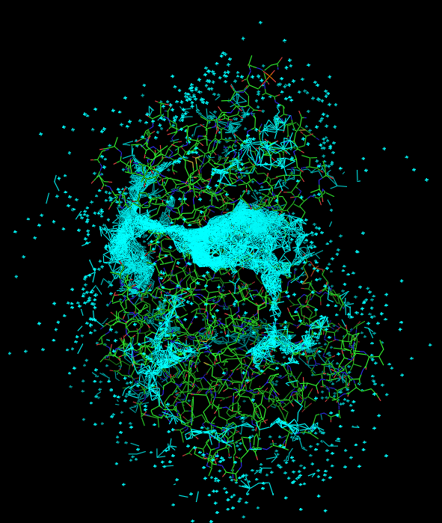
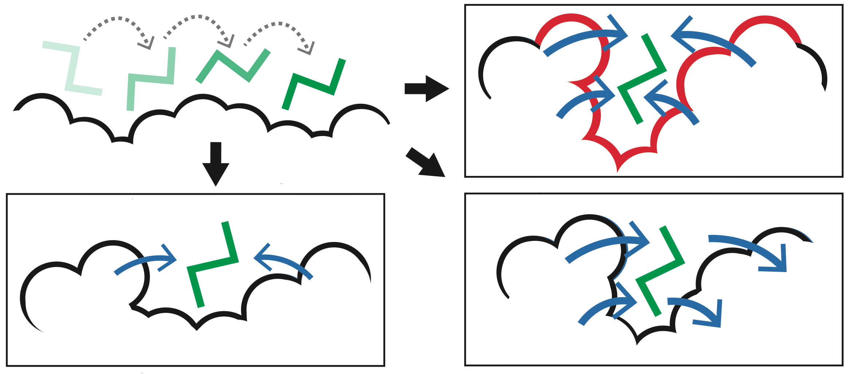
Predicting Allosterically-Important Residues at the Surface
MC simulations generate a large number of candidate sites
Score each candidate site by the degree to which it perturbs large-scale motions
Prioritize & threshold the list to identify the set of high confidence-sites
pdb 1J3H
Surface region with high
density of candidate sites
Surface region with low density of candidate sites
Adapted from Clarke*, Sethi*, et al (in press)

Slide 8
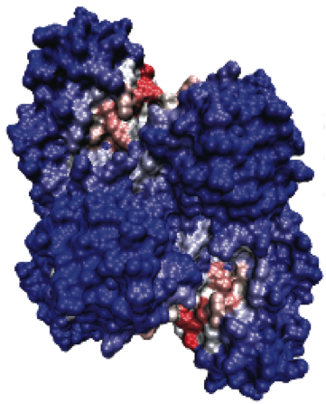
Predicting Allosterically-Important Residues at the Surface
PDB: 3PFK
Adapted from Clarke*, Sethi*, et al (in press)

Slide 9
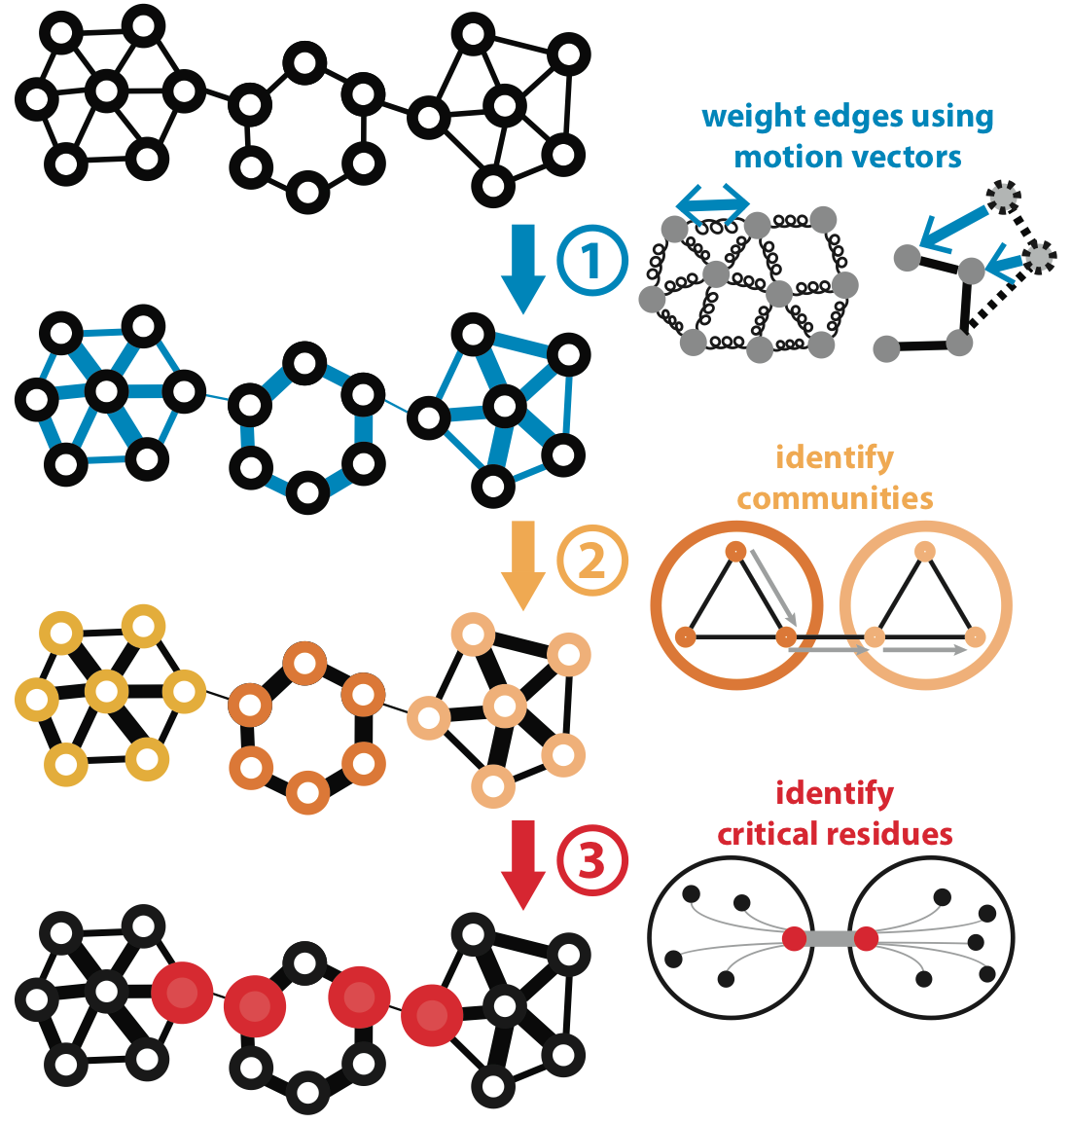
Predicting Allosterically-Important Residues within the Interior
Adapted from Clarke*, Sethi*, et al (in press)

Slide 10
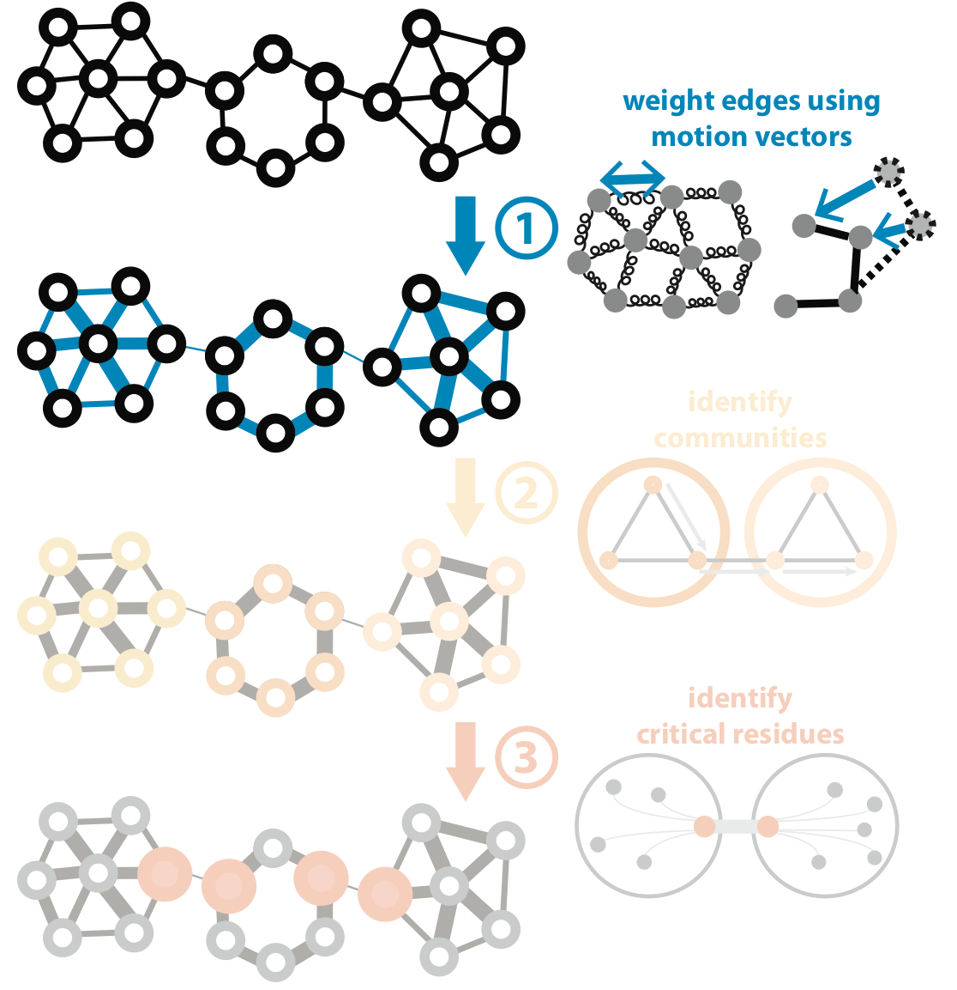
Predicting Allosterically-Important Residues within the Interior
Adapted from Clarke*, Sethi*, et al (in press)

Slide 11
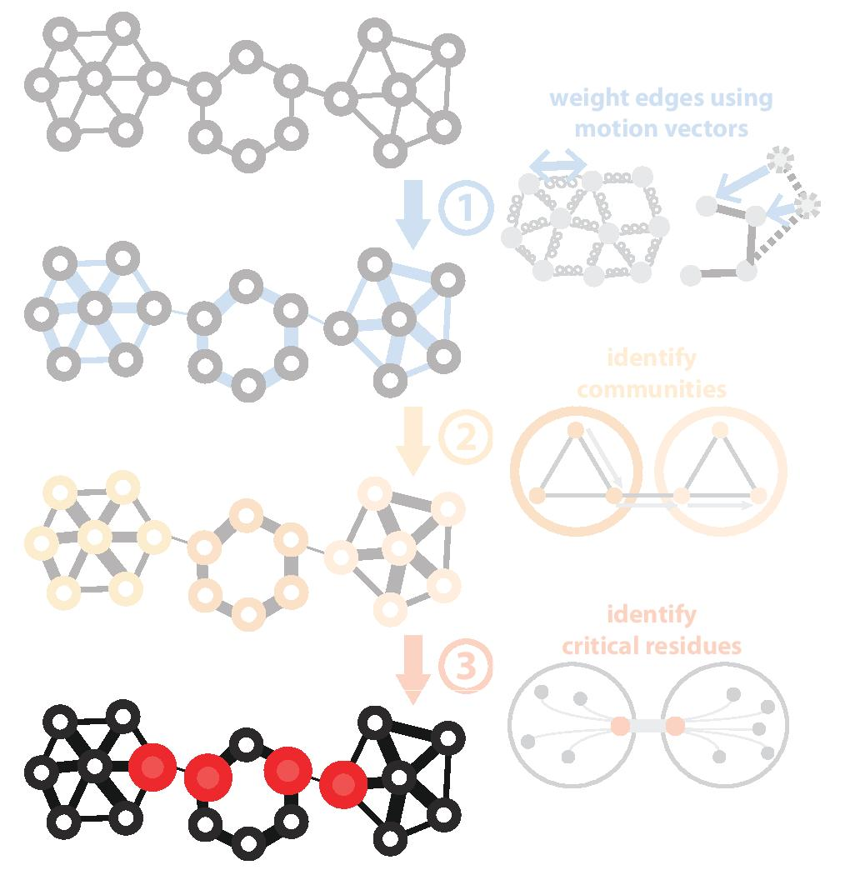
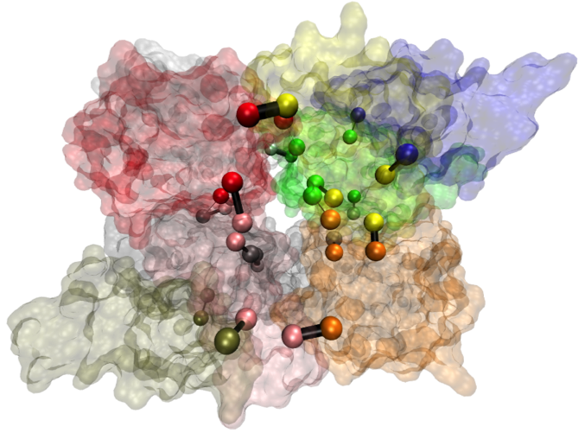
Predicting Allosterically-Important Residues within the Interior
PDB: 1XTT
Adapted from Clarke*, Sethi*, et al (in press)

Slide 12
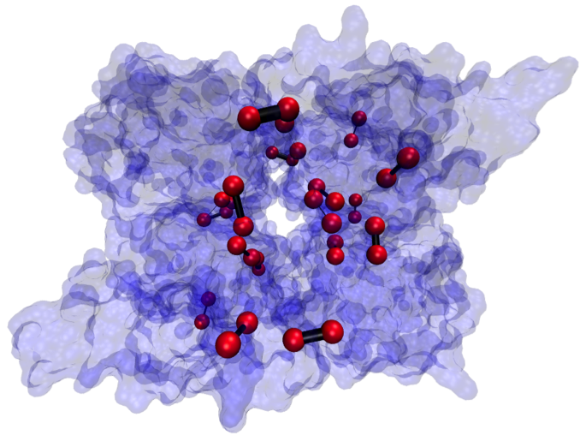
Predicting Allosterically-Important Residues within the Interior
PDB: 1XTT
Adapted from Clarke*, Sethi*, et al (in press)

Slide 13

STRESS Server Architecture: Highlights
stress.molmovdb.org
A light front-end server handles incoming requests, and powerful back-end servers perform calculations.
Auto Scaling adjusts the number of back-end servers as needed.
A typical structure takes ~30 minutes on a E5-2660 v3 (2.60GHz) core.
Input & output (i.e., predicted allosteric residues) are stored in S3 buckets.
Adapted from Clarke*, Sethi*, et al (in press)

Slide 14
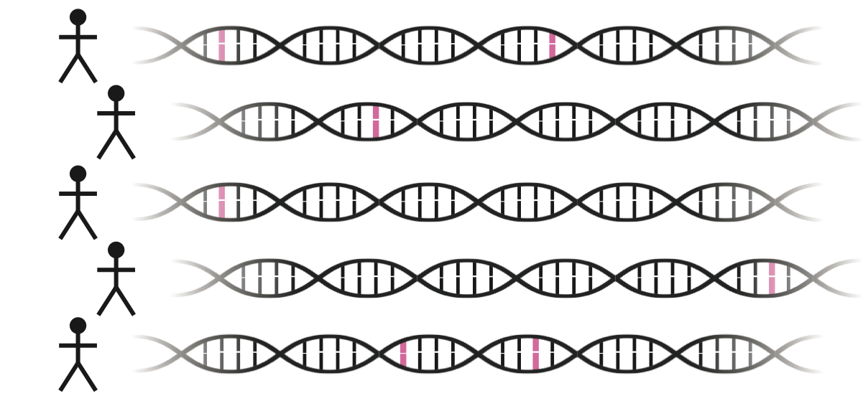
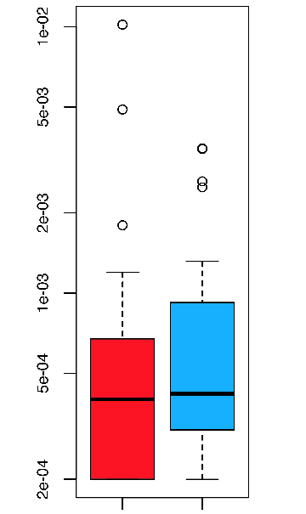
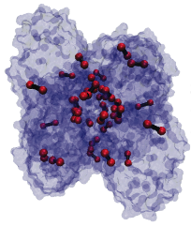
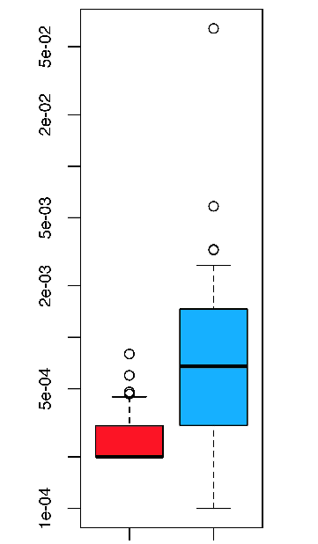
Intra-species conservation of predicted allosteric residues
1000 Genomes
Surface
Interior
Derived Allele Freq.
Derived Allele Freq.
p=0.309
p=1.80e-05
Adapted from Clarke*, Sethi*, et al (in press)

Slide 15
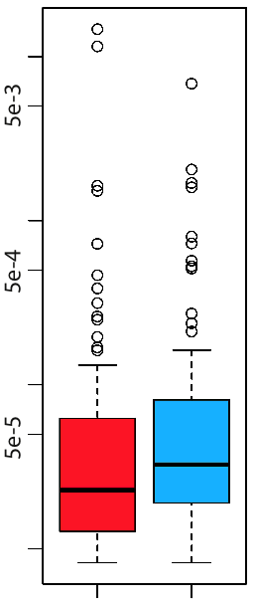
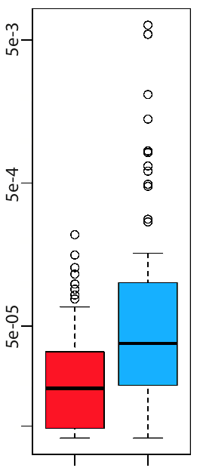
Intra-species conservation of predicted allosteric residues
ExAC
Surface
Interior
Minor Allele Freq.
Minor Allele Freq.
p=1.49e-3
p=7.98e-09
Adapted from Clarke*, Sethi*, et al (in press)

Slide 17
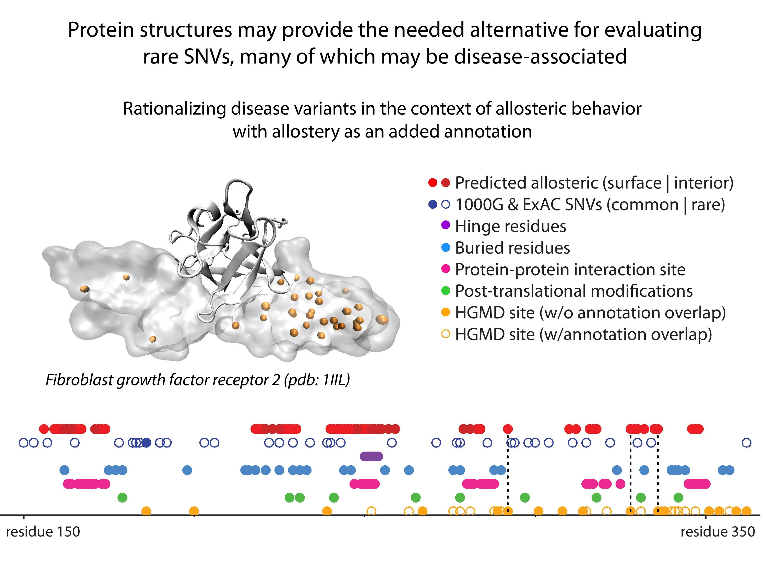
17
Adapted from Clarke*, Sethi*, et al (in press)

Slide 18
Acknowledgments
AlleleDB.gersteinlab.org
J Chen, J Rozowsky, TR Galeev, A Harmanci, R Kitchen, J Bedford, A Abyzov, Y Kong, L Regan
CostSeq2
P Muir, S Li, S Lou, D Wang, DJ Spakowicz, L Salichos, J Zhang, F Isaacs, J Rozowsky
FunSeq.gersteinlab.org
- & -
FunSeq2.gersteinlab.org
Y Fu, E Khurana, Z Liu, S Lou, J Bedford, XJ Mu, KY Yip, V Colonna, XJ Mu, … , 1000 Genomes Project Consortium, et al
LARVA.gersteinlab.org
  L Lochovsky, J Zhang, Y Fu, E Khurana
MUSIC.gersteinlab.org
  A Harmanci, J Rozowsky
archive.gersteinlab.org/proj/NetSNP
E Khurana, Y Fu, J Chen
STRESS.molmovdb.org
D Clarke, A Sethi, S Li, S Kumar, R W.F. Chang, J Chen

Slide 19
Acknowledgments – w/o merged FunSeq refs
AlleleDB.gersteinlab.org
J Chen, J Rozowsky, TR Galeev, A Harmanci, R Kitchen, J Bedford, A Abyzov, Y Kong, L Regan
CostSeq2
P Muir, S Li, S Lou, D Wang, DJ Spakowicz, L Salichos, J Zhang, F Isaacs, J Rozowsky
FunSeq.gersteinlab.org
E Khurana, Y Fu, V Colonna, XJ Mu, … , 1000 Genomes Project Consortium, et al
FunSeq2.gersteinlab.org
Y Fu, Z Liu, S Lou, J Bedford, XJ Mu, KY Yip, E Khurana
LARVA.gersteinlab.org
  L Lochovsky, J Zhang, Y Fu, E Khurana
MUSIC.gersteinlab.org
  A Harmanci, J Rozowsky
archive.gersteinlab.org/proj/NetSNP
E Khurana, Y Fu, J Chen
STRESS.molmovdb.org
D Clarke, A Sethi, S Li, S Kumar, R W.F. Chang, J Chen

Slide 20
Supplementary slides

Slide 21
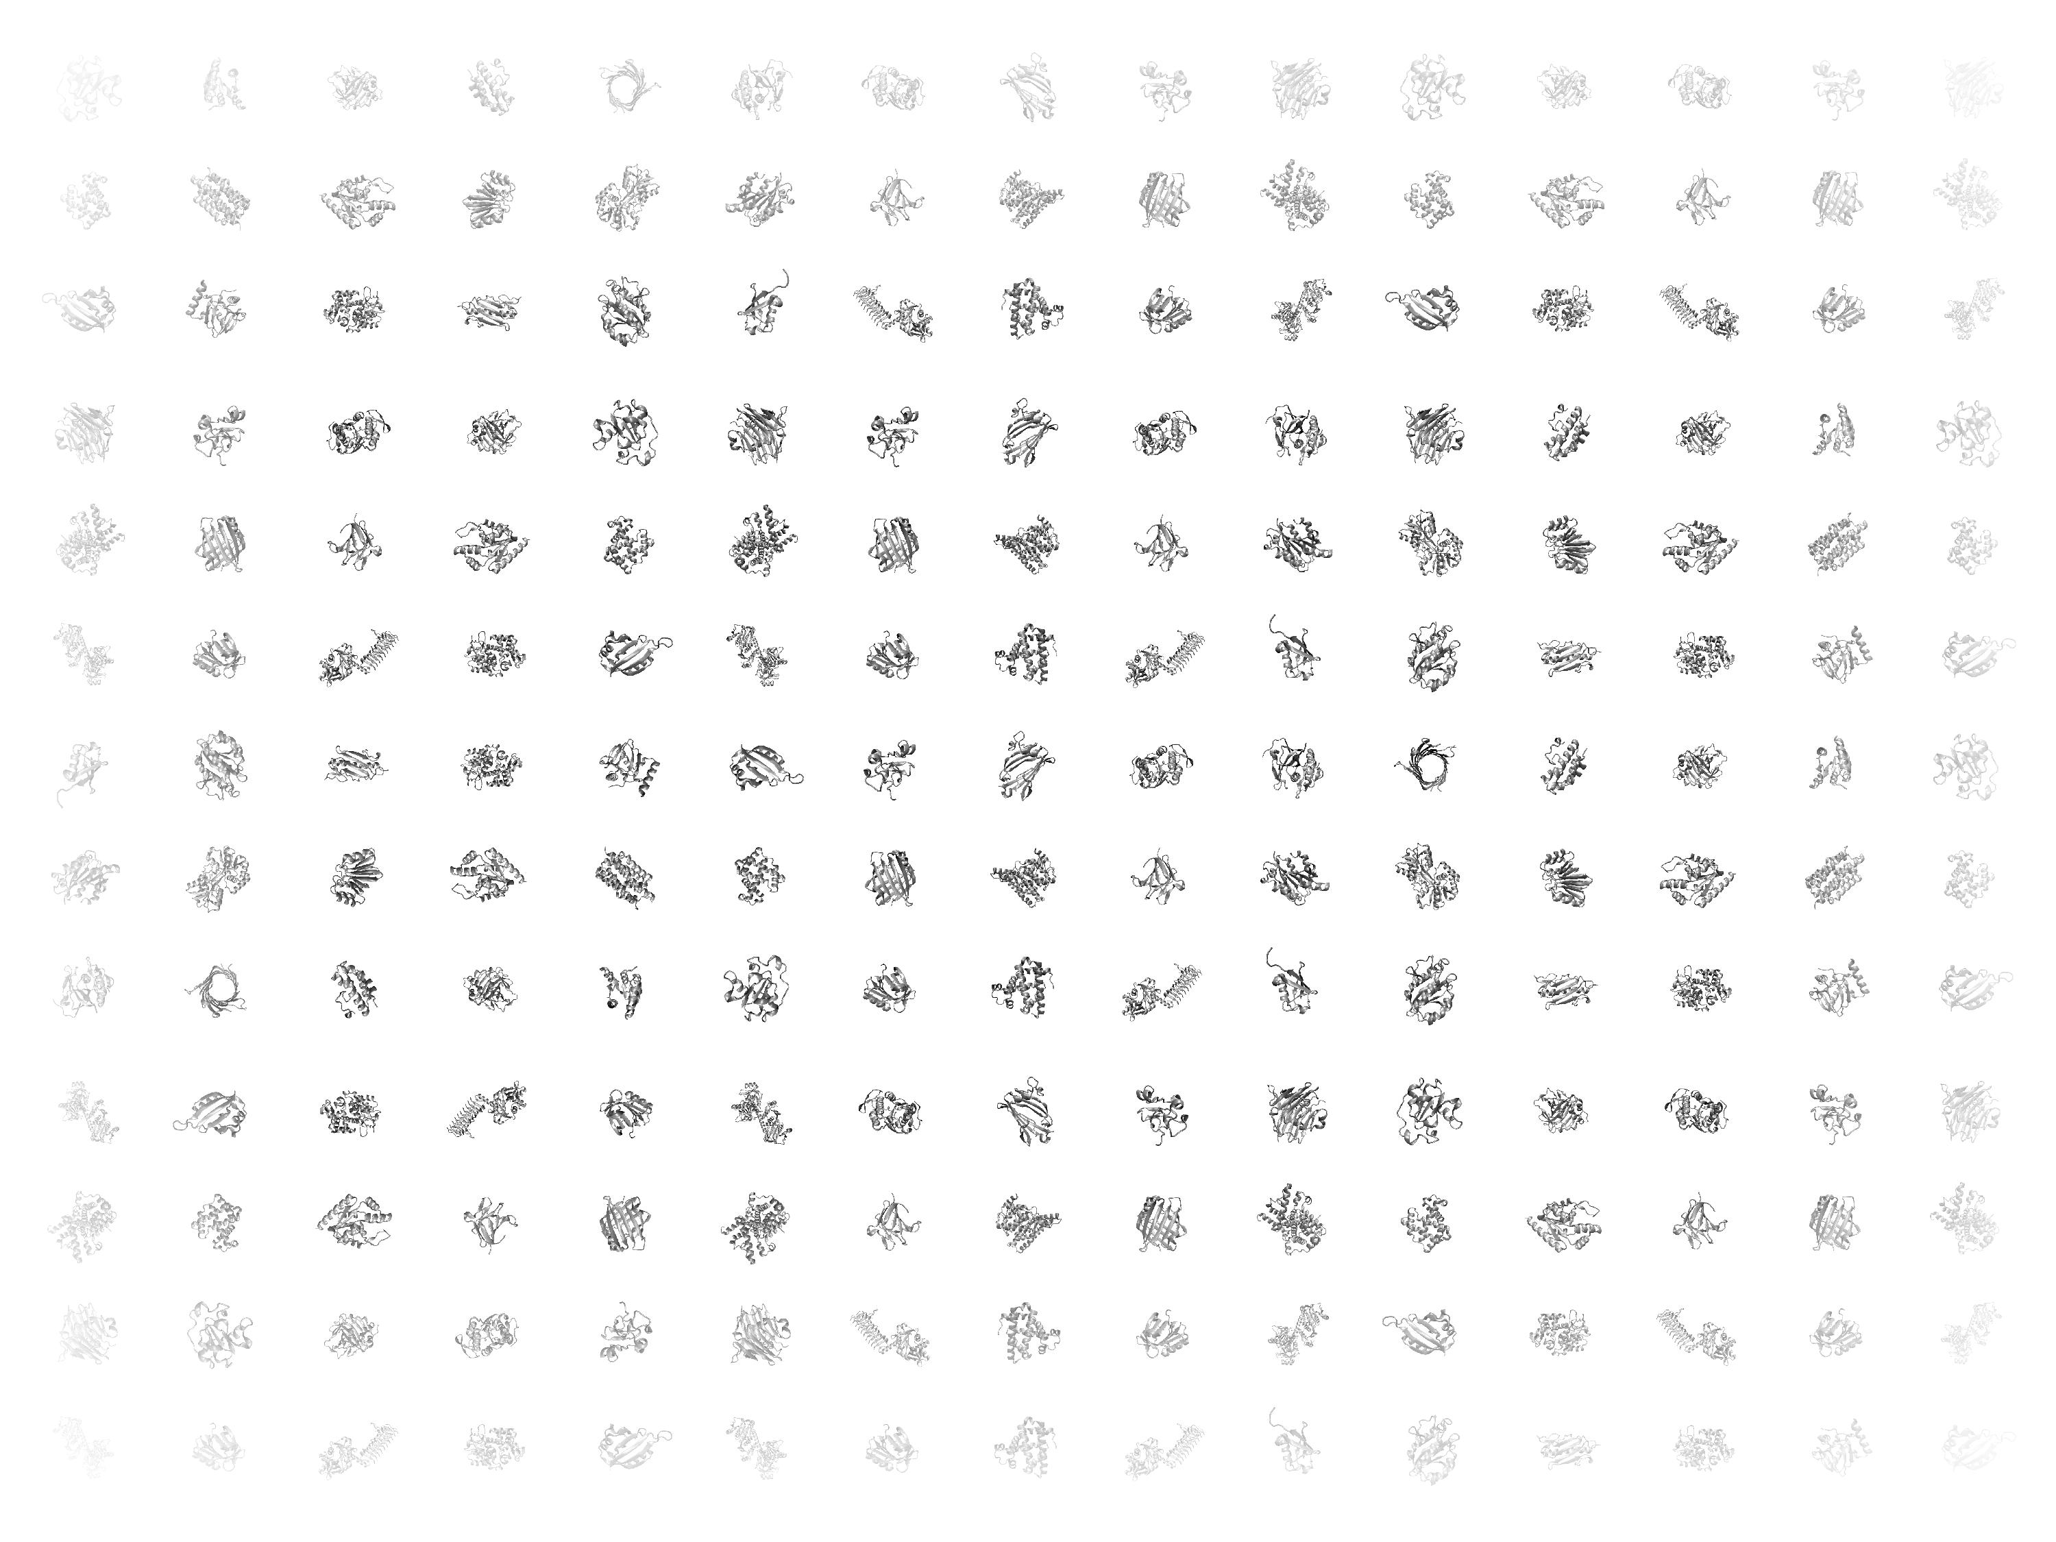

Slide 22
Basic Objective and Idea Behind the Formalism
For Predicting Allosteric Sites on the Surface
(A)
(B)
(C)
(D)
Identify pockets on the protein surface by running MC simulations in which a ligand walks along the proteins surface (A)
Score each pocket by the degree to which it perturbs large-scale motions. Shallow sites (C) or sites at which the ligand does not interfere with motion (D) earn low scores, whereas deeper pockets at which occlusion ‘blocks’ motion earn high scores (B).
Threshold the list or sites to identify the set predicted allosteric sites at the surface.

