Slide 1
Models of Protein Conformational Change
Motion Vectors from Normal Modes (ANMs)
PDB ID: 3RFU
Adapted from Fuglebakk et al, 2014

Slide 2
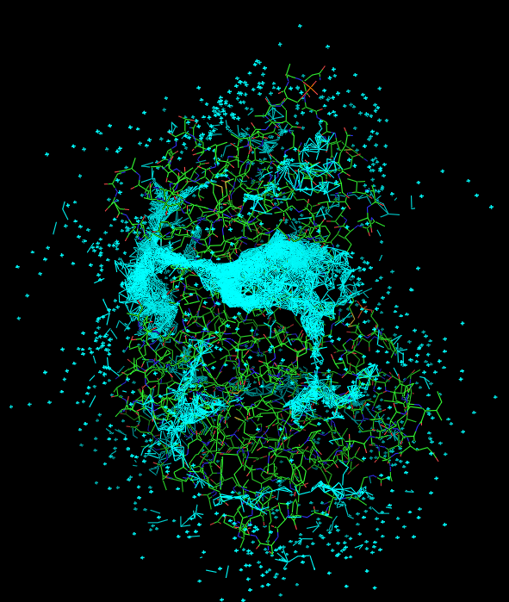
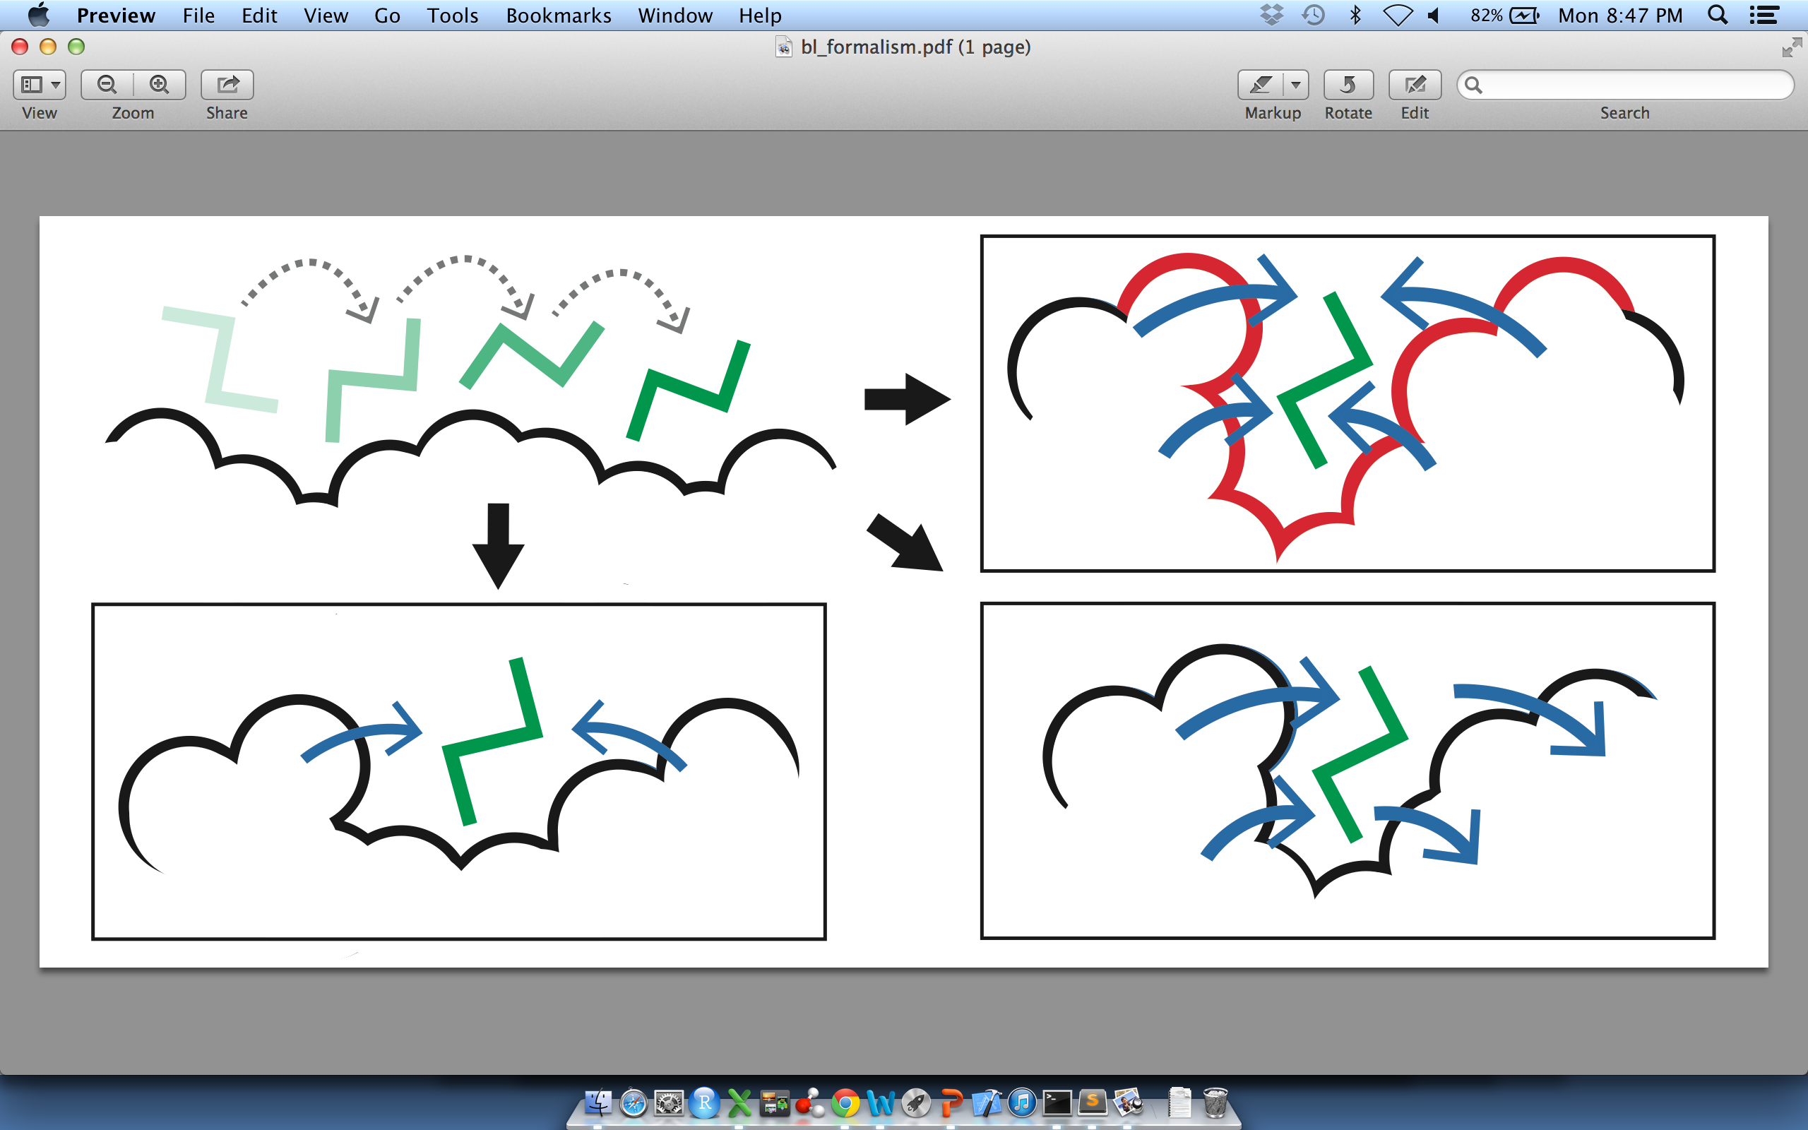
Predicting Allosterically-Important Residues at the Surface
MC simulations generate a large number of candidate sites
Score each candidate site by the degree to which it perturbs large-scale motions
Prioritize & threshold the list to identify the set of high confidence-sites
pdb 1J3H
Surface region with high
density of candidate sites
Surface region with low density of candidate sites
Adapted from Clarke*, Sethi*, et al (in press)

Slide 3
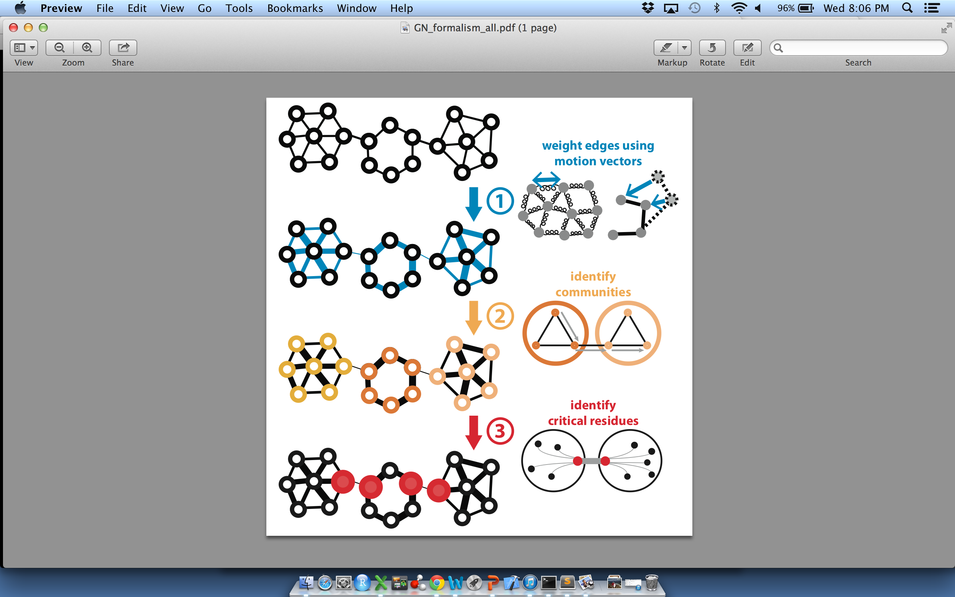
Predicting Allosterically-Important Residues within the Interior
Sethi et al, (2009) PNAS
Adapted from Clarke*, Sethi*, et al (in press)

Slide 4
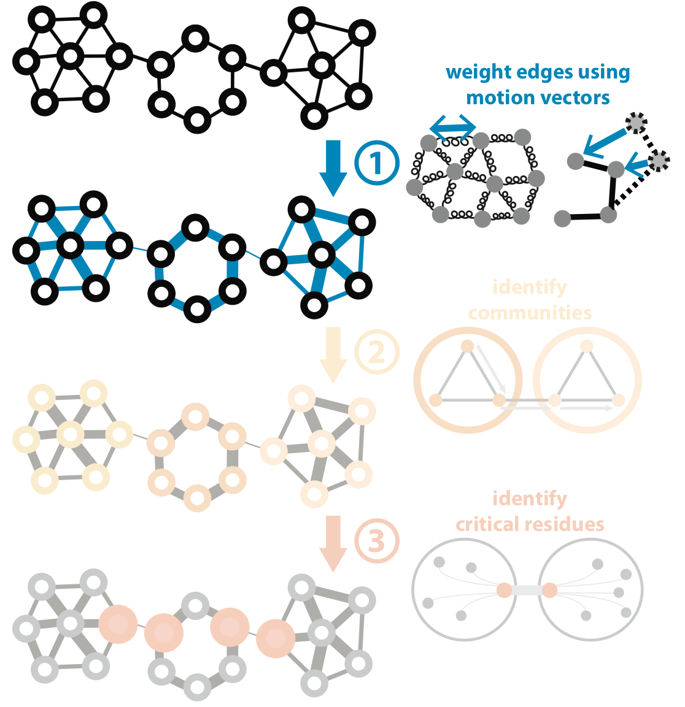
Predicting Allosterically-Important Residues within the Interior
Sethi et al, (2009) PNAS
Adapted from Clarke*, Sethi*, et al (in press)

Slide 5

STRESS Server Architecture: Highlights
stress.molmovdb.org
Output: the set of predicted allosteric residues.
A scalable architecture the Amazon cloud reduces running times. A light front-end server handles incoming requests, and powerful back-end servers perform algorithmic calculations.
Amazon's Elastic Beanstalk enables dynamic scalability. Auto Scaling adjusts the number of back-end servers as needed. Elastic Load Balancer automatically distributes incoming network traffic, ensuring that it can handle varying levels of demand.
Input & output files are stored remotely in an S3 bucket, which is accessible to each server via RESTful conventions.
A typical structure takes ~30 minutes on a E5-2660 v3 (2.60GHz) core.
Source code is available through Github: github.com/gersteinlab/STRESS
Adapted from Clarke*, Sethi*, et al (in press)

Slide 6
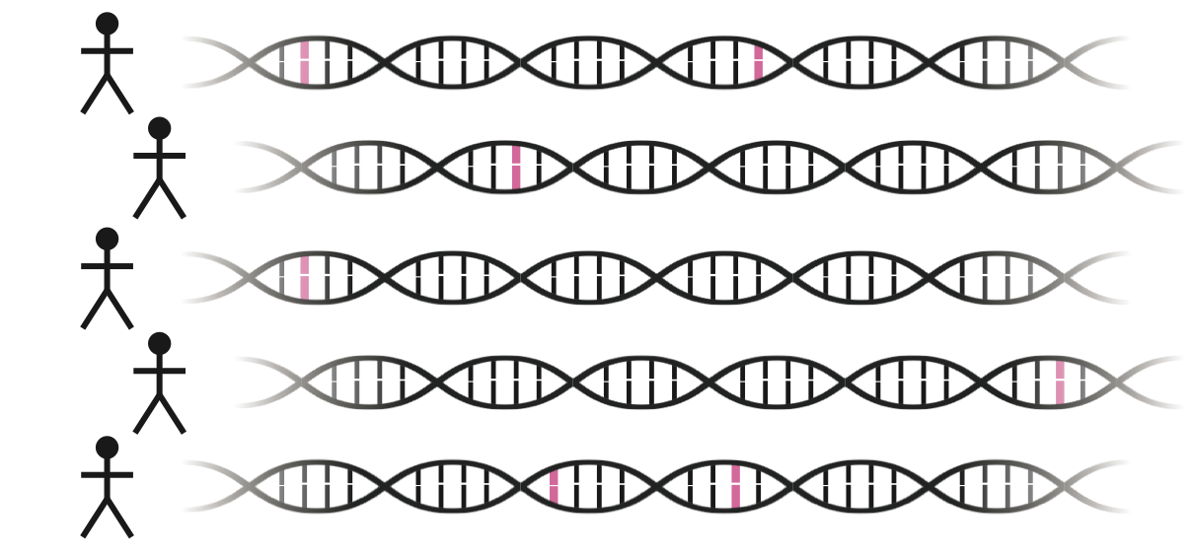
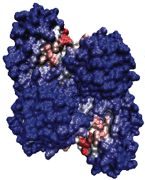
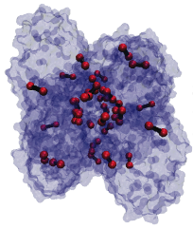
Intra-species conservation of predicted allosteric residues
1000 Genomes
Surface
Interior
p=0.309
p=1.80e-05
Adapted from Clarke*, Sethi*, et al (in press)

Slide 7
Intra-species conservation of predicted allosteric residues
ExAC
Surface
Interior
p=1.49e-3
p=7.98e-09
Adapted from Clarke*, Sethi*, et al (in press)

Slide 8
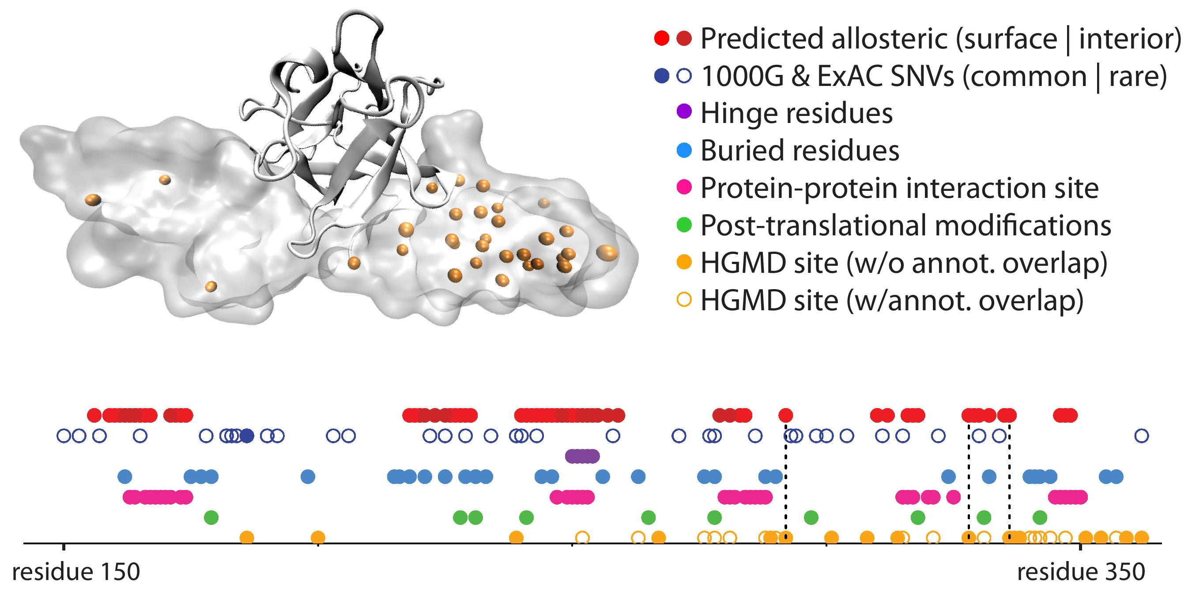
Rationalizing Disease Variants in the Context of Allosteric Behavior
Example: Fibroblast growth factor receptor 2
pdb: 1IIL

Slide 9
Supplementary slides

Slide 10
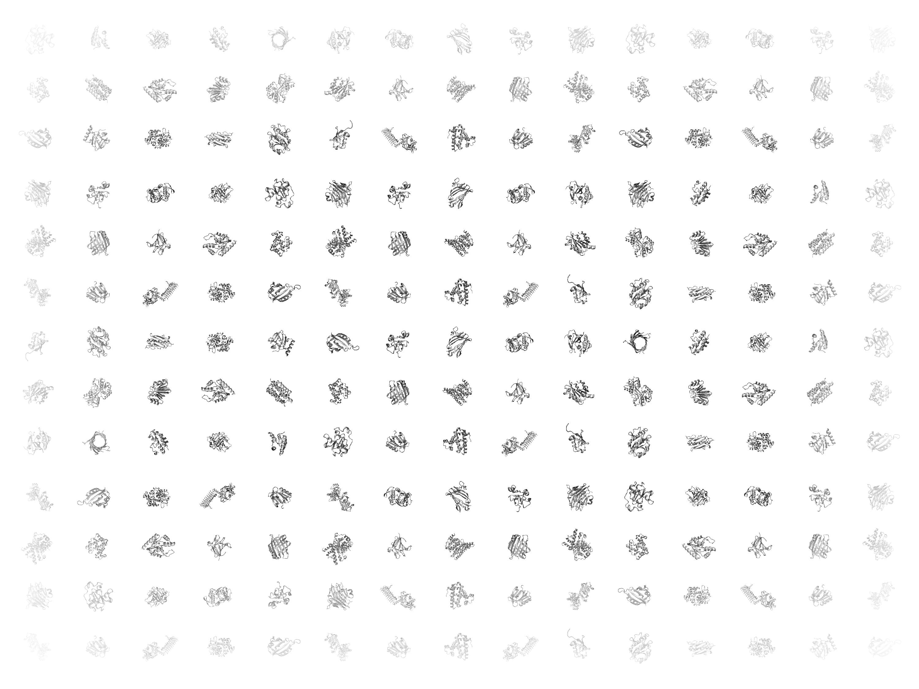

Slide 11
Basic Objective and Idea Behind the Formalism
For Predicting Allosteric Sites on the Surface
(A)
(B)
(C)
(D)
Identify pockets on the protein surface by running MC simulations in which a ligand walks along the proteins surface (A)
Score each pocket by the degree to which it perturbs large-scale motions. Shallow sites (C) or sites at which the ligand does not interfere with motion (D) earn low scores, whereas deeper pockets at which occlusion ‘blocks’ motion earn high scores (B).
Threshold the list or sites to identify the set predicted allosteric sites at the surface.

Slide 12
STRESS Output for Predicted
Allosteric Sites on the Surface
stress.molmovdb.org
PDB: 3PFK

Slide 13
Basic Objective and Idea Behind the Formalism
For Predicting Allosteric Residues within the Interior

Slide 14
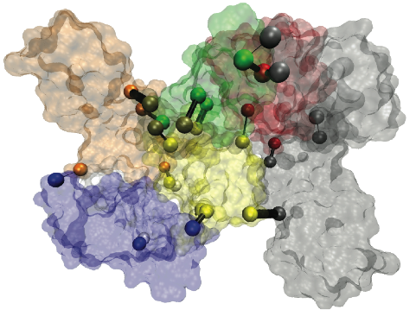
STRESS Output for Predicted
Allosteric Residues within the Interior
stress.molmovdb.org
PDB: 4AKE

