Slide 1
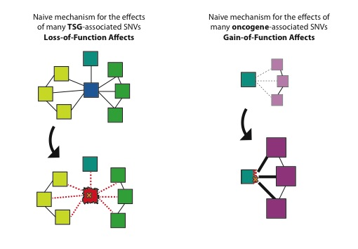
Notes:
/Users/admin/Desktop/rsch/frustration/surf_and_core_enrichment/tsg_oncos_schematic.pdf

Slide 2
Oncogenes
TSGs
Vogelstein, Bert, et al. "Cancer genome landscapes." Science (2013)

Slide 3
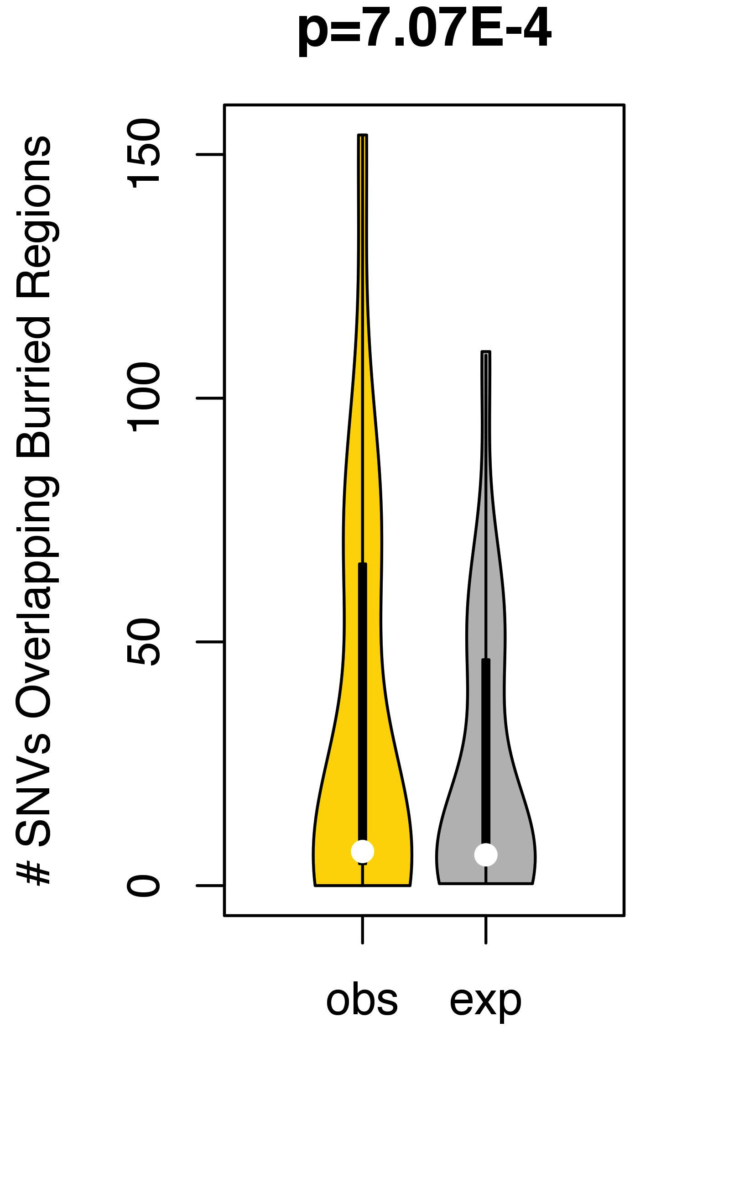
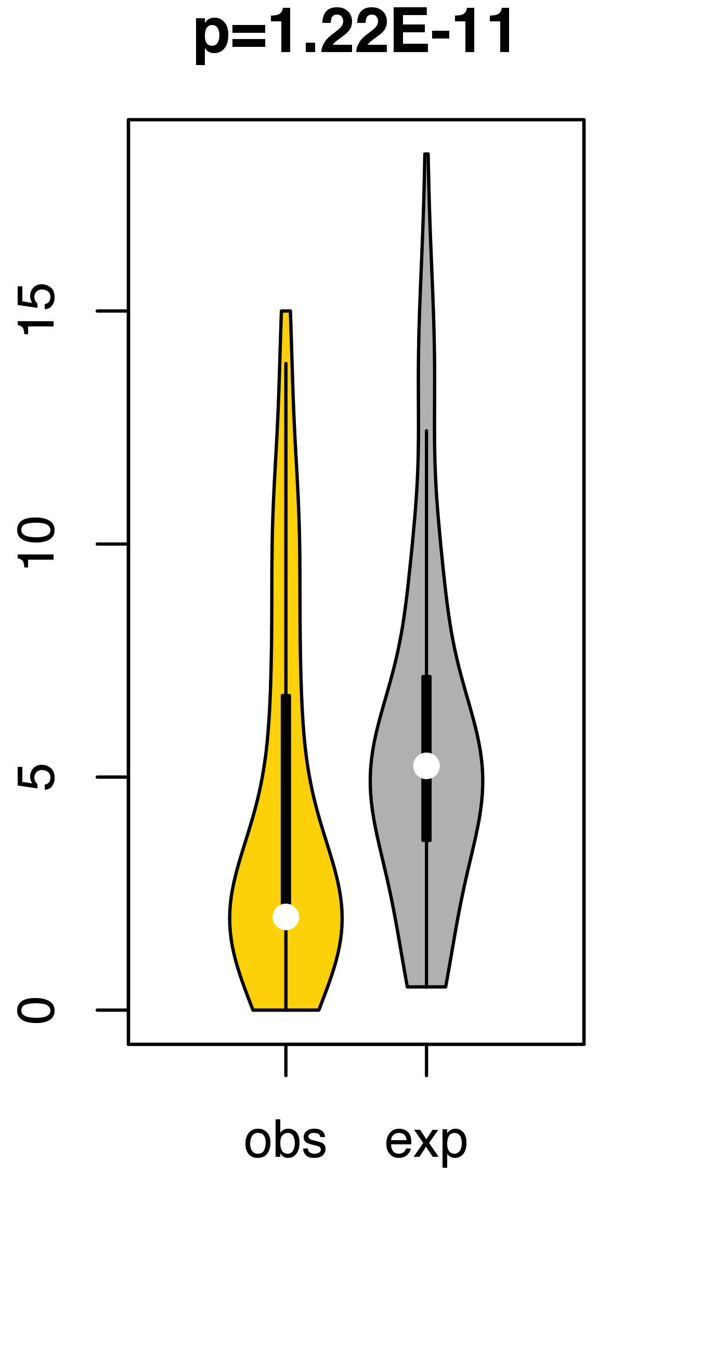
“Redundant” model: Counting
the # of SNVs that intersect buried regions
TSGs
Oncogenes
Notes:
Redundant model

Slide 4
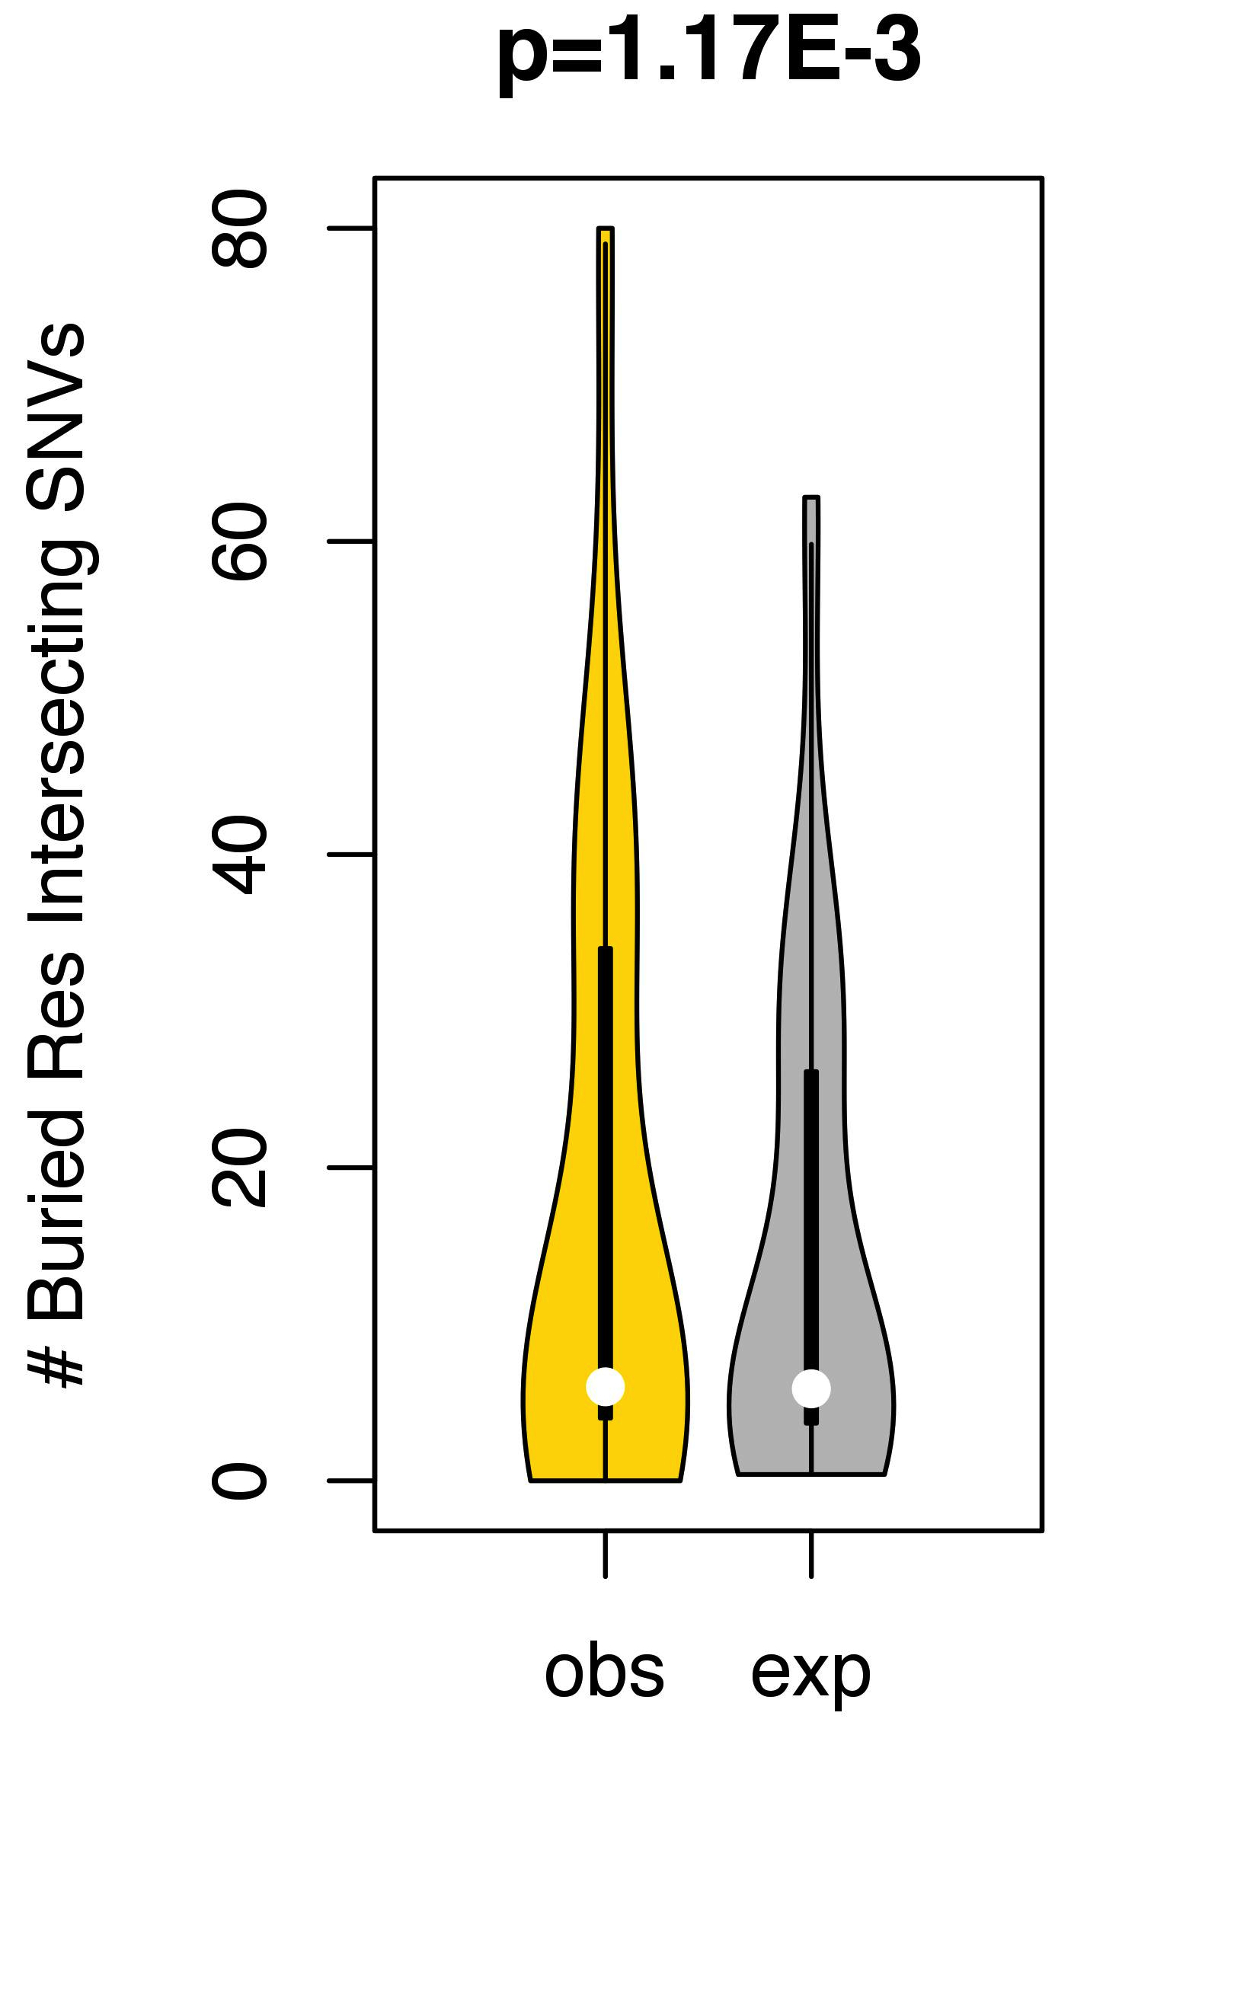
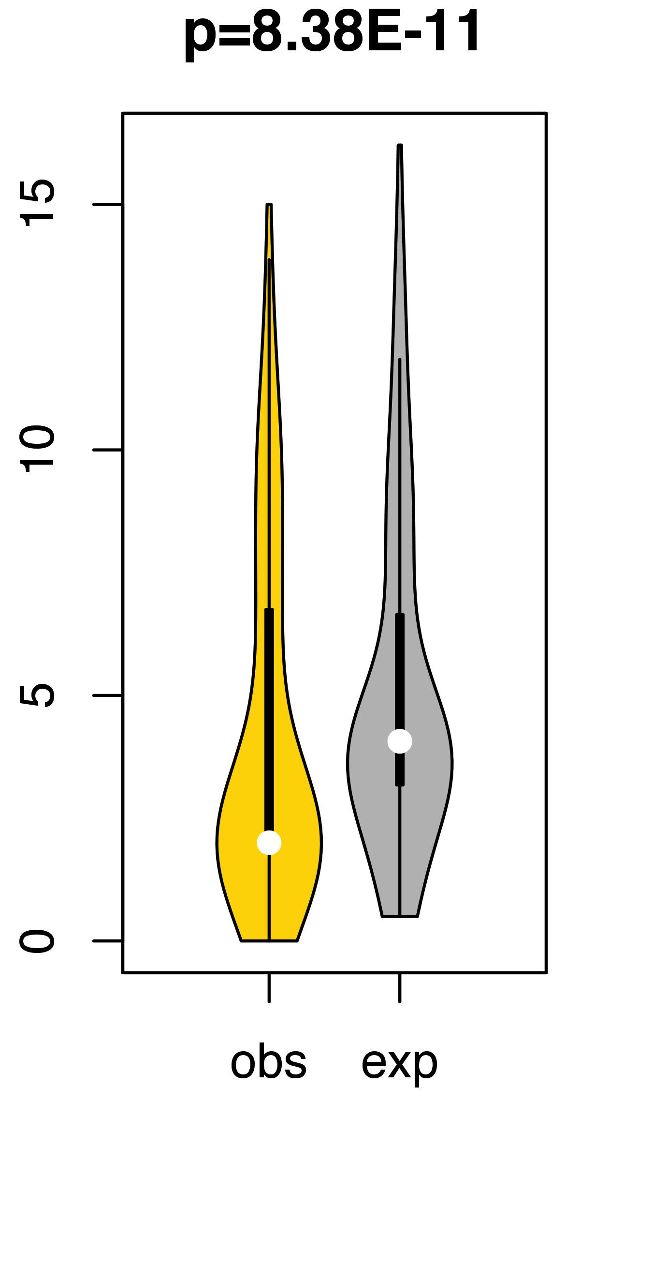
“Non-Redundant” model: Counting
the # of buried residues that intersect cancer-associated SNVs
TSGs
Oncogenes
Notes:
Non-Redundant model

Slide 5
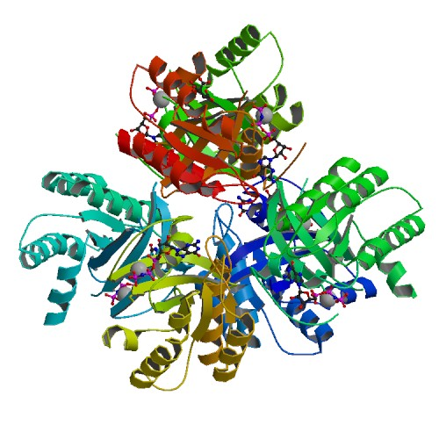
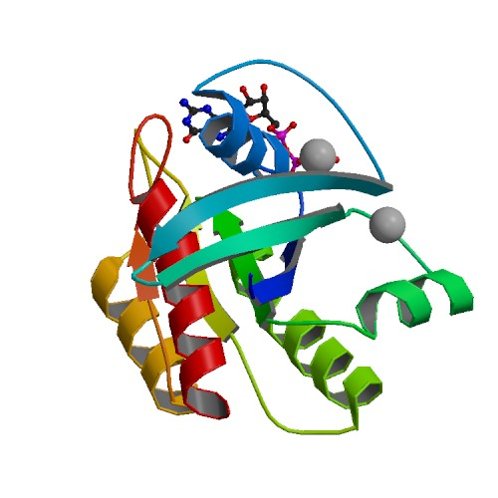
Asymmetric Unit vs. Biological Assembly
Ex PDB: 3GFT
Asymmetric
Bio Assembly
Notes:
Non-Redundant model

Slide 6
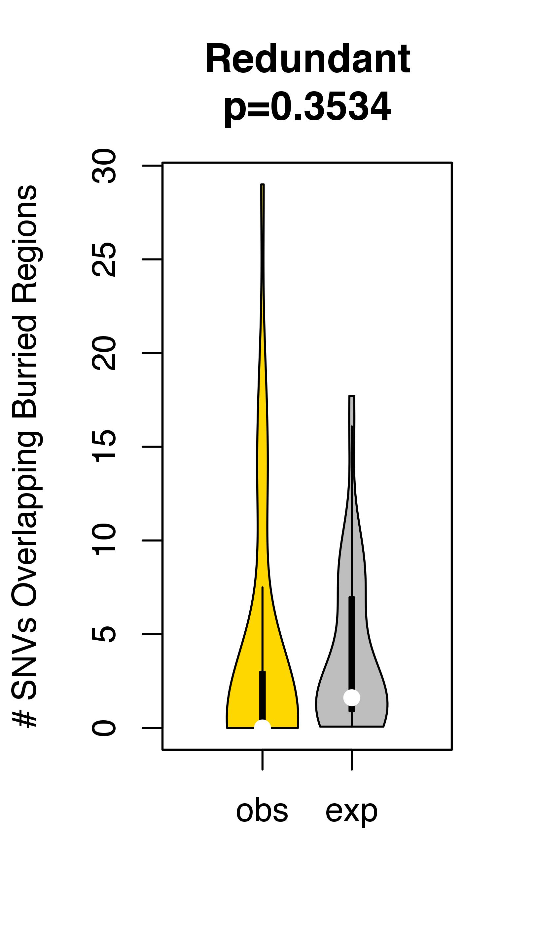
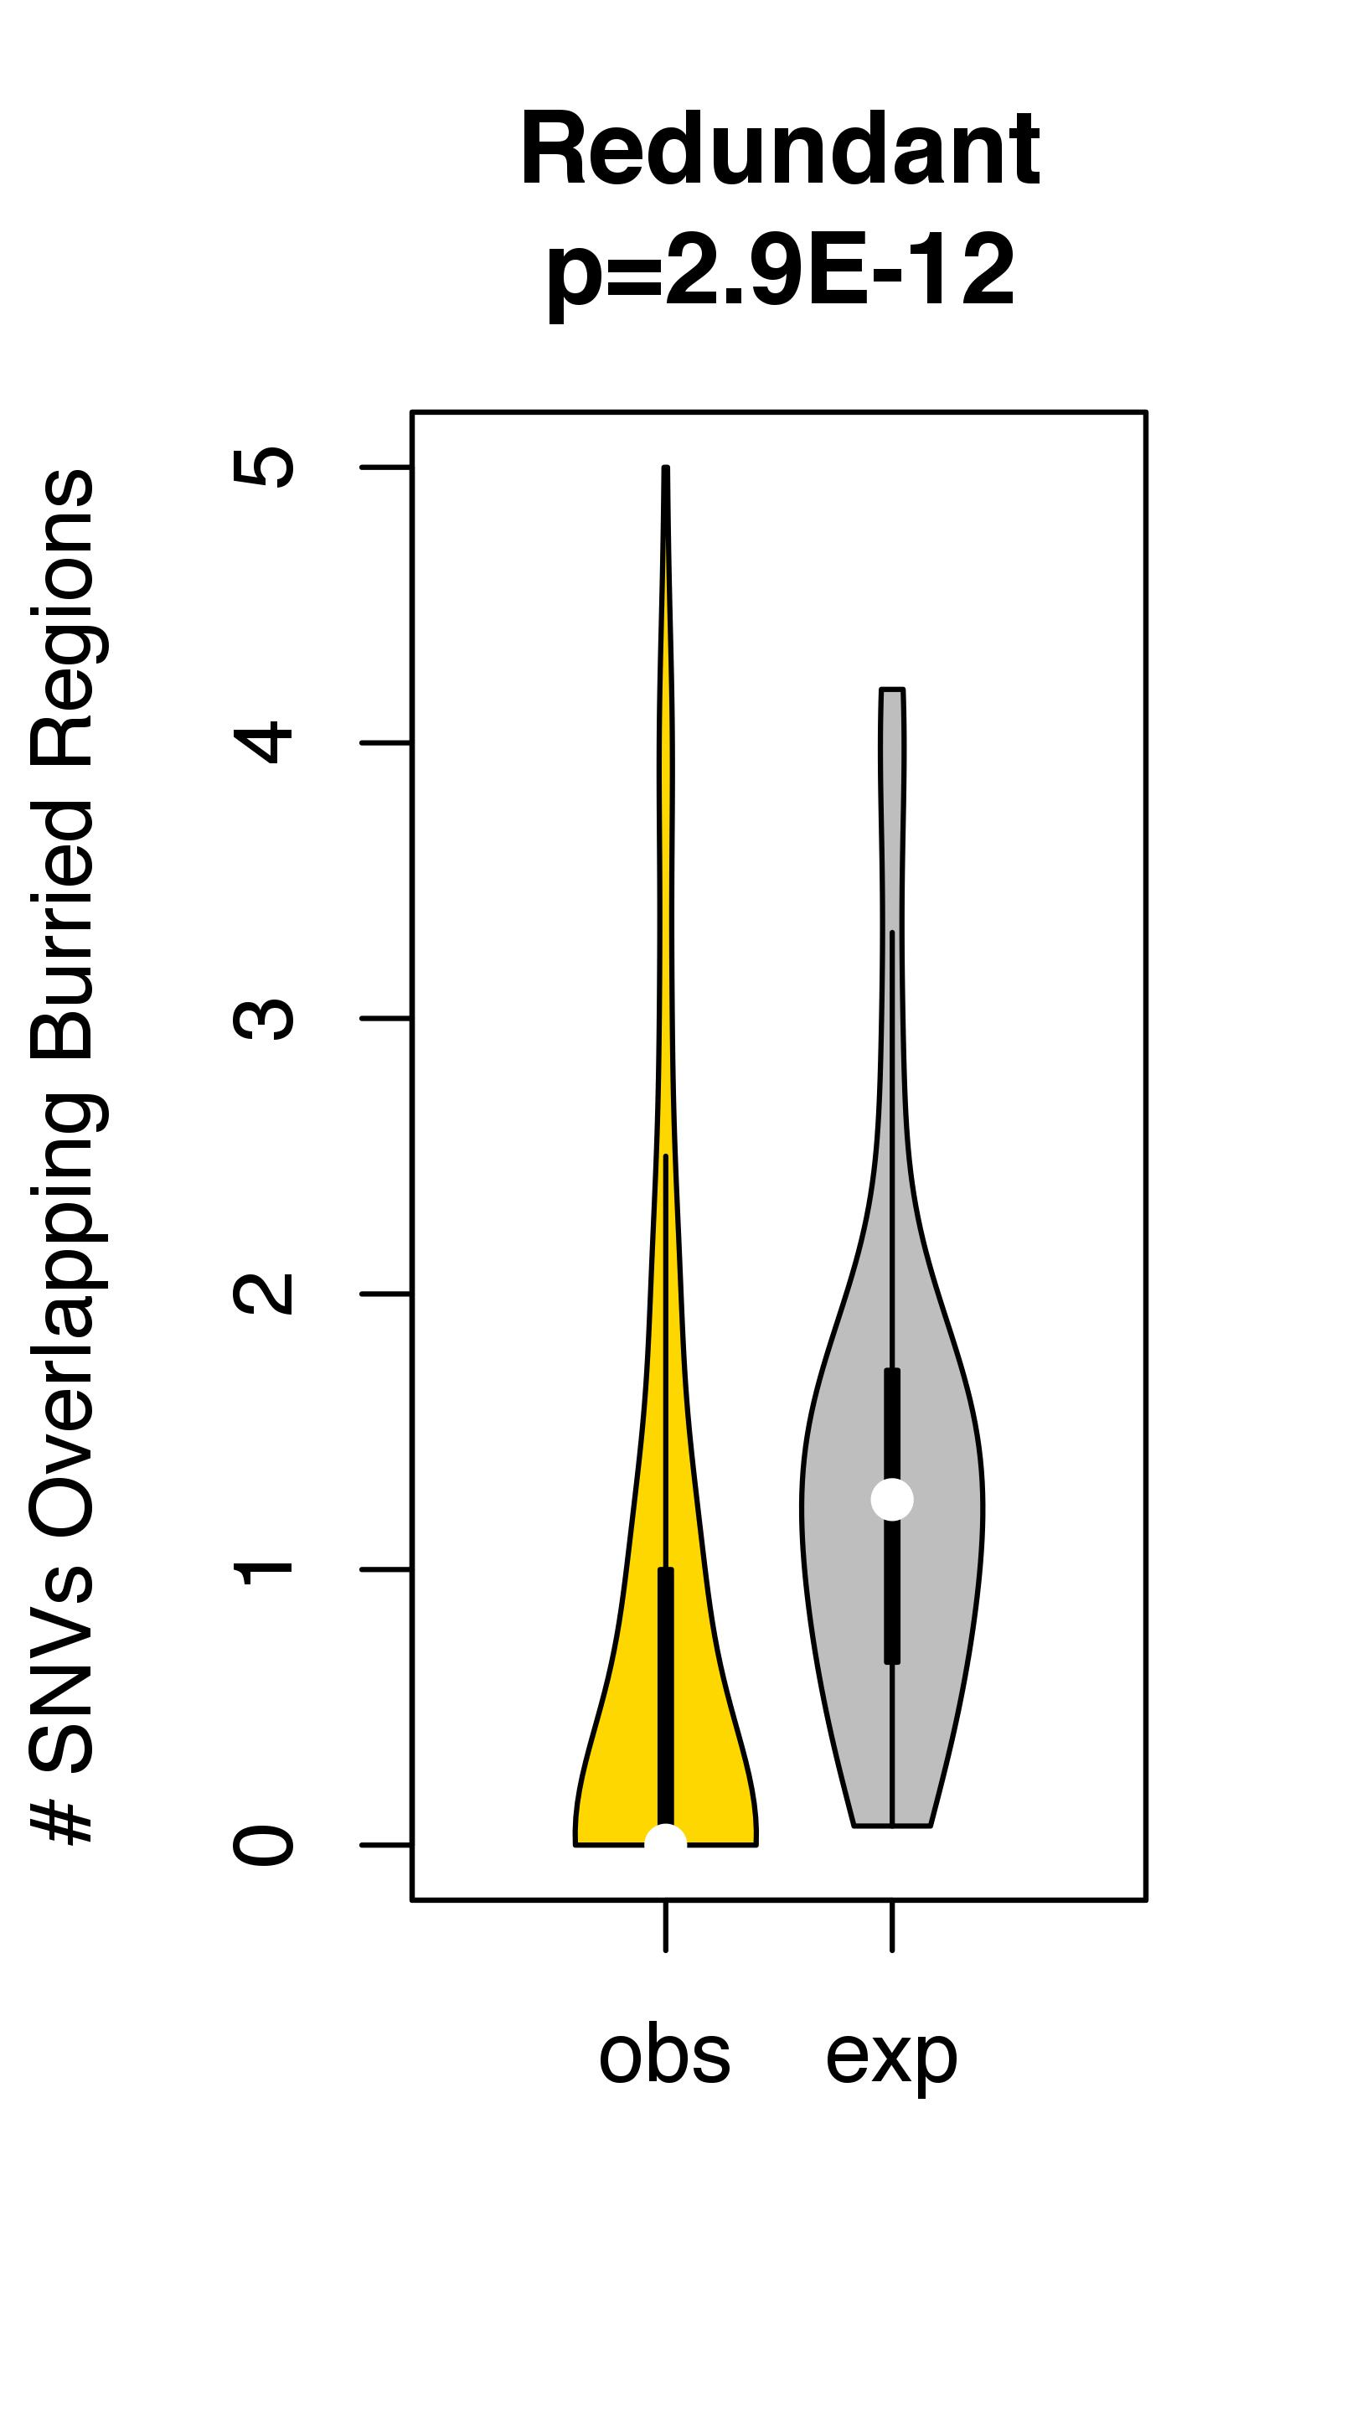
“Redundant” model: Counting - Biological Assembly Files
the # of SNVs that intersect buried regions
TSGs
Oncogenes
Notes:
Redundant model

Slide 7
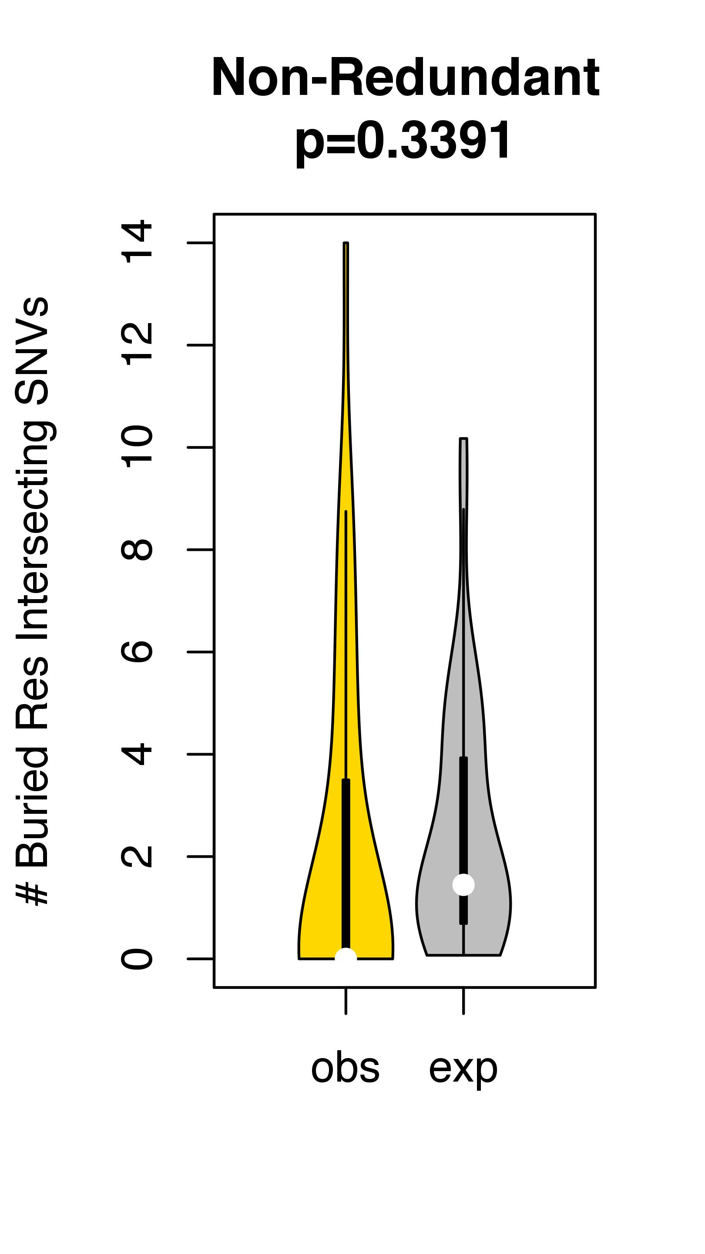
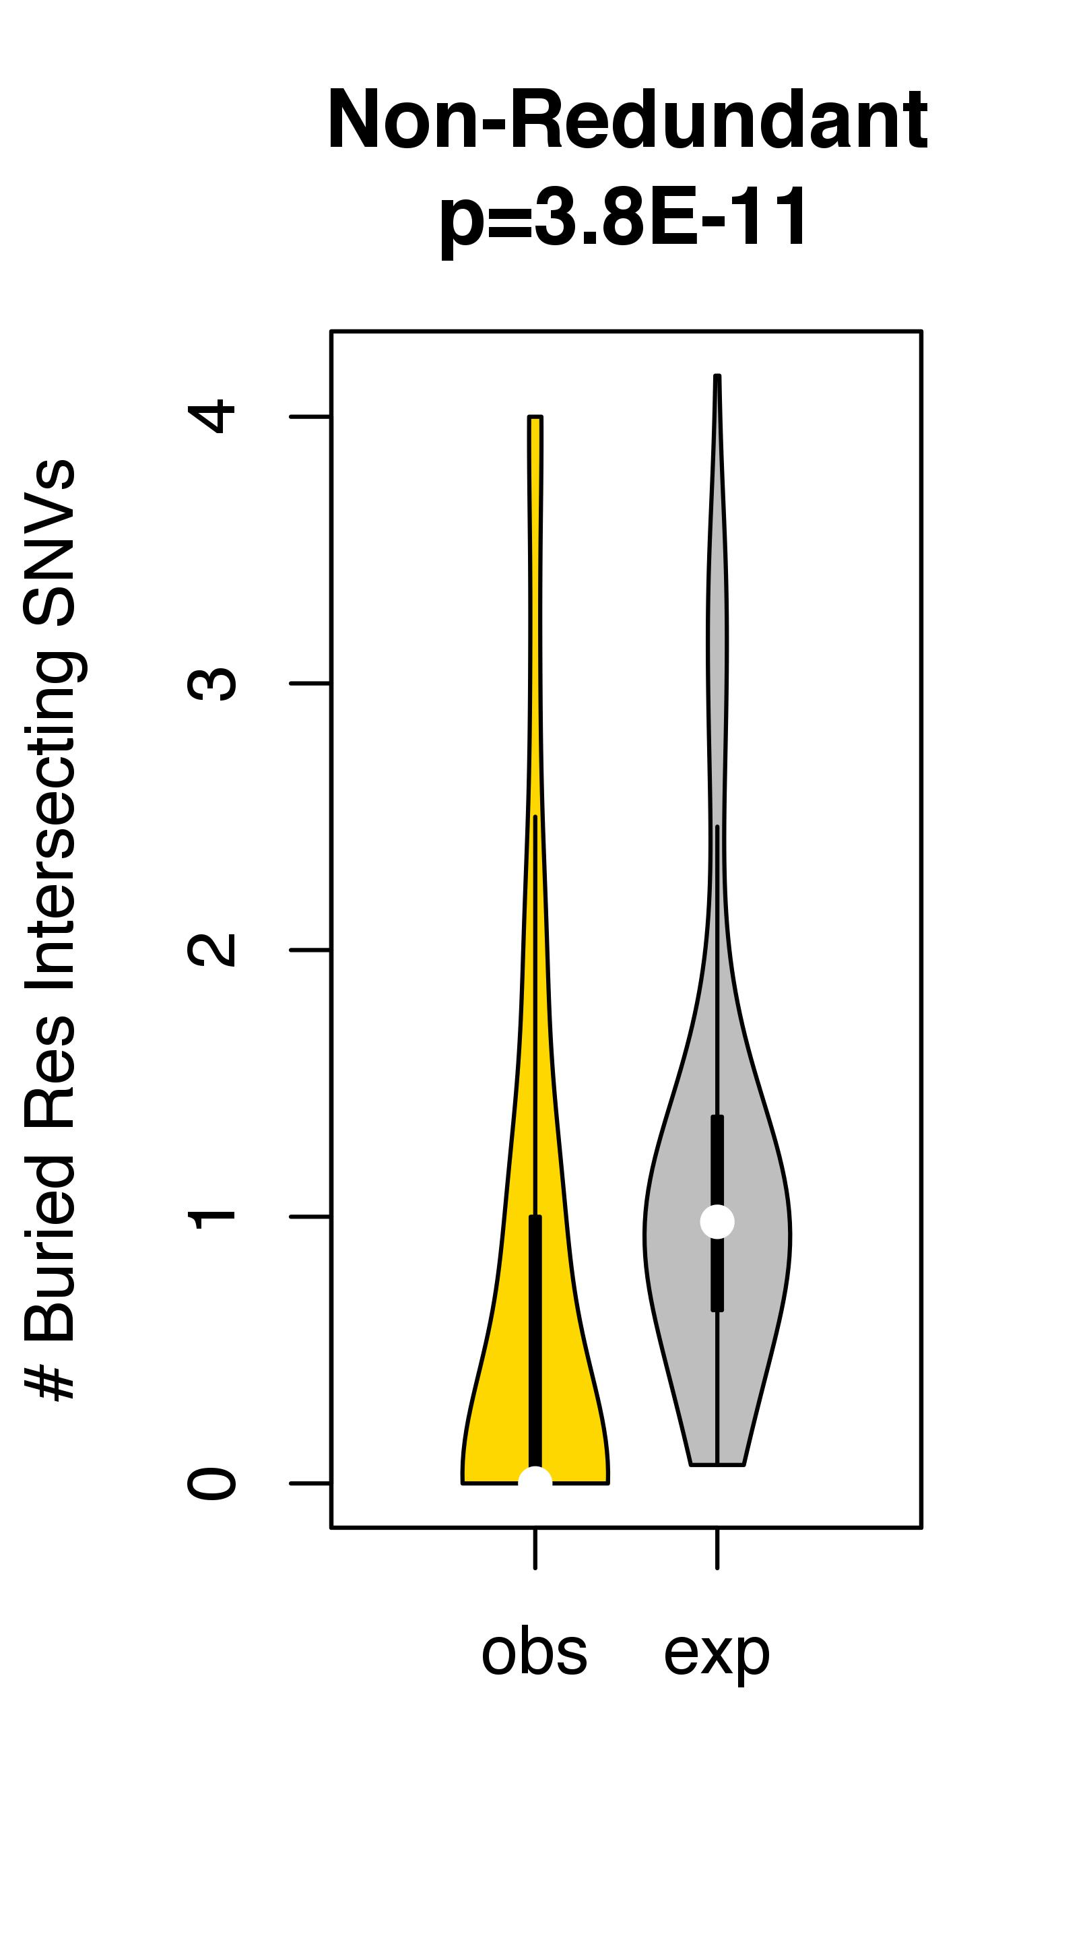
“Non-Redundant” model: Counting – Biological Assembly Files
the # of buried residues that intersect cancer-associated SNVs
TSGs
Oncogenes
Notes:
Non-Redundant model

