Slide 1
Flora’s IPSc ChIP-seq data
ID | Stage | CellType | Mark
310 | Fetal | IPS | H3K27ac
 | Fetal | IPS | H3K4me3
 | Fetal | IPS | INPUT
313 | Fetal | IPS | H3K4me3
 | Fetal | IPS | H3K27ac
 | Fetal | IPS | INPUT
320 | Fetal | IPS | H3K27ac
 | Fetal | IPS | H3K4me3
 | Fetal | IPS | INPUT
07-01 | Adult | IPS | H3K4me3
 | Adult | IPS | H3K27ac
 | Adult | IPS | INPUT
1120-01 | Adult | IPS | H3K4me3
 | Adult | IPS | H3K27ac
 | Adult | IPS | INPUT
1123-01 | Adult | IPS | H3K27ac
 | Adult | IPS | H3K4me3
 | Adult | IPS | INPUT

Slide 2
ChIP-Seq analysis pipeline
Quality metrics of read counts
(Strand cross-correlation analysis, number of reads in the peaks, library complexity)
ChIP FastQ file
Quality metrics
(FastQC, FASTX)
Read mapping
(Bowtie)
Signal generation,
file format conversion
(samtools, bedtools, bedGraphToBigWig)
ChIP bigwig file
Control FastQ file
Quality metrics
(FastQC, FASTX)
Read mapping
(Bowtie)
Signal generation,
file format conversion
(samtools, bedtools, bedGraphToBigWig)
Control bigwig file
Check peak calling results
Peak calling
(MACS2, MUSIC)
ChIP-Seq peaks
Downstream analysis
(peak comparison, peak annotation, motif analysis)

Slide 3
FASTQC & alignment using bowtie2
Basic Statistics
Measure | Value
Filename | aa759-21.Adult.07-01.H3K4me3.fastq.gz
File type | Conventional base calls
Encoding | Sanger / Illumina 1.9
Total Sequences | 8924929
Sequences flagged as poor quality | 0
Sequence length | 76
%GC | 44
Bowtie2 results:
45376752 reads; of these:
45376752 (100.00%) were unpaired; of these:
3160668 (6.97%) aligned 0 times
35387940 (77.99%) aligned exactly 1 time
6828144 (15.05%) aligned >1 times
93.03% overall alignment rate
Notes:
8924929
45376752

Slide 5
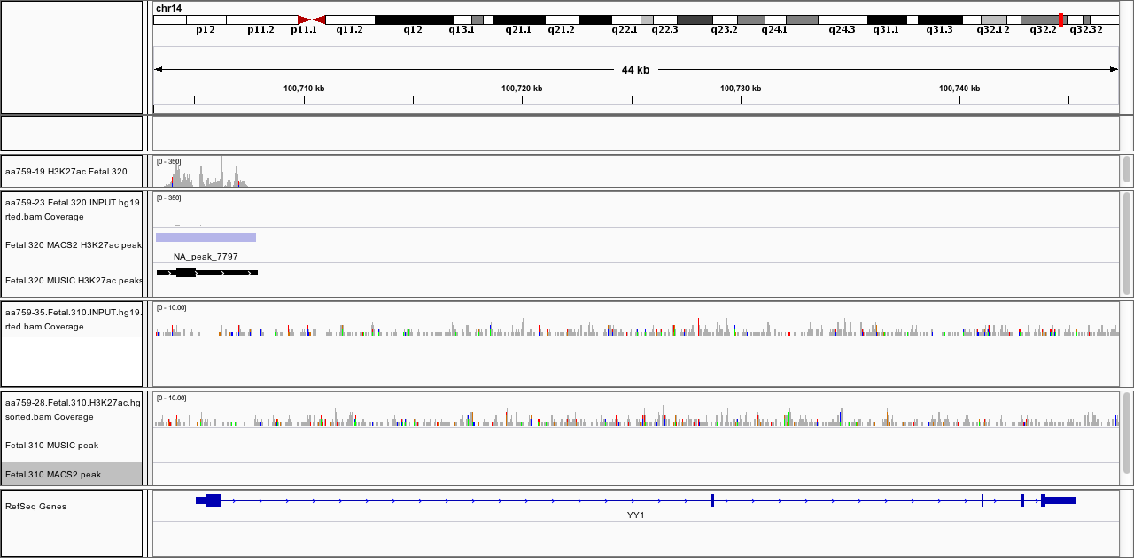

Slide 7
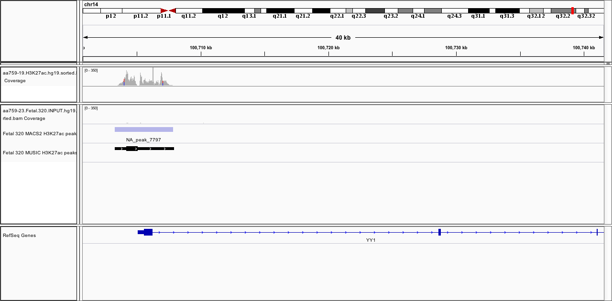
Peak overlap between MUSIC and MACS2
Fetal.320 MACS2 H3K27ac peaks
Fetal.320 MUSIC H3K27ac peaks
3650
24672
270

Slide 8
Peak overlap between samples

