Slide 1
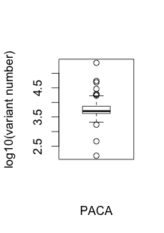
Pancreatic Cancer
Sample number | 224
Mean | 7609.067
Median | 5041
Min | 149
max | 226854

Slide 2
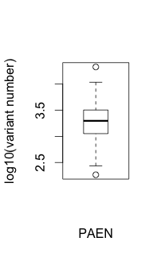
Pancreatic Cancer Endocrine neoplasms
Sample number | 104
Mean | 2761
Median | 1982
Min | 184
max | 21287

Slide 3
DHS peak input in BRCA
Min. 1st Qu. Median Mean 3rd Qu. Max.
325.0 578.0 766.0 898.8 1066.0 4914.0
Total number: 10825
Var | 1 | 2 | 3 | 4 | 5 | 20
element | 2327 | 528 | 111 | 37 | 8 | 1
PACA
Var | 1 | 2 | 3 | 4
element | 721 | 50 | 2 | 1
PAEN

Slide 4
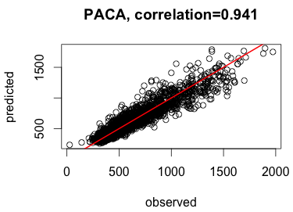
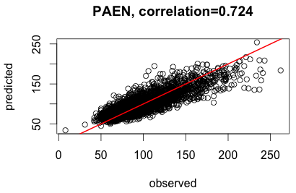

Slide 5
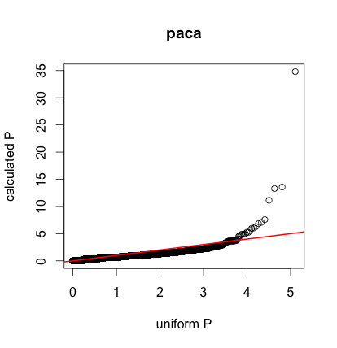

Slide 6
