Slide 1
Using personal genomes for ENCODE data
Jieming Chen
Gerstein Lab, Yale University
AWG Call
Mar 11 2016

Slide 2
Transitioning from
Reference Genome (RG) to Personal Genome (PG)
Hg19/GRCh37/Hg38/GRCh38

Slide 3
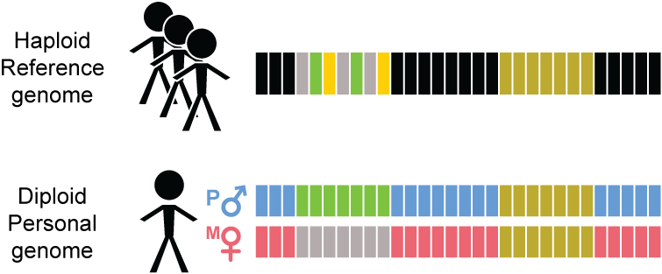
Reference Genome (RG)
Hg19/GRCh37/Hg38/GRCh38

Slide 4
Transitioning from
Reference Genome (RG) to Personal Genome (PG)

Slide 5
Why the personal genome (PG) should be the platform for functional genomics
Advantages of PGs
Diploid
--Ability to incorporate private variants of any size
--exhibit phase information
Scale easily with more samples and improving sequencing technologies: longer reads and more accurate phase information
--We have developed a tool for PG construction
Very useful in functional genomic assay analyses
a) read alignment
b) RNA-seq quantification
c) allele-specific analyses

Slide 6
Constructing a personal genome

Slide 7
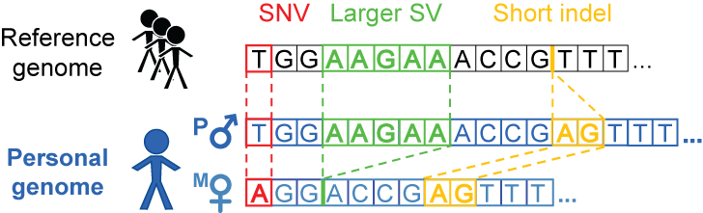
Personal genome construction using vcf2diploid tool allows variants of different sizes
(fasta; reference)
(vcf, variants
phased or unphased)
(fasta; for each
haplotype)
Rozowsky et al. Mol Syst Biol (2011)
Notes:
Compatible subseq in downstream processing or analyses e.g with aligners for indexing

Slide 8
Some construction considerations
1. Choice of call set(s)
-- e.g. different versions of 1000GP call sets
2. Choice of variants
-- e.g. SVs or indels or SNVs only
3. Choice of reference
-- choose the reference genome in which the call set is derived from
4. Assessment of call set quality
-- e.g. analysis of Mendelian inconsistency in family data
Notes:
Het/hom ratio
Ti/tv ratio

Slide 9
Assessment of call set quality: Mendelian inconsistency (e.g. GATK HC PCR-free CEU trio)
NA12891 Father | NA12892 Mother | NA12878 |  |  | total | %Err
 |  | RR | RA | AA
RR | RA | 518631 | 505499 | 1215 | 1025345 | 0.12
RR | AA | 1659 | 194589 | 1806 | 198054 | 1.75
RA | RR | 507750 | 506699 | 1110 | 1015559 | 0.11
RA | RA | 194409 | 397233 | 195245 | 786887 | ---
RA | AA | 742 | 194722 | 206720 | 402184 | 0.18
AA | RR | 1485 | 193636 | 1551 | 196672 | 1.54
AA | RA | 653 | 198416 | 202366 | 401435 | 0.16
AA | AA | 113 | 1316 | 816825 | 818254 | 0.17
*Autosomes only

Slide 10
NA12878 family of PGs we already have
 | Source | Refgen | Depth | Variants
1 | 1000 Genomes Project (1000GP) pilot | hg18 | 60x | SNVs, indels, deletions (including 33 from fosmid sequencing)
2 | GATK Best Practices v3 (UnifiedGenotype) | hg19 | 64x | SNVs, indels
3 | GATK Best Practices v4 (HaplotypeCaller, PCR-free) | hg19 | 64x | SNVs, indels
4 | 1000GP Phase 3 SNVs-only | hg19 | 7.4x | SNVs
5 | 1000GP Phase 3 SNVs-indels | hg19 | 7.4x | SNVs, indels
6 | 1000GP Phase 3 SNVs-indels-SVs | hg19 | 7.4x | SNVs, indels, SVs

Slide 11
Other possible choices of NA12878 call sets for ENCODE:
Genome In A Bottle (GIAB)
--HiSeq2500 300x, 150x150bp read, hg19
--44x PacBio SV calls (from Mt Sinai School of Medicine)
(https://sites.stanford.edu/abms/content/giab-reference-materials-and-data, updated Sep 2015)
Complete Genomics
--80x, SNVs, indels and SVs, GRCh37
(http://www.completegenomics.com/public-data/69-Genomes/)
Illumina Platinum Genomes
--HiSeq2000, PCR-free, 50x and 200x, SNVs and indels, available for both hg19 and hg38
(http://www.illumina.com/platinumgenomes/)
1000 Genomes Project SV group
--SV calls using longer reads: PacBio, Moleculo
Useful list of NA12878 public datasets (google sheet on GIAB site): https://docs.google.com/spreadsheets/d/1iL45zPit9-kVmk-9sDJEGMhxsUWf52n1nw_duTdNwcE/edit#gid=0

Slide 12
Highly scalable:
Use of personal genomes with ENCODE data
Constructed 382 personal genomes from 1000GP Phase 1 data
--SNVs and indels
--match with their corresponding RNA-seq and/or ChIP-seq sets (from 8 different studies)
Most of our ChIP-seq sets are from ENCODE
--14 GM cell lines with available 1000GP Phase 1 DNA data
**note that there are 35 GM cell lines in ENCODE, with ChIP-seq data (including CEU and YRI trios)
Notes:
Using tool, able to scale up, construct 382 personal genomes
33 GM cell lines in ENCODE, with ChIP-seq data

Slide 13
Utility of PGs:
Read alignment

Slide 14
Alignment gets better as variant sets get more complete: NA12878 Pol2 ChIP-seq (ENCODE)
 | Ref genome | Pgenome: SNVs only | Pgenome: SNVs + indels only | Pgenome: SNVs + indels + SVs
Reads processed | 208,051,087
# reads uniquely aligned | 171,944,588 (82.65%) | 172,591,380 (82.96%) | 172,738,321 (83.03%) | 172,743,175 (83.03%)
# reads that multimap | 17,826,675 (8.57%) | 17,795,258 (8.55%) | 17,782,167 (8.55%) | 17,779,800 (8.55%)
Almost 1M increase in reads
Notes:
We observe that

Slide 15
Alignment gets better as variant sets get more complete: NA12878 RNA-seq (Kilpinen et al. 2013)
 | Ref genome | Pgenome: snvs only | Pgenome: snvs + indels only | Pgenome: snvs + indels + SVs
Reads processed | 37,558,398
# reads uniquely aligned | 25,303,498 (67.37%) | 25,486,837 (67.86%) | 25,538,449 (68.00%) | 25,568,042 (68.08%)
# reads that multimap | 4,041,495 (10.76%) | 4,010,417 (10.68%) | 4,012,297 (10.68%) | 3,972,990 (10.58%)
Over 260K increase in reads

Slide 16
Utility of PGs:
RNA-seq quantification with SVs incorporated

Slide 17
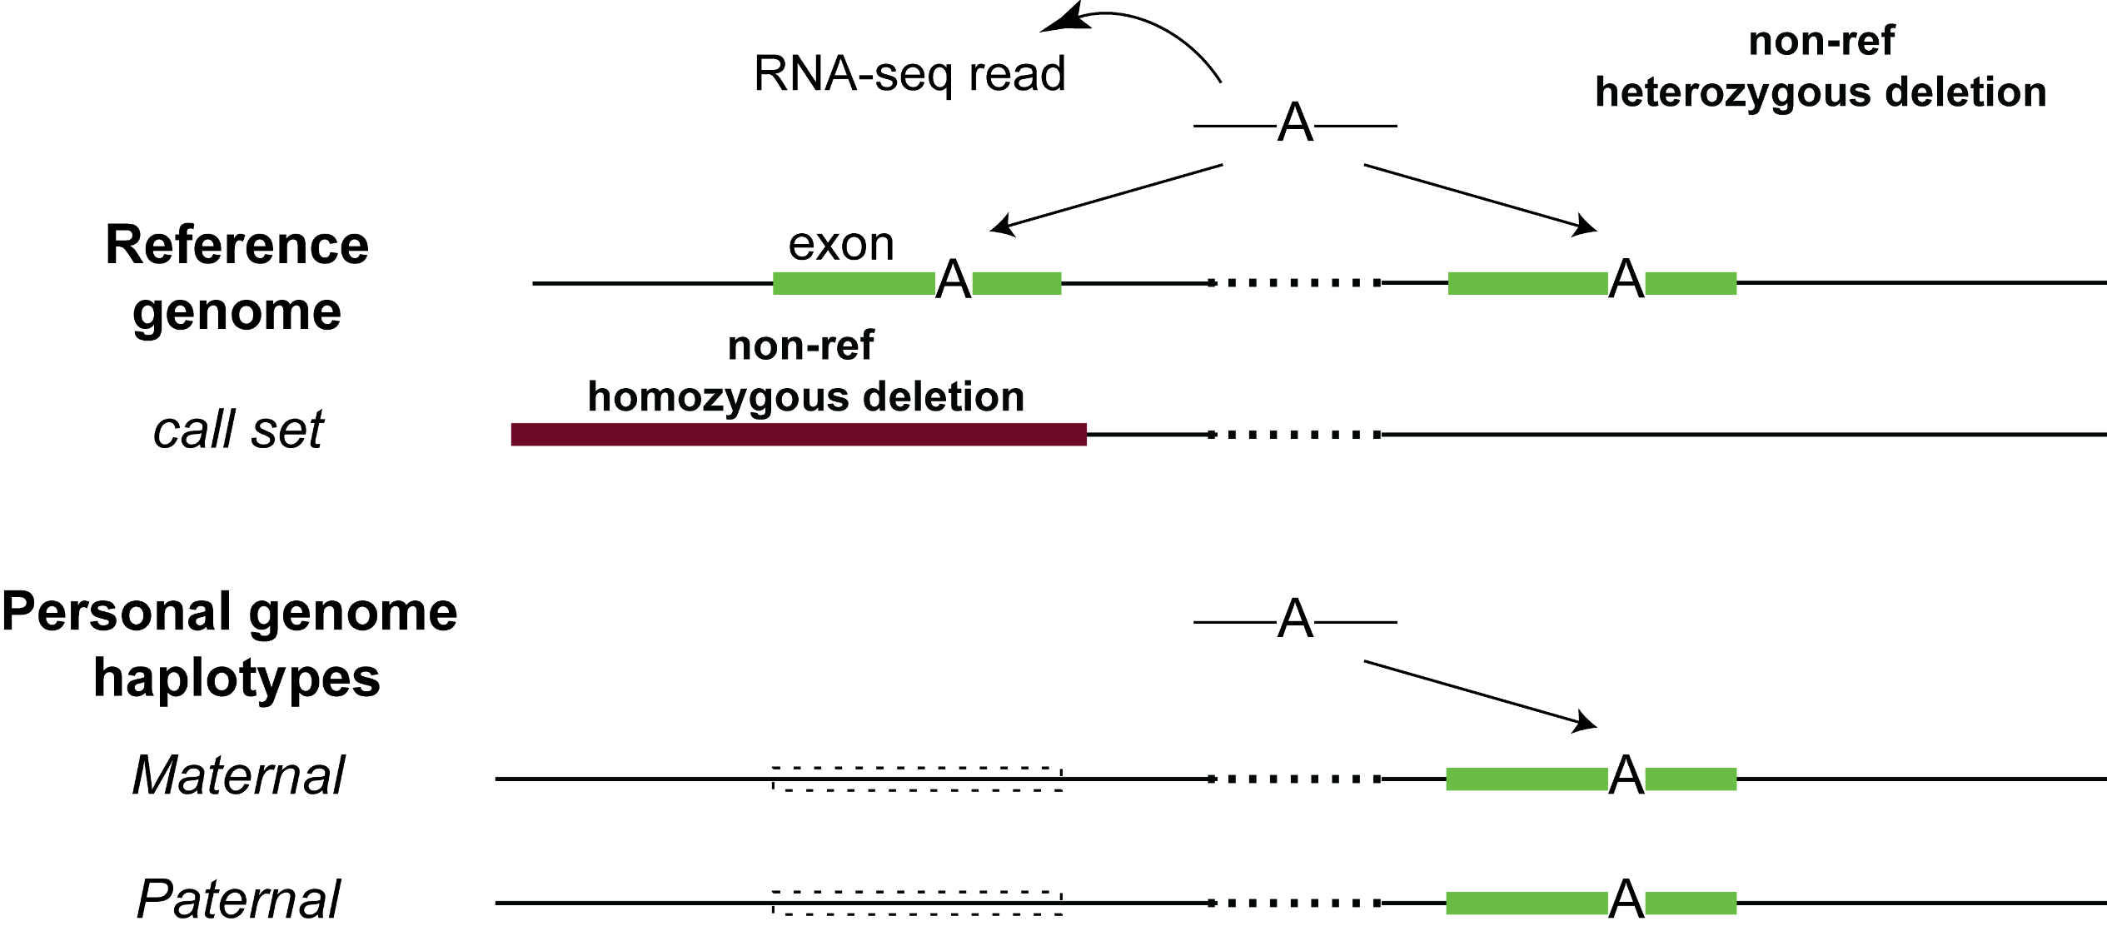
Including SVs in diploid personal genomes: a simple example
Notes:
And the diploid reference is very useful in functional read alignment especially with the current ability to detect rare variants in each individual that are not found in the reference
A simpler example is a non-ref insertion occurring in an exon and then RNA-seq mapping to that missing insertion in the reference – but should be rarer, since indel doesn’t occur much in exon

Slide 18
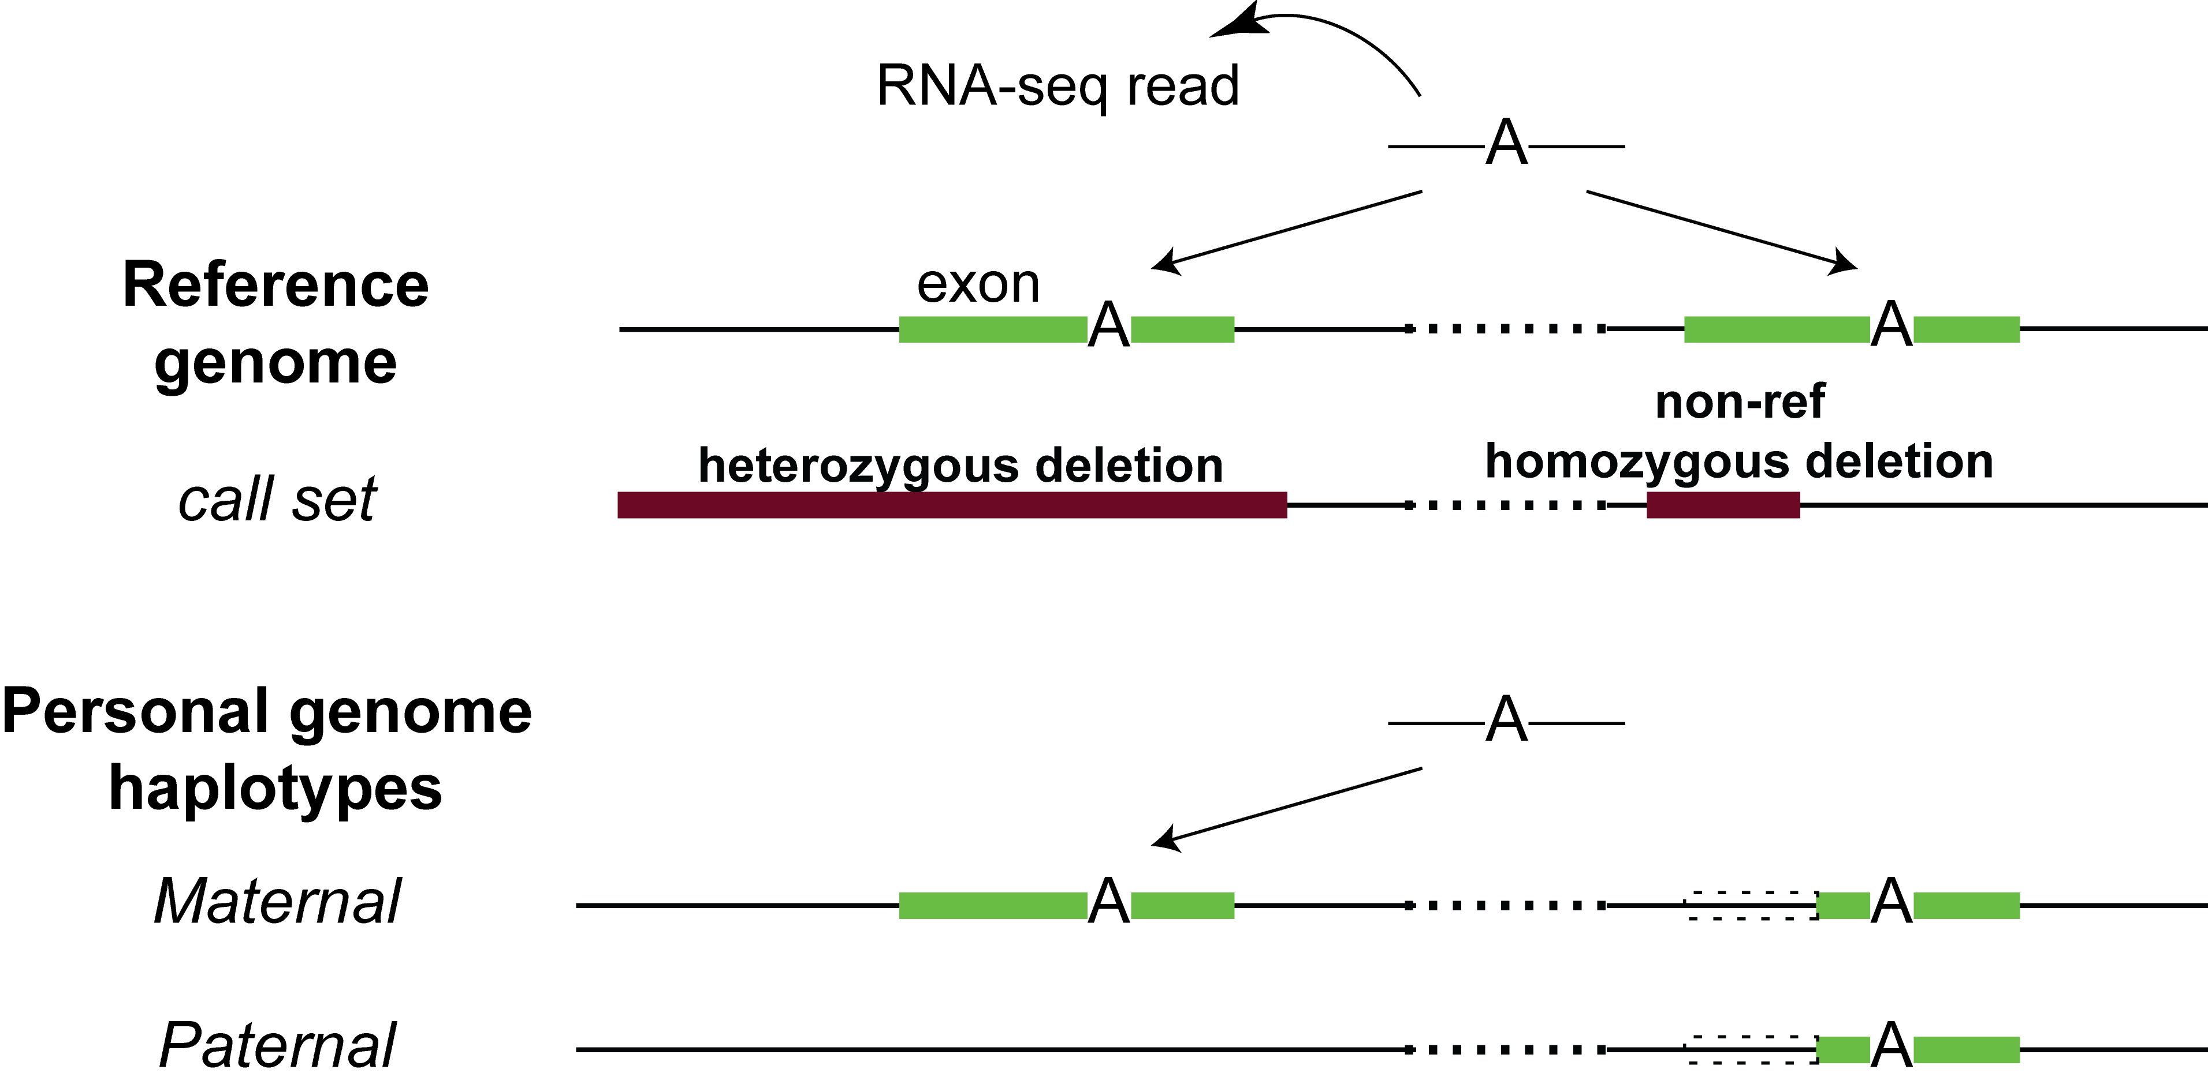
Including SVs in diploid personal genomes : more complex

Slide 19
SVs-in-PG analyses in Sudmant et al., Nature (2015)
Constructed 2 personal genomes of NA12878 based on GRCh37 reference genome
1000GP P3 SNVs and indels integrated call set (low coverage)
1000GP P3 SNVs, indels and SVs with breakpoint information
**1,383 SVs
--with breakpt info
--most are still sub-1kb
Oliver Stegle
Notes:
We have also shown the usefulness of PG in two publications:
In the recent 1000GP SV paper published in Nature
For the personalized genome approaches the union of unique reads (matched by read ID) mapped to the maternal or paternal alignment for a particular genomic feature were considered.

Slide 20
Utility of SVs: Exons with direct SV overlap
Comparing between vanilla GRCh37 ref and Pgenome-SVs
18 exons (5 genes) with a direct SV overlap
6/18 exons were affected in terms of expression (±10 reads)
4/6 showed substantial changes in expression using RNA-seq data from Kilpinen et al. (±10 reads, 2x change)
Oliver Stegle, Sudmant et al., Nature (2015)
Notes:
We showed the utility of including SVs in PG
Showed that PG captures the effects of personal variants in functional assay readouts
These numbers will improve as we gain the ability to build better personal genomes with more accurate call sets

Slide 21
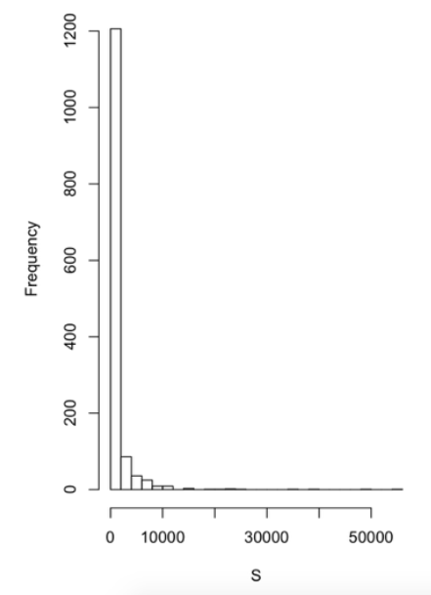
SVs-in-PG analyses in Sudmant et al., Nature (2015)
Constructed 2 personal genomes of NA12878 based on GRCh37 reference genome
1000GP P3 SNVs and indels integrated call set (low coverage)
1000GP P3 SNVs, indels and SVs with breakpoint information
**1,383 /68,000 SVs
--with precise breakpoint information
--most are still sub-1kb
Size of SVs (bp)
Oliver Stegle
Notes:
We have also shown the usefulness of PG in two publications:
In the recent 1000GP SV paper published in Nature
For the personalized genome approaches the union of unique reads (matched by read ID) mapped to the maternal or paternal alignment for a particular genomic feature were considered.

Slide 22
Utility of PGs:
Alleviate biases in detection of allele-specific variants

Slide 23
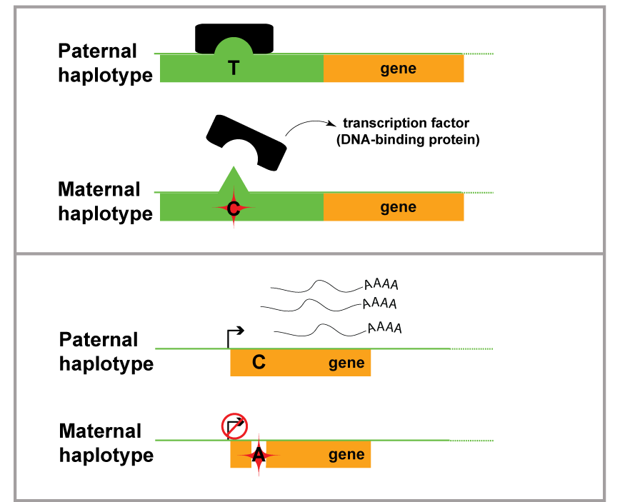
Allele-specific (AS) behavior

Slide 24


Compute allelic ratio (i.e. read difference at the 2 alleles)
e.g. a SNV @ chr 7 position 4345325
e.g. a SNV @ chr 5 position 12455
RNA-/ChIP-Seq Reads
ACTTTGATAGCGTCAACG
CTTTGATAGCGTCAACGC
CTTTGATAGCGTCAACGC
TTGACAGCGTCAATGCAC
TGATAGCGTCAATGCACG
ATAGCGTCAACGCACGTC
TAGCGTCAATGCACGTCG
CGTCAACGCACGTCGGGA
GTCAATGCACGTCGAGAG
CAATGCACGTCGGGAGTT
RNA-/ChIP-Seq Reads
ACTTTGATAGCGTCAATG
CTTTGATAGCGTCAATGC
CTTTGATAGCGTCAATGC
TTGACAGCGTCAATGCAC
TGATAGCGTCAATGCACG
ATAGCGTCAATGCACGTC
TAGCGTCAATGCACGTCG
CGTCAACGCACGTCGGGA
GTCAATGCACGTCGAGAG
CAATGCACGTCGGGAGTT
5 x T
5 x C
------
9 x T
1 x C
------
(ref)
(ref)
Allelic ratio = 0.5
(i.e. ‘null’ expectation)
Allelic ratio = 0.9
T
T
C
C
Notes:
In allele-specific analyses what people do conventionally is aligning the reads to the respectively alleles at positions with heterozygous SNVs

Slide 25
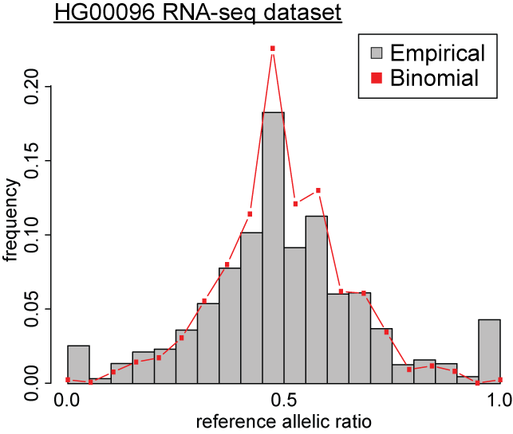
Binomial model on observed distribution
ASE/ASB Example:
…GTCAATGCAC
…GTCAATGCACG
…GTCAATGCACGTC
…GTCAATGCACGTCG
…GTCAACGCACGTCGGGA
GTCAATGCACGTCGAGAG
CAATGCACGTCGGGAGTT
AATGCACGTCGGGAGTTG
Non-allele-specific variants
e.g. allelic ratio = 0.5
Allele-specific variants
e.g. allelic ratio = 0.9
Observed
Binomial
Null Example:
ACTTTGATAGCGTCAATG
CTTTGATAGCGTCAACGC
TTGACAGCGTCAATGCAC
ATAGCGTCAATGCACGT…
TAGCGTCAACGCACGT…
CGTCAACGCACGT…
CAATGCACGT…
AATGCACGT…
Alt
Ref

Slide 26
Some issues in AS analyses
Reference bias
Ambiguous mapping bias
Over-dispersion

Slide 27
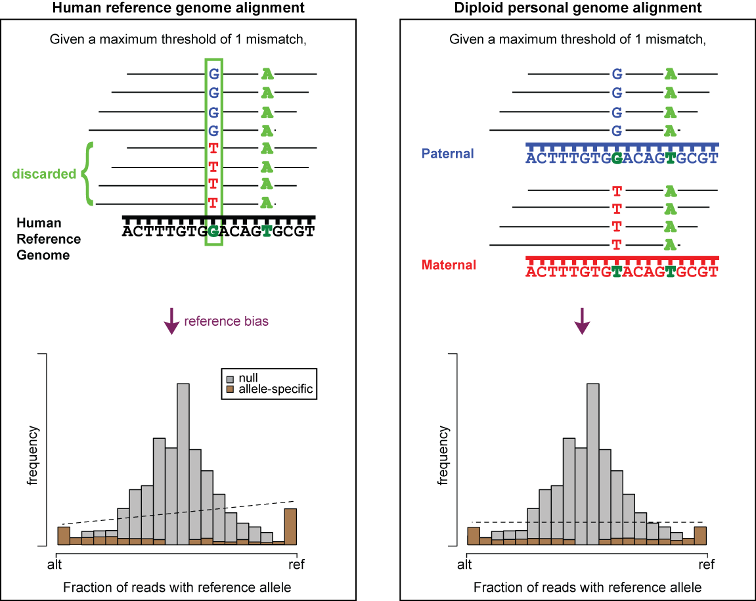
Reference bias
(naïve alignment to the human reference genome)

Slide 28
PG alleviates reference bias in alignment

Slide 29
PG alleviates reference bias in alignment

Slide 30
Some issues in AS analyses
Reference bias
Ambiguous mapping bias
Over-dispersion

Slide 31
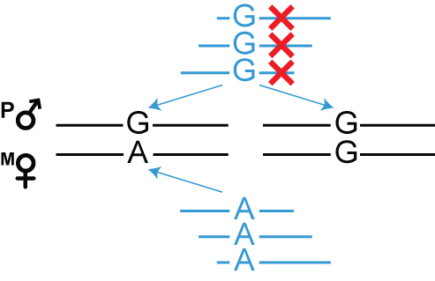
Ambiguous mapping bias due to sequence similarity
For AS analyses, discard reads that multi-map

Slide 32
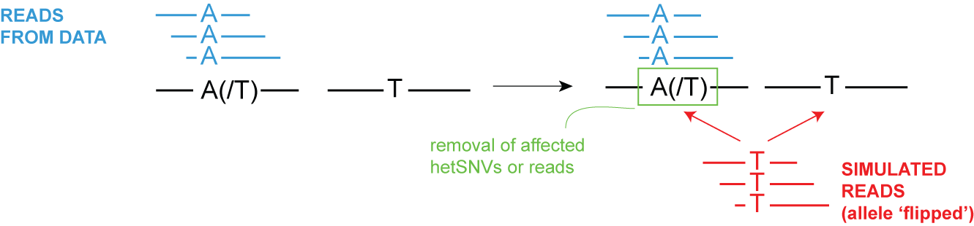
Account for ambiguous mapping bias
Using the reference genome, new simulated reads are created where alleles of the original reads are flipped (at het SNV positions)
Lappalainen et al. (2013)
Panousis et al. (2014)
Van de Geijn et al. (2015)
Notes:
There is currently a number of different methods that can help with this issue and one of more common methods is to do a simulation of flipped reads

Slide 33
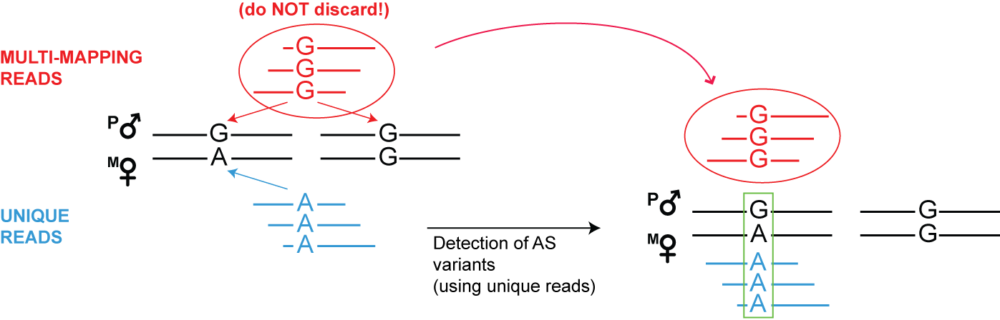
PG facilitates the resolution of ambiguous mapping bias
Using the personal genome, we do not need to simulate reads.
We can directly test affected sites using multi-mapping read pile
Keep track of they multi-map
Notes:
The flipping simulation can also be used in the

Slide 34
Some issues in AS analyses
Reference bias
Ambiguous mapping bias
Over-dispersion

Slide 35
Binomial model on observed distribution
ASE/ASB Example:
…GTCAATGCAC
…GTCAATGCACG
…GTCAATGCACGTC
…GTCAATGCACGTCG
…GTCAACGCACGTCGGGA
GTCAATGCACGTCGAGAG
CAATGCACGTCGGGAGTT
AATGCACGTCGGGAGTTG
Non-allele-specific variants
e.g. allelic ratio = 0.5
Allele-specific variants
e.g. allelic ratio = 0.9
Observed
Binomial
Null Example:
ACTTTGATAGCGTCAATG
CTTTGATAGCGTCAACGC
TTGACAGCGTCAATGCAC
ATAGCGTCAATGCACGT…
TAGCGTCAACGCACGT…
CGTCAACGCACGT…
CAATGCACGT…
AATGCACGT…
Alt
Ref

Slide 36
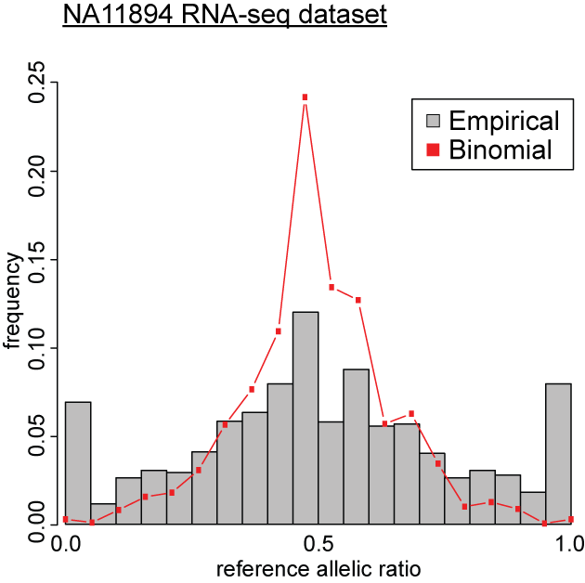
Over-dispersion
– broader distribution than expected
Binomial distribution insufficient to explain over-dispersed observed distribution
Observed
Binomial
)
Alt
Ref

Slide 37
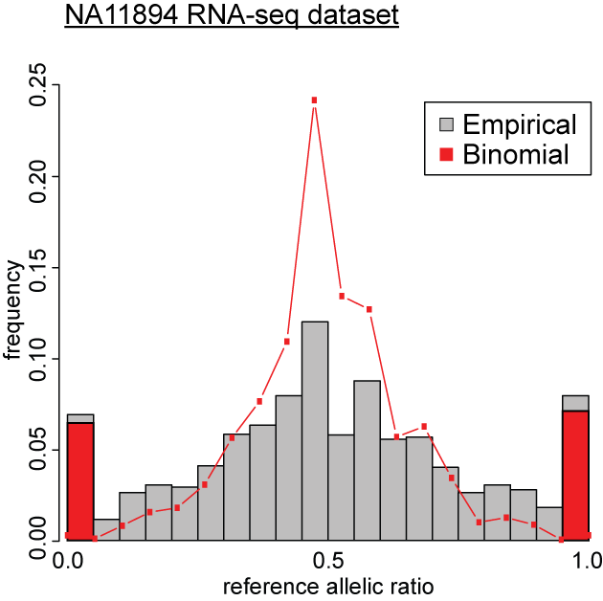
Over-dispersion
– broader distribution than expected
Binomial distribution insufficient to explain overdispersed empirical distribution
Binomial test over-calls allele-specific variants
Observed
Binomial
Alt
Ref
Notes:
non-optimal antibodies in ChIP-seq experiments
read mapping variability
true biological variation in factor binding or expression
etc. etc.

Slide 38

Beta-binomial distribution
– to account for over-dispersion
Binomial | Beta-binomial
2 parameters -- X ~ (n,k) | 4 parameters -- X ~ (n,k) -- k ~ Beta(α,ß)
n = total number of reads k = allelic ratio | n = total number of reads k = allelic ratio accounting for the overdispersion of allelic ratio distribution
Notes:
The default model is eta1 =logit(mu) and eta2 = logit(rho) because both parameters lie between 0 and 1. The mean (of Y) is p = mu = alpha / (alpha + beta) and the variance (of Y) is mu(1-mu)(1+(N-1)rho)/N. Here, the correlation rho is given by 1/(1 + alpha + beta) and is the correlation between the N individuals within a litter. A litter effect is typically reflected by a positive value of rho. It is known as the over-dispersion parameter.

Slide 39
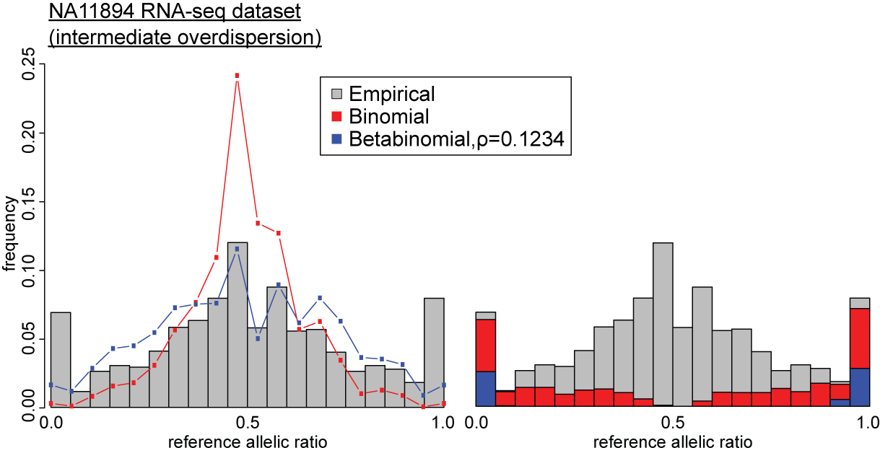
Accounting for overdispersion:
Binomial VS Beta-binomial
Observed
Binomial
Betabinomial
Alt
Ref

Slide 40
Accounting for overdispersion:
Binomial VS Beta-binomial
Observed
Binomial
Betabinomial
over-calls by binomial
Alt
Ref
Alt
Ref

Slide 41
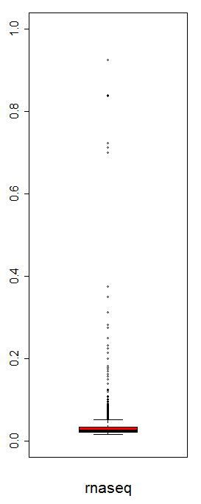
Overdispersion parameter (ρ) as a useful QC metric for data harmonization
Curated 987 RNA-seq datasets from eight different studies (including ENCODE)
-- removed 32 datasets with ρ ≥ 0.125 (1 sd from ρ_{mean})
Overdispersion parameter, ρ
ρ = 0.125

Slide 42
Accounting for overdispersion:
Binomial VS Beta-binomial
Observed
Binomial
Betabinomial
ρ=0.123
over-calls by binomial
Alt
Ref
Alt
Ref

Slide 43
Summary
PG is a more realistic and intuitive representation of the human genome
PG can incorporate variants of any size (e.g. SNVs, indels and SVs)
--improves alignment of reads from functional genomic assays
--improves accuracy of quantification
PG is able to include phase information and diploid nature
--alleviates reference bias
PG construction is highly scalable
--Scale easily with more samples and improving sequencing technologies, e.g. longer reads and more accurate phase information
--more than 300 PGs have been built
--rapid construction of a PG with vcf2diploid tool (~1h for NA12878 full set of variants: SNVs, indels and SVs)
PG is useful in processing and analyses of functional genomic assays
--e.g. read alignment, RNA-seq quantification and allele-specific analyses

Slide 44
Previous use of a personal genome for a single individual (NA12878) in ENCODE
Gerstein et. al., Nature (2012)
The Encode Consortium, Nature (2012)
Djebali et al., Nature (2012)

Slide 45
Future prospects of PGs in ENCODE
Diploid genomes for all GM cell lines and H1
--14/35 GM cell lines in ENCODE with available 1000GP Phase 1 DNA data
Dealing with non-diploid genomes, e.g. cancer cell lines (polyploid)
--make use of available HeLa genome (with phase and ploidy info)
Entex
--PGs and functional assays for multiple tissues
Notes:
--there are 35 GM cell lines in ENCODE, with ChIP-seq data

Slide 46
Acknowledgement
Yale University
Joel Rozowsky
Timur Galeev
Arif Harmanci
Rob Kitchen
Mark Gerstein
EMBL-EBI
Oliver Stegle
Mayo Clinic
Alexej Abyzov

