Slide 1
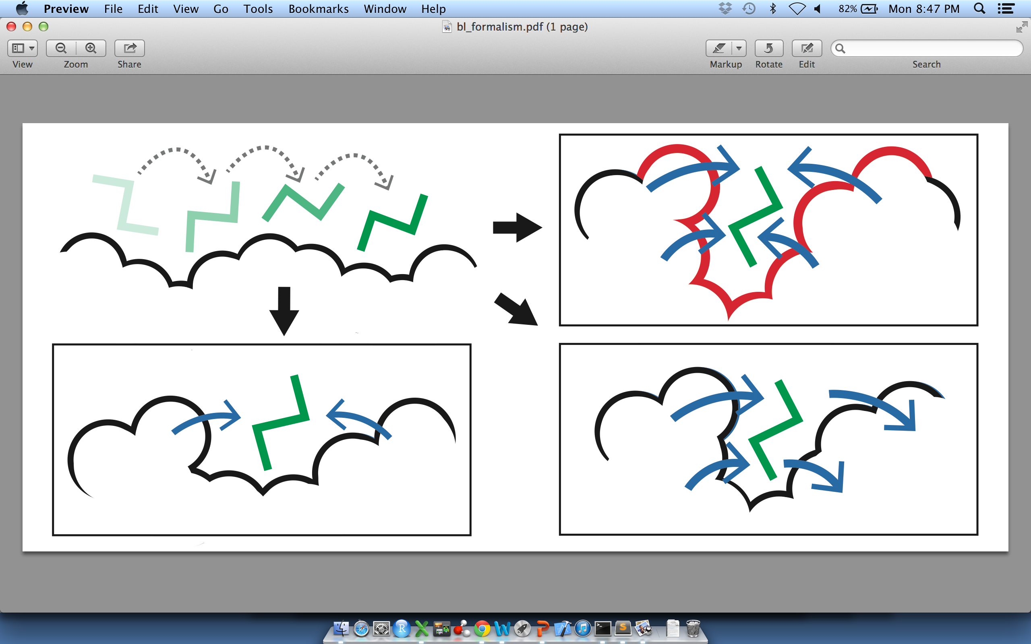
Basic Objective and Idea Behind the Formalism
For Predicting Allosteric Sites on the Surface
(A)
(B)
(C)
(D)
Identify pockets on the protein surface by running MC simulations in which a ligand walks along the proteins surface (A)
Score each pocket by the degree to which it perturbs large-scale motions. Shallow sites (C) or sites at which the ligand does not interfere with motion (D) earn low scores, whereas deeper pockets at which occlusion ‘blocks’ motion earn high scores (B).
Threshold the list or sites to identify the set predicted allosteric sites at the surface.

Slide 2
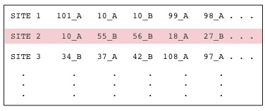
STRESS Output for Predicted
Allosteric Sites on the Surface
stress.molmovdb.org
Output
PDB: 3PFK

Slide 3
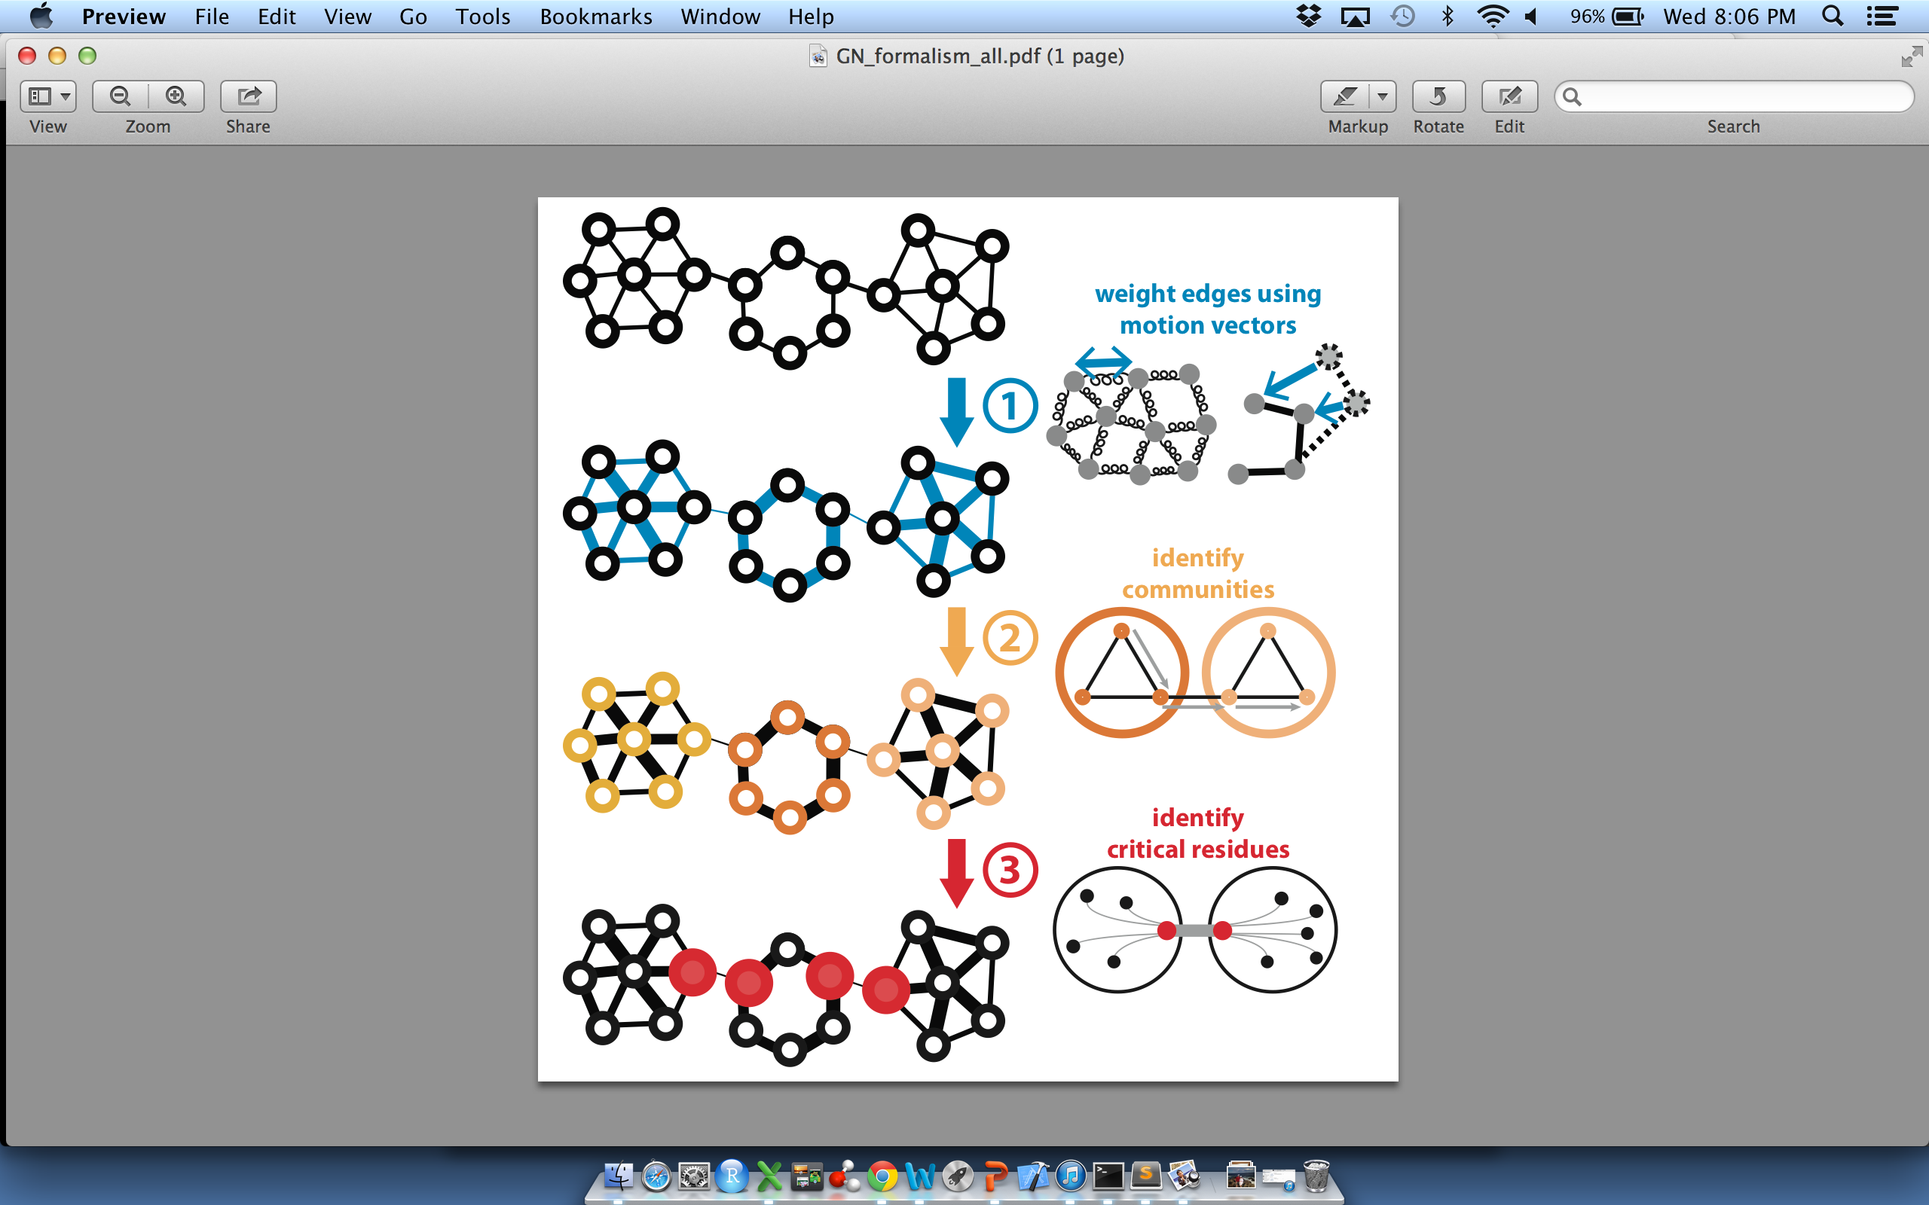
Basic Objective and Idea Behind the Formalism
For Predicting Allosteric Residues within the Interior

Slide 4
STRESS Output for Predicted
Allosteric Residues within the Interior
stress.molmovdb.org
Output
PDB: 4AKE

Slide 5
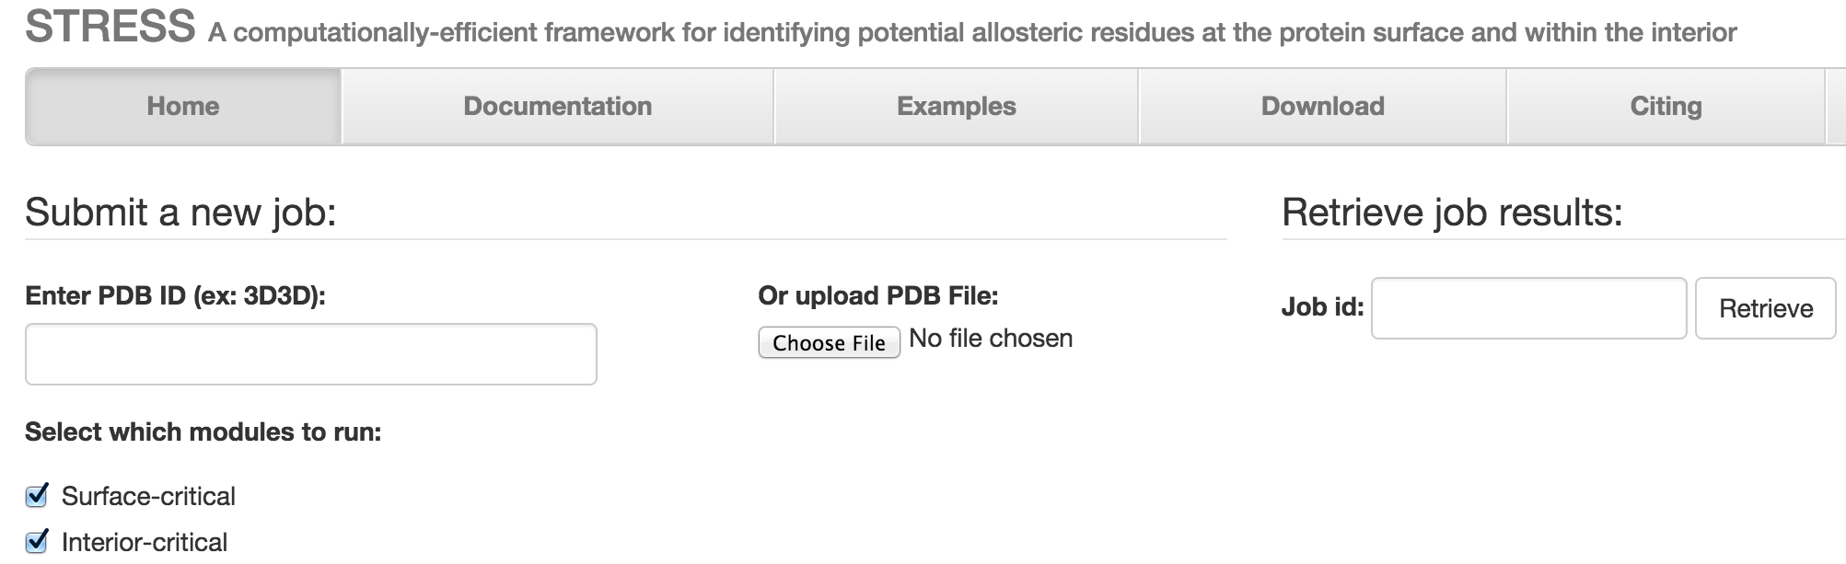
STRESS Server Architecture
stress.molmovdb.org

Slide 6
STRESS Server Architecture: Highlights
stress.molmovdb.org
Users submit a PDB, and the output is the set of predicted allosteric residues.
Running times are minimized by using a scalable server architecture that runs on the Amazon cloud. A light front-end server handles incoming requests, and powerful back-end servers perform the algorithmic calculations.
Amazon's Elastic Beanstalk enables dynamic scalability. Auto Scaling adjusts the number of back-end servers as needed.
Elastic Load Balancer automatically distributes incoming network traffic, ensuring that it can handle varying levels of demand.
Input and output files are stored remotely in an S3 bucket, which is accessible to each server via RESTful conventions.
By optimizing for speed (with optimizations introduced through changes in the workflow, data structures, numerical arithmetic, etc.), a typical case takes ~30 minutes on a E5-2660 v3 (2.60GHz) core.
Source code is available through Github: github.com/gersteinlab/STRESS

