Slide 1
Comparison of calls for subject Z with subject M & N
Z
M
Z
M
0.504
million
0.09
million
0.78
million
0.16
million
0.158
million
0.816
million
1.73
million
0.37
million
0.117
million
0.504
million
0.506
million
0.123
million
0.85
million
0.222
million
SNPS
N
INDELs
N

Slide 2
Comparison of calls for subject Z with YRI & CHN individuals
Z
CHN
Z
CHN
0.53
million
0.07
million
1.1
million
0.23
million
0.23
million
0.99
million
1.4
million
0.21
million
0.13
million
0.58
million
0.44
million
0.06
million
2.08
million
0.38
million
YRI
YRI
SNPS
INDELs

Slide 3
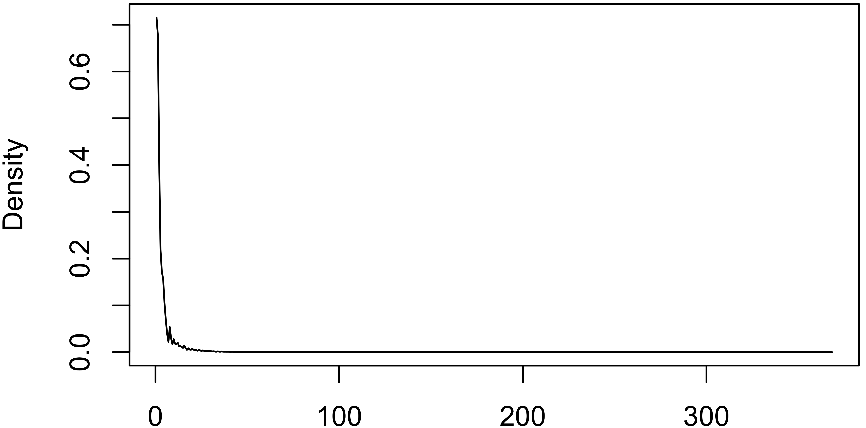
INDEL length distribution for subject Z
Length of INDELs

