Slide 1
Frequency
= 8 / 8
= 5 / 8
= 3/ 8
C√
C√
Time

Slide 2
ADDED Mutation rate
+ MRlb
(+ MRlb)+MRr
(+ MRlb+ MRr) + MRdb
C√
C√
Time

Slide 3
ADDED Replication rate
+ RRlb
(+ RRlb)+ RRr
(+ RRb+ RRr) + RRdb
C√
C√
Time

Slide 4
If mutation rate AND/OR Pop Size change
C√
C√
Time

Slide 5
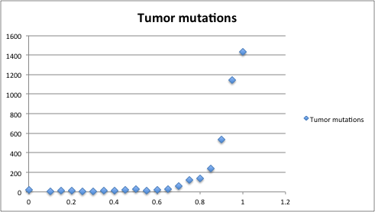
If mutation rate AND/OR PopSize change
Number of mutations per 0.05 step
0.05 step

Slide 6
If mutation rate AND/OR PopSize change
Slope depends on Fitness (Mutation rate and replication rate)
dS=0.05
x
Effect change from
=
y

Slide 7
If mutation rate AND/OR PopSize change
dS=0.05
x
(Xprim *Ynorm)
OddsRatio=
Effect change from
=
(Yprim*Ynorm)
y

Slide 8
Test Genes on KIRC data
GENE | Simple Av. Effect (x/y) | Average OR
VHL | 3.222222222 | 6.175925926
SDHB | 2.123076923 | 6.482967033
MET | 1.352678578 | 1.567754847
TSC2 | 1.290322581 | 1.01929592
SDH | 2.013369686 | 4.734865256
PMS2 | 1.789132132 | 3.099826529
SDHA | 2.003396301 | 4.575946912
dS=0.05
x
(Xprim *Ynorm)
(Yprim*Ynorm)
y

Slide 9
Expanding on
Any gene list/Cancer
Any coding or non-coding region

Slide 10
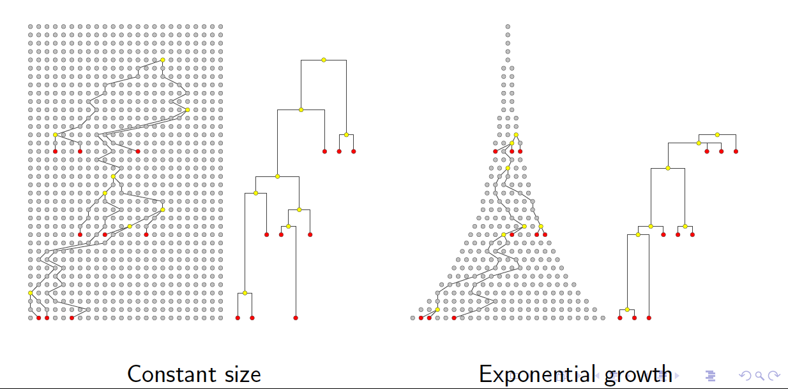
Different Clonal expansions

Slide 11
Three types of ADDED mutation rates
Coding DNA– Cancer genes (CanG)
Coding DNA – Genes linked to CanG (Funseq)
Non Coding – Regions linked to CanG (mirbase etc)
Coding DNA, 1000 random genes

