Slide 1
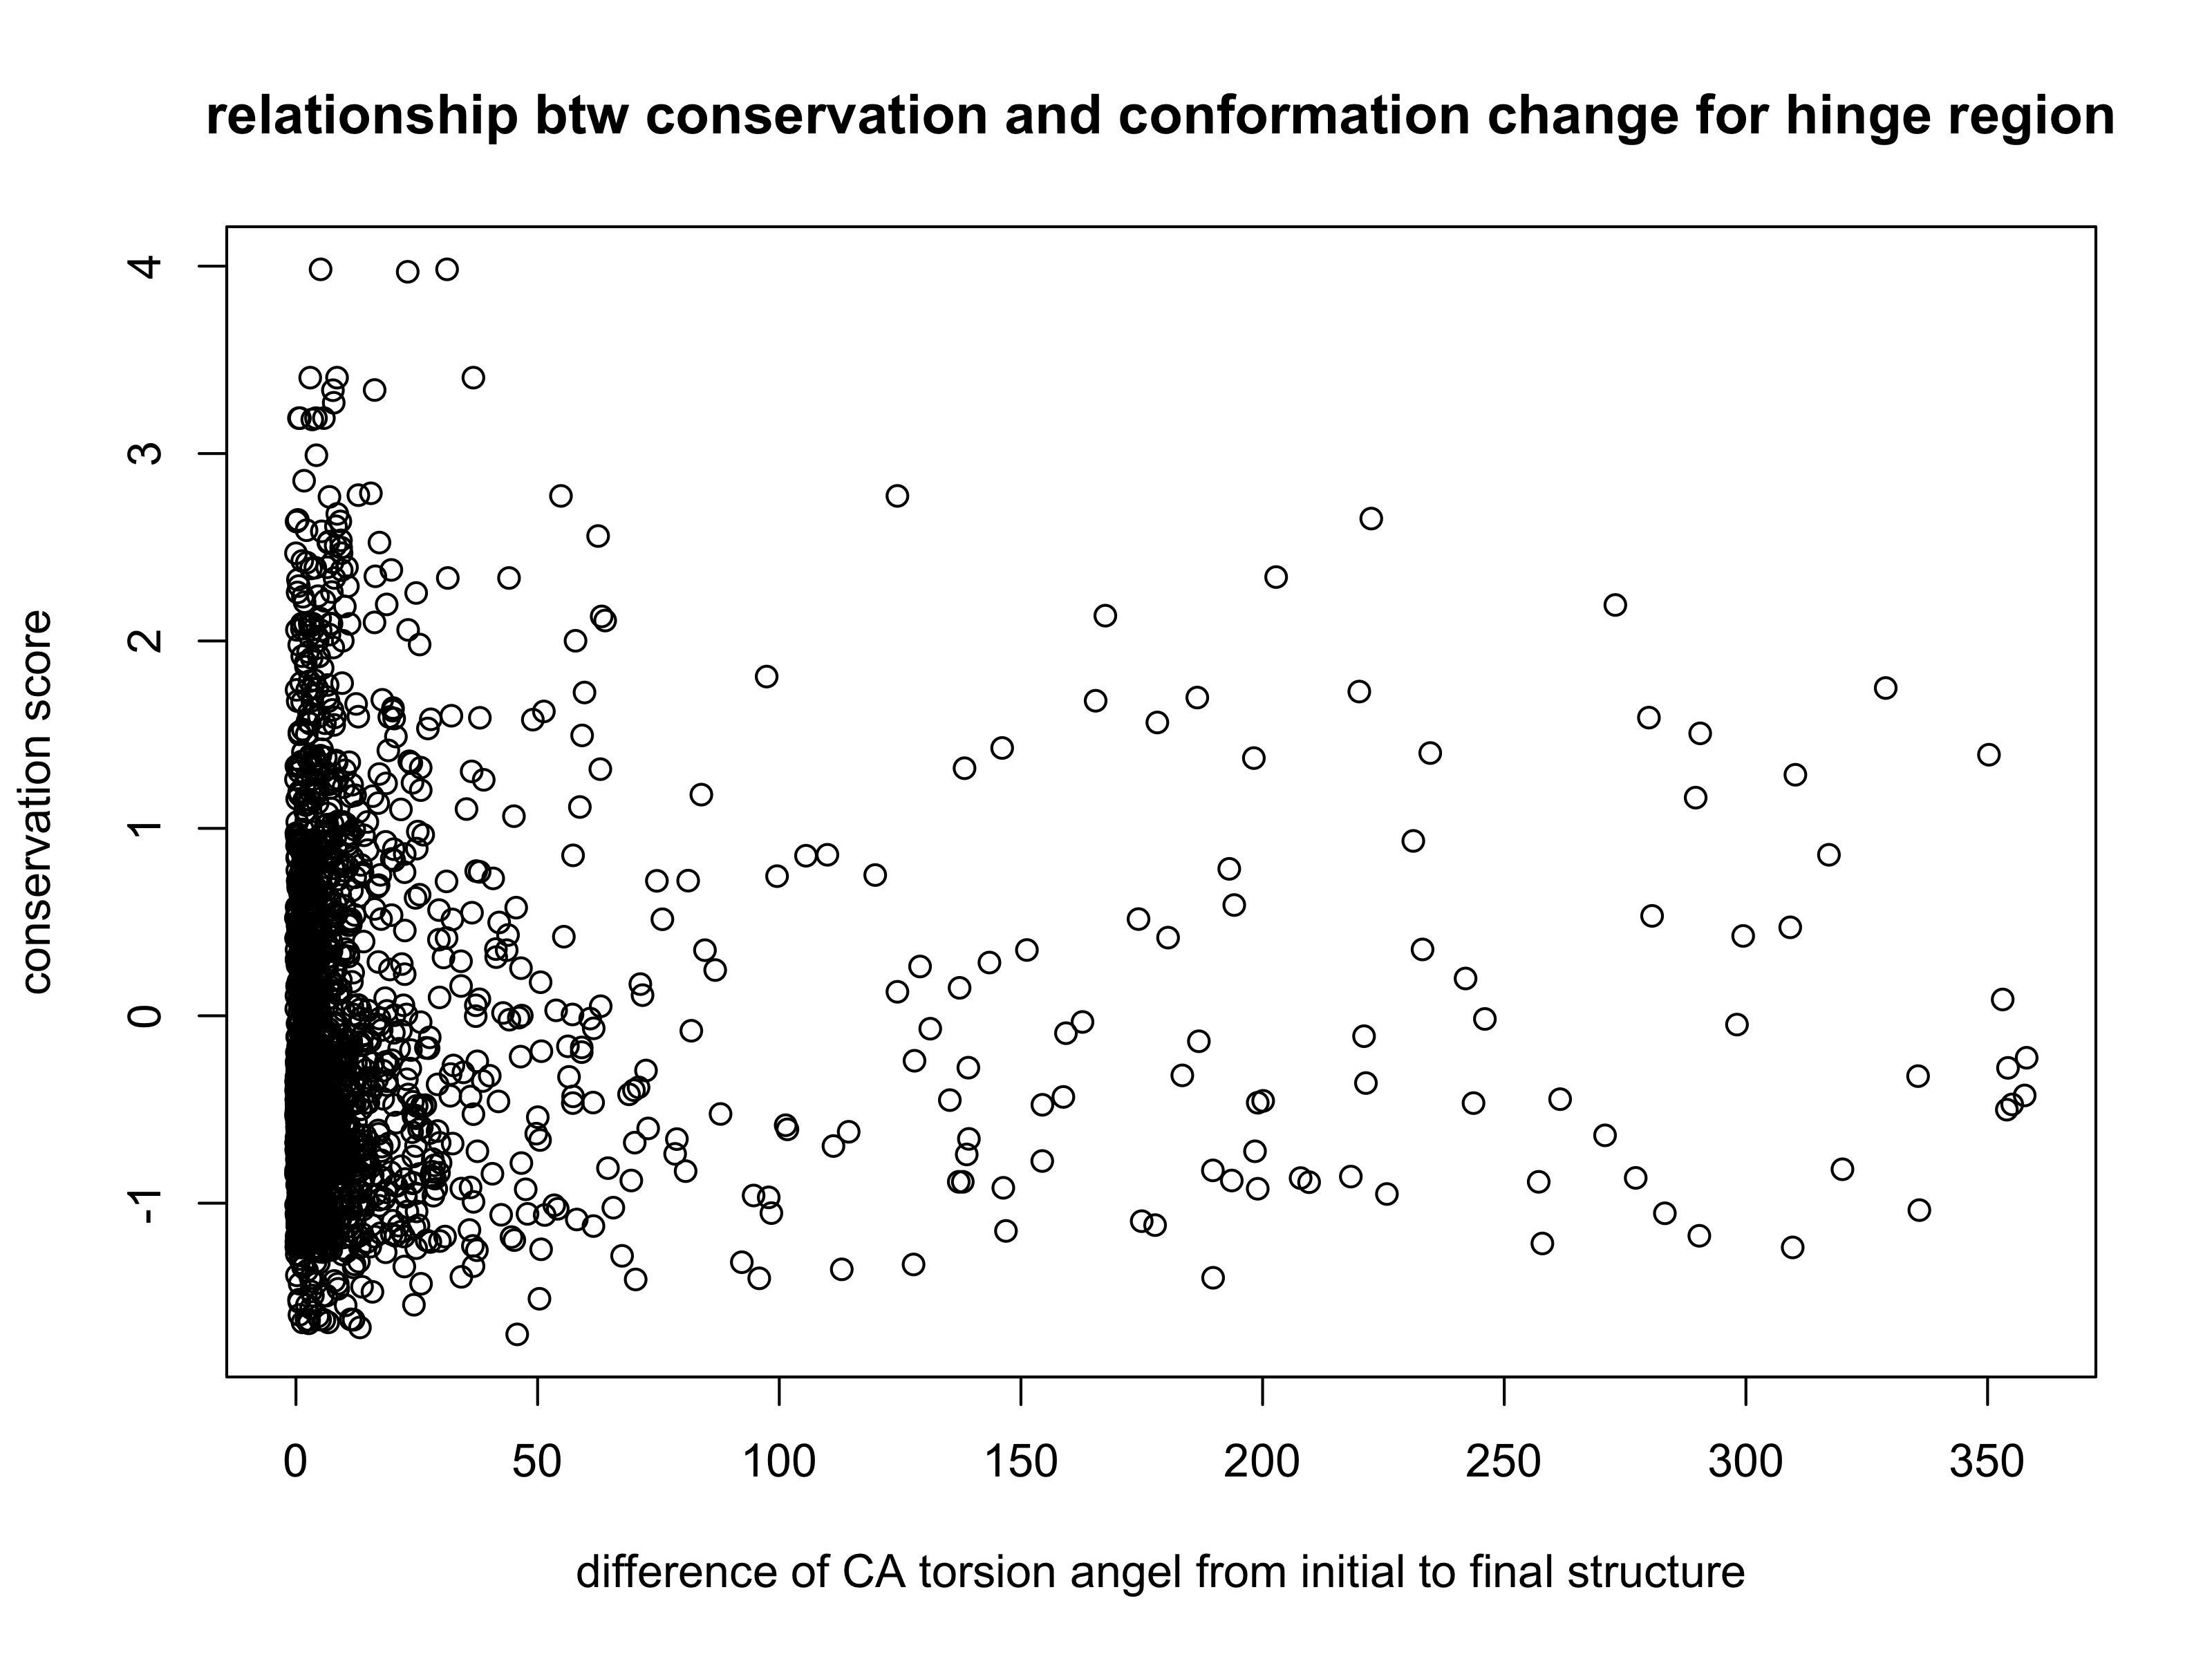
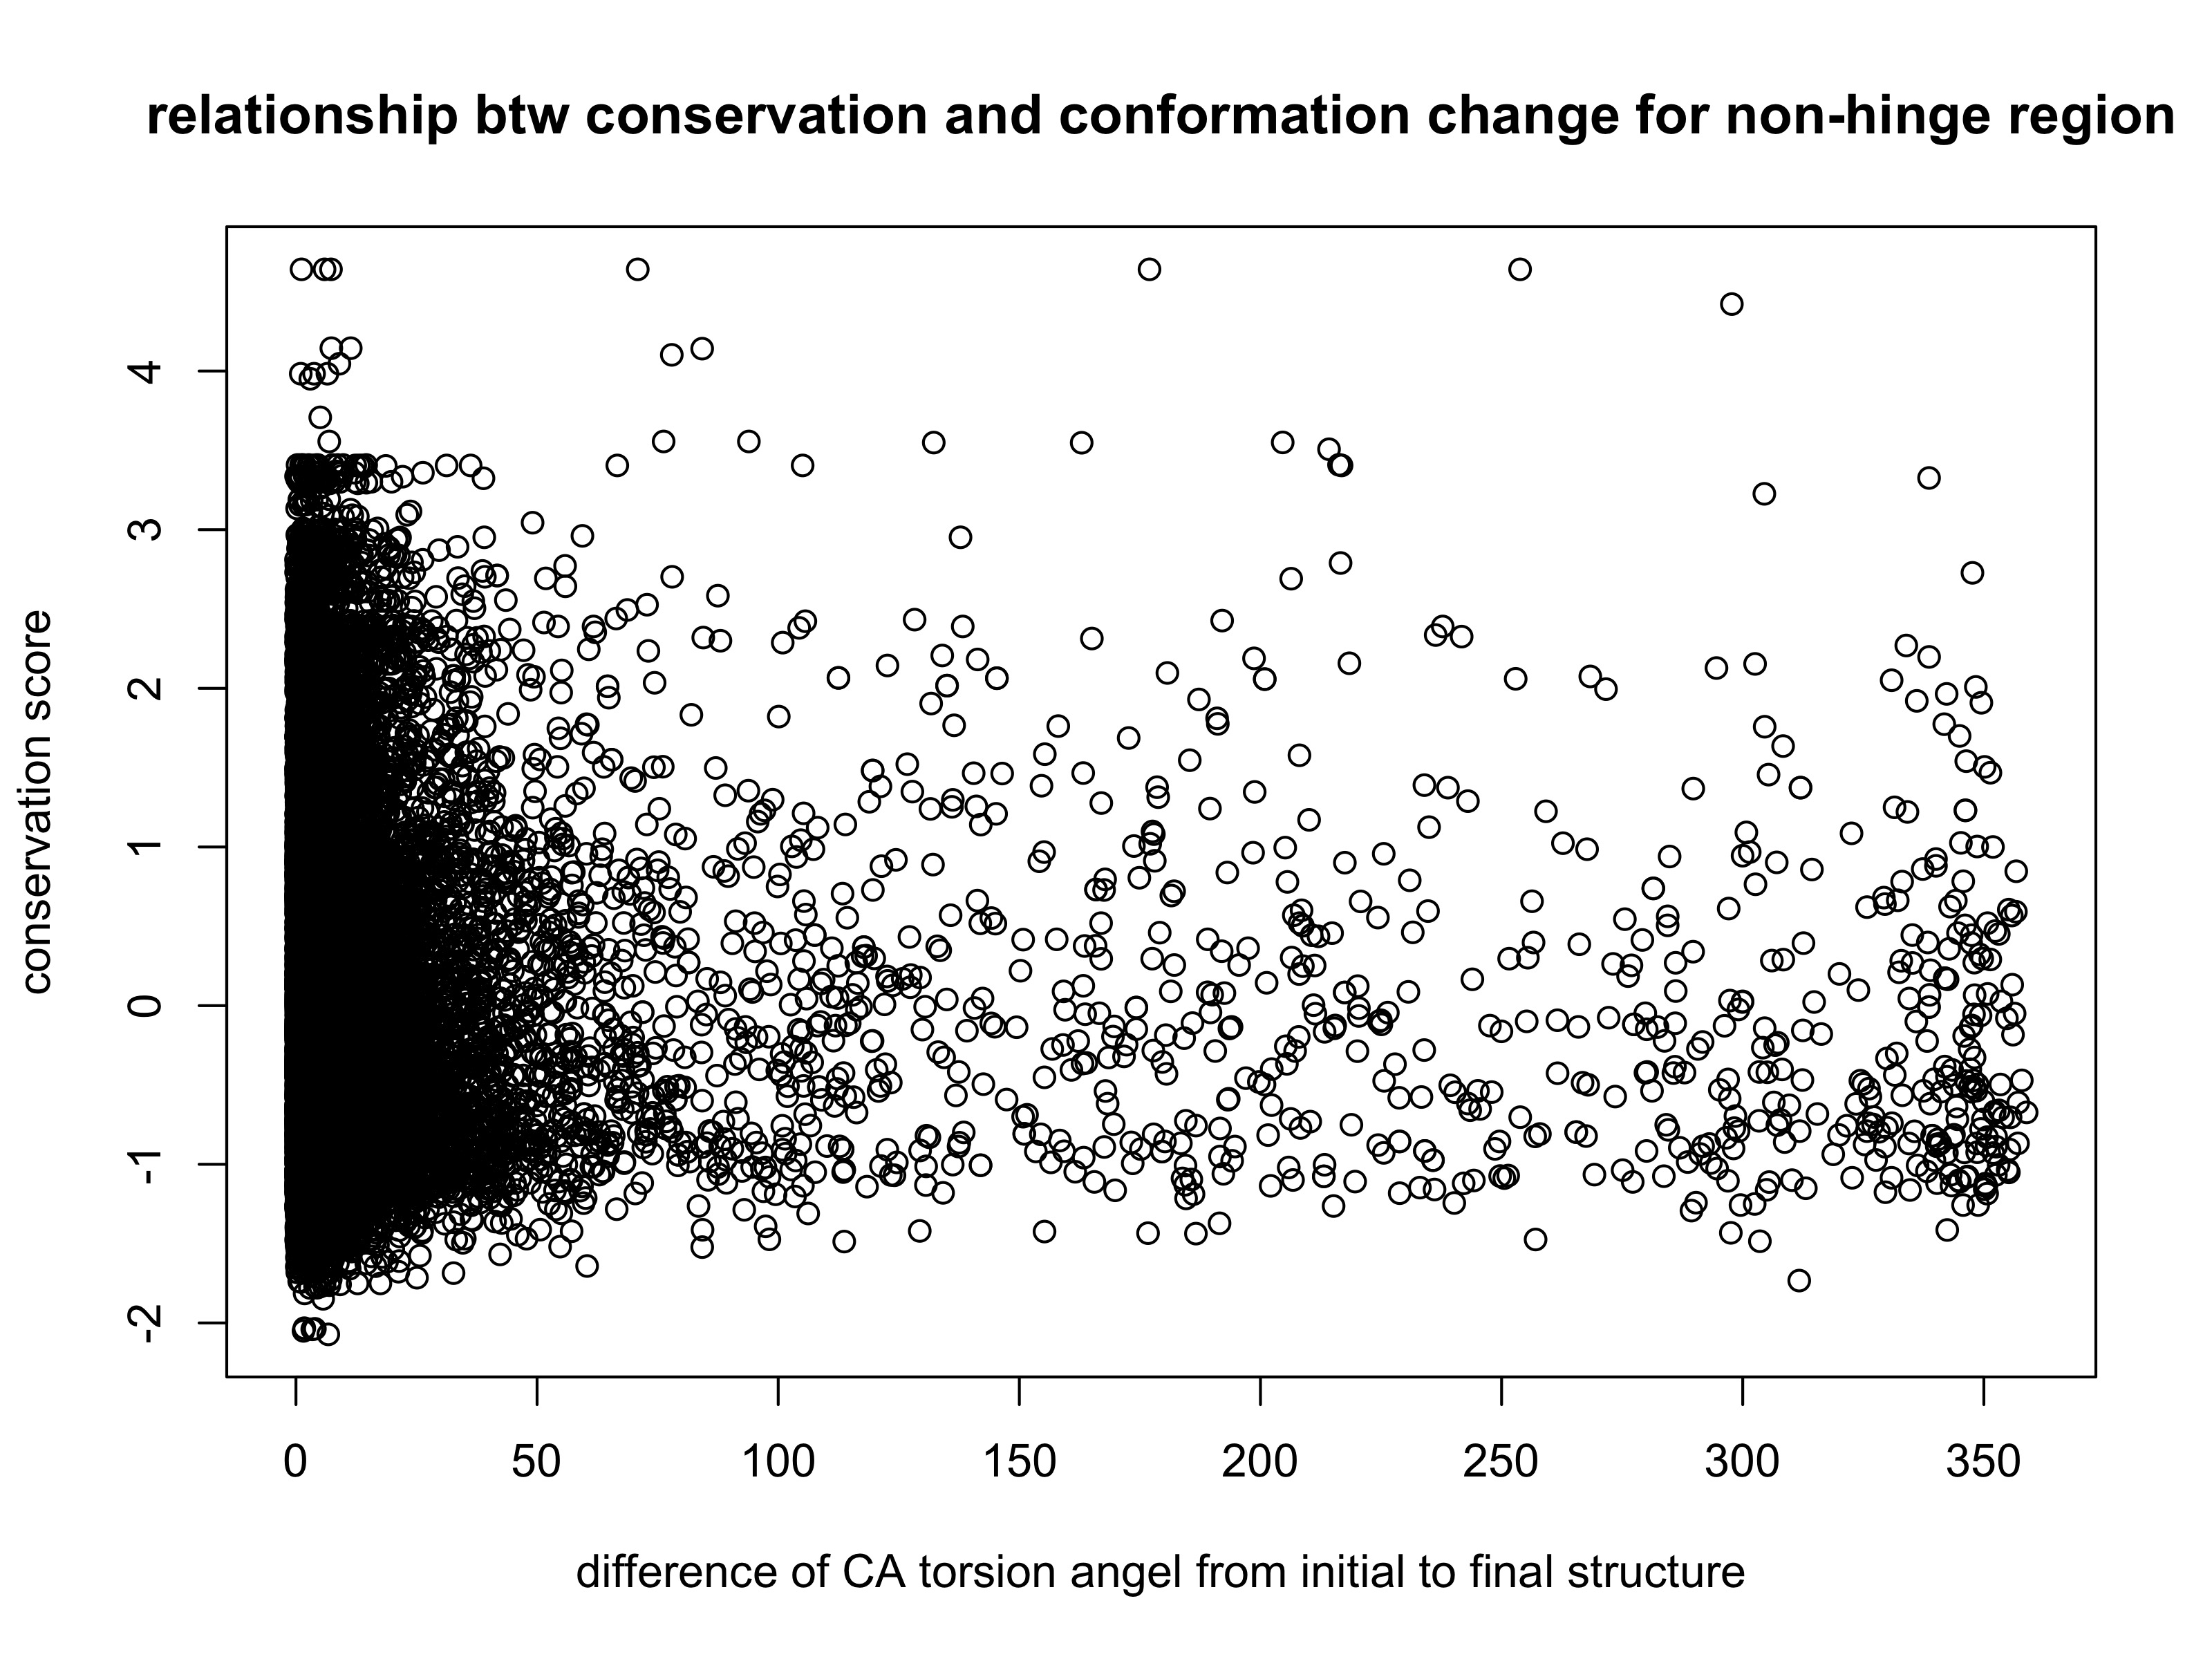

Slide 2
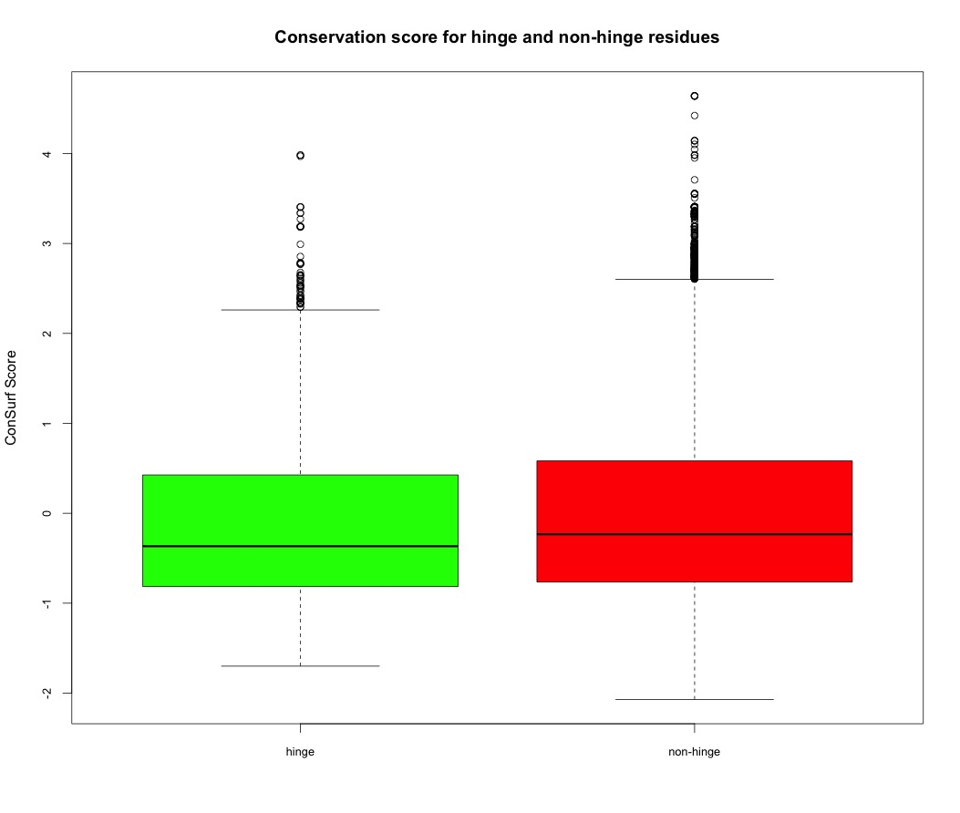
Mean of Hinge Score:
-0.1053686
Mean of Non-Hinge Score:
0.00599026

Slide 3
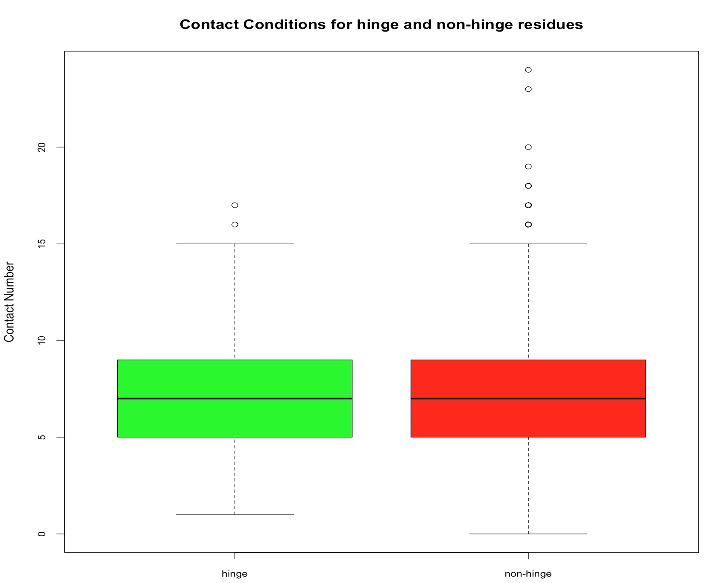
Mean of Hinge Contact:
7.110766
Mean of Non-Hinge Contact:
7.272807

Slide 4
Using Spline Interpolation to Fit Protein Backbone
and
Calculating Curve Torsion as an Alternative Approach for Backbone Dihedral Angles
(in progress)
Server Development
(in progress)

Slide 5
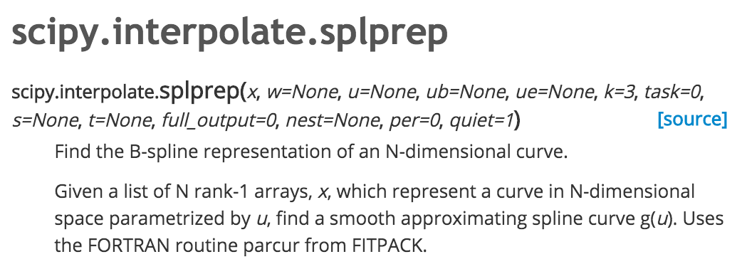
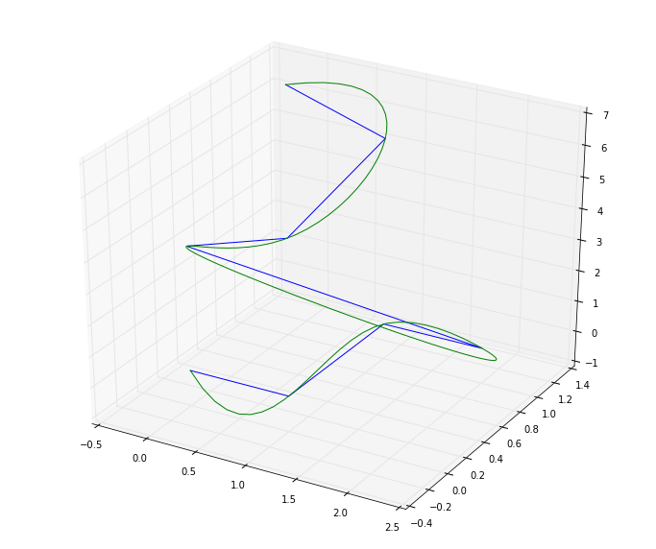
Key Parameter:
s: smoothing factor. Here I set s = 0, which means the
fitting curve would pass through every point.
Blue: Modeled 4 CA atoms in the space;
Green: Spline-fitted continuous curve for torsion calculation
How the spline fitting might help:
1. Interpolate more data points in the hinge region.
2. The smoothly fitted curve may reduce the bias and noise for the outcome data

Slide 6
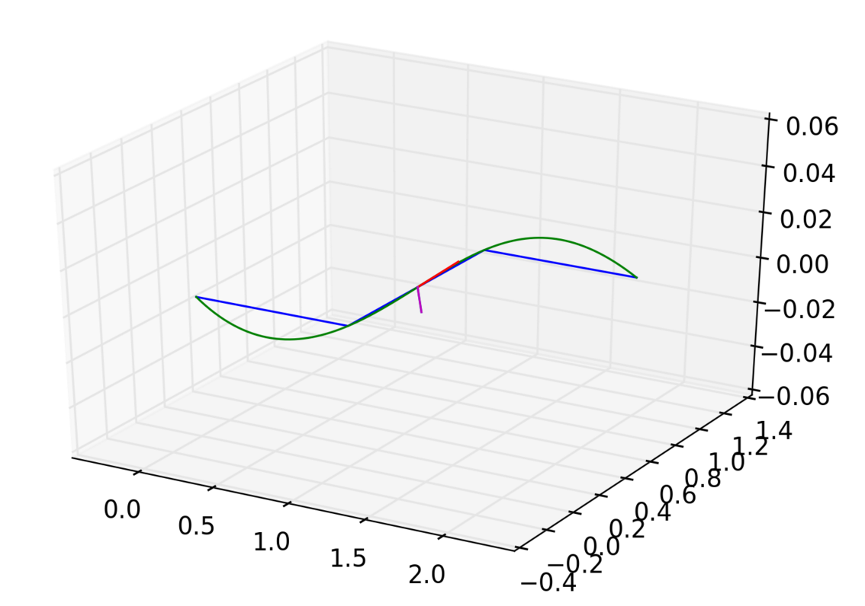
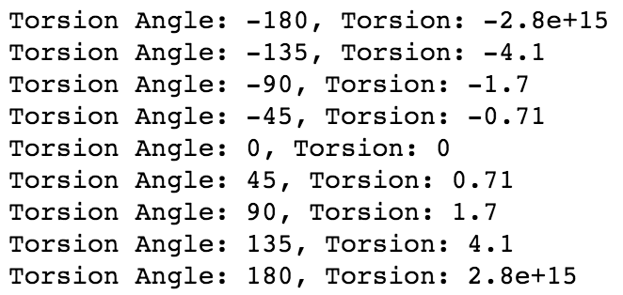
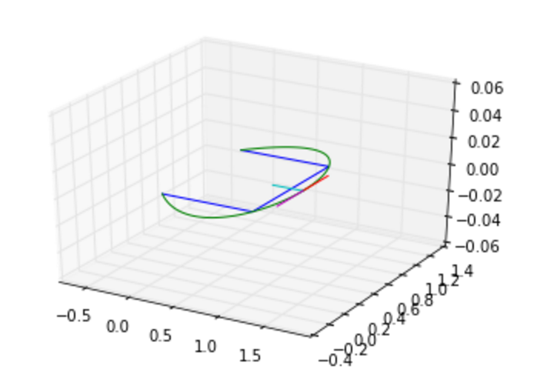
Result:
Some Dihedral Angle and Corresponded Torsions
B
N
180˚
Blue: Modeled 4 CA atoms in the space;
Green: Spline-fitted continuous curve for torsion calculation
B: unit binormal vector
N: unit normal vector
0˚

Slide 7
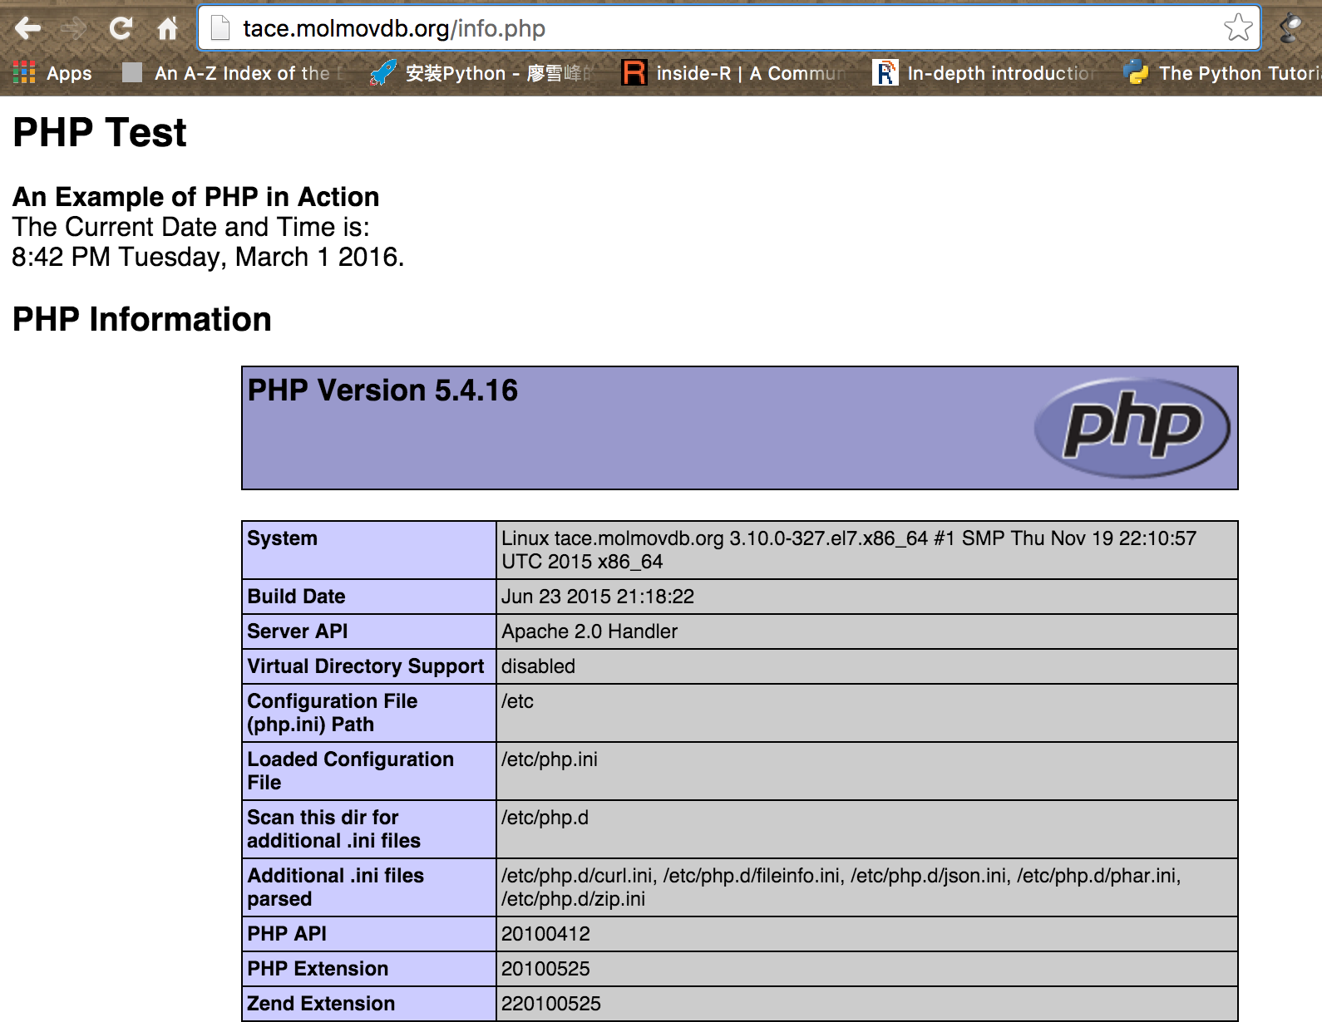
webserver:
Finished configuration work for
PHP and Apache on the virtue machine;
Start writing PHP scripts for file uploading,
Information retrieving;
Next: try to call Python script for torsion angle
Calculations and return back results.

