Slide 1
MotifVar
Jieming
Structure
Feb 29 2016

Slide 2
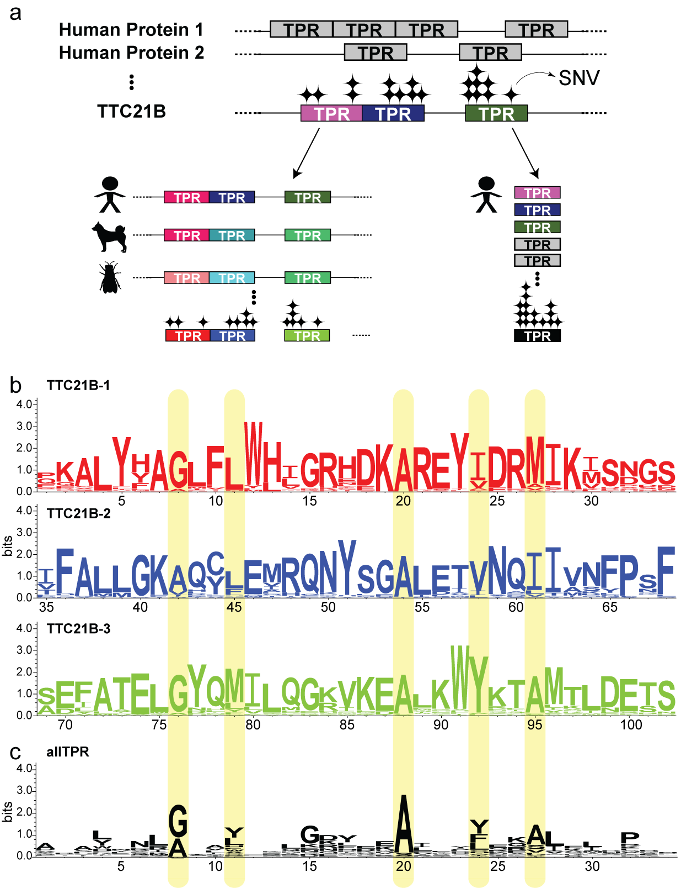

Slide 3
