Slide 1
Updated figures for PLoS review

Slide 2
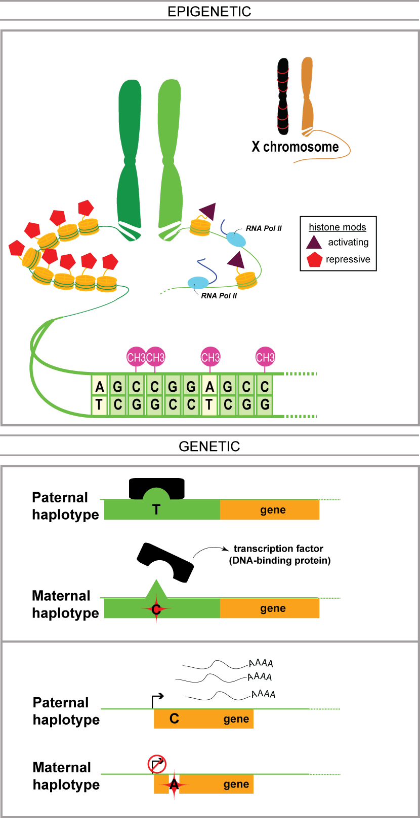
Allele-specific behavior can be due to epigenetic and genetic factors.

Slide 3
Alignment gets better with improved personal genomes
 | Ref genome | Pgenome: snvs only | Pgenome: snvs + indels only | Pgenome: snvs + indels + SVs
Reads processed | 208,051,087
# reads uniquely aligned | 171,944,588 (82.65%) | 172,591,380 (82.96%) | 172,738,321 (83.03%) | 172,743,175 (83.03%)
# reads that multimap | 17,826,675 (8.57%) | 17,795,258 (8.55%) | 17,782,167 (8.55%) | 17,779,800 (8.55%)
Almost 1M increase in reads
Notes:
We observe that

Slide 4
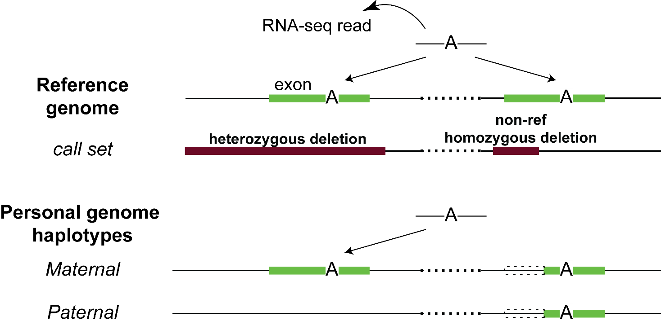
Some examples of AS behavior that can be accounted for using the personal genomes
Notes:
And the diploid reference is very useful in functional read alignment especially with the current ability to detect rare variants in each individual that are not found in the reference
A simpler example is a non-ref insertion occurring in an exon and then RNA-seq mapping to that missing insertion in the reference – but should be rarer, since indel doesn’t occur much in exon

Slide 5
Personal genome construction can be easily performed using vcf2diploid tool.
(fasta; reference)
(vcf, variants phased or unphased)
(fasta; for each haplotype)
Rozowsky et al. Mol Syst Biol (2011)

Slide 6
Personal genome construction can be easily performed using vcf2diploid tool.
(fasta; reference)
(vcf, variants phased or unphased)
(fasta; for each haplotype)
Rozowsky et al. Mol Syst Biol (2011)

Slide 7
Personal genome construction can be easily performed using vcf2diploid tool.
(fasta; reference)
(vcf, variants phased or unphased)
(fasta; for each haplotype)
Rozowsky et al. Mol Syst Biol (2011)

Slide 8
Some biases that are present in allele-specific analyses: reference bias and CNVs.

Slide 9
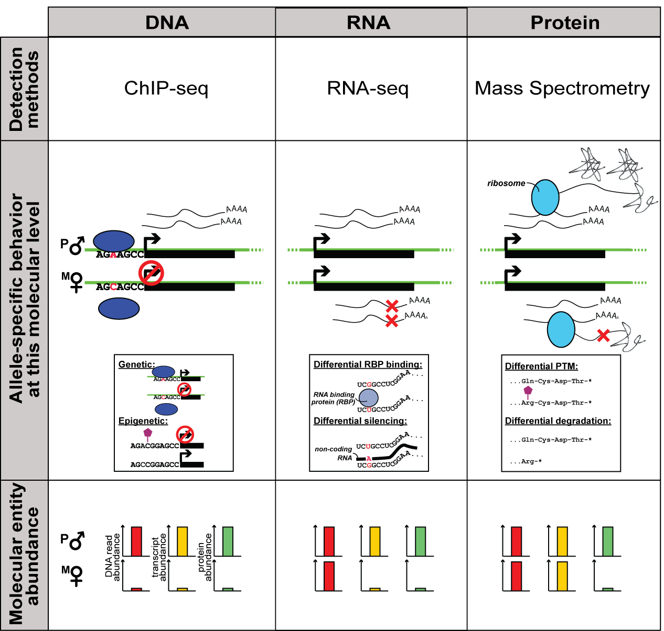
At different molecular level, we can use various methods to measure the abundance of corresponding entities (DNA, RNA or protein) to detect allele-specific behavior

