Slide 1
Using personal genomes for ENCODE data
Jieming Chen
Gerstein Lab
Yale University
Mar 11 2016
AWG Call

Slide 2
Transitioning from
Reference Genome (RG) to Personal Genome (PG)
Hg19/GRCh37/Hg38/GRCh38

Slide 3
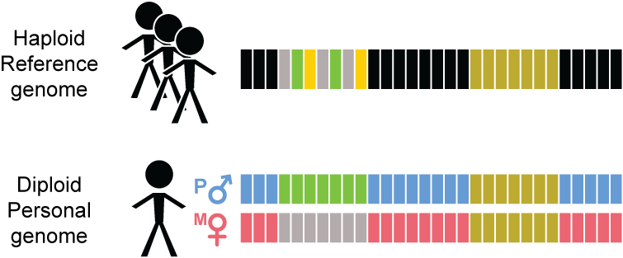
Reference Genome (RG)
Hg19/GRCh37/Hg38/GRCh38

Slide 4
Transitioning from
Reference Genome (RG) to Personal Genome (PG)

Slide 5
Why personal genome?
Functional reads (e.g. RNA-seq and ChIP-seq) alignment improves
--align more reads
--alleviate reference bias
Scale easily with more samples and improving sequencing technologies: longer reads and phase information
--We have developed a tool for PG construction
Ability to incorporate private variants of any size, exhibit phase information and diploid nature
--Diploid personal genome (PG) is a more realistic representation of the human genome
The use of PG improves downstream analyses
--Two examples for quantification (Sudmant et al., Nature 2015) and allele-specific analyses (Chen et al., Nature Commun 2016, in press)

Slide 6
Alignment gets better as variant sets get more complete: NA12878 Pol2 ChIP-seq (Encode2)
 | Ref genome | Pgenome: snvs only | Pgenome: snvs + indels only | Pgenome: snvs + indels + SVs
Reads processed | 208,051,087
# reads uniquely aligned | 171,944,588 (82.65%) | 172,591,380 (82.96%) | 172,738,321 (83.03%) | 172,743,175 (83.03%)
# reads that multimap | 17,826,675 (8.57%) | 17,795,258 (8.55%) | 17,782,167 (8.55%) | 17,779,800 (8.55%)
Almost 1M increase in reads
Notes:
We observe that

Slide 7
Alignment gets better as variant sets get more complete: NA12878 RNA-seq (Kilpinen et al. 2013)
 | Ref genome | Pgenome: snvs only | Pgenome: snvs + indels only | Pgenome: snvs + indels + SVs
Reads processed | 37,558,398
# reads uniquely aligned | 25,303,498 (67.37%) | 25,486,837 (67.86%) | 25,538,449 (68.00%) | 25,568,042 (68.08%)
# reads that multimap | 4,041,495 (10.76%) | 4,010,417 (10.68%) | 4,012,297 (10.68%) | 3,972,990 (10.58%)
Over 260K increase in reads

Slide 8
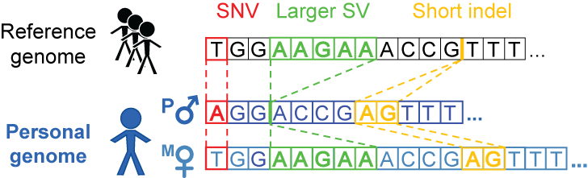
Personal genome construction using vcf2diploid tool
(fasta; reference)
(vcf, variants
phased or unphased)
(fasta; for each
haplotype)
Rozowsky et al. Mol Syst Biol (2011)

Slide 9
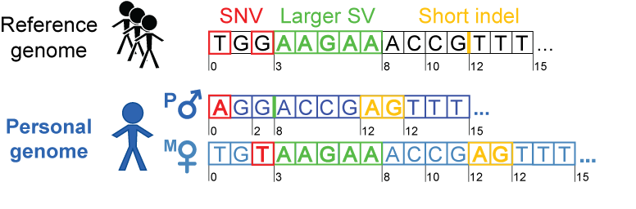
Personal genome construction using vcf2diploid tool
(fasta; reference)
(vcf, variants
phased or unphased)
(fasta; for each
haplotype)
Rozowsky et al. Mol Syst Biol (2011)

Slide 10

Personal genome construction using vcf2diploid tool
(fasta; reference)
(vcf, variants
phased or unphased)
(fasta; for each
haplotype)
Rozowsky et al. Mol Syst Biol (2011)

Slide 11
Construction considerations
1. Choice of call set(s)
-- e.g. different versions of 1000GP call sets
2. Choice of reference
-- choose the reference genome in which the call set is derived from
3. Choice of variants
-- e.g. SVs or indels or SNVs only
4. Order of incorporation
-- SVs > indels > SNVs
-- Increased SNV density around SV breakpoints (Abyzov et al. 2015)

Slide 12
Using personal genomes in downstream analyses
Two examples
Ability to incorporate large SVs in quantification
More accurate identification of allele-specific variants

Slide 13
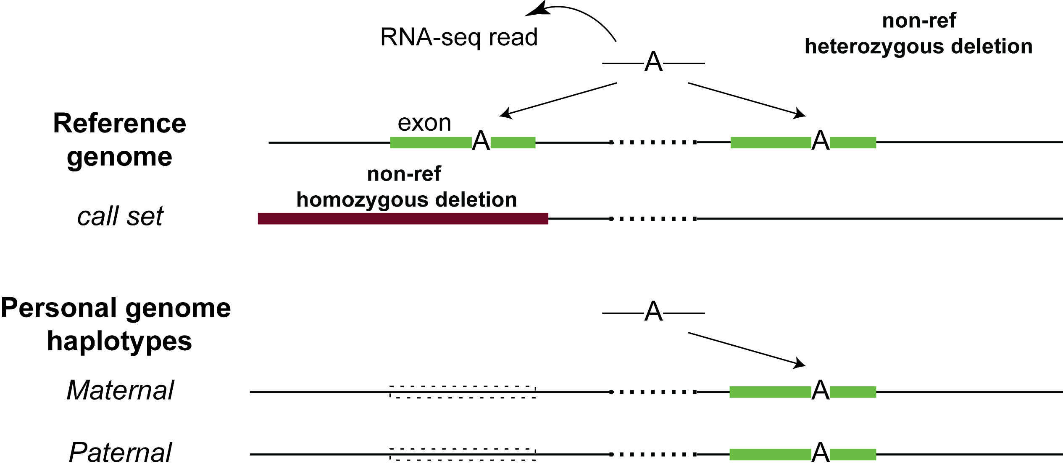
Including SVs in diploid personal genomes: a simple example
Notes:
And the diploid reference is very useful in functional read alignment especially with the current ability to detect rare variants in each individual that are not found in the reference
A simpler example is a non-ref insertion occurring in an exon and then RNA-seq mapping to that missing insertion in the reference – but should be rarer, since indel doesn’t occur much in exon

Slide 14
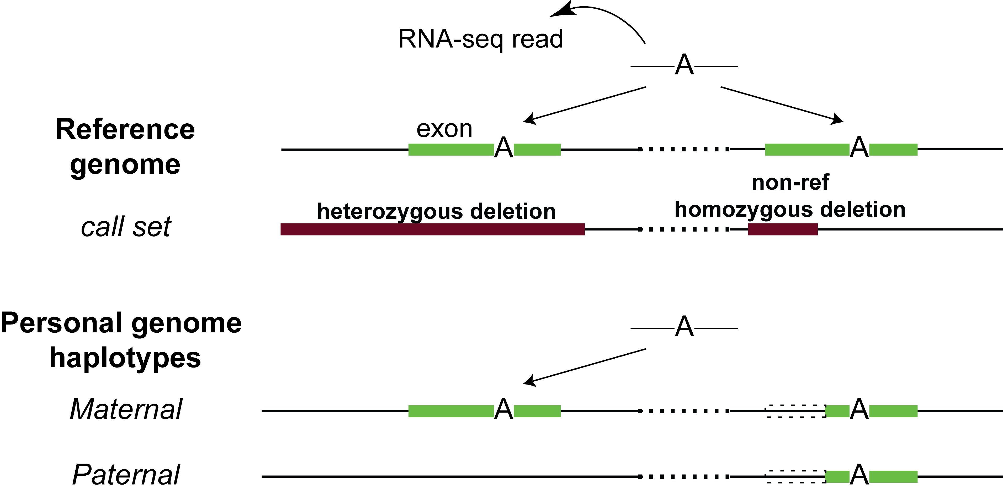
Including SVs in diploid personal genomes : more complex

Slide 15
SVs-in-PG analyses in Sudmant et al., Nature (2015)
Constructed 2 personal genomes of NA12878 based on GRCh37 reference genome
1000GP P3 SNVs and indels integrated call set (low coverage)
1000GP P3 SNVs, indels and SVs with breakpoint information from SVG
Notes:
We have also shown the usefulness of PG in two publications:
In the recent 1000GP SV paper published in Nature
For the personalized genome approaches the union of unique reads (matched by read ID) mapped to the maternal or paternal alignment for a particular genomic feature were considered.

Slide 16
Utility of SVs: Exons with direct SV overlap
Comparing between Pgenome-snpsIndels and Pgenome-SVs
18 exons with a direct SV overlap
6/18 exons were expressed (>10 reads)
4/6 showed substantial changes in expression using RNA-seq data from Kilpinen et al. (≥ 2-fold change)
Oliver Stegle, Sudmant et al., Nature (2015)
Notes:
We showed the utility of including SVs in PG
Showed that PG captures the effects of personal variants in functional assay readouts
These numbers will improve as we gain the ability to build better personal genomes with more accurate call sets

Slide 17
PG family of NA12878 we already have
SNVs, indels and SVs from GATK Best Practices v3 (UnifiedGenotype)
SNVs and indels from GATK Best Practices v4 (HaplotypeCaller; PCRfree)
1000 Genomes Project Phase 3 SNVs
1000 Genomes Project Phase 3 SNVs and indels
1000 Genomes Project Phase 3 SNVs, indels and SVs

Slide 18
Other possible choices of NA12878 call sets:
Genome in a bottle
Complete Genomics
Illumina Platinum Genomes
Broad’s GATK Best Practices bundles
1000 Genomes Project
-- long reads: PacBio, Moleculo

Slide 19
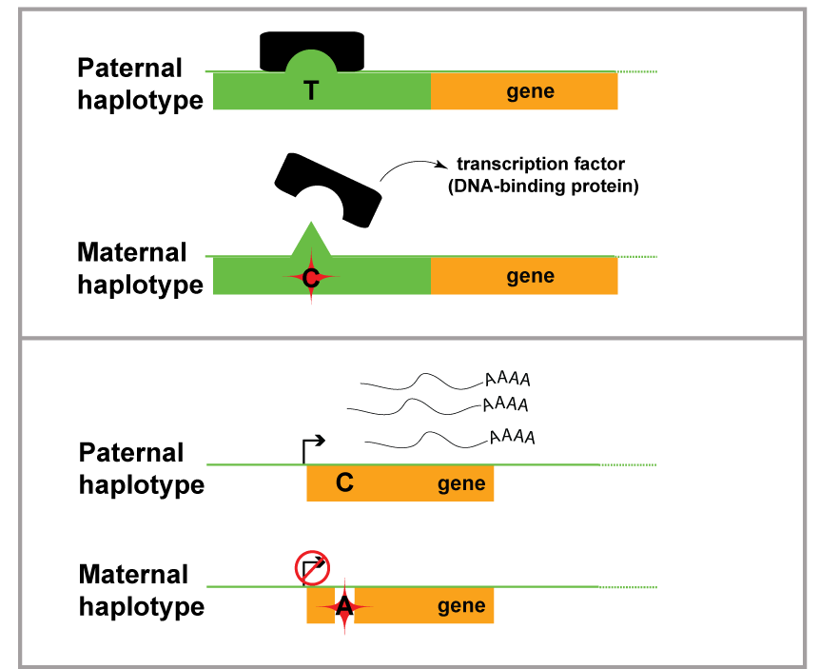
Use of personal genomes in allele-specific (AS) analyses in AlleleDB
alleledb.gersteinlab.org
Notes:
Using tool, able to construct 382 personal genomes
33 GM cell lines in ENCODE, with ChIP-seq data

Slide 20


Compute allelic ratio (i.e. reads difference at the 2 alleles)
e.g. a SNV @ chr 7 position 4345325
e.g. a SNV @ chr 5 position 12455
RNA-/ChIP-Seq Reads
ACTTTGATAGCGTCAACG
CTTTGATAGCGTCAACGC
CTTTGATAGCGTCAACGC
TTGACAGCGTCAATGCAC
TGATAGCGTCAATGCACG
ATAGCGTCAACGCACGTC
TAGCGTCAATGCACGTCG
CGTCAACGCACGTCGGGA
GTCAATGCACGTCGAGAG
CAATGCACGTCGGGAGTT
RNA-/ChIP-Seq Reads
ACTTTGATAGCGTCAATG
CTTTGATAGCGTCAATGC
CTTTGATAGCGTCAATGC
TTGACAGCGTCAATGCAC
TGATAGCGTCAATGCACG
ATAGCGTCAATGCACGTC
TAGCGTCAATGCACGTCG
CGTCAACGCACGTCGGGA
GTCAATGCACGTCGAGAG
CAATGCACGTCGGGAGTT
5 x T
5 x C
------
9 x T
1 x C
------
(ref)
(ref)
Allelic ratio = 0.5
(i.e. ‘null’ expectation)
Allelic ratio = 0.9
T
T
C
C
Notes:
In allele-specific analyses what people do conventionally is aligning the reads to the respectively alleles at positions with heterozygous SNVs

Slide 21
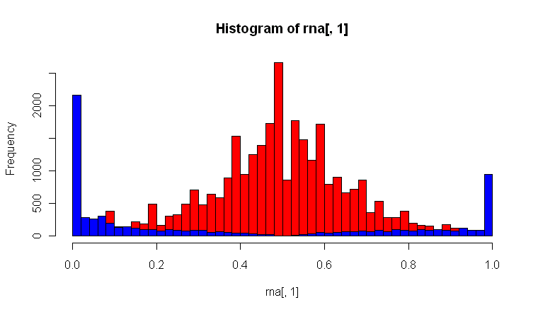
Reference Bias in functional read mapping
(naïve alignment against reference)
ASE/ASB Example:
…GTCAATGCAC
…GTCAATGCACG
…GTCAATGCACGTC
…GTCAATGCACGTCG
…GTCAACGCACGTCGGGA
GTCAATGCACGTCGAGAG
CAATGCACGTCGGGAGTT
AATGCACGTCGGGAGTTG
Null Example:
ACTTTGATAGCGTCAATG
CTTTGATAGCGTCAACGC
TTGACAGCGTCAATGCAC
ATAGCGTCAATGCACGT…
TAGCGTCAACGCACGT…
CGTCAACGCACGT…
CAATGCACGT…
AATGCACGT…
Binomial Null distribution
(no allele-specific behavior)
Allele-specific SNVs
Alternate Allele
Reference Allele
Fraction of reads mapping to reference allele
Notes:
In our allele-specific analyses we also observe that PG is able to alleviate reference bias found when aligning reads to the reference genome

Slide 22
Using personal genomes improves AS variant detection
Alleviates reference bias
We can account for two issues that exist with the use of PGs:
a) Overdispersion
b) Ambiguous mapping bias

Slide 23
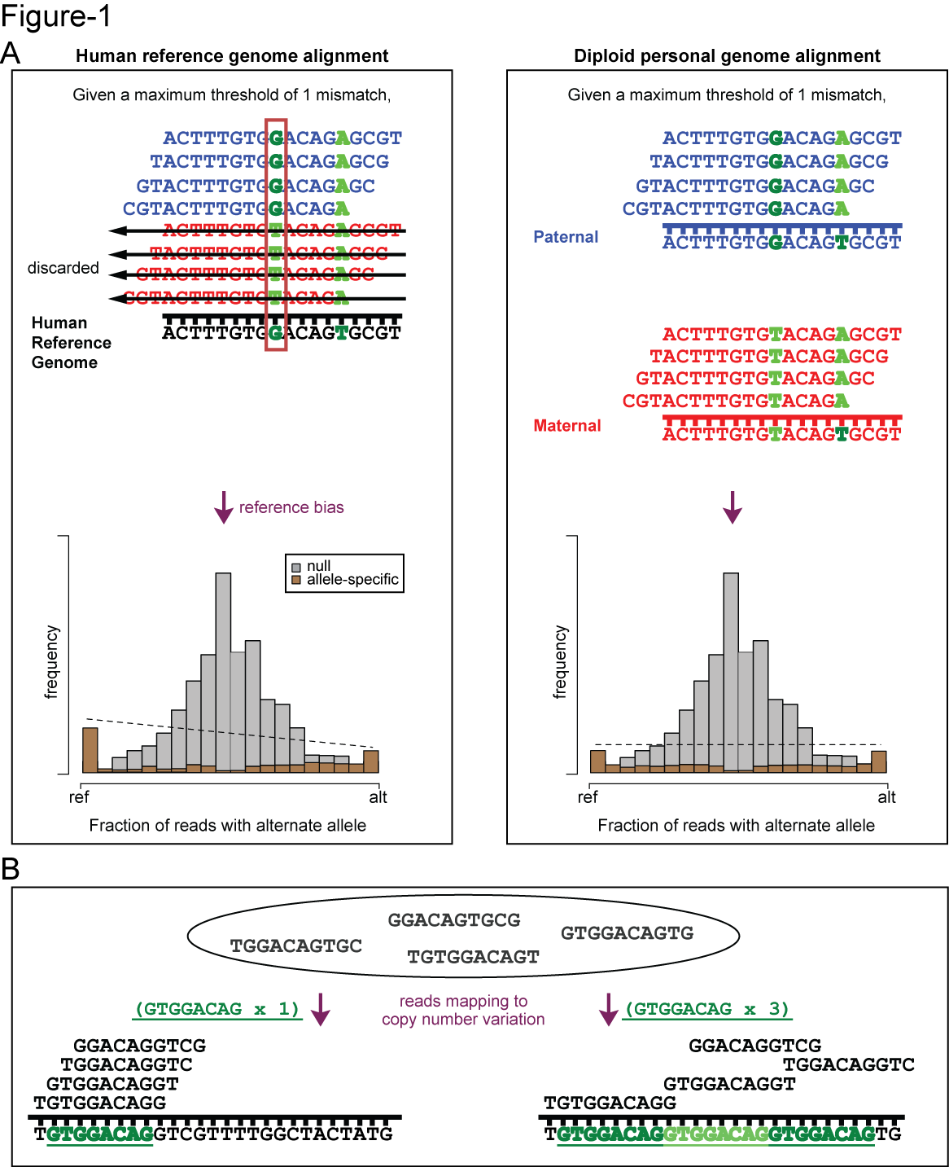
PG alleviates reference bias in alignment

Slide 24
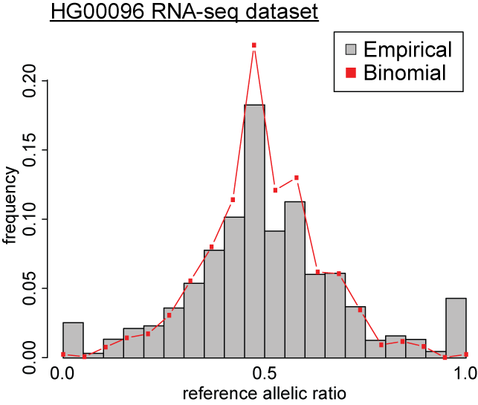
Binomial model on some empirical distributions
Non-allele-specific variants
e.g. allelic ratio = 0.5
Allele-specific variants
e.g. allelic ratio = 0.9
Alt
Ref

Slide 25
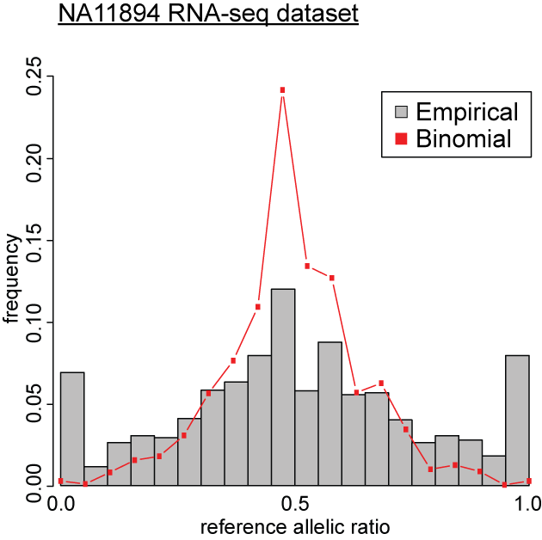
Over-dispersion
– broader distribution than expected
Binomial distribution insufficient to explain over-dispersed empirical distribution
)
Alt
Ref

Slide 26
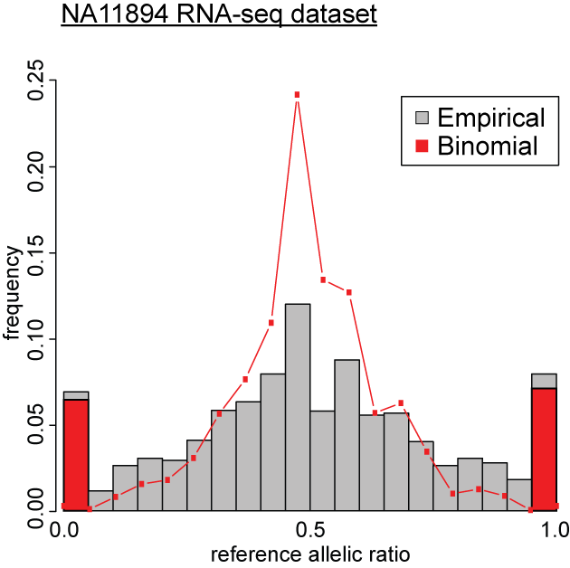
Over-dispersion
– broader distribution than expected
Binomial distribution insufficient to explain overdispersed empirical distribution
Detect more false positives
Alt
Ref
Notes:
non-optimal antibodies in ChIP-seq experiments
read mapping variability
true biological variation in factor binding or expression
etc. etc.

Slide 27
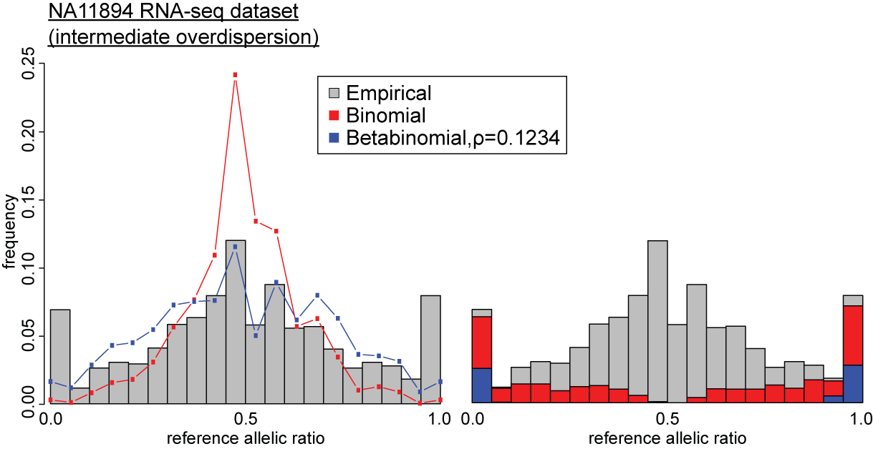
Accounting for overdispersion:
Binomial VS Beta-binomial
Alt
Ref
Chen J., et al. (Nature Commun, in press)

Slide 28
Accounting for overdispersion:
Binomial VS Beta-binomial
False
positives
Alt
Ref
Alt
Ref
Chen J., et al. (Nature Commun, in press)

Slide 29
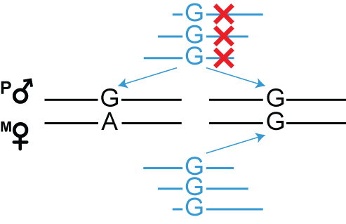
Ambiguous mapping bias due to sequence similarity in read alignment
0 mismatches in alignment for AS analyses

Slide 30
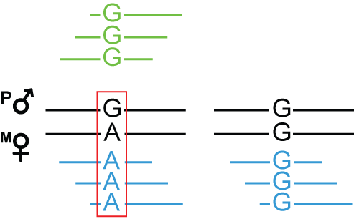
Accounting for ambiguous mapping bias
(do not
discard)
MULTI-MAPPING
READS
UNIQUE
READS
DETECTION OF AS VARIANTS
(using unique reads)
Timur Galeev

Slide 31
Use of personal genomes in allele-specific analyses in AlleleDB
Constructed 382 personal genomes from 1000GP
--with 1000 Genomes Project SNVs and indels
--match with their corresponding RNA-seq and/or ChIP-seq sets (from 8 different studies)
Most of our ChIP-seq sets are from ENCODE
--14 GM cell lines in ENCODE data, with ChIP-seq data and available 1000GP DNA data
CEU, YRI trios have ChIP-seq, RNA-seq and 1000GP DNA data
Chen et al., Nat Commun (in press)
Notes:
Using tool, able to construct 382 personal genomes
33 GM cell lines in ENCODE, with ChIP-seq data

Slide 32
Use of personal genomes in ENCODE
The Encode Consortium, Nature (2012)
Gerstein et. al., Nature (2012)

Slide 33
Future prospects of PGs in Encode
Diploid genomes for all GM cell lines and H1
Dealing with non-diploid genomes, e.g. cancer cell lines (polyploid)
--make use of HeLa genome; phase and ploidy information now available
Entex
--PGs and functional assays for multiple tissues
--possible to incorporate tissue-specific sequencing information

Slide 34
Summary
Incorporate variants of any size (e.g. SNVs, indels and SVs)
--improves alignment of functional reads
--improves accuracy of quantification
Include phase information and diploid nature
--improves allele-specific variant detection
--alleviates reference bias
Highly scalable
--more than 300 genomes have been built
--allows us to make use of parallel computing

Slide 35
Acknowledgement
Yale University
Joel Rozowsky
Timur Galeev
Arif Harmanci
Rob Kitchen
Mark Gerstein
EMBL-EBI
Oliver Stegle

Slide 36
Assessing quality of call set: Mendelian inconsistency (e.g. GATK UG CEU trio)
NA12891 Father | NA12892 Mother | NA12878 |  |  | total | %Err
 |  | RR | RA | AA
RR | RR | 61 | 2151 | 0 | 2212 | 97.24
RR | RA | 451122 | 457348 | 259 | 908729 | 0.03
RR | AA | 154 | 172539 | 192 | 172885 | 0.20
RA | RR | 440333 | 433838 | 73 | 874244 | 0.01
RA | RA | 166927 | 324836 | 170752 | 662515 | ---
RA | AA | 96 | 171202 | 180911 | 352209 | 0.03
AA | RR | 119 | 172052 | 150 | 172321 | 0.16
AA | RA | 53 | 174359 | 177919 | 352331 | 0.02
AA | AA | 0 | 10 | 730200 | 730210 | 0.00
*Autosomes only
Jieming Chen

Slide 37
Assessing quality of call set: Mendelian inconsistency (e.g. GATK HC PCR-free CEU trio)
NA12891 Father | NA12892 Mother | NA12878 |  |  | total | %Err
 |  | RR | RA | AA
RR | RR | 0 | 6072 | 311 | --- | ---
RR | RA | 518631 | 505499 | 1215 | 1025345 | 0.12
RR | AA | 1659 | 194589 | 1806 | 198054 | 1.75
RA | RR | 507750 | 506699 | 1110 | 1015559 | 0.11
RA | RA | 194409 | 397233 | 195245 | 786887 | ---
RA | AA | 742 | 194722 | 206720 | 402184 | 0.18
AA | RR | 1485 | 193636 | 1551 | 196672 | 1.54
AA | RA | 653 | 198416 | 202366 | 401435 | 0.16
AA | AA | 113 | 1316 | 816825 | 818254 | 0.17
*Autosomes only
Jieming Chen

Slide 38
Future development of personal genome construction
Iterative personal genome construction
iteration 1: construct pgenome per before
-- map DNA reads to pgenome
-- refine variants on pgenome
iteration 2: rebuild pgenome
What makes a personal genome ‘better’ than the other one
-- metrics to describe a ‘good’ personal genome

